Slide 1
Data Mining
Data Preprocessing
(Data Reduction)
Dr. Saumendra Pattnaik
Associate Professor
Department of Computer Science and Engineering
ITER, Siksha ‘O’ Anusandhan University.

Slide 2
Content
Data Reduction
Strategies for data reduction min-max normalization
Data Cube Aggregation
Attribute Subset Selection
Summary

Slide 3
Data Reduction
Warehouse may store terabytes of data: Complex data analysis/mining may take a very long time to run on the complete data set.
Data reduction
Obtains a reduced representation of the data set that is much smaller in volume but yet produces the same (or almost the same) analytical results.

Slide 4
Strategies for Data Reduction
Data cube aggregation
Aggregation operations are applied to the data in the construction of a data cube.
Attribute subset selection
Irrelevant, weakly relevant, or redundant attributes or dimensions may be detected and removed.
Dimensionality reduction
Encoding mechanisms are used to reduce the data set size.

Slide 5
Strategies for Data Reduction [Cont..]
Numerosity reduction
The data are replaced or estimated by alternative, smaller data representations such as parametric models or nonparametric methods such as clustering, sampling, and the use of histograms.
Discretization and concept hierarchy generation
Raw data values for attributes are replaced by ranges or higher conceptual levels.
Discretization and concept hierarchy generation are powerful tools for data mining.

Slide 6
Data Cube Aggregation
The lowest level of a data cube
the aggregated data for an individual entity of interest
e.g., a customer in a phone calling data warehouse.
Multiple levels of aggregation in data cubes
Further reduce the size of data to deal with
Reference appropriate levels
Use the smallest representation which is enough to solve the task
Queries regarding aggregated information should be answered using data cube, when possible

Slide 7
Attribute Subset Selection
Attribute subset selection6 reduces the data set size by removing irrelevant or redundant attributes.
The goal of attribute subset selection is to find a minimum set of attributes such that the resulting probability distribution of the data classes is as close as possible to the original distribution obtained using all attributes.

Slide 8
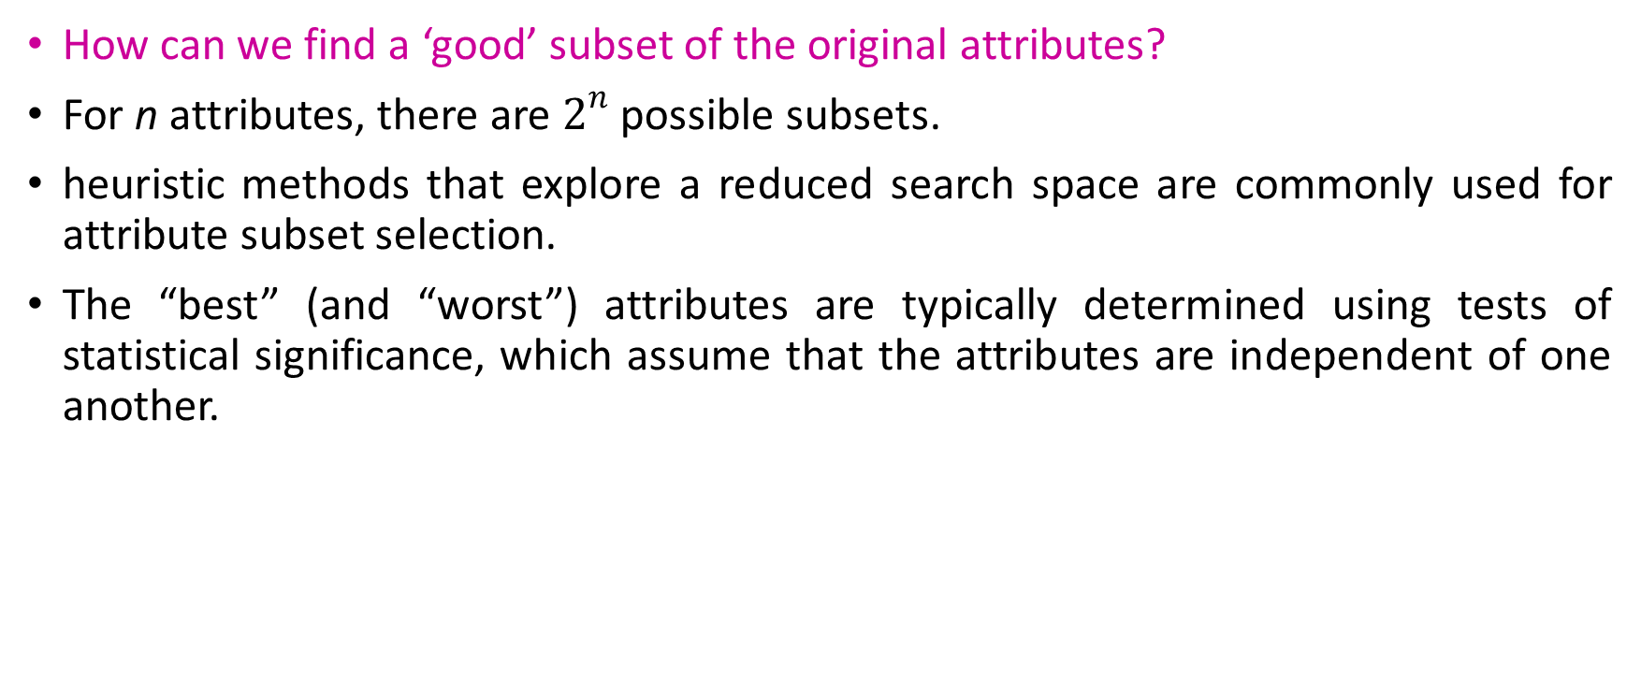
Attribute Subset Selection [Cont..]
How can we find a ‘good’ subset of the original attributes?
For n attributes, there are $2^{n}$possible subsets.
heuristic methods that explore a reduced search space are commonly used for attribute subset selection.
The “best” (and “worst”) attributes are typically determined using tests of statistical significance, which assume that the attributes are independent of one another.

Slide 9
Heuristic Methods for Attribute Subset Selection
Stepwise Forward Selection
The procedure starts with an empty set of attributes as the reduced set.
The best of the original attributes is determined and added to the reduced set.
At each subsequent iteration or step, the best of the remaining original attributes is added to the set.
Example
Initial Attribute Set
{A_{1,} A_{2,} A_{3,} A_{4,} A_{5,} A₆}
Initial reduced set
{}
→{A₁}
→{A_{1,} A₄}
Reduced attribute set
{A_{1,} A_{4,} A₆ }

Slide 10
Heuristic Methods for Attribute Subset Selection [Cont..]
Stepwise backward elimination
The procedure starts with the full set of attributes.
At each step, it removes the worst attribute remaining in the set.
Example:-
Initial attribute set:
{A1, A2, A3, A4, A5, A6}
→{A1, A3, A4, A5, A6 }
→{A1, A4, A5, A6}
Reduced attribute set:
{A1, A4, A6 }

Slide 11
Heuristic Methods for Attribute Subset Selection [Cont..]
Combination of forward selection and backward elimination
The stepwise forward selection and backward elimination methods can be combined so that, at each step, the procedure selects the best attribute and removes the worst from among the remaining attributes.

Slide 12
Heuristic Methods for Attribute Subset Selection [Cont..]
Decision tree induction
Decision tree induction constructs a flowchart like structure where each internal (non-leaf) node denotes a test on an attribute, each branch corresponds to an outcome of the test, and each external (leaf) node denotes a class prediction.
At each node, the algorithm chooses the “best” attribute to partition the data into individual classes.
When decision tree induction is used for attribute subset selection, a tree is constructed from the given data.
All attributes that do not appear in the tree are assumed to be irrelevant.
The set of attributes appearing in the tree form the reduced subset of attributes.

Slide 13
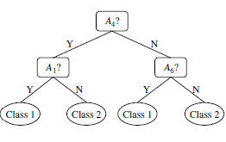
Heuristic Methods for Attribute Subset Selection [Cont..]
Initial attribute set:
{A1, A2, A3, A4, A5, A6}
Reduced attribute set:
{A1, A4, A6 }

Slide 14
Summary
Data Reduction includes data cube aggregation, attribute subset selection, dimensionality reduction, numerosity reduction, discretization and concept hierarchy generation.
Attribute subset selection reduces the data set size by removing irrelevant or redundant attributes.
Heuristic methods of attribute subset selection includes stepwise forward selection, stepwise backward elimination, combination of forward selection and backward elimination and decision tree induction.

Slide 15
Thank You

