Slide 1
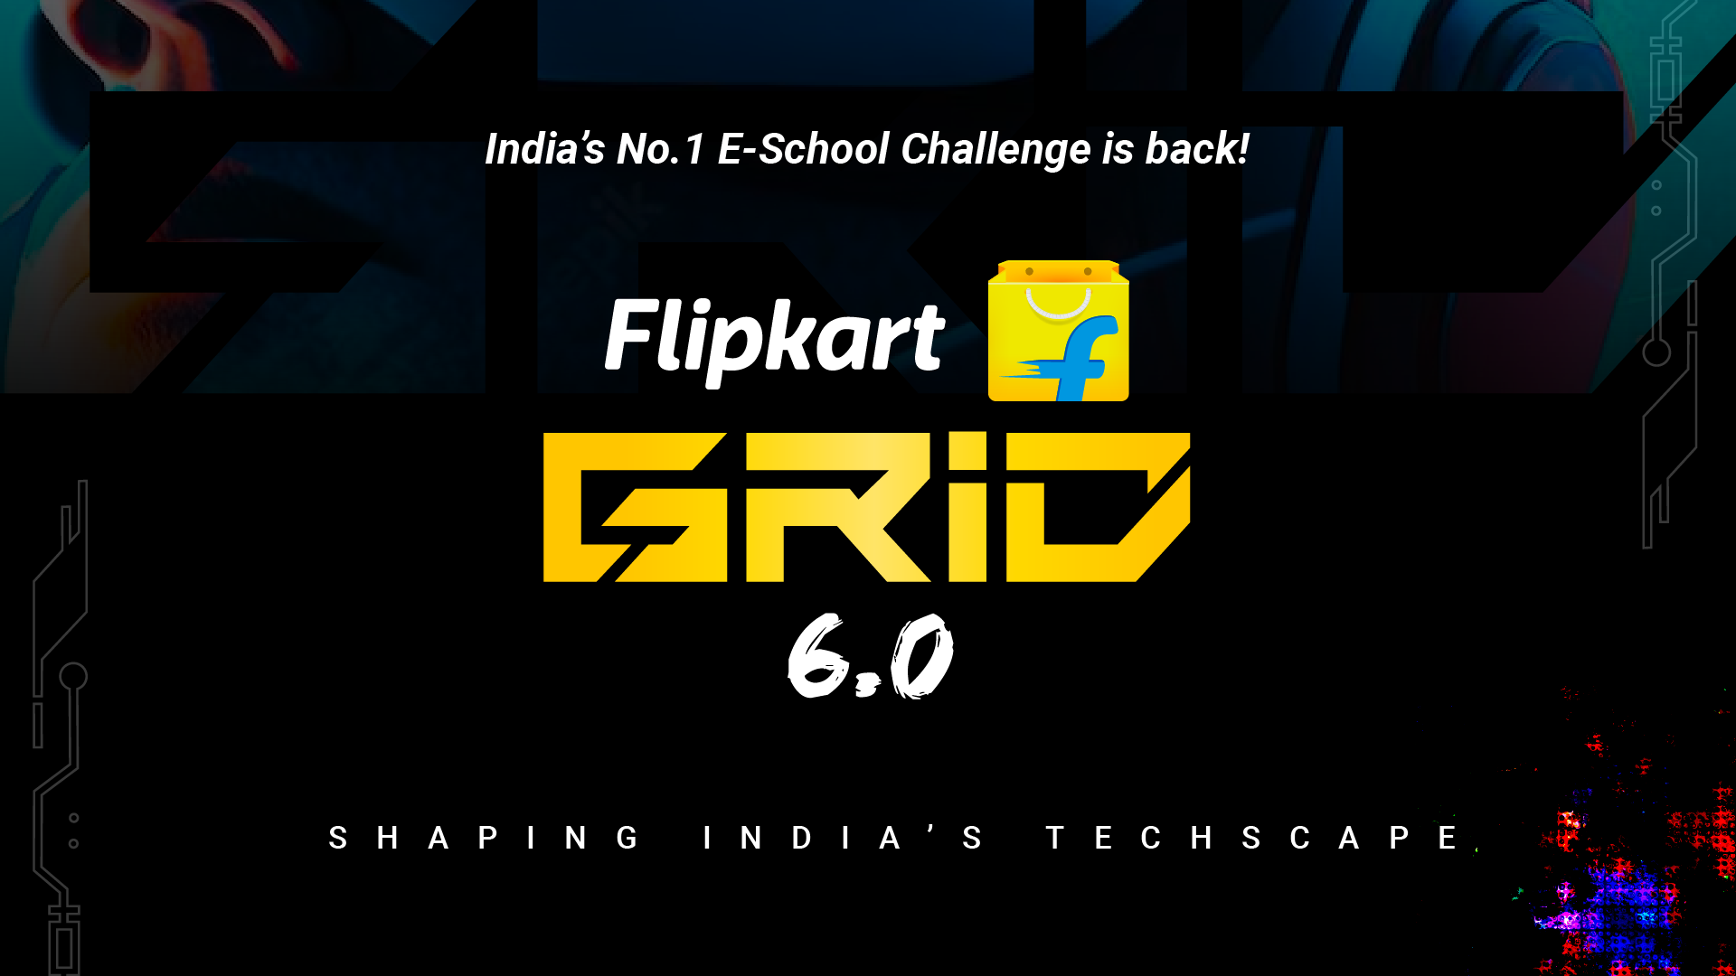
Notes:
#

Slide 2
Smart Vision Technology Quality Control
Track: Robotics Challenge
Team Name: T-800s
Team Members:
Ayushman Singh - Model training and creating Inference Pipeline for Object detection.
Sharad Prakash - Data cleaning and Augmentation, OCR for product details.
Devansh Varshney - Data collection and GUI for inference presentation(expected hardware solutions).
Harshit Shobhane - Data collection and annotation of images (expected hardware solutions).
Anil Alok – Dataset creation and annotation of images (expected hardware solutions).
College: Indian Institute of Information Technology, Ranchi.
Date of Submission: 20/10/24

Slide 3
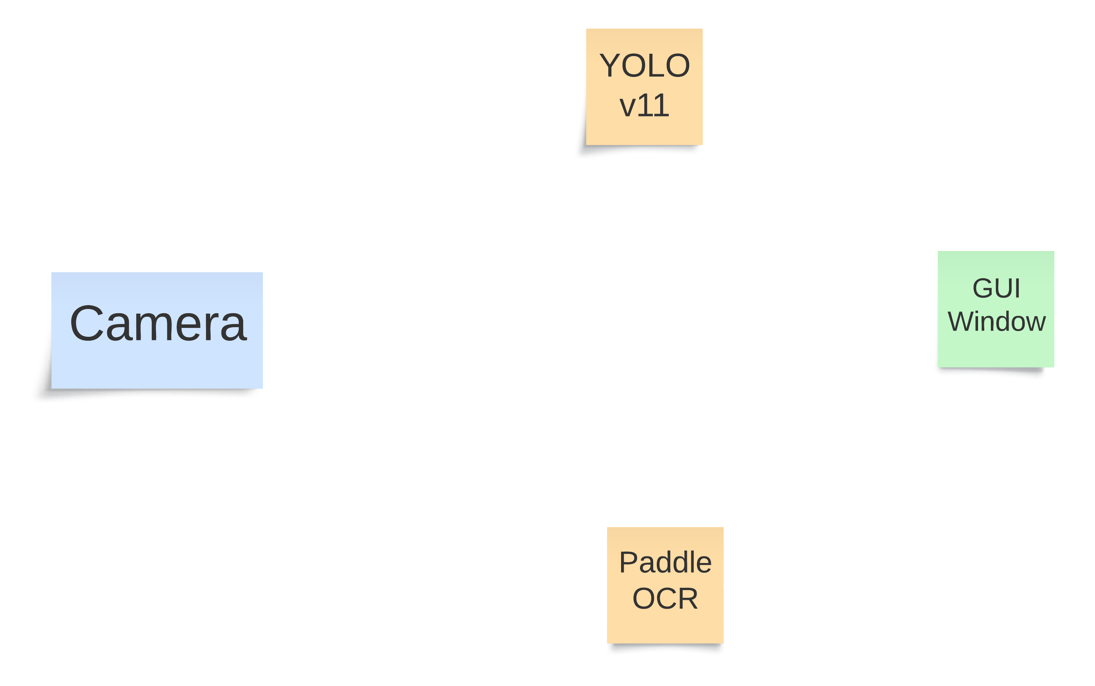
Executive Summary
We have decided to implement three of the four given use cases:
OCR to extract details from image/label.
Image Recognition and IR based counting.
Detecting freshness of fresh produce.
We omitted the use case: “Using OCR to get expiry date details”, due to highly inconsistent positioning and formatting of those details across different products and brands.
Two separate models are used to implement the use cases.
Brand Recognition and counting, Detection of freshness is done by a trained Yolov11m model.
Details are extracted from the images using the vanilla PaddleOCR model.
A camera feeds live video footage to the YOLOv11 and PaddleOCR models which are running parallelly. The output of the object detection model is displayed centrally on a GUI window. The extracted details and the count of various products are displayed in a sidebar.

Slide 4
Technical Approach
Data
6500 hand-labeled and annotated images of 33 products were used. The initial dataset was collected using a combination of images of store-bought products using our phone cameras, and images collected through web-scraping. This included images that had a single instance of one product and also images that had multiple instances of different products.
To ensure scaling, rotation and translation invariance, we augmented the images, increasing our total dataset size to 60,000 images. This augmented dataset was used for training our model.
The products used for training are:
['fresh apple', 'fresh banana', 'rotten apple', 'rotten banana', 'baidynath chyawanprash', 'bajaj almond drop', 'bournvita powder', 'dabur chyawanprash', 'dettol hand sanitizer', 'dot and key facewash', 'dove soap', 'everyuth facewash', 'exo safai scrub', 'fogg spray', 'garnier facewash', 'godrej hand wash powder', 'haldiram bhujia', 'haldiram moongdal', 'haldiram punjabi tadka', 'head and shoulders shampoo', 'joy body lotion', 'kamasutra spray', "Kellogg's chocos", 'kurkure packet', 'lakme sunscreen', 'lays chips packet', 'nivea body lotion', 'odonil room freshner spray', 'parachute jasmine oil', 'patanjali aloevera gel', 'saffola oats', 'sensodyne toothpaste', 'vaseline petroleum jelly', 'vim bar']

Slide 5
Models
YOLOv11 –m : Brand Recognition, Counting, and freshness index of fresh produce.
PaddleOCR: Extraction of details available on packaging material.
Training
Training of the Yolov11 model was done using Kaggle notebooks.
CPU- Dual core intel Xeon
GPU- 2x Nvidia Tesla T4
RAM- 30 GB
Inference
A laptop without any GPUs was used for inference.
CPU - AMD Ryzen 7 5800H
RAM -16 GB
YOLOv11 - Average inference time of 250 miliseconds, giving a virtually realtime inference.
PaddleOCR – 200 miliseconds to 1 second, depending on the amount of text in the frame.

Slide 6
Tech Stack
Python
Albumentations
Tkinter
OpenCV
Icrawler
Ultralytics
Code: Github Repository
Video Simulation:

