Slide 1
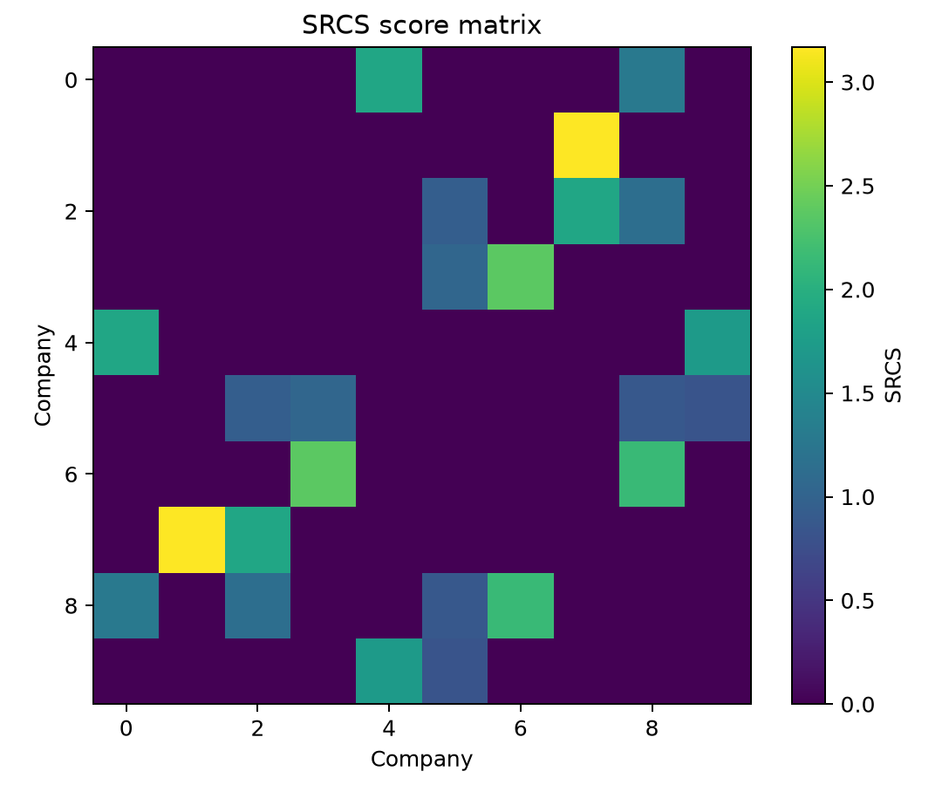
FINAL YEAR PROJECT | TRACK A
Inferring Hidden Economic Connections from Financial Shock Propagation
A synthetic and real-data prototype
Reproducible simulation • Calibrated inference • Event-level evidence
University submission deck | October 2026

Slide 2
PROBLEM
Research question and scientific boundary
Can repeated delayed responses to company-specific shocks reveal stable candidate connections?
Observed
Inferred
Not claimed
Standardized company states or abnormal returns, plus detected shock events.
A symmetric score for each pair and either a calibrated synthetic edge set or a real-data ranking.
Causality, supplier contracts, ownership links, or structural identification from co-movement alone.
Track A keeps the model interpretable: sparse networks, event conditioning, lag decay, consistency, and held-out evaluation.
TRACK A | 2

Slide 3
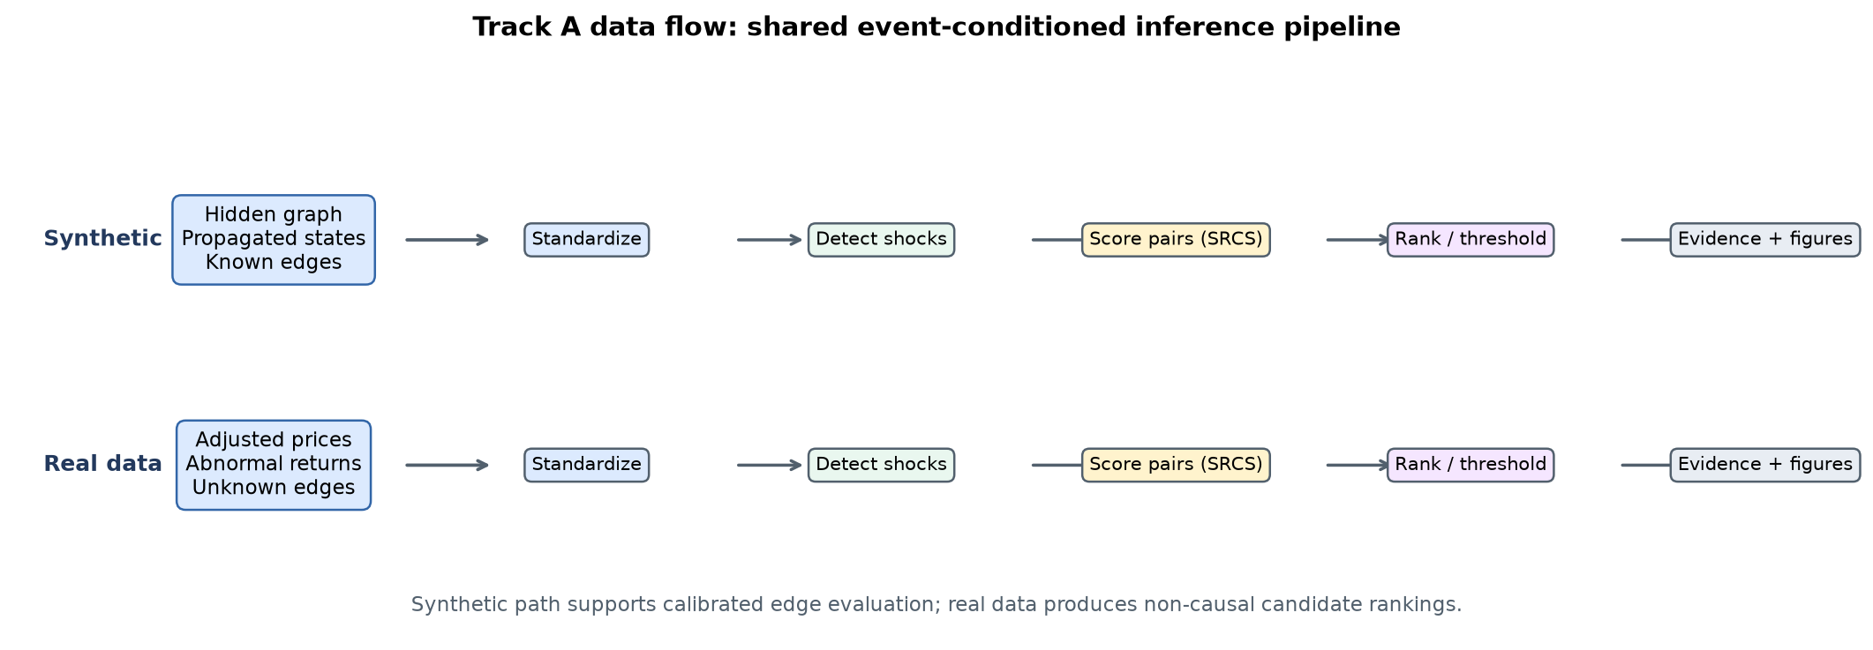
SYSTEM
One reusable pipeline supports two evidence regimes
Synthetic data supplies known edges for calibration and testing.
Real data supplies price histories and produces non-causal candidate rankings.
TRACK A | 3

Slide 4
METHOD
SRCS rewards prompt, repeated, sign-consistent responses
1
Condition on shocks
Use source-company shock events with complete future windows.
2
Scan delayed response
Take the strongest same-sign target response across configurable lags.
3
Apply lag decay
Discount later responses with an exponential weight.
4
Combine evidence
Multiply average response by the fraction exceeding the response threshold.
5
Symmetrize
Average the two directed scores for an undirected pair.
TRACK A | 4

Slide 5
EVALUATION DESIGN
Calibration and testing use disjoint random seeds
Development simulations
Frozen threshold
Independent test simulations
Generate separate graphs and observations. Search candidate thresholds and maximize mean F1 only on these seeds.
Carry one method-specific threshold forward. The inference function receives scores only and never reads true adjacency.
Report precision, recall, F1, confusion counts, ROC-AUC, and PR-AUC. Count each undirected pair once.
10 development seeds
1 frozen rule per method
10 independent test seeds
This design prevents test labels from selecting the threshold.
TRACK A | 5

Slide 6
RESULTS
SRCS led this synthetic benchmark, with close lagged baselines
Recorded results
SRCS: 0.951 ± 0.048
Lagged correlation: 0.921 ± 0.070
Granger-style: 0.917 ± 0.051
Pearson: 0.623 ± 0.050
Random: 0.349 ± 0.096
Interpretation: the event-conditioned score performed best here, but the margin over temporal baselines was modest.
TRACK A | 6

Slide 7
ROBUSTNESS
Performance degrades under weak propagation and high noise
Each point summarizes 10 independent development/test seed pairs. Error bars and raw trials are stored in the repository figures and CSVs.
TRACK A | 7

Slide 8
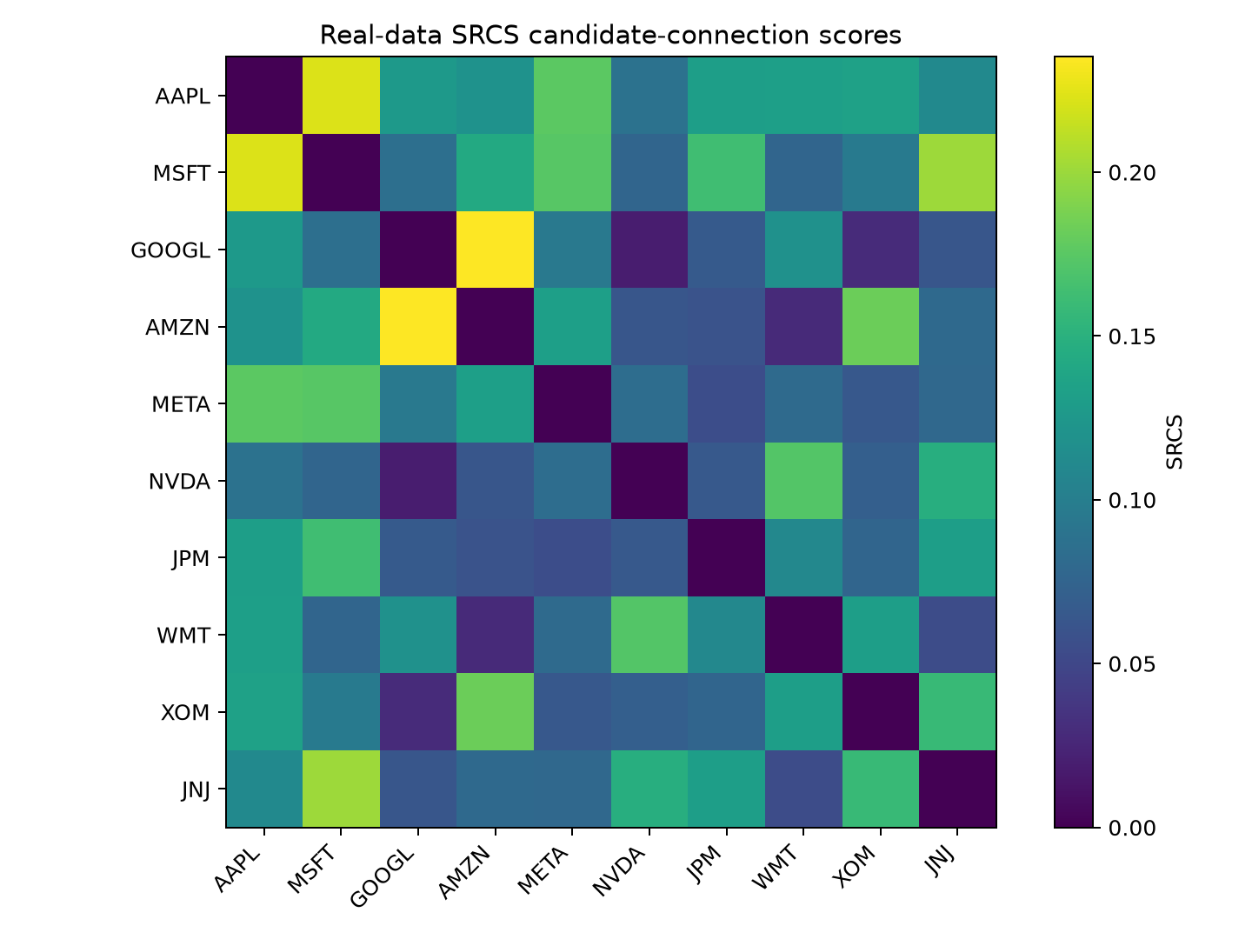
REAL DATA
The real-data run uses 1,003 genuine daily observations
Coverage
10 companies plus SPY
2022-01-01 to 2026-01-01
Yahoo Finance adjusted closes
Local CSV and provenance cache
Preprocessing
Align dates
Forward-fill short gaps
Compute log returns
Fit market model
Standardize residuals
TRACK A | 8

Slide 9
CASE STUDIES
Event-level evidence separates strong and ambiguous candidates
GOOGL – AMZN
AAPL – MSFT
GOOGL – NVDA
Highest ranked pair
SRCS 0.235
Inspect source shocks, response lag, direction, and magnitude in the exported evidence table.
Second ranked pair
SRCS 0.223
A repeated response pattern supports ranking, while shared exposures remain a plausible explanation.
Ambiguous low-ranked pair
SRCS 0.019
Weak or inconsistent delayed responses demonstrate that the method can return inconclusive evidence.
A high score is a screening signal, not proof of a supply-chain link, contract, or causal mechanism.
All event rows, ranked pairs, figures, source dates, and acquisition metadata are exportable.
TRACK A | 9

Slide 10
CONCLUSION
A complete prototype with explicit limits
Delivered
Limits
Reproduce
Synthetic workflow
Five compared methods
Three robustness sweeps
Verified real-data analysis
Seven-page Streamlit app
Tests, Docker, CI, DOCX, PDF
Thresholds depend on the simulation regime
Market residualization is linear
Events can overlap
Scores do not establish causality
External relationship labels remain absent
python -m pytest -q
python -m experiments.compare_methods
python -m experiments.run_robustness
python -m experiments.run_real_data
streamlit run app.py
Core contribution: a transparent event-conditioned inference workflow whose claims match its evidence.
TRACK A | 10

