Slide 1


V-Guard Sentinel
Your inverter knows when the power goes. Sentinel knows what to do.
Track 4 · From Smart Products to Intelligent Products
Team Codey Tingle (TI3271) · Ayush Garg · Eshan Shukla · Tanay Chaplot
Finale · Kochi · 24 September 2026
Notes:
[0:00–0:20] Good morning. We're Team Codey Tingle. In the next ten minutes we'll show you Sentinel — first the idea, then the working prototype live, then what's proven and what isn't. Behind us is our simulated village; you'll see it in action in a few minutes.

Slide 2

10:03 pm. The battery dies with no warning.
Three hours into a power cut, Home 6 in our village goes dark. Home 1 has the same battery and appliances and stays lit.
85 %
of Indian households face a power cut every day (LocalCircles, 2023)
×2 wear
every +10 °C: lead-acid life halves with heat the Indian summer is the battery's enemy
≈ 1.5 %
of V-Guard revenue goes to warranty (≈ ₹69 cr, FY24)
V-Guard Sentinel · Big Idea Tech 2026, Track 4 · Team Codey Tingle (TI3271)
2
Notes:
[0:20–0:50] Picture a family in Kochi. The evening power cut starts at seven. The inverter switches over in under ten milliseconds — it's fast. But nobody knows how much the battery has left, or how healthy it is. At three minutes past ten it simply dies: fridge, Wi-Fi, lights, all gone. Eighty-five percent of Indian homes face cuts daily. Heat halves lead-acid life every ten degrees. And for V-Guard, those surprise failures land in the warranty bill — about one and a half percent of revenue. The inverter is fast. The battery is blind. That's the gap.

Slide 3
Sentinel turns a smart inverter into an intelligent one.
Smart products take commands. Intelligent products predict, decide and act without the cloud.
CONNECTED
app on / off
SMART
schedules · alerts · usage
INTELLIGENT
predicts failure · learns the home
acts on its own offline
← Sentinel
1
Embedded a daughter-board inside new V-Guard inverters
2
Retrofit a 30-minute electrician fit on the installed base
3
Offline-first every core function works with zero internet
V-Guard Sentinel · Big Idea Tech 2026, Track 4 · Team Codey Tingle (TI3271)
3
Notes:
[0:50–1:10] Our idea in one sentence: Sentinel turns V-Guard's smart inverter into an intelligent one. Today's products take commands. Sentinel predicts when the battery will fail, decides which loads to keep alive, and acts on its own — even with no internet, which in India is a feature, not a compromise. It ships two ways: built into new inverters, or retrofitted by an electrician in half an hour.

Slide 4
Four jobs, one board & all on ESP32
1
2
3
4
Battery health
Habit autopilot
Energy coach + grid shield
Signed health log
Predicts a replacement window: 'replace in 6–14 weeks'
Keeps the fridge, lights and router alive during a cut
Names the big appliances; logs every sag and swell
Tamper-proof record: warranty decided by evidence
Same core, same sensors, different models → the platform extends to pumps, stabilisers and water heaters.
V-Guard Sentinel · Big Idea Tech 2026, Track 4 · Team Codey Tingle (TI3271)
4
Notes:
[1:35–1:50] Four jobs, one board. One: battery health — a warning window, not a guess. Two: the autopilot that keeps essentials alive. Three: the energy coach and grid shield — which appliances use what, and what the grid did to your home. Four: a signed health log, so warranty is decided by evidence, not argument. Let me take them one at a time, quickly.

Slide 5
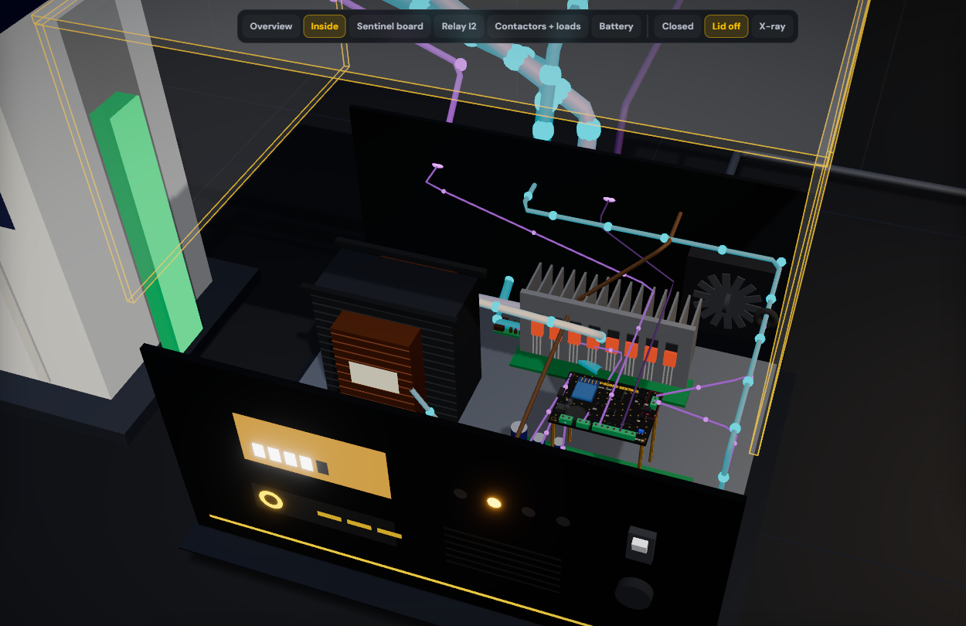
Inside the inverter, Sentinel taps what's already there.
Our 3D proof of concept of the Embedded SKU: lid off, every part clickable, live power flow.
1
Inverter's own shunt (I8)
→ INA228 · battery current
2
Mode / mains line
→ PC817 opto
3
SG3525 charge feedback
→ MCP4725 DAC · temperature-compensated charging
4
AC-OUT rail
→ AMC1311 + ATM90E32AS · V, P, Q
5
4 coil outputs
→ NC contactor panel · T1 / T2 / T3 / medical
V-Guard Sentinel · Big Idea Tech 2026, Track 4 · Team Codey Tingle (TI3271)
5
Notes:
[3:25–3:45] For new V-Guard inverters Sentinel isn't a box — it's a daughter-board inside. This is our 3D proof of concept with the lid off: transformer, MOSFET bridge, changeover relay, control board, and our board on standoffs. It taps five things the inverter already has: its current shunt, its mode line, the charger's feedback node — which is how Sentinel does temperature-compensated charging, only on the embedded version — the output rail, and four coil outputs to the contactors.

Slide 6
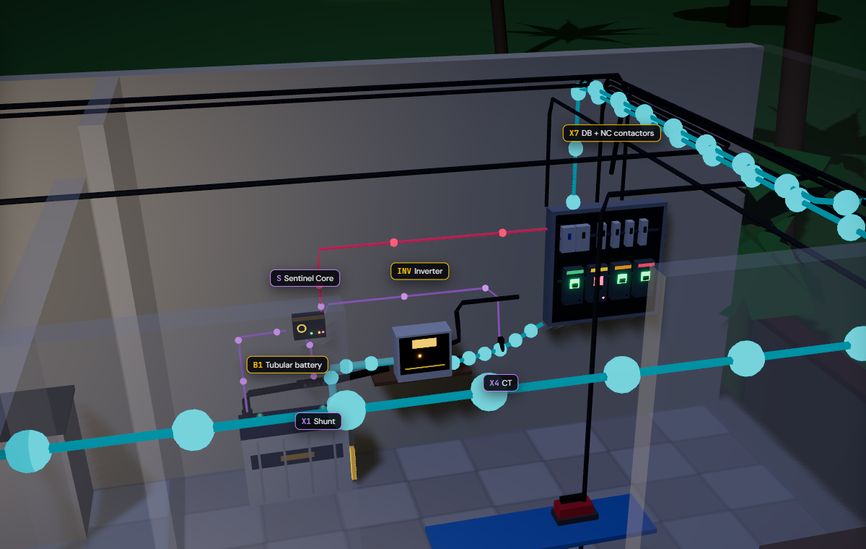
One small box reads the battery and switches the loads.
Nothing on the battery or the inverter is modified on the retrofit only the negative cable passes through a shunt.
1
Shunt in the battery − lead
battery current → INA228
2
NTC on the battery post
temperature: the #1 ageing driver
3
CT + voltage tap on AC-OUT
real & reactive power → ATM90E32AS
4
4 NC contactors in the DB
coil off = load ON, always
5
ESP32-S3 Sentinel Core
90 × 70 × 35 mm, powered by the battery
V-Guard Sentinel · Big Idea Tech 2026, Track 4 · Team Codey Tingle (TI3271)
12
Notes:
[1:10–1:35] Physically, Sentinel is a box the size of a deck of cards beside the inverter. This is the 'power corner' of Home 1 in our simulation. Five touch points: a shunt in the battery's negative cable for current, a temperature probe on the battery post, a current transformer on the inverter output, four fail-safe contactors in the distribution board — and the ESP32 core itself. Gold dots are mains power, cyan is battery power, violet is Sentinel sensing.

Slide 7
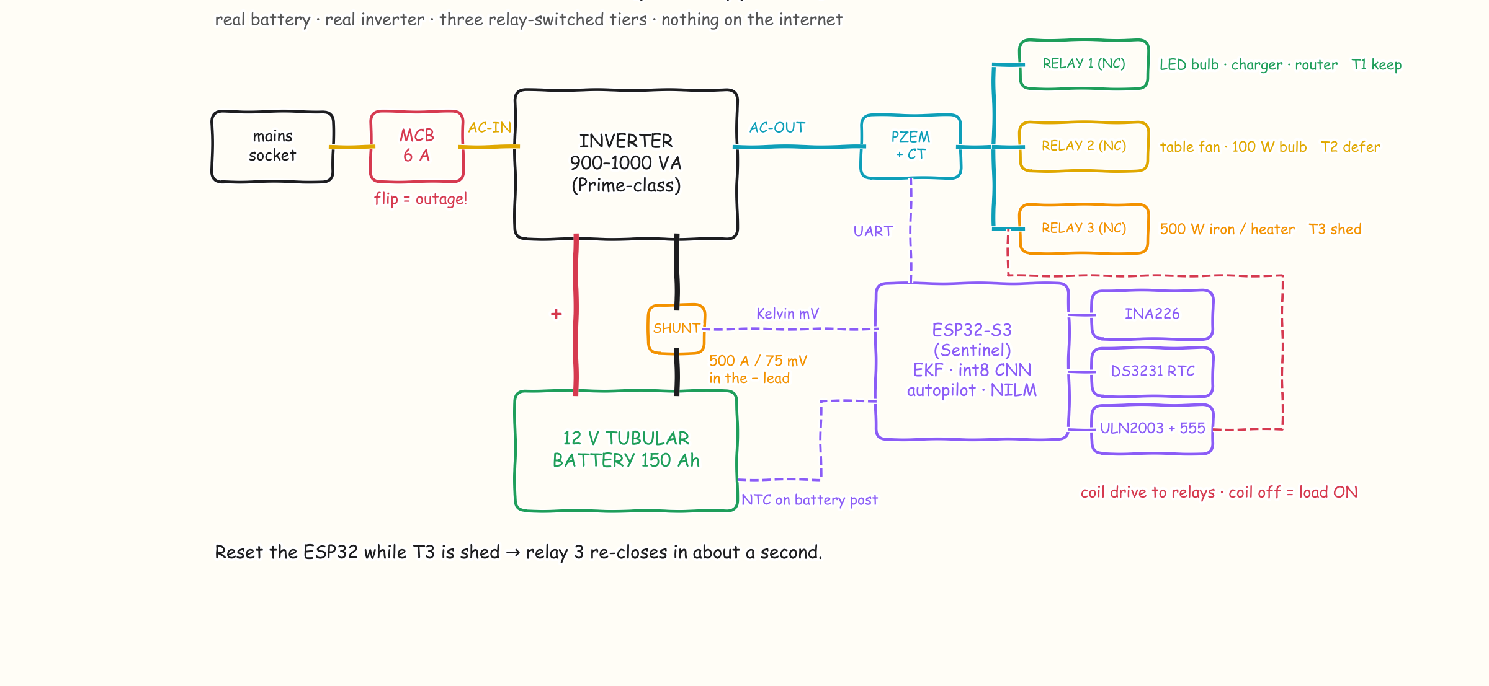
And this is exactly how the bench is wired.
Real battery, real inverter, off-the-shelf parts, every part available from Indian distributors today.
V-Guard Sentinel · Big Idea Tech 2026, Track 4 · Team Codey Tingle (TI3271)
6
Notes:
[4:00–4:10] And the simplest version — our bench sketch. Mains through a 6-amp MCB into a Prime-class inverter, a 150 Ah tubular battery with the shunt in its negative lead, an ESP32, and three normally-closed relays for the three tiers. Flipping that MCB is our outage. Let's do exactly that, live.

Slide 8
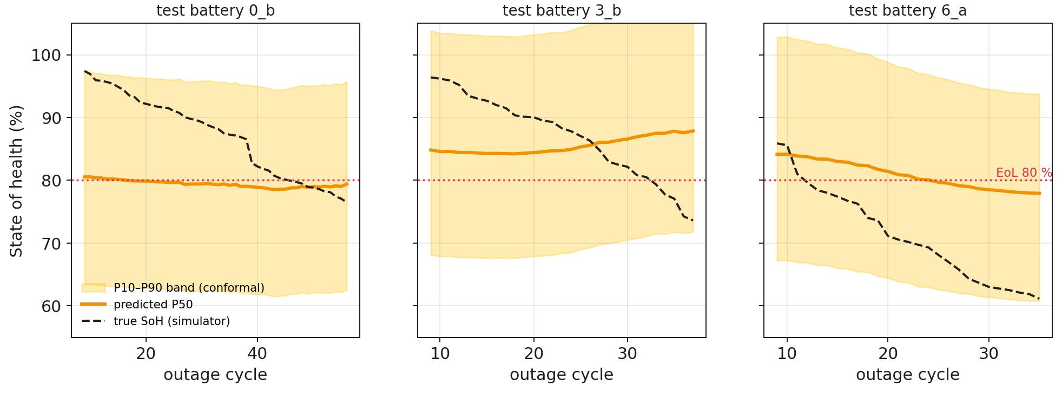
It gives a window, not a date: "replace in 6 –14 weeks".
Physics first, learning second every step runs on the ESP32.
1 Hz sensing
I / V / T
Kalman filter
SoC · R_int
14 + 6 features
per outage cycle
int8 CNN × 3
28 k params · 16 KB
Grade
window, never a date
8.2 pt
SoH error on 3 never-seen test batteries (Based on simulation data)
+0.01 pt
accuracy lost going float → int8 — it fits on the chip for free
V-Guard Sentinel · Big Idea Tech 2026, Track 4 · Team Codey Tingle (TI3271)
7
Notes:
[1:50–2:25] How does a small microcontroller predict battery life? Physics first. A Kalman filter turns current, voltage and temperature into charge and internal resistance. Each outage becomes 20 features the lead-acid literature says drive wear — resistance growth, heat stress, depth of discharge. A tiny int8 network — 28 thousand parameters, 16 KB of RAM — outputs a band, and we show a window: replace in 6 to 14 weeks, plan for 6. Honest numbers: on three batteries the model has never seen, the error is 8.2 points — on synthetic data. The band is calibrated but wide; real tubular aging data from the Kochi lab is what narrows it. And quantising to int8 cost us one hundredth of a point.

Slide 9
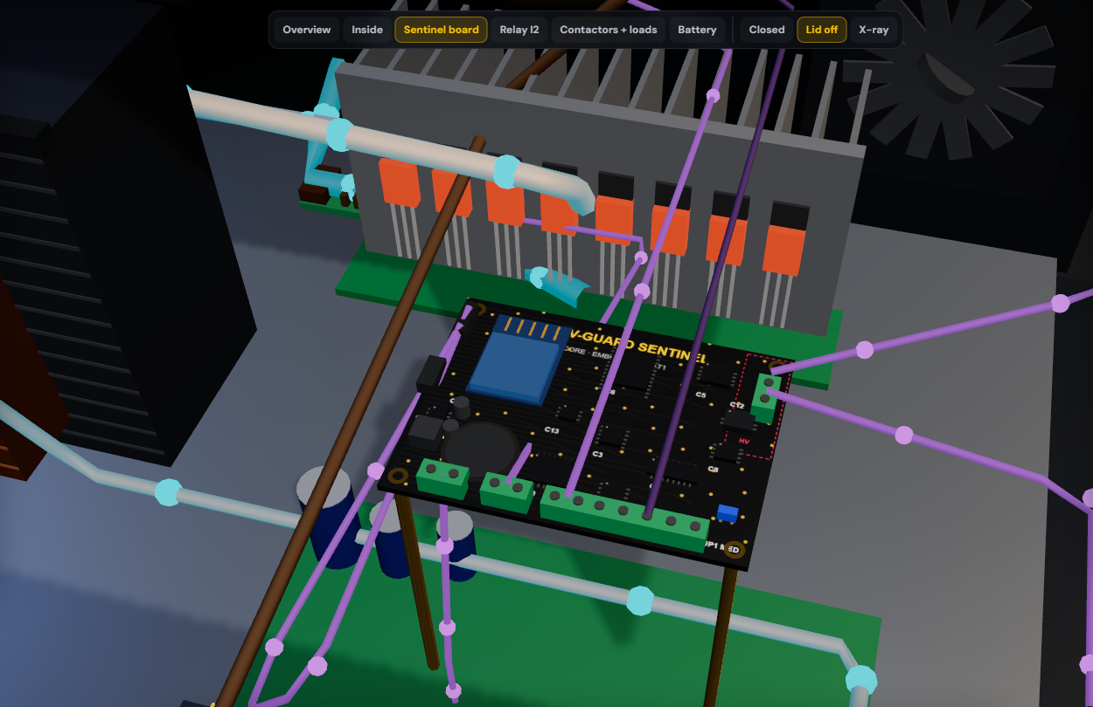
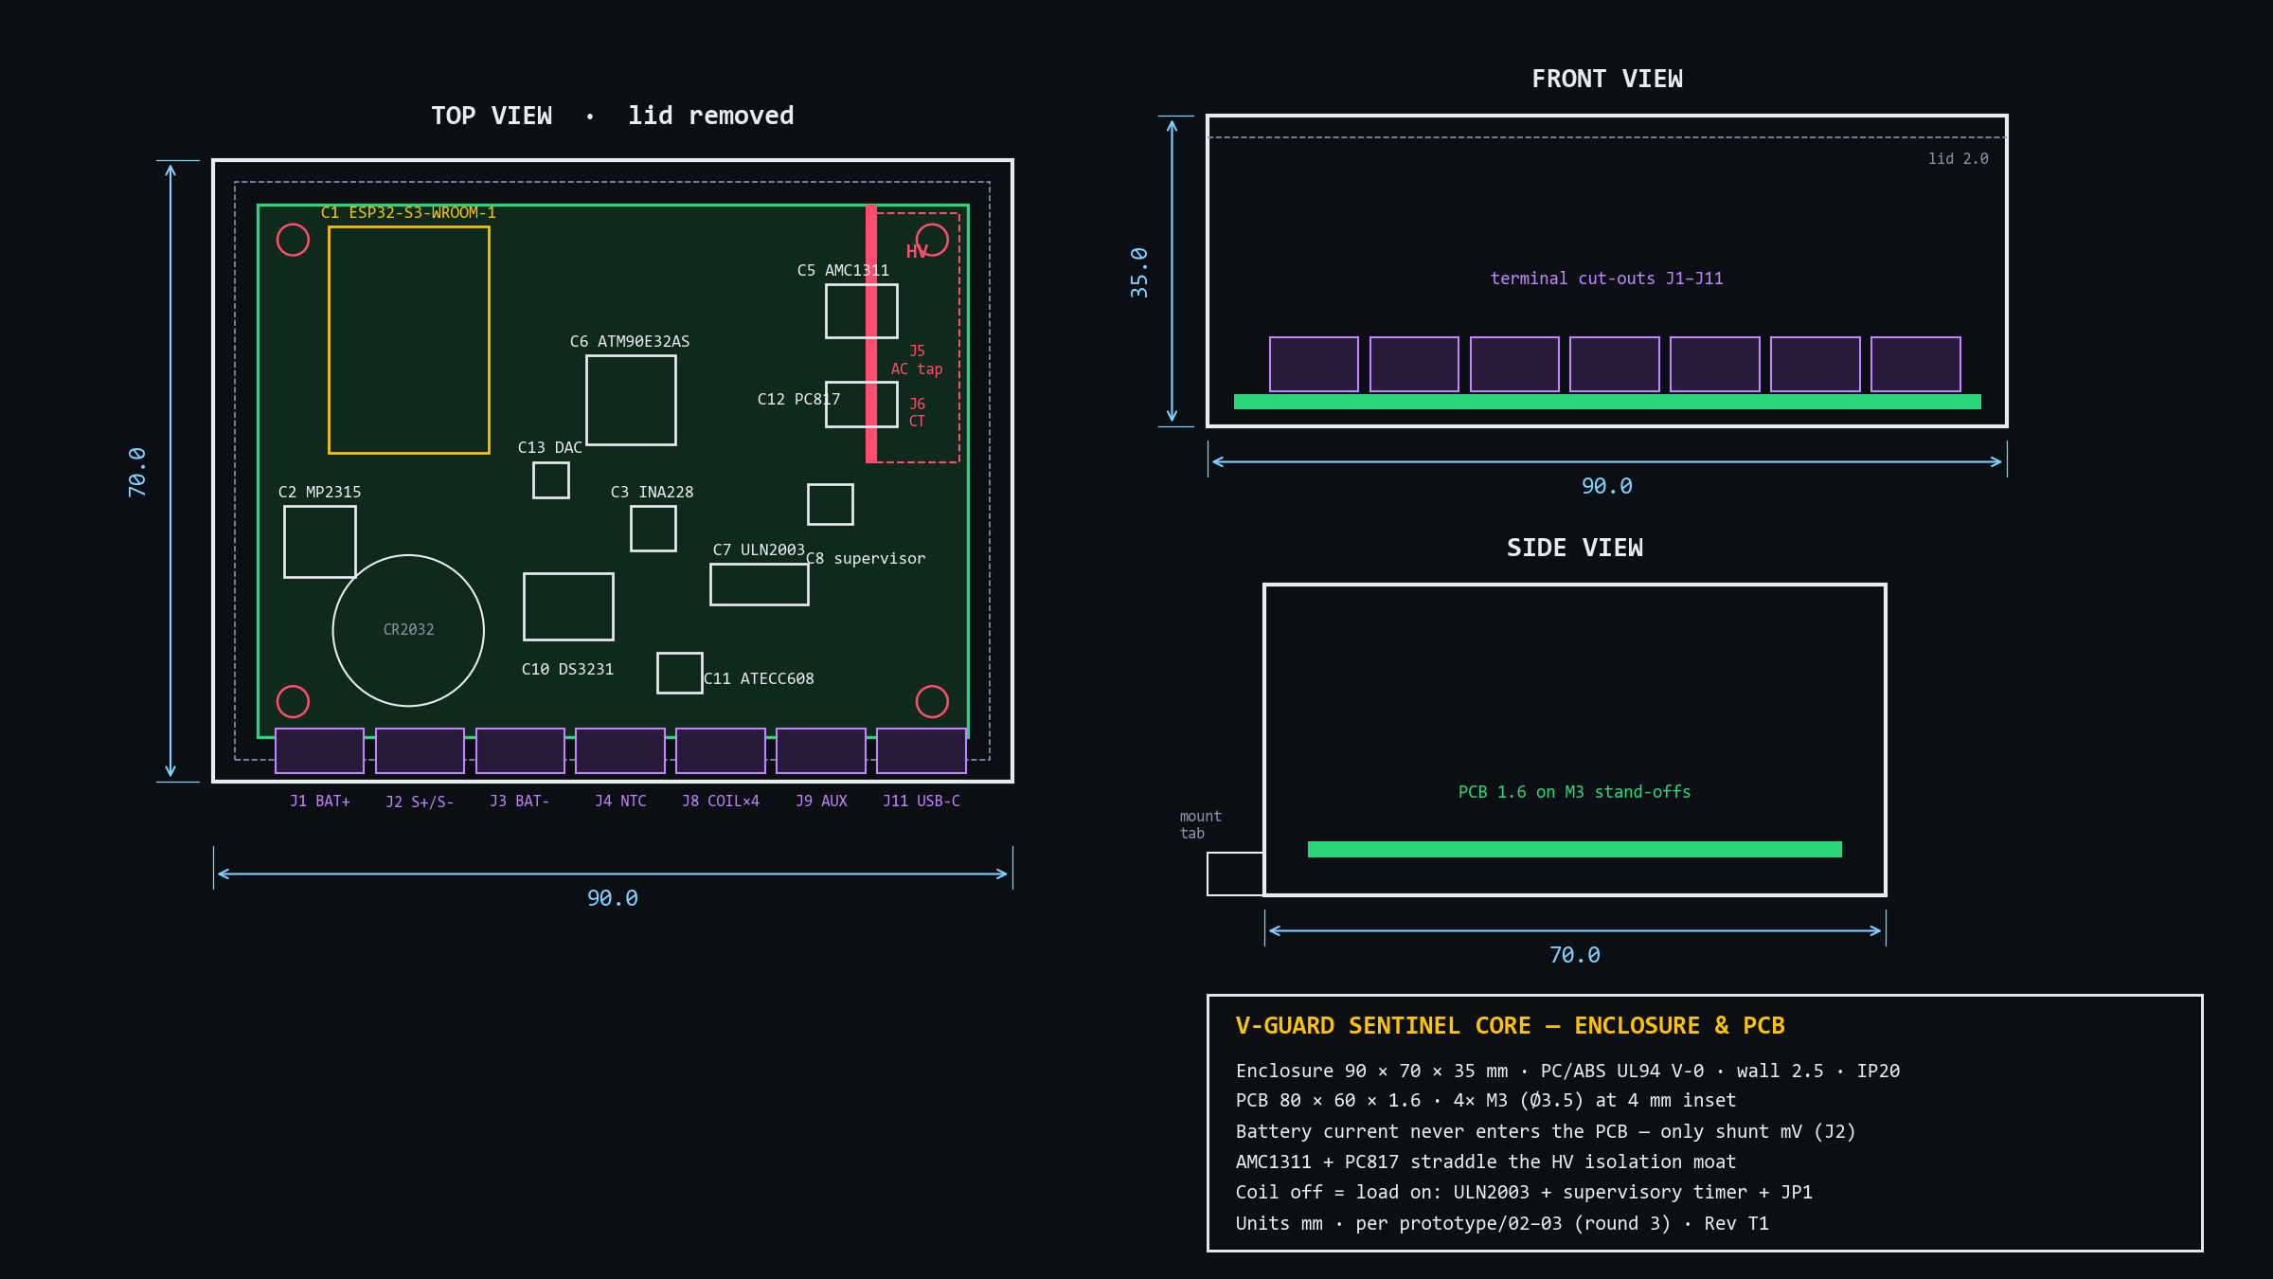
Designed to be built: 90 × 70 × 35 mm, HV zone fenced off.
Mechanical drawing from our round-3 spec, and the same board as a 3D render in the simulation.
Battery current never enters the PCB
only the shunt's millivolts do.
Isolation moat
AMC1311 and PC817 straddle the HV zone.
UL94 V-0 PC/ABS, 4× M3
DIN or screw mount beside the inverter.
V-Guard Sentinel · Big Idea Tech 2026, Track 4 · Team Codey Tingle (TI3271)
8
Notes:
[3:45–4:00] It's designed to be built. Enclosure 90 by 70 by 35, board 80 by 60, flame-retardant plastic. Two things we'd point an engineer to: the battery's 30-plus amps never touch our board — only the shunt's millivolts do — and the mains-side sensing sits behind an isolation moat that the isolated amplifier and optocoupler straddle. On the right, the same board as a 3D render with every chip where the drawing puts it.

Slide 10
Same outage, same battery: only Home 1 gets to keeps its fridge on.
Battery charge through the 7–11 pm cut, straight from our simulation engine
57 min
Home 6 sat in the dark until mains returned at 11 pm
8:24 pm · fans & TV deferred
(T2 at 55 %)
0 min
Home 1's fridge, router and hall light were never off
10:37 pm · heavy sockets shed
(T3 at 40 %)
Coil off = load on.
NC contactors, a hardware supervisory timer and a medical jumper: any crash or reset brings every load back.
10:03 pm · Home 6 cut-off:
fridge, router, lights OFF
V-Guard Sentinel · Big Idea Tech 2026, Track 4 · Team Codey Tingle (TI3271)
9
Notes:
[2:25–3:00] This is the heart of it, and it isn't a drawing — it's the output of our simulation engine. Home 1 and Home 6 have the identical 150 Ah battery and identical appliances. Only Home 1 has Sentinel. At 8:24 pm Home 1 drops to 55 percent and defers the fans and TV; its curve flattens. Home 6 keeps burning everything, and at 10:03 pm hits the cut-off — fridge, router, lights, all off for 57 minutes. Home 1 sheds the heavy sockets at 40 percent and keeps its essentials on till mains returns. The rule is a readable ladder — 55 and 40 percent with hysteresis — not a black box. And every contactor is normally-closed: if Sentinel crashes, every load comes back on.

Slide 11
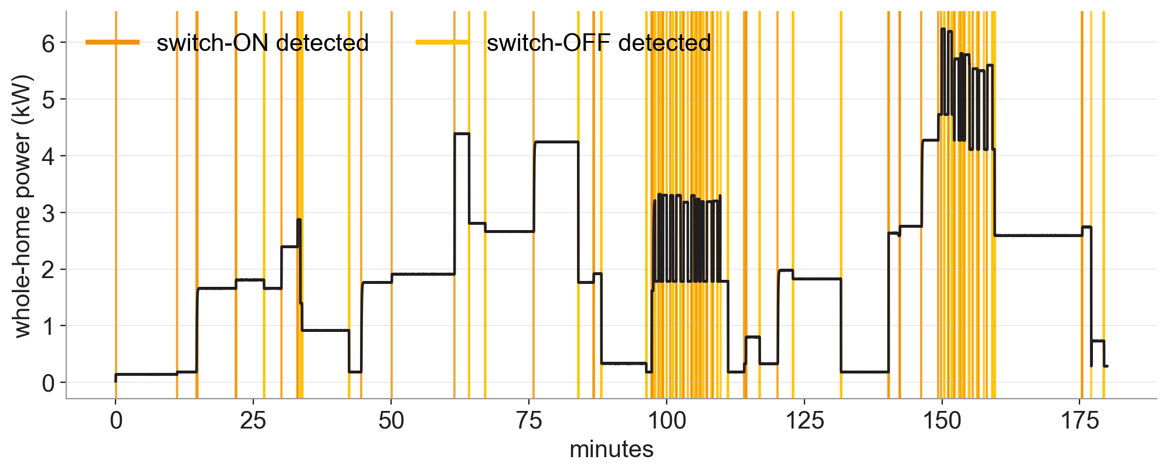
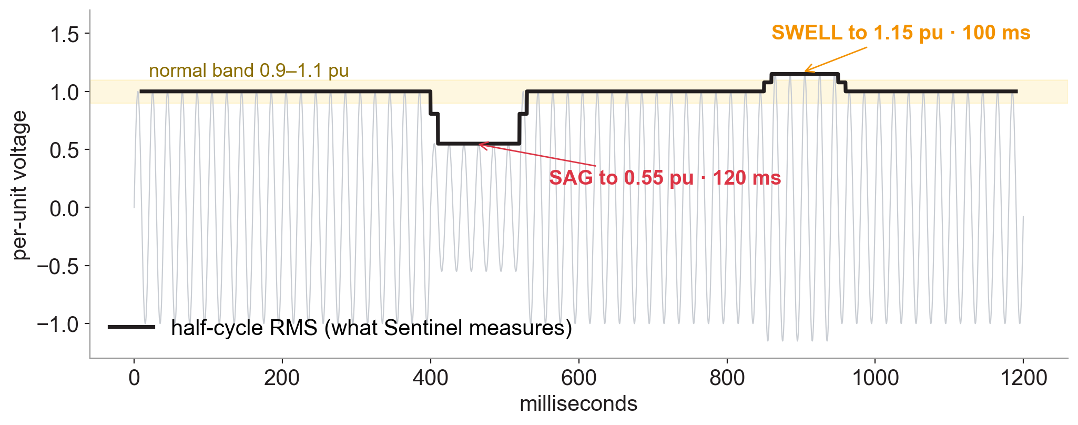
One sensor saves energy and catches a misbehaving grid.
Both run on the metering front-end (ATM90E32AS) and the isolated voltage tap (AMC1311)
Energy Coach 123 switch-ON/OFF events found in 3 h of whole-home power; each becomes a 13-number signature. Fridge F1 0.97, iron 1.00.
Grid Shield a 120 ms sag to 0.55 pu measured as 0.54; a 100 ms swell to 1.15 pu as 1.16. 13 / 13 dips caught. Logged, dated, signed.
V-Guard Sentinel · Big Idea Tech 2026, Track 4 · Team Codey Tingle (TI3271)
10
Notes:
[3:00–3:25] Engine three. We added a real metering chip on the inverter output — the kind inside a smart meter. On the left, three hours of a home's power: every orange line is an appliance switching on, gold is off — 123 events, each turned into a signature so the app can ask 'what just turned on?'. On the right, the grid shield: the chip computes RMS every half cycle, catches a 120-millisecond sag and a swell, and writes them into the signed log — evidence for the owner when a fluctuation damages an appliance. We're honest about scope: big appliances, not two identical fans.

Slide 12

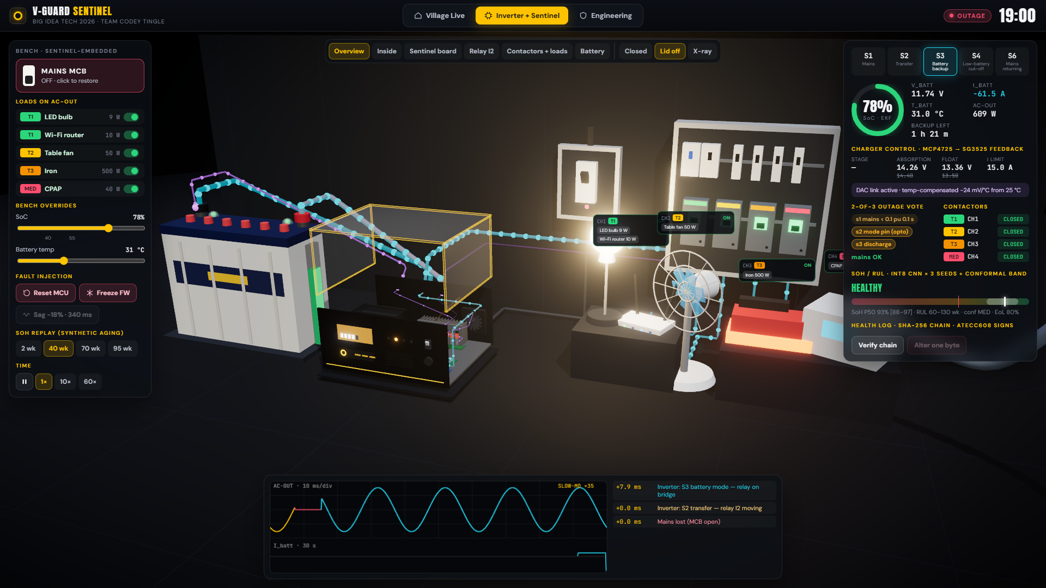
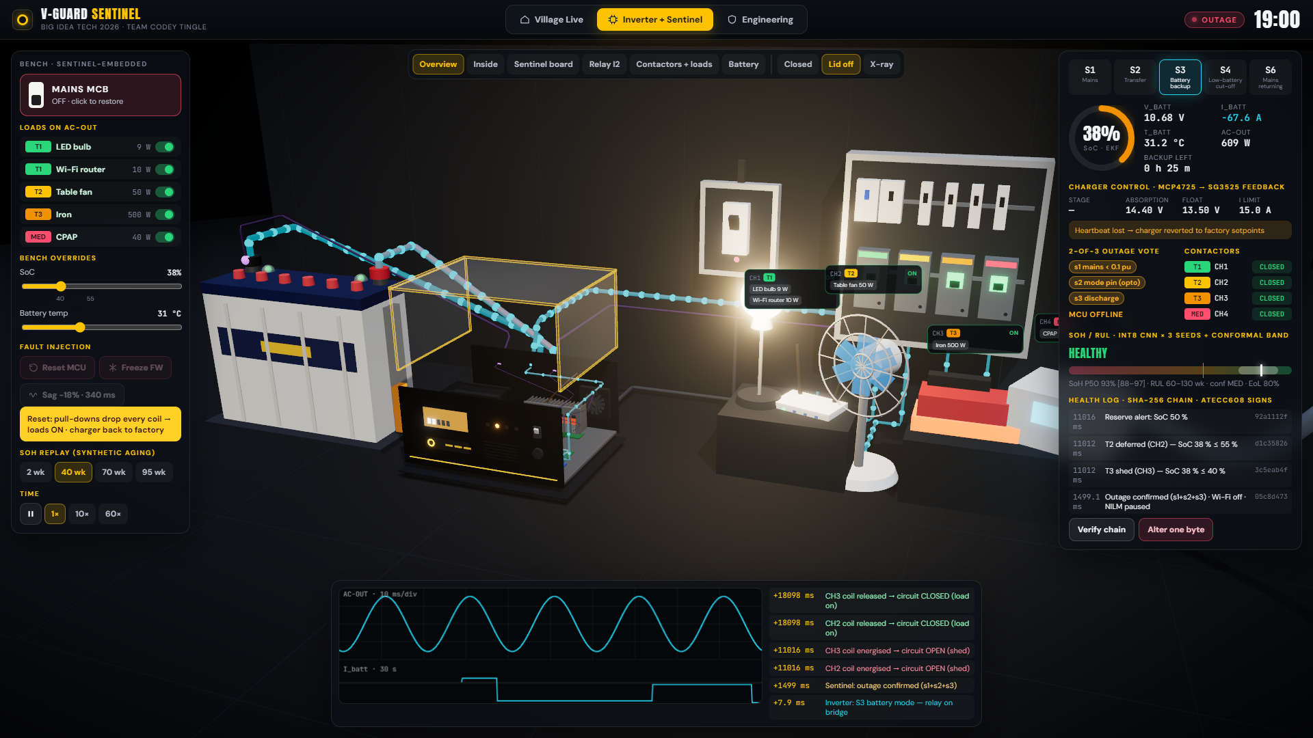
Let's watch it happen live.
Three moments to watch for:
1 · The village
2 · Flip the MCB
3 · Crash it
Feeder cuts at 7 pm. Watch Home 6 go dark at 10:03 while its twin stays lit.
Relay swings in slow motion: 8 ms gap on the scope, outage confirmed in 1.5 s.
Drop SoC below 40 % → the iron sheds. Reset the chip → every load comes back.
V-Guard Sentinel · Big Idea Tech 2026, Track 4 · Team Codey Tingle (TI3271)
11
Notes:
[4:10–8:10] LIVE DEMO (about 4 minutes). Switch to Sentinel-Live.html, full screen.
1) Village tab: press ⏭ 18:58 at 180×. Feeder drops at 19:00 — flows turn cyan, street lights go out. Click Home 1 → Power corner: point at shunt, NTC, CT, Sentinel, contactors. ⏭ 20:20: T2 deferred (bedroom dark). ⏭ 21:55: at 22:03 Home 6 goes DARK; Home 1 still lit. Press Reset MCU on Home 1: all loads back, re-shed after reboot.
2) Inverter + Sentinel tab: switch the iron on. Click MAINS MCB → slow motion: relay swings, scope shows the 8 ms gap gold→cyan, timeline +0.0 / +8.0 ms, Sentinel confirms at ~1.5 s. Hover the board: C1 ESP32, C6 metering, C13 DAC.
3) Drag SoC to 38 % → CH3 opens, iron goes cold; fan deferred. Reset MCU → everything back, charger reverts to factory. Restore MCB → S6 then bulk charging. Temp slider to 45 °C → setpoints drop, current derates. Verify chain → alter one byte → broken.
Back to slides.

Slide 13
Built in, Sentinel costs about half as much.
Same core board. The embedded version reuses what the inverter already has.
RETROFIT
EMBEDDED
a box beside any inverter
inside new V-Guard inverters
Battery health
+ autopilot
₹1,050
Battery health
+ autopilot
₹450–700
+ Energy Coach
+ Grid Shield
₹1,650–2,050
+ Energy Coach
+ Grid Shield
₹850–1,300
Electrician fit, 30–45 min
Factory fit, and it can control the charger
Embedded reuses the inverter's own:
current shunt
12 V supply
enclosure
mains signal
Component cost at prototype volumes, from Indian distributor prices; contactors extra. Retail pricing is V-Guard's call.
V-Guard Sentinel · Big Idea Tech 2026, Track 4 · Team Codey Tingle (TI3271)
13
Notes:
[1:35–1:55] Same core board, two ways to ship it. As a retrofit box it costs about 1,050 rupees in parts for battery health and the autopilot, and 1,650 to 2,050 with the Energy Coach and Grid Shield. Built into a new V-Guard inverter it's roughly half: 450 to 700, or 850 to 1,300, because it reuses the inverter's own current shunt, 12-volt supply, enclosure and mains signal. Only the embedded version can control the charger. The retrofit's advantage is that it works on the inverters already installed in homes today.

Slide 14
Sentinel pays off for the family and for V-Guard.
One home with a ₹15,000 battery, and V-Guard across 1 lakh such homes.
THE FAMILY
V-GUARD
battery revenue from 1 lakh homes, ₹ cr a year
2.5×
longer backup for the fridge, Wi-Fi and lights
6–14 wk
warning before the battery dies
₹6,250
Break-even at 48 % share of replacements
1 % less warranty cost ≈ ₹0.7 cr a year
less spent on batteries per decade*
* Embedded, if charge control adds 20 % life (to be measured). Model: 4-year battery life, 40 % of replacements to V-Guard today (assumed). Warranty: V-Guard Annual Report FY24.
V-Guard Sentinel · Big Idea Tech 2026, Track 4 · Team Codey Tingle (TI3271)
13
Notes:
[8:40–9:00] For the family: the essentials last about two and a half times longer, because they draw about 40 percent of the full load. The battery gives six to fourteen weeks' warning instead of dying without notice. And if the embedded version's charging adds the 20 percent life we're targeting, that's about 6,250 rupees less on batteries per decade. For V-Guard, per 1 lakh homes: longer life means fewer purchases, 15 crore drops to 12.5. But the warning tells V-Guard who will buy a battery and when. Win 48 percent of those replacements and it breaks even; at 55 percent it's 17.2 crore a year. And every 1 percent of warranty cost settled by signed evidence is about 70 lakh a year.

Slide 15
Three validation gates and what we need to pass the first.
1
2
3
GATE 1 · DATASET
GATE 2 · FIELD PILOT
GATE 3 · PRODUCT
Kochi reliability lab
100 retrofit homes
Smart Pro family
24–36 tubular batteries at 3 temperatures × 3 depths → real SoH labels and a measured life-extension number
SoC within 3 %, ≥ 75 % RUL-window hit rate, zero unsafe sheds, fridge/AC F1 ≥ 0.8
Embedded SKU into the inverter that already has Wi-Fi, BLE and the Smart 2.0 app
What V-Guard gains
battery replacements at the right time · warranty by evidence · a premium 'intelligent' tier · a fleet-data moat
What we ask for
one opened Prime-series inverter + charger schematic · ESP32 bench parts · batteries and cyclers for Gate 1
V-Guard Sentinel · Big Idea Tech 2026, Track 4 · Team Codey Tingle (TI3271)
14
Notes:
[9:05–9:35] Our roadmap is written as gates, not dates. Gate one: a proper aging campaign in V-Guard's Kochi reliability lab — that's what turns our synthetic accuracy into real accuracy. Gate two: a hundred retrofit homes for six months with hard pass criteria. Gate three: the embedded version inside the Smart Pro family, which already has Wi-Fi and the app. What V-Guard gets: well-timed battery sales, evidence-based warranty, a premium tier, and data no competitor can buy. What we ask for: one opened Prime inverter with its charger schematic, the bench parts, and lab time.

Slide 16
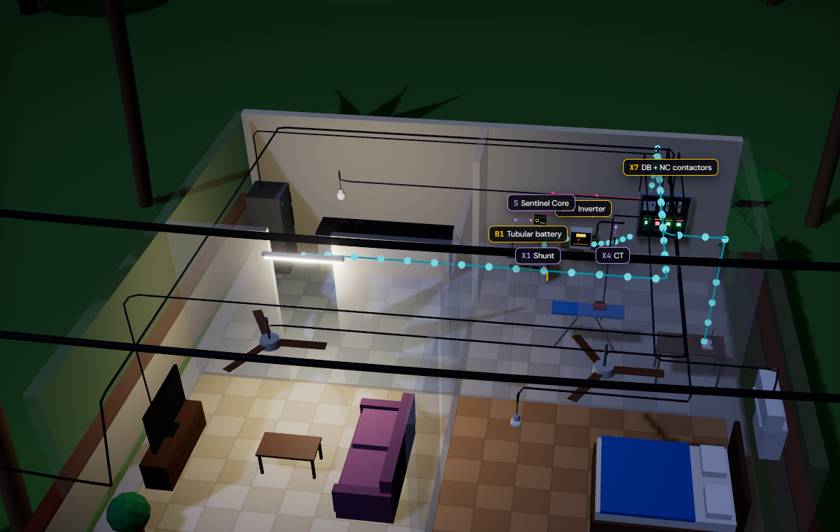
Coil off means loads on.
A window, never a date.
Offline first, fleet second.
Thank you — we'd love your questions.
Team Codey Tingle (TI3271)
Notes:
[9:35–10:00] Three lines to remember. Coil off means loads on — it fails safe. A window, never a date — it's honest about uncertainty. Offline first, fleet second — it works in the village before it ever talks to the cloud. Thank you — we'd love your questions. (Appendix slides follow for Q&A.)

