Slide 1





E-COMMERCE SALES &
CUSTOMER ANALYTICS
Power BI Dashboard Presentation
Business Intelligence · Revenue · Profit · Customers · Marketing
Prepared for IBM Day / IBM Workshop Simulated dataset Assigned by: Shubham Pathak

Slide 2











01
About Microsoft Power BI
The platform used to build this business intelligence dashboard
W hat is Power BI?
W hy use it?
How it helps
A business intelligence tool
It turns rows of data into KPIs,
Users can filter by date, region,
from Microsoft used to connect
charts, slicers and dashboards
product category or campaign
data, prepare it, analyse it and
so decision-makers can
and explore how the selected
present insights through
understand business
data affects business results.
interactive reports.
performance quickly.
Typical workflow
1
2
3
4
5
Import data
Clean & transform
Create DAX measures
Build visuals
Interpret insights
IBM Day · Power BI Dashboard · E-Commerce Analytics
02

Slide 3




02
Dataset & project purpose
A practical business scenario for demonstrating e-commerce analytics
W hy e-commerce data?
Important note
Online retail combines orders, products, customers, regions
and marketing—useful for answering real business
This is a simulated dataset for
questions.
analysis and presentation practice,
not verified records from a real
company.
W hat the dataset shows
Currency is not specified.
Revenue, profit, order volume, customer groups, returns,
Goal
regional contribution and campaign performance.
Turn data into clear insights that
support decisions about products,
customers, regions and marketing.
IBM Day · Power BI Dashboard · E-Commerce Analytics
03

Slide 4


03
KPIs — Revenue & Profit
What the two core financial indicators tell management
TOTAL REVENUE
TOTAL PROFIT
25M
7.76M
Meaning
Meaning
Total sales value generated by the orders in the
Profit recorded after the costs represented in the
dataset.
dataset.
Purpose
Purpose
Measures sales scale and helps compare
performance across dates, regions, categories and
Shows how much value the business retains and
campaigns.
helps identify profitable categories and periods.
IBM Day · Power BI Dashboard · E-Commerce Analytics
04

Slide 5
04
KPIs — Profit Margin & Orders
Efficiency and transaction volume
PROFIT MARGIN
TOTAL ORDERS
30.8%
1,500
Meaning
Meaning
Total Profit ÷ Total Revenue × 100.
Distinct orders counted in the dataset.
Purpose
Purpose
Shows the share of revenue retained as profit. A
Indicates transaction volume. Used with revenue,
higher margin can indicate stronger profitability,
it can help assess changes in order value and
subject to accurate cost data.
demand.
IBM Day · Power BI Dashboard · E-Commerce Analytics
05

Slide 6
05
KPIs — Customers & Returns
Customer reach and post-purchase outcomes
TOTAL CUSTOMERS
RETURNED ORDERS
391
183
Meaning
Meaning
Distinct customers represented in the dataset.
Orders marked as returned.
Purpose
Purpose
Helps assess customer reach. Pair it with order
Tracks return volume and highlights a potential
count and revenue to investigate repeat
area for reviewing product quality, descriptions,
purchasing and customer value.
delivery or customer expectations.
IBM Day · Power BI Dashboard · E-Commerce Analytics
06

Slide 7




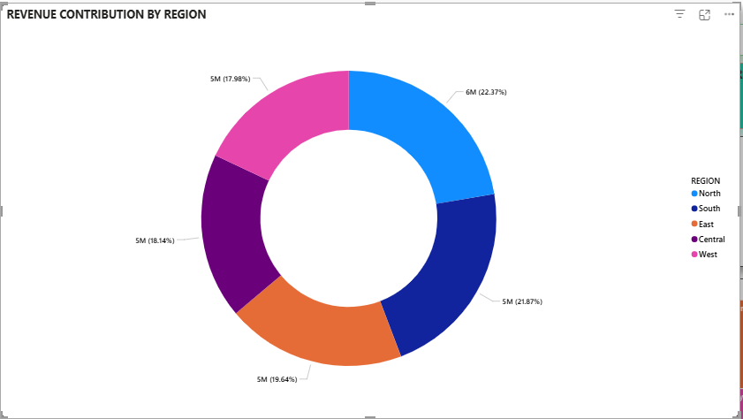
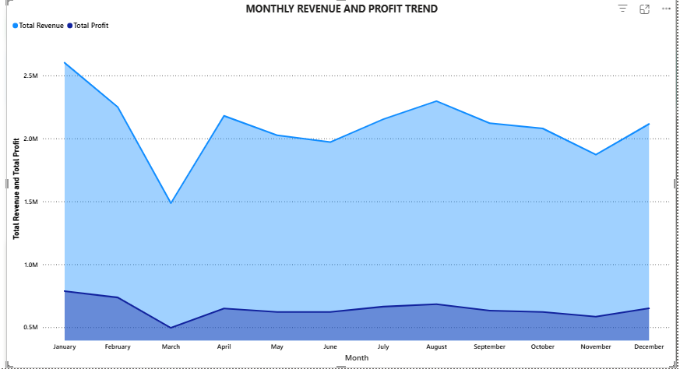
06
Charts — Trend & Region
Overall performance and geographic contribution
Monthly Revenue & Profit Trend
Revenue Contribution by Region
Are sales and profits improving over time? Read the month-
Which regions contribute most to revenue? Compare
to-month lines for growth, dips and seasonal patterns.
segments to see where sales are concentrated.
IBM Day · Power BI Dashboard · E-Commerce Analytics
07

Slide 8
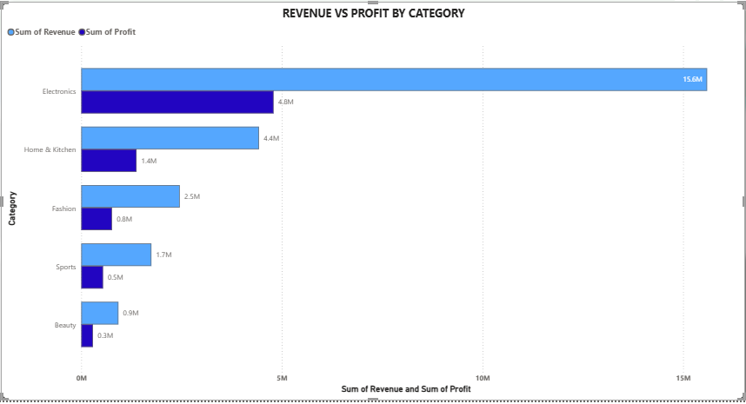
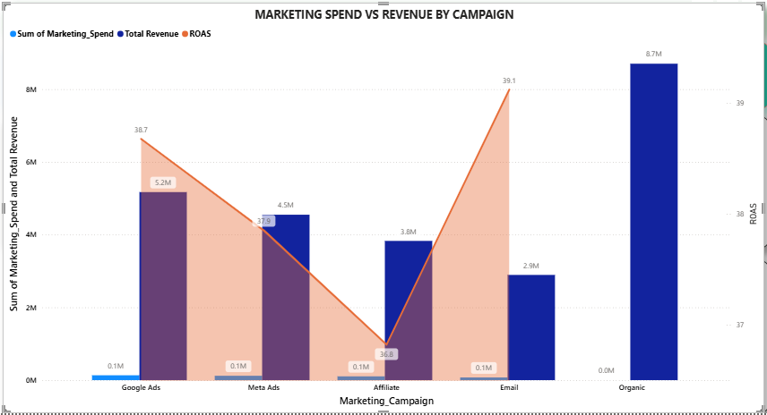
07
Charts — Product Categories & Campaigns
Compare profitability and marketing efficiency
Revenue vs Profit by Category
Marketing Spend vs Revenue by Campaign
Electronics leads in revenue. High revenue does not always
Compare revenue, spend and ROAS. Organic may have
mean the highest profit margin— compare both bars.
zero paid spend—validate definitions before budget
changes.
IBM Day · Power BI Dashboard · E-Commerce Analytics
08

Slide 9
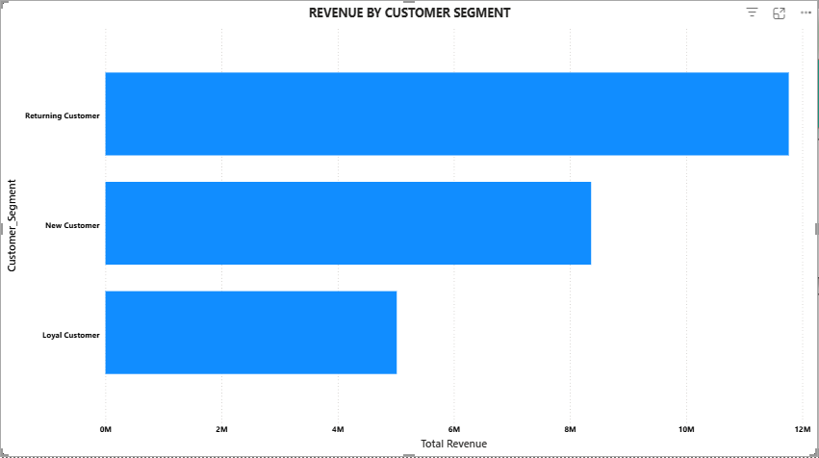
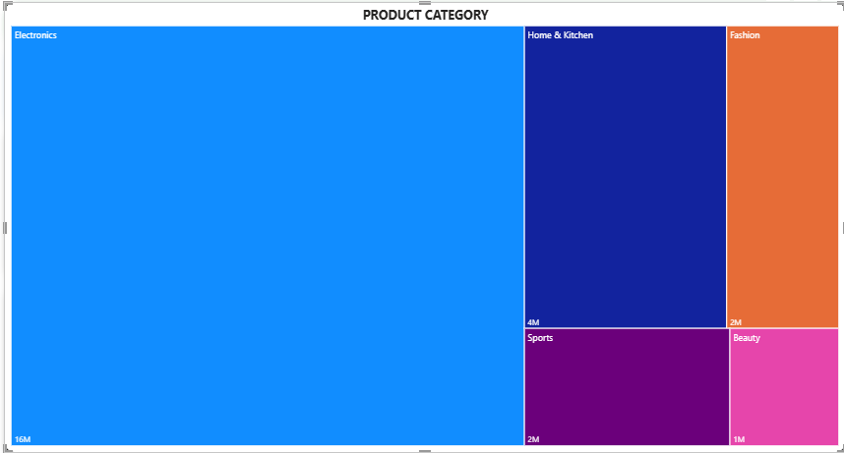
08
Charts — Customers & Product Mix
Who buys and which products drive sales
Revenue by Customer Segment
Revenue by Product Category
Returning customers lead. This suggests repeat buyers are
Electronics is the largest contributor, followed by Home
an important revenue group— consider loyalty initiatives.
& Kitchen. Rectangle size = relative revenue.
IBM Day · Power BI Dashboard · E-Commerce Analytics
09

Slide 10




09
Conclusion & business actions
Turning dashboard findings into practical next steps
Protect strong categories
01
Maintain availability and customer experience for Electronics; monitor profitability, not
revenue alone.
Retain customers
02
Returning customers lead the segment chart. Explore loyalty offers and reasons behind
repeat purchasing.
Review marketing ROI
03
Validate spend and ROAS, then compare paid campaigns using consistent definitions.
IBM Day · Power BI Dashboard · E-Commerce Analytics
10

Slide 11


Thank you
Questions?
The Power BI dashboard brings financial, customer, product, regional and campaign
metrics into one view.
It helps decision-makers ask better questions and prioritise further analysis.
IBM Day · Simulated e-commerce dataset · Assigned by Shubham Pathak

