Slide 1
Stock Price Prediction Using Machine Learning
Ayush Mittal
Hardik Gaur
Vikas Kumar Singh
GLA Unversity,Mathura.
Computer Science Engineering and Applications.
Date :29 Nov 2023.

Slide 2
Introduction
The core idea of the proposed application shows opening,high and low.
This model predicts today’s closing price.
Proposed application will give the closing price of a particular day.

Slide 3
Objectives
The primary objective of this project is to Predict the stock price of a particular company.
Stock Price changes everyday by market forces , this project aims to predict the price.

Slide 4
Problem Statement
Our Focus will be on the technical analysis and the visualization part for achieving maximum efficiency in the prediction made by our model.
It is relevant for Investment Decision Making, Financial Planning,etc.

Slide 5
Methodology
The project will employ the following methodologies, tools, and technologies:
1. Programming Languages: Python (for Backend Development), React (for FrontEnd Development).
2. Software: Vs Code, Jupter Notebook, Web Development tools.

Slide 6
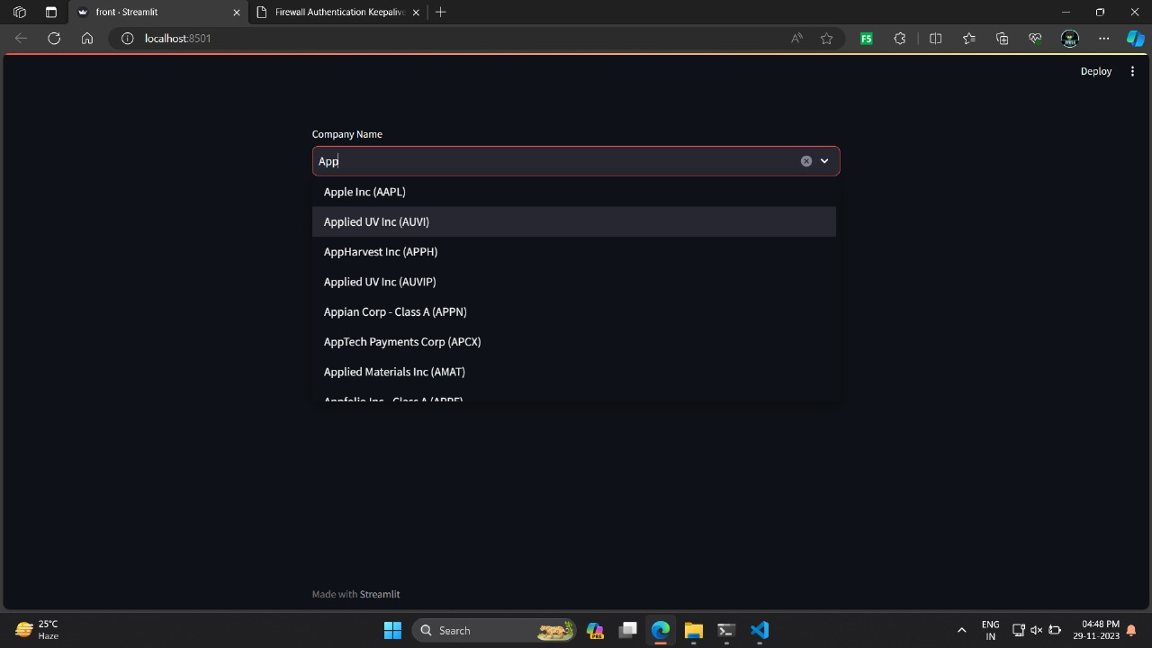
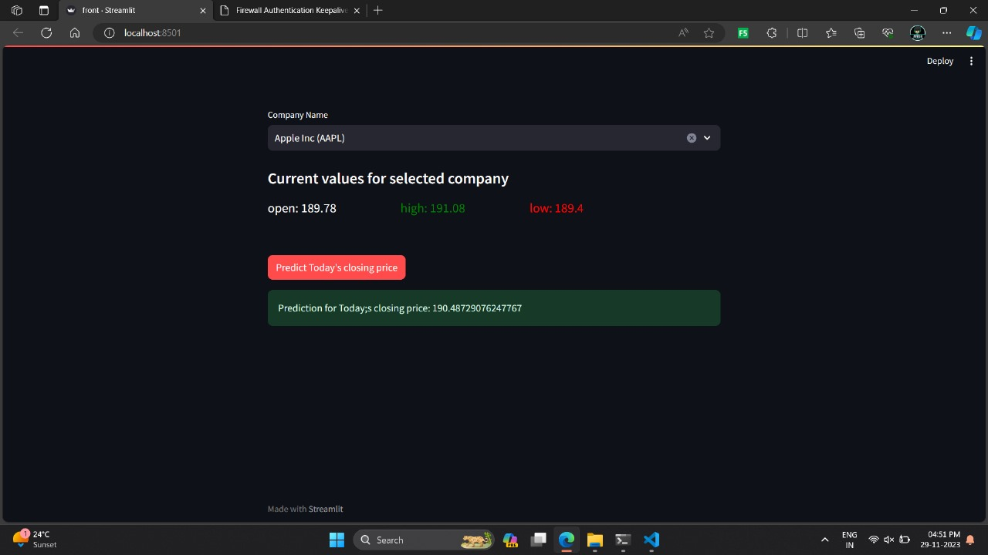
System Architecture

Slide 7
Implementation
1. Project Initiation and Requirements Analysis ( Days : 1 )
2. UI/UX Design ( Days : 2-3 )
3. Frontend Development :Days ( 4-6 )
4. ML model Implementation Days ( 7-10 )
5. Testing and Quality Assurance ( Day : 11)
6. Project Completion and Deployment ( Day : 12 )

Slide 8
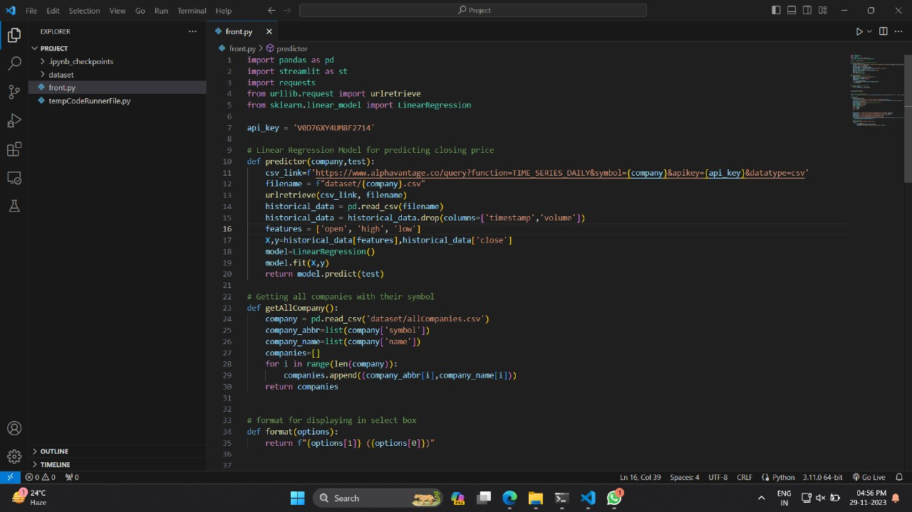
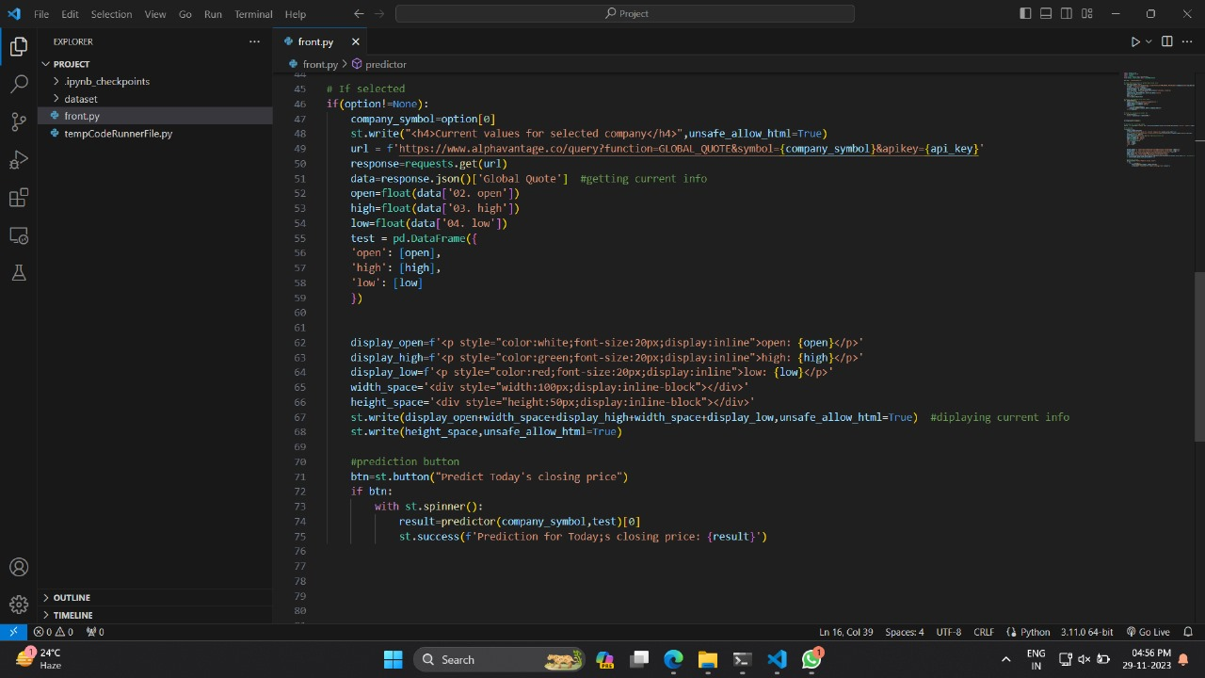
Code Snippets

Slide 9
Features
1. Highly Accurate Prediction.
2. Data Visualization.
3. Responsive UI.

Slide 10
Results

Slide 11
Challenges Faced
Fitting the model.
Implementing UI in Python.
Finding the correct API.

Slide 12
Future Work
Implementing graph for time series for stocks(requires Deep Learning).

Slide 13
Conclusion
The Project lays the foundation for the democratizing machine learning technologies for the retail investors , connecting predictions made by machine learning model to retail investors.

Slide 14
Acknowledgments
I would like to express my sincere appreciation to Mr. Anik Acharjee(Technical Trainer) for developing supporting environment for us to develop this project.

