Slide 1






IILM UNIVERSITY
GREATER NOIDA, UTTAR PRADESH
STUDENT CREDENTIALS
AYUSH MITTAL
AICTE – EDUSKILLS VIRTUAL INTERNSHIP
Siemens Data Science Master
Enrollment / Roll No.
CS-23411189
Program
B.Tech CSE (Cyber Security)
An 8-Week Professional Internship Presentation Report
HOST ORGANIZATION
EduSkills Foundation & Siemens
INTERNSHIP DURATION
Supported by AICTE National Internship Portal
April 2026 – June 2026 (8 Weeks)

Slide 2

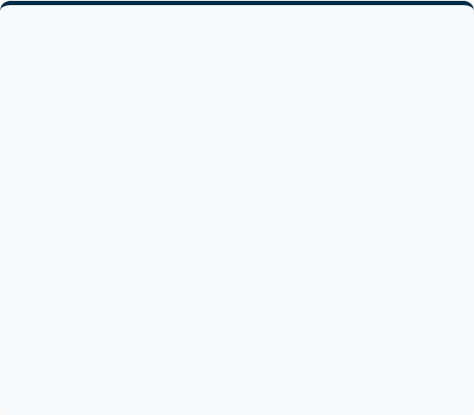
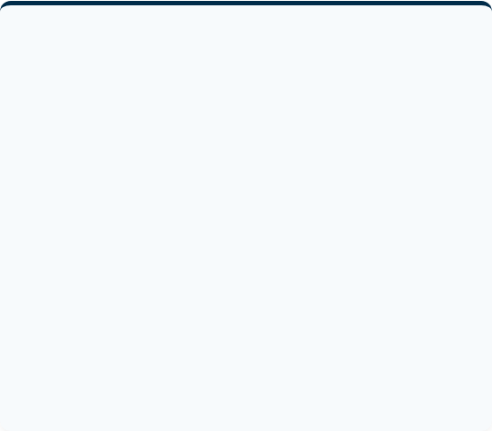
Program Overview
Candidate Profile
Internship Profile
Student Name: Ayush Mittal
Program Name: AICTE - EduSkills Virtual Internship
Program: B.Tech CSE (Cyber Security)
Domain: Siemens Data Science Master
Semester: Semester 6
Duration: April 2026 - June 2026 (8 Weeks)
Enrollment / Roll No: CS-23411189
Host Organizations: EduSkills Foundation & Siemens
Institution: IILM University, Greater Noida, Uttar Pradesh
Supported By: AICTE National Internship Portal

Slide 3









Organization Profiles
AICTE
EduSkills Foundation
Siemens
The statutory body of the Ministry of Education, responsible for technical education development and the parent body of the National Internship Portal.
The industry partner sponsoring the Data Science Master domain, providing the cutting-edge RapidMiner AI Hub platform and core curriculum.
An ISO 9001:2015 certified organization partnering with industry and academia to deliver skill-based virtual internship programs across India.

Slide 4

Problem Statement & Objectives
THE INDUSTRY CHALLENGE
Modern organizations generate vast data volumes but face a critical shortage of professionals who can translate this raw information into actionable, predictive insights using advanced analytical methodologies.
CORE OBJECTIVES
To identify business problems suitable for AI/ML, build highly accurate predictive models, deploy them into production environments, and manage the complete data science workflow lifecycle.

Slide 5
System Architecture & Workflow
1. Data Sources & Access Utilizing enterprise databases and cloud repositories as raw data input. Securely loading external data into the RapidMiner AI Hub environment.
2. Transformation & Feature Eng. Handling missing values, calculating newly derived business attributes, and preparing/engineering relevant attributes for model building.
3. Model Building & Validation Applying advanced regression, classification, and clustering algorithms. Evaluating model performance using strict cross-validation metrics.
4. Deployment & Administration Publishing finalized ML models as web services with active monitoring, and managing platform roles/enterprise ops on RapidMiner AI Hub.

Slide 6

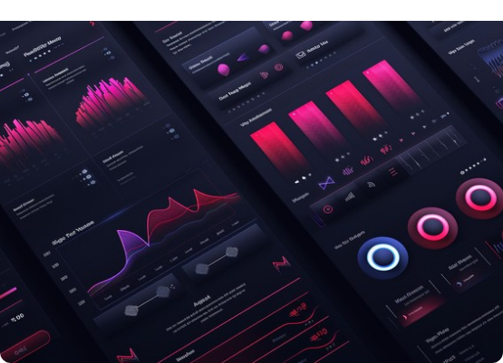
Technologies & Toolchain
RapidMiner AI Hub & Studio The core enterprise environment utilized for comprehensive data preparation, model deployment, and platform administration.
Machine Learning Algorithms Extensive application of statistical techniques, focusing specifically on regression, classification, and clustering operations.
Data Visualization Leveraging advanced dashboarding tools to interpret analytical results, feature importance, and overall model accuracy.
Cloud Virtual Labs & LMS Utilizing the AICTE-EduSkills portal for structured modules and a cloud-based sandbox for hands-on ML practice.

Slide 7



Curriculum Timeline (Weeks 1 to 4)
Week 4
Week 2
Data Prep Master
Data Engineering Pro
Mastering advanced data transformations and workflow automation techniques for production.
Gaining foundational skills to efficiently load, transform, and cleanse raw data.
Week 1
Week 3
Applications & Use Cases
Machine Learning Pro
Identifying and evaluating critical business problems suitable for machine learning solutions.
Building core, foundational machine learning models including basic regression and classification.

Slide 8


Curriculum Timeline (Weeks 5 to 8)
Week 6
Use Cases Master
Week 8
Transitioning to production by deploying, publishing, and monitoring ML models as web services.
Enterprise Ops & Final
Executing enterprise operations, final project documentation, and the Final Assessment Test.
Week 5
Week 7
Machine Learning Master
Platform Admin Master
Implementing highly advanced techniques, hyperparameter tuning, and optimizing performance.
Configuring, securing, and actively managing the RapidMiner AI Hub environment for users.

Slide 9
Key Outcomes & Demonstrated Skills
Business Alignment Achieved the ability to confidently identify and map complex business problems to suitable AI/ML-based solutions.
Robust Data Engineering Demonstrated practical proficiency in data access, complex transformations, pipelines, and mathematical calculations.
End-to-End ML Development Developed hands-on skills encompassing the entire lifecycle of building, validating, and deploying machine learning models.
Enterprise Administration & Academic Excellence Acquired a strong working knowledge of configuring platform operations on the RapidMiner AI Hub and successfully completed the rigorous program with an overall Grade 'O' (Outstanding).

Slide 10



Certification & Official Verification
Official Credential Details
Internship Title: Siemens Data Science Master
Academic Patronage: AICTE National Portal
Issuing Organization: EduSkills Foundation
Certificate ID / Offer Ref: C16Y2026M081417437
GRADE 'O' (Outstanding)

Slide 11



Thank You!
Siemens Data Science Master - Internship Presentation
Ayush Mittal

