Slide 1
LLM-Assisted System Test Generation from Software Documentation
Institute of Industrial Automation
and Software Engineering
Research Project Presentation
Ayush Mittal INFOTECH
Notes:
Ayush Mittal
3rd semester Masters Student in INFOTECH
The core question transform natural-language documentation be converted into reliable, executable system tests where entire process , pipeline is driven By LLM agent

Slide 2
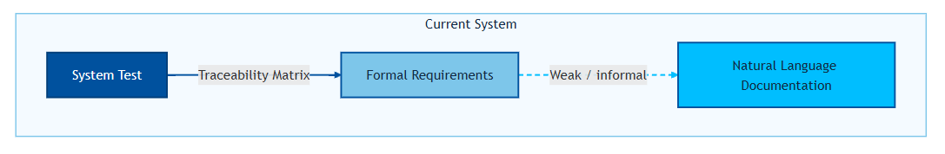
Motivation
Problem in Context
Notes:
System tests are often connected to formal requirements using traceability matrices but remain largely disconnected from ever changing software documentation.
We did a literature review to better understand the current state of the systems where LLMs were used at the core to generate the system tests
We came across API testing, where input documentation to API testing is usually the Open AI specification ; formal specification about the behaviour of the API

Slide 3
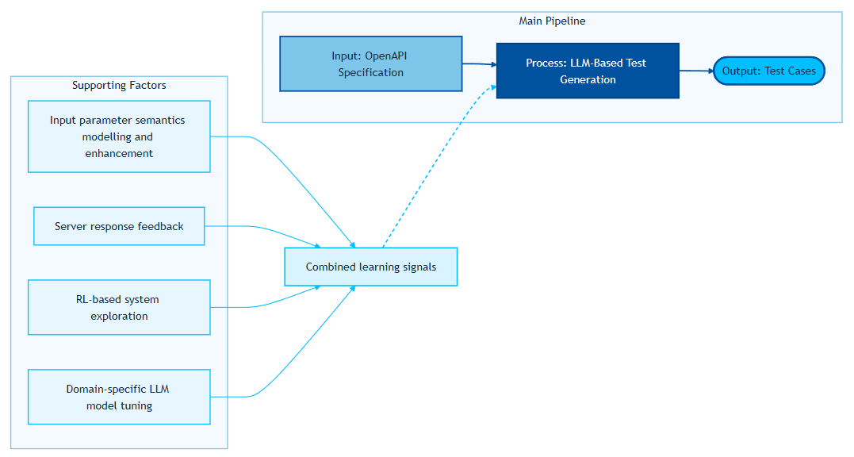
Motivation
Problem in Context
Notes:
We discovered very novel ways in which People were using LLM
- Found Open ai spec lacks information
Input sematic modelling and knowledge graph
RL system , reward the system

Slide 4
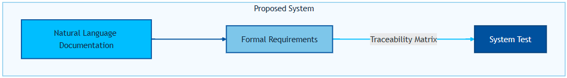
Motivation
Problem in Context
Notes:
- There is a research gap for systems where documentation (not formal schema) is the primary specification—current LLM approaches are not designed for these documentation-driven platforms ,
We thought OK, can we somehow connect Documentation to formal requirements and then derive test cases from these formal requiremenrs

Slide 5
Agenda
Motivation
Objectives
Methodology Overview
VS Code Agentic Infrastructure
Representation and Test Generation Methodology
Experimental Setup and Results
Learnings and Future Work
Notes:
Yes , we will take a look at a great detail such pipeline which tries to achieve the same
What went in to prompt engineering
Learning
We defined objectives for such system
We will ook how Cluade sonne 4.6 behance in such piple and also what heppend when we switch the LLM to a different one keeping wverything same

Slide 6
Objectives
Transform natural-language documentation into structured representations for test derivation.
Use AI agents to generate deterministic, infrastructure-aligned tests.
Evaluate effectiveness and failure profile of LLM-assisted generation.
Notes:
These were the objectives that we set
Can we convert unstructed documentation into more structured representation which has information about user flows , state diagrams , sequence diagrams , Formal requirements - > Learnings from Literature review
Test our modelling -> by generating the testcase
Evaluate effectiveness and

Slide 7
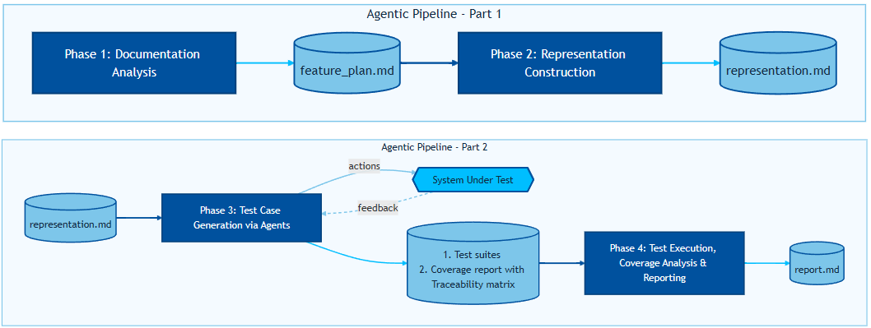
Methodology Overview
Multi-Phase Pipeline Overview
Notes:
We designed a pipeline which logically breaks down the process, Strong separation of concerns->planning-> representation-> generation-> execution, reporting
Documentation as the sole input to the system , no source code
We will not look phase 4 in greater detail, but we will dive deep down into phase 1, 2 and 3
We create a more structured , formal representation such as test cases can be derived from it
Rep -> test cases ; system interac

Slide 8
Representation & Test Generation
Agentic Pipeline Part -1

Slide 9
Representation & Test Generation
Structured Representation Layer
Role Specialization: Prompts assign explicit roles (Senior QA Architect, Formal Modeling Engineer).
Identify: FR , NFR , BR , Actors , inputs , outputs , system states, pre/post conditions, edge cases.
Representation Selection: The pipeline mandates a formal analysis of documentation to select the most suitable intermediate representation (state diagrams, Gherkin, traceability tables, etc.) based on test derivation, traceability, and verification needs.
Mermaid Diagram Enforcement: If diagrams are required, agents must consult official Mermaid syntax documentation.
Justification: Why is certain representation chosen ?
Traceability & Coverage: Every modeled element is assigned a unique ID and explicit traceability reference, enabling systematic test derivation and bidirectional mapping to documentation.
Validation & Quality Control: The pipeline includes explicit validation steps—completeness, syntactic correctness, and coverage checks—ensuring the representation is exhaustive and suitable for automation.
Strict Output Discipline: Follow output report structure.
Notes:
Role Specialization: Prompts assign explicit roles (Senior QA Architect, Formal Modeling Engineer) to enforce domain expertise and methodological rigor.
Representation Selection: The pipeline mandates a formal analysis of documentation to select the most suitable intermediate representation (state diagrams, Gherkin, traceability tables, etc.) based on test derivation, traceability, and verification needs.
Mermaid Diagram Enforcement: If diagrams are required, agents must consult official Mermaid syntax documentation, treat Mermaid as a formal grammar, and lock syntax rules before rendering—preventing ad-hoc or invalid diagrams.
Logical Model First: Agents build a logical model (states, transitions, conditions, IDs) before rendering, separating semantics from syntax for correctness and clarity.Traceability & Coverage: Every modeled element is assigned a unique ID and explicit traceability reference, enabling systematic test derivation and bidirectional mapping to documentation.
Validation & Quality Control: The pipeline includes explicit validation steps—completeness, syntactic correctness, and coverage checks—ensuring the representation is exhaustive and suitable for automation.
Strict Output Discipline: Agents never output representations or analysis directly in the user panel; all artefacts are persisted in structured files for review and downstream automation.

Slide 10
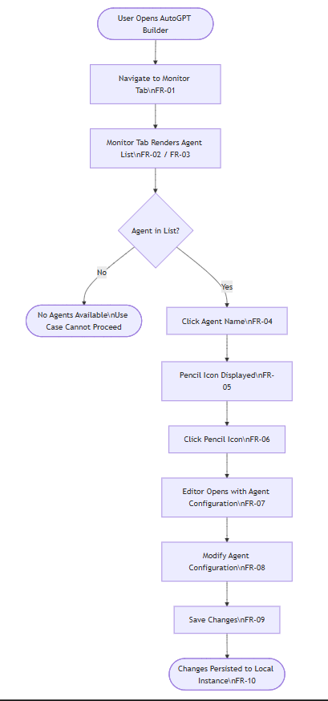
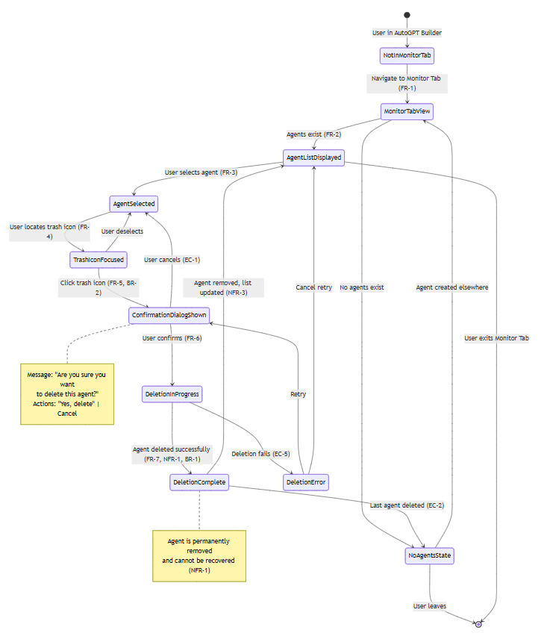
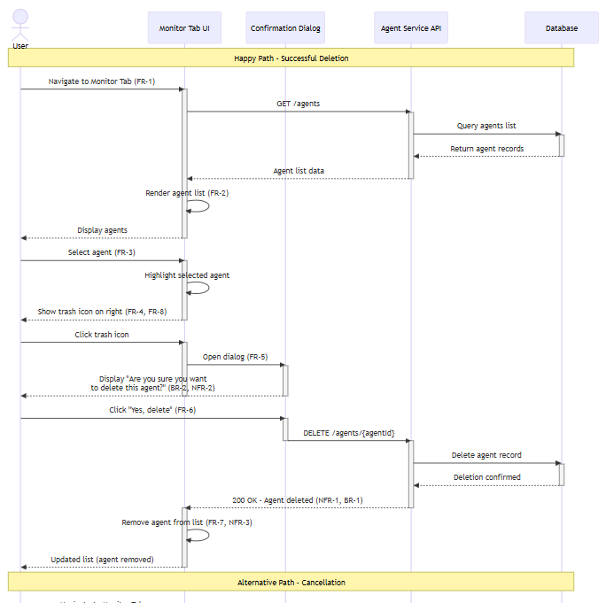
Representation & Test Generation
Structured Representation Layer - Example

Slide 11
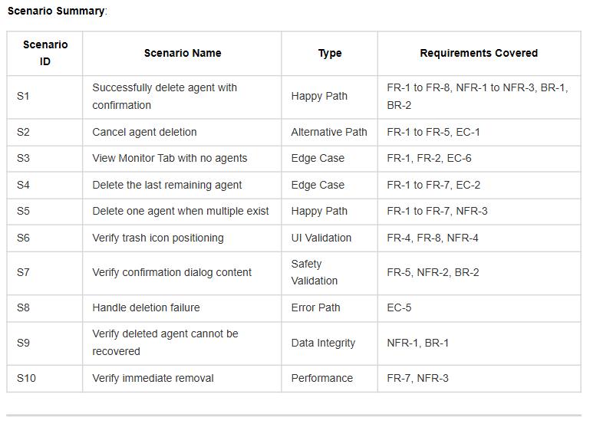
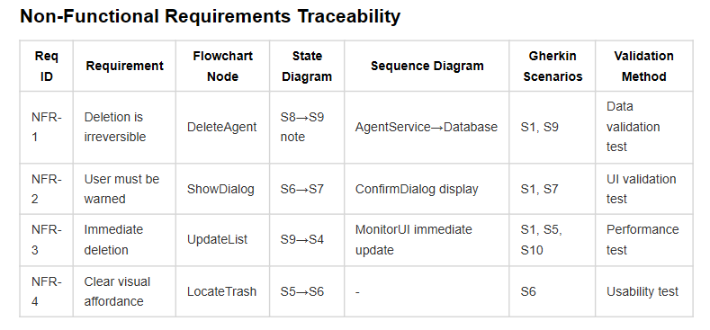
Representation & Test Generation
Structured Representation Layer - Example

Slide 12
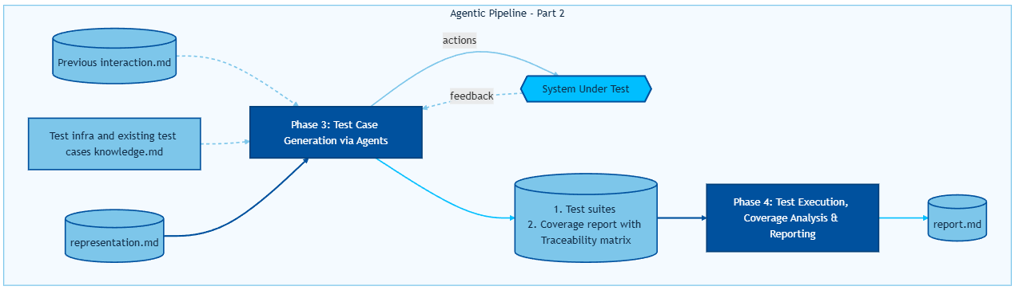
Methodology Overview
Multi-Phase Pipeline Overview

Slide 13
VS Code Agentic Infrastructure
Representation-Driven, Empirically Grounded Playwright Tests
Documentation describes intent; implementation IS reality — no test line may exist without a corresponding playwright-cli-captured code snippet or DOM snapshot as evidence.
7-phase gated pipeline (Infrastructure Analysis → Scenario Extraction → State Dependency Analysis → Precondition Strategy → Feasibility Gate → Live Exploration → Test Synthesis) — each gate must fully complete before the next begins.
Mandatory Code Bank: every playwright-cli action emits verbatim TypeScript; only these captured selectors and actions are permitted in test code — zero hand-written selectors allowed.
Snapshot-driven assertion derivation: after every state-changing action, a DOM snapshot is captured and interrogated (URL, new/removed elements, dialogs) — these observations become the assertions, not the requirements document.

Slide 14
VS Code Agentic Infrastructure
Representation-Driven, Empirically Grounded Playwright Tests
Iteration 1 (Representation → Tests → Heal): agent generates tests directly from Gherkin/state diagrams, then attempts repair from execution logs — high failure rate due to hallucinated selectors, unverified preconditions, and implicit state assumptions
Iteration 2 (Representation → Tests → Heal): thinks about , unverified preconditions, and implicit state assumptions, plans about it and then agent generates tests and then attempts repair from execution logs — high failure rate due to hallucinated selectors, and lack of system knowledge
Iteration 2 (Representation → playwright-cli exploration → Tests → Heal): introducing live system exploration before synthesis eliminated speculative selectors; the "Code Bank" pattern ensured every action had empirical backing — significant pass-rate improvement.
Note : As the agent explore → more efficient → gains more knowledge about the system → every interaction is documented → More Testcases → Stronger System Model

Slide 15
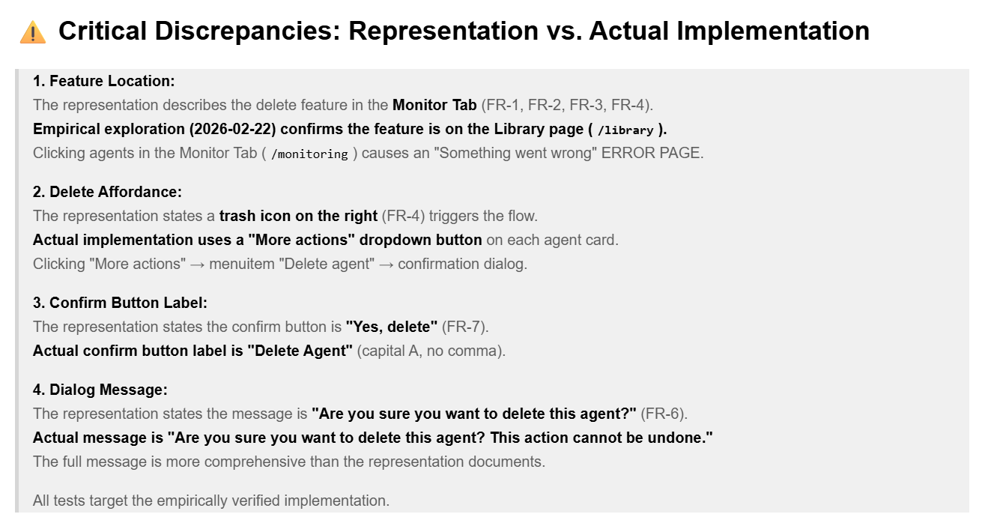
VS Code Agentic Infrastructure
Representation-Driven, Empirically Grounded Playwright Tests

Slide 16
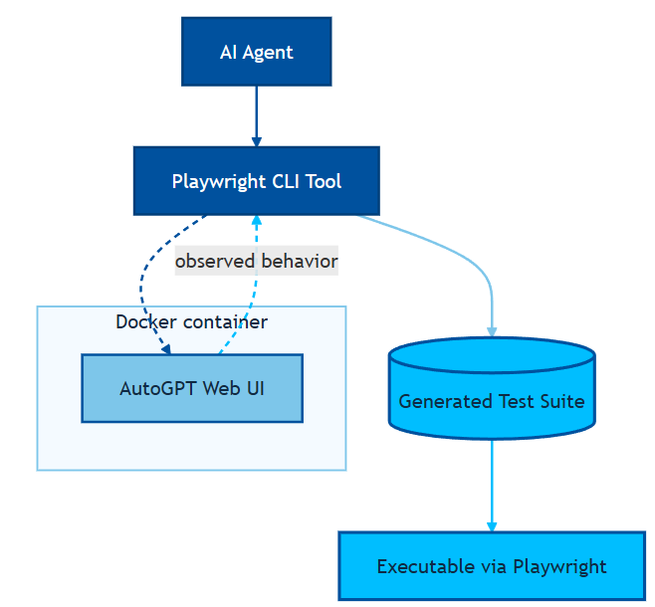
Experimental Setup & Results
Experimental Infrastructure
Experimental Infrastructure on Auto-GPT Platform
Auto-GPT web UI with no-code agent-builder workflows.
Docker-based setup.

Slide 17
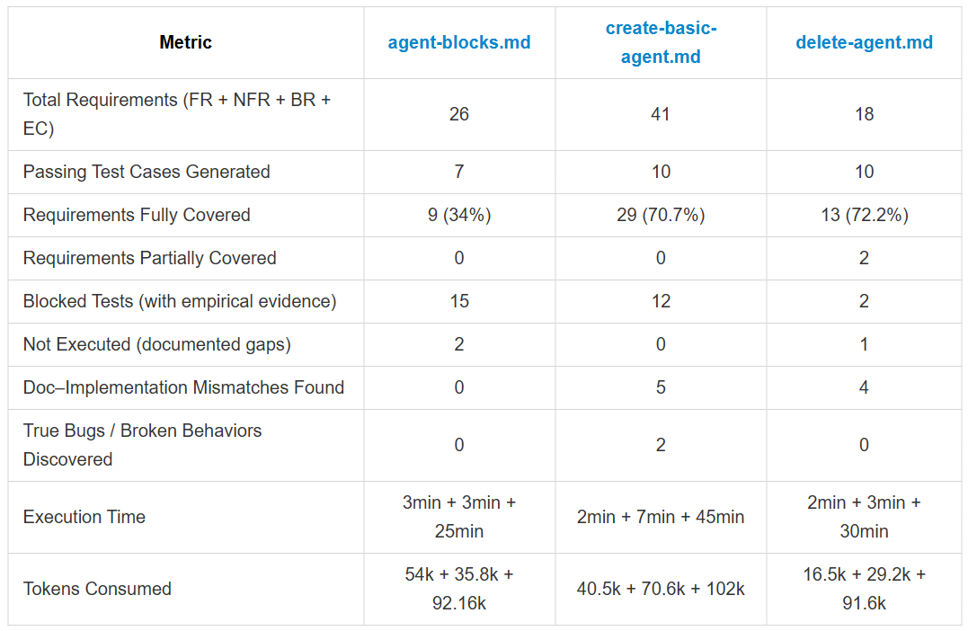
Experimental Setup & Results
Test Generation Outcomes and Coverage
Notes:
Token consumption for Phase 2 (test generation) is roughly similar (~92–102k) regardless of feature complexity — the execution/healing phase dominates cost
Time taken in Phase 3

Slide 18
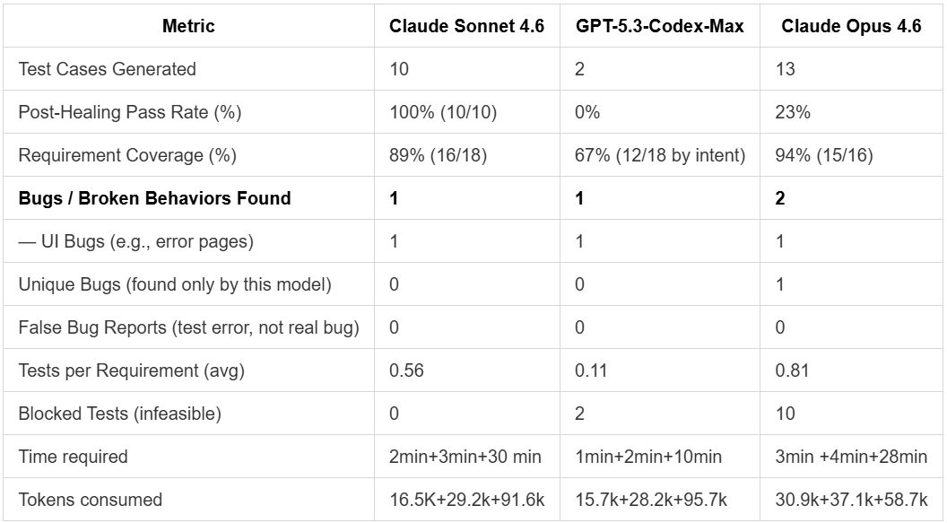
Experimental Setup & Results
Comparison Between different Models
Notes:
Common Finding: All three models independently discovered the Monitor Tab agent-click crash
Claude Sonnet 4.6 — Highest effective execution
Discovered delete feature operates on Library page (/library), not Monitor Tab
Empirical pivot → 10 fully executable tests
Found 4 documentation–implementation mismatches:
Feature location
Delete trigger mechanism
Confirm button label
Dialog message text
GPT-5.3-Codex-Max — "Honesty-first" approach
Exploration confirmed Monitor Tab crash blocked documented delete flow
Generated only 2 intentionally-empty test.skip() stubs
0% execution — but zero hallucinated test logic
Did not discover Library page alternative path
Claude Opus 4.6 — Most comprehensive suite
13 tests covering 94% of requirements (17 STT-row-derived scenarios)
Constrained by Monitor Tab crash → only 3 tests executed
Uniquely discovered DELETE API foreign key constraint bug
LibraryAgent_agentGraphId_agentGraphVersion_fkey
Requires two-step deletion workaround
Did not discover Library page alternative path
GPT- 4.1 asking me to continue after every phase
Claude Sonnet 4.5 created a single representation file while Claude Sonnet 4.6 created bunch of artifacts
GPT 4.1 and GPT 4o failed misreably

Slide 19
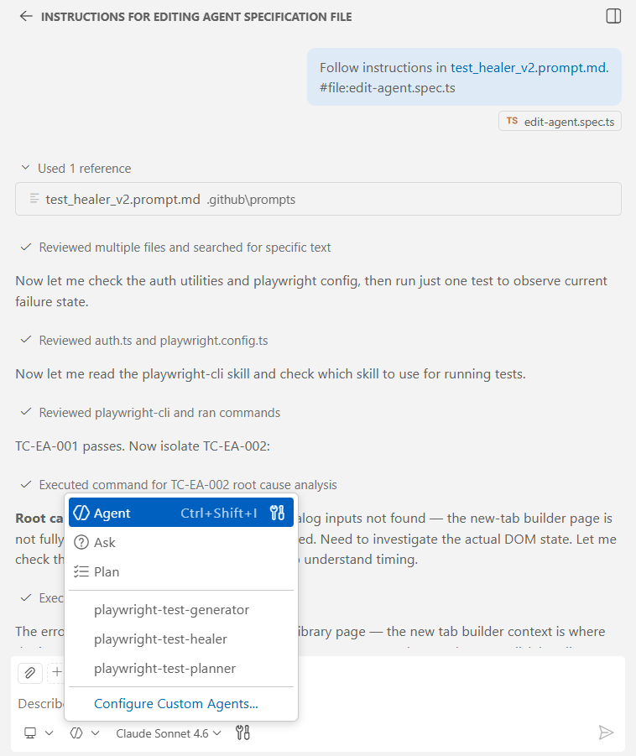
VS Code Agentic Infrastructure
VS Code + GitHub Copilot Agents for Structured Test Generation
Not using any agentic framework like Lang Chain or OpenAI Agents SDK.
Using prompt files feature of VS code ( specify instructions and tools ).
Prompt files work on top of in-built/custom agents.

Slide 20
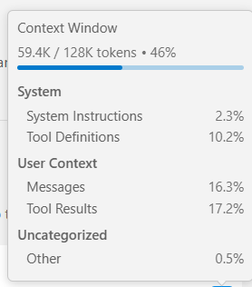
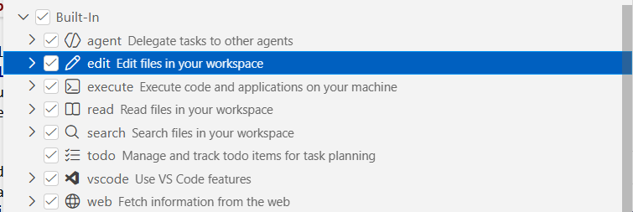
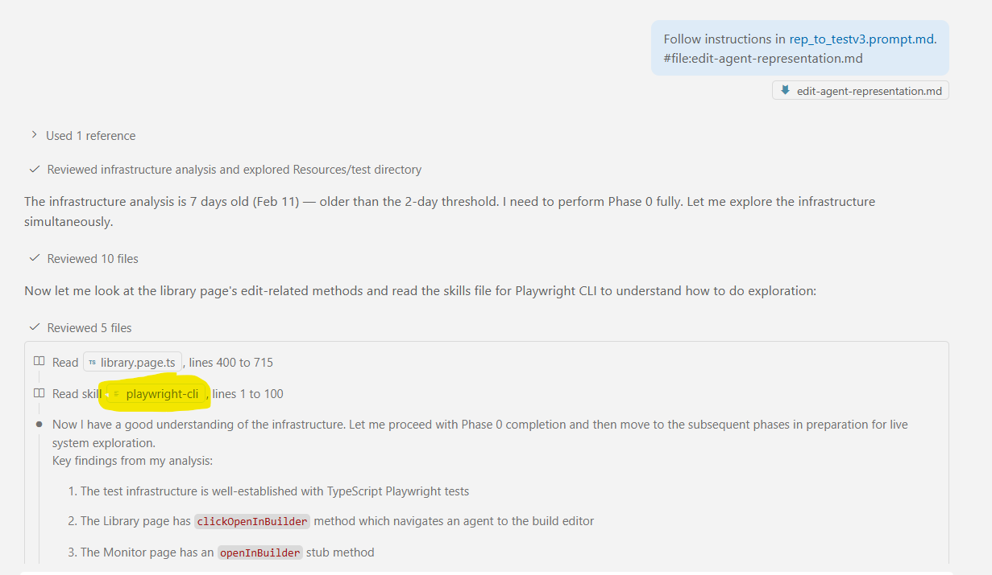
VS Code Agentic Infrastructure
Context Management and Tools
LLMs have a limited context window.
The process is decomposed into clear, logical steps.
Each process produces outputs(.md file) that become explicit inputs for the next, enabling agents to operate with a fresh, focused context at every stage.
Skills.md defines reusable agent capabilities which are read when needed, while tool definition is provided in the prompt file.
Summarize conversation.
Playwright-cli as tool.
Notes:
Limitted attention span : > The LLM puts more attention to the rescent or last words more than middle part

Slide 21
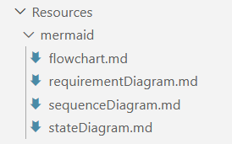
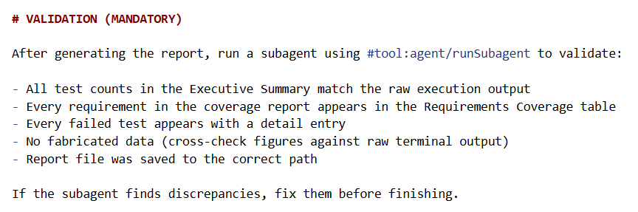
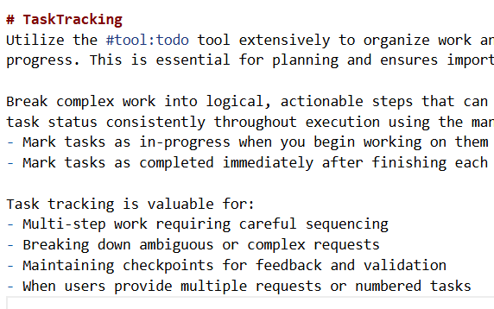
VS Code Agentic Infrastructure
Prompt Design Methodology
Prompts specify roles (e.g., Senior QA Architect, Formal Modeling Engineer).
Gated and phased prompting.
Prompting is a iterative process which works when a strong baseline exists.
Prompts encode constraints (mandatory checks, forbidden shortcuts).
Task tracking and tool calls reduce hallucinations and improve traceability and visibility.
Subagents enforce quality standards and validation rules.

Slide 22
Learnings and Future Directions
Testing APIs driven by agent where the reinforcement algorithm or other novel algorithm , expert , findings are designed as prompt but not implemented in code.
Building and modelling the complex system side by side with Knowledge graph when the Agent explores the system under test.
Extend the framework to security testing, can help in anticipating and mitigating vulnerabilities in SDVs by generating tests that probe for security weaknesses based on documentation and observed behavior and known vulnerabilities internet.
Combine multiple LLMs output for more comprehensive results
Single prompt for multiple LLMs ?

Slide 23

Institut of Industrial Automation
and Software Engineering
Ayush Mittal
st192649@stud.uni-stuttgart.de
INFOTECH

