Slide 1

MEDGEMMA IMPACT CHALLENGE 2026
Clinical Integration of HAI-DEF Models
in Uro-Oncological Decision-Making
MedGemma as Predictor & Judge for German Renal Cell Carcinoma
Radu Alexa | Board-Certified Uro-Oncologist
Ayush Nangia | AI Researcher
Aman Gokrani | AI Researcher, ex-Microsoft Health AI
MAIN TRACK
NOVEL TASK PRIZE

Slide 2
The Problem: Tumor Board Preparation
Clinical Challenge
Our Dataset
Weekly tumor board meetings at 500+ German cancer centers
Clinicians compile patient data, cross-reference national guidelines, draft therapy recommendations
Error-prone: staging typos, guideline drift, documentation inconsistencies
No validated AI assistant for German-language clinical oncology
69 real RCC cases from German tumor boards
Structured per NCC guidelines
Full clinical data: ECOG, Karnofsky, TNM staging, IMDC risk, histology, imaging, prior therapies
Ground truth = actual tumor board consensus
Unmet need: Medical AI benchmarks overwhelmingly use English data. German clinical NLP is underserved.
52% / 48%
Metastatic vs. Localized cases
1,242
Total expert reviews (100% coverage)

Slide 3
Three-Tier Evaluation Pipeline
Tier 1
LLM Therapy Recommendation
6 models receive structured German clinical JSON with embedded IMDC therapy guidelines
Prediction
Output: is_metastatic, IMDC risk, therapy, category, reasoning, confidence
v
Tier 2
Automated Judge Evaluation
GPT-5.2 and MedGemma 27B independently score each prediction
AI Judge
Formula: overall = semantic(40%) + clinical(40%) + reasoning(20%)
v
Tier 3
Uro-Oncologist Validation
Board-certified physician reviews ALL model predictions AND judge evaluations
Expert
Metrics: acceptability, exact match, quality (0-9), judge agreement
414
828
1,242
Model Predictions
Judge Evaluations
Expert Reviews

Slide 4
Models & Infrastructure
Inference Pipeline
Hyperparameters
Modal vLLM on H100 GPUs
Parameter
Standard
Thinking
Cloud GPU inference with grammar-guided generation
Temperature
0.3
0.6
Top-p
0.95
0.95
Pydantic Schema Enforcement
Max Tokens
32,768
65,536
Structured JSON output for therapy predictions
Seed
42
42
Structured
Pydantic
Post-parse
German Clinical Prompts
Full IMDC therapy algorithm embedded in prompt
Production Web Platform
Next.js 16 + React
Supabase PostgreSQL
Vercel deployment
Structured review workflows
Deterministic Reproducibility
Seed=42, fixed temperature, nucleus sampling
Thinking Model Support
OLMo Think: 65K tokens, JSON after reasoning

Slide 5
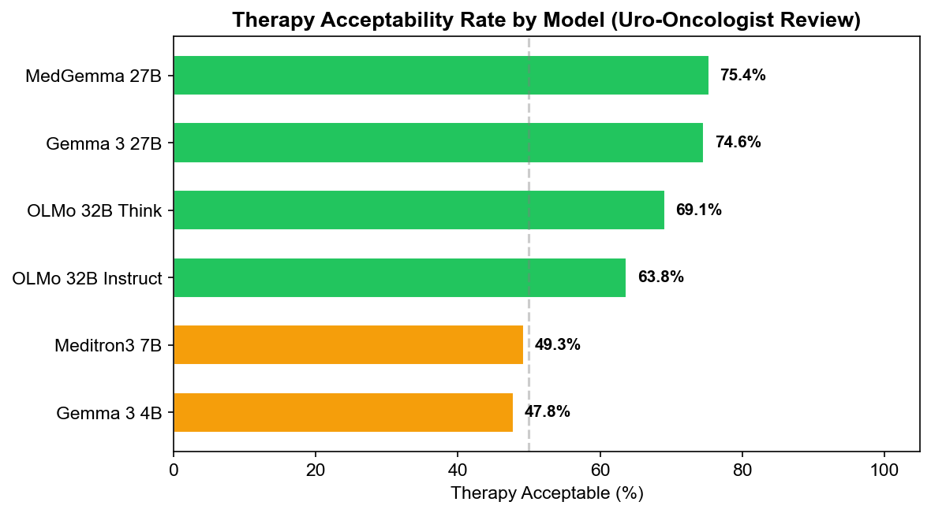
Model Performance — Uro-Oncologist Review
Clinically Acceptable Rate by Model
MedGemma 27B
75.4% clinically acceptable
6.1 / 9 quality score
46.4% exact therapy match
0.76 judge score (best)
All 6 Models (avg)
63.5% metastatic detection
58.7% clinically acceptable
30.9% exact therapy match
5.1 / 9 quality score

Slide 6
Novel Task: MedGemma as Structured Judge
NOVEL TASK PRIZE
Judge Scoring System
Why This Is Novel
Repurposed for evaluation: MedGemma was trained as a clinical model, not a judge — we adapt it for structured scoring of other models
German medical NLP: Judge evaluates in German with domain-specific oncology terminology
Structured JSON output: Grammar-guided generation ensures consistent scoring format
Expert-validated: 828 judge evaluations reviewed by uro-oncologist (100% coverage)
Bias discovery: Self-judging bias (p=0.017) — a finding with broad implications for LLM-as-judge pipelines
overall = sem(.4) + clin(.4) + reas(.2)
Weighted composite score (0 - 1 scale)
40%
Semantic Match
Same drug=1.0, same class=0.5-0.7, different=0-0.3
40%
Clinical Appropriateness
First-choice=0.9-1.0, acceptable alt=0.6-0.8
20%
Reasoning Quality
Complete+correct=0.8-1.0, errors=0-0.4

Slide 7
Judge Agreement with Uro-Oncologist
MedGemma 27B
GPT-5.2
Medical-specialized judge
General-purpose judge
INTER-JUDGE
0.675
0.629
0.725
Cohen's kappa (substantial)
Cohen's kappa (substantial)
Cohen's kappa
Agreement Rate
84.5%
Agreement Rate
81.8%
F1 Score
0.873
F1 Score
0.845
Sensitivity
0.844
Sensitivity
0.782
Specificity
0.847
Specificity
0.880
Doctor Agrees
85.3%
Doctor Agrees
85.0%
Reasoning Quality
7.2 / 10
Reasoning Quality
7.1 / 10
CONCORDANCE
86.5%
Agreement rate

Slide 8
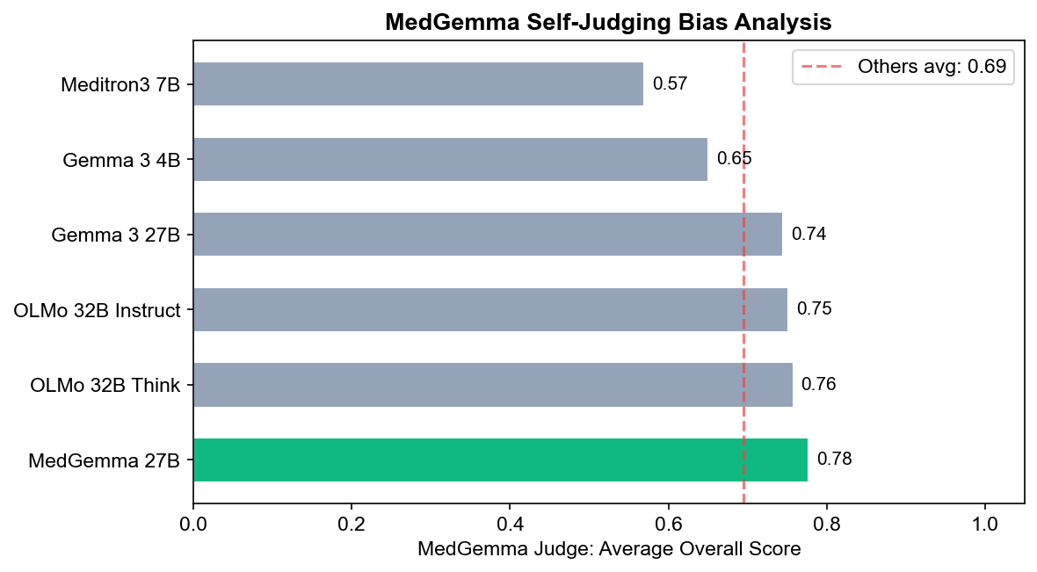
Key Discovery: Self-Judging Bias
p = 0.017
SELF-JUDGING
JUDGING OTHERS
STATISTICAL TEST
0.777
0.695
Mann-Whitney U
U = 14,062 | p = 0.017
n = 69 evaluations
n = 345 evaluations
MEDIAN DIFFERENCE
0.850 vs 0.780
+0.082
Self vs. Others median scores
MedGemma scores its own predictions higher
Implication
Self-evaluation pipelines must account for this bias. Models should not be sole judges of their own outputs without independent calibration. This finding generalizes to any LLM-as-judge pipeline.

Slide 9
Clinical Safety Analysis
False Positives (Dangerous)
Safety Takeaways
Judge approves what doctor rejects
Both judges are conservative — they err toward rejecting, which is safer in clinical context
GPT-5.2 has lowest dangerous error rate (8.2%) — better for safety-critical screening
MedGemma is less strict (24.0% vs 29.8% FN) — catches more valid alternatives
Complementary strengths: Using both judges and flagging disagreements maximizes safety
AI judges as screening tools, not final arbiters — physician review remains essential
GPT-5.2
8.2%
MedGemma 27B
9.6%
False Negatives (Overly Strict)
Judge rejects what doctor approves
GPT-5.2
29.8%
MedGemma 27B
24.0%

Slide 10
Summary & Future Work
75.4%
0.675
1,242
p=0.017
Best Acceptable
(MedGemma 27B)
Best Judge Kappa
(MedGemma 27B)
Expert Reviews
(100% coverage)
Self-Judging Bias
(Novel discovery)
Key Contributions
Live Demo
medical-review-site.vercel.app
MedGemma dual role: Best predictor (75.4%, 6.1/9) AND best judge (kappa=0.675)
Novel task: MedGemma adapted as structured medical judge
Real clinical validation: 69 German tumor board cases, not synthetic benchmarks
100% expert coverage: Board-certified uro-oncologist reviewed all 1,242 outputs
Bias discovery: Statistically significant self-judging bias (p=0.017)
Production system: Live web app with Supabase, deployed on Vercel
Code Repository
github.com/ayushnangia/Med_LLM
Future Work
Multiple physician reviewers
Expand to prostate, urothelial, testicular
Fine-tune MedGemma on validated dataset
AI co-pilot for tumor board prep

