Slide 1


StockSense
Every move, accounted for
Connected inventory management
Ayush Pandey / Team X
Notes:
0:00–0:15. I’m Ayush Pandey from team X. StockSense connects warehouse work, manager decisions and stock records in one workspace. Every stock change has a clear owner and a traceable record. Presenter: Ayush Pandey. Team: X. Institution: X. Cover is conceptual brand artwork, not a photograph of a customer site.
Source: StockSense local source code, README, final verification logs, and isolated demo screenshots. Team, institution, and contact details remain placeholders.

Slide 2
The warehouse handoff
Planned quantities and physical work need a shared record.
10
8
Who
approves?
planned units
reported units
The manager needs the quantity, the reason, and the person responsible.
Illustrative receipt scenario
Notes:
0:15–0:35. Imagine a receipt planned for ten units while the warehouse reports eight. Who records the difference, who approves it, and which quantity changes inventory? This is an illustrative scenario, not customer research or a measured result.
Source: StockSense local source code, README, final verification logs, and isolated demo screenshots. Team, institution, and contact details remain placeholders.

Slide 3
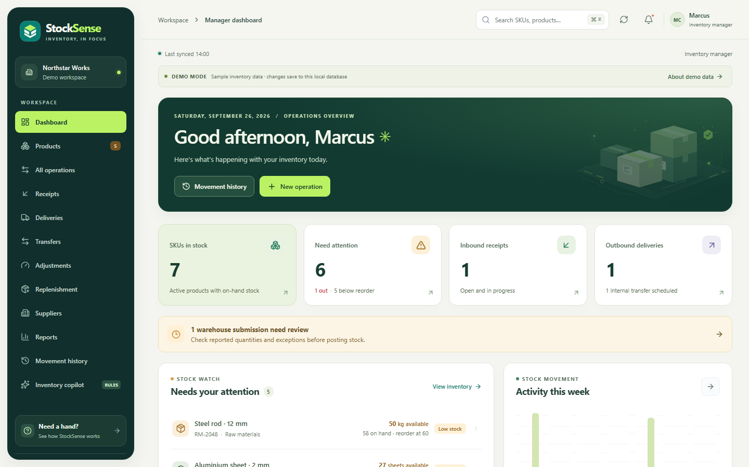
One workspace for every role
Administrator
Access and warehouse assignments
Inventory manager
Planning, exceptions and posting
Warehouse staff
Assigned work and actual quantities
Notes:
0:35–1:00. Administrators manage access and locations. Inventory managers plan and validate movements. Warehouse staff work from assigned tasks and submit actual quantities. The server checks organization, role and warehouse scope. All screens use one API and database. Source: src/client/App.tsx and src/server/server.ts. Screenshot: isolated demo workspace.
Source: StockSense local source code, README, final verification logs, and isolated demo screenshots. Team, institution, and contact details remain placeholders.

Slide 4
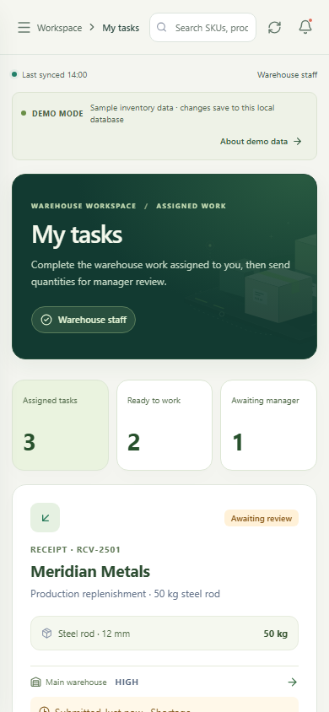
A controlled posting sequence
01
Plan the movement
Drafts record intent without changing stock.
02
Stage the work
Ready deliveries and transfers reserve stock.
03
Report what happened
Assigned staff submit quantities and exceptions.
04
Review and post
Manager validation updates balances and ledger.
Notes:
1:00–1:20. Drafts capture intent. Ready deliveries and transfers reserve stock. Staff report actual quantities. A manager reviews and posts the movement. The final step changes balances and ledger together. Reservations apply to outgoing delivery/transfer operations, not every receipt. Source: README Stock posting rules and operation handlers.
Source: StockSense local source code, README, final verification logs, and isolated demo screenshots. Team, institution, and contact details remain placeholders.

Slide 5
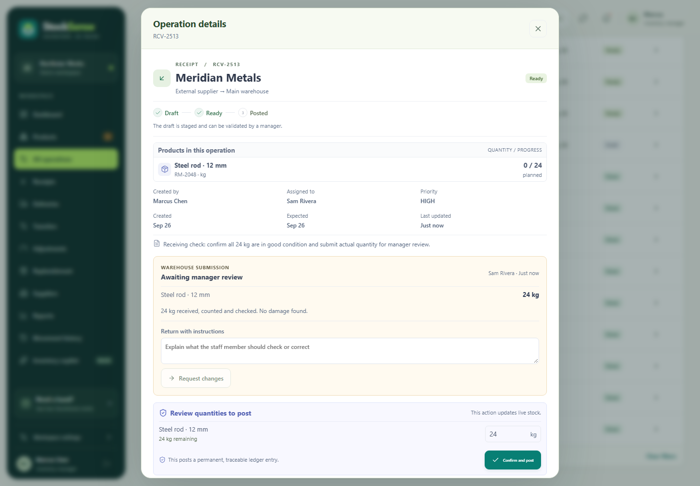
One handoff, end to end
A receipt moves through staff review and manager approval.
46 kg
before the receipt
46 kg
awaiting review
70 kg
after manager approval
Captured demo: RCV-2513, 24 kg received into Main warehouse.
Notes:
1:20–2:50. Live demo: use separate manager and staff browser profiles. Show starting stock and a prepared ready receipt. Staff submits actual quantities. Show pending review and unchanged stock. Reopen the manager detail, inspect the submission, Validate movement, Confirm and post. Finish with the ledger and updated balance. The animated browser deck can instead show a labeled captured walkthrough. Never pretend recorded frames are a live demonstration.
Source: StockSense local source code, README, final verification logs, and isolated demo screenshots. Team, institution, and contact details remain placeholders.

Slide 6
The stock record has safeguards
Safe retries
Balanced transfers
The same request key reuses its result.
Conflicting quantities are rejected.
Source and destination entries
commit in the same transaction.
Fresh counts
Protected reservations
Intervening movements invalidate
a stale physical count.
A count cannot reduce on-hand stock
below active commitments.
Notes:
2:50–3:15. Same-key retries reuse a stored validation result. A different payload with the same key is rejected. Transfers post matching source and destination entries in one transaction. Counts carry a ledger revision, rejecting stale counts even if stock later returns to the same quantity. Counts also cannot consume reserved stock. Source: transaction and idempotency handlers and security regression tests.
Source: StockSense local source code, README, final verification logs, and isolated demo screenshots. Team, institution, and contact details remain placeholders.

Slide 7
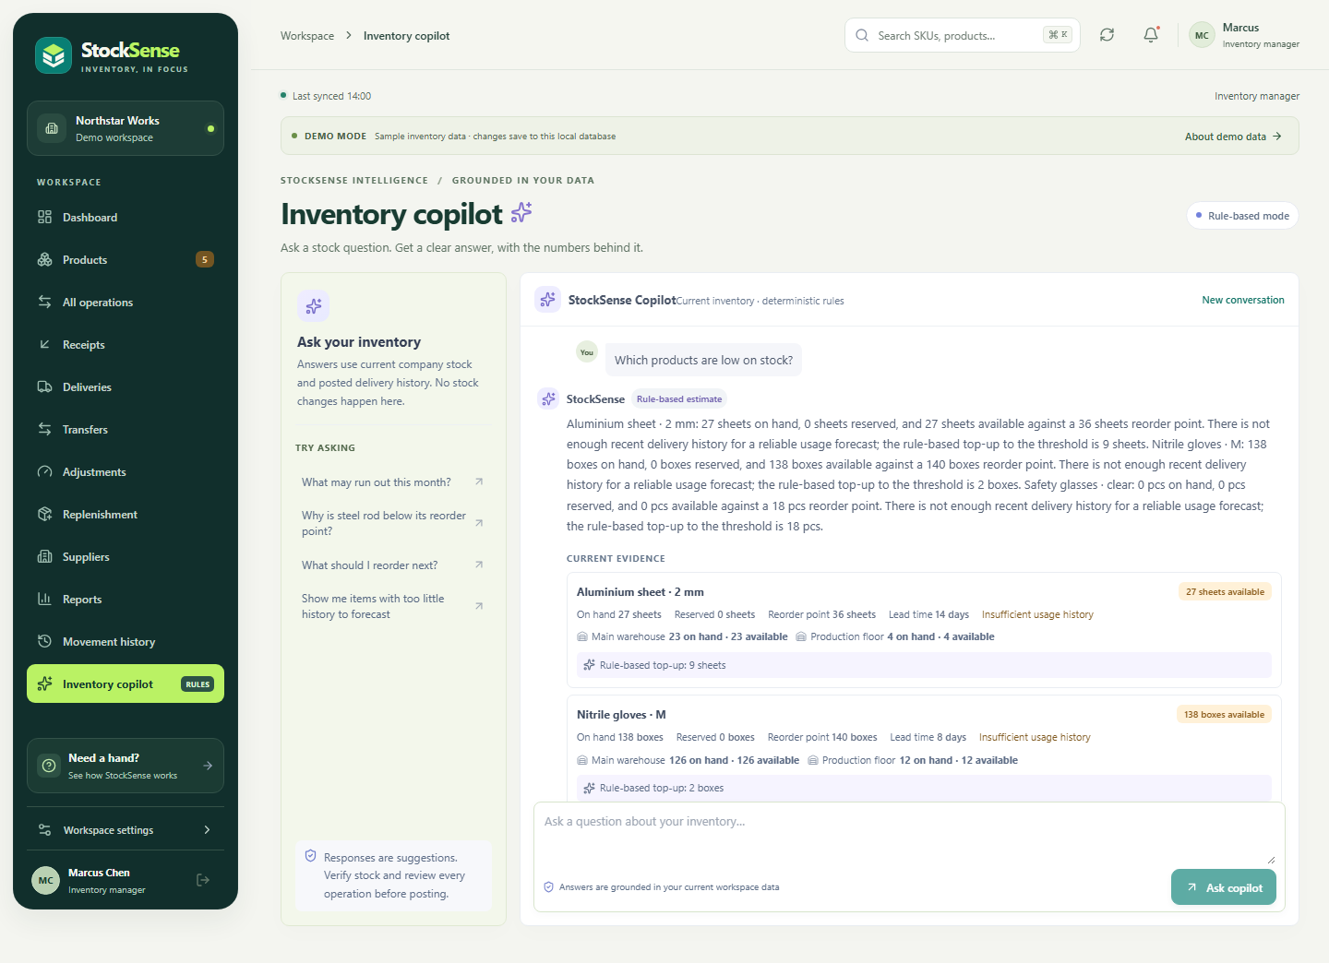
Answers grounded in inventory
Stock facts first
Availability, reorder points and recent movements inform the answer.
Rules work locally
Optional AI explanations.
Human approval for posting.
Notes:
3:15–3:40. Replenishment uses available stock, thresholds, lead time and recent posted deliveries. The app says when there is insufficient history. The default copilot uses labeled deterministic rules. Optional OpenAI Responses integration explains inventory facts. AI cannot post stock or change settings. This demo uses the rules path. Source: /api/copilot and /api/insights, README.
Source: StockSense local source code, README, final verification logs, and isolated demo screenshots. Team, institution, and contact details remain placeholders.

Slide 8
Built and checked
27
14
13
security regression groups
production scenarios
browser scenarios
React + TypeScript / Express / SQLite
Workflow smoke tests, build and dependency audit also checked.
Local automated checks. Scope and remaining limits appear in the verification report.
Notes:
3:40–4:00. React and TypeScript power the interface. Express and SQLite enforce workflow rules. The current verification report records 27 security regression groups, 14 production scenarios and 13 browser scenarios, plus inventory smoke checks, type checking and production build. The dependency audit reports zero known vulnerabilities at this check. These are local automated results, not an independent penetration test or production deployment certification. Source: FINAL-CHECK.md and the current verification logs.
Source: StockSense local source code, README, final verification logs, and isolated demo screenshots. Team, institution, and contact details remain placeholders.

Slide 9
A pilot with measurable outcomes
Proposed first users
Small warehouse teams with frequent stock handoffs
Measure | Pilot question
Reconciliation time | Can the team close a count faster?
Exception turnaround | How quickly can a manager resolve a mismatch?
Movement traceability | Can each posted quantity link to its operation?
Pilot proposal. No adoption, savings or customer results are claimed.
Notes:
4:00–4:20. Proposed first users are small warehouse teams. Establish a baseline, run a limited pilot and compare reconciliation time, exception resolution time and traceability. These are proposed validation metrics, not achieved business outcomes. No customer traction or savings have been measured.
Source: StockSense local source code, README, final verification logs, and isolated demo screenshots. Team, institution, and contact details remain placeholders.

Slide 10
The next milestones
01
Validate the pilot
Measure value and willingness to pay with a warehouse team.
02
Improve floor workflows
Barcode capture, richer reporting and larger catalogue support.
03
Prepare the deployment
TLS, restore drills, monitoring and a plan beyond one database node.
Notes:
4:20–4:45. We propose a workspace subscription with tiers by warehouses and active users, plus onboarding. Pricing and willingness to pay need a pilot. Next product work includes barcodes and stronger reports. Before live deployment we need TLS, backup/restore, monitoring and provider verification. SQLite is currently single-node. Larger deployments need infrastructure and database work. Source: README scope boundaries.
Source: StockSense local source code, README, final verification logs, and isolated demo screenshots. Team, institution, and contact details remain placeholders.

Slide 11
Every posted
movement is
traceable
StockSense
Ayush Pandey / Team X / Contact X
Notes:
4:45–5:00. StockSense makes the warehouse-to-manager handoff visible and gives every posted movement a traceable record. The workflow is built. The next step is validating its value with a pilot partner. I’m Ayush Pandey from team X. Thank you. Contact: X.
Source: StockSense local source code, README, final verification logs, and isolated demo screenshots. Team, institution, and contact details remain placeholders.

Slide 12
Architecture
Layer | Technology | Responsibility
Client | React + TypeScript | Role screens, forms and accessible interactions
API | Express + Zod | Authorization, validation and stock transactions
Storage | SQLite | Balances, operations, ledger, audit and sessions
Optional providers | OpenAI / Resend | Explanations and reset-email delivery
Current deployment model: one application node and one SQLite database.
Notes:
Backup slide for technical questions. React uses same-origin /api calls. Express enforces authorization, location scope, input schemas, idempotency and transactions. SQLite stores inventory, operations, ledger, audit and hashed sessions. Optional OpenAI and Resend integrations stay server-side. In development Vite proxies API calls without rewriting the browser host. Production serves built assets and requires a secure environment.
Source: StockSense local source code, README, final verification logs, and isolated demo screenshots. Team, institution, and contact details remain placeholders.

Slide 13
Questions worth asking
How is this different?
What if AI is unavailable?
The staff-to-manager handoff connects
physical work to approved stock changes.
Labeled inventory rules remain available.
Posting still requires a person.
How would it earn revenue?
What needs work before rollout?
Proposed workspace subscriptions
by locations and active users.
TLS, restore drills and monitoring.
Scale work beyond SQLite on one node.
Notes:
Backup questions. Differentiate through the controlled handoff, without claiming competitors lack these features. Pricing is a subscription hypothesis, not validated revenue. The default rules path remains useful without AI credentials. Current scale is single-node. Existing tests are evidence for the stated scenarios, not a claim that every risk is eliminated. More detailed answers and the demo checklist are in the presenter guide.
Source: StockSense local source code, README, final verification logs, and isolated demo screenshots. Team, institution, and contact details remain placeholders.

