Slide 1
CSE541 Computer Vision Group - 2
Mentor: Dr. Mehul Raval
Improvising Multi-Object Tracking using SORT Algorithm
Ayush Patel AU2140052
Kunj Kanzariya AU2140202
Rutul Patel AU2140206
Saumil Patel AU2140026
Btech. CSE, School of Engineering and Applied Sciences
Btech. CSE, School of Engineering and Applied Sciences
Btech. CSE, School of Engineering and Applied Sciences
Btech. CSE, School of Engineering and Applied Sciences

Slide 2
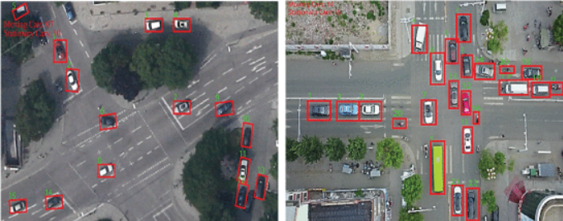
Problem Definition
Enhancing Multi Object Tracking Algorithm [SORT] for Video Captured Imagery.
Figure [1]
[1] M. Alonazi et al., "A Smart Traffic Control System Based on Pixel-Labeling and SORT Tracker," in IEEE Access, vol. 11, pp. 80973-80985, 2023, doi: 10.1109/ACCESS.2023.3299488.

Slide 3
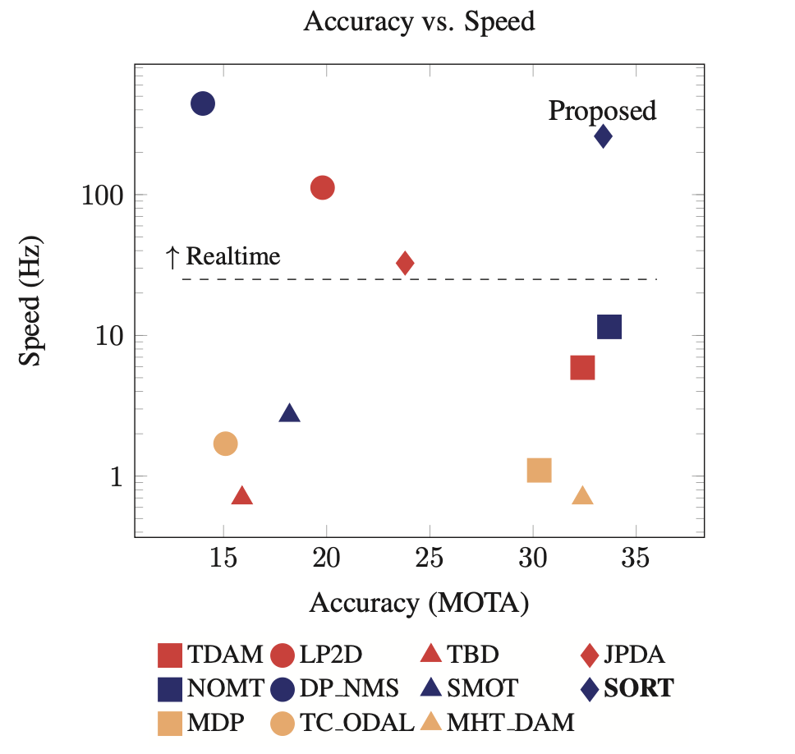
What is SORT?
Utilizes Faster Region CNN for robust object detection
Integrating Kalman filter efficient data association.
Computes assignment cost matrix based on intersection-over-union (IOU) distance.
Enables rapid experimentation and adaptation
Figure - [2]
[2] A. Bewley, Z. Ge, L. Ott, F. Ramos and B. Upcroft, "Simple online and realtime tracking," 2016 IEEE International Conference on Image Processing (ICIP), Phoenix, AZ, USA, 2016, pp. 3464-3468, doi: 10.1109/ICIP.2016.7533003.
[3] Zhu, P., Wen, L., Du, D., Bian, X., Fan, H., Hu, Q., & Ling, H. (2021). Detection and Tracking Meet Drones Challenge. IEEE Transactions on Pattern Analysis and Machine Intelligence, 1-1. doi:10.1109/TPAMI.2021.3119563

Slide 4
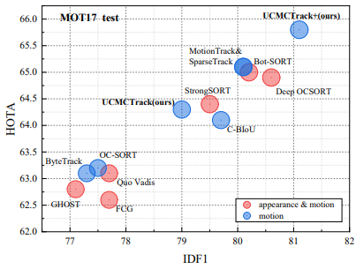
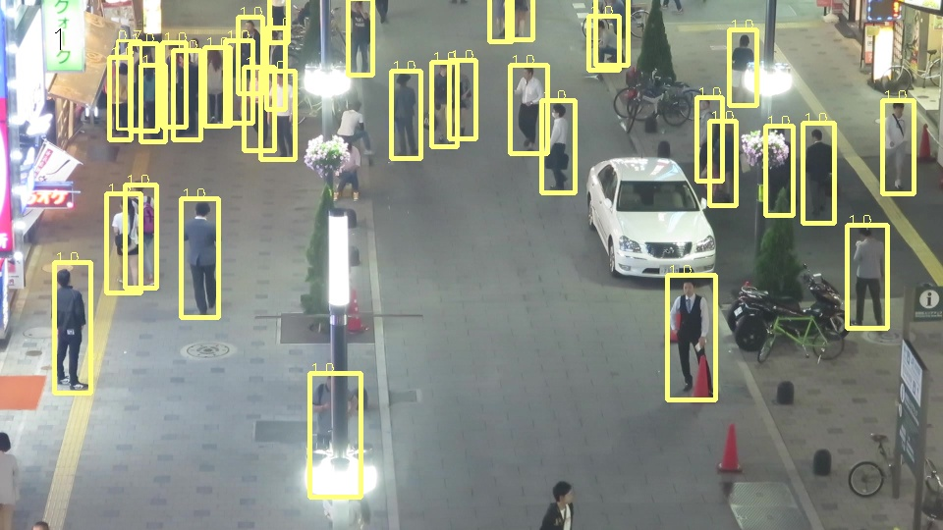
Dataset Used
Multi-Object Tracking on MOT15
MOTChallenge: Standardized benchmark for tracking methods.
First two data releases: 35,000 frames, 700,000 annotated pedestrians.
Accurate annotations, including extra classes like vehicles.
Analysis of 101 trackers across MOT15, MOT16, MOT17 datasets.
[2]A. Bewley, Z. Ge, L. Ott, F. Ramos and B. Upcroft, "Simple online and realtime tracking," 2016 IEEE International Conference on Image Processing (ICIP), Phoenix, AZ, USA, 2016, pp. 3464-3468, doi: 10.1109/ICIP.2016.7533003.

Slide 5
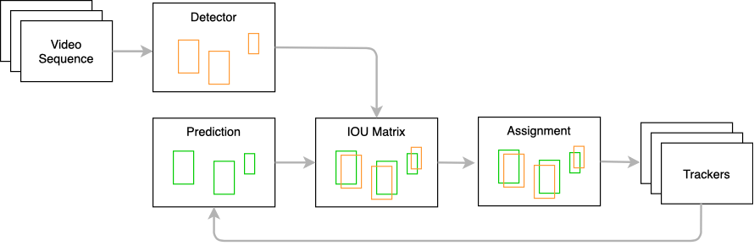
SORT Implementation
Extract features using deep learning(YOLOv5s) from image data.
Match features to track object movement between frames.
Tackle occlusion challenges in tracking.
Enhance robustness with Kalman filters for accurate position estimation.
[4] Architecture of deep sort (simple online and real time tracking ... (n.d.-a). https://www.researchgate.net/figure/Architecture-of-Deep-SORT-Simple-online-and-real-time-tracking-with-deep-association_fig2_353256407

Slide 6
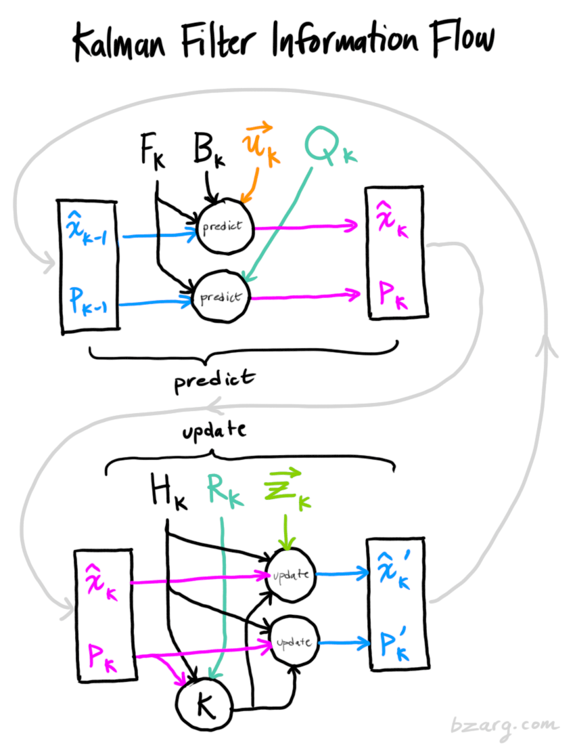
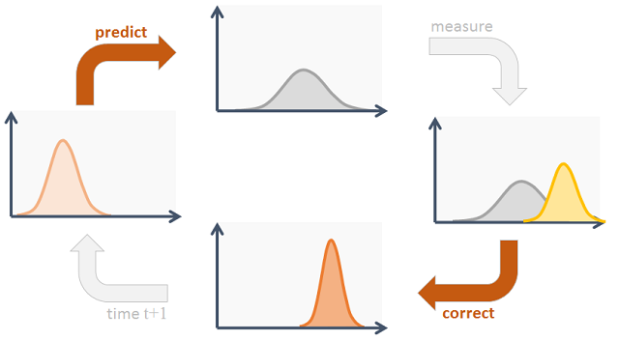
Working of Kalman Filter
[5]Bzarg, "How a Kalman filter works, in pictures," Bzarg, 24-Apr-2024. [Online]. Available: https://www.bzarg.com/p/how-a-kalman-filter-works-in-pictures/.
Raghavan, "Kalman Filter Explained: Example," Medium, 14-Apr-2019. [Online]. Available: https://medium.com/@raghavan99o/kalman-filter-explained-example-95b3f2d324ee.

Slide 7
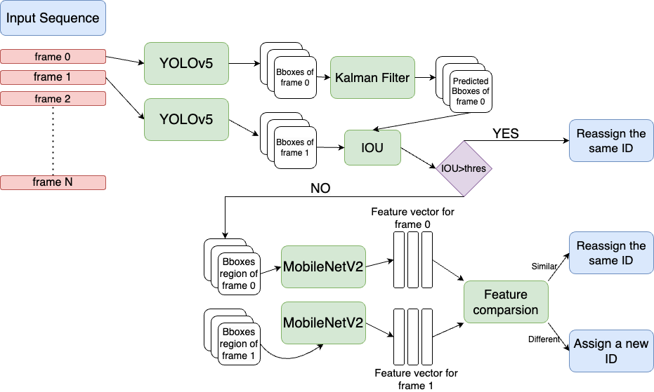
Our Approach

Slide 8
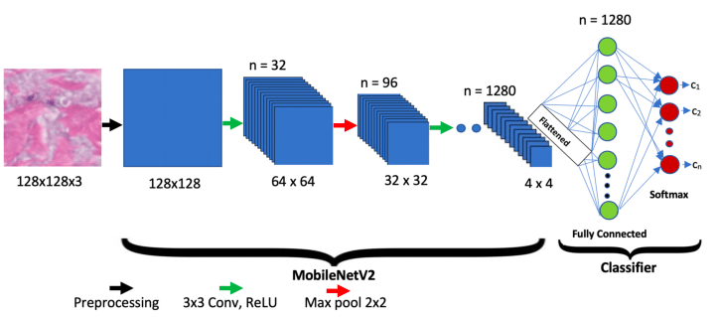
Feature Extractor - MobileNetV2
M. Sandler, A. Howard, M. Zhu, A. Zhmoginov and L. -C. Chen, "MobileNetV2: Inverted Residuals and Linear Bottlenecks," 2018 IEEE/CVF Conference on Computer Vision and Pattern Recognition, Salt Lake City, UT, USA, 2018, pp. 4510-4520, doi: 10.1109/CVPR.2018.00474. keywords: {Manifolds;Neural networks;Computer architecture;Standards;Computational modeling;Task analysis},

Slide 9
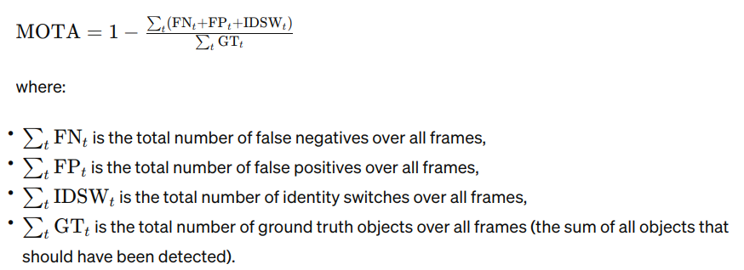
Results - comparison
Tracking Method | MOTA
SORT (SDP-Scale dependant pooling) | 23
SORT (DPM-Deformable Part Models) | 11
Our Approach | 34.15

Slide 10

Results

Slide 11
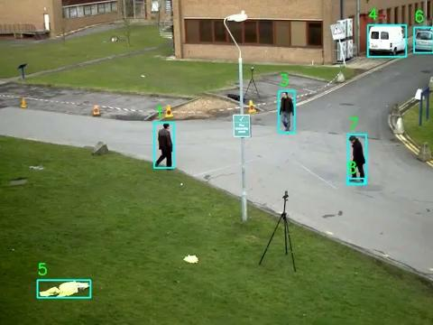
Limitations

Slide 12
Future Work
Our biggest Limitation is - when the object remains in occluded state for a long time.
We can make the feature extraction scale-invariant.
This way, even if object shows up after a long time, the features can exactly be matched with the original ones.
This will improve its performance when lot of objects are crowded in an image.

Slide 13
References
[1] M. Alonazi et al., "A Smart Traffic Control System Based on Pixel-Labeling and SORT Tracker," in IEEE Access, vol. 11, pp. 80973-80985, 2023, doi: 10.1109/ACCESS.2023.3299488.
[2] A. Bewley, Z. Ge, L. Ott, F. Ramos and B. Upcroft, "Simple online and realtime tracking," 2016 IEEE International Conference on Image Processing (ICIP), Phoenix, AZ, USA, 2016, pp. 3464-3468, doi: 10.1109/ICIP.2016.7533003.
[3] Zhu, P., Wen, L., Du, D., Bian, X., Fan, H., Hu, Q., & Ling, H. (2021). Detection and Tracking Meet Drones Challenge. IEEE Transactions on Pattern Analysis and Machine Intelligence, 1-1. doi:10.1109/TPAMI.2021.3119563
[4] Architecture of deep sort (simple online and real time tracking ... (n.d.-a). https://www.researchgate.net/figure/Architecture-of-Deep-SORT-Simple-online-and-real-time-tracking-with-deep-association_fig2_353256407
[6]Kanjee, R. (2022, May 9). DeepSORT - deep learning applied to object tracking. Medium. https://medium.com/augmented-startups/deepsort-deep-learning-applied-to-object-tracking-924f59f99104
[7]Du, Yunhao & Zhao, Zhicheng & Song, Yang & Zhao, Yanyun & Su, Fei & Gong, Tao & Meng, Hongying. (2023). StrongSORT: Make DeepSORT Great Again. IEEE Transactions on Multimedia. PP. 1-14. 10.1109/TMM.2023.3240881.
[8]M. Sandler, A. Howard, M. Zhu, A. Zhmoginov and L. -C. Chen, "MobileNetV2: Inverted Residuals and Linear Bottlenecks," 2018 IEEE/CVF Conference on Computer Vision and Pattern Recognition, Salt Lake City, UT, USA, 2018, pp. 4510-4520, doi: 10.1109/CVPR.2018.00474. keywords: {Manifolds;Neural networks;Computer architecture;Standards;Computational modeling;Task analysis},

Slide 14
THANK YOU

