Slide 1
CSE541 Computer Vision Group - 2
Mentor: Dr. Mehul Raval
Improvising Object Tracking Algorithm SORT for Long-Term Trajectory Extraction
Ayush Patel AU2140052
Kunj Kanzariya AU2140202
Rutul Patel AU2140206
Saumil Patel AU2140026
Btech. CSE, School of Engineering and Applied Sciences
Btech. CSE, School of Engineering and Applied Sciences
Btech. CSE, School of Engineering and Applied Sciences
Btech. CSE, School of Engineering and Applied Sciences

Slide 2
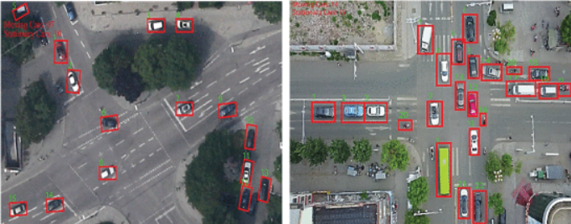
Problem Definition
Enhancing Object Tracking Algorithm [SORT] in Drone-Captured Imagery: Addressing Limitations and Integrating CNN-Based Detection Frameworks.
Figure [1]
[1] M. Alonazi et al., "A Smart Traffic Control System Based on Pixel-Labeling and SORT Tracker," in IEEE Access, vol. 11, pp. 80973-80985, 2023, doi: 10.1109/ACCESS.2023.3299488.

Slide 3
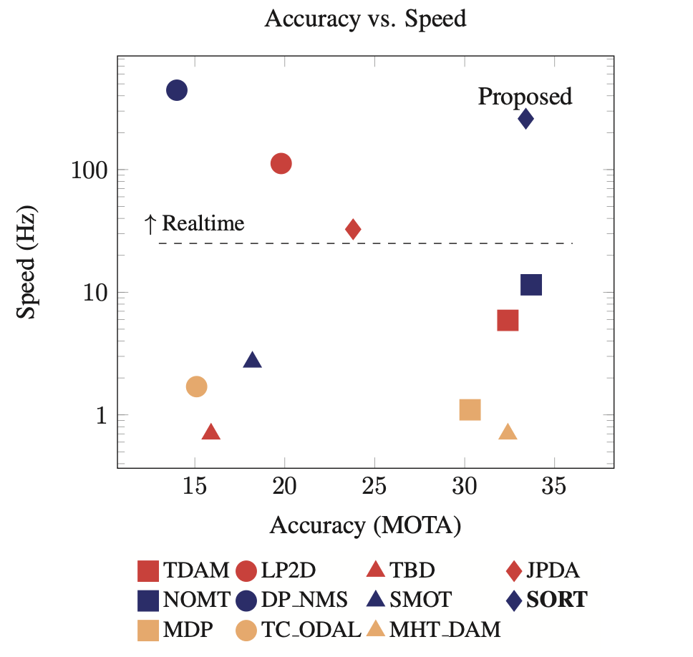
What is SORT?
Utilizes Faster Region CNN for robust object detection
Integrating Kalman filter and Hungarian algorithm for efficient data association.
Computes assignment cost matrix based on intersection-over-union (IOU) distance, optimizing object-to-track association via the Hungarian algorithm.
Enables rapid experimentation and adaptation
Figure - [2]
[1] A. Bewley, Z. Ge, L. Ott, F. Ramos and B. Upcroft, "Simple online and realtime tracking," 2016 IEEE International Conference on Image Processing (ICIP), Phoenix, AZ, USA, 2016, pp. 3464-3468, doi: 10.1109/ICIP.2016.7533003.
[2] Zhu, P., Wen, L., Du, D., Bian, X., Fan, H., Hu, Q., & Ling, H. (2021). Detection and Tracking Meet Drones Challenge. IEEE Transactions on Pattern Analysis and Machine Intelligence, 1-1. doi:10.1109/TPAMI.2021.3119563

Slide 4
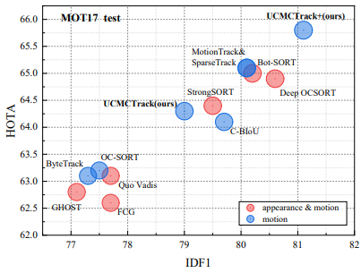
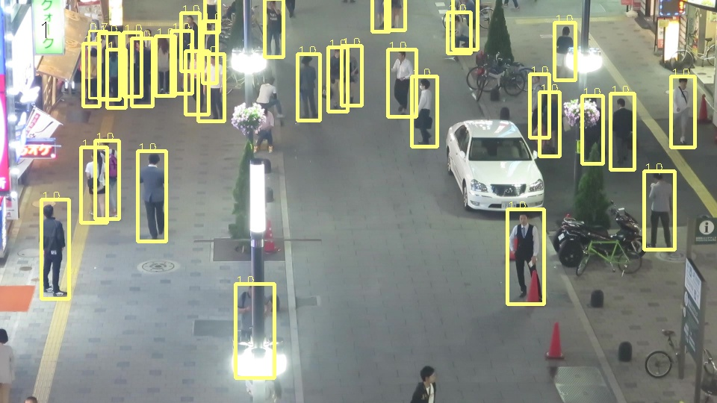
Dataset Used
Multi-Object Tracking on MOT17
MOTChallenge: Standardized benchmark for tracking methods.
First two data releases: 35,000 frames, 700,000 annotated pedestrians.
Accurate annotations, including extra classes like vehicles.
Analysis of 101 trackers across MOT15, MOT16, MOT17 datasets.
[1]A. Bewley, Z. Ge, L. Ott, F. Ramos and B. Upcroft, "Simple online and realtime tracking," 2016 IEEE International Conference on Image Processing (ICIP), Phoenix, AZ, USA, 2016, pp. 3464-3468, doi: 10.1109/ICIP.2016.7533003.

Slide 5
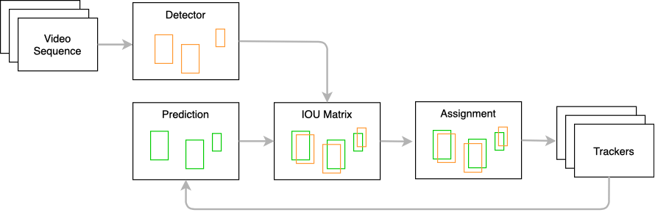
SORT Implementation
Extract features using deep learning(YOLOv5s) from image data.
Match features to track object movement between frames.
Tackle occlusion challenges in tracking.
Enhance robustness with Kalman filters for accurate position estimation.
Architecture of deep sort (simple online and real time tracking ... (n.d.-a). https://www.researchgate.net/figure/Architecture-of-Deep-SORT-Simple-online-and-real-time-tracking-with-deep-association_fig2_353256407

Slide 6
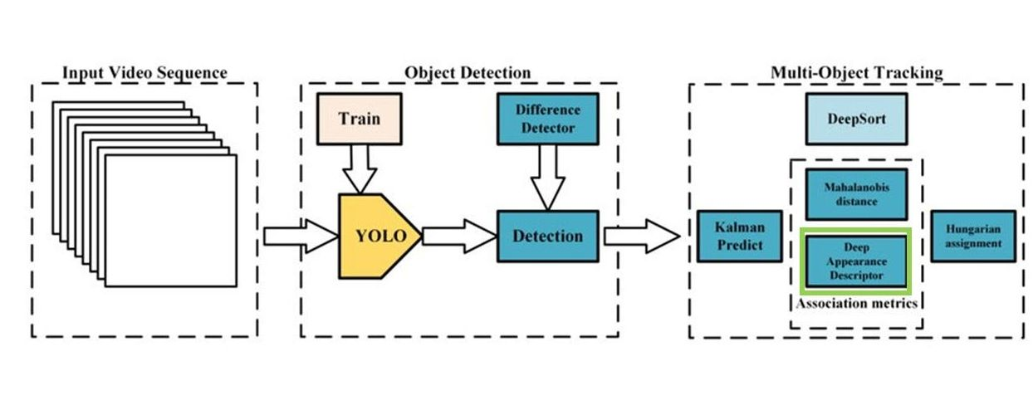
DeepSORT Implementation
Object Detection: Locates objects (cars, people) in images/videos (bounding boxes, confidence scores)
Multi-Object Tracking: Follows objects across frames, assigns unique IDs (tracks movement)
DeepSORT Combine deep learning (feature extraction) with traditional methods (Kalman Filter) for robust tracking
[6] Kanjee, R. (2022, May 9). DeepSORT - deep learning applied to object tracking. Medium. https://medium.com/augmented-startups/deepsort-deep-learning-applied-to-object-tracking-924f59f99104

Slide 7

Results - SORT

Slide 8
Results - comparison
Tracking Method | MOTA
SORT (SDP-Scale dependant pooling) | 23
DeepSORT | 34.15
SORT (DPM-Deformable Part Models) | 11

Slide 9
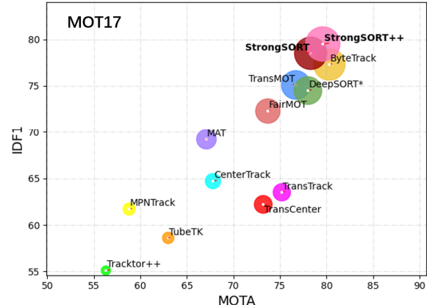
Future Work
We'll try YOLOv8 and YOLOX model for better object detection.
We'll implement variations of SORT like StrongSORT [SOTA] to find out the possible advancement in tracking algorithms.
Du, Yunhao & Zhao, Zhicheng & Song, Yang & Zhao, Yanyun & Su, Fei & Gong, Tao & Meng, Hongying. (2023). StrongSORT: Make DeepSORT Great Again. IEEE Transactions on Multimedia. PP. 1-14. 10.1109/TMM.2023.3240881.

Slide 10
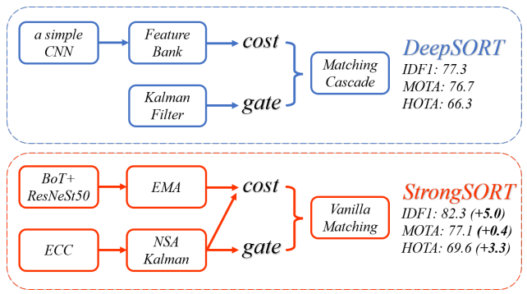
Future Work
Limitations : We are unable to achieve the accuracy of DeepSORT currently. For that we need to make several changes:
Using YOLOX for object detection
Then implement StrongSORT using same object detection method to have precise comparison
Du, Yunhao & Zhao, Zhicheng & Song, Yang & Zhao, Yanyun & Su, Fei & Gong, Tao & Meng, Hongying. (2023). StrongSORT: Make DeepSORT Great Again. IEEE Transactions on Multimedia. PP. 1-14. 10.1109/TMM.2023.3240881.

Slide 11
References
[1] M. Alonazi et al., "A Smart Traffic Control System Based on Pixel-Labeling and SORT Tracker," in IEEE Access, vol. 11, pp. 80973-80985, 2023, doi: 10.1109/ACCESS.2023.3299488.
[2] A. Bewley, Z. Ge, L. Ott, F. Ramos and B. Upcroft, "Simple online and realtime tracking," 2016 IEEE International Conference on Image Processing (ICIP), Phoenix, AZ, USA, 2016, pp. 3464-3468, doi: 10.1109/ICIP.2016.7533003.
[3] Zhu, P., Wen, L., Du, D., Bian, X., Fan, H., Hu, Q., & Ling, H. (2021). Detection and Tracking Meet Drones Challenge. IEEE Transactions on Pattern Analysis and Machine Intelligence, 1-1. doi:10.1109/TPAMI.2021.3119563
[4] Architecture of deep sort (simple online and real time tracking ... (n.d.-a). https://www.researchgate.net/figure/Architecture-of-Deep-SORT-Simple-online-and-real-time-tracking-with-deep-association_fig2_353256407
[6]Kanjee, R. (2022, May 9). DeepSORT - deep learning applied to object tracking. Medium. https://medium.com/augmented-startups/deepsort-deep-learning-applied-to-object-tracking-924f59f99104
[7]Du, Yunhao & Zhao, Zhicheng & Song, Yang & Zhao, Yanyun & Su, Fei & Gong, Tao & Meng, Hongying. (2023). StrongSORT: Make DeepSORT Great Again. IEEE Transactions on Multimedia. PP. 1-14. 10.1109/TMM.2023.3240881.

Slide 12
THANK YOU

