Slide 1
CSE523 Machine Learning Team - Smooth Operators
Mentor: Dr. Mehul Raval
Classification of Drivers based on their Driving Patterns
Ayush Patel AU2140052
Kunj Kanzariya AU2140202
Rutul Patel AU2140206
Saumil Patel AU2140026
Btech. CSE, School of Engineering and Applied Sciences
Btech. CSE, School of Engineering and Applied Sciences
Btech. CSE, School of Engineering and Applied Sciences
Btech. CSE, School of Engineering and Applied Sciences

Slide 2
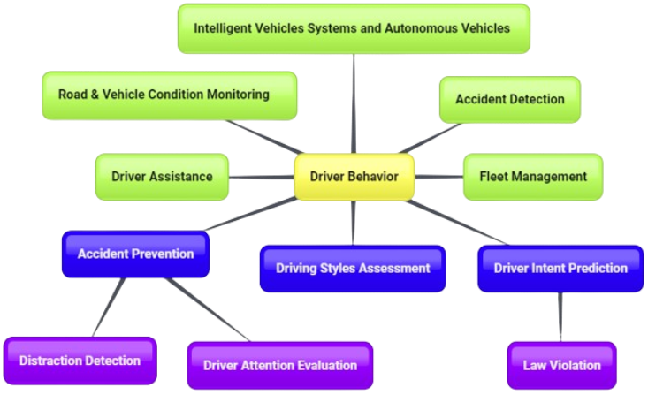
Problem Statement
Develop a driver classification system using machine learning to categorize drivers based on their distinct driving patterns for personalized driving analysis and interventions.
Fig-1: Problem Statement
driver behavior analysis methods: Applications oriented study. (n.d.). https://www.researchgate.net/publication/324153684_Driver_Behavior_Analysis_Methods_Applications_oriented_study

Slide 3
Literature Survey
Sr.No | Title | Model | Dataset | Accuracy/Metrics
1 | Driver Identification Based on Wavelet Transform Using Driving Patterns [1] | SVM, RandomForest, XGBoost | OBD-II public data | SVM - 87.2% Random Forest - 89.4% XGBoost - 92.5%
2 | Driving Behavior Prediction Based on Combined Neural Network Model [2] | CNN-LSTM with Gradient Boosting Decision Tree | NGSIM | 94.15%
3 | Driving behavior analysis and classification by vehicle OBD data using machine learning [3] | SVM, AdaBoost, RandomForest | Self - Generated OBD Data | SVM - 99% , AdaBoost - 99%, RandomForest - 100% (10 classes)
1. B. -c. Guo, Y. -l. Wang, M. Gao, J. Lu, G. -s. Han and L. -b. Zhang, "End to End Autonomous Driving Behavior Prediction Based on Deep Convolution Neural Network," 2022 IEEE 2nd International Conference on Digital Twins and Parallel Intelligence (DTPI), Boston, MA, USA, 2022, pp. 1-6, doi: 10.1109/DTPI55838.2022.9998956.
2. 1.kumar, R., Jain, A. Driving behavior analysis and classification by vehicle OBD data using machine learning. J Supercomput 79, 18800–18819 (2023). https://doi.org/10.1007/s11227-023-05364-3
3. B. I. Kwak, M. L. Han and H. K. Kim, "Driver Identification Based on Wavelet Transform Using Driving Patterns," in IEEE Transactions on Industrial Informatics, vol. 17, no. 4, pp. 2400-2410, April 2021, doi: 10.1109/TII.2020.2999911

Slide 4
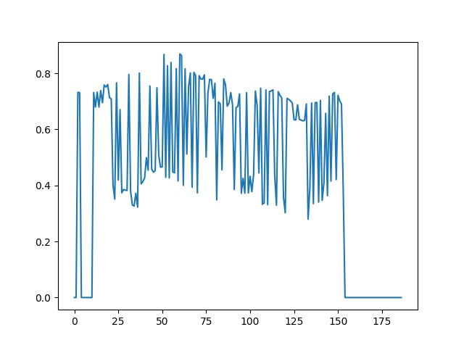
Dataset Description
AU Drone Dataset
Contains Trajectory data of 213 drivers.
Each file contains information about position of the vehicle and the risk factors associated with that instance.
Position information is given in the form of Bounding Box coordinates.
Risk value
time
Fig-2: Visualisation of Data

Slide 5
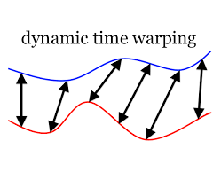
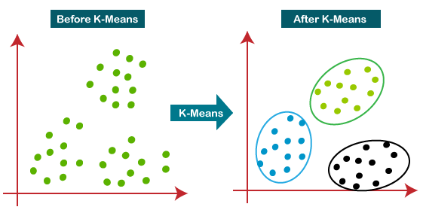
Our Approach
We used tslearn library to apply k-means clustering on AU drone dataset.
We filtered out Driver data containing less than 50 data points.
We used DTW metrics to evaluate our model’s performance, because we have variable sequence length.
Fig-3: DTW visualisation
Fig-4: K-Means clustering
[4] Dynamic time warping (DTW). File Exchange - MATLAB Central. (n.d.). https://www.mathworks.com/matlabcentral/fileexchange/43156-dynamic-time-warping-dtw
[5] K-means clustering algorithm - javatpoint. (n.d.). https://www.javatpoint.com/k-means-clustering-algorithm-in-machine-learning

Slide 6
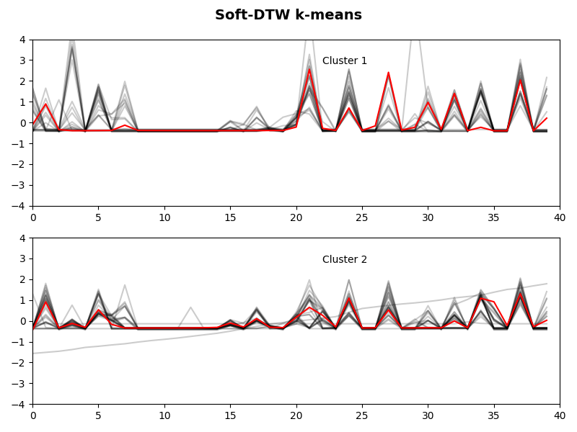
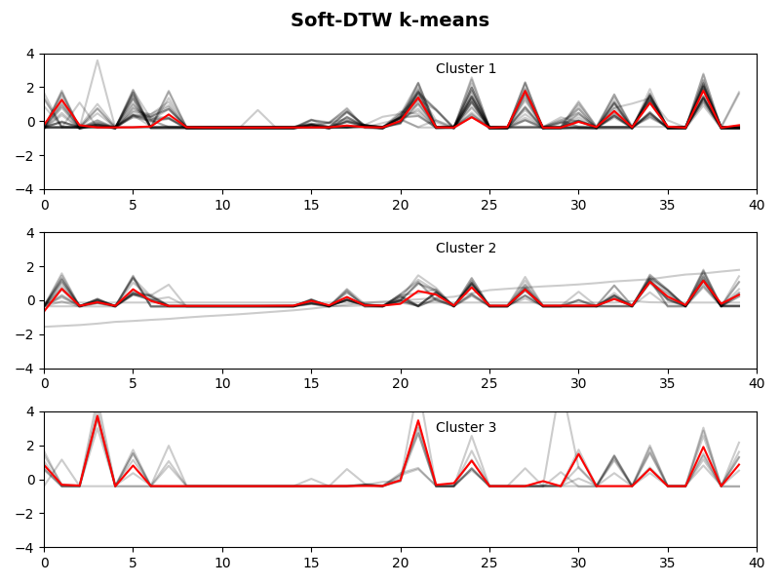
Results
We used the elbow method to determine the number of clusters
The Clusters formed when we take k=2 and k=3 in k-means
Silhouette score (k=2) = 0.373
Silhouette score (k=3) = 0.319
Fig. 5 - For 2 clusters
Fig. 6 - For 3 clusters

Slide 7
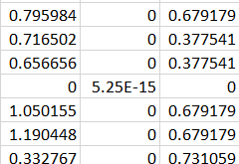
Future Work
1. Weighted Risk Values
Need - Different weight values for three risk factors can provide a more accurate representation.
Methods -
Find out correlations between the risk values and the reward.
Find out acceleration of the vehicle and its impact with different risk scores.
Fig. 7 - 3 Risk Values

Slide 8
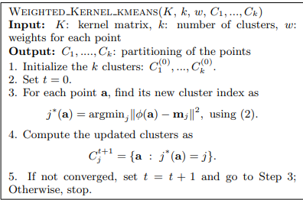
Future Work
2. Explore Different Clustering Methods
Kernel K-Means
Advantages -
Can handle non-linearity in data.
Can identify features that are not linearly separable in original feature space.
Methods -
Common kernel functions include Gaussian (RBF), polynomial and sigmoid.
Optimize cluster centres in kernel space (by gradient descent or Expectation-Optimization).
Fig. 8 - kernel k-means algorithm
Inderjit S. Dhillon, Yuqiang Guan, and Brian Kulis. 2004. Kernel k-means: spectral clustering and normalized cuts. In Proceedings of the tenth ACM SIGKDD international conference on Knowledge discovery and data mining (KDD '04). Association for Computing Machinery, New York, NY, USA, 551–556. https://doi.org/10.1145/1014052.1014118

Slide 9

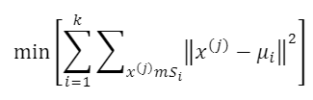

Future Work
3.DBA(DTW Barycenter Averaging) K-Means
Advantages -
Can effectively model complex relationships.
Can identify features that are not linearly separable in original feature space.
Methods -
In the Euclidean K-means method, estimate the distance between the centres of weight.
Common kernel functions include exponential, Gaussian (RBF), polynomial and sigmoid.
Optimize cluster centres in kernel space (by gradient descent or Expectation-Optimization).
«centers of weight»
Fig. 9 - DBA k-means Algorithm
Kobylin, Oleg & Lyashenko, Vyacheslav. (2020). Time Series Clustering Based on the K-Means Algorithm. Journal La Multiapp. 1. 1-7. 10.37899/journallamultiapp.v1i3.191.

Slide 10
References
B. I. Kwak, M. L. Han and H. K. Kim, "Driver Identification Based on Wavelet Transform Using Driving Patterns," in IEEE Transactions on Industrial Informatics, vol. 17, no. 4, pp. 2400-2410, April 2021, doi: 10.1109/TII.2020.2999911.
Fu, X., Meng, H., Wang, X., Yang, H., & Wang, J. (2022). A hybrid neural network for driving behavior risk prediction based on distracted driving behavior data. PloS one, 17(1), e0263030. https://doi.org/10.1371/journal.pone.0263030
B. -c. Guo, Y. -l. Wang, M. Gao, J. Lu, G. -s. Han and L. -b. Zhang, "End to End Autonomous Driving Behavior Prediction Based on Deep Convolution Neural Network," 2022 IEEE 2nd International Conference on Digital Twins and Parallel Intelligence (DTPI), Boston, MA, USA, 2022, pp. 1-6, doi: 10.1109/DTPI55838.2022.9998956. keywords: {Convolution;Roads;Neural networks;Predictive models;Feature extraction;Data models;Behavioral sciences;automotive engineering;autonomous driving;deep convolution neural network;driving behavior prediction;attention mechanism}
Dynamic time warping (DTW). File Exchange - MATLAB Central. (n.d.). https://www.mathworks.com/matlabcentral/fileexchange/43156-dynamic-time-warping-dtw
K-means clustering algorithm - javatpoint. (n.d.). https://www.javatpoint.com/k-means-clustering-algorithm-in-machine-learning

Slide 11
THANK YOU

