Slide 1
Domain Name Server (DNS)

Slide 2
Introduction
DNS is a hierarchical and decentralized naming system for computers, services, and other resources connected to the internet.
Converts human-readable domain names (e.g., www.google.com) into IP addresses (e.g., 142.250.190.78).
Key Components:
DNS Query
DNS Response

Slide 3












DNS Packet Structure
DNS Query
Header: Contains flags and identifiers.
Question Section:
Name: The domain name being queried
Type: Record type (e.g., A, AAAA, MX).
DNS Response
Answer Section:
Name: The queried domain name.
Type: Record type (e.g., A, AAAA).
TTL: Time-to-Live value for caching.
Data: The resolved IP address.

Slide 4





Common DNS Record Types
Record Type | Description | Example
A | IPv4 Address | 93.184.216.34
AAAA | IPv6 Address | 2606:2800:220:1:248:1893:25c8:1946
MX | Mail Exchange Server | mail.example.com
NS | Name Server | ns1.example.com
CNAME | Canonical Name (Alias) | www -> web.example.com

Slide 5
DNS (Domain Name System)
www.xyz.edu/index.html
User’s host must first obtain the IP address
Same user machine runs the client side of the DNS application
DNS client sends a query containing the hostname to a DNS server
DNS client receives a reply, which includes the IP address
The browser receives the IP address from DNS, it initiates a TCP connection to the HTTP server process

Slide 6





Hierarchy of DNS Servers
Root DNS Servers:
Handle requests for the top-level domains (TLDs) like .com, .org, .edu, etc.
Top-Level Domain (TLD) Servers:
Responsible for top-level domains such as com, org, net, edu, and gov, and the country’s top-level domains such as uk, fr, ca, and jp.
Examples: .com DNS servers handle requests for yahoo.com, amazon.com, etc.
Authoritative DNS Servers:
Contain the actual IP address mappings for specific domain names.
Example: yahoo.com DNS servers provide the IP address for www.yahoo.com.

Slide 7
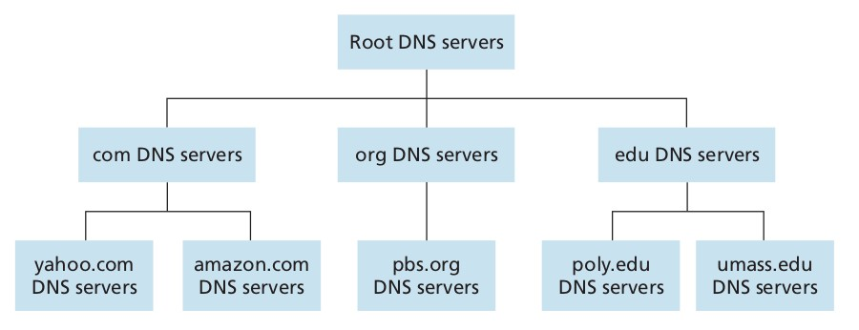
Hierarchy of DNS Servers

Slide 8



Additional Services
Host Aliasing:
Provides alternate names (aliases) for a single host.
Example: www.example.com may alias to server1.example.com
Mail Server Aliasing:
Maps domain names to mail servers for email routing.
Example: mail.example.com
Load Distribution:
Balances traffic among multiple servers hosting the same domain.

Slide 9












Host Aliasing
Host aliasing is a mechanism in the DNS that allows a single domain name to serve as an alias for another domain name.
This is typically implemented using CNAME (Canonical Name) records.
Example:
A user types blog.example.com in their browser.
The DNS server contains
blog.example.com CNAME www.example.com
www.example.com A 192.168.1.50
The browser resolves blog.example.com to www.example.com and finally to 192.168.1.50.

Slide 10



Testing Host Aliasing
Using dig command:
To query a CNAME record, run:
dig www.example.com
The response will show the alias and its canonical name.
Using Wireshark:
Capture DNS queries with the filter
dns && dns.qry.name == "www.example.com"
Observe the DNS response.

Slide 11












Mail Server Aliasing
A mechanism in the DNS that uses Mail Exchange (MX) records to direct email to the correct mail server for a given domain.
How Mail Server Aliasing Works:
DNS Query for MX Records
When someone sends an email to user@example.com, the sending mail server queries DNS to find the MX record(s) for the domain example.com.
Prioritized Mail Servers
MX records include a priority value (also called preference).
If multiple mail servers are listed, the sending server attempts to deliver the email to the highest-priority server first. If that server is unavailable, it tries the next one in line.
Alias to Different Mail Servers
Mail server aliasing allows a domain to specify alternate mail servers, ensuring redundancy and load balancing.

Slide 12






nslookup
Stands for Name Server Lookup
used for DNS-related queries
Syntax:
nslookup <domainName>
Ex- nslookup google.com
Command | Description
nslookup -type=any <domainName> | view all the available DNS records
nslookup -type=soa <domainName> | SOA record (start of authority), provides the authoritative information about the domain
nslookup -type=ns <domainName> | NS (Name Server) record maps a domain name to a list of DNS servers authoritative for that domain

Slide 13





ipconfig
ipconfig stands for Internet Protocol Configuration
used to view current TCP/IP network configuration values
Command | Description
ipconfig | display the basic TCP/IP configuration for all adapters
ipconfig /all | display the full TCP/IP configuration for all adapters
ipconfig /flushdns | flush the DNS resolver when troubleshooting name resolution problems

