Slide 1
TCP (Transmission Control Protocol)

Slide 2
Introduction to TCP
Connection-Oriented
TCP establishes a virtual circuit between two endpoints before data exchange can begin. This connection remains active until the communication is terminated.
Reliable Data Transmission
TCP ensures reliable delivery of data packets between devices. It provides error checking, flow control, and congestion management.

Slide 3
Connection-Oriented vs. Connectionless Transmission
Feature | Connection-Oriented | Connectionless
Handshake Required | Yes | No
Reliability | High (Acknowledgments, Retransmission) | Low (No guarantees)
Order of Data | Maintained | No guarantee
Overhead | High | Low
Example Protocols | TCP, SCTP | UDP, ICMP
Use Cases | File transfer, web browsing, email | Streaming, VoIP, gaming

Slide 4
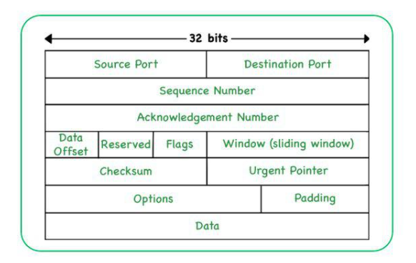

Packet Structure and Header Fields
TCP Packet format consists of the following fields:
Source Port(16 bits)
Destination Port (16 bits)
Sequence Number (32 bits)
Acknowledgment Number (32 bits)
Data Offset (4 bits)
Reserved
Control Flags (9 bits)
SYN
ACK
FIN
RST
Window Size (16 bits)
Checksum (16 bits)
Urgent Pointer (16 bits)
Options (Variable length)
Padding
Data Payload

Slide 5





TCP Connection Process (A 3-Way Handshake)
Source IP: Client’s IP SYN
Source Port: Client’s Port
Destination IP: server’s IP
Destination Port: Server’s Port
Flags: SYN
Sequence Number: 1000
Client
Server
SYN
Source IP: Server’s IP SYN-ACK
Source Port: Server’s port
Destination IP: Client’s IP
Destination Port: Client’s Port
Flags: SYN, ACK
Sequence Number: 5000
Acknowledgment Number: 1001 (Client’s ISN +1)
SYN-ACK
ACK
Source IP: Client’s IP ACK
Source Port: Client’s Port
Destination IP: Server’s IP
Destination Port: Server’s Port
Flags: ACK
Sequence Number: 1001
Acknowledgement Number: 5001

Slide 6

Calculating Round-Trip Time
1
Packet Sent
A packet is sent from the sender to the receiver.
2
Packet Received
The Receiver receives the packet.
3
Acknowledgment Sent
The Receiver sends an acknowledgment back to the sender.
4
RTT Calculated
The time elapsed from sending the packet to receiving the acknowledgment is the RTT.

Slide 7



Cumulative Acknowledgment
Client
Server
Sequential Delivery
TCP ensures data arrives in order.
Efficient Acknowledgements
The receiver acknowledges receipt of all data up to the highest received sequence number.
ACK Number = Last Received Sequence Number + Data Size

Slide 8

TCP Termination Process (A 4-Way Handshake)
Client
Server
FIN
Step:1
The client system sends the TCP FIN control segment to the server.
ACK
Step:2
The server receives FIN and replies with ACK. Closes connection, sends FIN.
FIN
ACK

Slide 9

RTT(Round-Trip Time)
RTT is the time it takes for a signal to travel from a source to a destination and back again.
Sample RTT
Sample RTT is the measured round-trip time for a single packet.
Sample RTT = ACK Reception Time - Packet Sent Time
Estimated RTT
Sample RTT varies due to network conditions.
Estimated RTT provides a smoother value.
Estimated RTT = (1 - α) * Estimated RTT + α * Sample RTT

