Slide 1

BMS College of Engineering
(Autonomous College under VTU)
Department of Artificial Intelligence and Data Science
Project Work Phase-II (23AI7PWPP1) — Review-2
CUSTOS
Runtime Drift Enforcement for Production ML Models
Presented by
AYUSH PANDEY 1BM23AD074
VIVEK BOORA 1BM23AD073
NITIN 1BM24AD404
Under the guidance of
Dr. Seemanthini K G
HOD, Dept. of AI & DS, BMSCE

Slide 2
Table of Contents
Abstract
Progress since Review-1
Introduction — motivation, existing vs proposed system, objectives
Literature survey and research gap
Requirement analysis and specification
System design — architecture and decision logic
Implementation — new: risk engine and admission control
Results and validation
Engineering rigour, governed self-healing, work plan, conclusion

Slide 3
Abstract
Machine-learning models are validated once and then trusted indefinitely, yet the data they see keeps changing. A drifted model fails quietly: it stays up, answers confidently, and is wrong.
Custos is a runtime trust layer between a model and the consequential action taken on its output. On every request it fuses three signals — population drift (PSI and KS against a fixed baseline), business policy, and per-request risk — into a trust score and an ALLOW, REVIEW or BLOCK verdict within a 50 ms budget, and appends each verdict to a tamper-evident hash chain. Drift is computed offline so the request path stays fast.
The detector is validated by calibration against shifts of known size, the gateway by open-loop load testing, and the gating idea itself by a pre-registered study on 589,186 real loans. That study found that gating on population drift catches fewer bad loans than random review. We report it as measured, and it now decides what we build next.

Slide 4
Progress since Review-1
Every commitment from the Review-1 closing slide, and what happened to it — including what did not get done.
Committed at Review-1 | Status | Evidence
Admission control: shed load at the door | Done | Gateway refuses past a bounded in-flight limit with 503; the SDK then applies the tenant's fail-open / fail-closed policy
Move the audit write off the hot path | Done | Dedicated single writer thread; event loop no longer blocks. p99 at 100 req/s: 49 ms → 9 ms
Validate against real drift (Lending Club) | Done — negative | Pre-registered study, 589,186 real loans: drift gating caught fewer defaults than random review. Reported as measured
Model and data versioning + retraining trigger | Not started | Moved to the final-review plan
Re-measure against Postgres | Not started | Harness supports --database-url; needs the Postgres container
Not committed — added: real RiskEngine | Done | Amount anomaly (robust z-score) + request velocity; the third signal is live instead of a stub

Slide 5
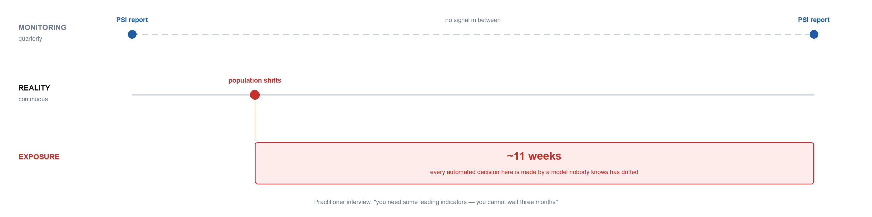
Introduction — Overview and Motivation
A model is validated once, deployed, and then trusted indefinitely. Drift is checked on a quarterly report — but decisions are made every second.

Slide 6
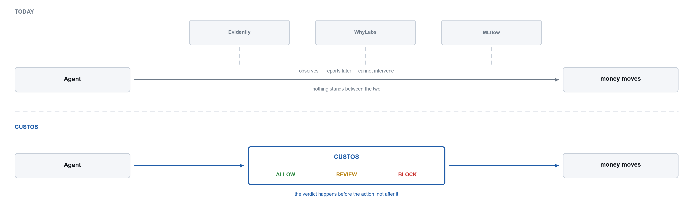
Existing System vs Proposed System
Monitoring tools sit beside the request path and report afterwards. Guardrails block in real time, but only on content. Custos gates the decision itself on whether the model still fits its traffic.

Slide 7
Objectives, Scope and SDGs
Objectives
O1 Put drift on the live request path, inside a 50 ms budget
O2 Attribute drift to the individual inputs that moved
O3 Fuse drift, policy and risk into one explainable verdict
O4 Record every verdict in a tamper-evident chain
O5 Stay correct under overload — refuse, never queue or change answers (new)
Scope
Custos does not train, serve or retrain models. It decides, records and proposes repairs to its own gating; humans approve.
SDGs
9 — auditable infrastructure · 10 — limits systematically unfair credit decisions · 16 — verifiable records for regulators

Slide 8
Literature Survey
Eight works, each checked against its published venue. New since Review-1: Paleyes et al. (2022) and Rauba et al. (NeurIPS 2024).
Paper Title | Name of Journal / Conference | Published Year | Novelty / Techniques | Limitations | Gap Identified
Hidden Technical Debt in Machine Learning Systems Sculley et al., Google | NeurIPS | 2015 | ML code is a small part of a real ML system; data dependencies and glue dominate | Diagnoses the problem; proposes no runtime mechanism | Names the infrastructure gap but does not close it
A Survey on Concept Drift Adaptation Gama, Zliobaite, Bifet et al. | ACM Computing Surveys | 2014 | Canonical taxonomy of drift detectors and adaptation strategies | Offline / streaming learning; no enforcement step | Detection decoupled from any decision
Learning under Concept Drift: A Review Lu, Liu, Dong, Gu, Gama, Zhang | IEEE TKDE | 2019 | Unifies drift detection, understanding and adaptation | Assumes labels arrive; evaluated in batch | Unlabelled live traffic not addressed
Failing Loudly: Detecting Dataset Shift Rabanser, Günnemann, Lipton | NeurIPS | 2019 | Empirical comparison of shift detectors and two-sample tests | Offline batch study; no latency budget | Detectors never placed on a request path
Data Validation for Machine Learning Breck, Polyzotis et al., Google | MLSys | 2019 | Schema-driven validation of training and serving data in TFX | Validates schema conformance, not distributional trust | Pipeline-time only; no per-request verdict
Challenges in Deploying Machine Learning: A Survey of Case Studies Paleyes, Urma, Lawrence | ACM Computing Surveys | 2022 | Maps real deployment failures to each stage of the workflow, incl. monitoring and trust | Catalogues the problems; proposes no mechanism | Monitoring named as a gap in practice, left open
Self-Healing Machine Learning Rauba, Seedat, Kacprzyk, van der Schaar | NeurIPS | 2024 | Monitor → diagnose → adapt → test loop; LLM proposes corrective actions | Repairs the model autonomously after degradation; no per-decision audit | Acts on the model, not on the decision in flight; no human checkpoint
Certificate Transparency Laurie, Langley, Kasper, Google | RFC 6962, IETF | 2013 | Append-only logs that make modification of history detectable | Built for TLS certificates, not model decisions | Tamper-evidence never applied to ML decision records

Slide 9
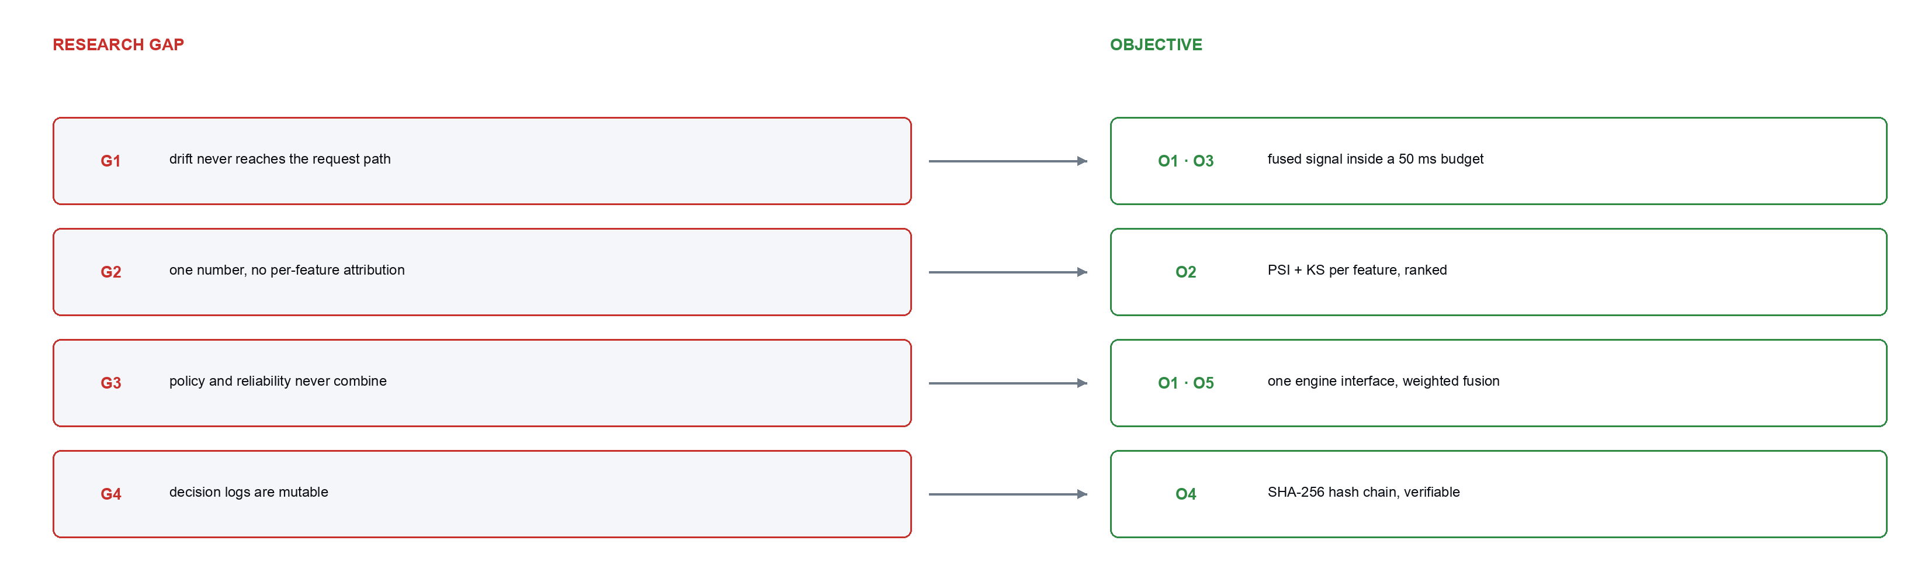
Research Gap and Objectives
Every work stops at detection or repairs the model afterwards. None gates the decision in flight on whether the model still fits its traffic.

Slide 10
Requirement Analysis and Specification
Review-1's requirements plus three new ones (marked). NFR7 is what the load test forced: overload must be refused, never queued.
 | Functional |  | Non-functional
FR1 | Register models and capture a reference distribution | NFR1 | Gateway p99 <= 50 ms; 20 ms per-engine cap
FR2 | Compute PSI and KS per feature, offline | NFR2 | A Custos failure must not fail the caller
FR3 | Roll per-feature statistics into one severity | NFR3 | tenant_id on every table and every query
FR4 | Evaluate tenant policy rules against request context | NFR4 | Keys stored as SHA-256; rule text parsed, never eval'd
FR5 | Fuse signals into a weighted trust score | NFR5 | A new signal must not modify existing code
FR6 | Return ALLOW / REVIEW / BLOCK with reasons | NFR6 | Gateway and worker horizontally scalable
FR7 | Honour an engine veto over all other signals | NFR7 | new — Overload is refused, never queued (bounded in-flight)
FR8 | Append every decision to a tamper-evident chain |  | Python 3.11, FastAPI, SQLAlchemy 2, Celery
FR9 | Verify a chain and report the first modified entry |  | React 18 + TypeScript 5, Vite
FR10 | Route unregistered models to REVIEW |  | PostgreSQL 16 + Redis 7; SQLite on one node
FR11 | new — Score per-request risk: unusual amount, request velocity
FR12 | new — Never auto-approve a model in the significant drift band

Slide 11
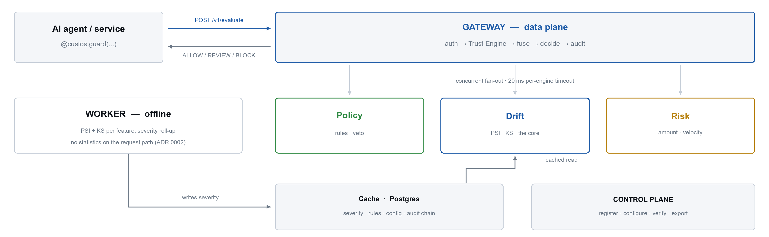
System Design — Architecture
Two planes: the request path does the minimum, statistics run offline. New: all three engines are live — risk is no longer a stub.

Slide 12
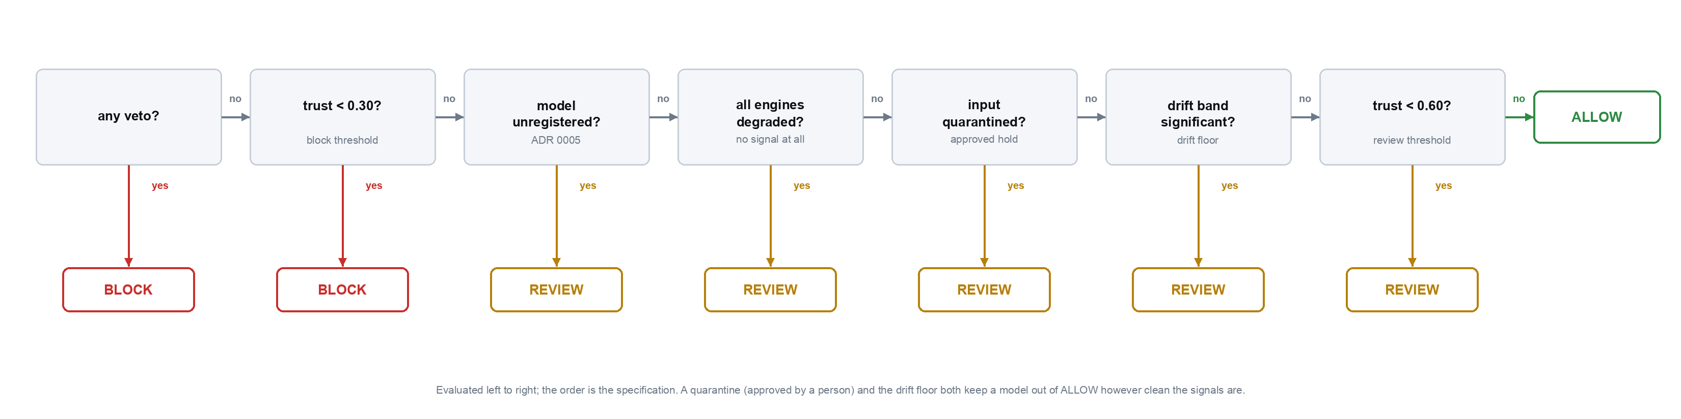
System Design — Decision Logic
Seven rules, evaluated in order. New: the drift floor — a significantly drifted model is never auto-approved. Slide 20 tests it on real data.

Slide 13
Implementation — Status
Eleven of twelve components complete. New since Review-1 are marked.
Component | What was built | Status
Drift engine | PSI and KS in pure Python, monotone severity roll-up, offline worker, cached hot-path read | Complete
Policy engine | Tokeniser, recursive-descent parser, AST evaluator, veto — no eval anywhere | Complete
Risk engine | new — robust amount anomaly (median / MAD) + per-customer velocity, per tenant | Complete
Trust engine | Concurrent fan-out, per-engine timeouts, weighted fusion, 8-rule decision cascade | Complete
Admission control | new — bounded in-flight gate, 503 shed, audit write moved to a dedicated thread | Complete
Audit chain | SHA-256 hash chain, race-safe append, verification and evidence export | Complete
Gateway + control plane | /v1/evaluate, /health, /metrics and 23 control-plane endpoints | Complete
Python SDK | @guard decorator, fail-open client — standard library only | Complete
Dashboard | React + TypeScript operator console: models, drift, decisions, audit | Complete
Replay harness | Real-data drift replay; date-order bug fixed; calibrated on a planted shift | Complete
Lending Club study | new — pre-registered field study on 589,186 matured loans; results committed | Complete
Governed self-healing | new — feed-vs-shift diagnosis, shadow-tested repairs, named approval, audited | Complete
Versioning + retraining | Model / data version tracking and a drift-driven retrain signal | Final review

Slide 14
Implementation — Risk Engine (new)
Drift asks whether the model still fits. Policy asks whether the action is allowed. Risk asks whether this one request is unusual — and abstains rather than guess when it cannot tell.
Component | What it measures | How | When it abstains
Amount | Is this amount unusual for this tenant and model? | Robust z-score against the last 2,000 amounts — median and MAD, so outliers cannot drag the baseline. No risk at z ≤ 3, full risk at z ≥ 10 | Fewer than 50 amounts seen: “normal” is not yet known
Velocity | Is one customer firing requests in a burst? | Requests by the same customer_id in the last 60 s. No risk at ≤ 3, full risk at ≥ 10 | No customer / account / subject id in the request
Combined | Engine score = 1 − worst component | Worst, not average: one red flag is enough | No component can vote → degraded, excluded from fusion

Slide 15
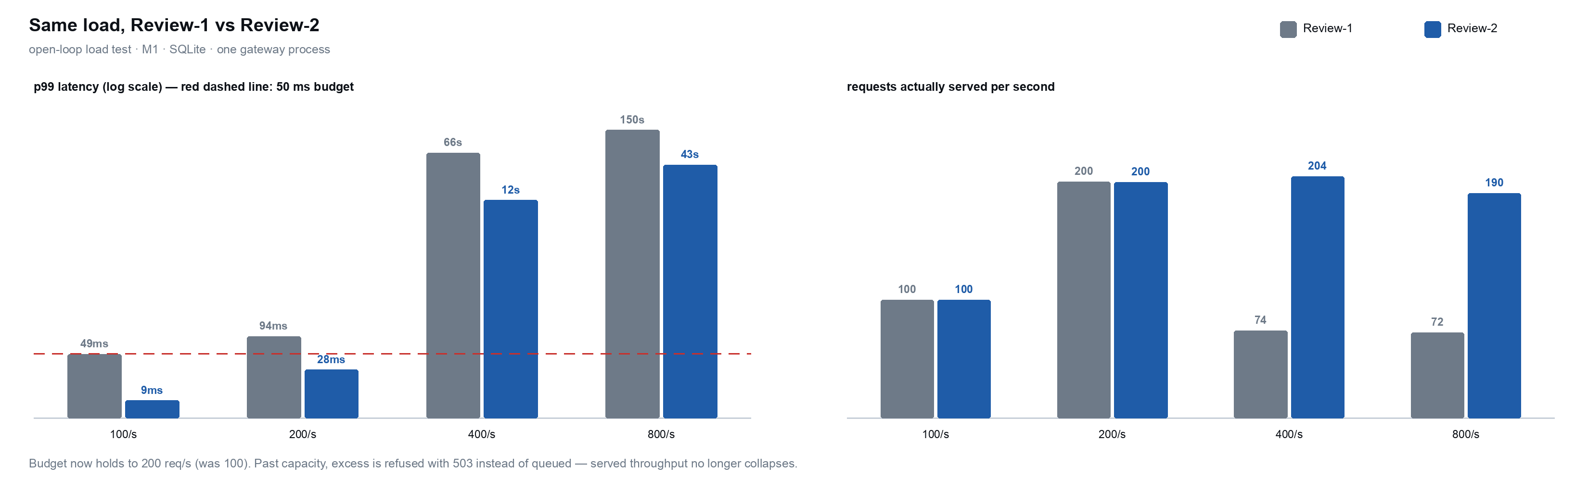
Implementation — Admission Control (new)
At Review-1, overload made the gateway queue, collapse and change its answers. It now refuses what it cannot serve, and under overload zero verdicts change (was up to 985 per phase).

Slide 16
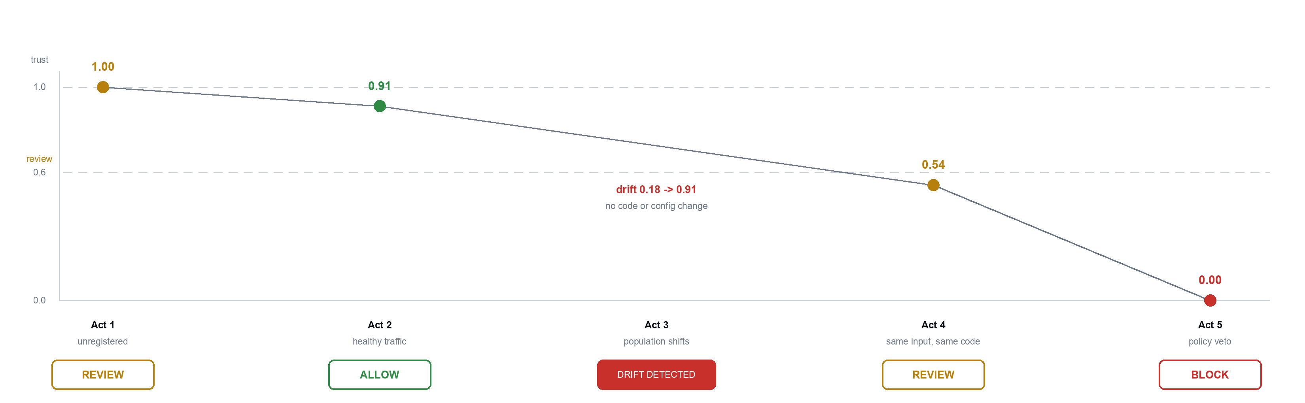
Results — Live Demonstration
Same five acts as Review-1, all three signals live. Act 4 is now held by the drift floor, with the reason stated in plain language.

Slide 17
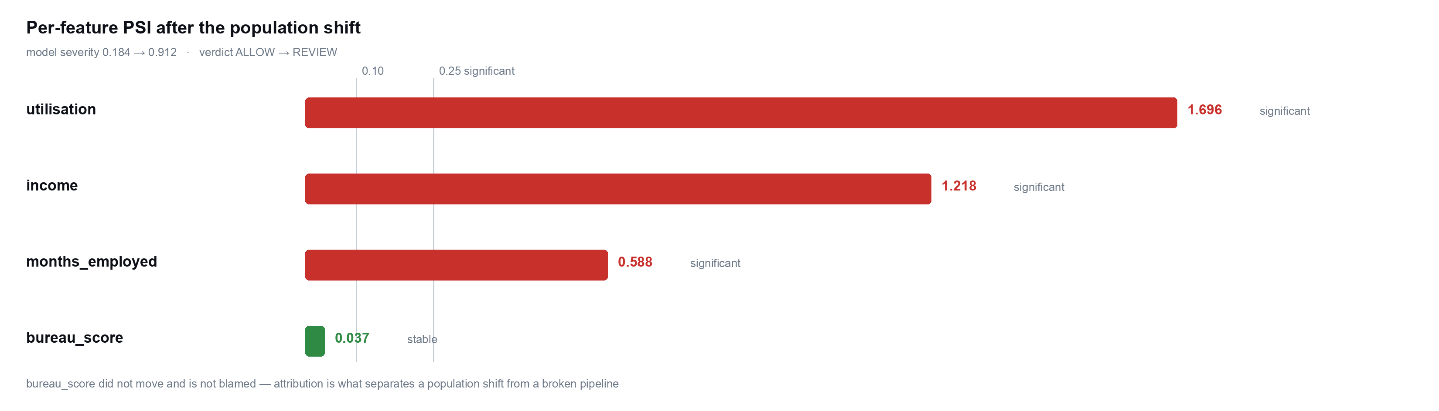
Results — Drift Attribution
Severity says the model moved; attribution says which input moved — the difference between a population shift and a broken upstream feed.

Slide 18
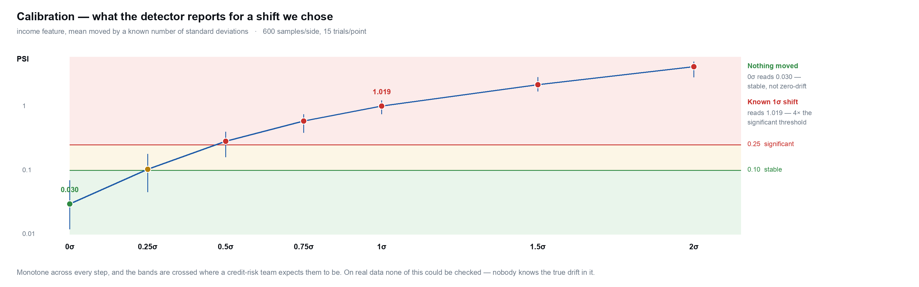
Validation — Calibration
Custos is a measuring instrument, so it is validated like one: shifts of a known size in, readings checked against the known answer.

Slide 19
Validation — Field Study: How It Was Run
Calibration proves the detector is correct. A field study tests whether gating on drift actually helps: 2.26 million real Lending Club loans, of which 589,186 matured loans from 2012–2015 were evaluated against a model trained on 2007–2011.
Pre-registered — hypotheses, metrics and what each outcome would mean were committed and pushed before the dataset was even downloaded.
Leakage and censoring enforced in code — only fields known when the loan was made, and only loans whose term had ended, so outcomes are real.
Seven review strategies compared at the same review budget, from random review to the model's own risk score to Custos's drift gating.
Two bugs caught before the real run — dates sorted as text, and a harm measure that could not see miscalibration. Both fixed, both recorded.

Slide 20
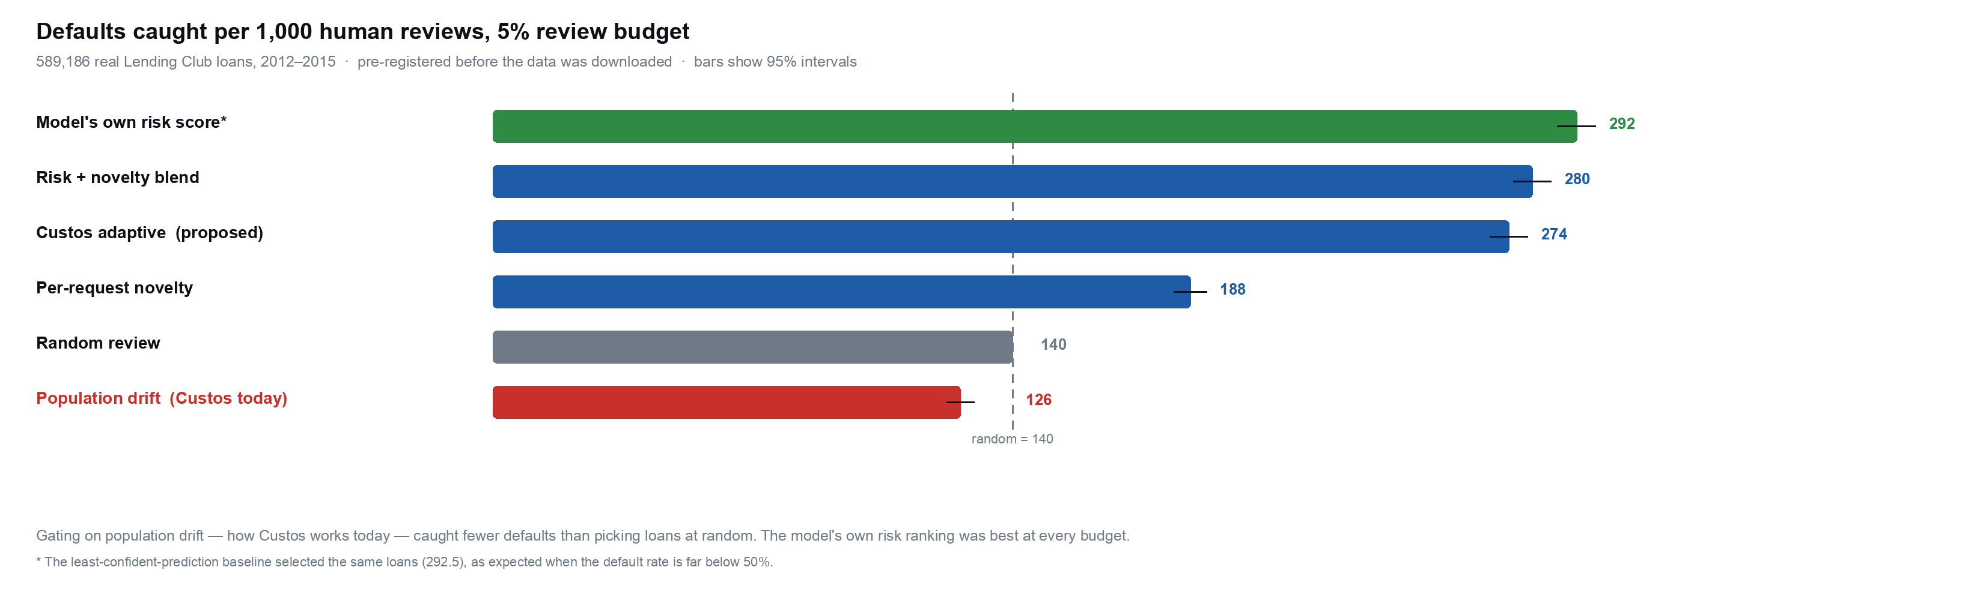
Field Result — Our Core Assumption Failed
Asked to pick 5% of 589,186 real loans for human review, gating on population drift — how Custos works today — caught fewer defaults than picking at random. The model's own risk score caught 2.1× random.

Slide 21
Engineering Rigour — Problems We Found in Our Own System
Seven problems, found by our own tooling. The largest: real data contradicted the assumption the gating was built on.
Found by | Defect | Fix
Load harness (R1) | Published p99 of 0.5 ms measured a timer that stops before the audit write; real figure was 49 ms | Report client-observed latency; now 9 ms at the same rate
Load harness (R1) | Audit chain dropped entries under concurrency and still verified as intact | Advisory lock + jittered backoff; 0 lost from 2 to 48 writers
Load harness (R1) | Overload changed verdicts: ~13% flipped ALLOW → REVIEW | Event loop unblocked + admission control: 0 flips under overload
Unit test (R2) | Replay harness sorted dates as text — “Aug-2018” became the 2007 baseline | Parse dates; regression test on Lending Club's own date format
Fusion arithmetic (R2) | Adding a live risk signal let a significantly drifted model reach ALLOW | Explicit drift-floor rule in the decision cascade, pinned by tests
Pre-registered study (R2) | On real loans, drift gating caught fewer defaults than random; the drift floor would escalate 92% of decisions for no gain | Not yet fixed — gating to be rebuilt around risk-ranked review
Self-healing (R2+) | Drift window scored the baseline's own rows as live traffic: healthy drift read 0.02, honestly 0.18 | Window starts at the current baseline; regression test

Slide 22
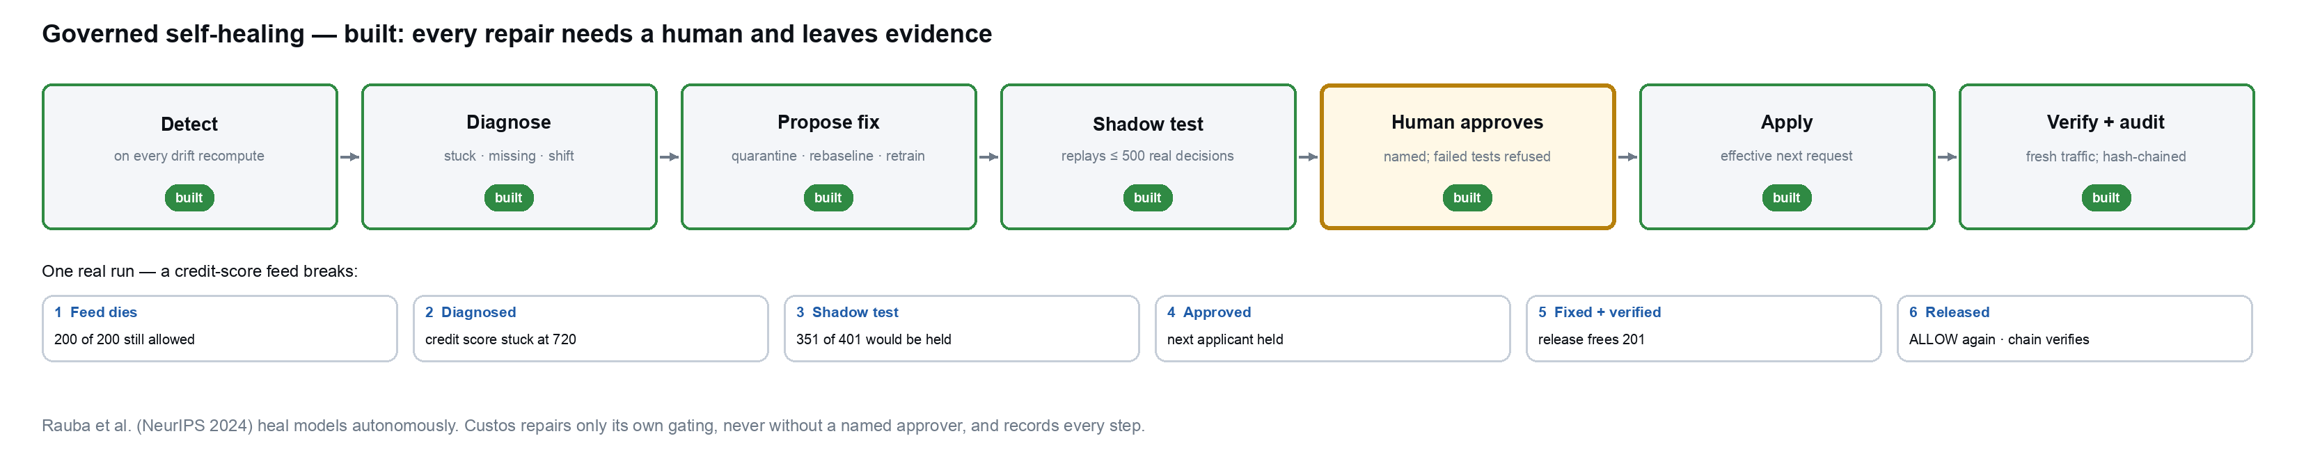
Governed Self-Healing — Built
Drift is a poor per-decision gate but a strong alarm, so Custos now acts on it: it tells a broken data feed from a real population shift, proposes a repair, shadow-tests it on real decisions, and applies it only when a named person approves. Domain-agnostic — any model whose output triggers an action.

Slide 23
Work Plan to the Final Review
What remains, and what each item depends on.
Item | Why it matters | Depends on
Rebuild gating around risk-ranked review | On real loans the model's risk ranking caught 2.1× random; drift gating caught less than random | —
Replicate on a second credit dataset | One dataset cannot support a general claim | Dataset access
Scale-out: multiple gateway workers | One process saturates near 300 req/s; past that, requests queue before the gate can see them | Postgres for shared state
Postgres load measurement | SQLite is the pessimistic floor; production runs Postgres | Docker
Self-healing: more fault signatures (unit change, partial outage) | Today only stuck and missing feeds are diagnosed; a feed that is wrong but still varies reads as a shift | —
Per-user sign-in for approvers | Approvers are named, not authenticated — Custos has tenant keys, not user accounts | —
Final report and paper draft | Department submission | All of the above

Slide 24
Conclusion
397 tests passing · latency budget holds to 200 req/s, double Review-1 · overload no longer changes verdicts · all three trust signals live · governed self-healing built.
And the hardest result: on 589,186 real loans, gating on drift did worse than random review. Pre-registered, reported as measured — and it now decides what we build next.
Team member | USN | Modules owned
AYUSH PANDEY | 1BM23AD074 | Architecture and ADRs · drift engine (PSI/KS detectors, severity roll-up, offline worker) · trust engine fusion and decision matrix
VIVEK BOORA | 1BM23AD073 | Gateway and control-plane APIs · policy engine and rule grammar · tamper-evident audit chain and evidence export
NITIN | 1BM24AD404 | Python SDK · React operator dashboard · fintech demonstration · 397-test suite across unit, integration and end-to-end

