Slide 1

BMS College of Engineering
(Autonomous College under VTU)
Department of Artificial Intelligence and Data Science
Project Work Phase-II (23AI7PWPP1) — Review-1
CUSTOS
Runtime Drift Enforcement for Production ML Models
Presented by
AYUSH PANDEY 1BM23AD074
VIVEK BOORA 1BM23AD073
NITIN 1BM24AD404
Under the guidance of
Dr. Shruthi K R
Dept. of AI & DS, BMSCE

Slide 2
Contents
The problem — and why existing tooling does not close it
Literature survey and research gap
Objectives, scope and requirements
System design — architecture, request flow, drift pipeline, decision logic
Implementation status
Results — live demonstration and drift attribution
Data and validation — how the detector is calibrated, and against what
Engineering rigour — load testing, the defects it found, and the fixes
Team contributions and conclusion

Slide 3
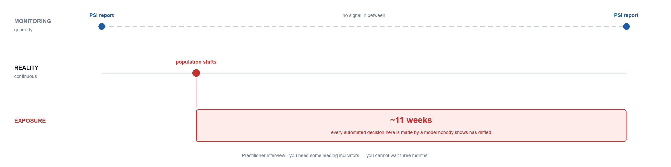
The Problem
A model is validated once, deployed, and then trusted indefinitely. Drift is checked on a quarterly report — but decisions are made every second.

Slide 4
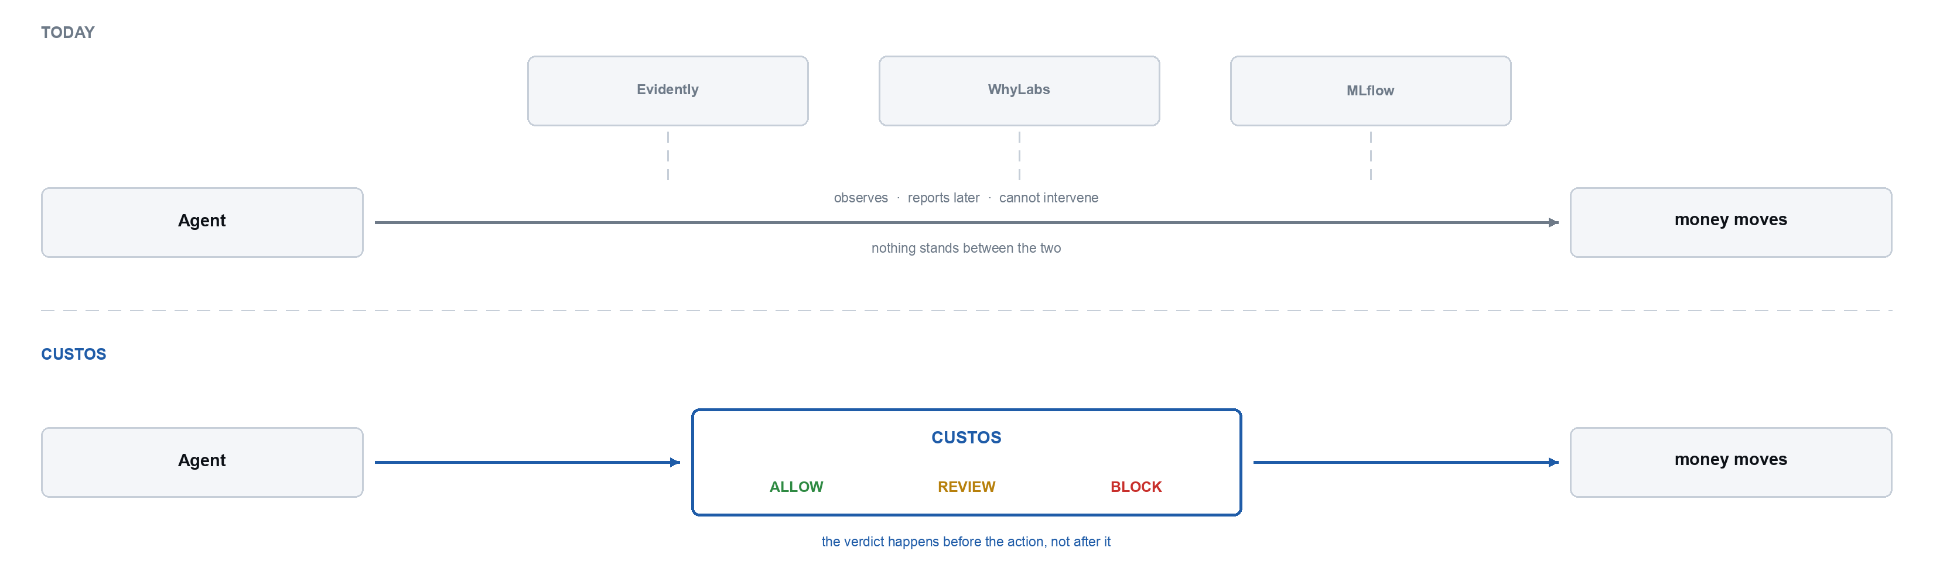
Why Existing Tooling Does Not Close It
The tools exist. They sit beside the request path and report afterwards. None of them can stop the decision that is about to be made.

Slide 5
Literature Survey
Six works across three areas: ML systems infrastructure, distribution-shift detection, and tamper-evident logging.
Paper Title | Name of Journal / Conference | Published Year | Novelty / Techniques | Limitations | Gap Identified
Hidden Technical Debt in Machine Learning Systems Sculley et al., Google | NeurIPS | 2015 | Shows ML systems accrue hidden debt: glue code, configuration and data dependencies dominate the codebase | Diagnoses the problem; proposes no runtime mechanism | Names the infrastructure gap but does not close it
A Survey on Concept Drift Adaptation Gama, Zliobaite, Bifet et al. | ACM Computing Surveys | 2014 | Canonical taxonomy of drift; detectors, adaptive windowing, ensemble adaptation | Framed as offline / streaming learning; no enforcement step | Detection is fully decoupled from any decision
Learning under Concept Drift: A Review Lu, Liu, Dong, Gu, Gama, Zhang | IEEE TKDE | 2019 | Consolidates drift detection, understanding and adaptation into one framework | Assumes labels arrive; evaluated in batch | Unlabelled live traffic is not addressed
Failing Loudly: Detecting Dataset Shift Rabanser, Gunnemann, Lipton (CMU) | NeurIPS | 2019 | Empirical comparison of shift detectors; dimensionality reduction plus two-sample tests | Offline batch study; no latency budget considered | Detectors are never placed on a request path
Data Validation for Machine Learning Breck, Polyzotis et al., Google | MLSys | 2019 | Schema-driven validation of training and serving data in production TFX pipelines | Validates schema conformance, not distributional trust | Pipeline-time only; no per-request verdict
Certificate Transparency Laurie, Langley, Kasper, Google | RFC 6962, IETF | 2013 | Append-only Merkle-tree logs making modification of history detectable | Designed for TLS certificates, not model decisions | Tamper-evidence never applied to ML decision records

Slide 6
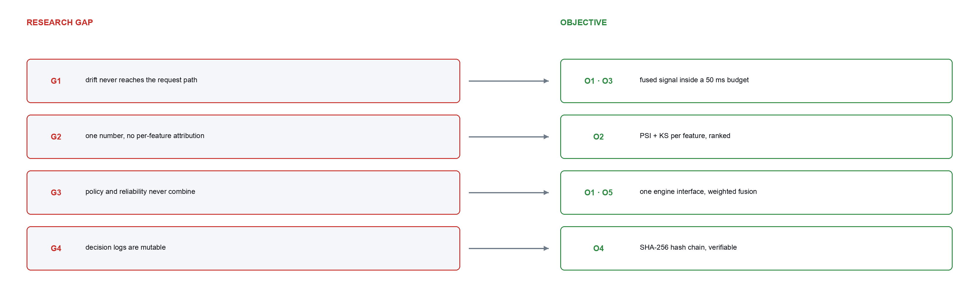
Research Gap and Objectives
Every gap the survey identified maps to an objective, and every objective is implemented and demonstrated.

Slide 7
Scope and SDG Alignment
In scope
Drift detection with per-feature attribution, policy evaluation, signal fusion, runtime enforcement, tamper-evident audit, multi-tenant configuration.
Out of scope
Custos does not train, serve or host models. It does not explain individual predictions, and it does not retrain or roll back. It decides and records — humans act.
SDG alignment
SDG 9 Industry, Innovation and Infrastructure — auditable infrastructure for automated decisions.
SDG 10 Reduced Inequalities — blocking a drifted model limits systematically unfair credit decisions.
SDG 16 Peace, Justice and Strong Institutions — verifiable records support regulatory audit.

Slide 8
Requirements
Ten functional requirements and six non-functional ones. The latency and fail-open constraints drove most of the architecture.
 | Functional |  | Non-functional
FR1 | Register models and capture a reference distribution | NFR1 | Gateway p99 <= 50 ms; 20 ms per-engine cap
FR2 | Compute PSI and KS per feature, offline | NFR2 | A Custos failure must not fail the caller
FR3 | Roll per-feature statistics into one severity | NFR3 | tenant_id on every table and every query
FR4 | Evaluate tenant policy rules against request context | NFR4 | Keys stored as SHA-256; rule text parsed, never eval'd
FR5 | Fuse signals into a weighted trust score | NFR5 | A new signal must not modify existing code
FR6 | Return ALLOW / REVIEW / BLOCK with reasons | NFR6 | Gateway and worker horizontally scalable
FR7 | Honour an engine veto over all other signals |  | Python 3.11, FastAPI, SQLAlchemy 2, Celery
FR8 | Append every decision to a tamper-evident chain |  | React 18 + TypeScript 5, Vite
FR9 | Verify a chain and report the first modified entry |  | PostgreSQL 16 + Redis 7; SQLite on a single node
FR10 | Route unregistered models to REVIEW |  | Docker Compose; runs on a laptop, no services

Slide 9
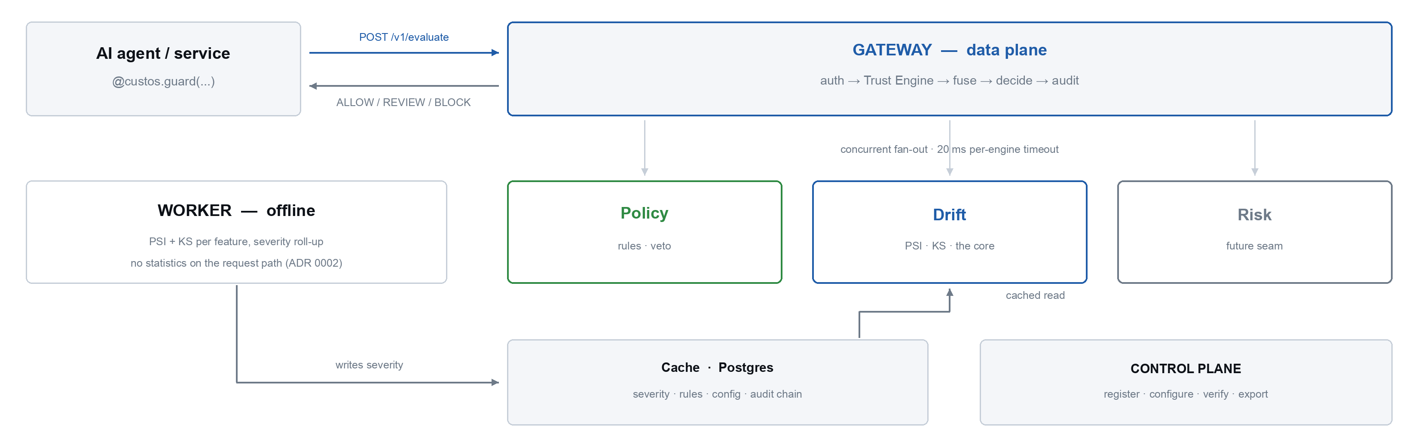
System Architecture
Two planes. The data plane does the minimum possible work per request; everything expensive lives on the control plane or in the offline worker.

Slide 10
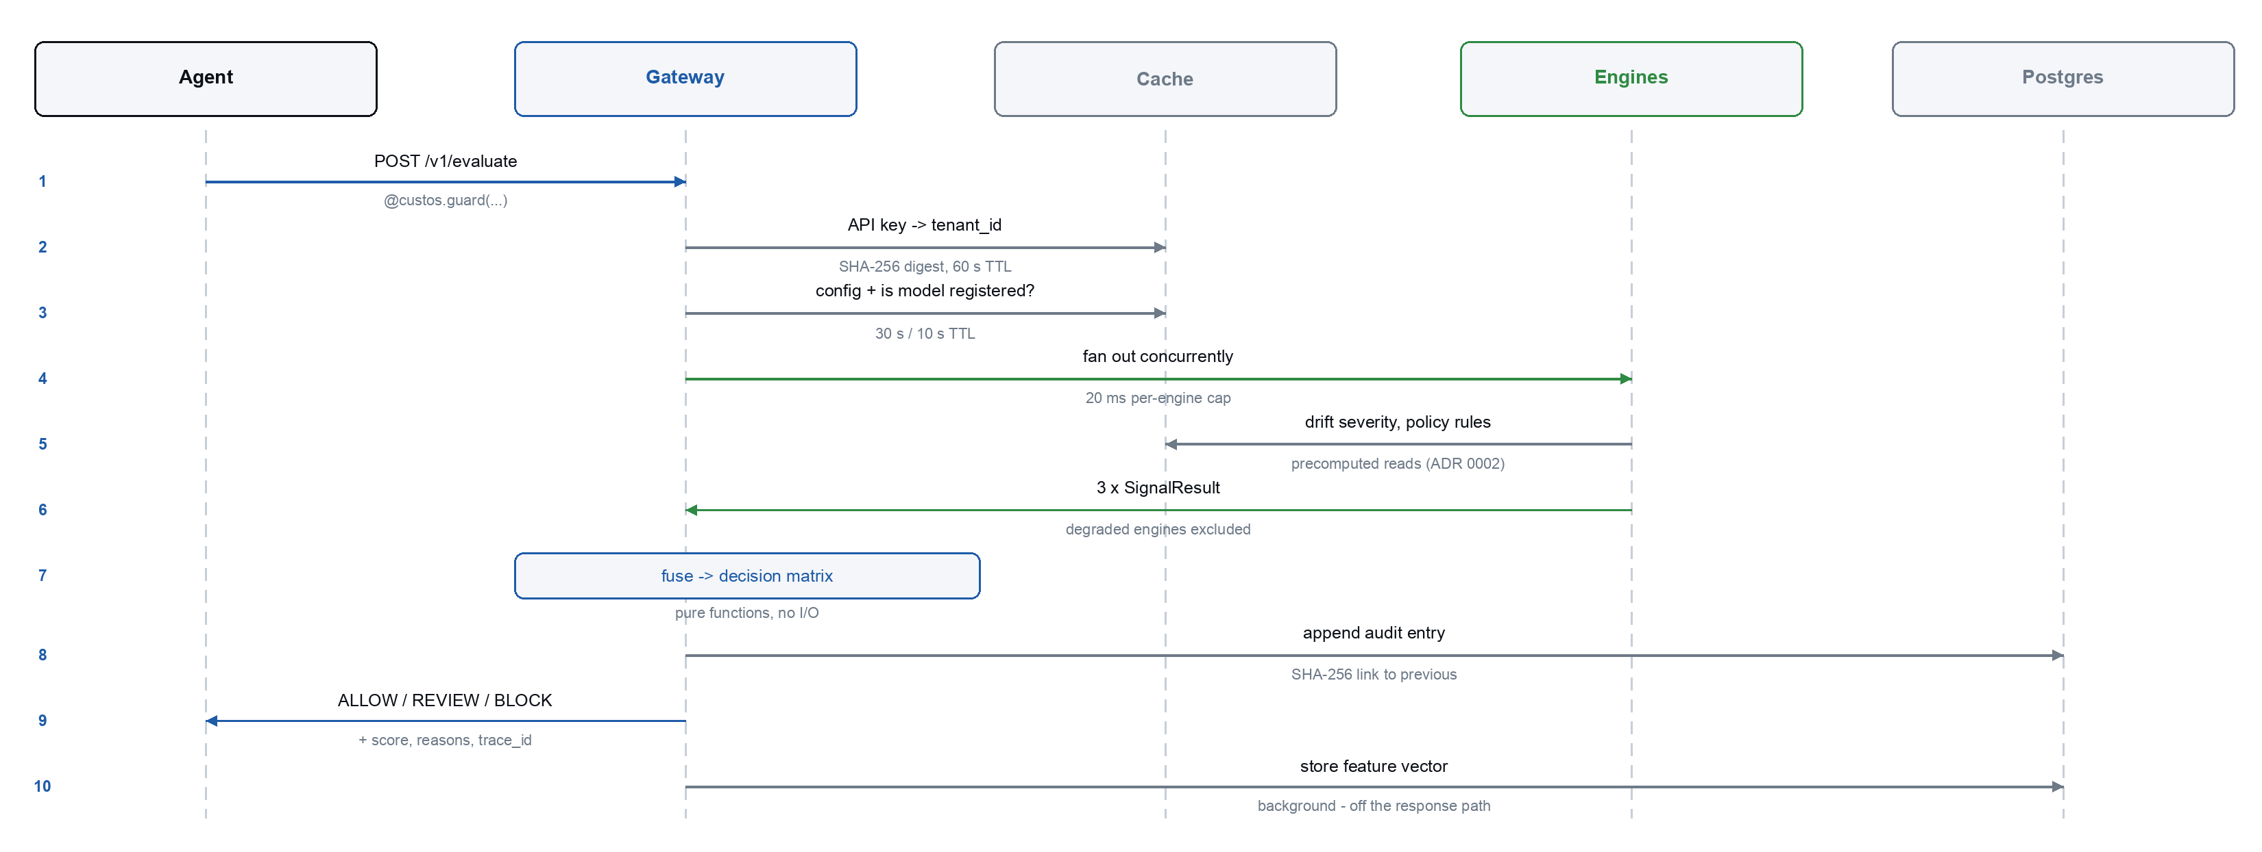
Request Flow
One /v1/evaluate call. Steps 2, 3 and 5 are cached reads; step 7 is pure computation; only 8 and 10 touch the database — and 10 runs after the caller already has its answer.

Slide 11
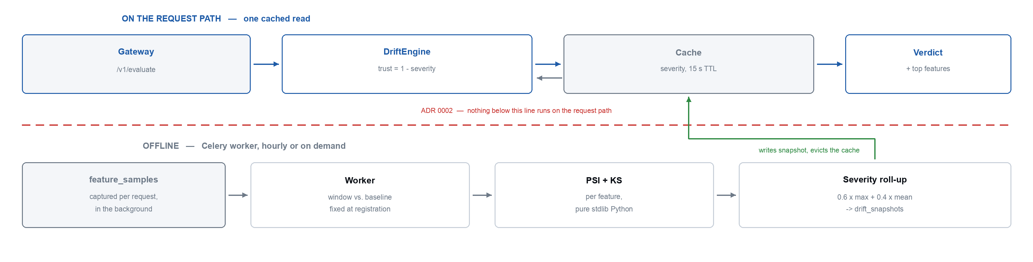
Drift Pipeline
Where the statistics run, and where they do not. This split is what makes a 50 ms budget achievable while still computing PSI and KS over full windows.

Slide 12
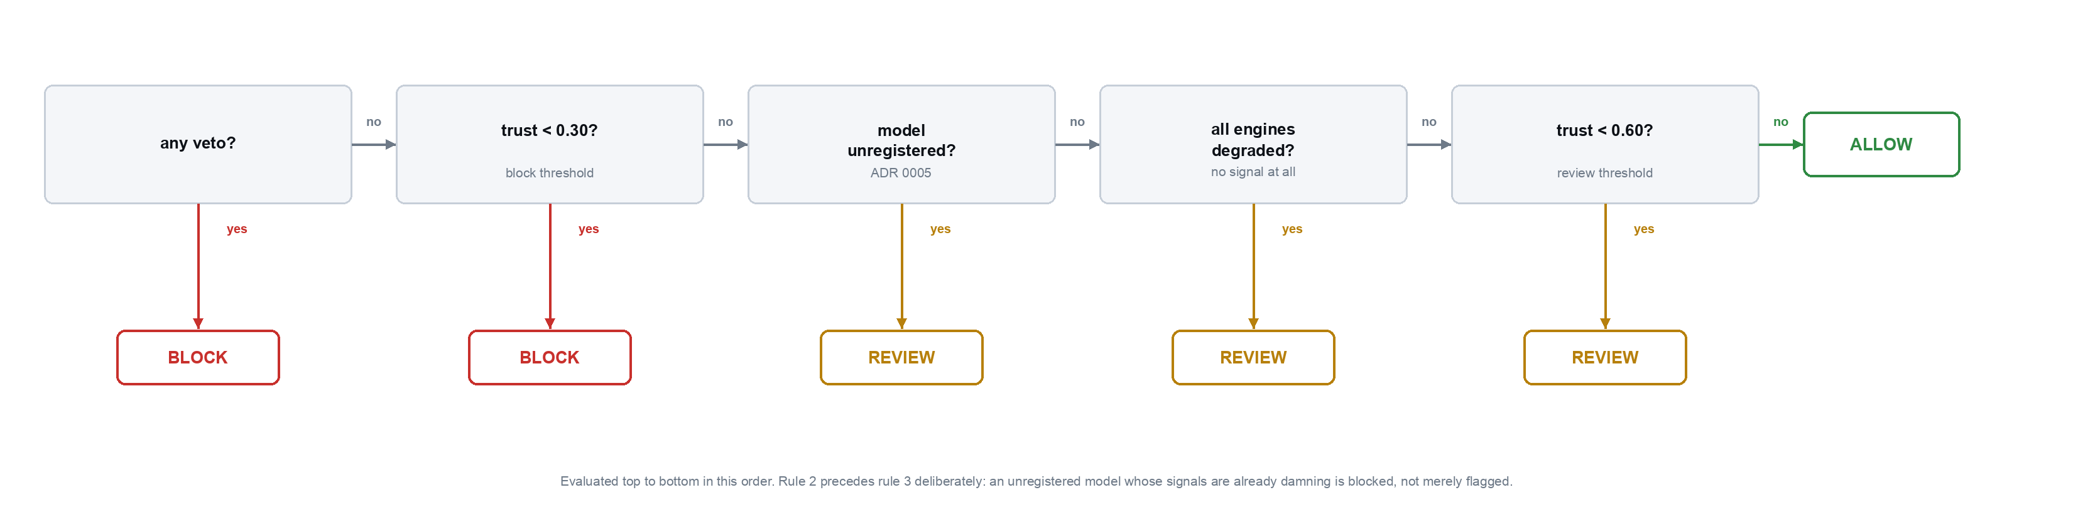
Decision Logic
Signals fuse as a weighted mean over non-degraded engines; a veto clamps the score to zero. The cascade below is then evaluated in order — the order is the specification.

Slide 13
Implementation Status
Nine of eleven components are complete and exercised end to end. The remaining two are deliberate, not unfinished.
Component | What was built | Status
Contract layer | Pydantic schemas, SQLAlchemy ORM over 7 tables, Alembic migration, TTL cache, tenant config, JSON logging, metrics | Complete
Drift engine | PSI and KS in pure stdlib Python, band mapping, monotone severity roll-up, offline Celery worker, cached hot-path read | Complete
Policy engine | Tokeniser, recursive-descent parser, AST evaluator, veto handling — no eval anywhere | Complete
Trust engine | Concurrent fan-out with per-engine timeouts, weighted fusion, degraded exclusion, decision matrix | Complete
Audit chain | SHA-256 chain with race-safe append, verification endpoint, streamed evidence export | Complete
Gateway + control plane | /v1/evaluate, /health, /metrics and 14 control-plane endpoints across 5 route modules | Complete
Python SDK | @guard decorator, gate() context manager, fail-open client — standard library only | Complete
Dashboard | React + TypeScript operator console: models, drift, decisions, audit, chain verification | Complete
Fintech demo | Credit model, guarded loan agent, three drift scenarios, narrated one-command runner | Complete
Risk engine | Seam registered and wired; returns degraded so it cannot contribute unearned trust | By design
Sidecar proxy | Language-agnostic interceptor for non-Python callers | Review-2

Slide 14
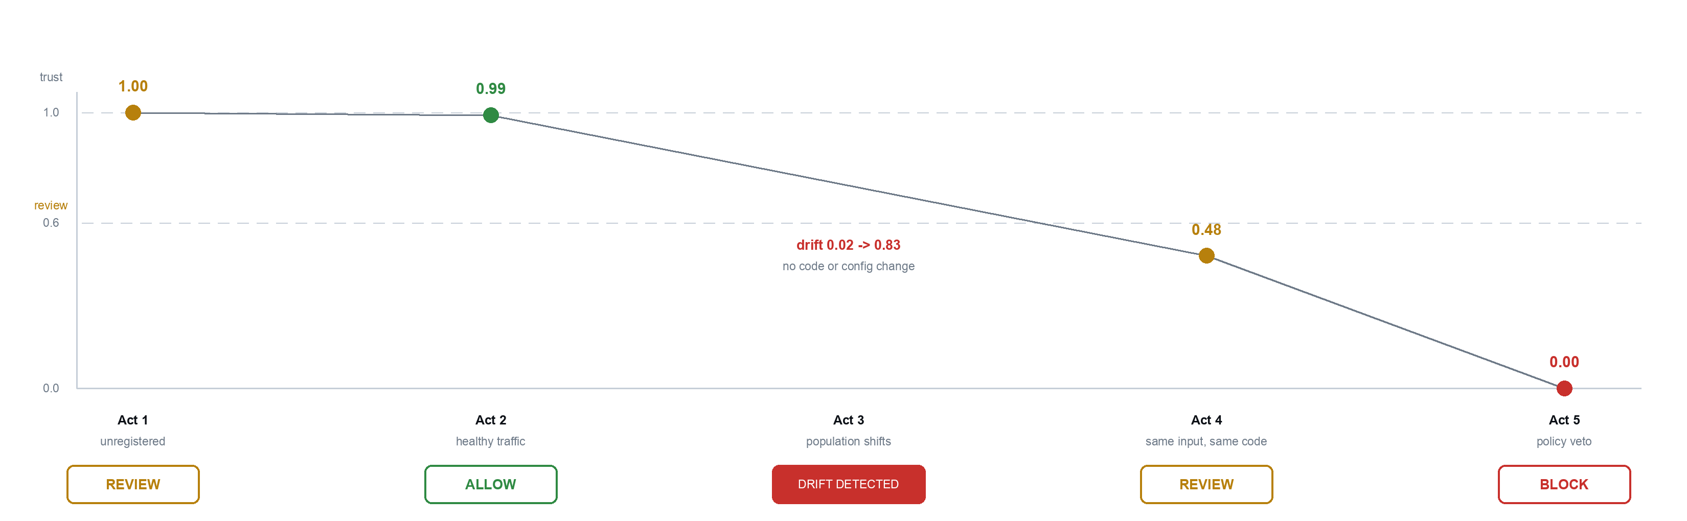
Results — Live Demonstration
A lending agent auto-approves loans behind Custos. One command, no external infrastructure. The model and the code never change — only the incoming population does.

Slide 15
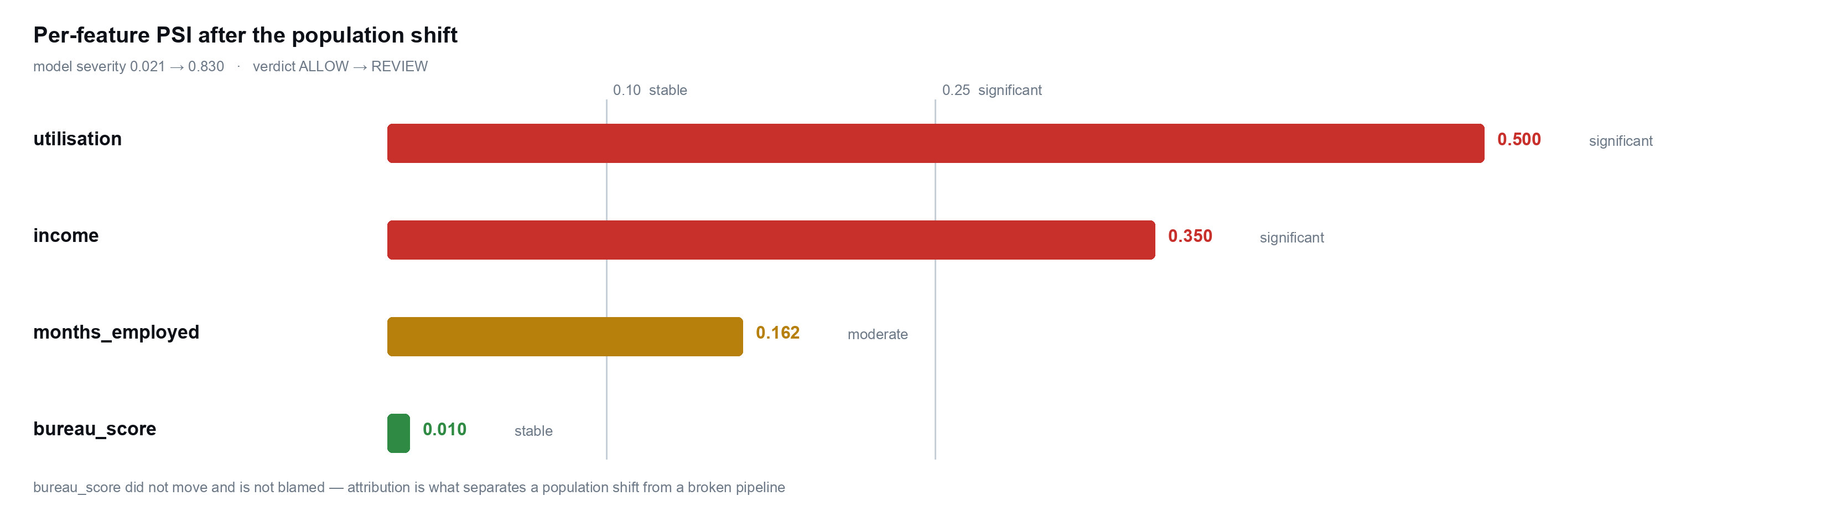
Results — Drift Attribution
Severity says the model moved; attribution says which input moved — the difference between a population shift and a broken upstream feed.

Slide 16
Data and Validation
Custos contains no trained model, no fitted parameters, no weights. It is a measuring instrument — so it is validated the way instruments are, by calibration against known inputs, not by accuracy on held-out data.
A thermometer is not validated by pointing it at random objects. It goes into melting ice to read 0 °C and boiling water to read 100 °C. The reference points have to be known, or the reading cannot be checked against anything.
 | Data used | Question it answers | Ground truth | Status
Calibration | Controlled distributions with shifts of a chosen size, injected into the demo's own feature population | Is the detector correct? | Known — we chose the shift, so the right answer exists | Done · 43 detector tests
Field | Public real-world credit data, replayed in time order through the same drift code the gateway runs | Does it fire on drift that actually happened? | Unknown — but nobody chose the drift, which is what makes it fair | Harness built · Lending Club run is Review-2

Slide 17
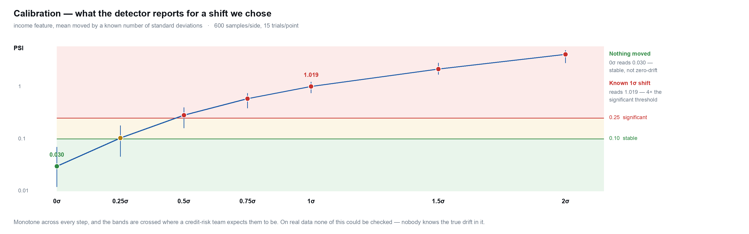
Calibration — the Instrument in Ice and Steam
Shift a feature's mean by a chosen number of standard deviations and check what PSI reports back. Because the input was chosen, the correct output is known — which is precisely what real data cannot offer.

Slide 18
What the Controlled Data Proves
Five properties, 43 detector tests. The right-hand column is the answer to “why not just use a real dataset?” — none of these could be checked on one.
What is checked | How | Why it could not be done on real data
PSI is arithmetically right | Checked against a value computed by hand from the definition; KS against a case where the CDF gap is exactly 0.5 by construction | There is no hand-computable right answer for 2.2 million rows
0σ reads stable | Two draws from the same distribution report PSI 0.030 — below the 0.10 stable band | No real dataset is known to contain zero drift
1σ reads significant | A one-standard-deviation mean shift reports PSI 1.019 — 4× the 0.25 threshold a credit-risk team already uses | The true shift in real data is unmeasured, so the reading cannot be graded
Severity never moves the wrong way | 500 randomised perturbations: increasing any feature's drift can never lower the reported severity | Requires controlling the input to know which direction is correct
It refuses to guess | An empty window raises rather than returning 0.0; below MIN_SAMPLES = 30 it reports insufficient data | Reporting 'no drift' for 'no data' is the exact failure the system exists to prevent

Slide 19
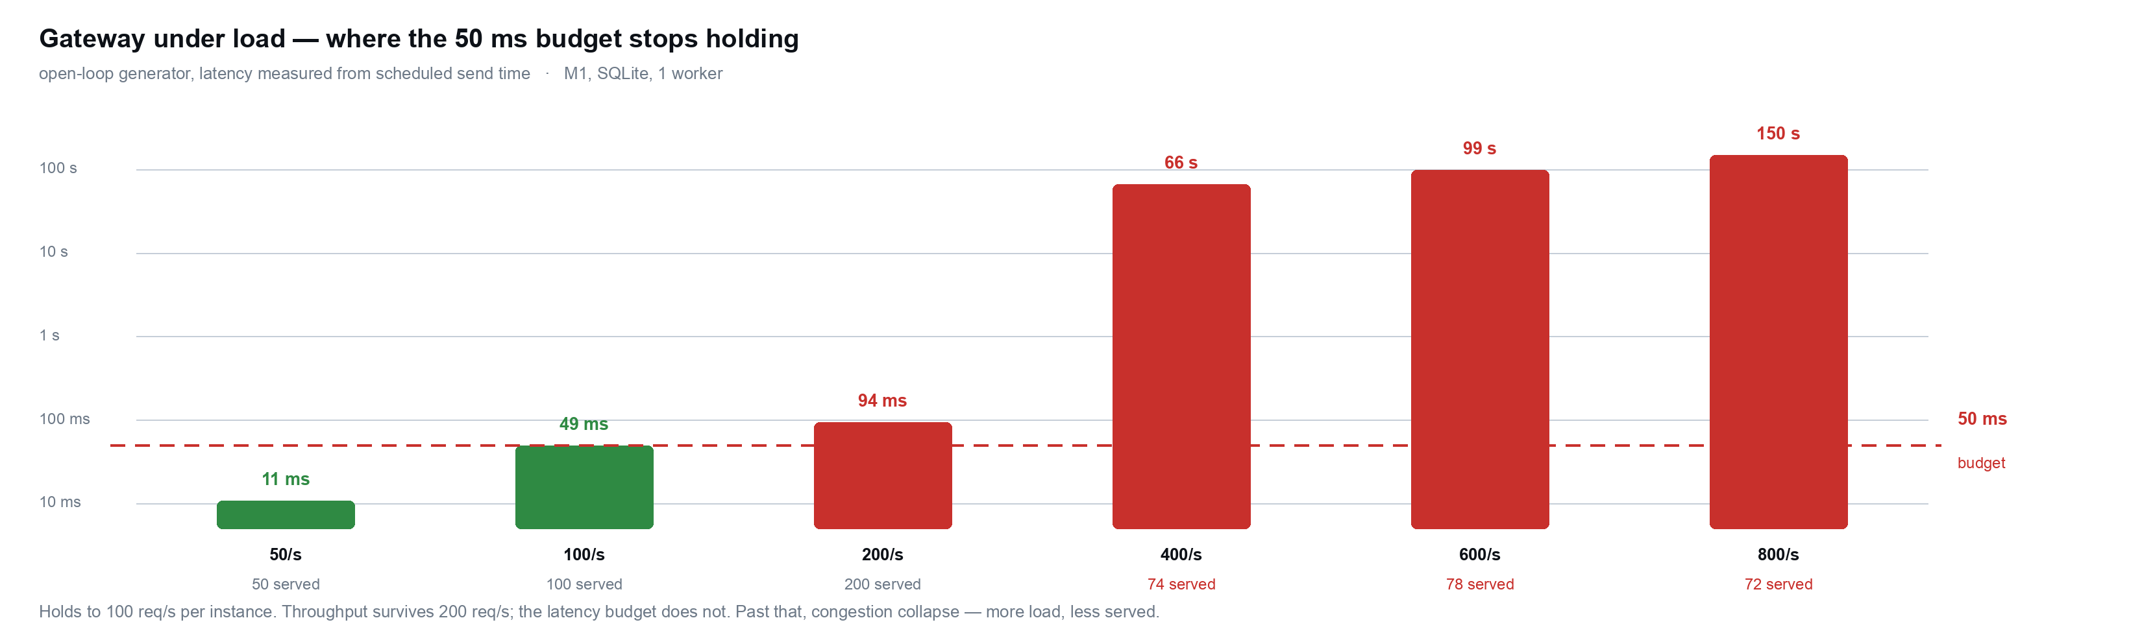
Validating the Latency Claim
NFR1 asserts a 50 ms p99. An assertion in a design document is not evidence, so we built the instrument that could falsify it — and it did.

Slide 20
What Load Testing Exposed
Three defects, none of them reachable by a test that sends one request at a time. This is the difference between a suite that passes and a system that works.
What we believed | What the harness measured | What we did
Gateway p99 is 0.5 ms | 0.5 ms was the trust engine's own timer, which stops before the audit write. The caller actually waits 49 ms at the ceiling — 98% of the budget, not 1% | Report the client-observed number; treat the internal metric as a component timing, not the request
The audit chain records every decision | Under concurrent appends, 2 of 96 entries were dropped — and verification still reported the chain intact, because a hash chain detects a modified entry, never a missing one | Per-tenant advisory lock on Postgres, jittered backoff everywhere. 0 lost from 2 to 48 writers
Overload makes it slow | Overload makes it answer differently: past the ceiling, engines exceed their 20 ms timeout, drop out of fusion, and ~13% of verdicts flip ALLOW to REVIEW on traffic an idle gateway allows | Documented as an operational property; admission control is the Review-2 fix

Slide 21
Case Study — The Audit Log That Lied
Our strongest claim is tamper-evident evidence for every decision. Under concurrency it was dropping entries and reporting itself intact.
Symptom
At 24 concurrent writers, 2 of 96 appends were lost — and GET /audit/verify still returned “all 94 entries verified”. A hash chain detects a modified entry, never a missing one.
Diagnosis before cure
Measured where it was actually reachable: 0 lost at 1 uvicorn worker, 2 lost at 4. The event loop already serialised single-worker writes, so the obvious per-tenant in-process lock would have protected the only configuration that was not broken.
Fix
Postgres: pg_advisory_xact_lock per tenant, taken before the chain head is read. Every backend: jittered backoff, because five instant retries kept the racers in lockstep. Result: 0 lost from 2 to 48 writers — and 2× the throughput, since the retry storm was itself the load.

Slide 22
Contributions and Conclusion
274 tests passing · 50 ms p99 budget verified under load to 100 req/s per instance · two concurrency defects found by our own harness and fixed · audit chain demonstrated under an actual tampering attempt.
Next, for Review-2
Admission control: shed load at the door rather than let a spike silently convert auto-approvals into review backlog.
Validate against real drift using the Lending Club dataset, replacing the controlled synthetic scenarios.
Model and data versioning, plus a retraining trigger — the components practitioners named as prerequisites.
Move the audit write off the hot path, and re-measure against Postgres rather than SQLite.
Team member | USN | Modules owned
AYUSH PANDEY | 1BM23AD074 | Architecture and ADRs · drift engine (PSI/KS detectors, severity roll-up, offline worker) · trust engine fusion and decision matrix
VIVEK BOORA | 1BM23AD073 | Gateway and control-plane APIs · policy engine and rule grammar · tamper-evident audit chain and evidence export
NITIN | 1BM24AD404 | Python SDK · React operator dashboard · fintech demonstration · 274-test suite across unit, integration and end-to-end

