Slide 1

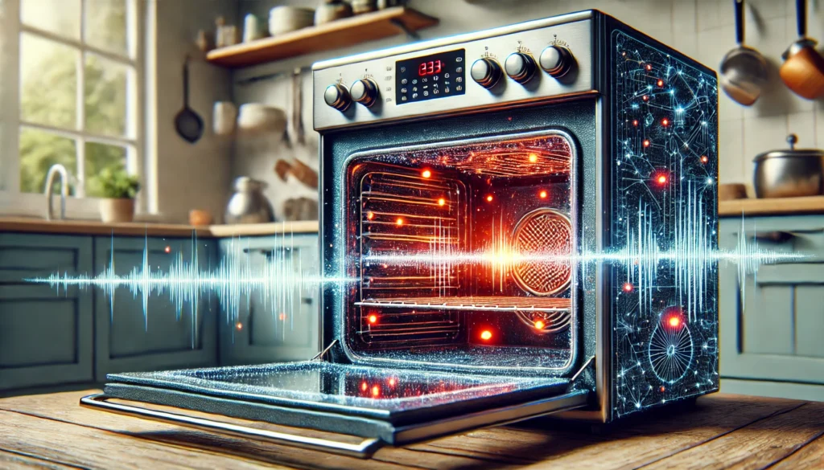
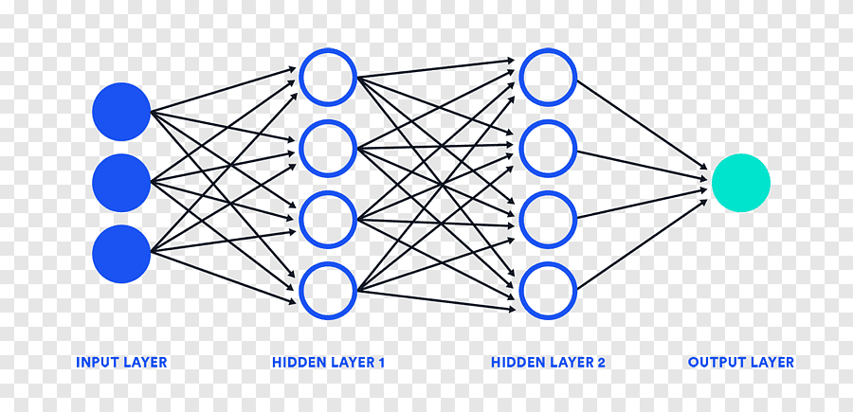
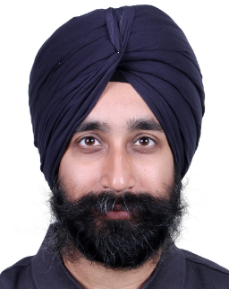
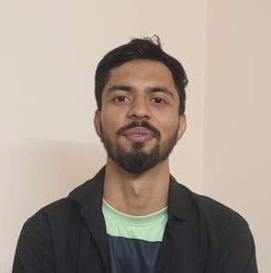
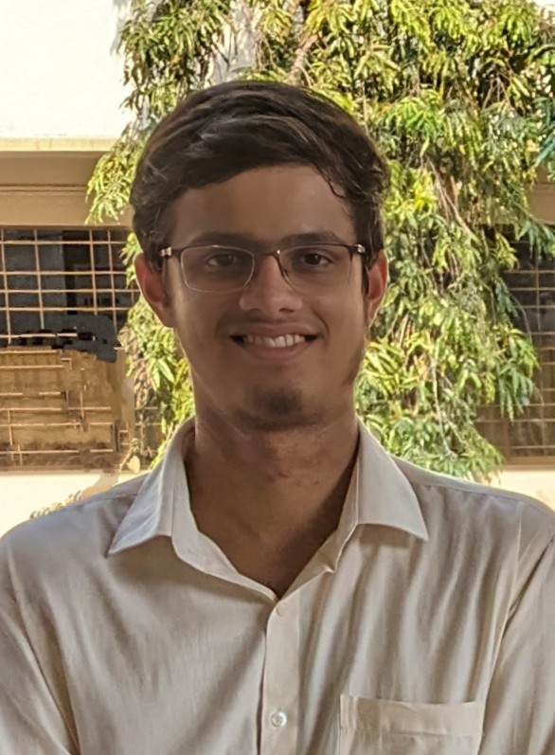
Work-let Area – AI, IoT, Smart Home | Deep Learning Model to Classify Kitchen Sounds to Cooking
Work-let expected duration – 4 months with 3-4 Students
Problem Statement
The primary goal is to provide users with insights into their cooking habits and improve the overall smart home experience.
Samsung’s SmartThings Smart Home Platform serves millions of users globally, targeting 1 billion users by 2030.
While kitchen-related smart devices (e.g., refrigerators, water purifiers) are widely integrated, critical cooking devices like cooktops may be absent.
To address this gap, a deep learning model to analyse raw kitchen sound data is essential. The model will analyse ambient audio from kitchen/surrounding areas to detect cooking devices and finally categorizing if the sound is related to Cooking activity or Non-Cooking activity.
Expectations
Develop a deep learning model that categorizes raw sound data into Cooking Activity or Non-Cooking activity.
The model must achieve high precision & recall.
Model can be trained on open source datasets, real generated dataset or high quality and synthetic dataset.
Operate reliably in diverse acoustic environments (background noise, overlapping sounds).
Training/ Pre-requisites
Good understanding of audio signal processing (e.g., spectrogram analysis, feature extraction).
Proficiency in deep learning frameworks (TensorFlow/PyTorch) for audio classification model implementation.
Experience with Python libraries (e.g., Librosa, Pandas, NumPy) for audio pre-processing.
Ability to create synthetic sound datasets if needed using Large Models.
Output Category:
Cooking or Not-Cooking
(Binary Classification)
Raw sound generated inside Kitchen
Filter noise, categorization
Kick Off <1 - 2 Months>
Find a suitable open source dataset/ generate synthetic dataset that simulate kitchen sounds (e.g., use of cooktops, ovens) and non-cooking noises (e.g., dishwashers, conversations).
Audio signal processing & augmentation to prepare it for model training.
Milestone 1 <3rd Month>
Design and implement a suitable deep learning architecture.
Train the model using dataset preprocessed.
Evaluate the model’s performance.
Optimize the model to improve its predictions.
Closure <4th Month>
Document the entire development process, including data generation (if done), model architecture, training procedures, and evaluation results.
Prepare a comprehensive report detailing the model’s capabilities, limitations, and potential areas for improvement.
Release the code and dataset
Work-let closure
Manbir Singh Soni
Senior Chief Engineer,
manbir.soni@samsung.com
9686642020
Amit Yadav
Lead Engineer
amit.yad@samsung.com
9582843927
Aakash G Acharya
Engineer,
aakash.ach@samsung.com
8660690331

