Slide 1
Titanic Survival Prediction
Ayush Pandey
Sec.:A
University Roll No.:171500077
Department of Computer Engineering & Applications
GLA University, Mathura

Slide 2
contents
Introduction
Types of ML
ML techniques
Input and output features
Missing data completion
Different algorithm
Experience and learning

Slide 3
Introduction
“ A computer program said to learn from experience (E) with some class of tasks (T) and a performance measure (P) if its performance at tasks in T as measured by P improves with E.”

Slide 4
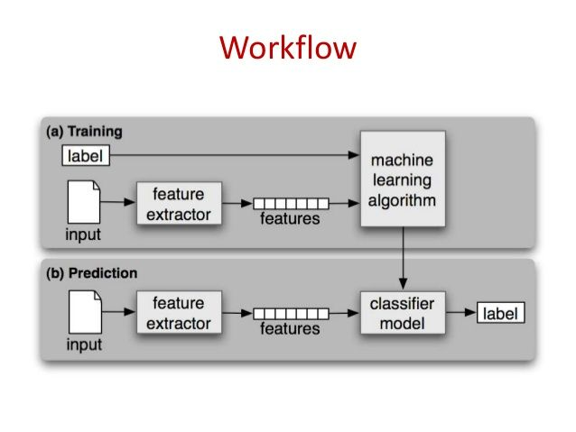

Slide 5
Types of machine learning
Supervised Learning
Unsupervised Learning
Semi-Supervised Learning
Reinforcement Learning

Slide 6
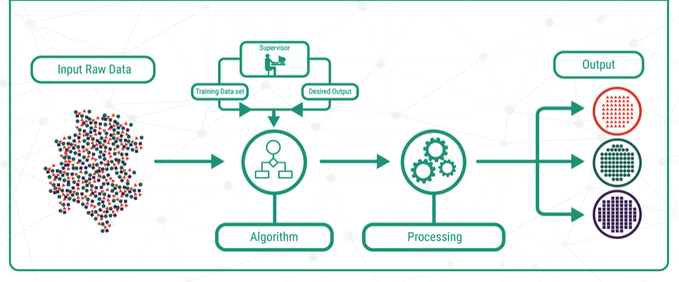
Supervised learning
The correct classes of the training data are known

Slide 7
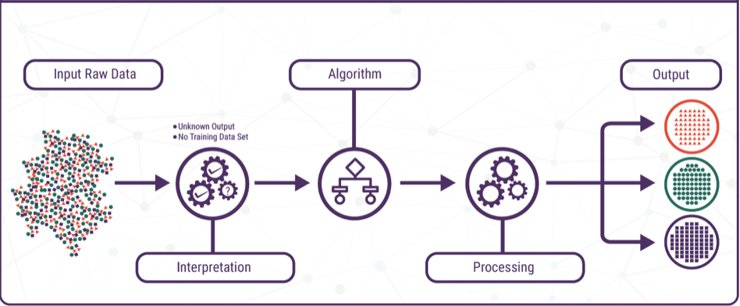
Unsupervised learning
The correct classes of the training data are not known

Slide 8
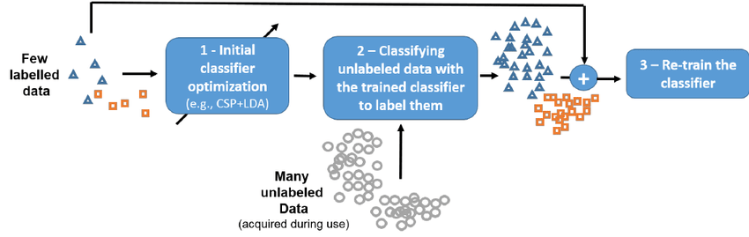
Semi-supervised learning
A mix of supervised and unsupervised learning

Slide 9
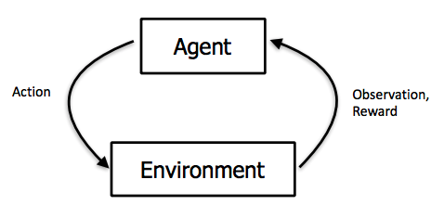
Reinforcement learning
Allows the machine or software agent to learn its behavior based on feedback from the environment.
This behavior can be learnt once and for all, or keep on adapting as time goes by.

Slide 10
Machine learning techniques

Slide 11
techniques
Classification: predict class from observation
Clustering: group observations into “meaningful” groups
Regression(prediction): predict value from observations

Slide 12
Titanic survival prediction
Goal- which passenger is able to survived the tragedy?

Slide 13
Input features
Passenger ID
Passenger class
Name
Sex
Age
No. of passenger’s sibling & spouse on board
No. of passenger’s parents & children on board
Ticket
Fare
Cabin
City where passenger embarked

Slide 14
Missing data completion techniques
age
236 missing values
Two approaches
embarked
Two missing value
Substitute with “S” as many passengers had embarked from southamptons
Fare
Median value
Decision tree
One NA value
Two approaches
Replace with the median value
Decision tree

Slide 15
roadmap
Import necessary libraries
Read in and explore the historic data
Data analysis
Data visualization
Cleaning data
Choosing the best model
Creating submission file

Slide 16
Attributes considered
Given attributes
Pclass, age ,sex, fare, sibsp, parch, cabin
Engineered attributes
Title, surname, mother, father, extended relation

Slide 17
Simple linear model
Accuracy
77.09%
learning
All the attributes do not follow standardize distribution

Slide 18
Random forest
Accuracy
83.25%
learning
Limitation with number of factor affected the accuracy

Slide 19
SVM
Accuracy
82.74%
learning
Less accuracy because all the attributes could not be factored

Slide 20
Naïve bayes
Accuracy
78.68%
learning
Considering the conditional and individual probabilistic dependence of each variable on survival rate.

Slide 21
Experience and learning
Each algorithm gave different results
No algorithm can predict with 100% accuracy

Slide 22


Slide 23


