Slide 1

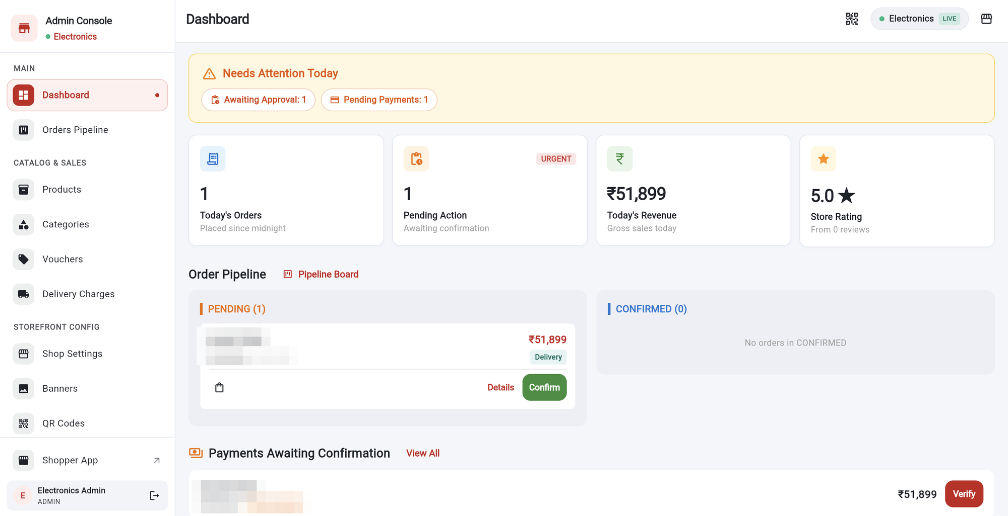
Admin App
User Guide
For shop owners and managers. Manage products, orders, staff and your storefront, step by step with real screens.
Screens captured in Google Chrome with test data
Notes:
Welcome. This guide shows shop owners and managers how to run the shop from the Admin app.

Slide 2






INTRODUCTION
Welcome to the Admin app
Everything you need to run your shop, in one place.
Orders
Products
Categories
See new orders, confirm them and follow them to delivery.
Add products, prices, stock, add-ons, and publish or hide them.
Group products and choose which products belong where.
Team
Storefront
Plan and reports
Add employees and give each one the right role.
Control the banners, categories and trending items shoppers see.
Check your plan limits and download sales reports.
Notes:
These are the areas of the Admin app.

Slide 3
INTRODUCTION
What is in this guide
1
Getting started
Sign in, dashboard, menu and common icons
Slides 4–8
2
Products
List, search, add, options, add-ons, publish, QR
Slides 9–17
3
Categories
List, add and assign products
Slides 18–20
4
Orders
Pipeline, order life, details, actions and roles
Slides 21–24
5
Employees
Add staff and choose the right role
Slides 25–26
6
Storefront settings
Home screen content and the password lock
Slides 27–31
7
Growth and control
Plan, vouchers, delivery, shop settings, reports
Slides 32–41
8
Help
Not available features, tips, FAQ
Slides 42–48
Notes:
Use this page to jump to a section.

Slide 4
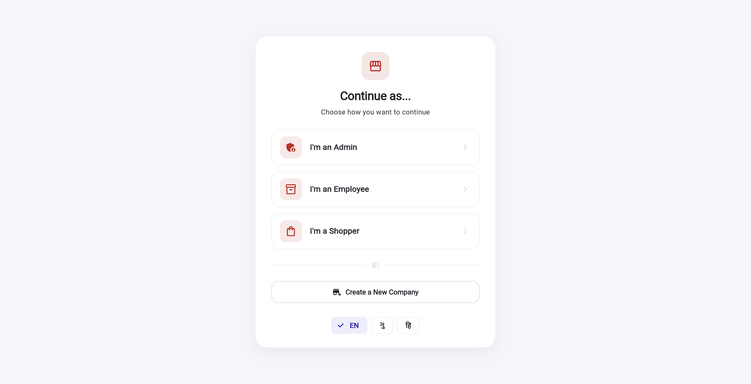
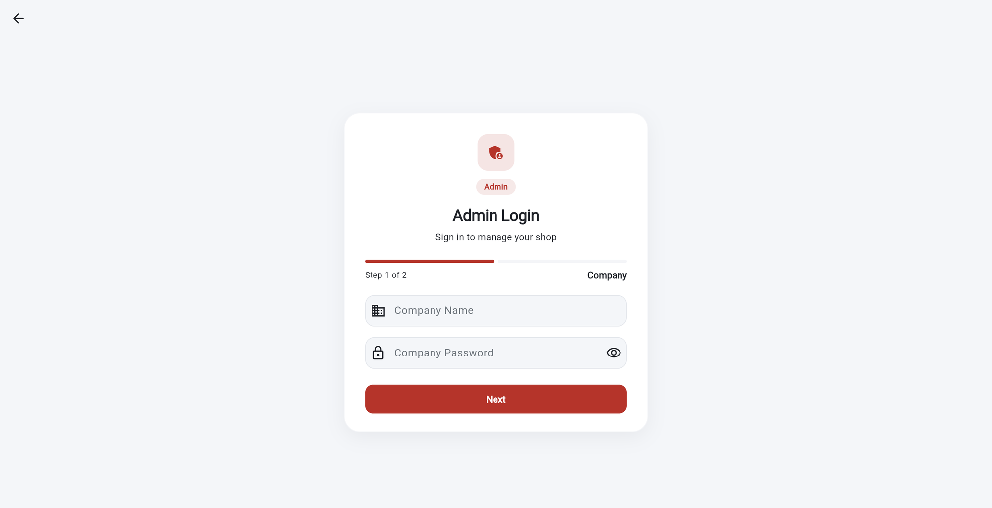
GETTING STARTED
Sign in to the Admin app
1
1
2
2
3
1
Open the app and tap “I’m an Admin”.
Employees use I’m an Employee.
1
Step 1 of 2: your company.
Company name and company password.
2
Eye icon
shows what you typed. Then tap Next.
2
New shop?
Create a New Company starts the setup.
3
Step 2 of 2: your account.
Admin email and password, then Login.
Tip If the sign-in fails, check the company name and password first, then your email and password.
Notes:
Admins sign in in two steps: first the company, then their own account.

Slide 5
GETTING STARTED
The dashboard at a glance
1
Needs Attention Today.
Quick links for orders waiting for approval and payments still to confirm.
1
2
Four cards.
Today’s orders, pending action, today’s revenue and the store rating.
2
3
Order Pipeline.
Pending and Confirmed orders. Tap Details to open one, or Confirm.
3
4
Payments Awaiting Confirmation.
Tap Verify after you have received the money.
4
Tip Revenue and counts are for the current day. Open Orders Pipeline for the full picture.
Notes:
The dashboard is the first page after sign in. It shows what needs attention today.

Slide 6
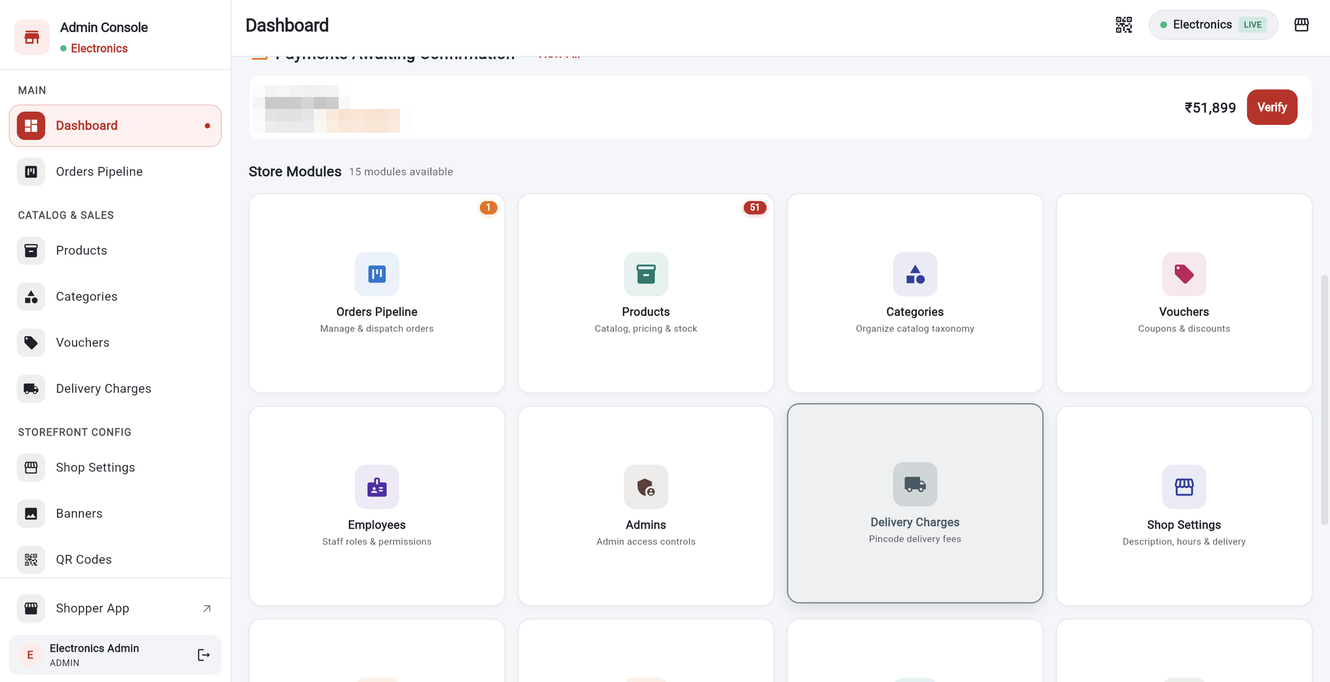
GETTING STARTED
Open any area from the dashboard
1
Store Modules.
Scroll down on the dashboard to see all 15 areas.
2
Orange badge.
On Orders Pipeline it shows how many orders are waiting.
1
2
3
4
3
Red badge.
On Products it shows how many products you have in total.
4
Tap a card
to open that area. The same areas are in the left menu.
Notes:
The Store Modules grid is a shortcut to every area. The number badge shows a count.

Slide 7
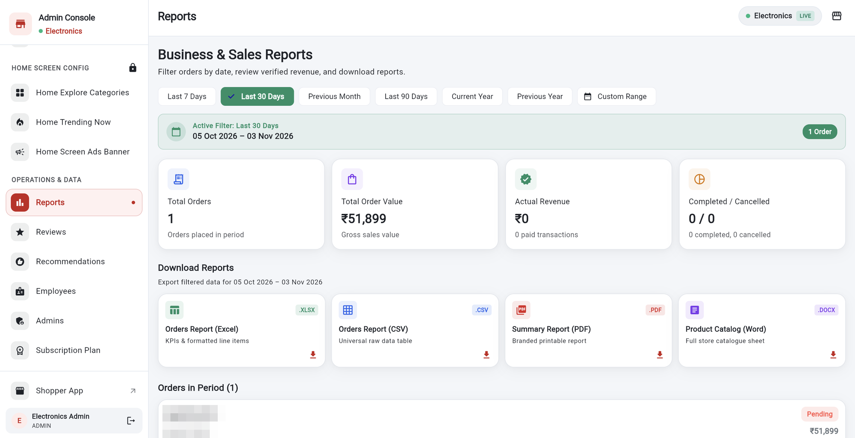
GETTING STARTED
The left menu
1
1
2
2
3
3
1
Groups.
Main, Catalog & Sales, Storefront Config.
1
Scroll the menu.
More groups appear below.
2
Shopper App
opens the customer view of your shop.
2
Home Screen Config
has a padlock. It needs a password (see slide 27).
3
Your name and arrow icon
sign you out.
3
Operations & Data
Reports, Reviews, Employees, Plan and more.
Tip On a narrow window the menu becomes a drawer opened from the top-left button.
Notes:
The menu is grouped. The Home Screen Config group has a padlock.

Slide 8
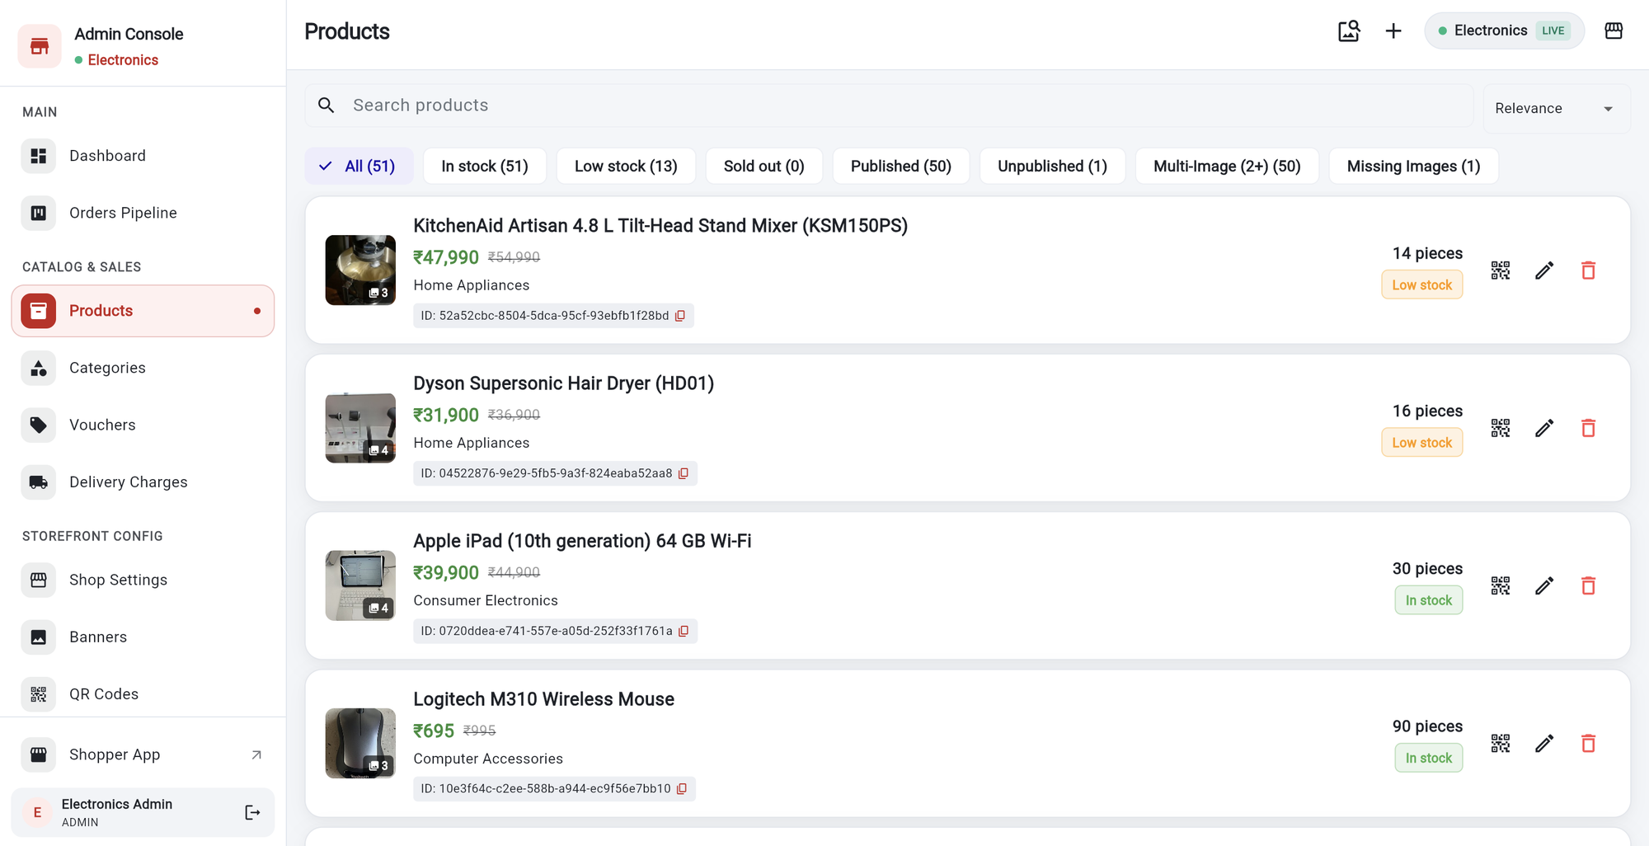
GETTING STARTED
Common buttons and icons
1
Picture icon (top)
checks which products have images.
1
2
6
2
Plus (+)
adds a new item on that page.
3
4
5
3
QR icon
opens a QR code and link for that item.
4
Pencil
edits the item.
5
Red bin
deletes the item after you confirm.
6
Search and copy icon.
Search the list. Copy icon copies an ID.
Notes:
These icons appear on most list pages.

Slide 9
PRODUCTS
Your product list
1
Search products
by name or ID.
4
1
2
3
2
Sort
with the Relevance menu.
5
3
Filter chips.
In stock, Low stock, Sold out, Published, Unpublished and more. Each shows a count.
4
Plus (+)
adds a product.
5
QR, pencil and bin
show the link, edit, or delete.
Tip Each card shows price, old price (crossed out), category, stock and the product ID.
Notes:
The Products page lists every product, including hidden ones.

Slide 10
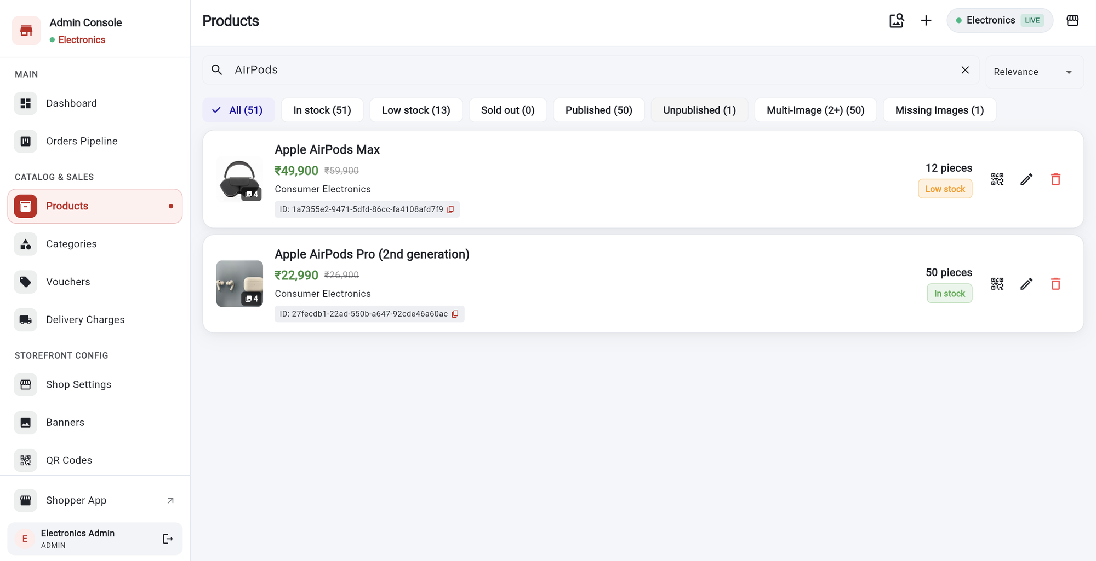
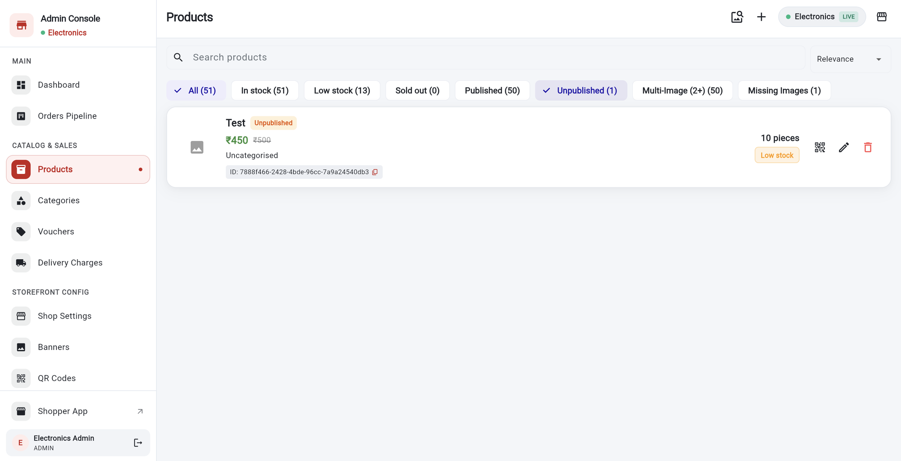
PRODUCTS
Search and filter products
1
2
1
2
1
Type in the search box.
The list narrows as you type.
1
Tap Unpublished
to see hidden products only.
2
Tap X
to clear the search.
2
A label marks hidden products.
Tap the chip again to clear the filter.
Tip Search and chips combine. “Unpublished” plus a search with no match shows “No products match these filters”.
Notes:
Search and the chips work together.

Slide 11
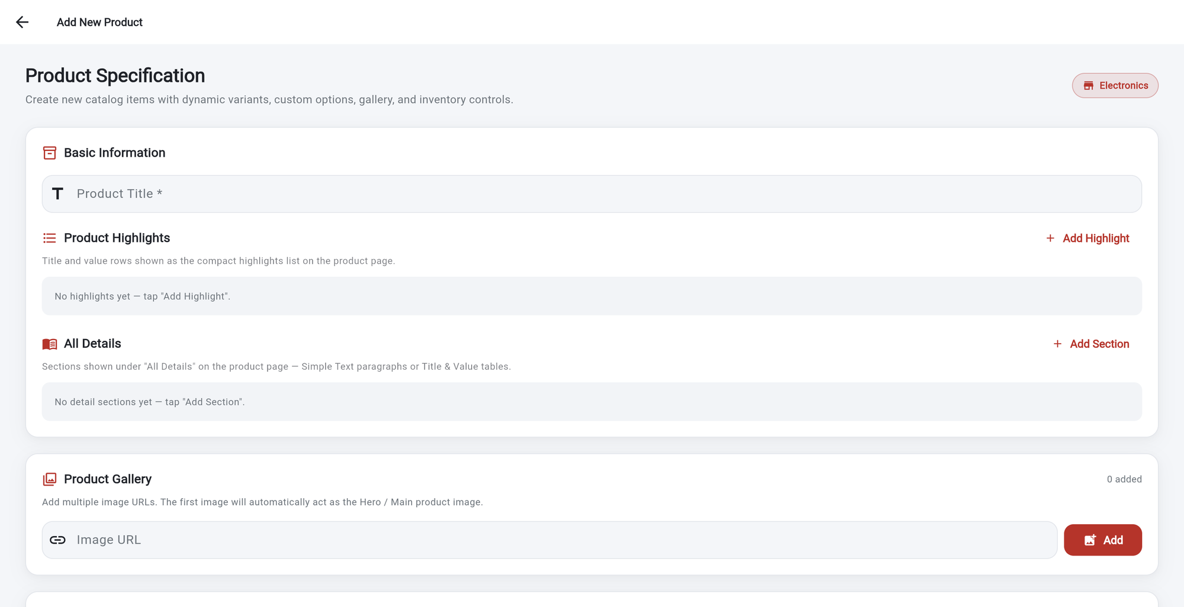
PRODUCTS
Add a product: the basics
1
Product Title *
is required. Use a clear name shoppers will search for.
2
Add Highlight.
Short title and value rows, for example Battery: 20 hours.
1
2
3
Add Section
adds longer details as text or as a title and value table.
3
4
Image URL.
Paste a picture link. Images are added by link, not uploaded.
Tap Add.
The first picture becomes the main one.
4
5
5
Tip Add several pictures. The first one is shown first to shoppers.
Notes:
Tap plus on the Products page. Fields with a star are required.

Slide 12
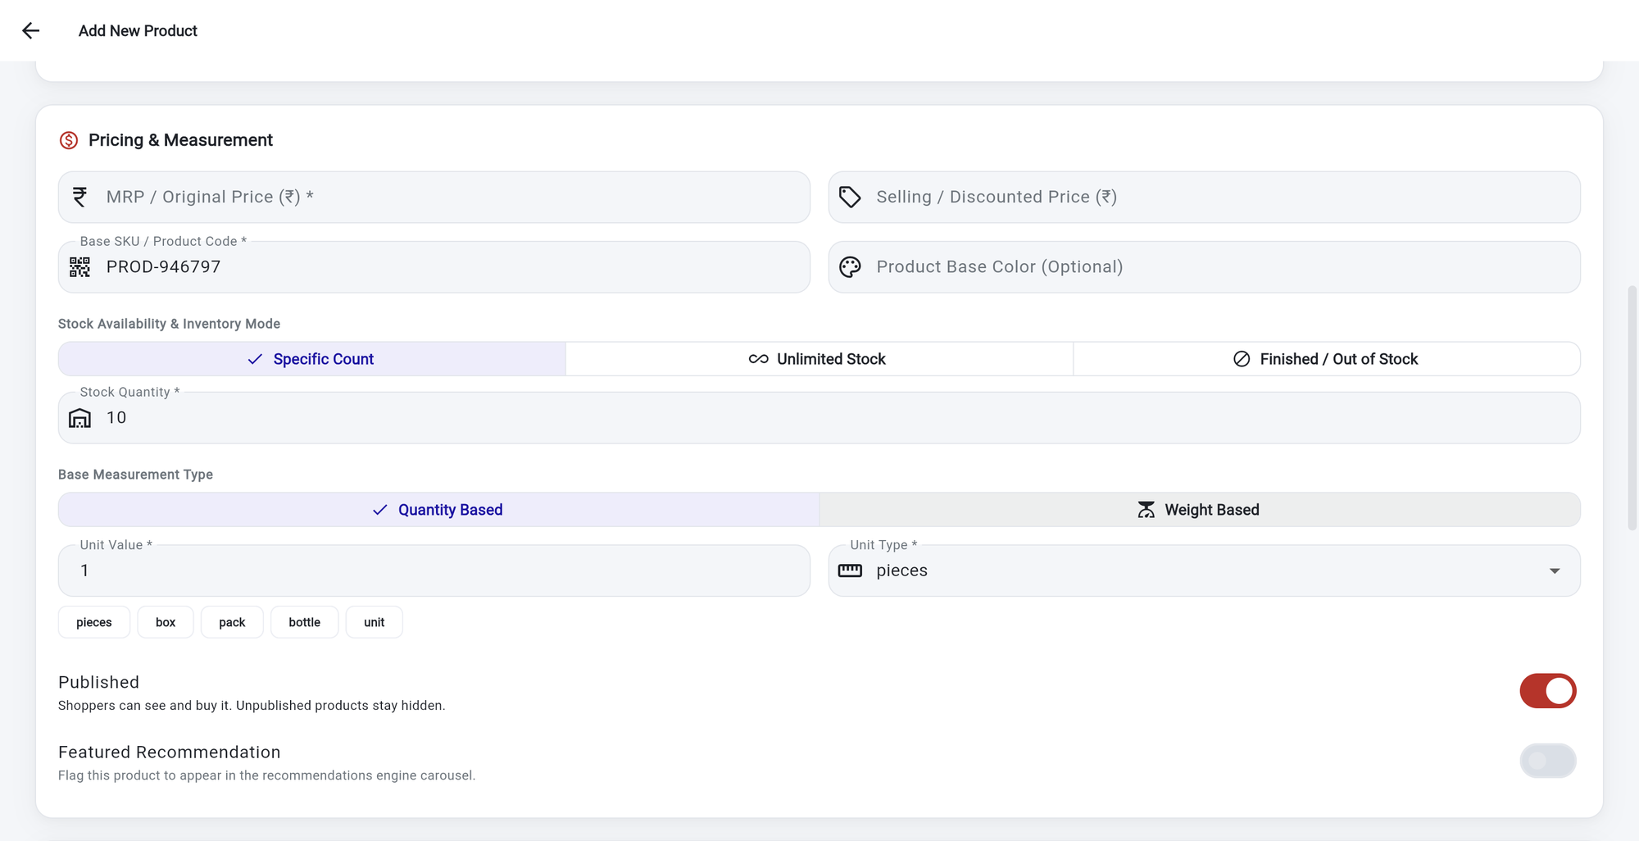
PRODUCTS
Price, stock and measurement
1
MRP / Original Price *
The full price. Required.
2
Selling / Discounted Price.
Leave empty for no discount. It must be lower than the MRP.
1
2
3
3
Base SKU.
A product code is filled in for you. You can change it.
4
5
4
Stock mode.
Specific Count, Unlimited Stock, or Finished / Out of Stock.
6
5
Stock Quantity.
How many you have, when you use Specific Count.
7
6
Unit Type.
Pieces, box, pack, bottle or unit.
7
Published switch.
On: shoppers can buy it. Off: hidden.
Notes:
MRP is required. Selling price is the discounted price.

Slide 13
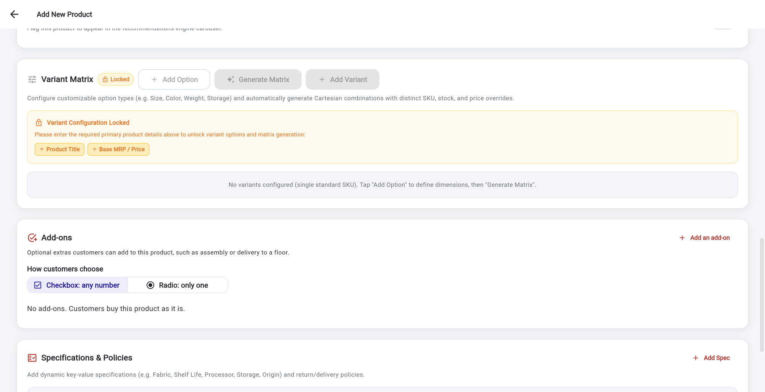
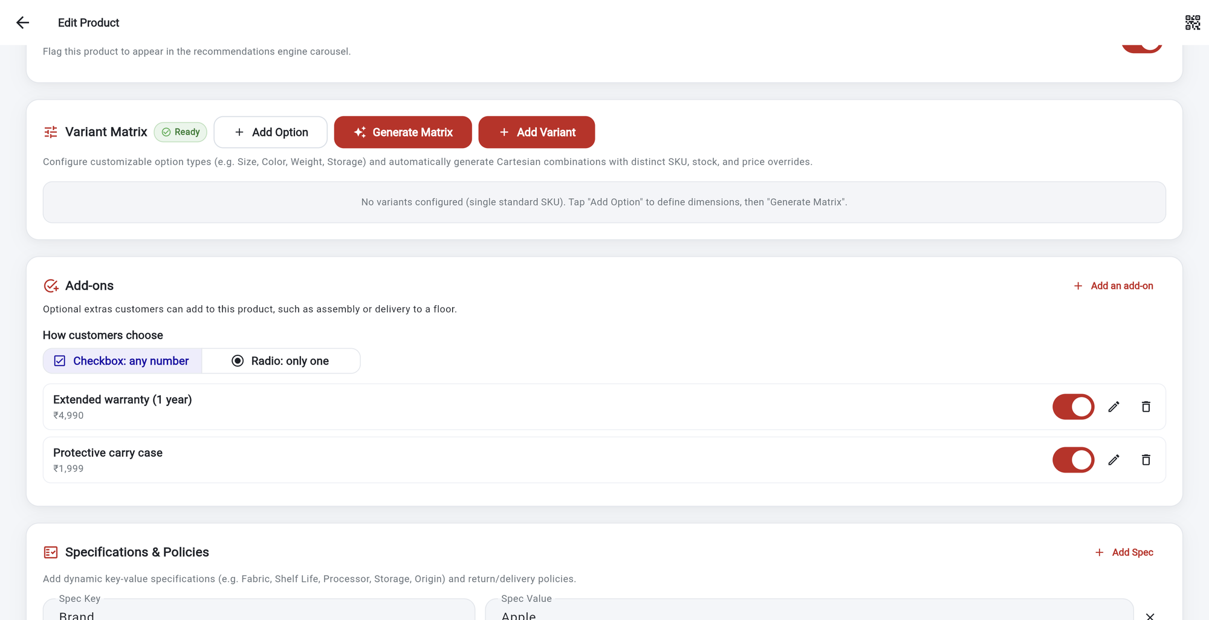
PRODUCTS
Options (variants) and add-ons
2
3
1
1
2
3
1
Variants are locked
until Product Title and MRP are filled in.
1
Ready
shows the matrix is available.
2
Add Option, then Generate Matrix
for sizes, colours or storage.
2
Add an add-on.
A name and a price, e.g. Carry case ₹1,999.
3
Add-ons: how customers pick.
Checkbox: any number. Radio: only one.
3
Switch, pencil, bin.
Turn an add-on off, edit it, or delete it.
Tip Add-ons are optional extras. Their price is added to the product price at checkout.
Notes:
Variants are unlocked after the title and price are filled in. Add-ons are optional extras.

Slide 14
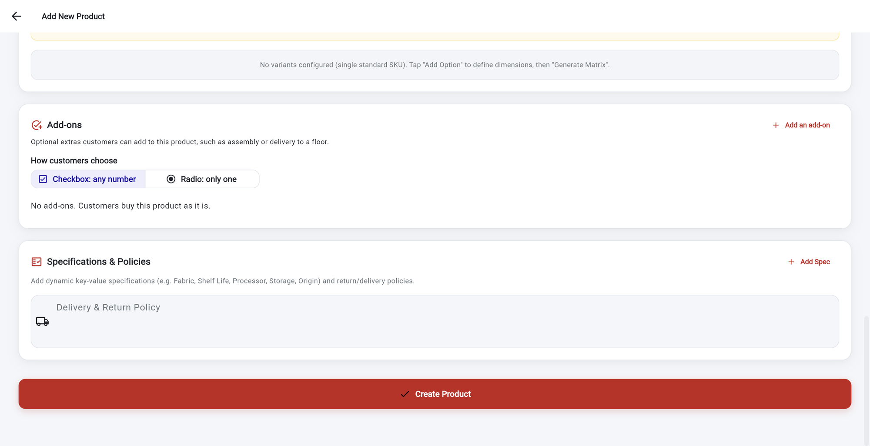
PRODUCTS
Specifications and saving
1
Add Spec.
Key and value rows, such as Brand: Apple.
2
Delivery & Return Policy.
Optional text shown on the product page.
3
Tap Create Product.
The product is saved to your shop.
1
2
3
Tip If your plan limit is reached, a message appears (see the next slide).
Notes:
Finish by tapping Create Product.

Slide 15
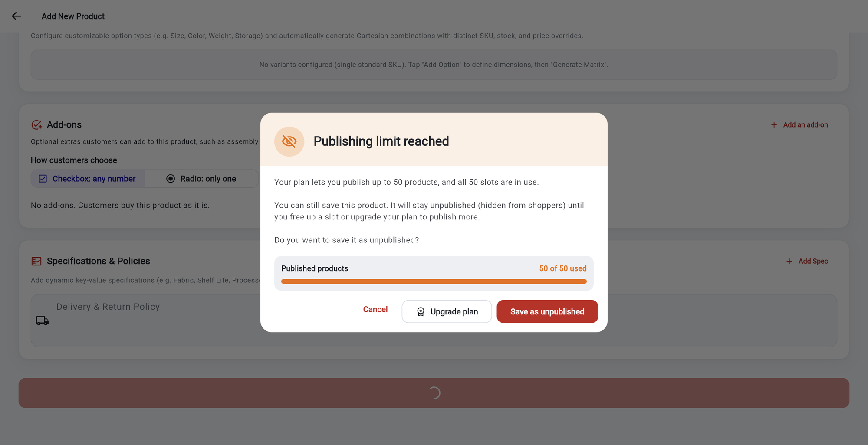
PRODUCTS
Publish limit reached
1
2
1
2
3
1
The bar shows slots used:
50 of 50.
1
Unpublished products
are hidden from shoppers but safe in your list.
2
Cancel saves nothing.
Upgrade plan opens the Subscription Plan page.
2
Free up a slot
by hiding another product, or upgrade the plan, then publish this one.
3
Save as unpublished
keeps the product, hidden from shoppers.
Good to know Hidden products still count towards your total limit (for example 60 on the Basic plan).
Notes:
This dialog appeared on the Electronics shop because it had used all 50 publish slots.

Slide 16
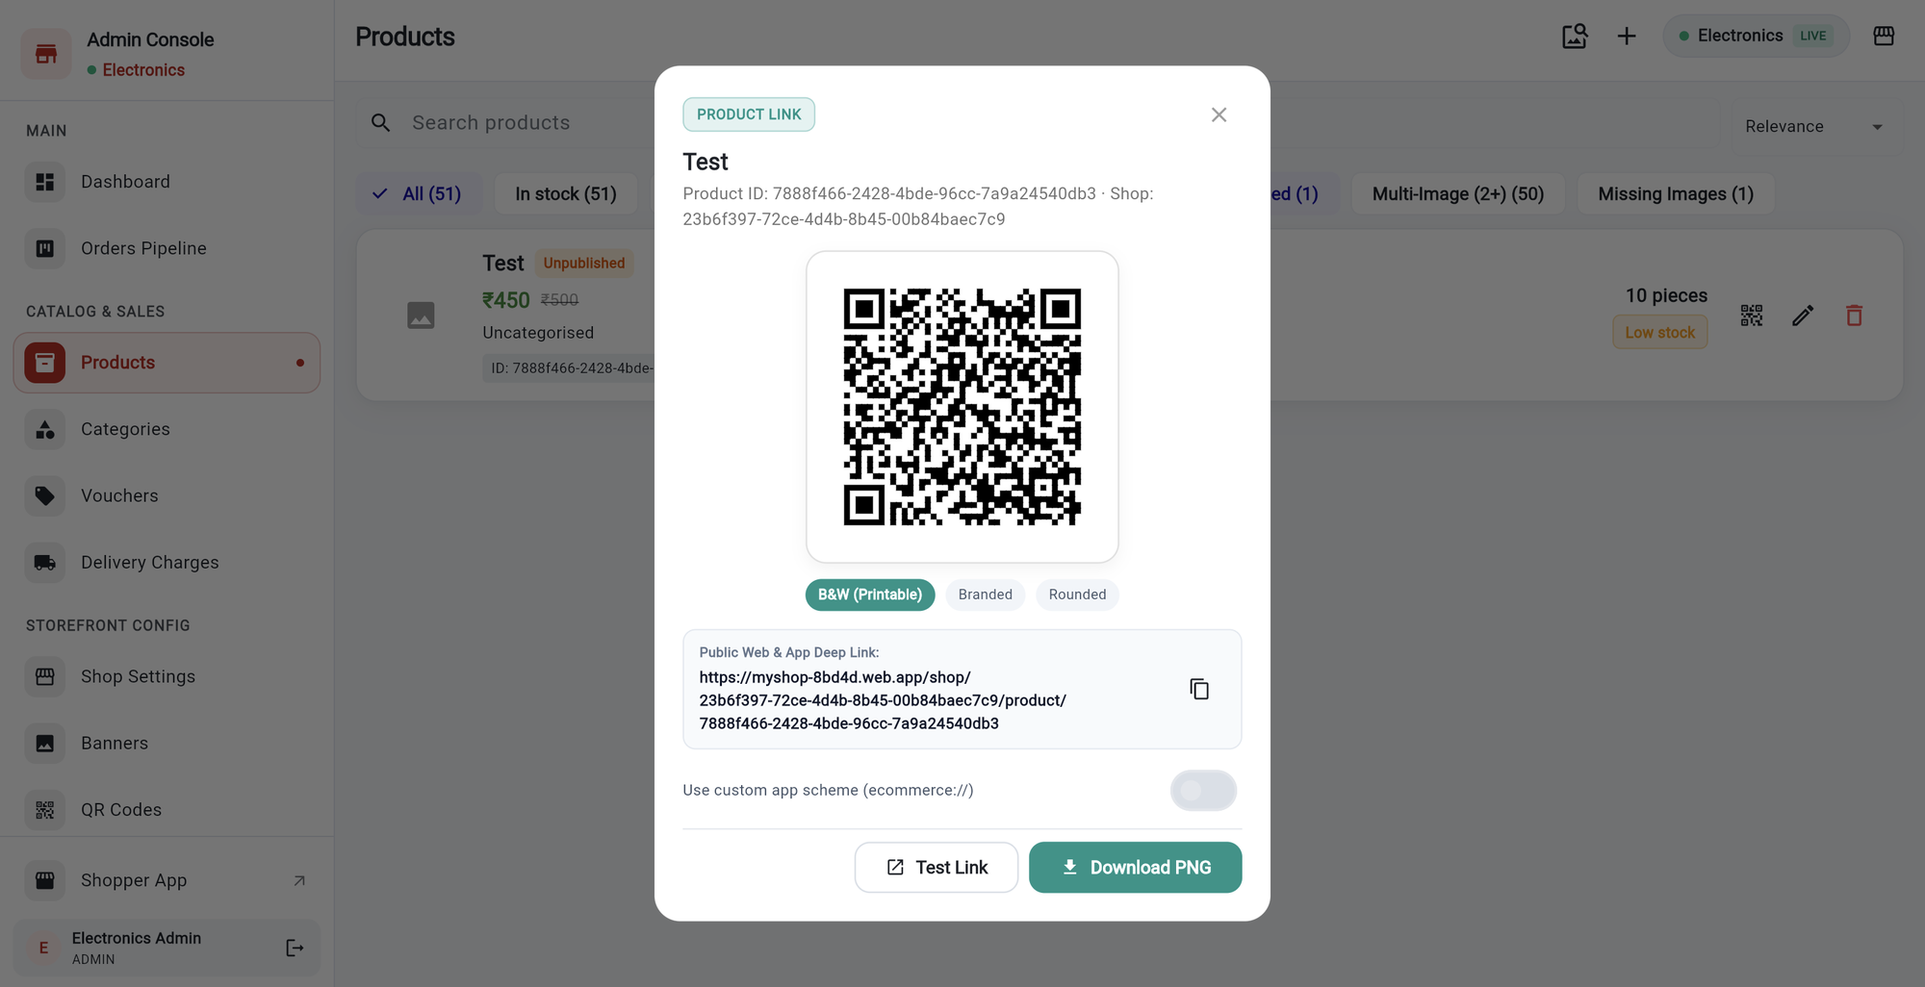
PRODUCTS
Product QR code and link
1
Tap the QR icon
on a product card.
2
Pick a style:
B&W (printable), Branded or Rounded.
1
3
Public link.
Shoppers who open it land on this product.
2
4
Copy icon
copies the link to share.
3
4
5
6
5
Test Link
opens the link to check it.
6
Download PNG
saves the QR picture to print.
Notes:
Use the QR icon on a product card.

Slide 17
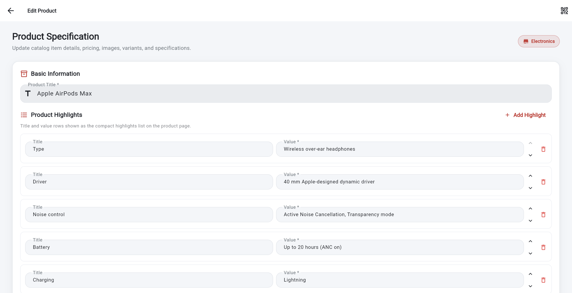
PRODUCTS
Edit or delete a product
1
2
1
2
3
1
Tap the pencil.
Edit Product opens with the fields filled in.
1
Red bin.
Asks you to confirm. It also removes the product from its categories.
2
Change what you need.
Arrows reorder rows. The bin removes a row.
2
Not ready to delete?
Switch Published off, or set stock to Finished / Out of Stock.
3
QR icon (top right)
shows this product’s QR and link.
Tip Check the list afterwards. Your change shows straight away.
Notes:
Use the pencil to edit. The bin asks for confirmation.

Slide 18
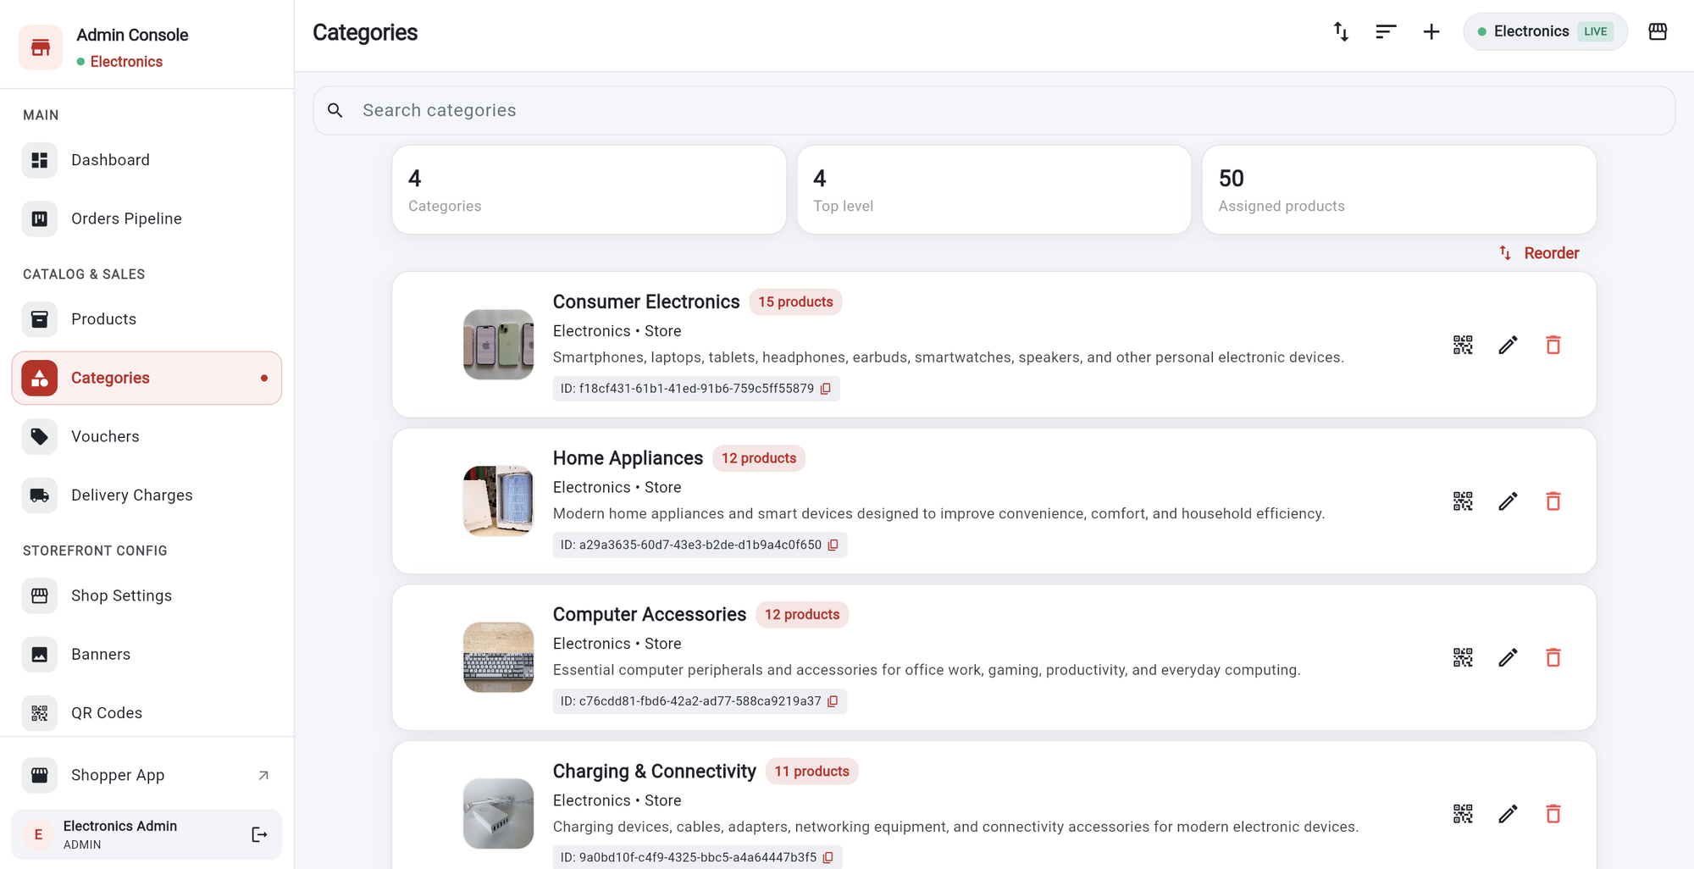
CATEGORIES
Your categories
1
Summary cards.
Categories, top-level categories, and assigned products.
1
2
Reorder.
Drag categories to change the order shoppers see.
2
3
4
5
3
Product count
next to each name.
4
QR, pencil and bin
show the link, edit, or delete.
5
Plus (+)
adds a category.
Good to know Your plan limits how many categories you can have (Basic: 4). Check the Subscription Plan page.
Notes:
Categories group products. The list shows how many products each has.

Slide 19
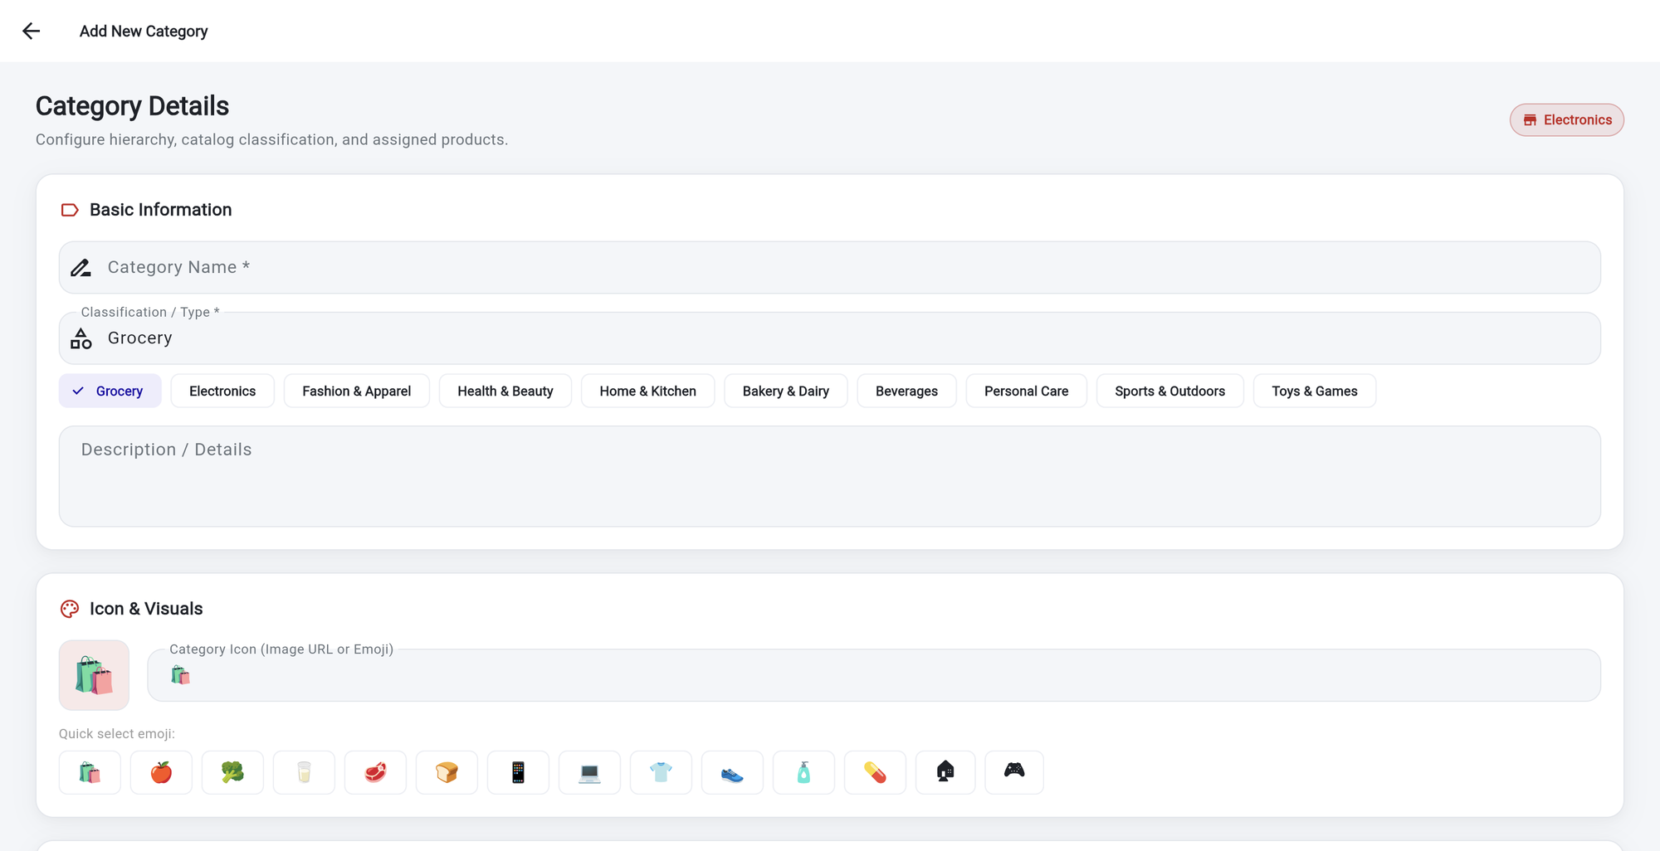
CATEGORIES
Add a category
1
Category Name *
Required. The name must be unique in your shop.
2
Classification / Type *
Pick one of the chips, for example Electronics.
1
2
3
Description.
Optional text about the category.
3
4
Category Icon.
Paste an image link, or pick an emoji.
4
Notes:
Fields with a star are required.

Slide 20
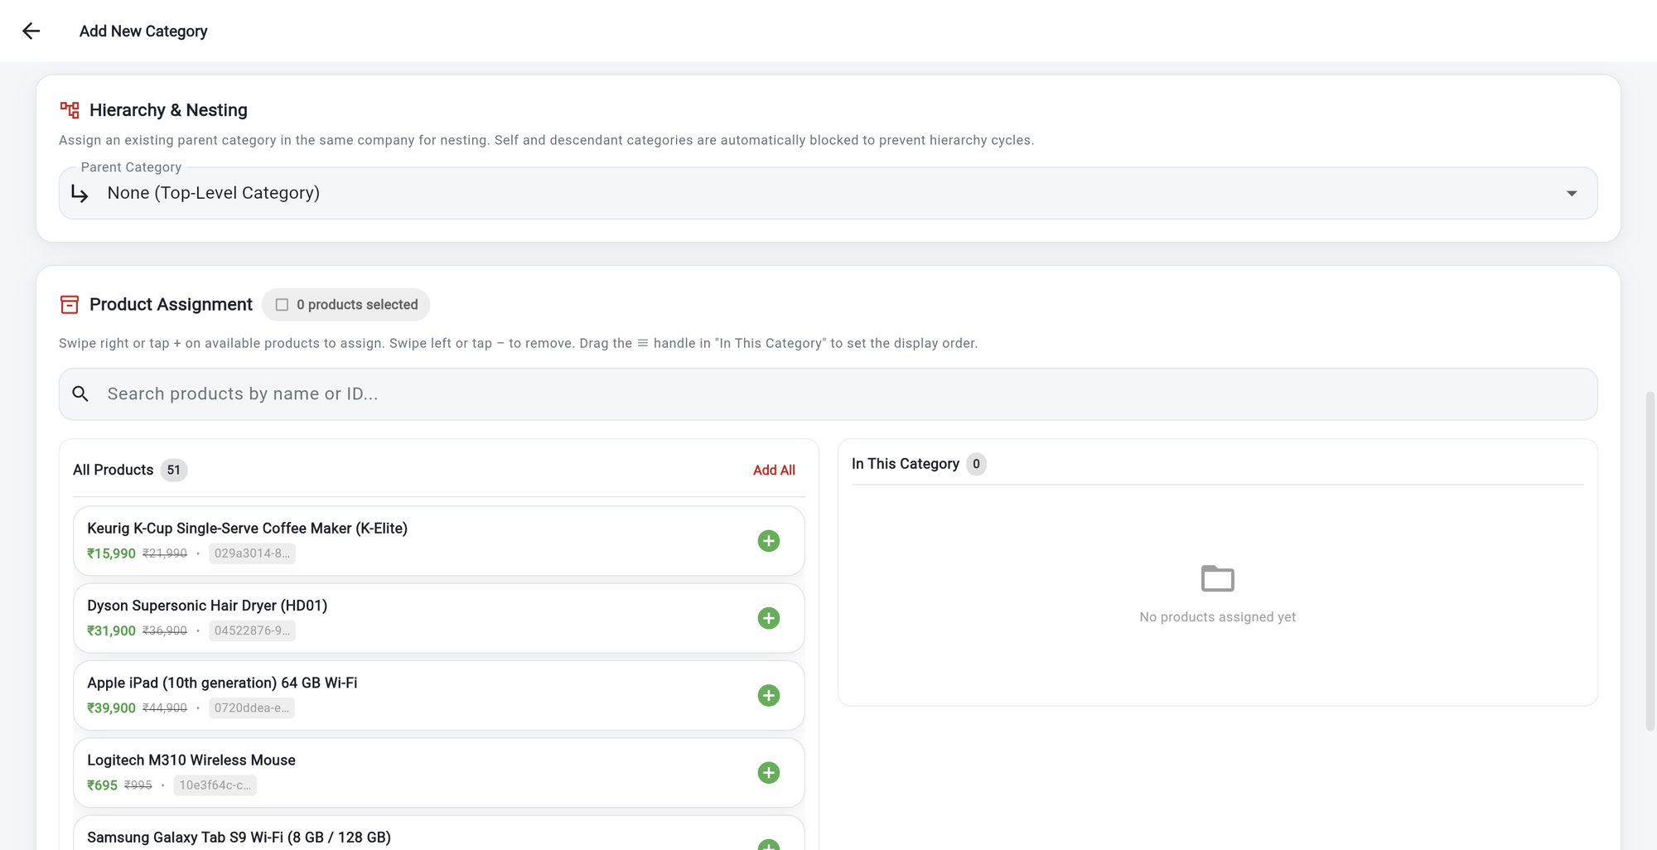
CATEGORIES
Choose parent and products
1
Parent Category.
Leave None for a top-level category, or nest it under another.
2
Search
products by name or ID.
1
3
Add All
moves every product across.
2
3
4
4
Plus (+)
adds one product. Swipe or tap minus to remove it.
5
5
In This Category.
Drag a row to set the order shoppers see.
Tip Scroll to the bottom and save to keep your changes.
Notes:
Products are assigned on the same page. Nothing is saved until you save.

Slide 21
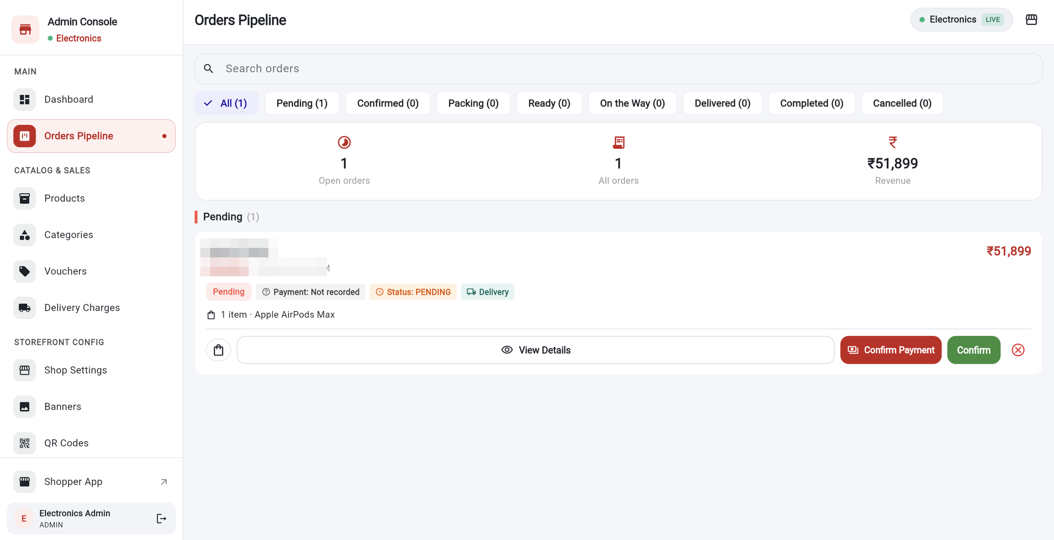
ORDERS
The orders pipeline
1
Search
by name, phone, product or reference.
1
Status chips.
From Pending to Cancelled, each with a count.
2
2
3
3
Summary:
open orders, all orders and revenue.
4
View Details
opens the order.
4
5
6
7
5
Confirm Payment
records that you were paid.
6
Confirm
accepts the order.
7
Red X
cancels it.
Notes:
New orders appear here as soon as shoppers place them.

Slide 22
ORDERS
The life of an order
Pending
Confirmed
Packing
Ready
On the Way
Delivered
Completed
Order placed by the shopper
You accepted it
Being packed
Packed and ready
Out for delivery
Handed over
After the shopper’s review
Cancelled An order can be cancelled before it is On the Way. After that it can only move forward.
Who can move an order
Step | Admin | Manager | Order Packer | Order Delivery
Pending → Confirmed | Yes | Yes | No | No
Confirmed → Packing → Ready | Yes | Yes | Yes | No
Ready → On the Way → Delivered | Yes | Yes | No | Yes
Cancel an order | Yes | Yes | No | No
Completed happens automatically when the shopper reviews a delivered order. There is no button for it.
Notes:
The order moves forward step by step. Only the steps shown are allowed.

Slide 23
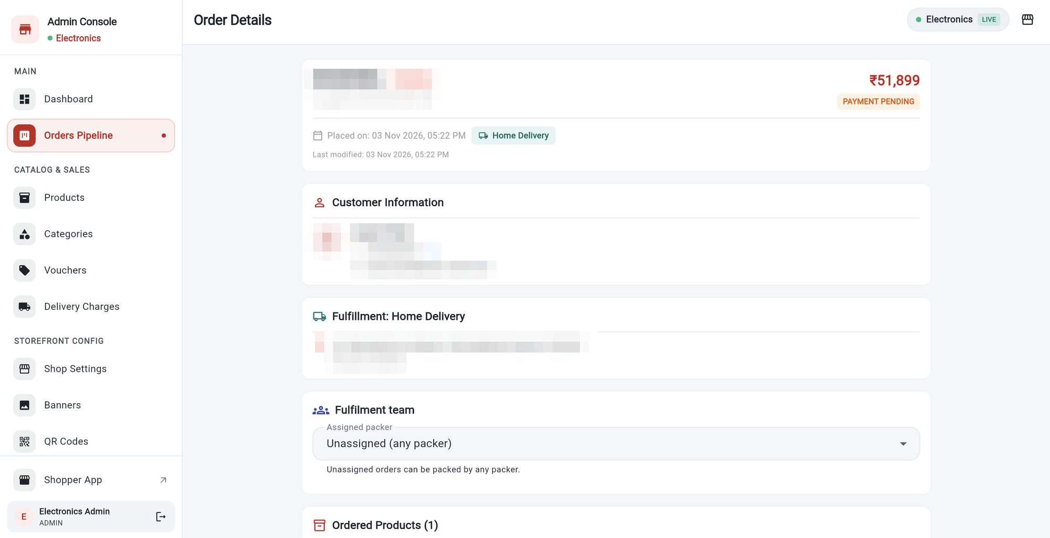
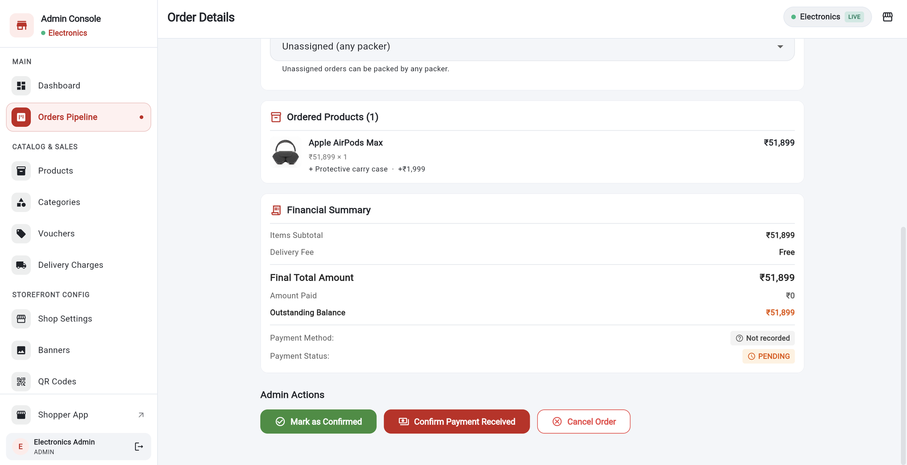
ORDERS
Open an order
1
2
1
3
2
3
1
Header and payment state.
Reference, status and total.
1
Ordered Products
with the add-ons the customer chose.
2
Customer and Fulfillment.
Contact details, and the delivery address or pickup.
2
Financial Summary.
Subtotal, delivery, total, paid and balance.
3
Assigned packer.
Pick a packer, or leave it open to any packer.
3
Admin Actions:
Mark as Confirmed, Confirm Payment, Cancel.
Tip Customer details are blurred in this guide. You will see them in your own app.
Notes:
The details page has everything about one order.

Slide 24
ORDERS
Confirm, take payment, or cancel
1
Mark as Confirmed.
A box asks you to confirm. The shopper then sees the order as Confirmed.
4
2
Confirm Payment Received.
Record the method (cash or UPI), the amount and a reference. Payment status becomes paid.
3
Cancel Order.
Add a reason, for example out of stock. The shopper sees it under Cancelled.
4
After Confirmed,
your packers and delivery staff move it on to Packing, Ready, On the Way and Delivered.
1
2
3
Tip Shoppers pay on delivery or at pickup, so you record the payment yourself.
Notes:
Confirming asks for confirmation first. Cancelling asks for a reason.

Slide 25
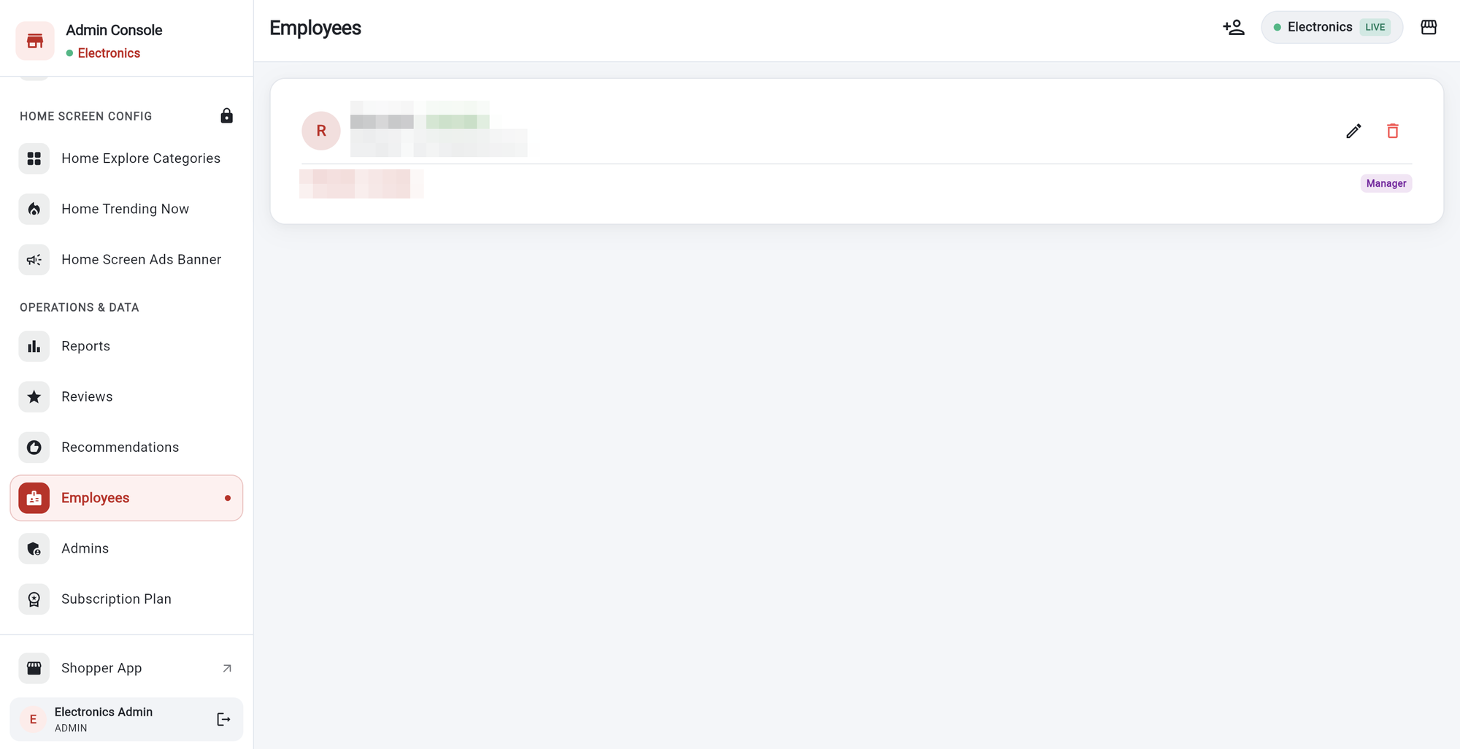
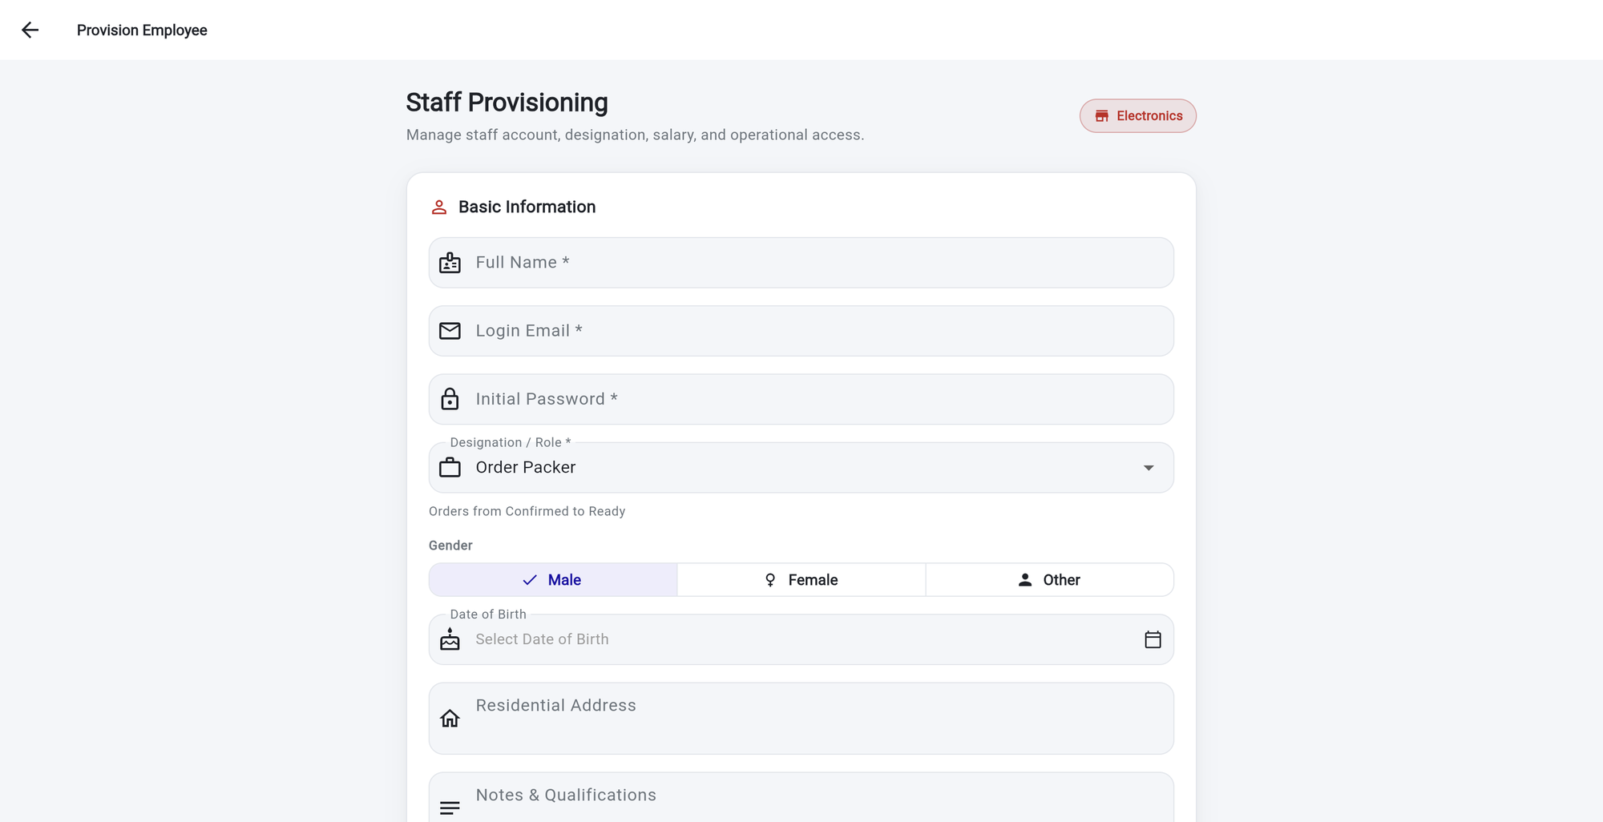
EMPLOYEES
Employees
1
3
2
1
2
3
1
Each employee is a card:
name, role label and shift status.
1
Name, Login Email, Initial Password.
All required. The employee signs in with these.
2
Pencil and bin
edit or remove the employee.
2
Designation / Role.
Manager, Order Packer or Order Delivery.
3
Add person icon (top)
adds an employee.
3
More fields below:
date of birth, address, notes, salary.
Tip Your own name, staff names and salary details are blurred in this guide.
Notes:
Only the admin adds and edits employees.

Slide 26
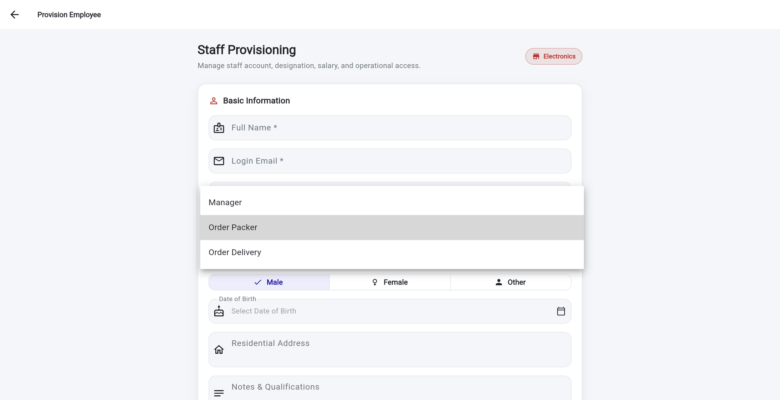
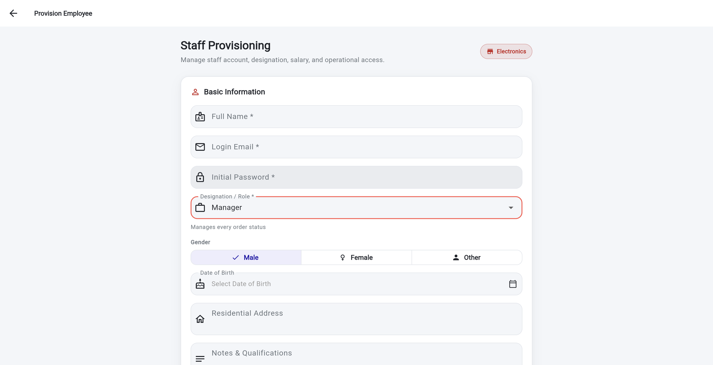
EMPLOYEES
Choose the right role
1
2
2
3
1
1
Manager
Manages every order status.
1
A line under the role
explains what it allows.
2
Order Packer
Orders from Confirmed to Ready.
2
Employees see only Orders and Employees.
No products, settings or reports.
3
Order Delivery
Orders from Ready for Delivery to Delivered.
3
Only a Manager can cancel orders
(besides you, the admin).
Tip Give each person the smallest role that does their job. A packer cannot dispatch, and a delivery person cannot pack.
Notes:
A role decides what an employee can do with orders. Choose carefully.

Slide 27
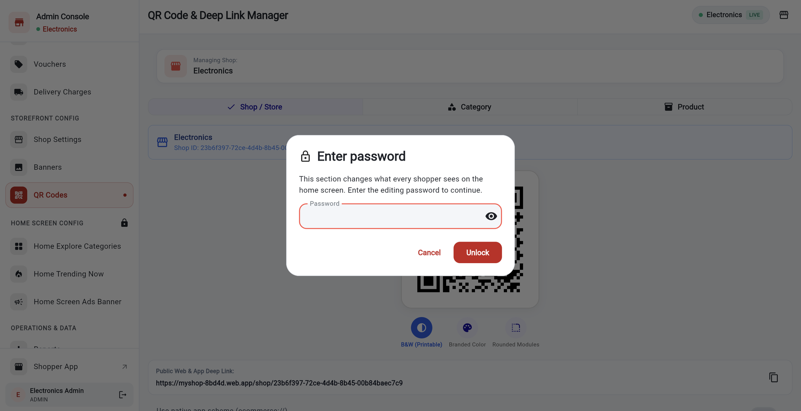
STOREFRONT SETTINGS
Protected home screen settings
1
Padlock group.
Home Screen Config holds Explore Categories, Trending Now and Ads Banner.
2
Open any of the three.
A password box appears.
3
Enter the editing password.
Ask the person who set up your shop if you do not have it.
1
3
4
4
Eye icon
shows what you typed.
2
6
5
5
Unlock
opens all three pages at once.
6
Cancel
keeps them locked.
Tip You only unlock once. The three pages stay open while you are signed in.
Notes:
Three pages change what every shopper sees on the home screen, so they are locked with a password.

Slide 28
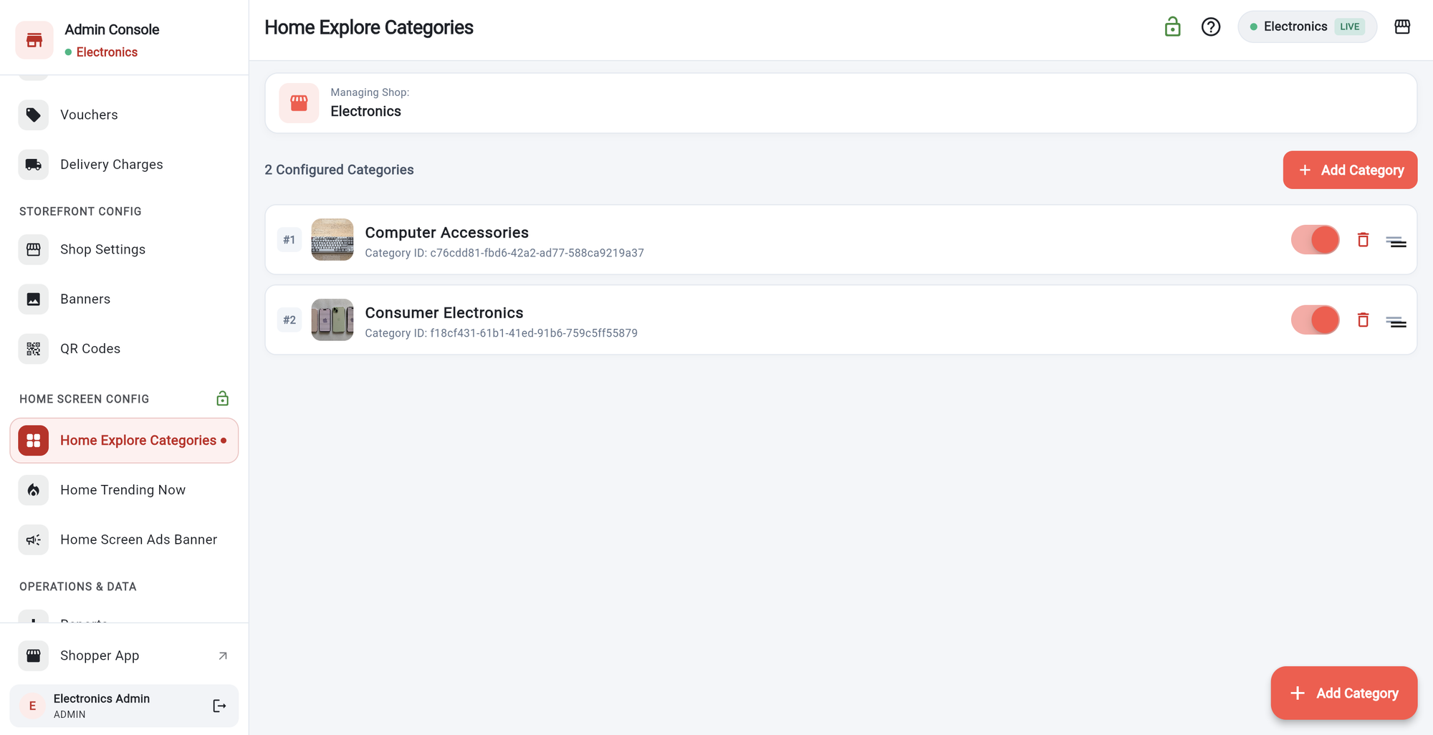
STOREFRONT SETTINGS
Home Explore Categories
1
Green open padlock
means the section is unlocked.
1
2
Add Category
picks a category to show on the home screen.
2
3
4
5
6
3
Number
is the position shoppers see.
4
Switch
shows or hides a tile without deleting it.
5
Bin
removes it from the home screen.
6
Drag handle
changes the order.
Notes:
These are the category tiles shoppers see on the home screen.

Slide 29
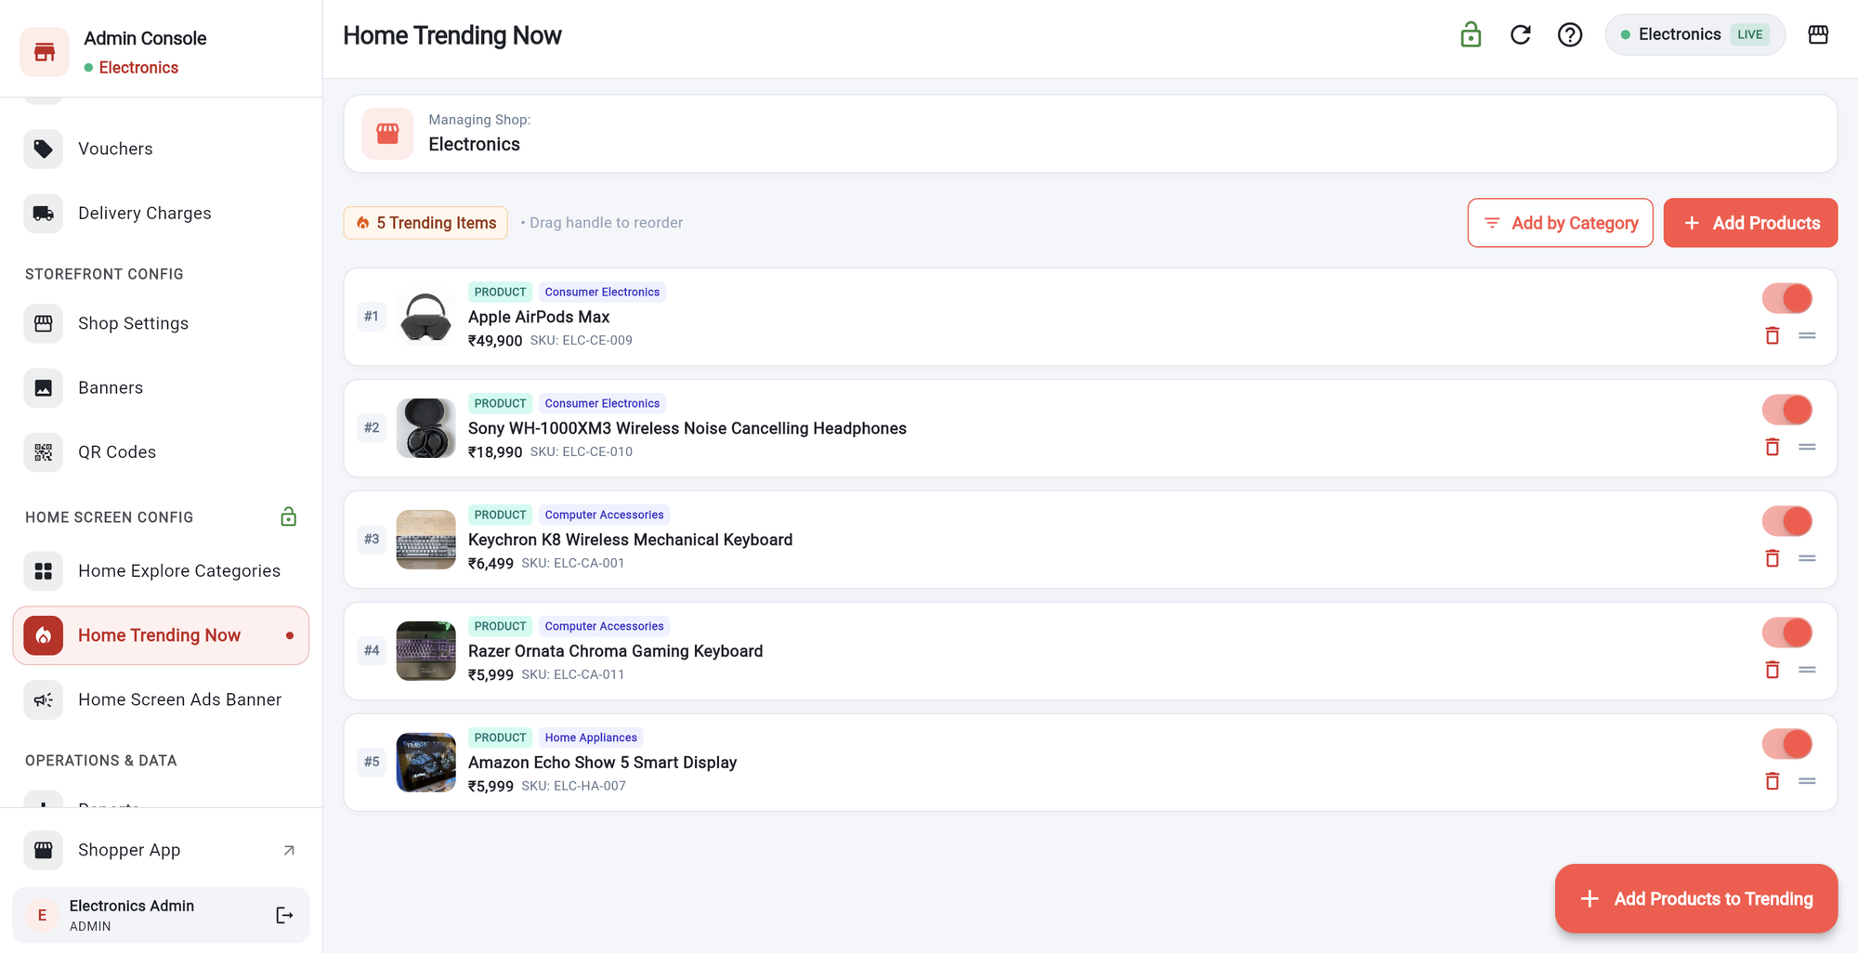
STOREFRONT SETTINGS
Home Trending Now
1
Add by Category
adds many products from one category.
3
2
Add Products
picks products one by one.
1
2
4
5
6
3
Refresh icon
reloads the list.
4
Switch
shows or hides an item.
5
Bin
removes it.
6
Drag handle
changes the order shoppers see.
Tip You can see the list change in the Shopper app’s Trending Now section.
Notes:
These products appear in Trending Now on the shopper home screen.

Slide 30
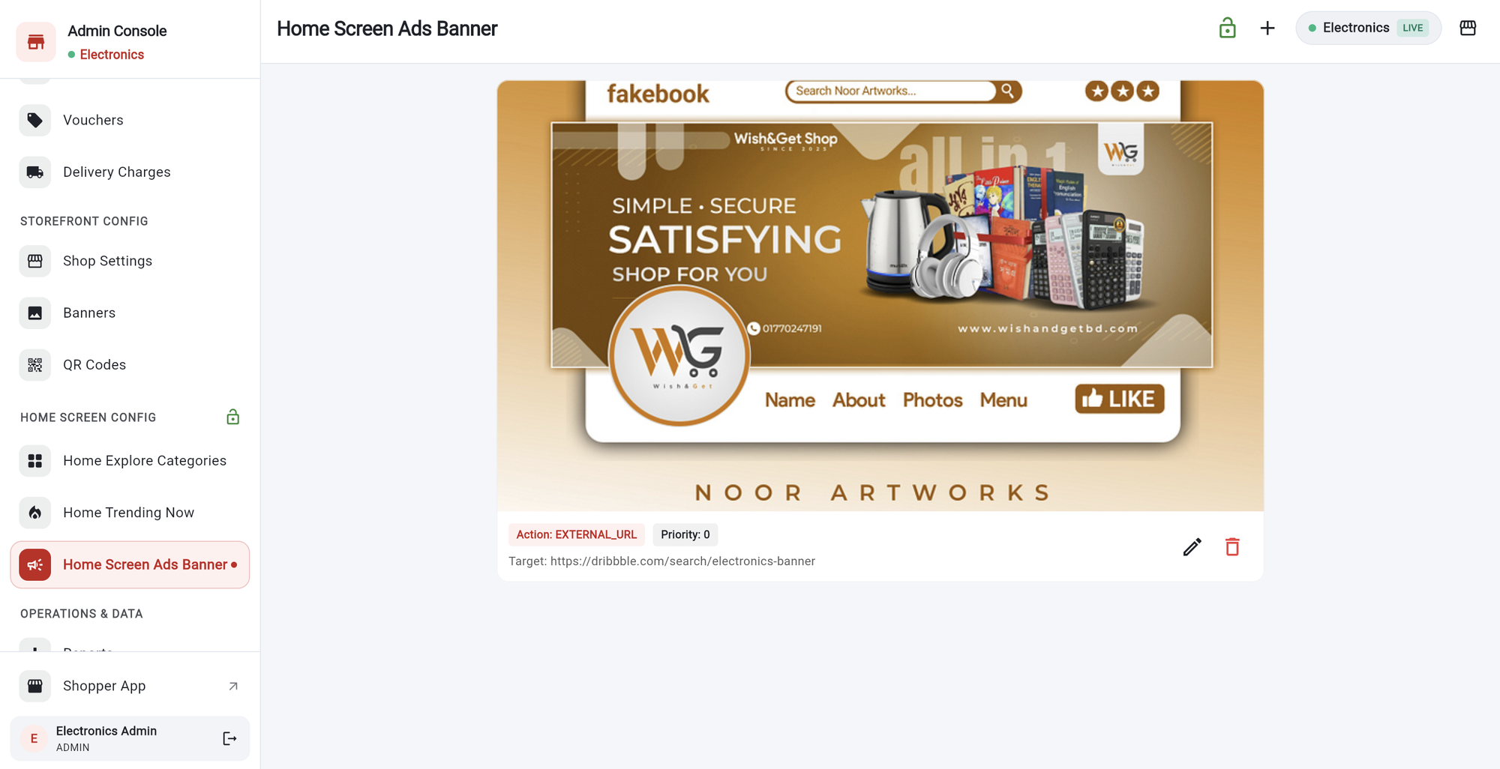
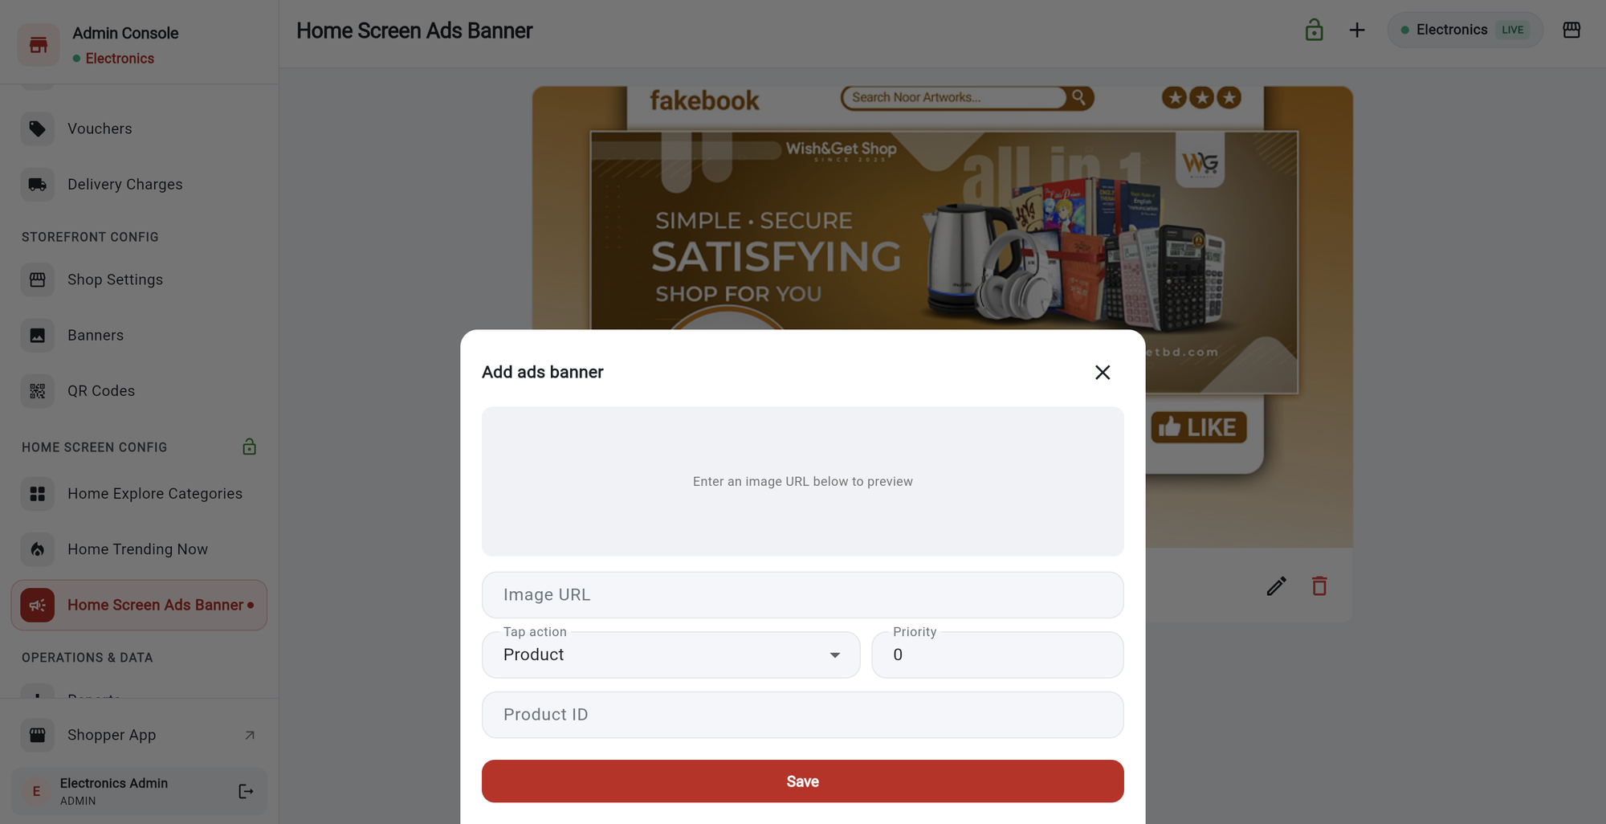
STOREFRONT SETTINGS
Home Screen Ads Banner
1
2
3
1
2
3
1
Each banner shows
its tap action and priority.
1
Image URL.
Paste a picture link. A preview appears.
2
Pencil
edits it. Bin deletes it.
2
Tap action and priority.
Product, Category or External URL.
3
Plus (+)
adds a banner.
3
Target, then Save.
Enter the product ID, category ID or link.
Tip Banners belong to your shop and are shown on your shop’s home screen.
Notes:
Banners rotate at the top of the shopper home screen.

Slide 31
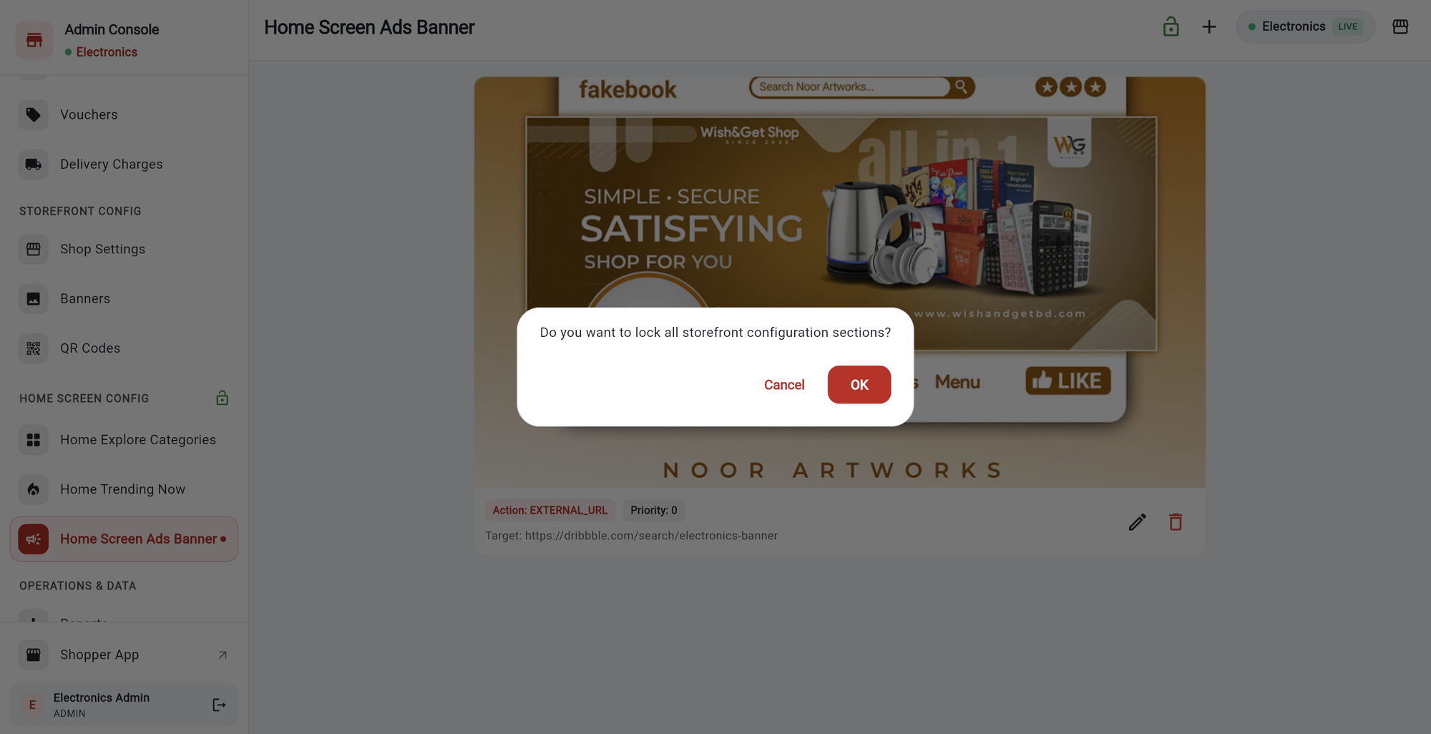
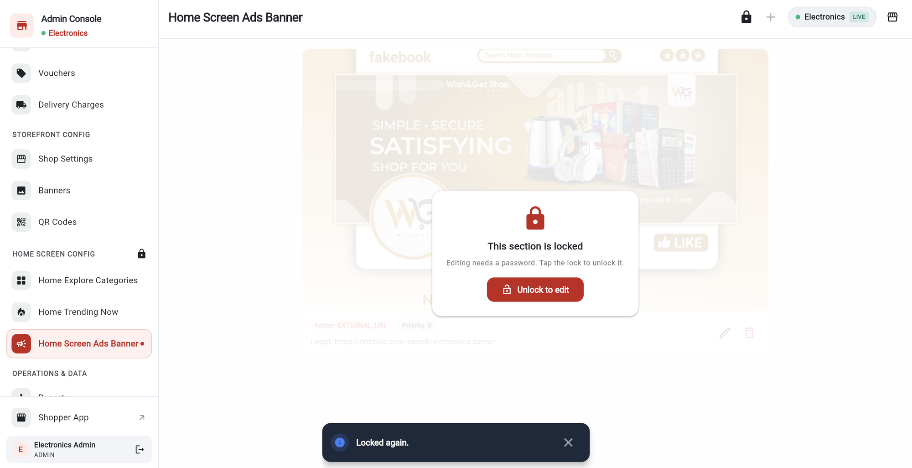
STOREFRONT SETTINGS
Lock the settings again
2
1
2
1
1
Tap the padlock icon (top right).
A question asks: lock all storefront configuration sections?
1
Locked pages
show “This section is locked” and cannot be changed.
2
OK locks everything.
Cancel keeps it open.
2
Unlock to edit
asks for the password again.
Tip Moving to other pages does not lock it. It locks only when you tap the padlock or sign out.
Notes:
You can lock manually. Signing out also locks.

Slide 32
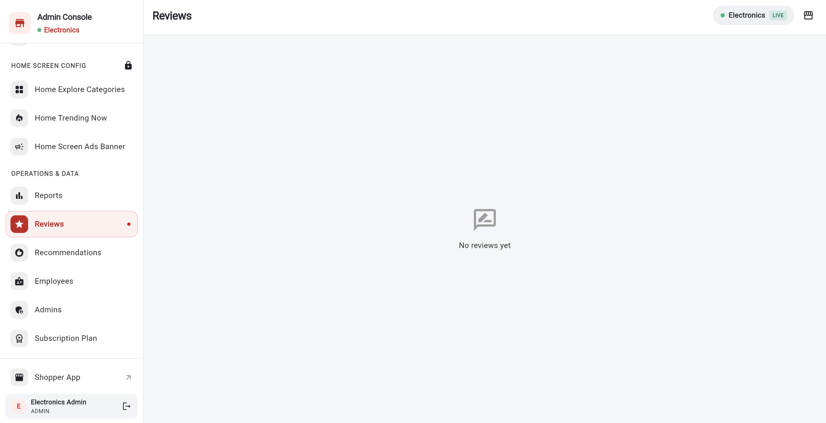
GROWTH AND CONTROL
Reviews
1
This shop has no reviews yet,
so the page says “No reviews yet”.
2
When reviews arrive
each shows the stars, the comment, the customer, the product and the order.
3
You can hide or show a review
from the list. Hiding removes it from the shopper pages.
1
Tip Shoppers can only review an order after it is delivered.
Notes:
Reviews appear here once shoppers rate delivered orders.

Slide 33
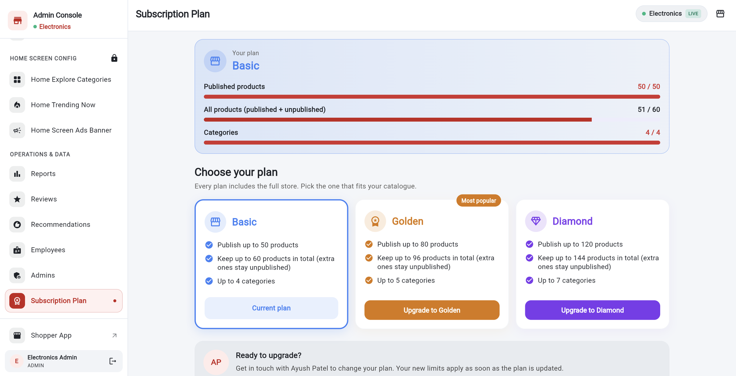
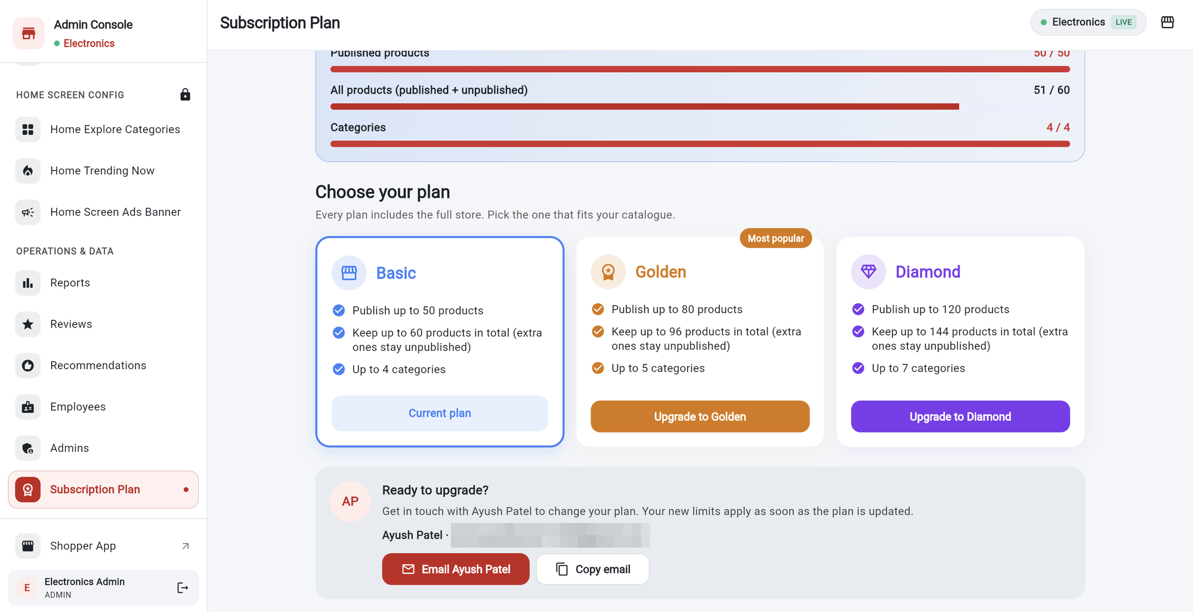
GROWTH AND CONTROL
Your plan and product limits
1
2
3
1
2
3
1
Your plan card
(here: Basic) shows three meters.
1
Basic, Golden and Diamond:
50, 80 and 120 published products.
2
Published products: 50 of 50.
Products shoppers can see.
2
Email the contact
to upgrade. A message opens with the plan filled in.
3
All products: 51 of 60.
Published plus hidden. Categories: 4 of 4.
3
Copy email
if your email app does not open.
Tip Your new limits apply as soon as the plan is updated by the team.
Notes:
The Subscription Plan page shows what is included and how much you have used.

Slide 34
GROWTH AND CONTROL
Understanding the limits, with an example
Published
Hidden extras
Categories
50 of 50
10 more
4 of 4
Visible to shoppers. This is your publish limit.
You can keep up to 60 products in total. The extra ones stay hidden.
Basic allows 4 categories. Golden 5, Diamond 7.
1
You have 50 published products and add a new one.
The app says Publishing limit reached.
2
Choose Save as unpublished.
The product is saved but hidden. It uses one of your 10 hidden slots.
3
Want it visible?
Hide another product to free a slot, or upgrade your plan.
4
At 60 total products,
no more products can be added until you delete some or upgrade.
Notes:
Simple example using the Basic plan numbers.

Slide 35
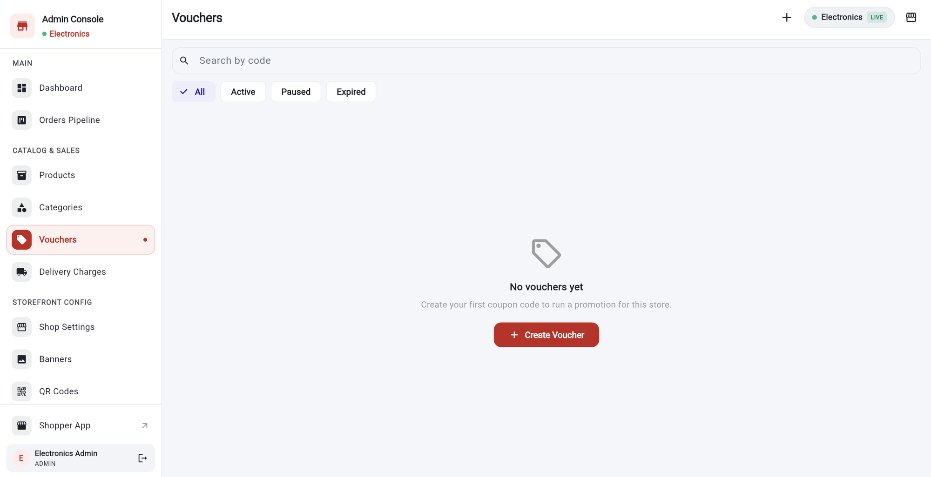
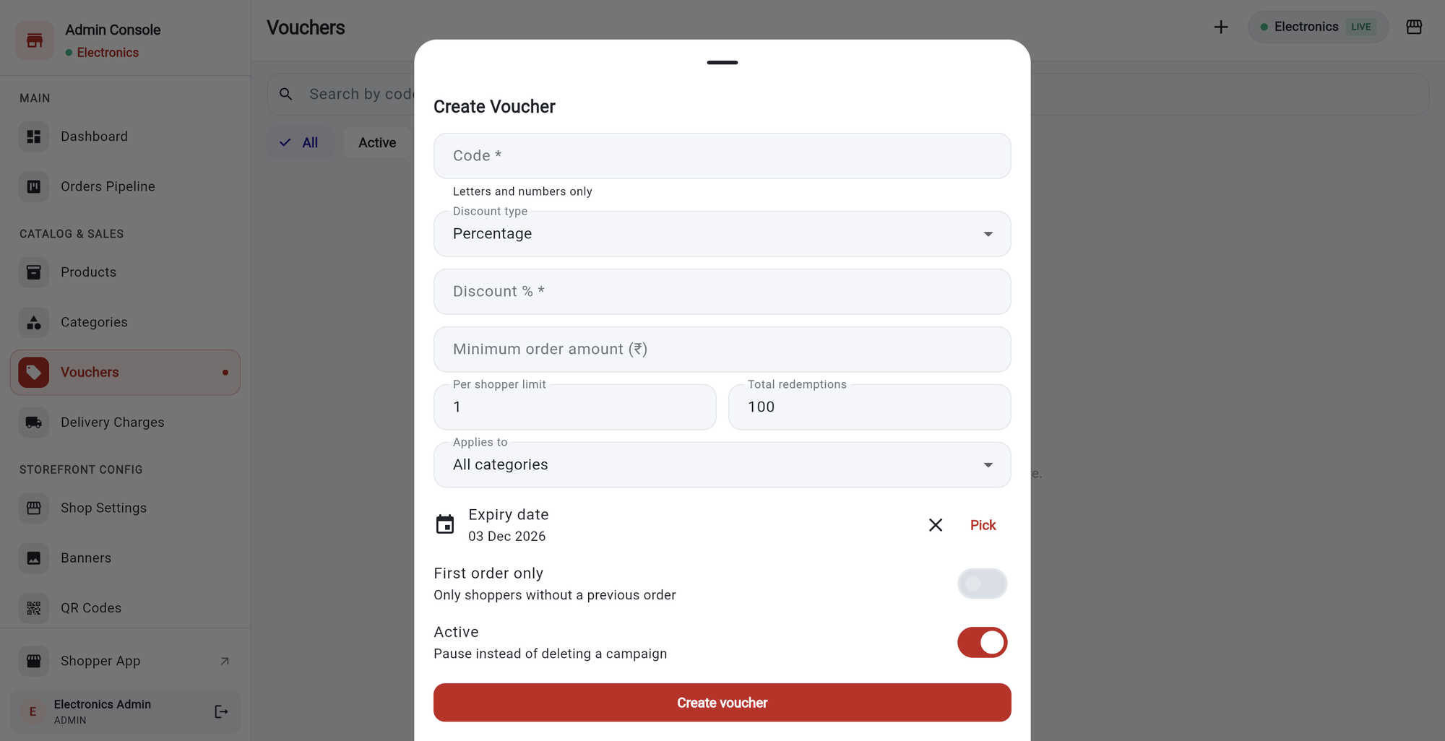
GROWTH AND CONTROL
Vouchers
1
2
1
2
3
3
1
Search by code,
and filter: All, Active, Paused, Expired.
1
Code *.
Letters and numbers only, unique in your shop.
2
Create Voucher
(or the plus) starts a new coupon.
2
Discount type
Percentage or fixed amount, then the value.
3
This shop has none yet,
so the page invites you to create the first.
3
Minimum order, per-shopper limit, total redemptions, applies to, expiry date.
First order only and Active switches finish it.
Tip Pause a voucher with the Active switch instead of deleting it.
Notes:
Vouchers are coupon codes shoppers type at checkout.

Slide 36
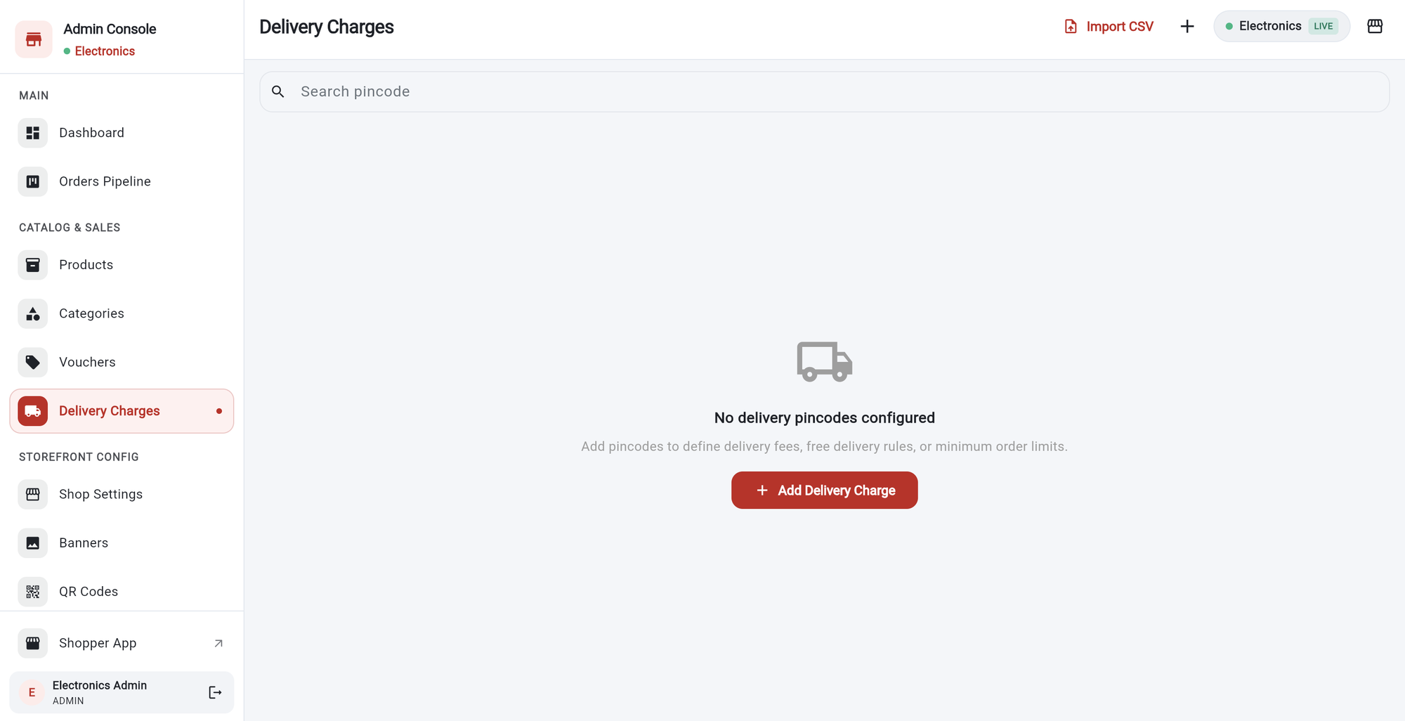
GROWTH AND CONTROL
Delivery charges
1
Search a pincode.
Each pincode has its own delivery fee.
2
3
1
2
Import CSV
adds many pincodes at once from a file.
3
Plus (+) or Add Delivery Charge
adds one pincode.
4
4
Free delivery and minimum order rules
can be set per pincode.
Tip This shop has no pincodes yet. Shoppers choosing home delivery need a charge set for their pincode.
Notes:
Delivery charges are set by pincode.

Slide 37
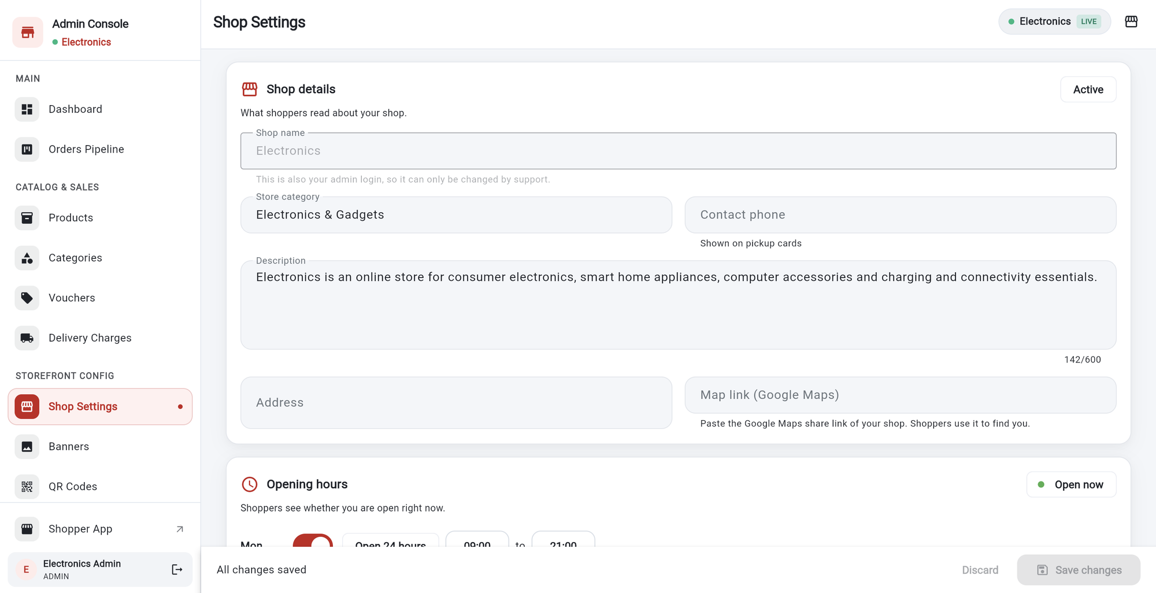
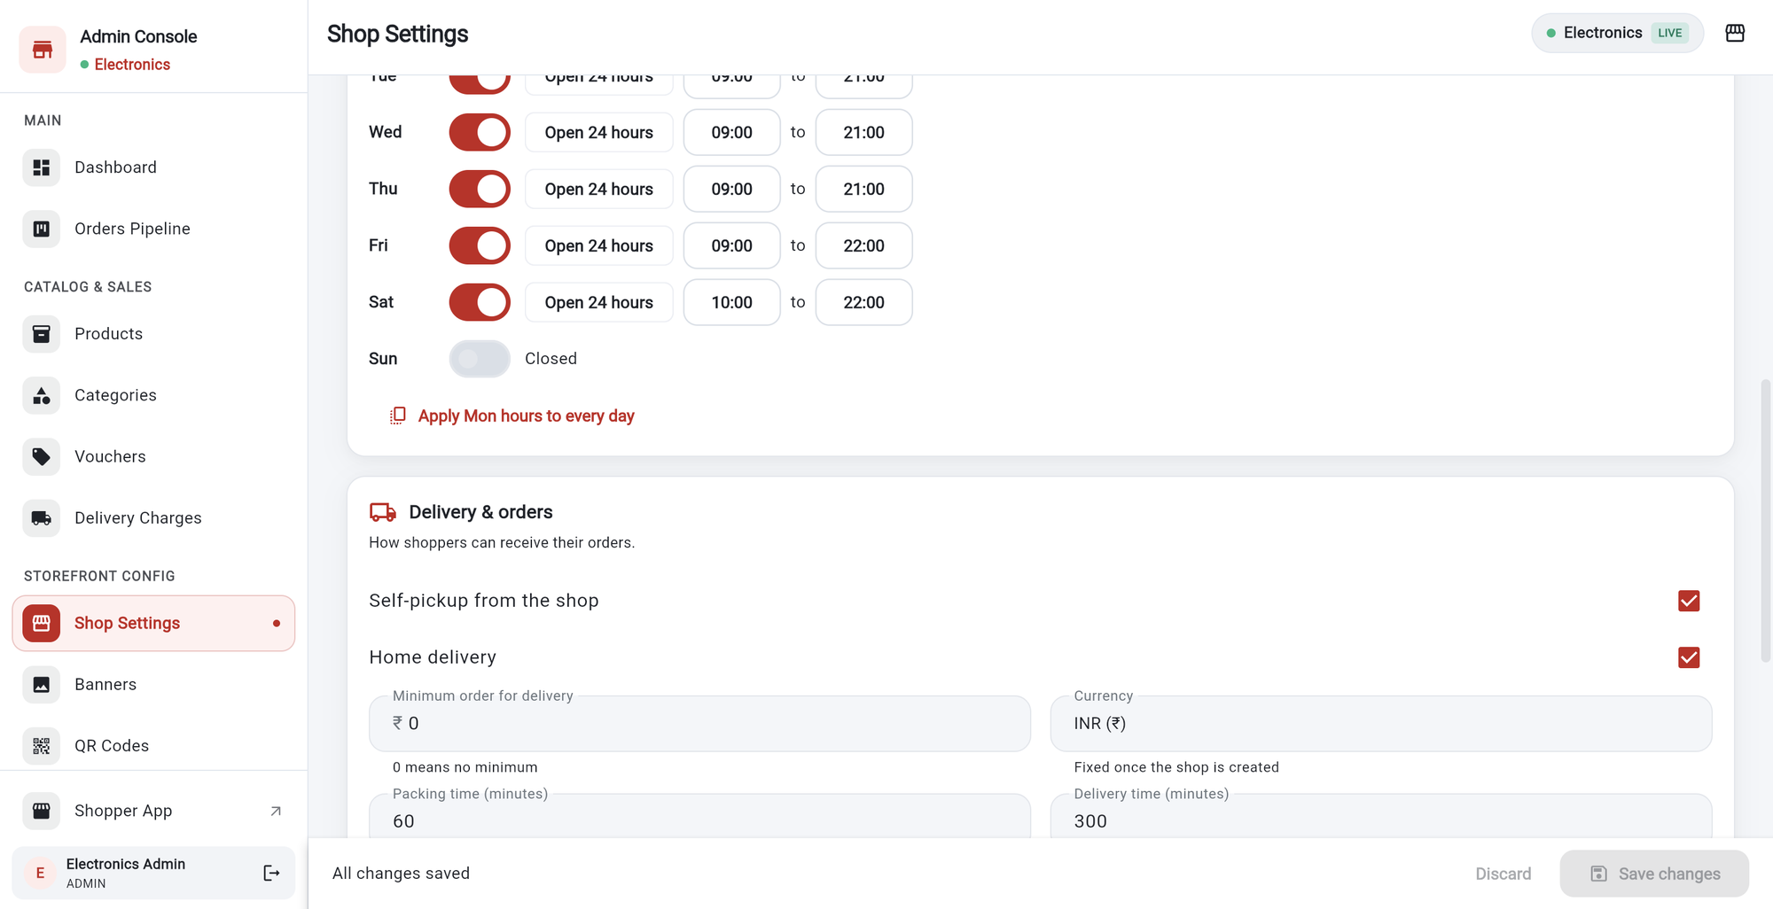
GROWTH AND CONTROL
Shop settings
1
2
1
2
3
3
1
Shop name
is also your login, so only support can change it.
1
Opening hours.
Switch each day on or off, set times, or Open 24 hours.
2
Category, phone, description, address and map link.
This is what shoppers read.
2
Apply Mon hours to every day
copies one day to all.
3
Save changes
appears at the bottom. Discard undoes your edits.
3
Delivery.
Tick Self-pickup and/or Home delivery, minimum order, packing and delivery time.
Tip Shoppers see Open now or the closing time based on these hours.
Notes:
Shop settings holds what shoppers read about your shop, opening hours and delivery options.

Slide 38
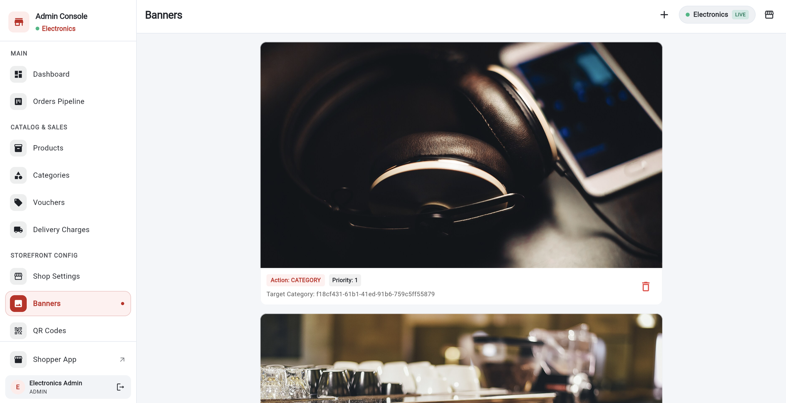
GROWTH AND CONTROL
Offer banners
1
Each banner
is a wide picture with its tap action.
4
2
Action label
shows what happens when a shopper taps it, such as opening a category.
1
3
Bin
deletes the banner.
2
3
4
Plus (+)
adds a banner.
Tip These are different from the Home Screen Ads Banner, which is on the main shopper home screen.
Notes:
Offer banners are graphics for your own shop page.

Slide 39
GROWTH AND CONTROL
Reports
1
Pick a period:
Last 7 or 30 days, previous month, 90 days, this or last year, or a custom range.
1
2
Active filter
shows the dates and number of orders.
2
3
3
Four cards:
orders, order value, actual revenue, completed / cancelled.
4
Download:
Excel, CSV, a PDF summary, or a Word product catalogue.
4
Notes:
Reports show sales for a date range and can be downloaded.

Slide 40
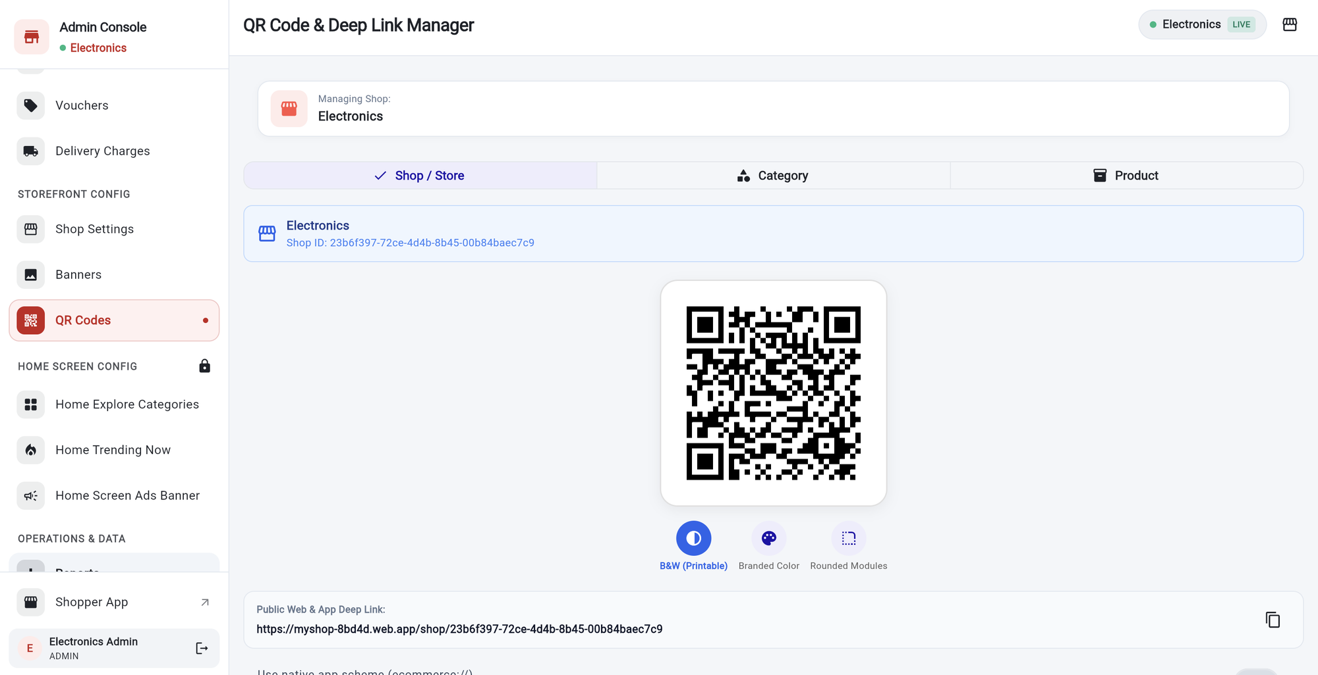
GROWTH AND CONTROL
QR codes and shop links
1
Three tabs:
Shop / Store, Category and Product.
2
Choose the item,
and the QR code appears.
1
2
3
3
Style:
B&W (printable), Branded Color or Rounded Modules.
4
4
Public link
opens your shop in the Shopper app or website. Copy it to share.
Tip Print the QR code for your shop counter so customers can scan it.
Notes:
Create a QR code for your whole shop, one category or one product.

Slide 41
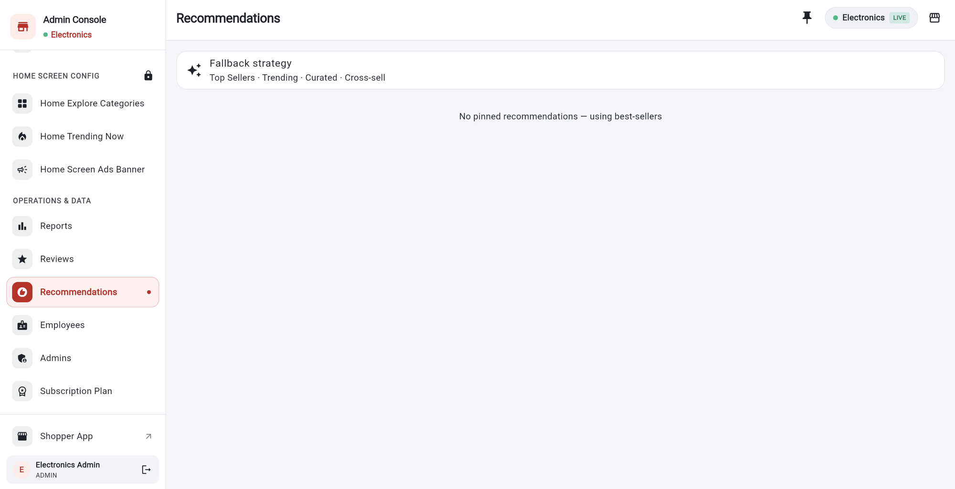
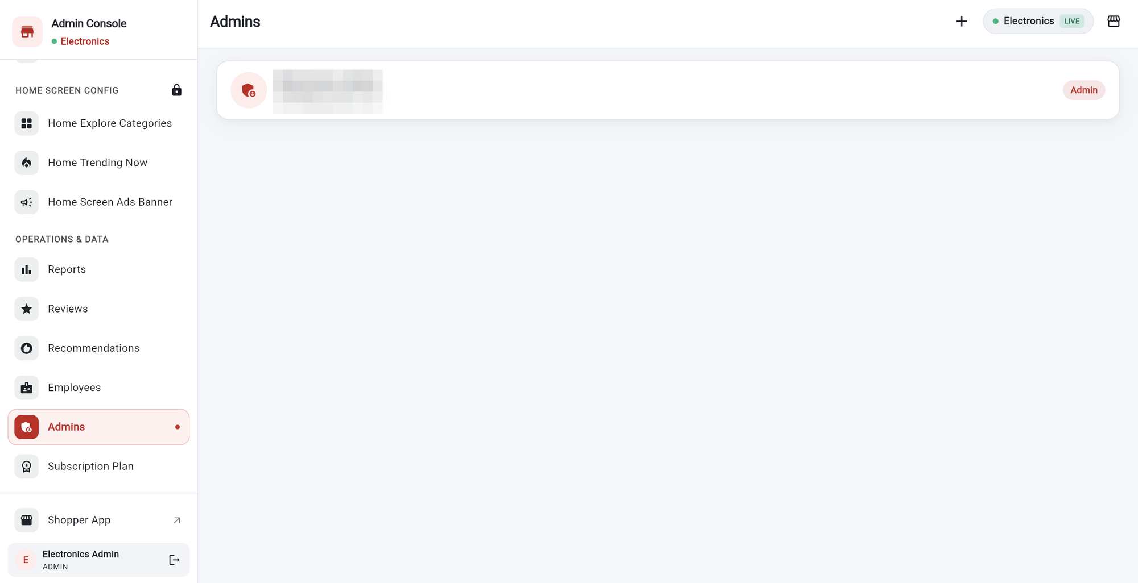
GROWTH AND CONTROL
Recommendations and admins
2
2
1
1
1
Fallback strategy
is used when nothing is pinned: top sellers, trending, curated, cross-sell.
1
Admins
lists the people who can manage this shop.
2
Pin icon
pins a product so it is recommended first.
2
Plus (+)
adds another admin to your shop.
Notes:
Recommendations let you pin a product. Admins lists who can sign in as admin.

Slide 42

HELP
Not part of this version
We only show what really exists in the app. These are not available:
Content, Guides and Articles
Service requests
There is no content management area. Use product highlights, details and policy text instead.
There is no service request screen.
Digital warranty
Customer list
There is no warranty screen. Use the product’s Delivery & Return Policy text.
There is no customer management. You see customer details inside each order.
Several shops / branches
Uploading images
Each admin manages one shop. There is no branch or shop list.
Pictures are added by pasting a link, not by uploading a file.
Notes:
These areas do not exist in this version of the Admin app.

Slide 43





HELP
Helpful tips
Check orders daily
Right role, right job
Hide, do not delete
Watch your limits
Open the dashboard first. Confirm new orders quickly so shoppers know you have them.
Use Order Packer and Order Delivery for floor staff. Keep Manager for people you trust.
Switch a product to unpublished or out of stock instead of deleting it.
Check Subscription Plan before a big upload. Hidden products still count.
Keep the password safe
Share your shop
Use vouchers wisely
Download reports
Lock the home screen settings when you finish, and never share the password.
Print the shop QR code for your counter and add the link to your social pages.
Set a minimum order and an expiry date so offers stay profitable.
Export a monthly report to keep your own records.
Notes:
A few habits that help.

Slide 44
HELP
Frequently asked questions (1/3)
How do I add a new product?
How do I change a product?
Products, then the plus (+) button. Fill in the title, MRP and stock, then tap Create Product.
Products, tap the pencil on the product, edit the fields and save.
How do I mark a product out of stock?
How do I manage options?
Edit the product and set the stock mode to Finished / Out of Stock. Or switch Published off to hide it.
In the product form, use Variant Matrix: Add Option, then Generate Matrix. Extras go in Add-ons.
How do I confirm an order?
How do I record a payment?
Orders Pipeline, tap Confirm on the order, or open it and tap Mark as Confirmed.
Open the order and tap Confirm Payment Received. Choose cash or UPI and enter the amount.
Notes:
Answers to common questions.

Slide 45
HELP
Frequently asked questions (2/3)
How do I give someone a role?
How do I change the Shopper home screen?
Employees, the add icon, then pick Manager, Order Packer or Order Delivery under Designation / Role.
Unlock Home Screen Config, then edit Explore Categories, Trending Now or the Ads Banner.
Why can’t I publish another product?
How do I upgrade my plan?
Your plan’s publish limit is full (for example 50 of 50 on Basic). Save it as unpublished, free a slot, or upgrade.
Open Subscription Plan, choose Upgrade, and email the contact shown. Your new limits apply once updated.
Can I add a voucher?
How do I get a QR code?
Yes. Vouchers, Create Voucher. Set the code, discount, minimum order and expiry date.
Use the QR icon on a product or category, or open QR Codes for your whole shop. Then Download PNG.
Notes:
Answers to common questions.

Slide 46
HELP
Frequently asked questions (3/3)
How do I lock the home screen settings?
Where can I see my sales?
Tap the padlock at the top right of the page and choose OK. Signing out also locks them.
Reports. Choose a period, read the cards, and download Excel, CSV or PDF.
Where are the guides and articles?
How do I set delivery fees?
This version of the app does not have a Content area. Use the product highlights and details instead.
Delivery Charges, add a pincode and its fee. Or import many with a CSV file.
Can I use more than one shop?
How do I sign out?
No. An admin account manages one shop.
Tap your name and the arrow icon at the bottom of the left menu.
Notes:
Answers to common questions.

Slide 47
HELP
About this guide
Where the screens come from
Every screenshot was taken in Google Chrome from the running Admin app, signed in to a test shop called Electronics.
Privacy
Customer names, phone numbers, emails, addresses, staff details, salary and order numbers are hidden with blurred blocks. No passwords are shown.
What was not changed
No product, order or setting was saved while making this guide. The “publish limit” box was cancelled. A few screens are shown empty because this test shop has no data there (vouchers, delivery charges, reviews).
Not shown
The employee roles in the order table follow the role descriptions in the app. Creating a company, adding a voucher and confirming an order were not performed to avoid changing live data.
Bazaar
Notes:
About the screens in this guide.

Slide 48
Thank you
Happy selling!
Need a plan change? Open Subscription Plan and use the contact shown there.
Notes:
Thank you for using the Admin app.

