Slide 1
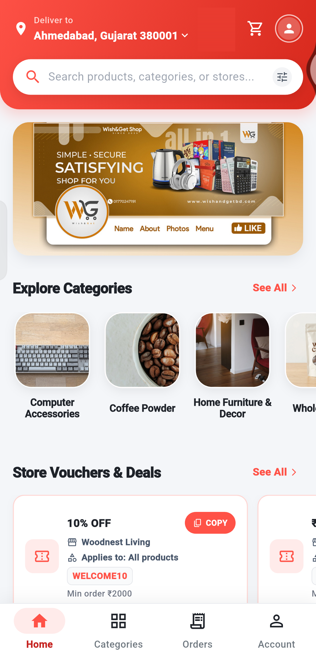

Shopper App
User Guide
Find products, place your order and follow it to your door. A step-by-step guide with real screens from the app.
Captured on an Android phone with test data
Notes:
Welcome. This guide shows, step by step, how to use the Shopper app to find products, place orders and track them.

Slide 2






INTRODUCTION
Welcome to the Shopper app
Everything you need to shop from local stores, in one place.
Browse and search
Deals and coupons
Cart and checkout
Open categories and shops, or search for any product.
Copy a store coupon and use it at checkout.
Add items, choose home delivery or self pickup, place your order.
Track your orders
Rate and review
Account and help
See every step from Pending to Delivered.
Tell others what you think of what you bought.
Save addresses, change language and get support.
Notes:
These are the main things you can do in the app.

Slide 3
INTRODUCTION
What is in this guide
1
Getting started
Open the app, sign in, find your way around
Slides 4–7
2
Browse and find
Categories, search and shops
Slides 8–10
3
Product details
Photos, price, options, favourites
Slides 11–14
4
Cart and checkout
Cart, delivery or pickup, placing an order
Slides 15–18
5
Full order walkthrough
3 shops, add-ons, voucher, order confirmation
Slides 19–29
6
Your orders
Order list, tracking, reviews
Slides 30–33
7
Deals and help
Coupons, warranty information, Help & Support
Slides 34–36
8
Account
Profile, addresses, language, log out
Slides 37–40
Notes:
A quick map of this guide.

Slide 4
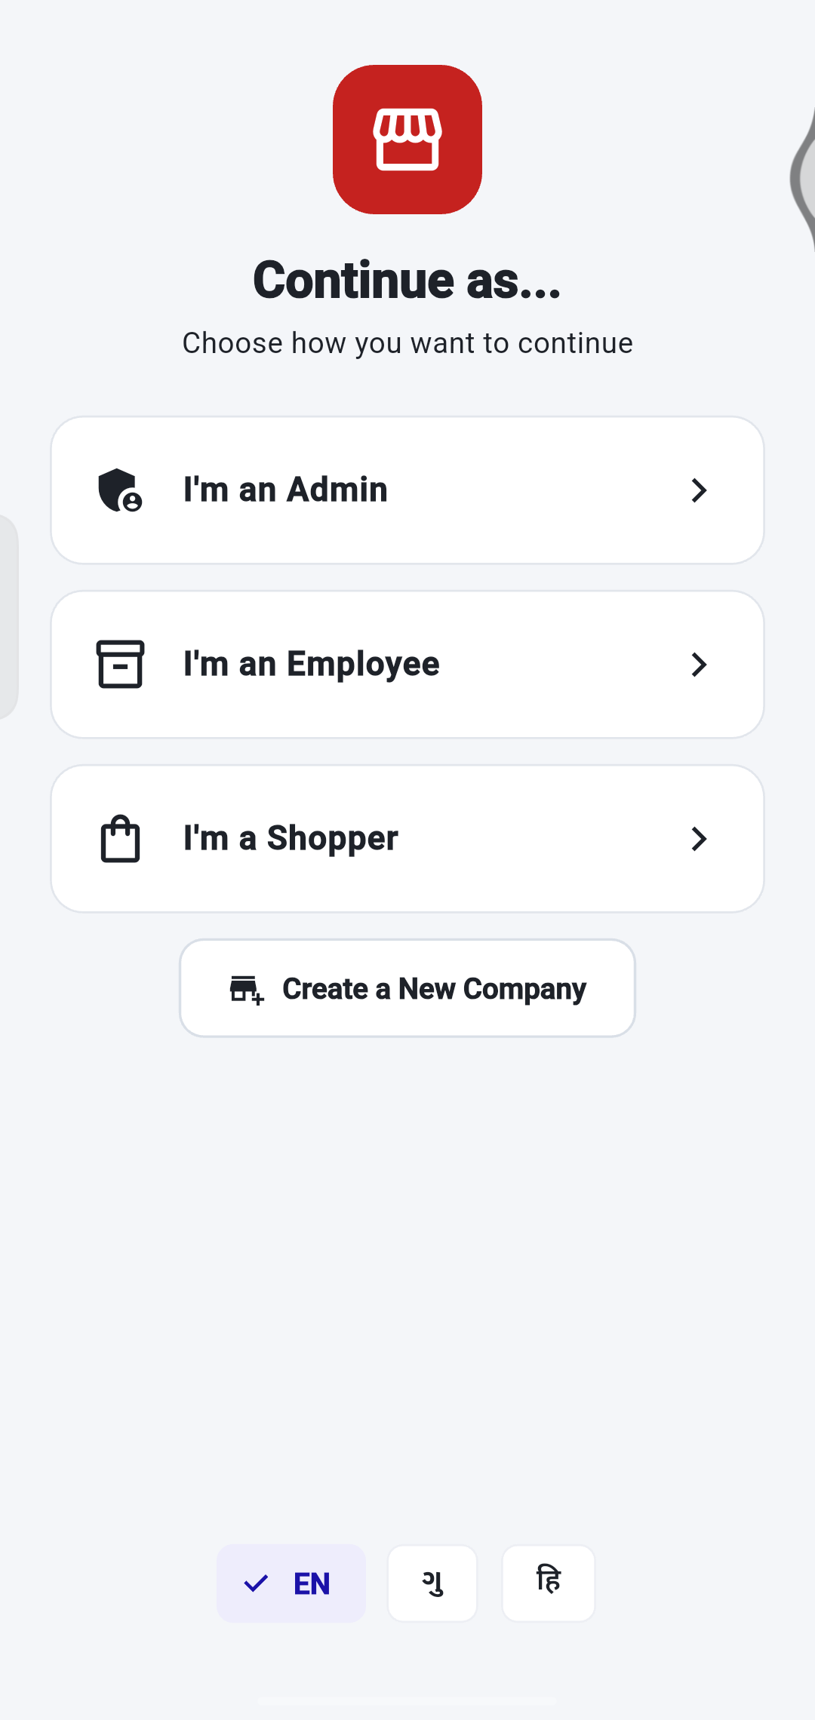
GETTING STARTED
Open the app and start shopping
1
Tap “I’m a Shopper”.
You can look around without an account.
2
Pick your language.
EN, ગુ (Gujarati) or हि (Hindi) – at the bottom of this screen.
1
2
Tip The Admin, Employee and Create a New Company buttons are for shop staff. Shoppers do not need them.
Notes:
When you open the app you choose how to continue. Shoppers tap I'm a Shopper.

Slide 5
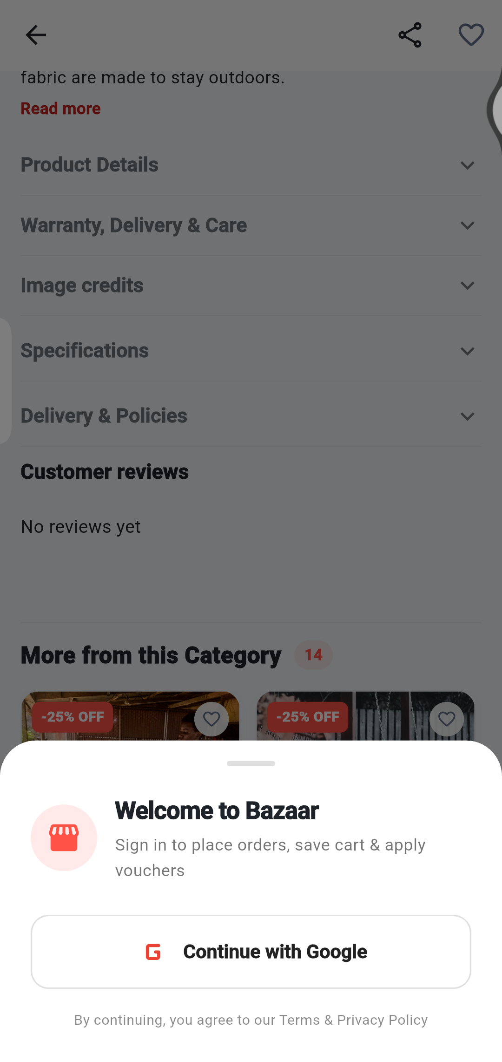
GETTING STARTED
Sign in when the app asks
1
Browse first.
Categories, shops and products are open to everyone.
2
Sign in to continue.
Adding to the cart, placing orders, saving favourites and using vouchers need an account.
3
Tap “Continue with Google”.
Choose your Google account. The app then carries on with what you were doing.
2
Tip Never share your Google password with anyone, not even store staff.
3
Notes:
You can browse freely. Signing in is needed for the cart, orders and favourites.

Slide 6
GETTING STARTED
Find your way around
6
5
1
Home
Banner, categories, coupons, shops and trending products.
2
Categories
Browse every category and shop.
3
Orders
Your orders and their progress (sign in needed).
4
Account
Profile, saved items, addresses, language and help.
5
Cart
Top right of the screen. The number shows how many items are inside.
6
Delivery area
Top left shows where you are shopping for.
1
2
3
4
Notes:
The bottom bar has four tabs. The cart is at the top.

Slide 7
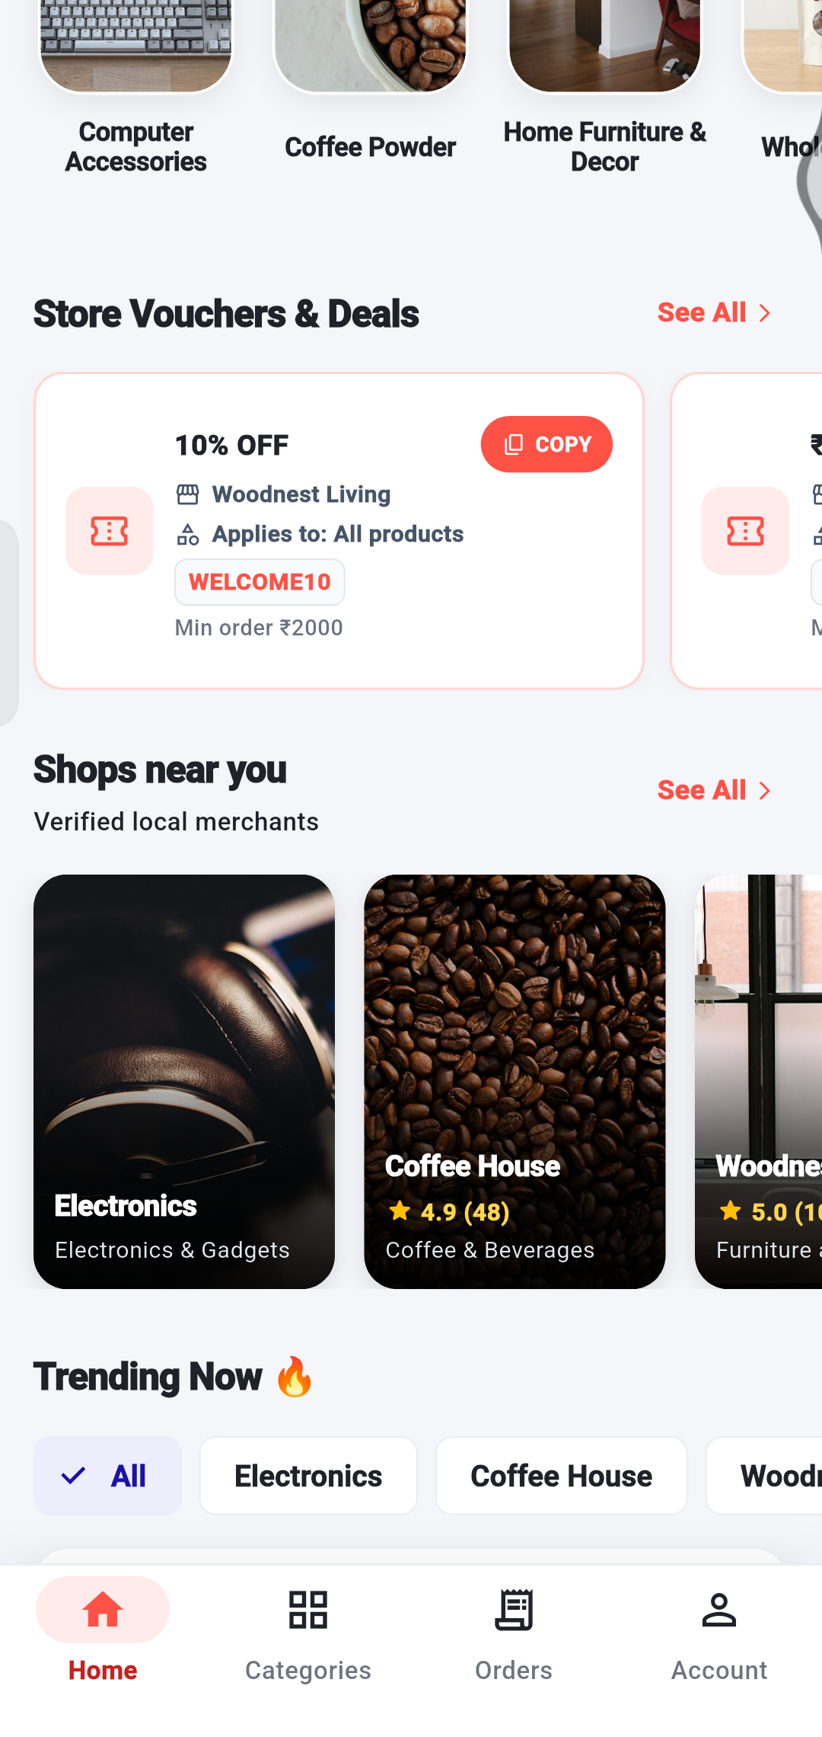
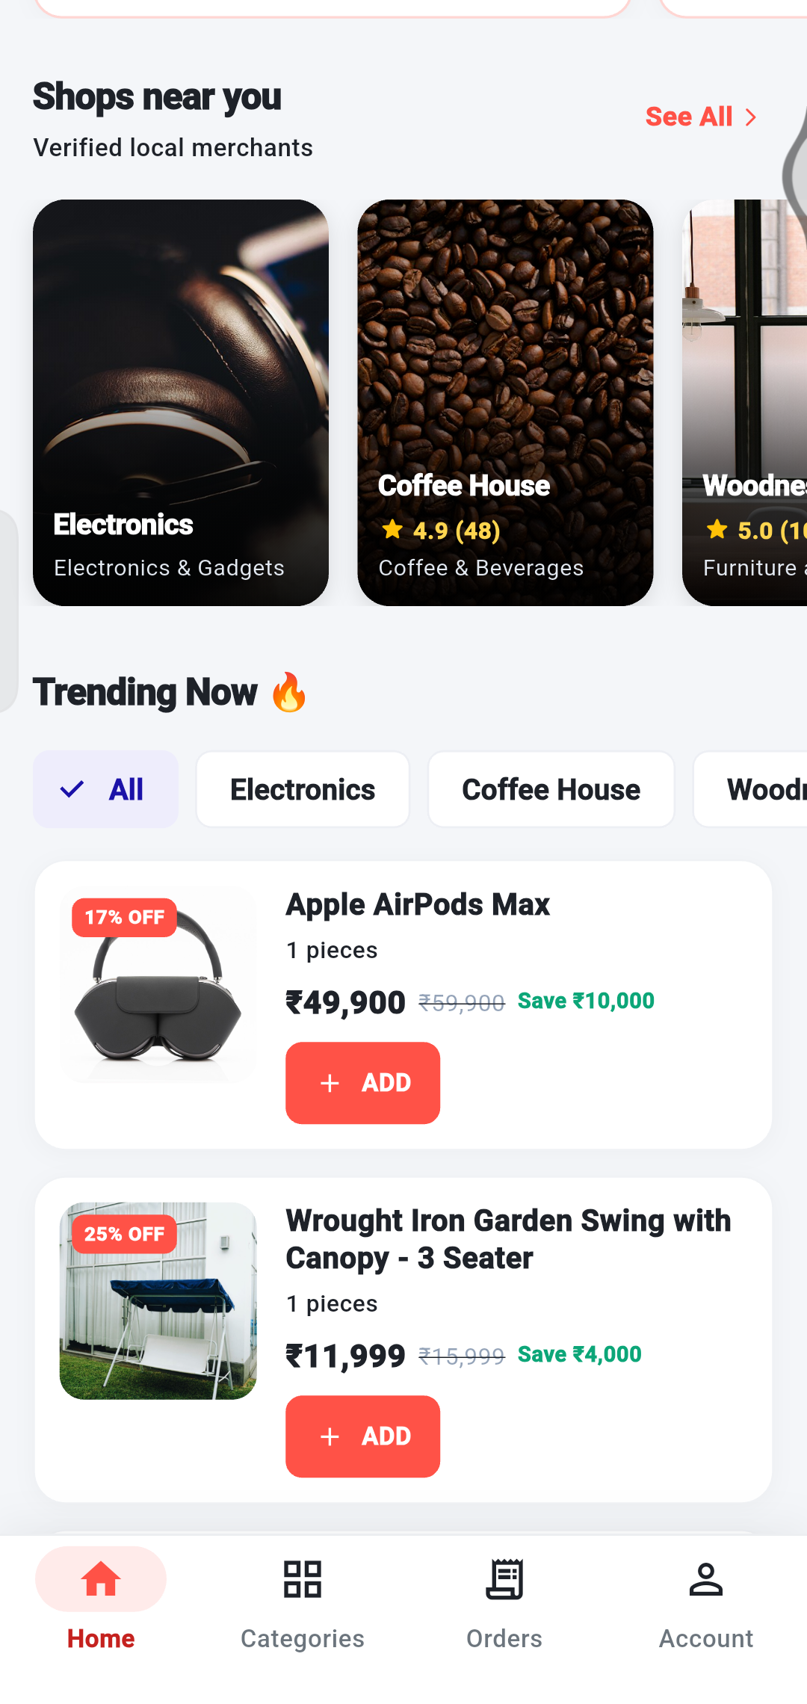
GETTING STARTED
The Home screen
1
Store Vouchers & Deals.
Coupons from stores. Tap COPY, or See All.
1
2
Shops near you.
Tap a shop to see everything it sells.
3
Trending Now.
Pick All or a shop name to filter the list.
2
4
4
Product cards.
Price, discount and a red ADD button. Tap the card for full details.
3
Tip Scroll down the Home screen – new sections appear as you go.
Notes:
Scroll down the home screen to see coupons, shops and trending products.

Slide 8
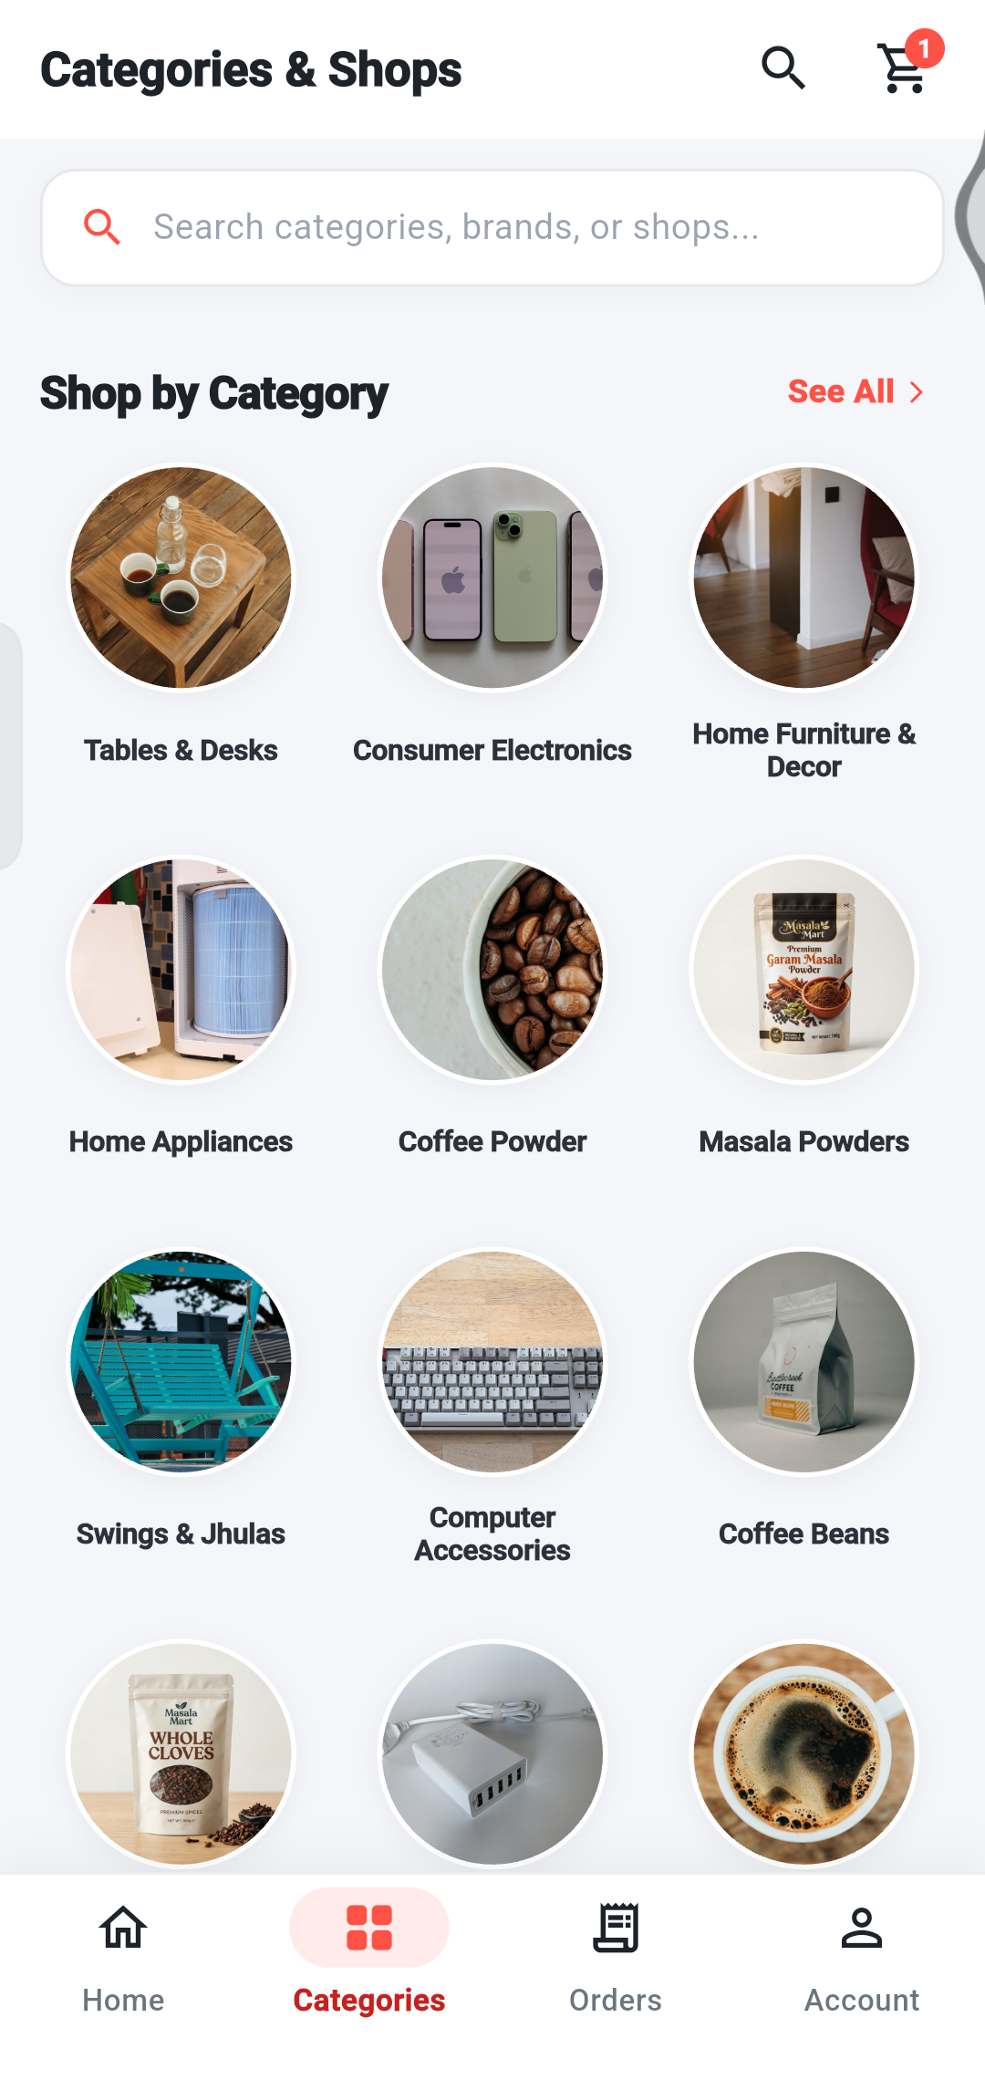
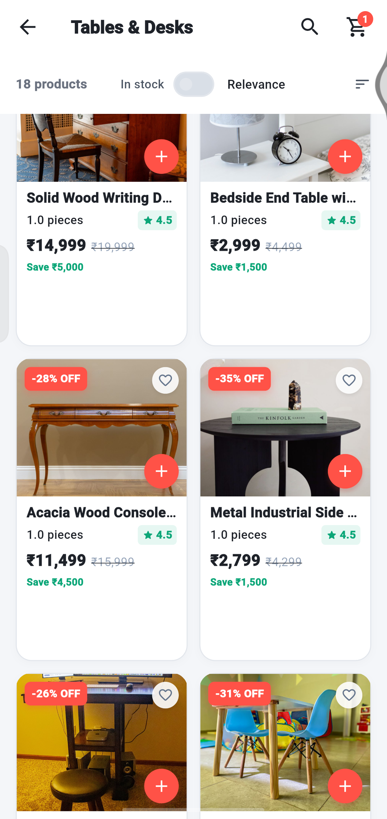
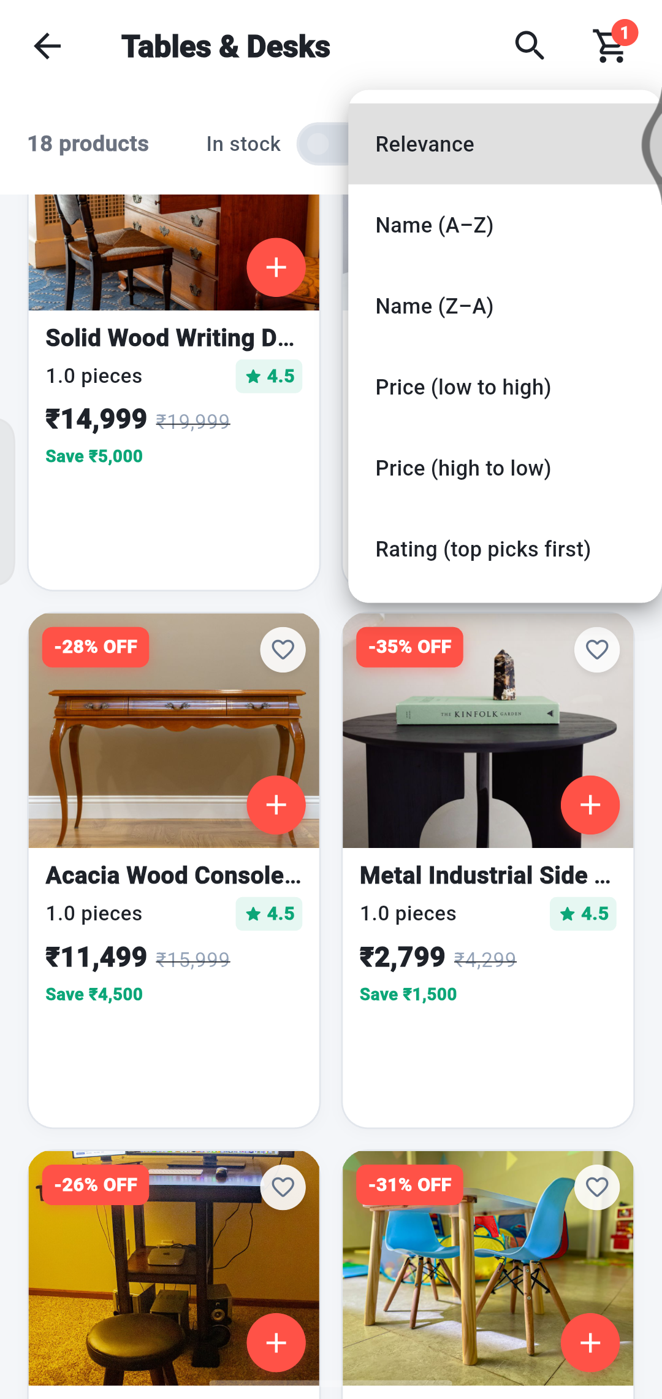
BROWSE AND FIND
Browse by category
3
4
5
2
6
1
1 Tap the Categories tab.
2 Tap a category picture, for example Tables & Desks.
3 How many products the category has.
4 Switch on In stock to hide sold-out items.
5 Tap Relevance to sort.
6 Choose the order: name A–Z or Z–A, price low to high or high to low, or top-rated first.
Notes:
Open the Categories tab, choose a category, then sort or filter the products.

Slide 9
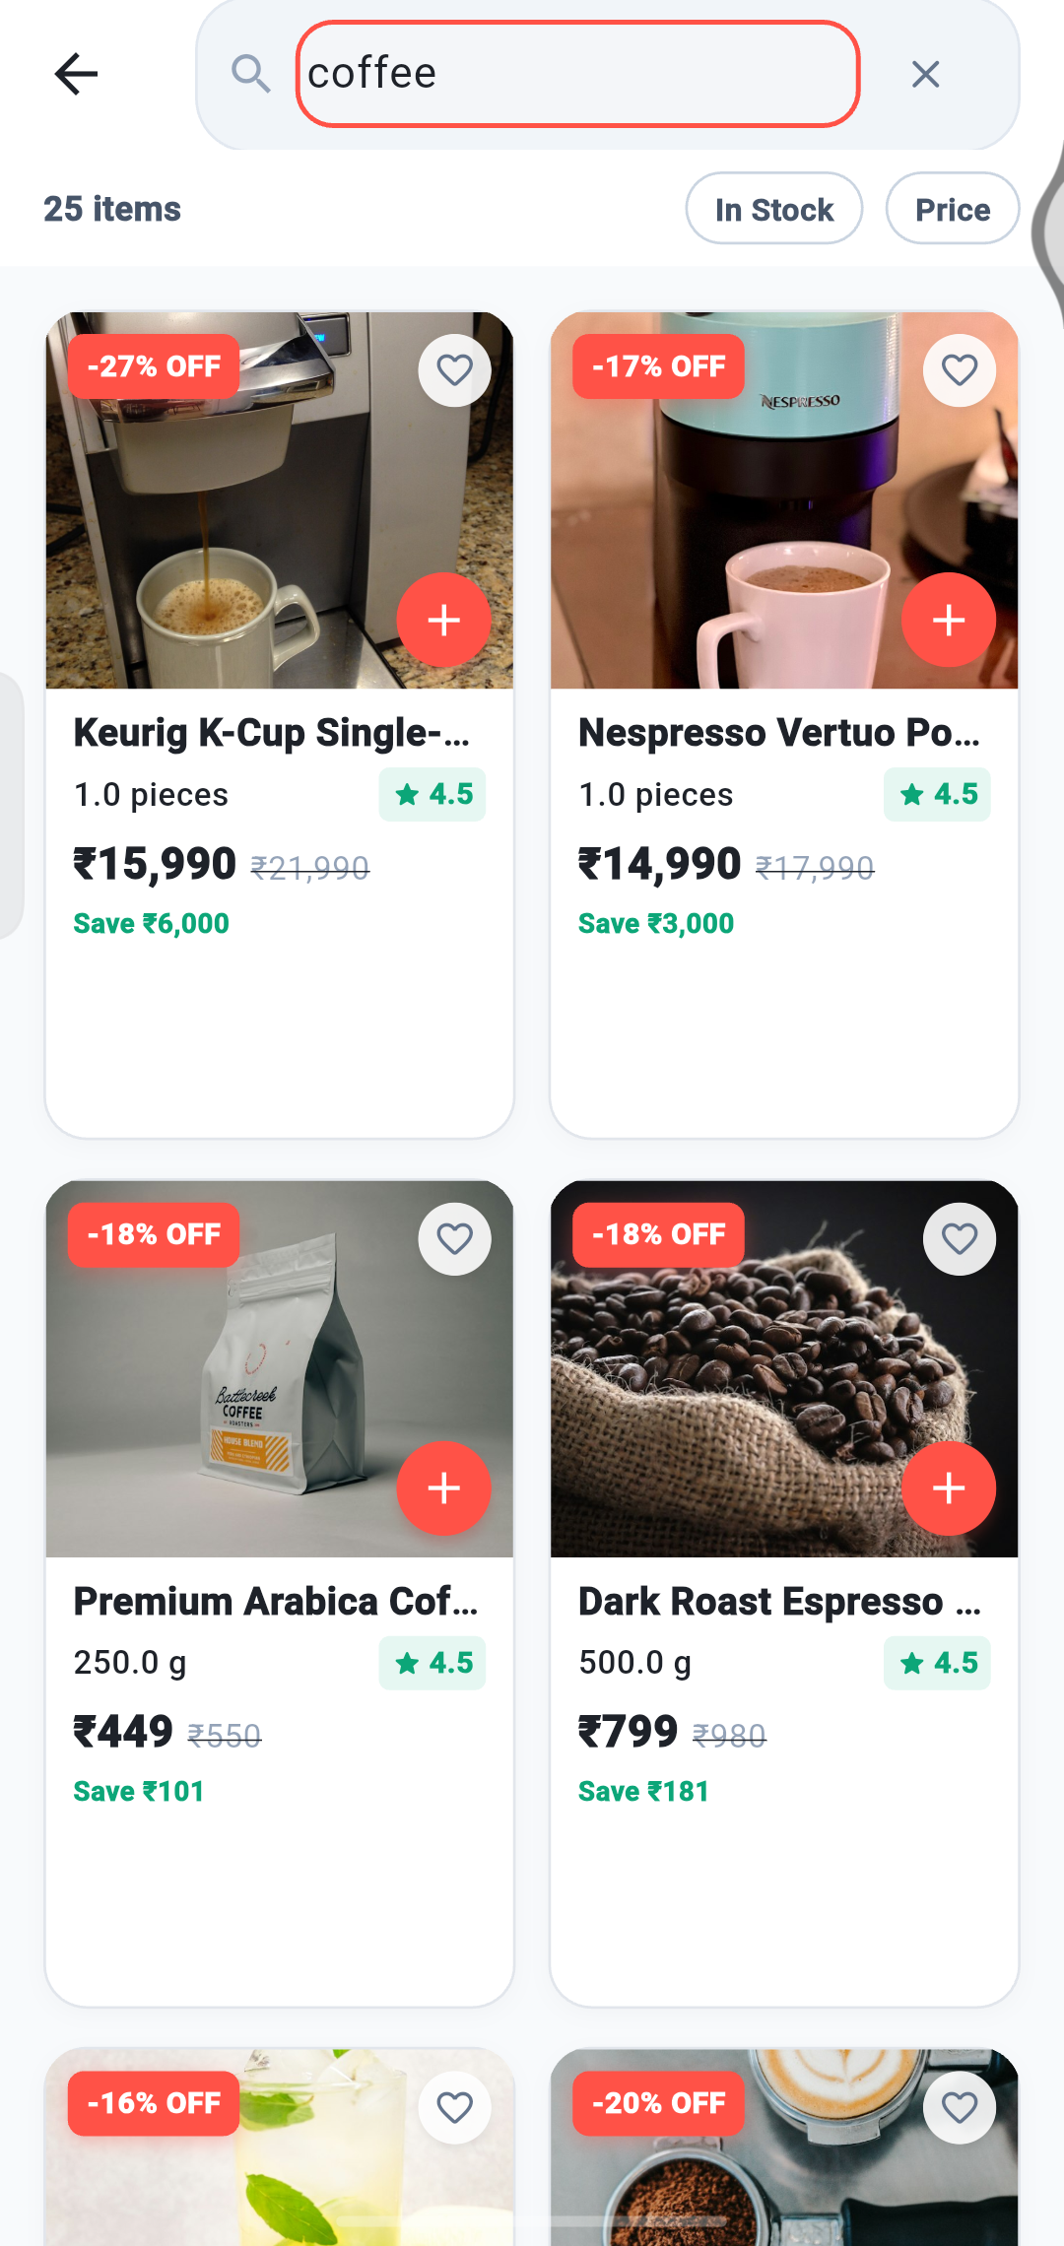
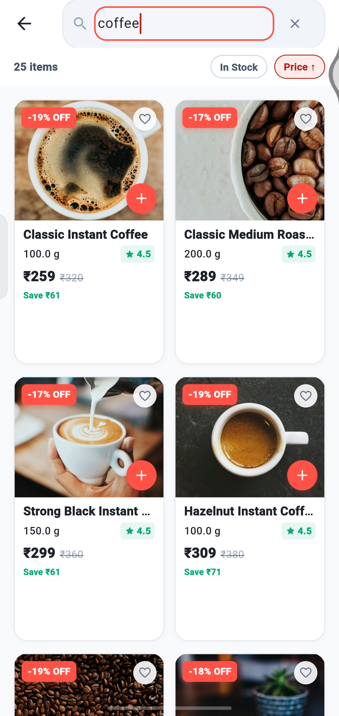
BROWSE AND FIND
Search for a product
1
2
3
3
1
Tap the search bar.
It is at the top of Home and Categories.
2
Type what you want.
For example “coffee”. The number of matches is shown (25 items).
3
Use the chips above the results.
In Stock hides sold-out products. Price sorts by price.
4
Tap a product
to open its page, or the red + to add it.
Notes:
Type a product name in the search bar. Use the chips to narrow the results.

Slide 10
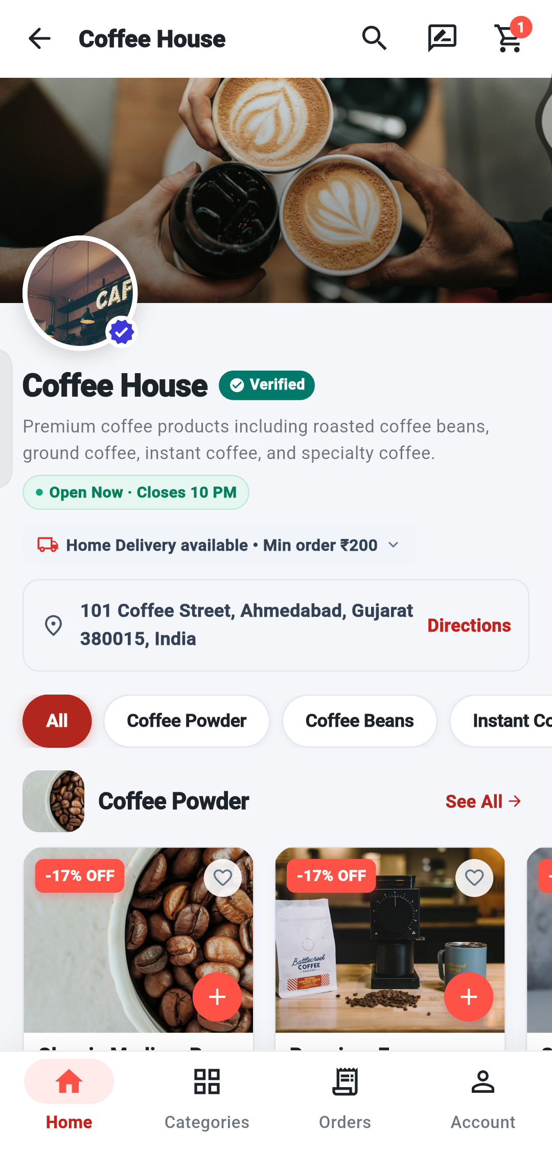
BROWSE AND FIND
Visit a shop
1
Open a shop
from Shops near you on Home, or from the Categories tab.
2
Check it is open.
The green label shows Open Now and when it closes.
2
3
3
See delivery details.
Home delivery and the minimum order amount are shown.
4
5
4
Tap Directions
to see where the shop is.
5
Use the category chips
to jump to a type of product inside the shop.
Notes:
Each shop has its own page with opening hours, delivery information and products.

Slide 11
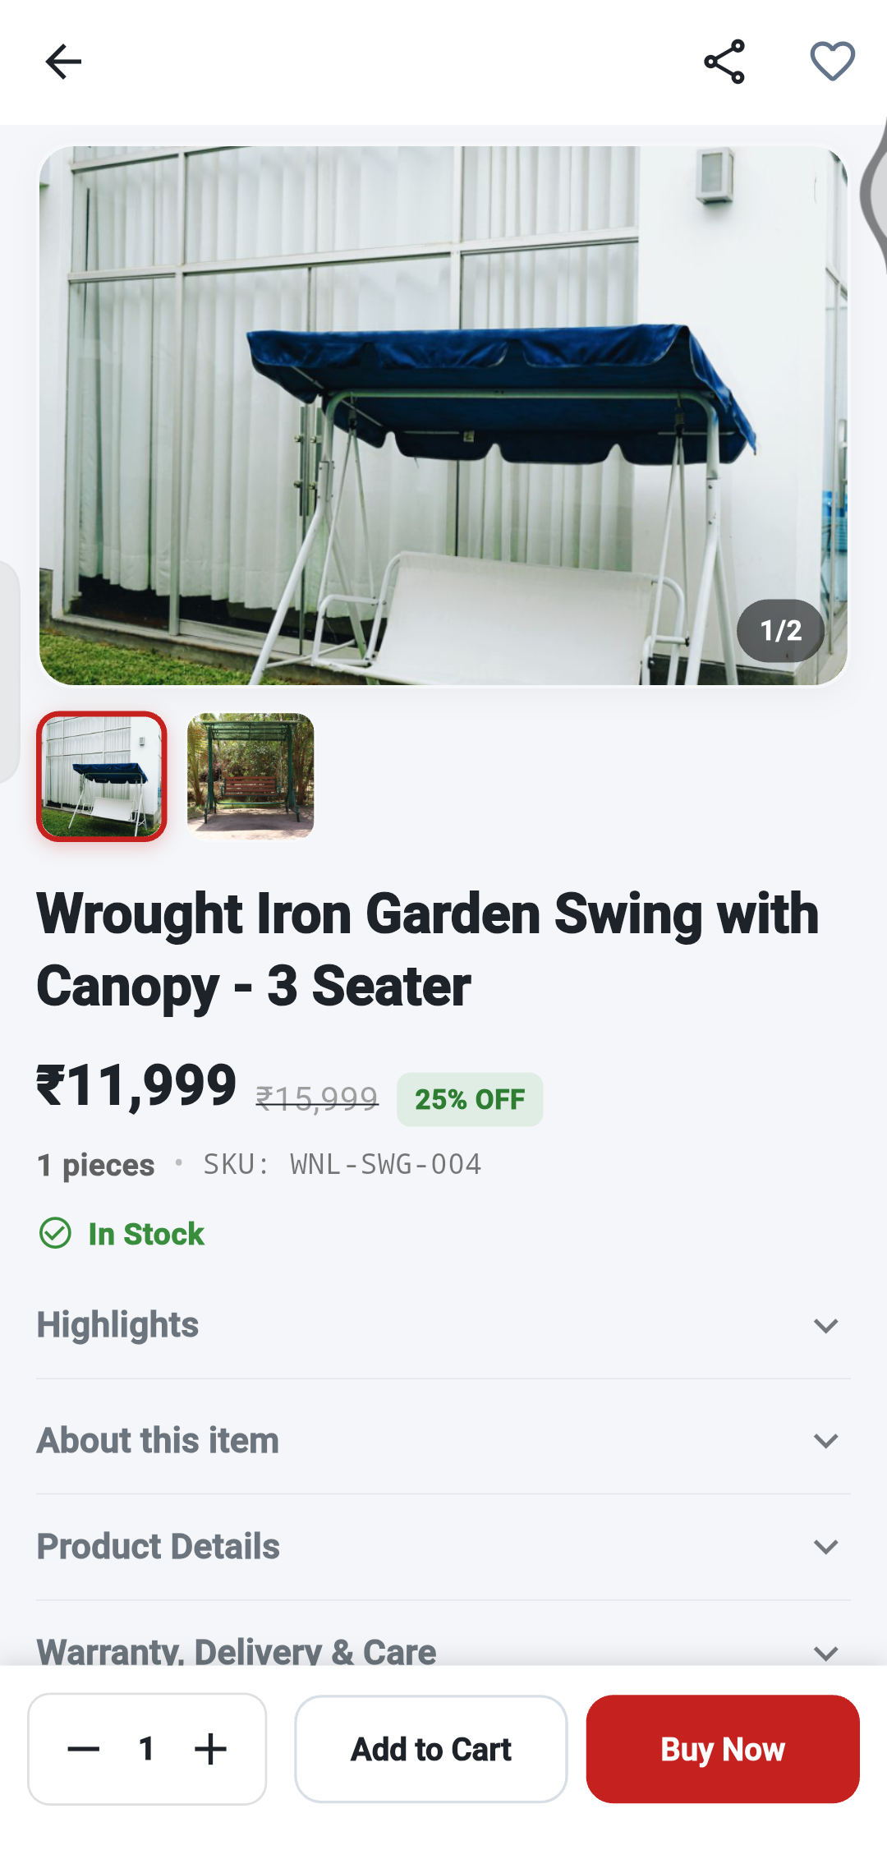
PRODUCT DETAILS
Understand a product page
1
2
1
Share
sends the product link to friends.
2
Heart
saves the product to your Liked products.
3
3
Photos.
Swipe, or tap a small picture. 1/2 means picture 1 of 2.
4
4
Price.
The big price is what you pay. The crossed-out price was the old price, with the % OFF.
5
5
Stock.
A green “In Stock” means you can buy it.
6
Bottom bar.
Pick a quantity with − and +, then Add to Cart or Buy Now.
6
Notes:
The product page shows photos, price, stock and the buttons to buy.

Slide 12
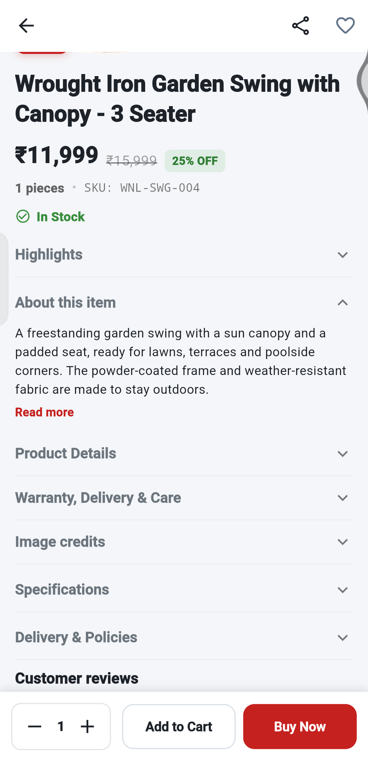
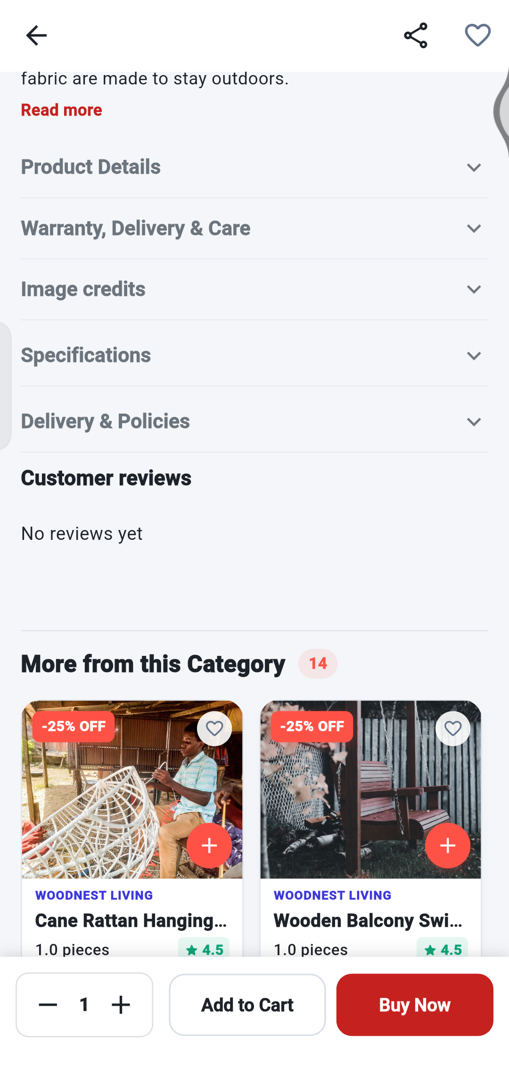
PRODUCT DETAILS
Read more about the product
1
Tap a heading to open it.
Highlights, About this item, Product Details, Warranty, Delivery & Care, Image credits, Specifications and Delivery & Policies.
2
Read more
opens long descriptions in full.
3
3
Customer reviews.
See what other buyers said. “No reviews yet” means nobody has reviewed it.
2
1
4
4
More from this Category.
Swipe sideways to see similar products.
Notes:
Tap a heading to open it. Scroll to the bottom to see reviews and similar products.

Slide 13
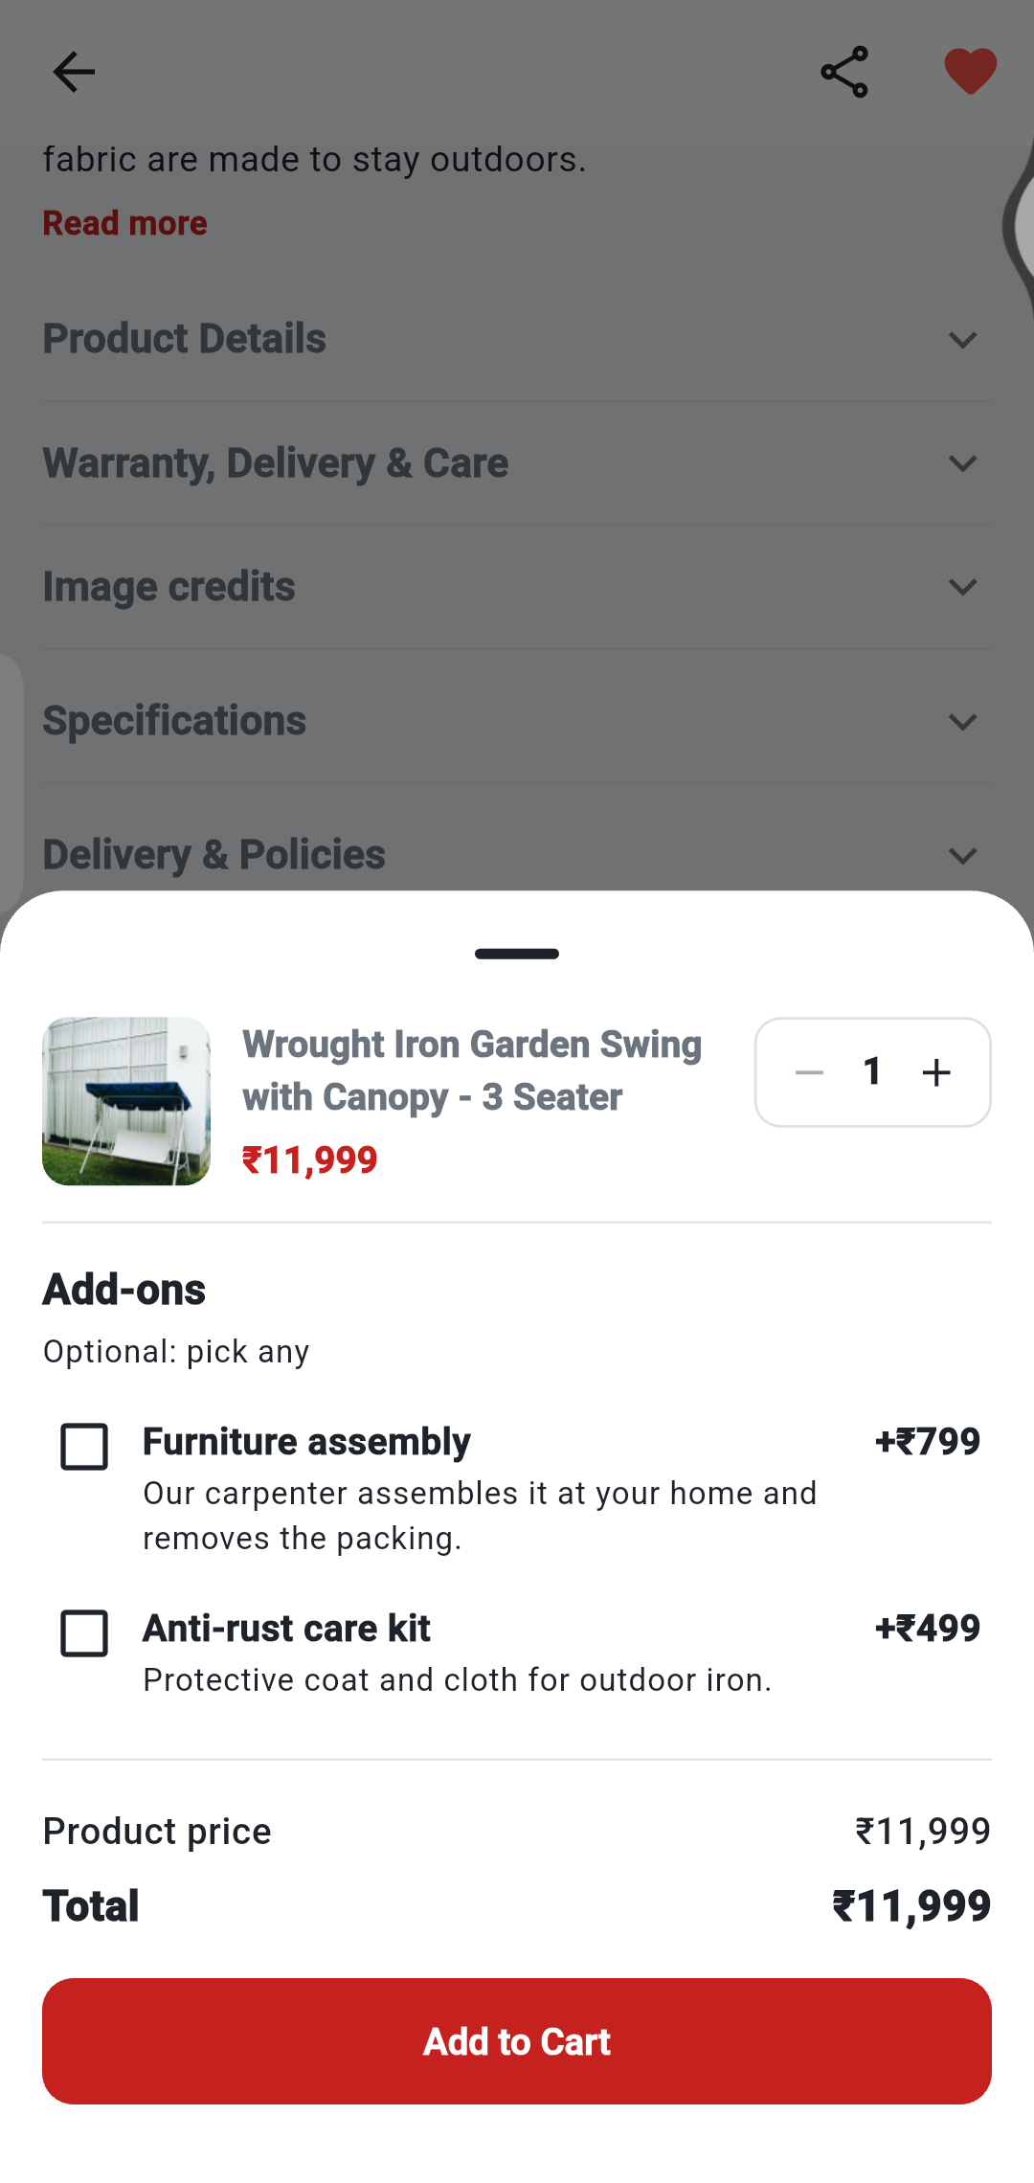

PRODUCT DETAILS
Choose options and add to cart
1
Change the quantity
with − and + at the top right of the panel.
2
Tick any extras you want.
Add-ons are optional and add to the price (e.g. +₹799).
3
Check the Total.
It updates as you choose.
1
4
Tap Add to Cart.
The item goes into your cart.
2
5
Tap VIEW CART
in the confirmation message to go to your cart.
3
5
Tip Tap Add to Cart on the product page to open this panel.
4
Notes:
Some shops offer extras, called add-ons, such as assembly. They are optional.

Slide 14
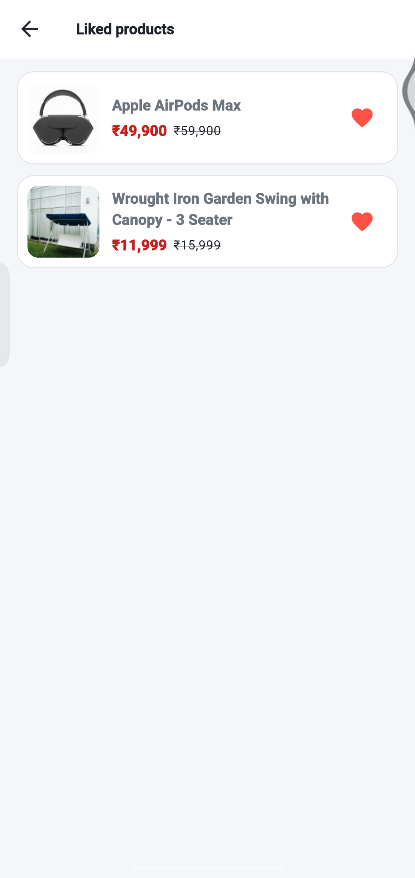
PRODUCT DETAILS
Save and share products
2
1
3
1
Tap the heart
on a product. It turns red when saved.
2
Tap Share
to send the product link to someone.
3
Find saved products
in Account → Liked products. Tap one to open it.
Tip You can like up to 25 products. Liking another one asks you to replace the oldest.
Notes:
Liked products are kept in your account. You can like up to 25 products.

Slide 15
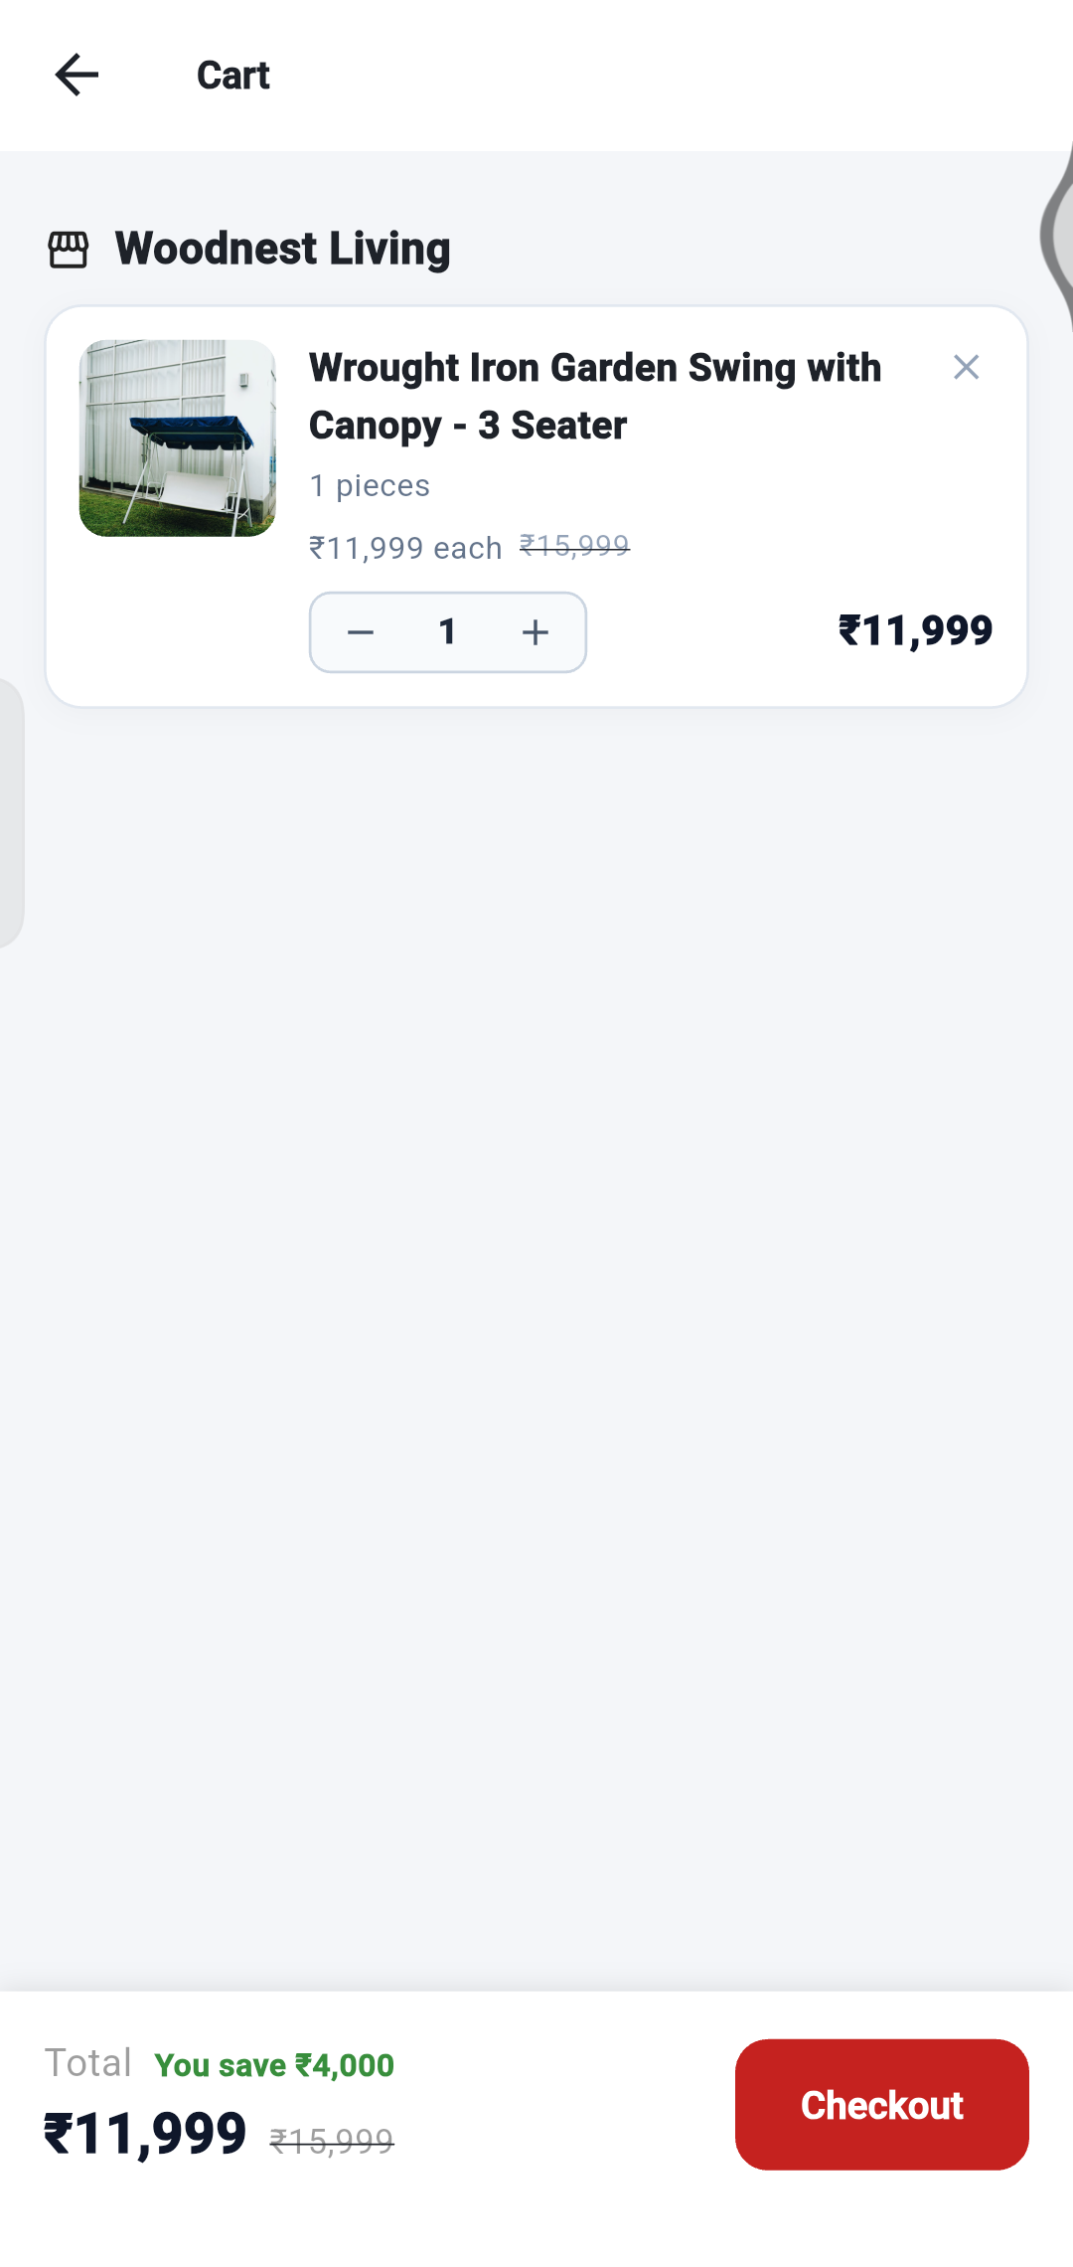
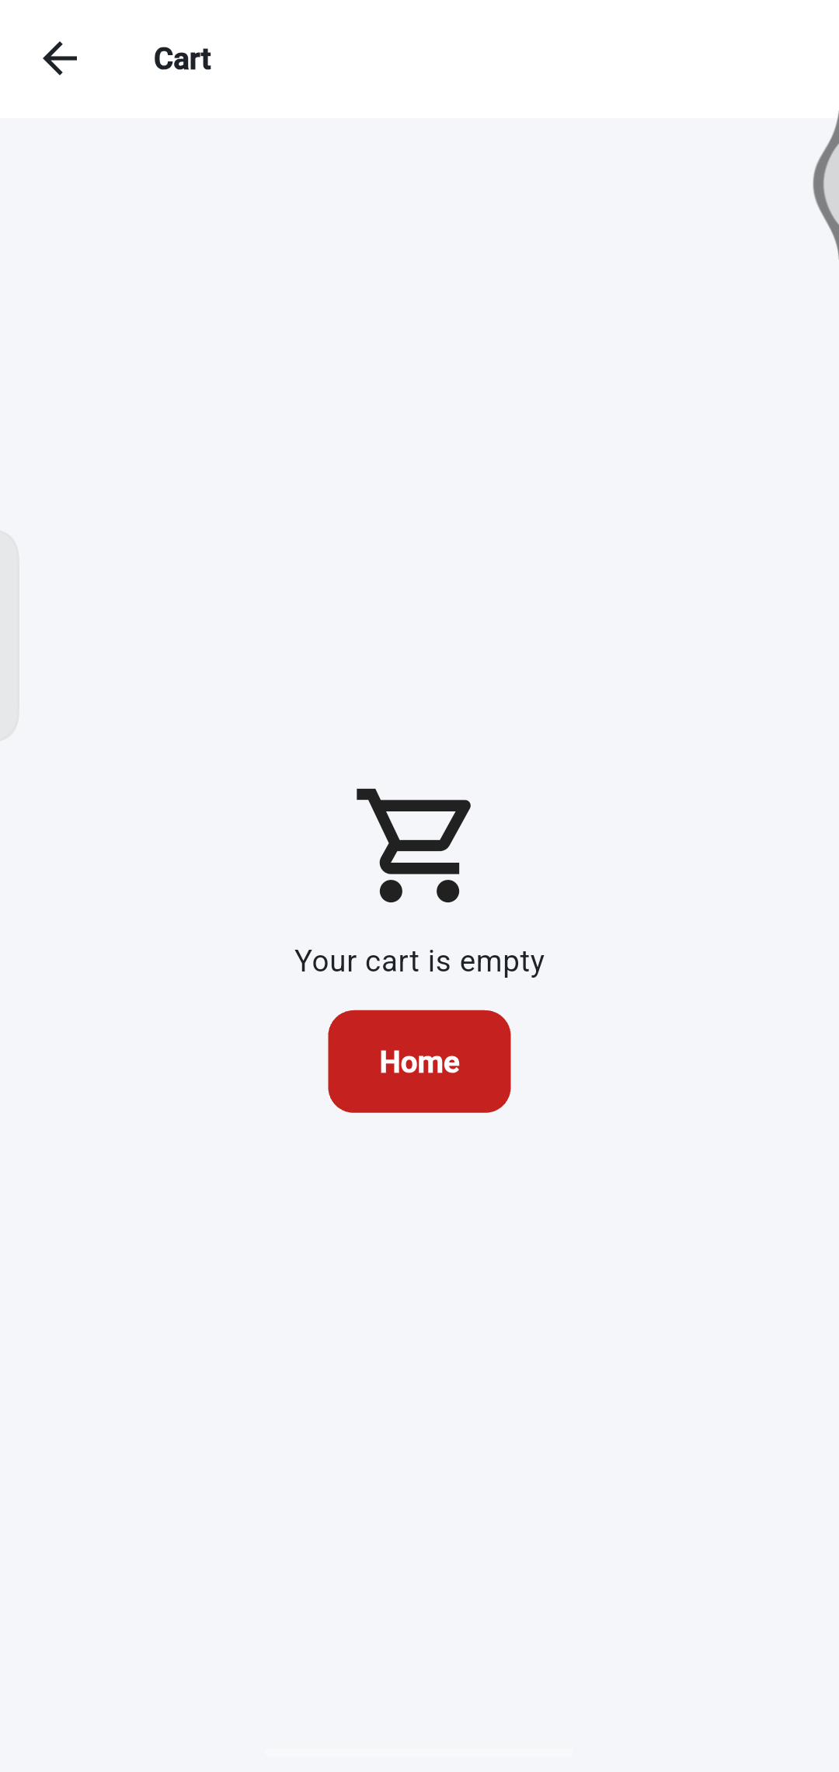
CART AND CHECKOUT
Manage your cart
3
1
Open the cart
with the cart icon at the top of Home.
2
2
Change quantity
with − and + next to the item.
3
Remove an item
with the X at its top right.
1
4
Check the total.
“You save” shows your discount.
5
Tap Checkout.
An empty cart shows “Your cart is empty” with a Home button.
4
5
Notes:
The cart groups your items by shop. Check the total before you continue.

Slide 16
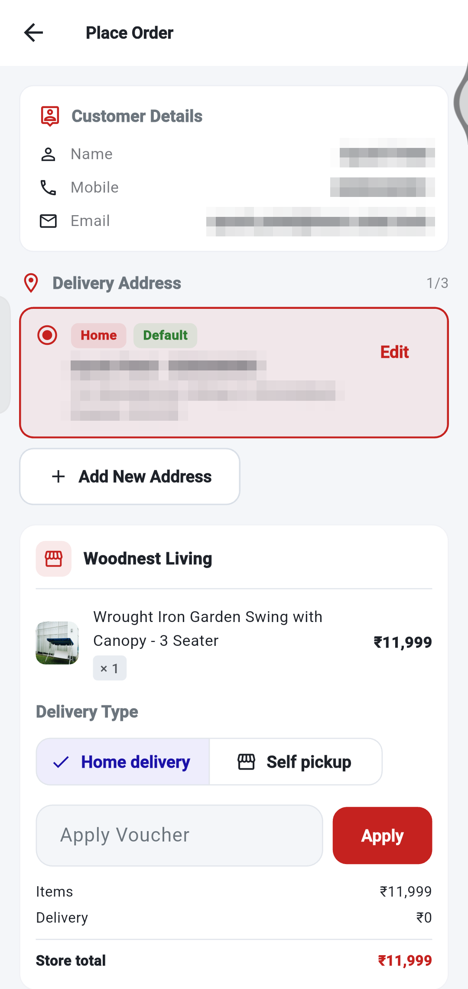
CART AND CHECKOUT
Checkout: your details and address
1
1
Customer details.
Your name and mobile number must be filled in before you can place an order.
2
Delivery address.
The selected address is highlighted. Tap Edit to change it.
2
3
3
Add New Address
if you need another one.
4
Delivery Type.
Choose Home delivery or Self pickup.
4
Tip Your own details are hidden in this guide. You will see them on your screen.
Notes:
Name and mobile number are required. Choose your delivery address and delivery type.

Slide 17
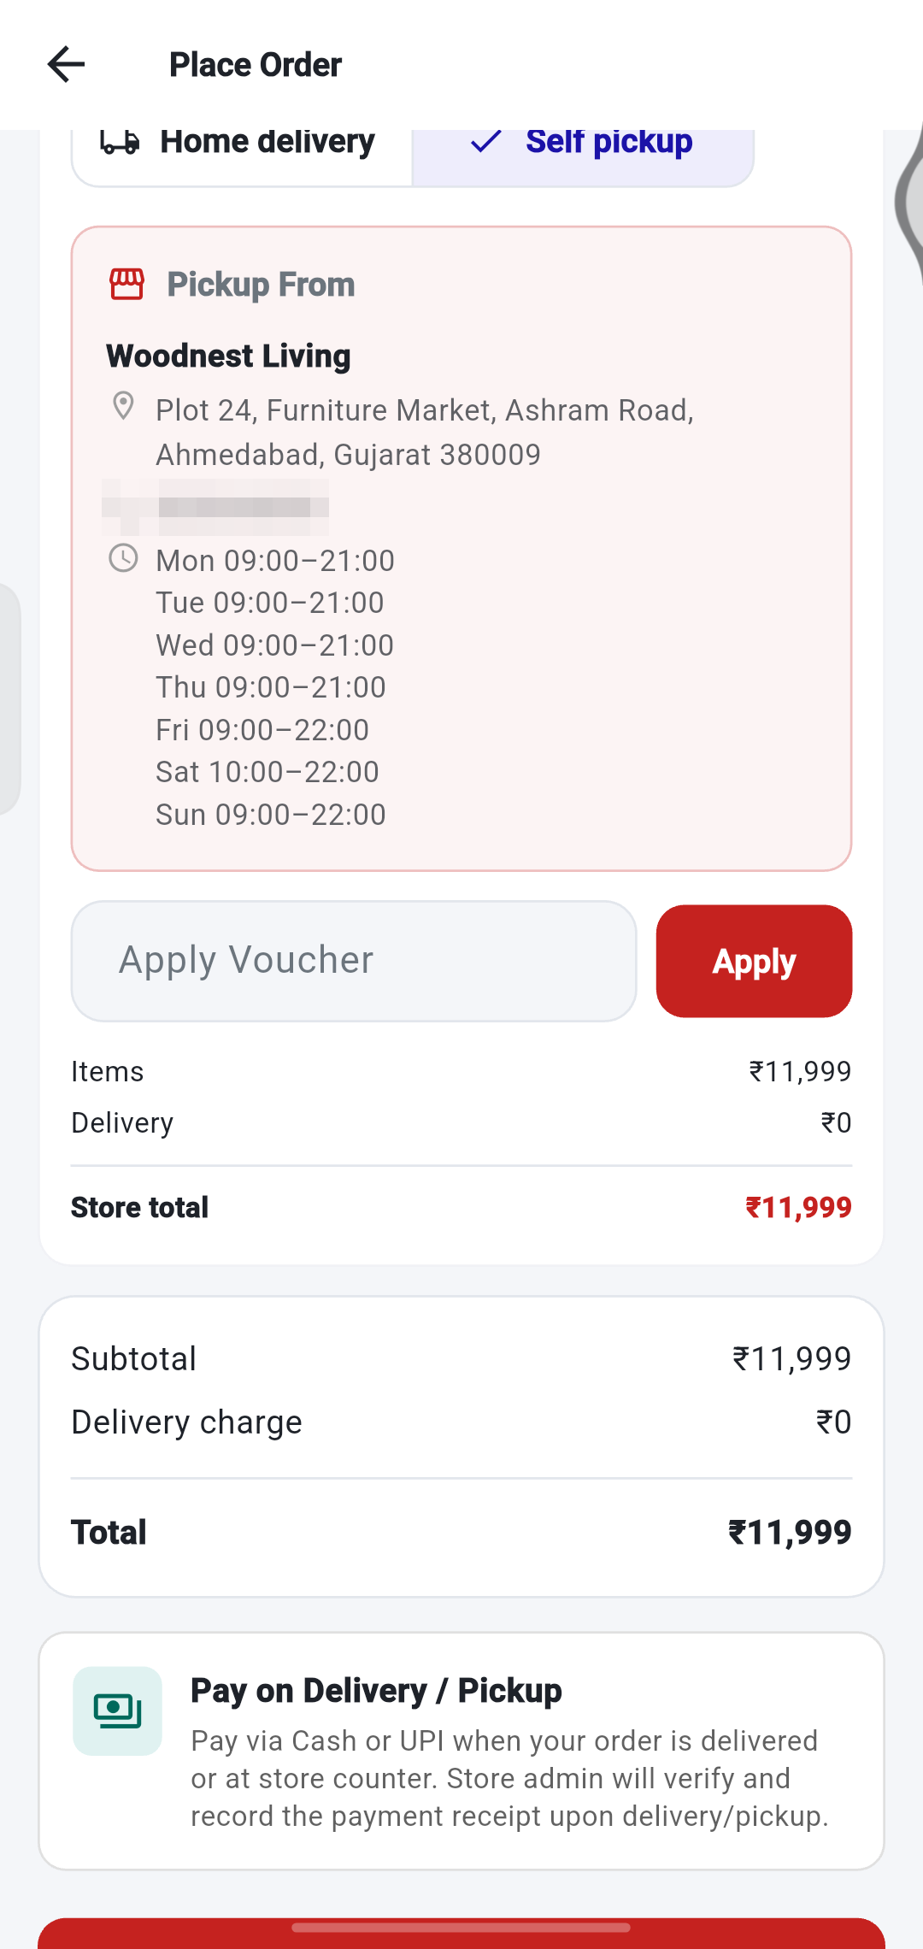
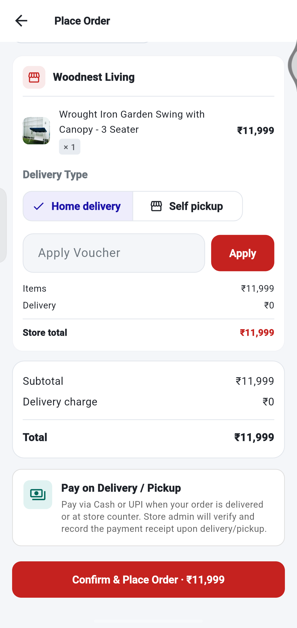
CART AND CHECKOUT
Vouchers, totals and payment
1
Self pickup
shows the shop address and opening times.
1
2
Apply Voucher.
Paste or type a coupon code and tap Apply.
2
3
Check the totals.
Items, delivery charge and the final Total.
3
4
Pay on Delivery / Pickup.
You pay by cash or UPI when you receive the order. The store records it.
4
5
Confirm & Place Order.
Tap to place your order.
5
Notes:
Self pickup shows the shop address and timings. Payment is made on delivery or pickup.

Slide 18
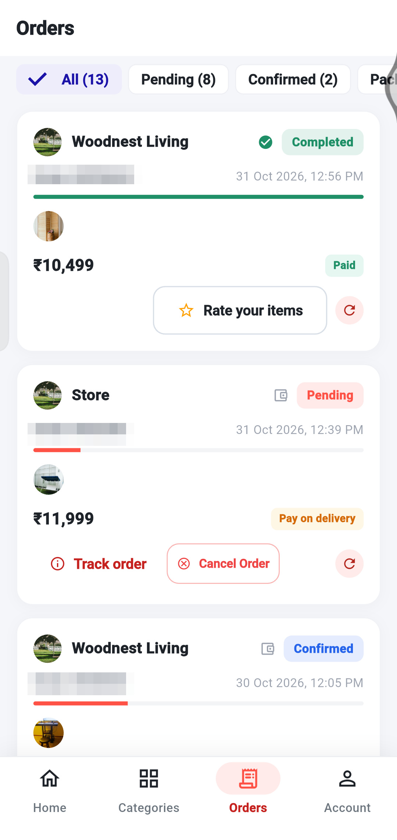
CART AND CHECKOUT
What happens after you place an order
1
Confirm & Place Order
You tap the red button at the bottom of checkout.
2
Order created
One order is created for each shop in your cart.
3
3
Pending
The store has your order and will confirm it.
4
Follow it
Open the Orders tab at any time to track progress.
Tip If your cart has items from two shops, you get two separate orders.
Notes:
After you place an order it appears in your Orders tab as Pending.

Slide 19
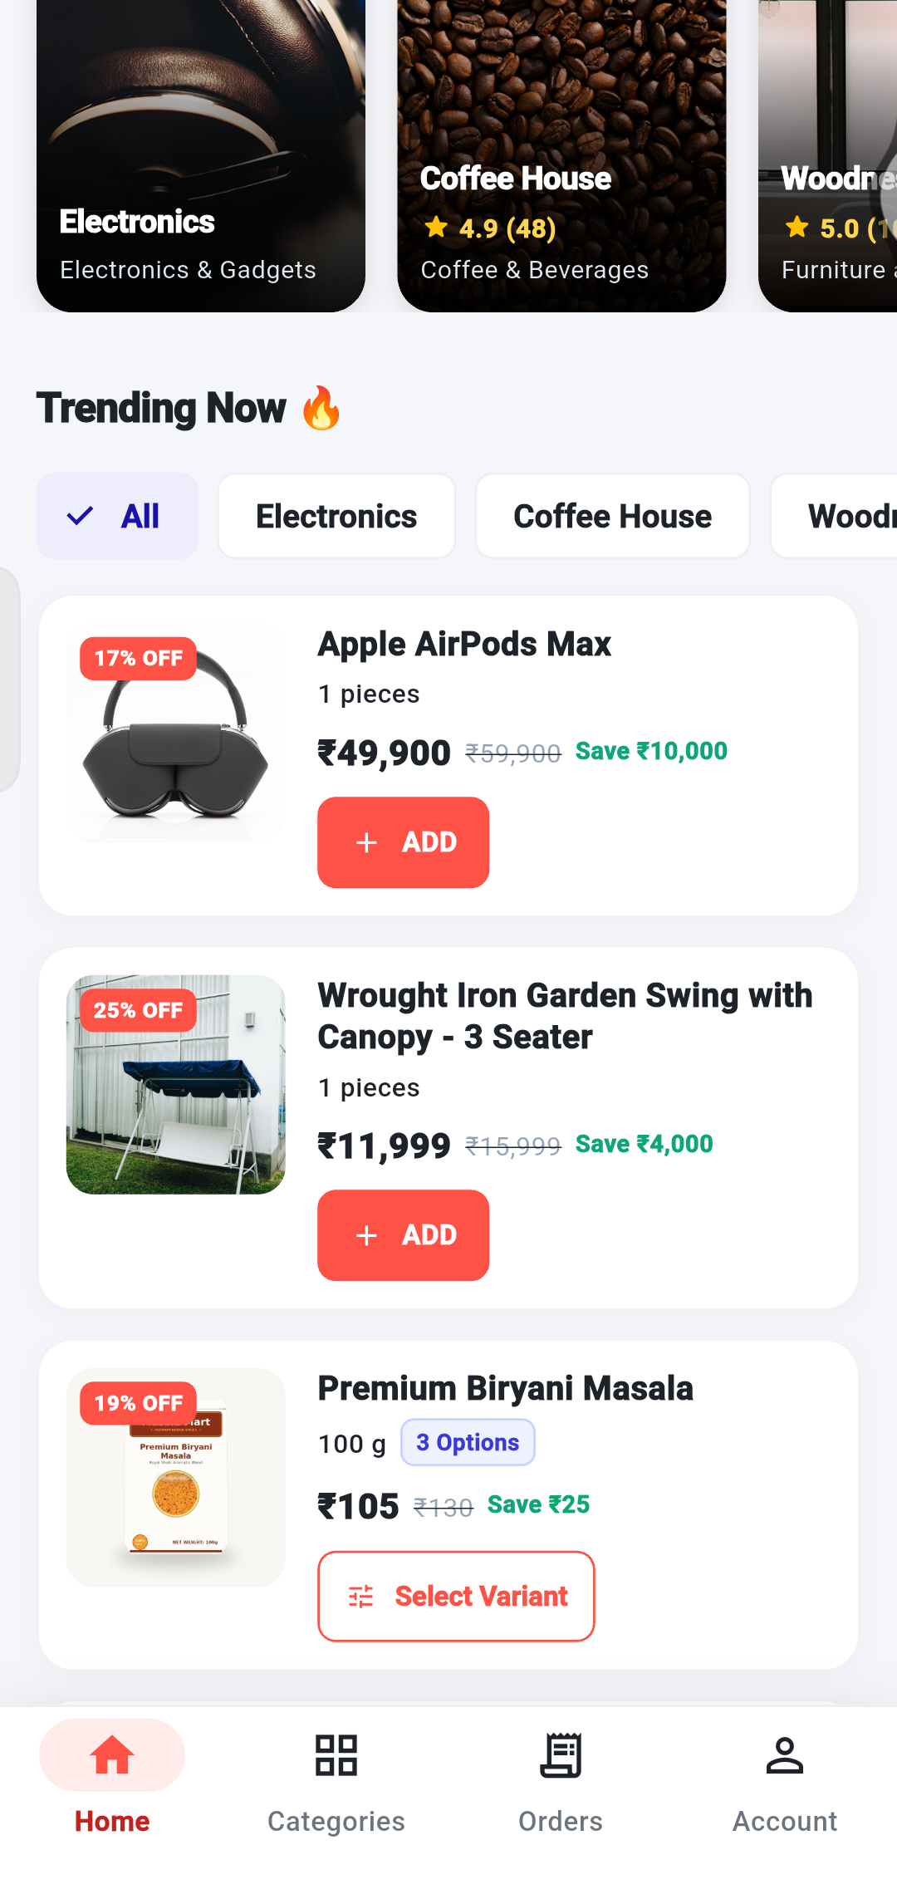
FULL ORDER WALKTHROUGH
Walkthrough: add products from different shops
1
Pick a shop (optional).
On Home, the chips under Trending Now filter products by shop.
1
2
Tap ADD on a product.
Products from any shop can go into the same cart.
2
3
Products with sizes show Select Variant.
Choose the size first, then add it.
3
Tip In this walkthrough: AirPods Max (Electronics), Green Cardamom (Masala Mart) and a Garden Swing (Woodnest Living).
Notes:
We added three products from three different shops: Apple AirPods Max (Electronics), Green Cardamom (Masala Mart) and a Garden Swing (Woodnest Living).

Slide 20
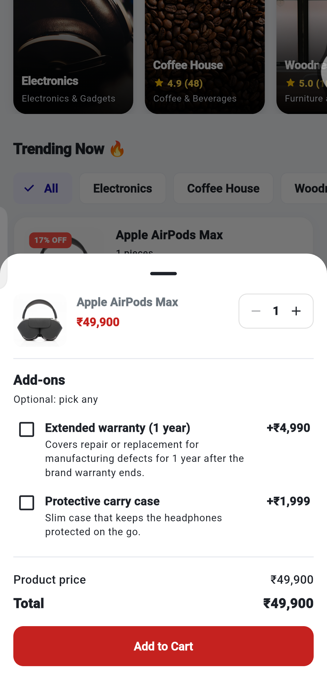
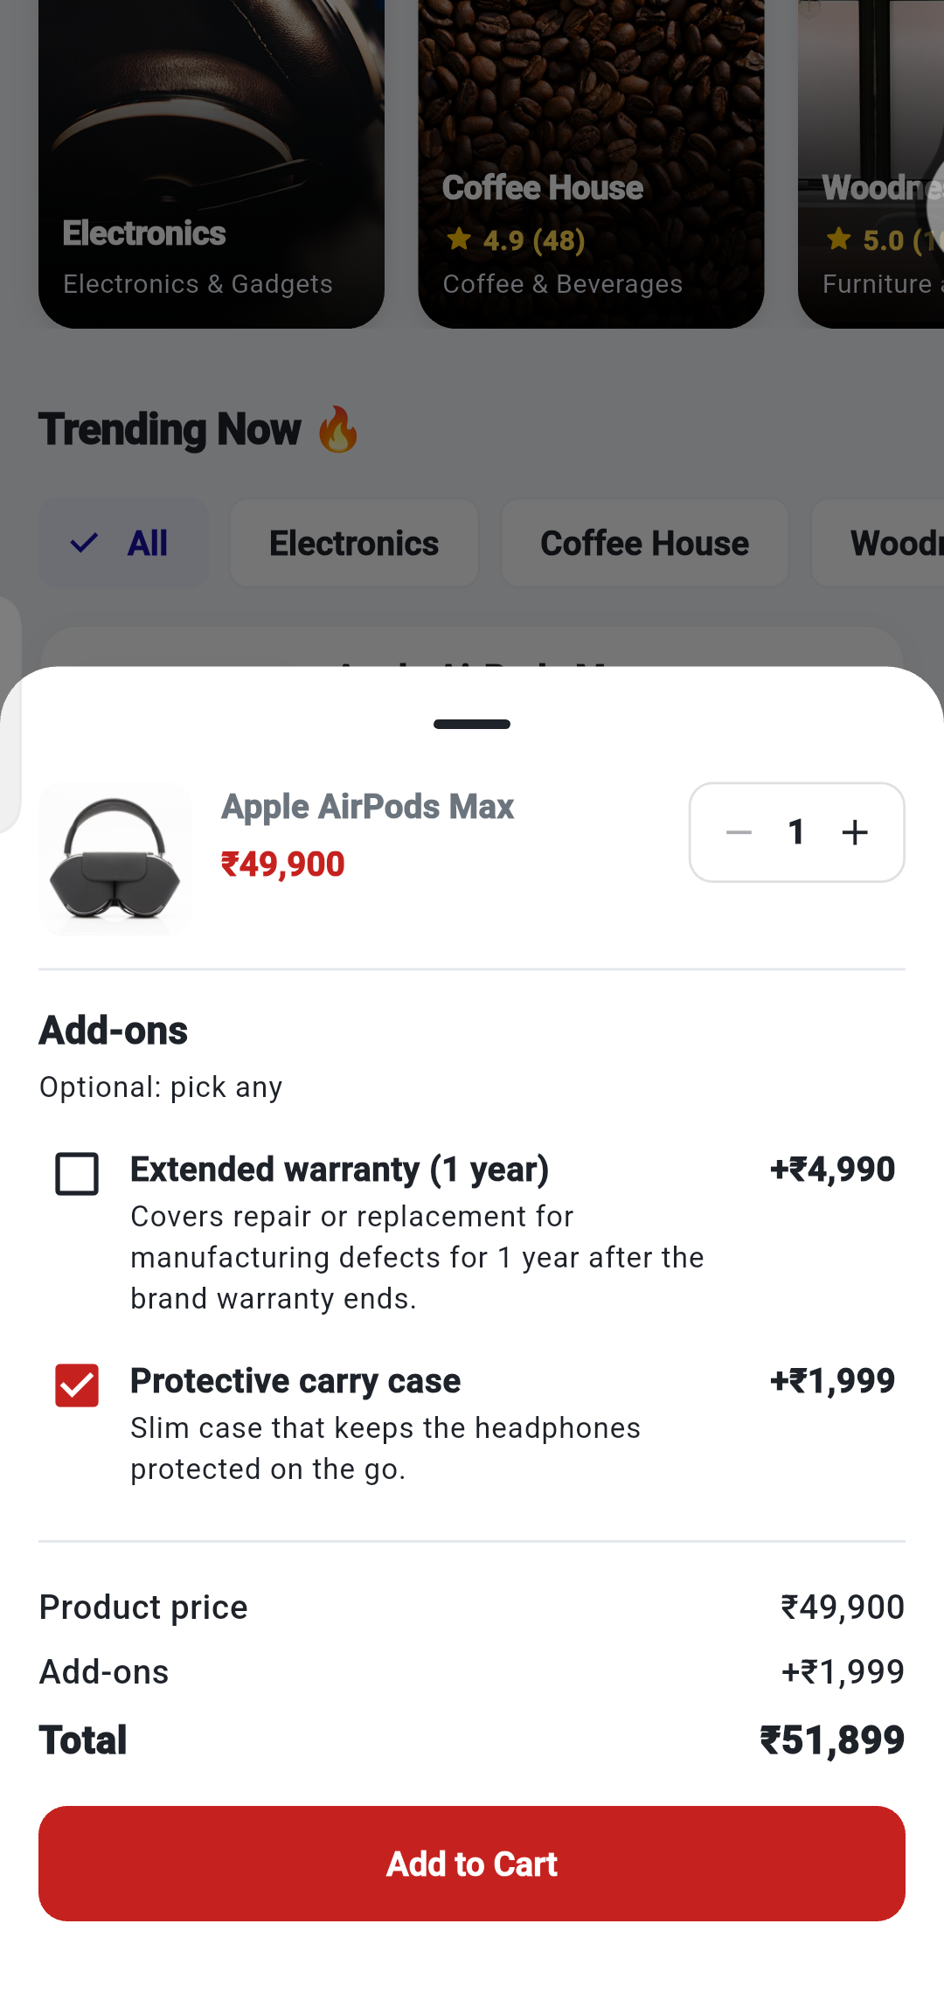
FULL ORDER WALKTHROUGH
Walkthrough: choose add-ons
1
Choose the quantity
with − and + (top right of the panel).
2
Tick the add-ons you want.
Each add-on has its own price, for example Protective carry case +₹1,999.
1
3
Watch the Total.
₹49,900 became ₹51,899 after adding the carry case.
2
4
Tap Add to Cart.
The item is added together with its add-ons.
2
3
Tip Add-ons are optional. Leave them unticked if you do not need them.
4
Notes:
Add-ons are optional extras. Each has its own price and is added to the product price.

Slide 21
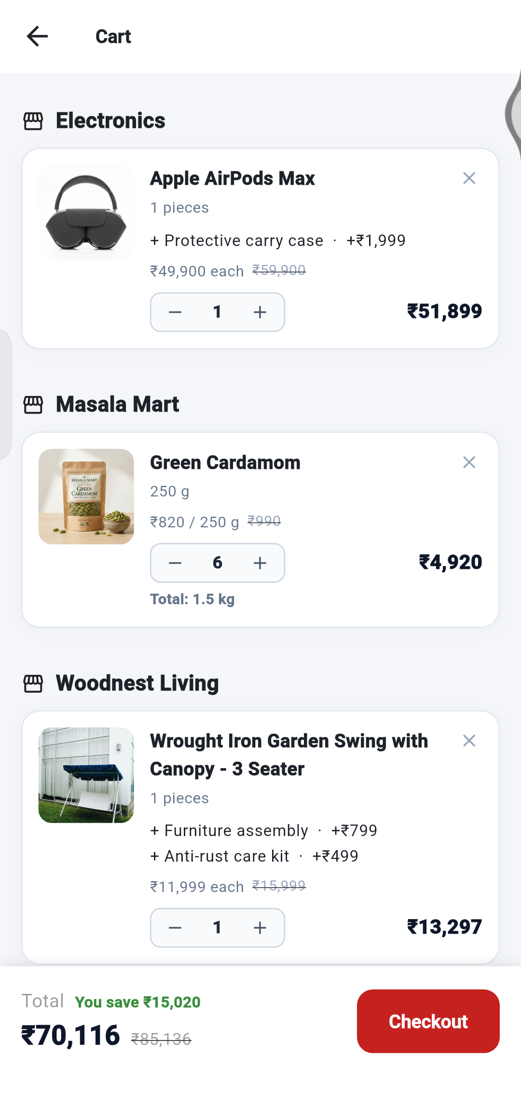

FULL ORDER WALKTHROUGH
Walkthrough: update quantities
1
Tap − or + next to an item.
Here the Green Cardamom quantity went from 6 down to 2.
2
The item price updates.
₹4,920 (6 × ₹820) became ₹1,640 (2 × ₹820).
The cart total updates.
₹70,116 became ₹66,836.
1
2
1
2
3
Tip To remove an item completely, tap the X at its top right.
3
3
Notes:
Reducing Green Cardamom from 6 to 2 lowered the cart total from 70,116 to 66,836.

Slide 22
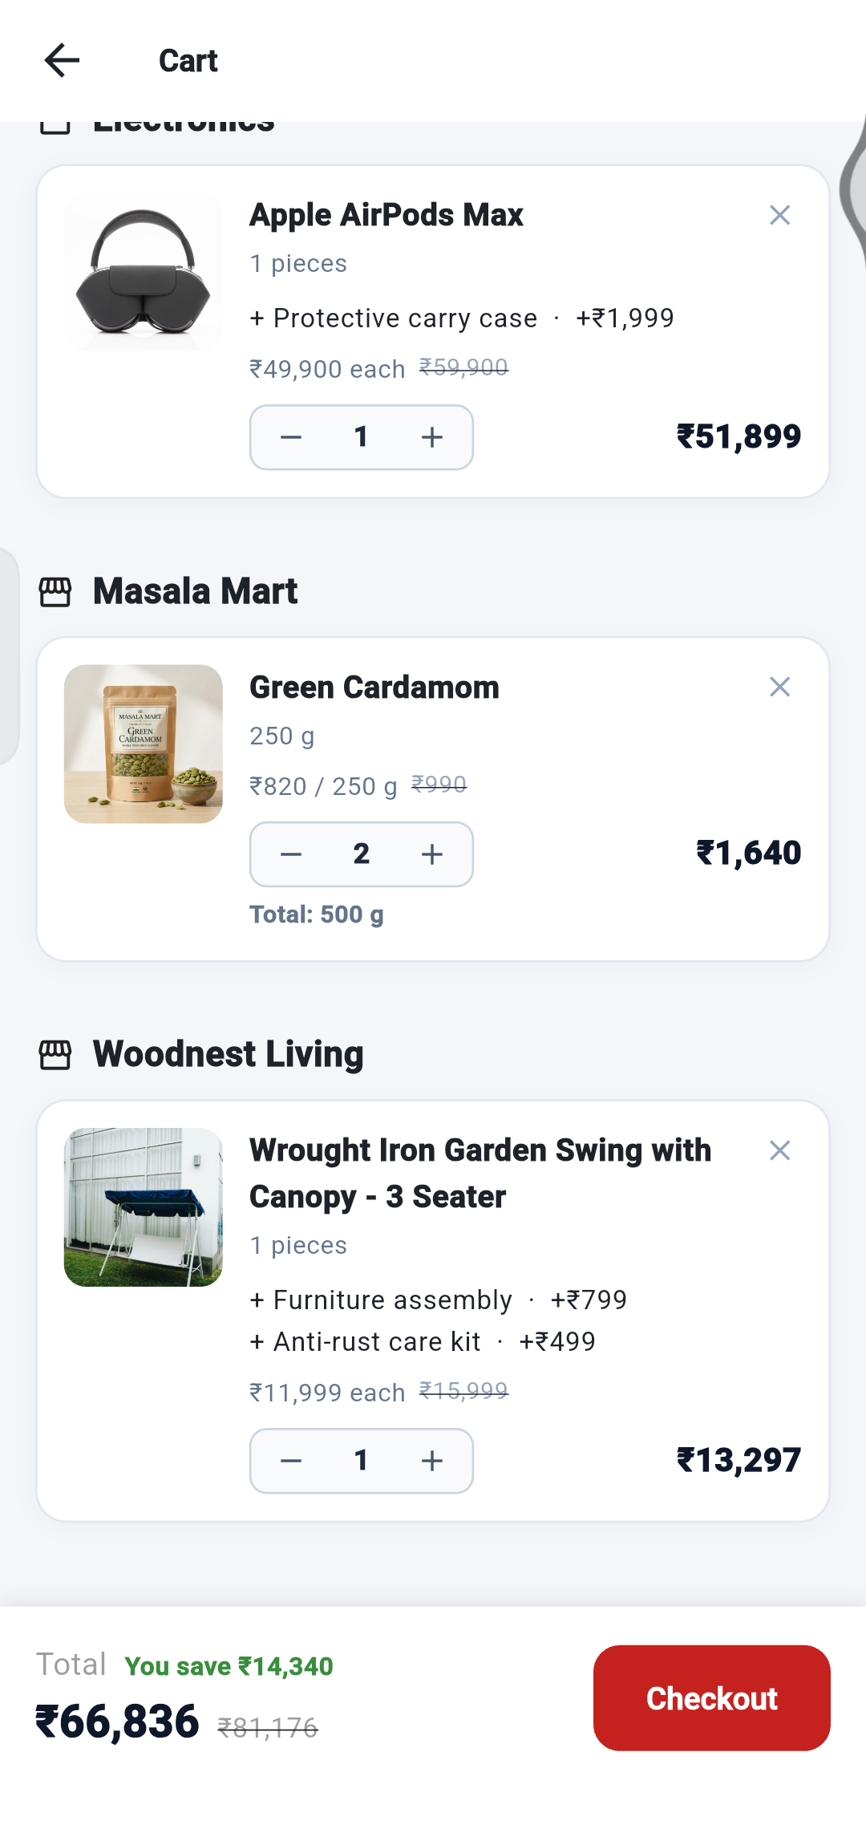
FULL ORDER WALKTHROUGH
Walkthrough: how the cart adds up
Electronics
₹51,899
AirPods Max ₹49,900 + carry case ₹1,999
1
Masala Mart
₹1,640
Green Cardamom 250 g: ₹820 × 2
Woodnest Living
₹13,297
2
Swing ₹11,999 + assembly ₹799 + anti-rust kit ₹499
3
Cart total ₹51,899 + ₹1,640 + ₹13,297 = ₹66,836
Tip Add-ons are counted inside the item price, so they are multiplied together with the quantity.
4
Notes:
Each shop is its own group in the cart. Add-ons are added to the item price before it is multiplied by the quantity.

Slide 23
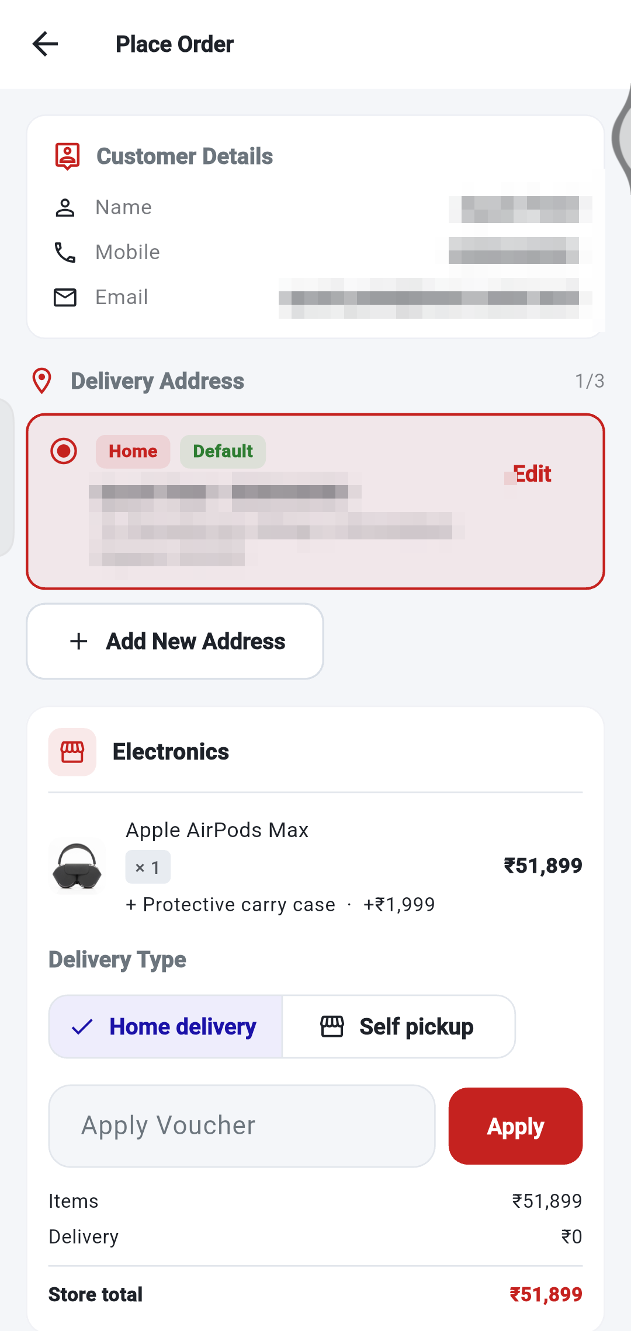
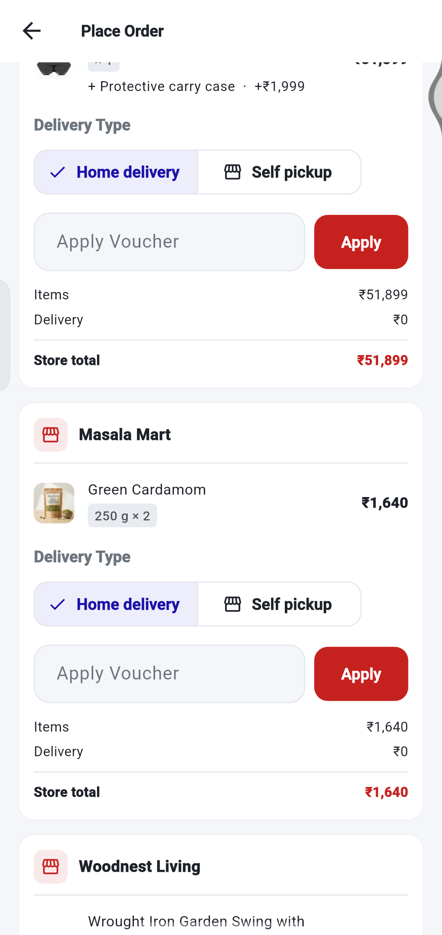
FULL ORDER WALKTHROUGH
Walkthrough: checkout with several shops
1
1
Your details and address
are shared by all the orders. Choose or edit the address here.
2
Each shop has its own section.
Items and add-ons are listed under the shop that sells them.
3
Choose the delivery type per shop.
Home delivery or Self pickup.
2
4
4
Each shop has its own voucher box.
A voucher works only for its own shop.
3
Store total
is the amount for that shop’s order.
5
5
Notes:
Checkout shows one section for each shop. Each shop has its own delivery type, voucher box and store total.

Slide 24
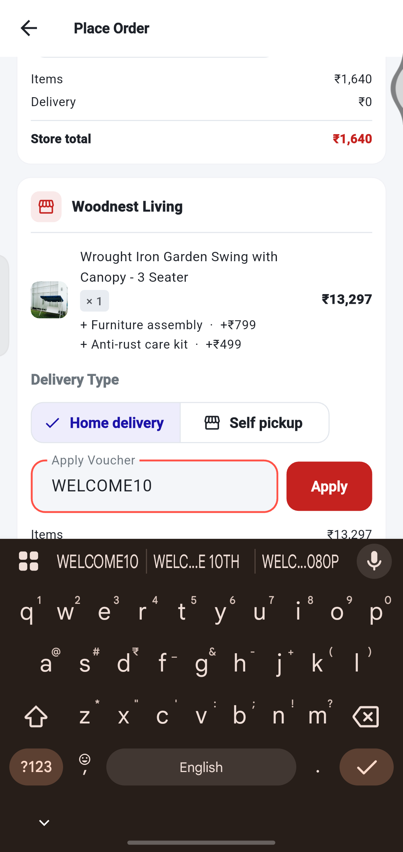
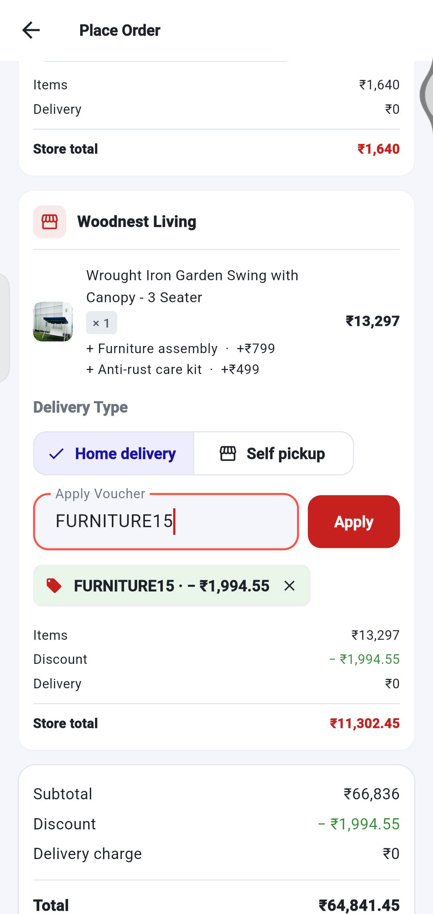
FULL ORDER WALKTHROUGH
Walkthrough: apply a voucher
1
Type the code
into the Apply Voucher box of the shop. We used FURNITURE15 for Woodnest Living.
2
Tap Apply.
The message “Voucher applied” appears.
3
A green label shows your saving.
FURNITURE15 · −₹1,994.55. Tap X on it to remove the voucher.
1
2
4
The Discount line
is taken off the shop’s items.
3
5
Store total drops
from ₹13,297 to ₹11,302.45.
4
5
Tip 15% of ₹13,297 = ₹1,994.55, so ₹13,297 − ₹1,994.55 = ₹11,302.45.
Notes:
FURNITURE15 gives 15 percent off at Woodnest Living. 15 percent of 13,297 is 1,994.55.

Slide 25
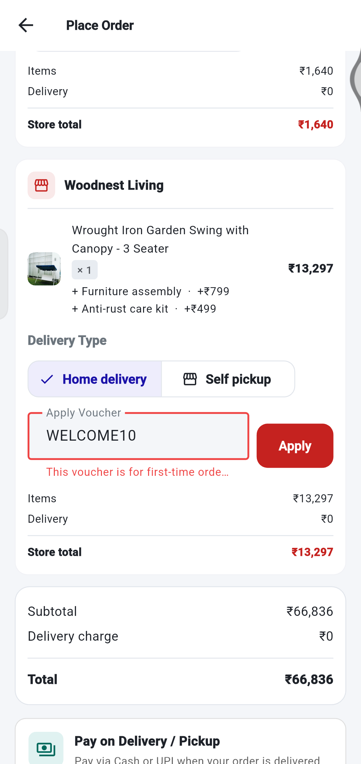
FULL ORDER WALKTHROUGH
When a voucher is not accepted
1
Type a code and tap Apply.
We tried WELCOME10 first.
2
Read the red message under the box.
Here: “This voucher is for first-time orders only.” This account already has orders.
3
Try another code.
The coupons list on Home shows each coupon’s shop and minimum order amount.
1
2
Tip Nothing is charged for a rejected code. Your totals stay the same.
Notes:
We first tried WELCOME10. The app said it is for first-time orders only, because this test account already has orders.

Slide 26
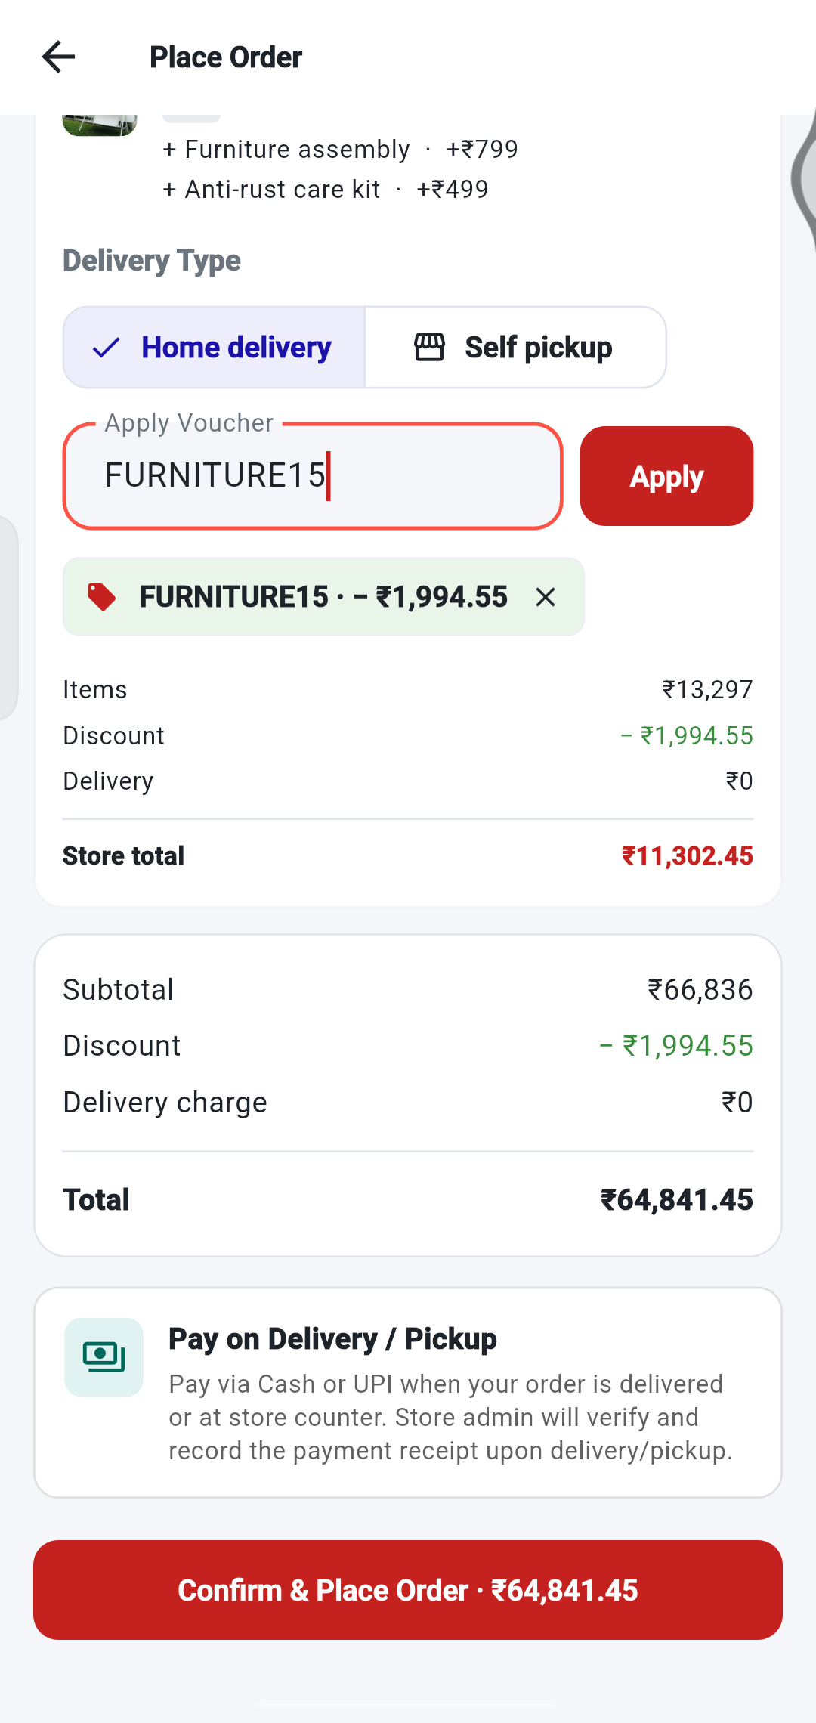
FULL ORDER WALKTHROUGH
Walkthrough: review and place the order
1
Check the Discount.
−₹1,994.55 from the voucher.
2
Check the Total.
₹66,836 − ₹1,994.55 = ₹64,841.45.
3
Tap Confirm & Place Order.
The button shows the amount you will pay on delivery or pickup.
1
2
Tip You pay when the order is delivered or collected. Nothing is paid in the app.
3
Notes:
The final payable amount is the sum of all shops after the voucher. Payment is made on delivery or pickup.

Slide 27
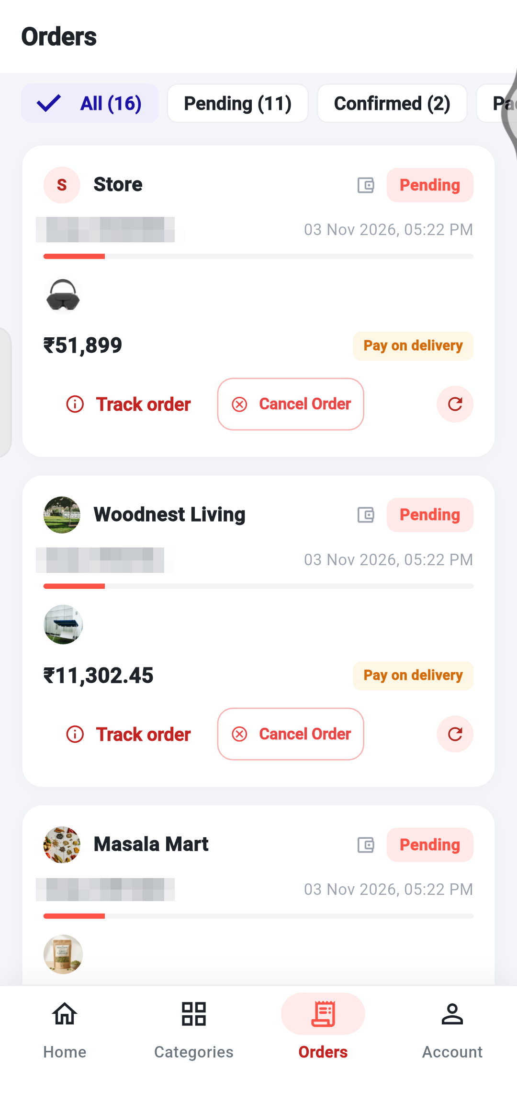
FULL ORDER WALKTHROUGH
Order confirmation: one order for each shop
1
4
1
The app opens your Orders list.
There is no separate confirmation screen when you order from several shops.
2
2
Three new orders appear.
One for each shop, each with its own order number.
3
Each order shows its own amount.
₹51,899, ₹11,302.45 and ₹1,640.
3
4
All start as Pending.
The store will confirm them. “Pay on delivery” shows how you will pay.
Tip With one shop only, the app opens that order’s status page instead.
Notes:
After placing, the app opens the Orders tab. There is one order for each shop, all Pending.

Slide 28
FULL ORDER WALKTHROUGH
Your three orders at a glance
Shop | Products and add-ons | Voucher | Order total
Electronics | Apple AirPods Max ₹49,900 + Protective carry case ₹1,999 | None | ₹51,899
Woodnest Living | Garden Swing ₹11,999 + Furniture assembly ₹799 + Anti-rust care kit ₹499 = ₹13,297 | FURNITURE15 −₹1,994.55 | ₹11,302.45
Masala Mart | Green Cardamom 250 g × 2 = ₹1,640 | None | ₹1,640
Total to pay |  |  | ₹64,841.45
Tip Each order is handled separately by its own shop, so they can be confirmed and delivered at different times.
Notes:
The three orders created from the walkthrough, with the voucher only on the Woodnest order.

Slide 29
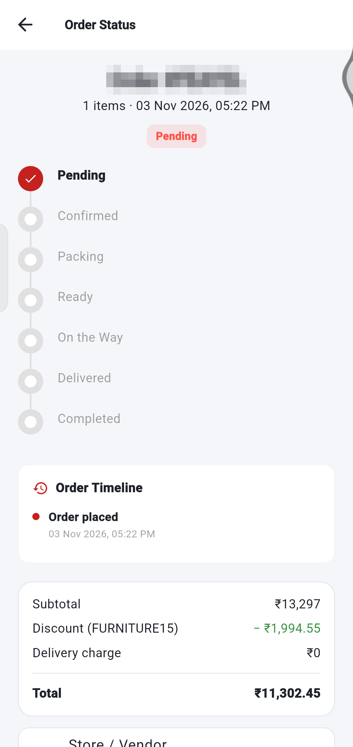
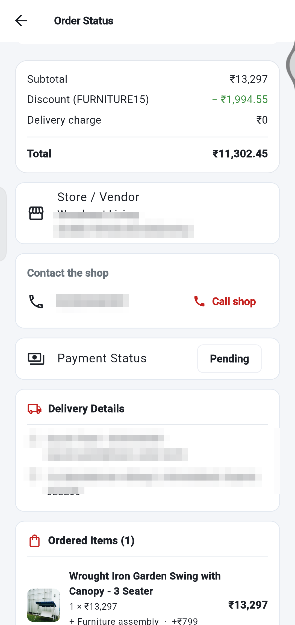
FULL ORDER WALKTHROUGH
Open an order to see its details
1
Tap Track order.
The status page shows the order number and its status, here Pending.
1
3
2
2
Follow the steps.
The red tick shows where the order is now.
3
See the price breakdown.
Subtotal ₹13,297, Discount (FURNITURE15) −₹1,994.55, Total ₹11,302.45.
4
4
Payment Status
stays Pending until the shop records your payment.
5
Ordered Items
lists the product and each add-on you chose.
3
5
Notes:
Tap Track order to see the progress, the price breakdown including the voucher, and the items with their add-ons.

Slide 30
YOUR ORDERS
See all your orders
1
2
1
Filter tabs.
All, Pending, Confirmed and more. The number shows how many orders.
2
Status label
on each order (Completed, Pending, Confirmed…).
5
3
Track order
opens the live progress of the order.
4
Cancel Order
is available while the order is Pending.
6
3
4
5
Rate your items
appears on completed orders.
6
Circle arrow.
Adds the same items to your cart again.
Notes:
The Orders tab lists every order. Use the tabs at the top to filter by status.

Slide 31
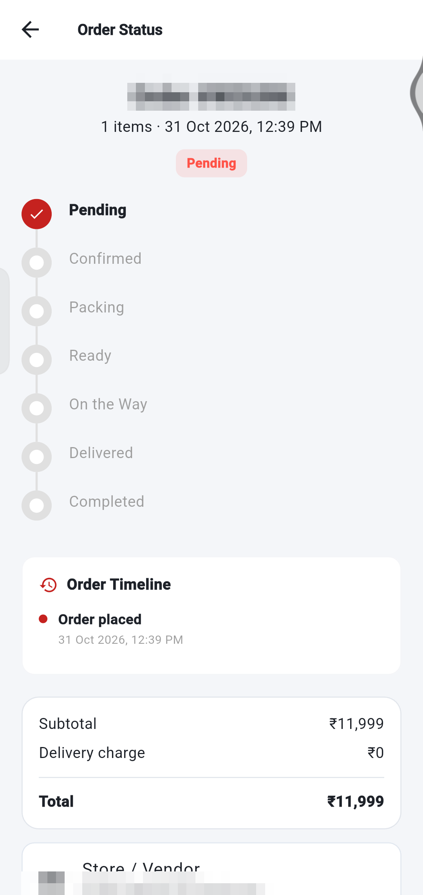
YOUR ORDERS
The journey of an order
1
Pending Order placed. Waiting for the store.
2
Confirmed The store accepted your order.
3
Packing Your items are being packed.
1
4
Ready Packed and ready.
5
On the Way Your order is out for delivery.
6
Delivered Your order has been handed over.
7
Completed Done. This happens after you review your order.
Cancelled The order was cancelled. You can cancel yourself only while it is Pending.
Notes:
Each order moves through these steps. You can follow it live.

Slide 32
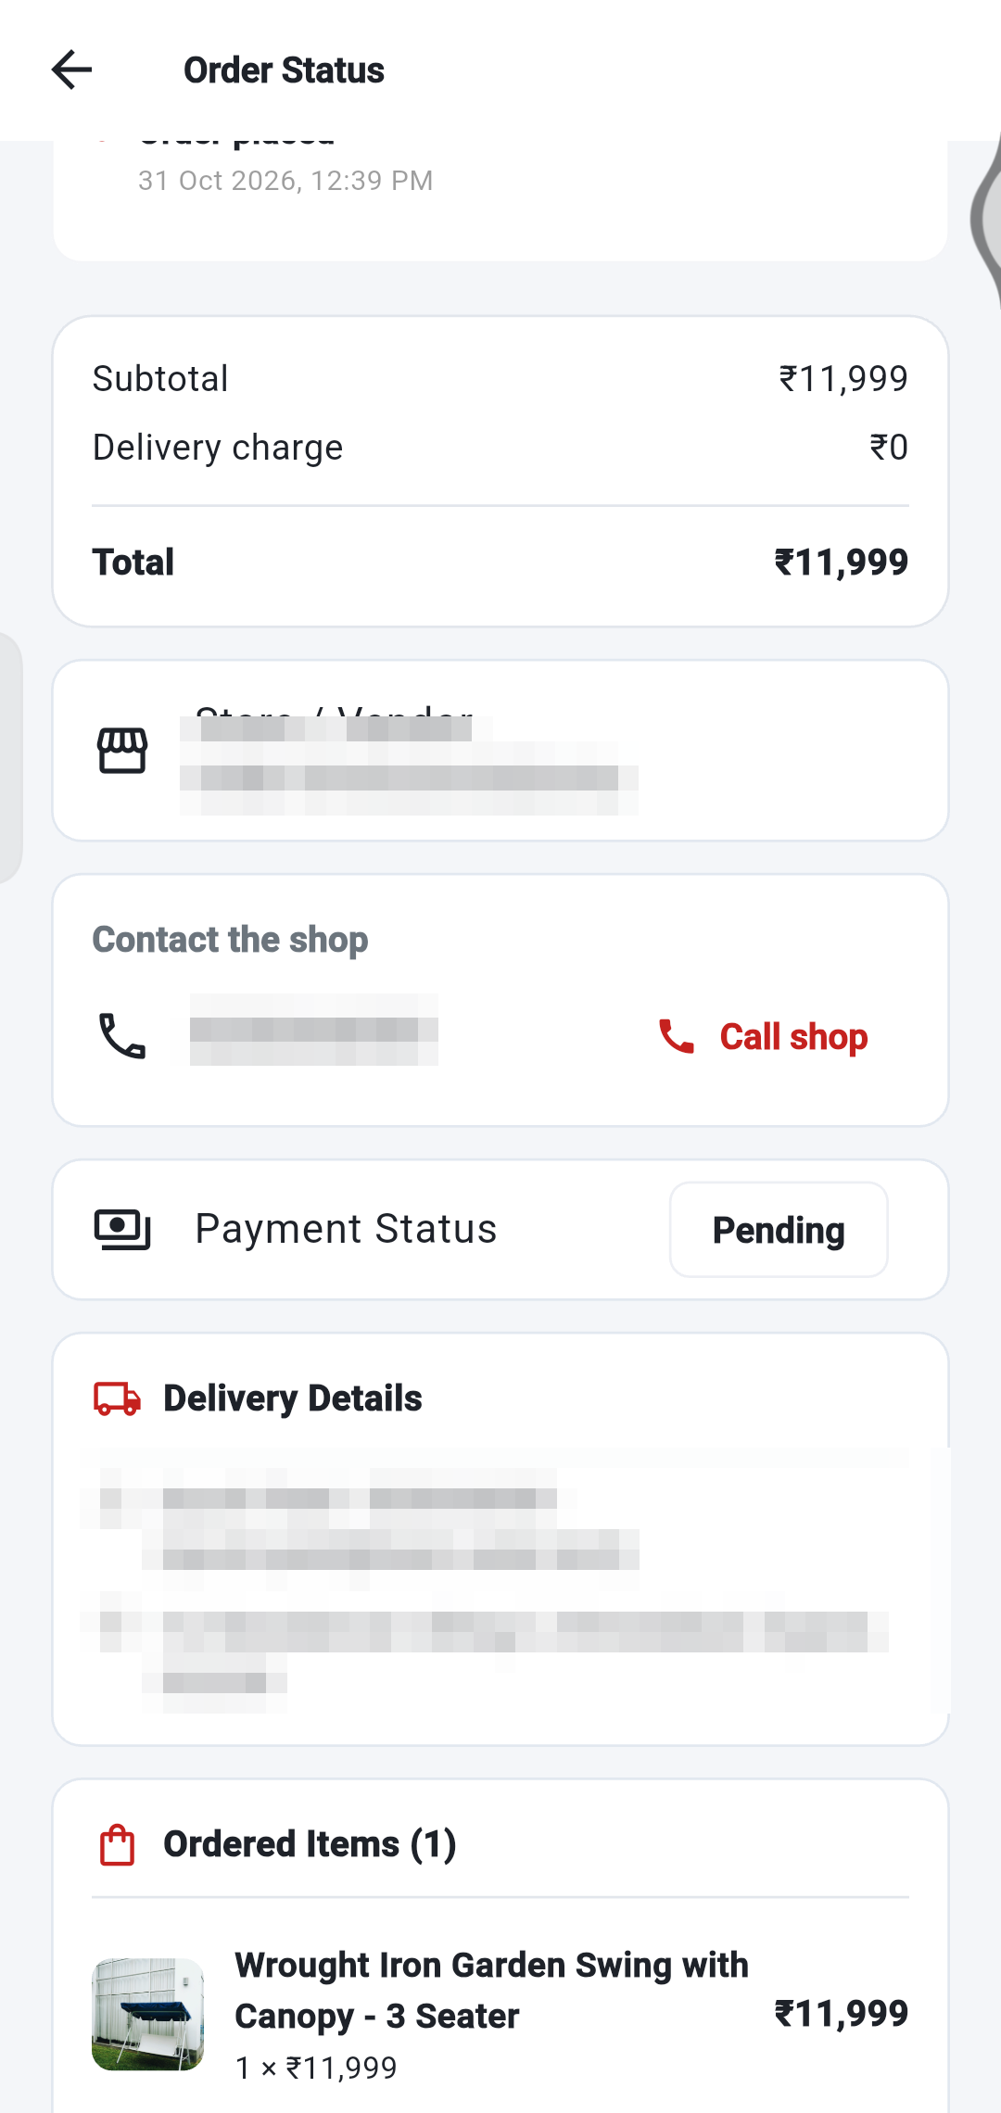
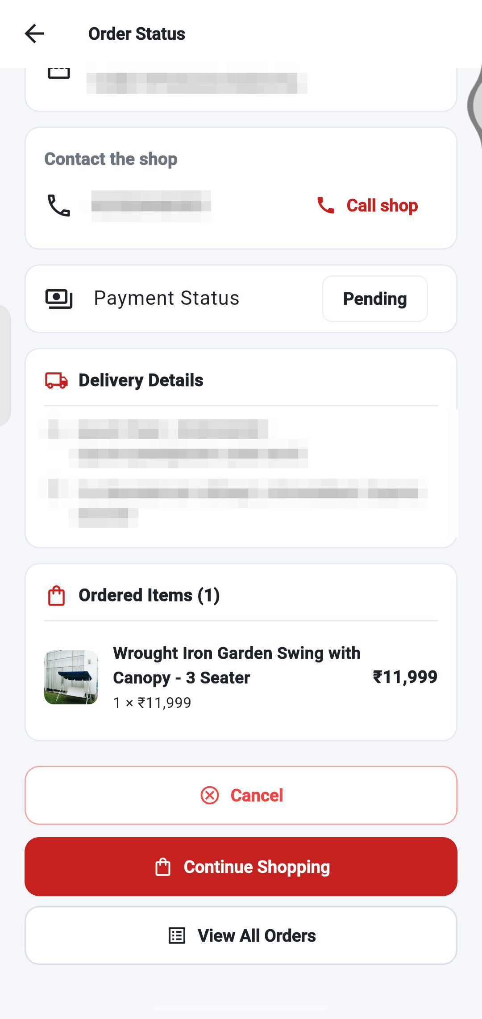
YOUR ORDERS
Open an order to see everything
1
3
4
2
5
6
7
8
1 Progress: the red tick shows where your order is.
2 Order Timeline lists each update with date and time.
3 Call shop to phone the store.
4 Payment Status stays Pending until the store records it.
5 Delivery Details and Ordered Items.
6 Cancel (only while Pending).
7 Continue Shopping.
8 View All Orders.
Notes:
Order details show progress, payment, delivery details and the items you ordered.

Slide 33
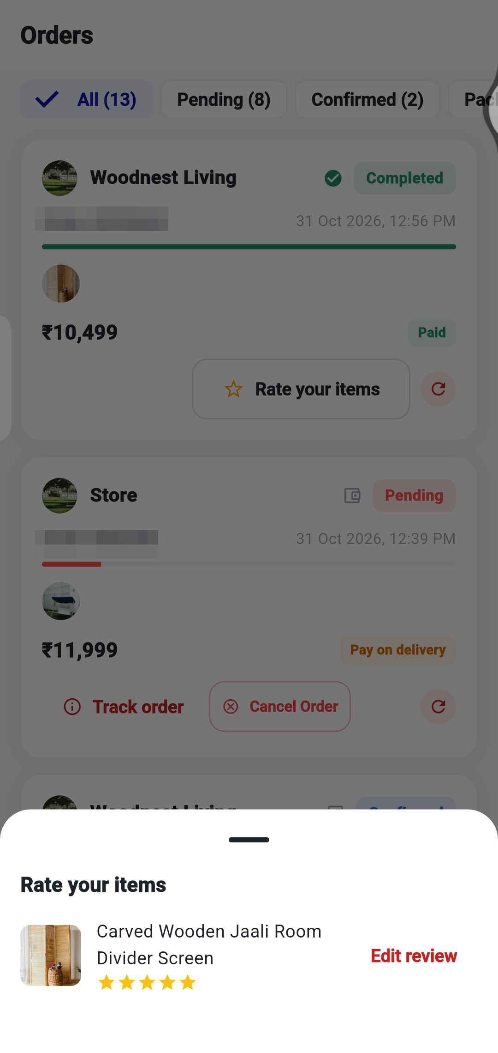
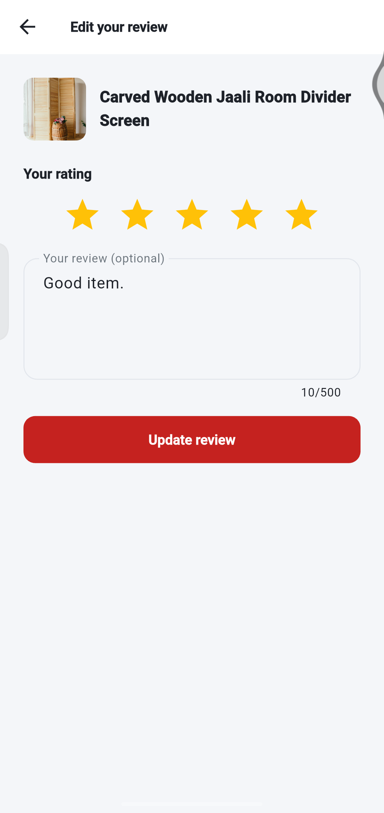
YOUR ORDERS
Rate and review what you bought
1
Tap “Rate your items”
on a delivered or completed order.
3
2
Choose the product.
If you already reviewed it you will see Edit review.
Tap the stars.
From 1 star to 5 stars.
4
3
5
4
Write a comment (optional).
Up to 500 characters.
5
Tap Submit or Update review.
Other buyers see it on the product page.
1
Tip Reviewing is only possible after your order has been delivered.
2
Notes:
You can review once an order is delivered. You can edit your review later.

Slide 34
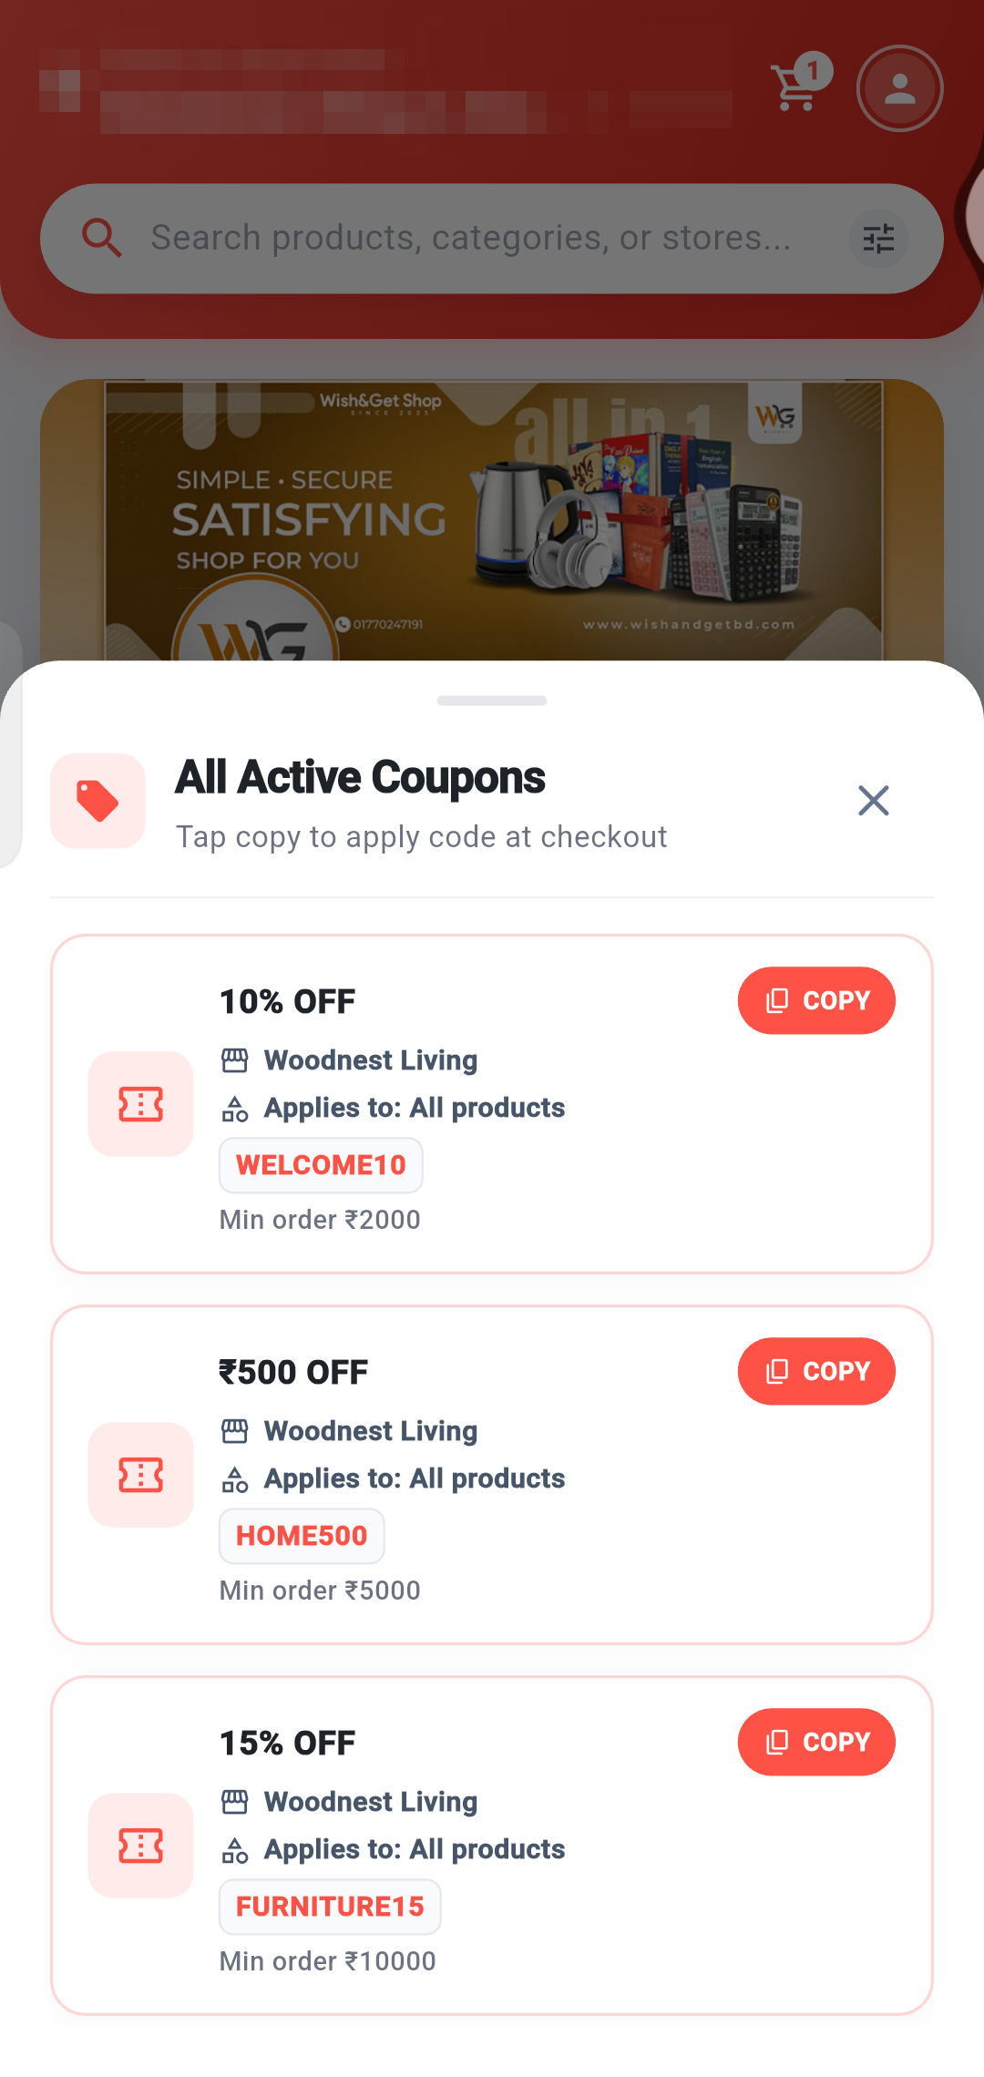
DEALS AND HELP
Use deals and coupons
1
Open See All
next to Store Vouchers & Deals on Home.
2
Read each coupon.
It shows the discount, the shop, what it applies to and the minimum order.
1
4
3
3
Tap COPY
to copy the code, for example WELCOME10.
2
4
At checkout, paste it
into Apply Voucher and tap Apply.
Tip A coupon works only for its own shop and when your order reaches the minimum amount.
Notes:
Coupons come from stores. Copy a code and apply it at checkout.

Slide 35
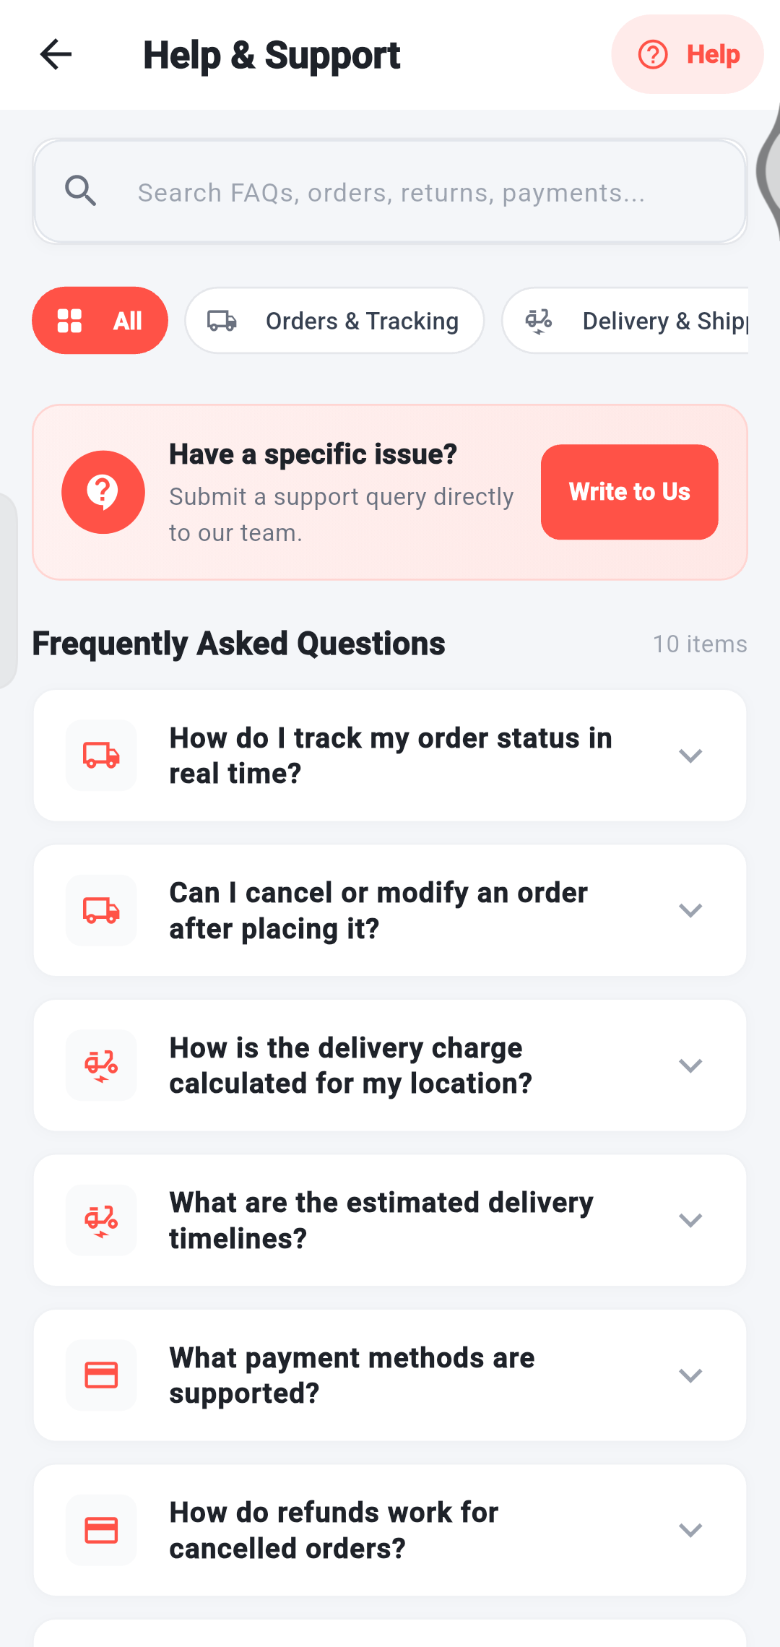
DEALS AND HELP
Warranty and service requests
1
Digital Warranty is not in this version.
There is no warranty records screen.
4
2
Service Requests are not in this version.
There is no service request form.
3
Warranty, Delivery & Care.
Each product page has this section with the seller’s information.
3
4
Need help?
Use Help & Support → Write to Us (see the Account section).
Tip We only show screens that really exist in the app.
Notes:
These features are not part of this version of the app. Here is what is available instead.

Slide 36
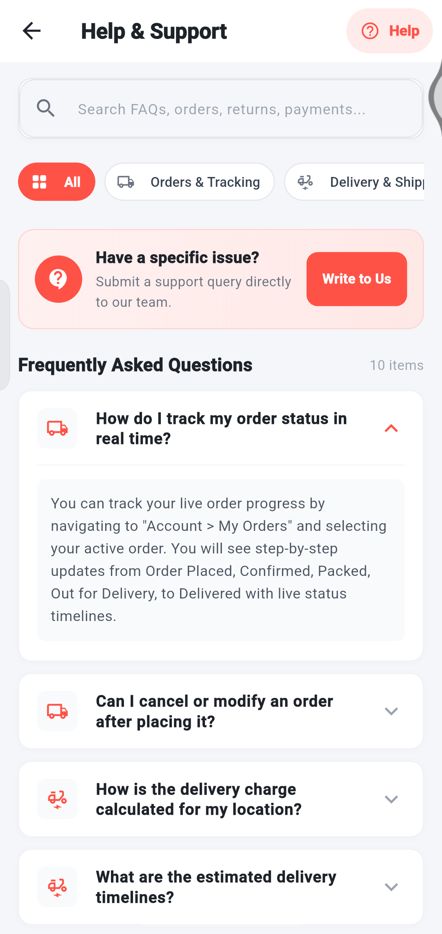
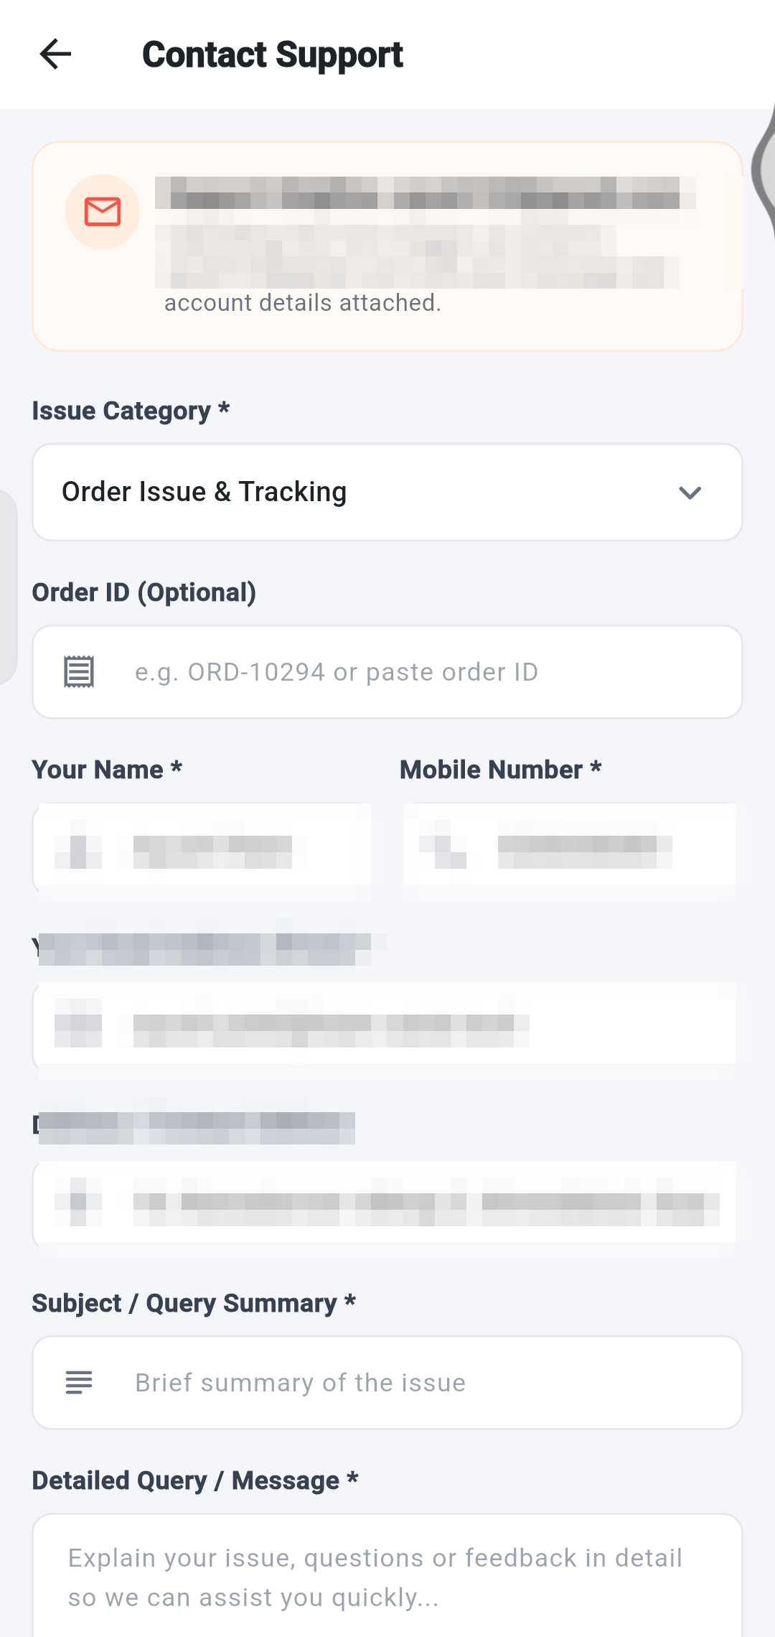
DEALS AND HELP
Get help
1
2
3
5
4
6
7
1 Search the questions.
2 Filter by topic.
3 Tap Write to Us for a specific issue.
4 Tap a question to read the answer. Tap again to close it.
5 Choose the issue type.
6 Your details are filled in for you.
7 Add a summary and your message, then send it.
Notes:
Help & Support has answers to common questions and a form to contact the team.

Slide 37
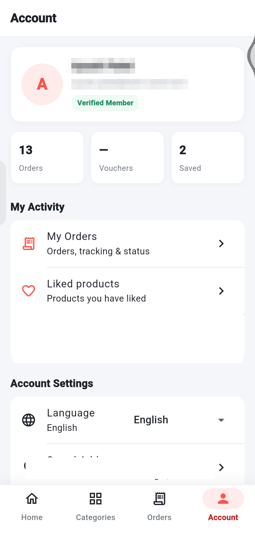
ACCOUNT
Your account
1
1
Profile.
Your name and email. A Verified Member badge shows under them.
2
2
Quick numbers.
How many Orders you have, your Vouchers and Saved items.
3
3
My Orders.
Opens your order list.
4
4
Liked products.
Everything you saved with the heart.
Tip Your name and email are hidden in this guide.
Notes:
The Account tab shows your profile and a summary of your activity.

Slide 38
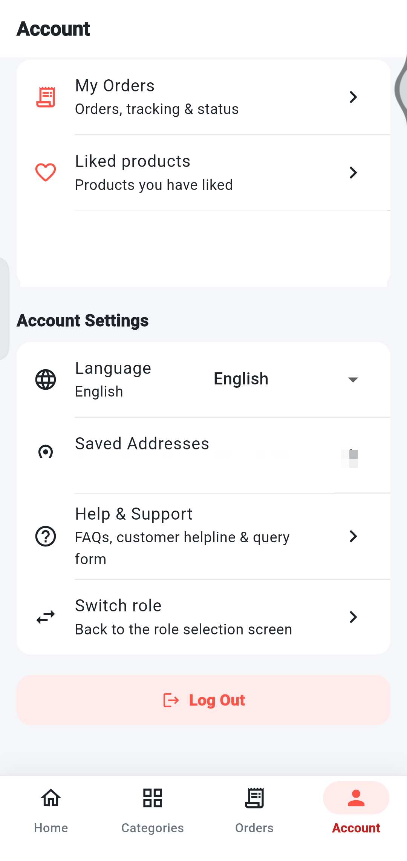
ACCOUNT
Account settings
1
Language.
Choose English, Hindi or Gujarati.
2
Saved Addresses.
Add, edit or delete delivery addresses.
1
3
Help & Support.
FAQs and a form to contact the team.
2
3
4
Switch role.
Goes back to the first screen. Shoppers rarely need it.
4
5
5
Log Out.
Signs you out of the app on this phone.
Notes:
Scroll down in the Account tab to find the settings.

Slide 39
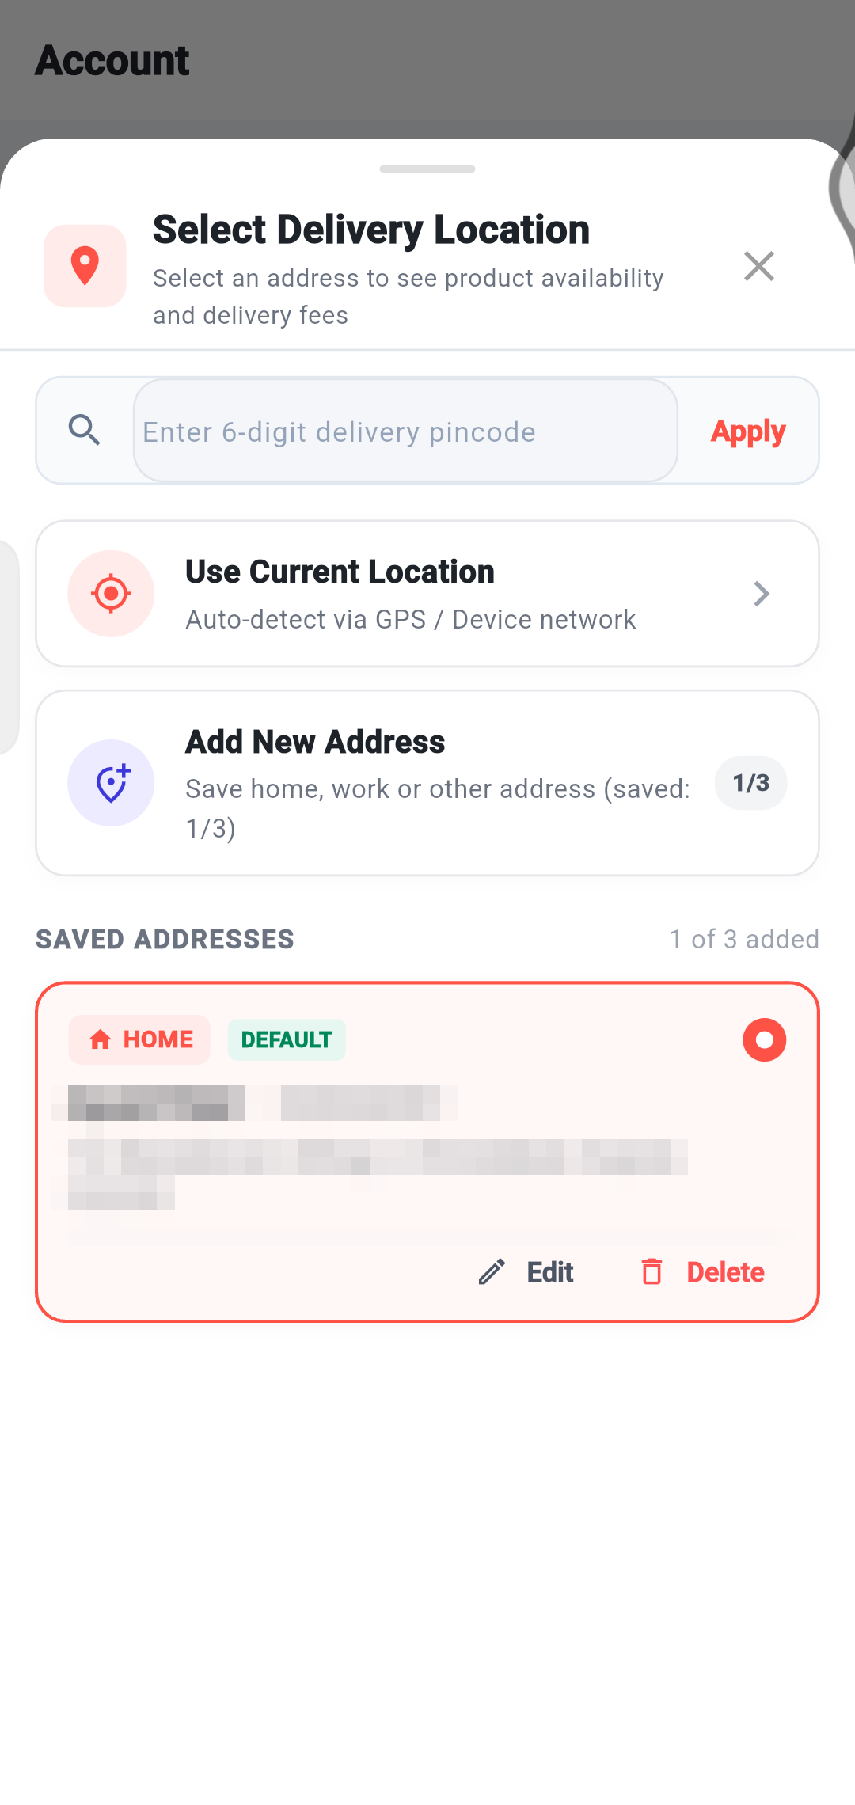
ACCOUNT
Saved addresses and delivery location
1
Enter a pincode
and tap Apply to see what is available in that area.
1
2
2
Use Current Location
to detect where you are.
3
3
Add New Address.
You can save up to 3 addresses (it shows 1/3).
4
4
Your saved addresses.
The DEFAULT one is used first. Edit or Delete them here.
Tip Your own address is hidden in this guide.
Notes:
You can keep up to three addresses. Choose one at checkout.

Slide 40
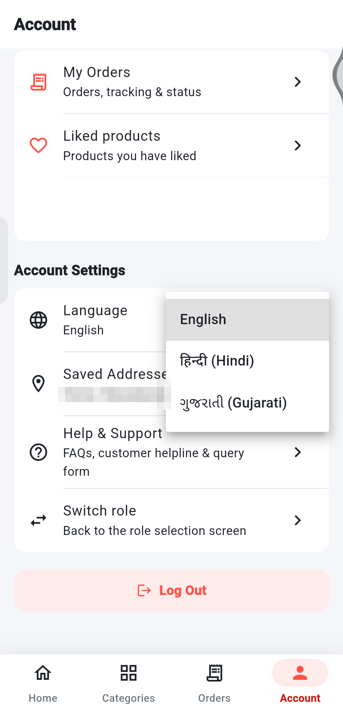
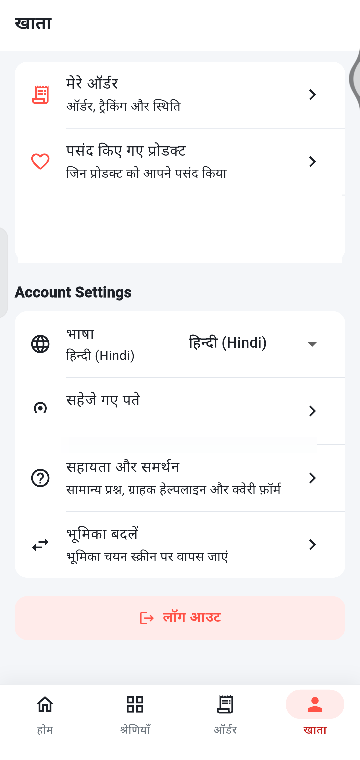
ACCOUNT
Change the language
1
Open Account.
Find Language under Account Settings.
2
Tap the language box.
Choose English, हिन्दी (Hindi) or ગુજરાતી (Gujarati).
1
3
2
3
Everything updates.
Menus, buttons and the bottom bar change to your language.
Tip You can also change language on the very first screen with EN / ગુ / हि.
Notes:
The whole app changes language straight away.

Slide 41




WRAP UP
Helpful tips
Browse first
Copy a coupon
Check your total
Choose how to receive
You do not need an account just to look around.
Check Store Vouchers & Deals before you check out.
Review items, delivery charge and the Total before you place the order.
Home delivery or Self pickup – pick what suits you.
Track from Orders
Cancel early
Save favourites
Use your language
Open the Orders tab any time to see where your order is.
You can cancel an order only while it is Pending.
Tap the heart to find a product again quickly.
Switch between English, Hindi and Gujarati in Account.
Notes:
A few habits that make shopping easier.

Slide 42
WRAP UP
Frequently asked questions (1/2)
How can I find a product?
How do I add a product to my cart?
Tap the search bar on Home or Categories and type its name. Use In Stock and Price to narrow the results, or browse by category or shop.
Open the product and tap Add to Cart, or use the ADD / + button on a product card. Tick any extras, tap Add to Cart, and sign in if asked.
Can I change the quantity?
How do I place an order?
Yes. Use − and + on the product page or in the cart. Tap the X in the cart to remove an item.
Cart → Checkout → check your details and address → choose Home delivery or Self pickup → Confirm & Place Order.
Where can I check my order status?
How do I pay?
Open the Orders tab and tap Track order, or open an order to see its progress and timeline.
Pay on delivery or pickup, by cash or UPI. The store records your payment.
Notes:
Answers to the most common questions.

Slide 43
WRAP UP
Frequently asked questions (2/2)
Can I cancel an order?
How do I write a review?
Yes, while its status is Pending: open the order and tap Cancel. Once the store confirms it, it can no longer be cancelled.
When an order is delivered, open Orders → Rate your items, choose the product, tap the stars and add a comment if you like.
How do I change the language?
Where can I get help?
Account → Language, then choose English, Hindi or Gujarati.
Account → Help & Support. Read the FAQs, or tap Write to Us to contact the team.
Notes:
More answers.

Slide 44
WRAP UP
About this guide
Where the screens come from
Every screenshot was taken on a real Android phone (Vivo V2403) using the running app with test data.
Privacy
Names, phone numbers, email addresses, street addresses and order numbers are hidden with blurred blocks.
Not shown in this guide
The sign-up form and the phone’s share panel were not captured. The order walkthrough placed three test orders on a test account. Digital Warranty and Service Requests are not part of this version. The app has no account deletion or privacy settings screen.
Bazaar
Notes:
About the screens in this guide.

Slide 45
Thank you
1
Happy shopping!
Need help? Open Account → Help & Support in the app to read the FAQs or write to the team.
Notes:
Thank you for using the Shopper app.

