Slide 1
PORTFOLIO PROJECT / BUSINESS ANALYTICS
UPSC Civil Services
Examination
2019–2024 | Participation, Progression & Recommendation Analysis
Ayush Patel
A six-year view of the examination pipeline
Excel • SQL • BigQuery • Power BI • DAX
2019
2020
2021
2022
2023
2024

Slide 2
01 | THE ANALYTICAL QUESTION
What changed across the examination pipeline?
The project looks at the full 2019–2024 period rather than treating two endpoint years as the main comparison.
01
02
03
04
05
Applications
→
Appearance
→
Mains
→
Interview
→
Recommendation
How many candidates applied?
How many actually appeared?
How large was the mains-qualified pool?
How many reached interview?
How many were recommended?
Supporting lens
Vacancies are tracked alongside recommendations to add annual capacity context.
The objective is descriptive: identify patterns, changes and relationships in the published annual data — not to infer causes.
02
UPSC CIVIL SERVICES EXAMINATION | PORTFOLIO PROJECT
02
UPSC CIVIL SERVICES EXAMINATION | PORTFOLIO PROJECT

Slide 3
02 | DATA & METHOD
From raw annual figures to an interactive analytical view
A compact workflow designed around reproducibility and clear business-style communication.
01
Data preparation
Organise annual examination data, standardise fields and validate the analysis table.
Excel
STACK
Excell
02
SQL analysis
Aggregate applicants, appearance, progression, recommendations and vacancies.
BigQuery
SQL
03
DAX metrics
Build reusable totals and rate measures for Power BI.
Power BI
DAX
04
Dashboard design
Turn the metrics into a focused 16:9 interactive dashboard.
Output
A portfolio-ready dashboard that lets the viewer filter the year and inspect the examination pipeline.
03
UPSC CIVIL SERVICES EXAMINATION | PORTFOLIO PROJECT
03
UPSC CIVIL SERVICES EXAMINATION | PORTFOLIO PROJECT

Slide 4
03 | PARTICIPATION
Participation became a more important part of the story
The dashboard tracks applicants and candidates appeared for every year from 2019 through 2024.
2019 APPEARANCE RATE
2024 APPEARANCE RATE
CHANGE
50.8%
58.8%
+8.0 pp
baseline year
endpoint year
2019 → 2024
How to read the trend
Applicants and appearance counts are plotted year-by-year in Power BI. The appearance rate is the share of applicants who appeared.
Across the full period, the endpoint rate is 8.0 percentage points higher than in 2019. This is a descriptive change, not a causal conclusion.
04
UPSC CIVIL SERVICES EXAMINATION | PORTFOLIO PROJECT
04
UPSC CIVIL SERVICES EXAMINATION | PORTFOLIO PROJECT

Slide 5
04 | PROGRESSION
The later-stage candidate pools expanded over the period
Mains-qualified and interview counts provide a second lens beyond headline application volume.
MAINS QUALIFIED
INTERVIEW
MAINS QUALIFICATION RATE
11,845 → 14,627
2,034 → 2,845
2.05% → 2.51%
+23.5% across endpoints
+39.9% across endpoints
+0.46 pp
Applications
Mains qualified
Interview
Recommended
Large top-of-funnel population
Much smaller pool reaches the next stage
Pool narrows further
Final annual recommendation count
The dashboard shows every annual observation; endpoint changes are used here only to quantify the overall movement.
05
UPSC CIVIL SERVICES EXAMINATION | PORTFOLIO PROJECT
05
UPSC CIVIL SERVICES EXAMINATION | PORTFOLIO PROJECT

Slide 6
05 | CONVERSION
More candidates reached the final stage, while the recommendation rate changed
Absolute counts and rates answer different questions — both are needed to interpret the pipeline.
RECOMMENDATIONS
RECOMMENDATION RATE
WHAT THIS PREVENTS
829 → 1,009
40.76% → 35.47%
Count ≠ rate
+21.7% across endpoints
−5.29 pp
avoid a misleading single metric
Interpretation
The number recommended increased across the endpoints, but recommendations represented a smaller share of candidates who appeared.
This is an observed relationship in the annual data; the project does not establish why the rate changed.
06
UPSC CIVIL SERVICES EXAMINATION | PORTFOLIO PROJECT
06
UPSC CIVIL SERVICES EXAMINATION | PORTFOLIO PROJECT

Slide 7
06 | CAPACITY CONTEXT
Vacancies add context to the recommendation count
The dashboard places annual vacancies beside final recommendations instead of treating recommendations in isolation.
2019
Important distinction
829
927
The recommendation-to-vacancy ratio is a comparison of two annual totals.
recommended
vacancies
It should not be described as an individual candidate's probability of selection. Vacancies and recommendations are related administrative totals, not a candidate-level selection rate.
89.43% recommendation-to-vacancy ratio
2024 vacancy values are retained from the source table and can be inspected directly in the Power BI dashboard.
07
UPSC CIVIL SERVICES EXAMINATION | PORTFOLIO PROJECT
07
UPSC CIVIL SERVICES EXAMINATION | PORTFOLIO PROJECT

Slide 8
07 | WHAT THE ANALYSIS SAYS
Four observations from the six-year view
These are descriptive findings from the 2019–2024 annual dataset.
01
Participation
02
Progression
Appearance rate increased from 50.8% in 2019 to 58.8% in 2024.
Mains-qualified candidates increased by 23.5% across the endpoints; interview counts rose 39.9%.
03
Recommendations
04
Context
Final recommendations increased by 21.7% across the endpoints, while recommendation rate fell 5.29 pp.
Vacancies provide capacity context, but vacancy-to-recommendation comparisons are not candidate-level selection probabilities.
Read the six-year dashboard for the year-by-year pattern; the figures above are selected summary points, not a substitute for the full trend.
08
UPSC CIVIL SERVICES EXAMINATION | PORTFOLIO PROJECT
08

Slide 9
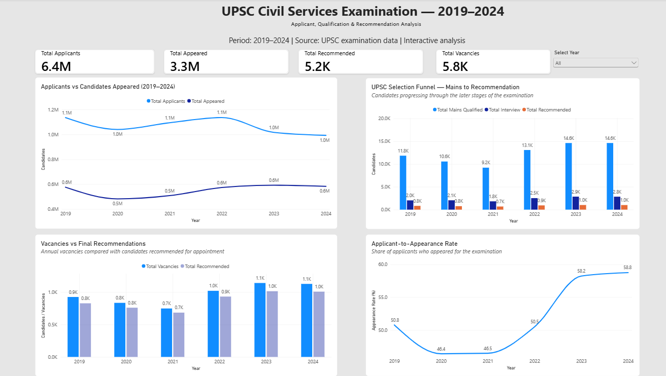
08 | INTERACTIVE DASHBOARD
The analysis in one view
Power BI dashboard • 2019–2024 • Year filter • KPI cards • Trend & funnel views
UPSC CIVIL SERVICES EXAMINATION | PORTFOLIO PROJECT
09

Slide 10
09 | PORTFOLIO TAKEAWAY
A compact example of end-to-end analytics work
The value of the project is the workflow as much as the final chart.
DATA
ANALYZE
COMMUNICATE
Prepare & validate
Measure & explain
Visualize & present
Turn raw annual figures into a consistent analytical table.
Use SQL and DAX to calculate totals, rates and comparisons.
Build a focused Power BI view and explain the evidence clearly.
Built as a Business Analytics portfolio project — with emphasis on structured analysis, reusable metrics and decision-ready communication.
Ayush Patel • SQL | BigQuery | Power BI | DAX
10
UPSC CIVIL SERVICES EXAMINATION | PORTFOLIO PROJECT
10
UPSC CIVIL SERVICES EXAMINATION | PORTFOLIO PROJECT

