Slide 1
Cellular Network Security
By: Dr. Abhinav Kumar

Slide 2
Outline
EPS Architecture and Signalling
EPS User Plane
LTE Security Functions and Procedures
EPS Key Hierarchy
Message flow for EPS AKA
Establishment of NAS and AS security contexts during initial attach

Slide 3
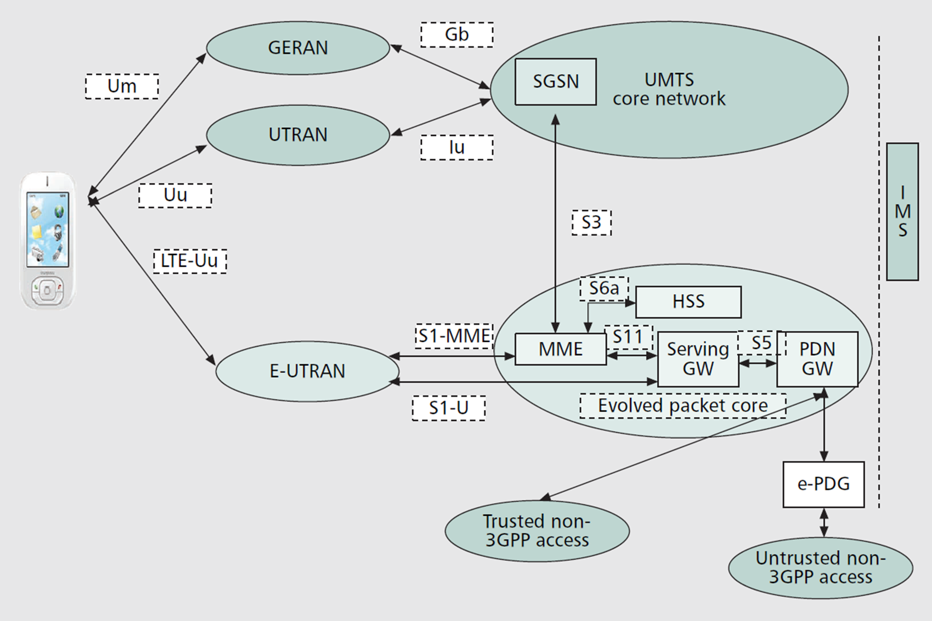
EPS Architecture and Signalling
Notes:
Tevolved universal terrestrial radio access network (EUTRAN) + evolved packet core (EPC) = evolved packet system (EPS)
eNode-B talks to mobility management entity (MME) on signaling + serving gateway (S-GW) on data plane
EPC all-IP network , voice using the IP multimedia subsystem (IMS) network.
integrity protection and ciphering applicable to all NAS signaling.
MME transfers subscription and authentication data terminates the NAS level security

Slide 4
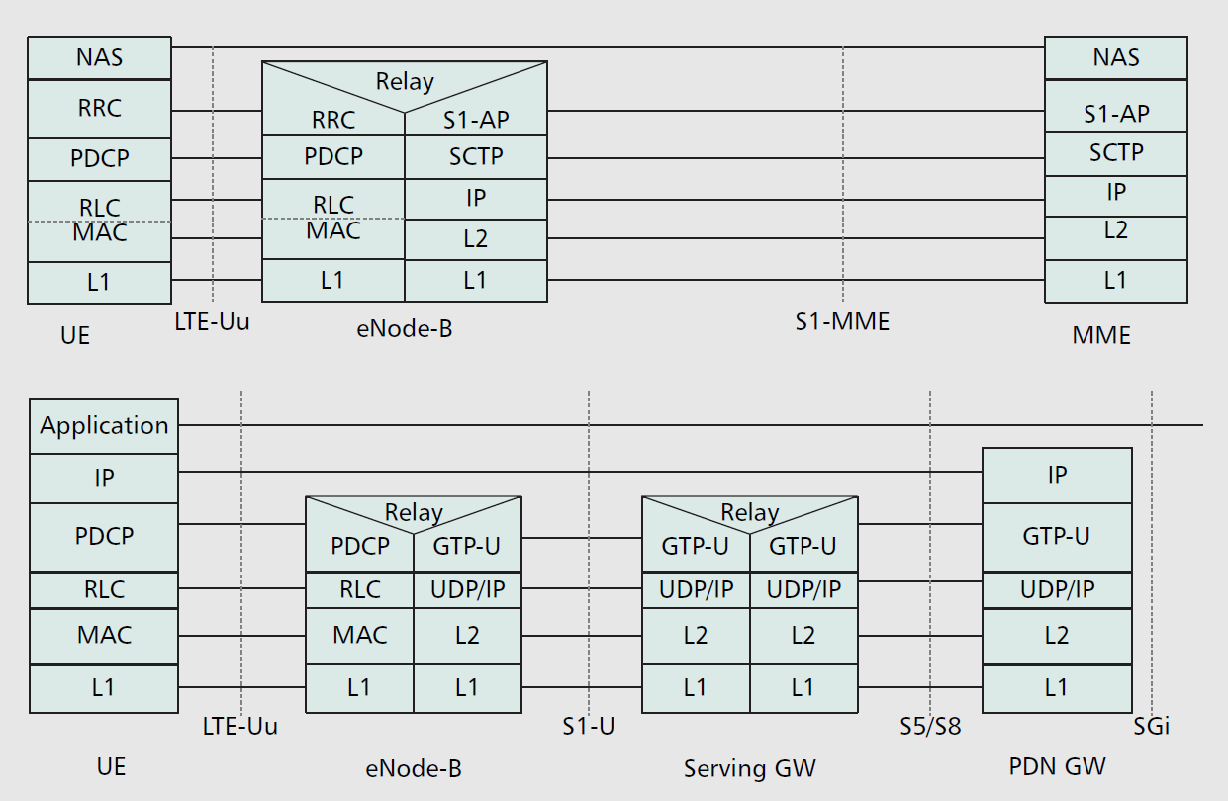
EPS User Plane

Slide 5
Major Security Threats
Illegal access and usage of the user’s and mobile equipment’s (ME’)s identities
Tracking the user based on the Ues temporary identity/signaling messages
Illegal access and usage of the keys used in security procedures
Malicious modification of UE parameters to lock out the phone
Willful tampering with the system information broadcast by E-UTRAN
Eavesdropping and illegal modification of IP packet contents
Denial of service to the UE
Attacks on the integrity of data (signaling or user traffic) by replaying

Slide 6
Key Security Requirements
User identity confidentiality
Mutual authentication of the user and network
Data confidentiality
Data integrity
Interworking with GERAN/UTRAN
Replay protection

Slide 7
Levels of security in EPS
Network access security (level I): integrity protection and ciphering
Network domain security (level II): IPSec
User domain security (level III): Between USIM and ME
Application domain security (level IV): VoIP

Slide 8
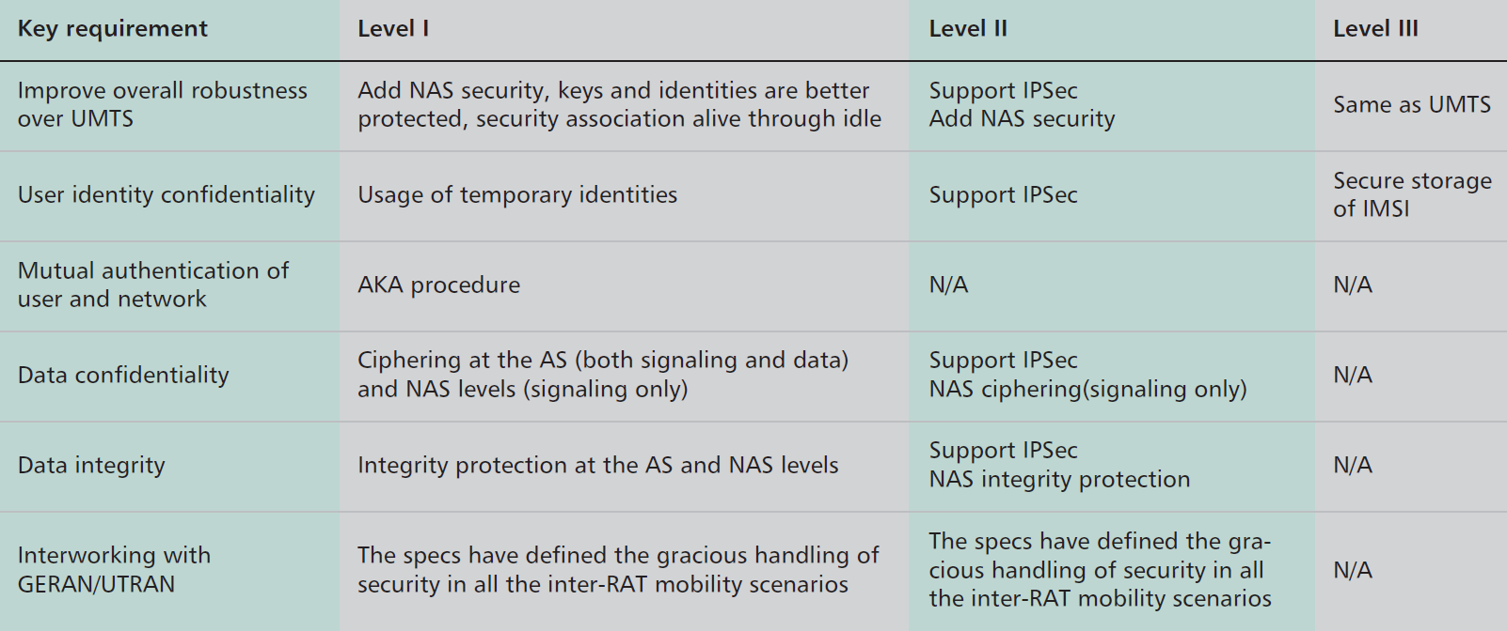
LTE Security Functions and Procedures

Slide 9
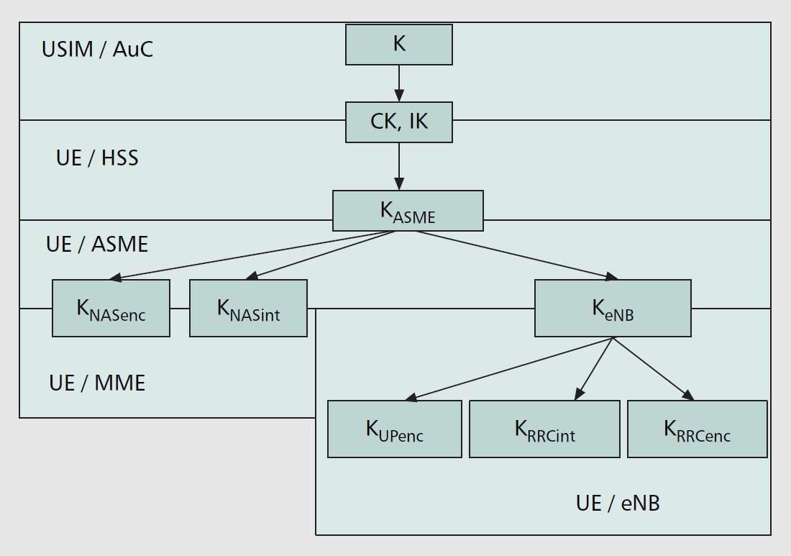
EPS Key Hierarchy
Notes:
The E-UTRAN keys are cryptographically separated from the EPC keys

Slide 10
KDF
Cryptographic Strength
Length of the Key Derivation Key
Key Separation
Context Binding

Slide 11
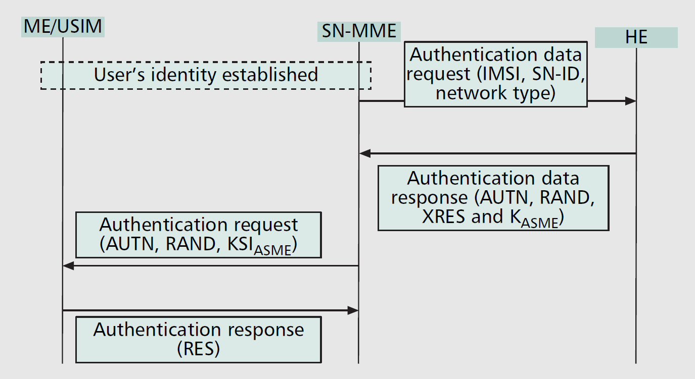
Message flow for EPS AKA

Slide 12
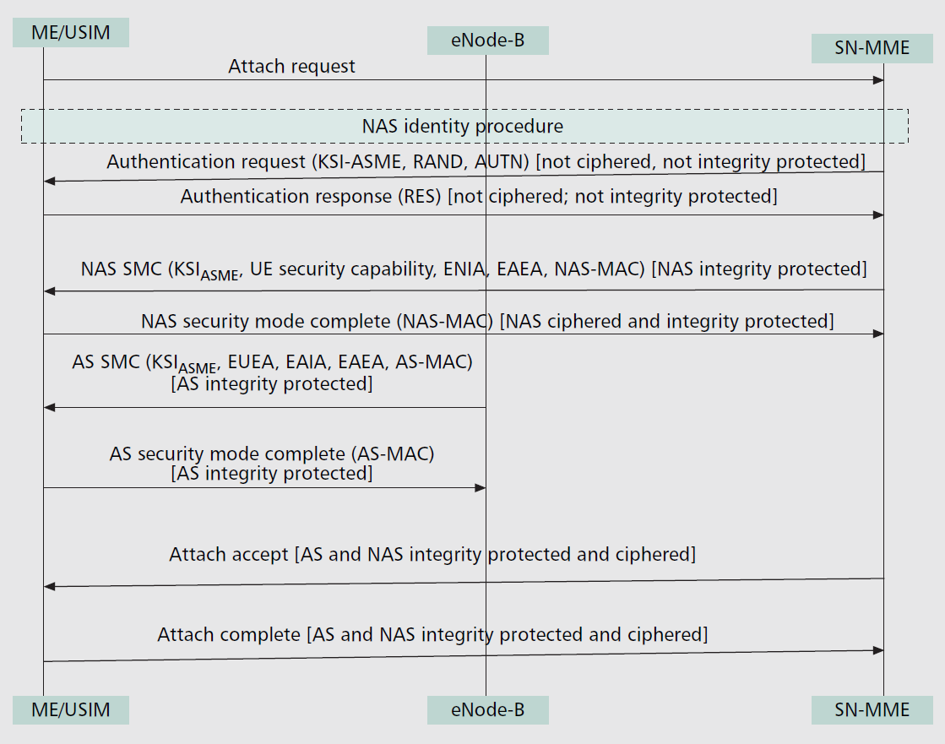
Establishment of NAS and AS security contexts during initial attach

Slide 13
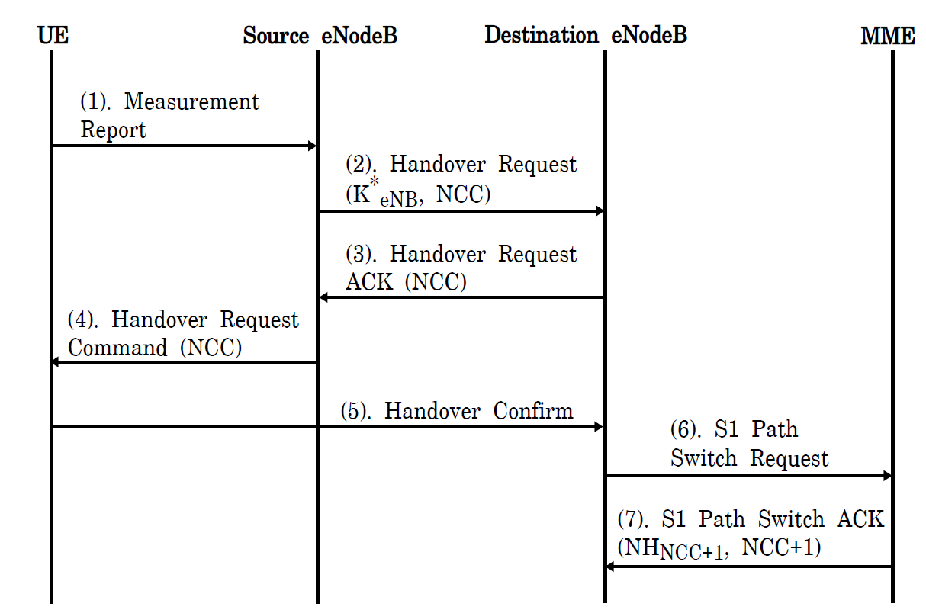
Message flow during handover

Slide 14
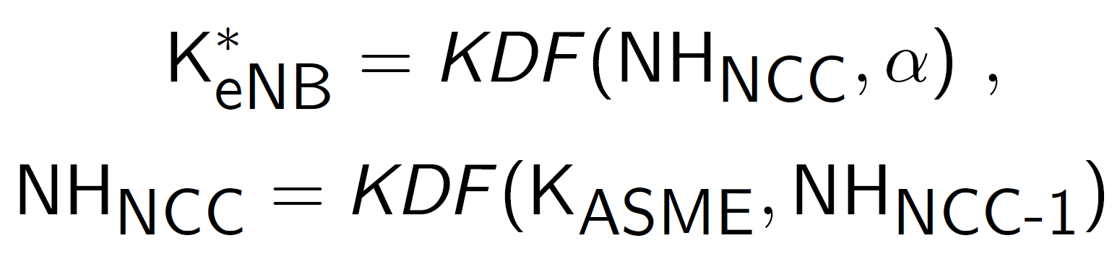
Vertical Key Derivation

Slide 15
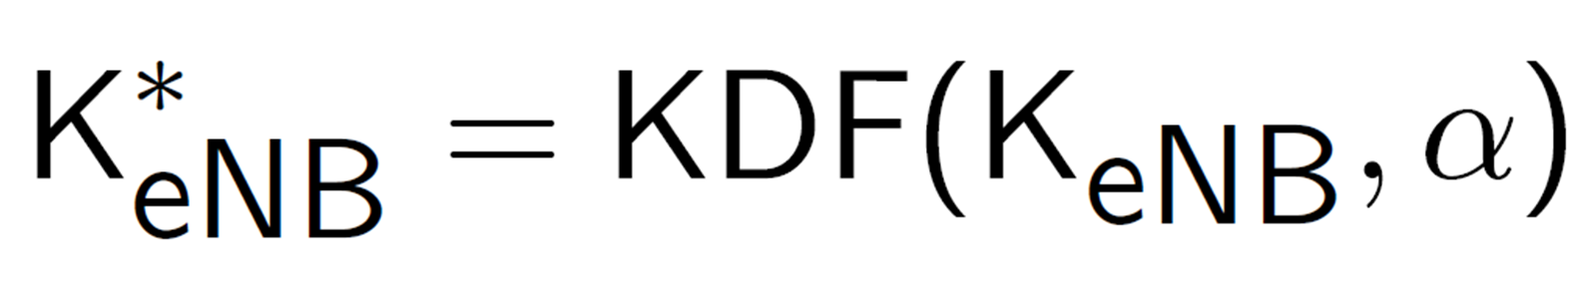
Horizontal Key Derivation

Slide 16
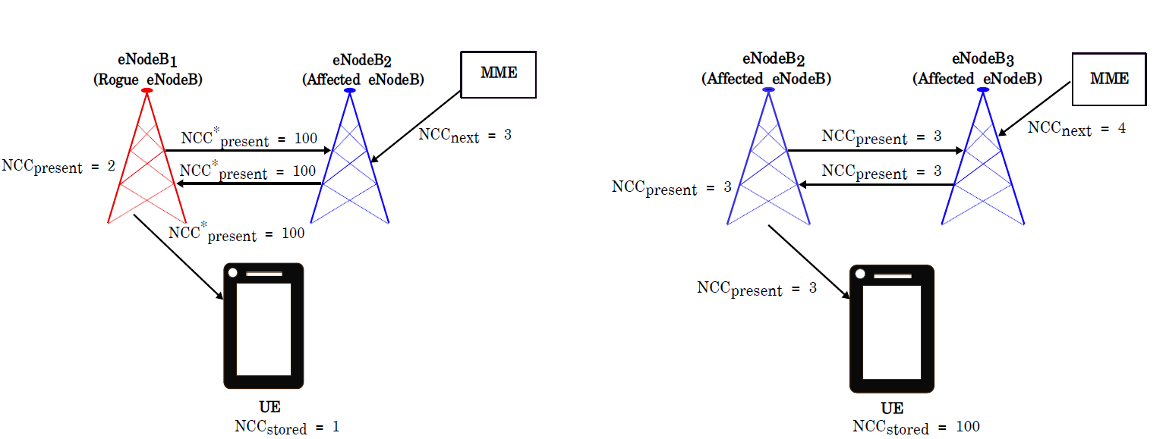
Desynchronization Attack

Slide 17
Possible remedies
Additional encryption
Frequent key derivation from primary key
Other ?

Slide 18
References
C. B. Sankaran, "Network access security in next- generation 3GPP systems: A tutorial," in IEEE Communications Magazine, vol. 47, no. 2, pp. 84-91, February 2009.

