Slide 1
Public Key Infrastructure and Applications

Slide 2
Agenda
PKI Overview
Digital Signatures
  What is it?
  How does it work?
Digital Certificates
Public Key Infrastructure
  PKI Components
  Policies
Internet Security
  Web Security with SSL
Smart Cards
Email signing – S/MIME

Slide 3

What’s the problem?
Information over the Internet is Free, Available, Unencrypted, and Untrusted.
Not desirable for many Applications
        Electronic Commerce
        Software Products
        Financial Services
        Corporate Data
        Healthcare
        Subscriptions
        Legal Information

Slide 4
Multiple Security Issues
Privacy
Authentication
Interception
Spoofing
Integrity
Non-repudiation
Modification
Proof of parties involved

Slide 5
Security Algorithms
Symmetric Algorithms
  Triple-DES, DES, CAST, RC2, IDEA
Public Key Algorithms
  RSA, DSA, Diffie-Hellman, Elliptic Curve
Hashing Algorithms
  SHA-1, MD5, RIPEMD

Slide 6


Symmetric Key Encryption
If any one’s key is compromised, all keys need to be replaced
Not practical or cost effective for Internet environments
INTERNET

Slide 7

Public Key Cryptography
Public-Key Cryptography is an encryption scheme that uses mathematically related, but not identical keys.
Each user has a key pair (public key/private key).
Sender
Original
Document
Public
Encrypted
Document
Private
Original
Document
Receiver
Encryption
Decryption
Information encrypted with the public key can only be decrypted using the private key.

Slide 8
What is a Digital Signature ?
A Digital Signature is the result of encrypting the Hash of the data to be exchanged.
A Hash (or Message Digest) is the process of mathematically reducing a data stream down to a fixed length field.
The Hash uniquely represents the original data.
The probability of producing the same Hash with two sets of different data is <.001%.
Signature Process is opposite to Encryption Process
  Private Key is used to Sign (encrypt) Data
  Public Key is used to verify (decrypt) Signature

Slide 9
Digital Signature Process
Step 1.
Step 2.
Data
Hash
Encrypt
Digital Signature
Hash
Private
Digital Signature
Step 3.
Public
Step 1. Hash (digest) the data using one of the supported Hashing algorithms, e.g., MD2, MD5, or SHA-1.
Step 2. Encrypt the hashed data using the sender’s private key.
Step 3. Append the signature (and a copy of the sender’s public key) to the end of the data that was signed.

Slide 10

Signature Verification Process
Step 1.
Hash
Hash
Step 3.
Data
Step 2.
Decrypt
Digital Signature
Hash
Public Key
Step 1. Hash the original data using the same hashing algorithm.
Step 2. Decrypt the digital signature using the sender’s public key. All digital signatures contain a copy of the signer’s public key.
Step 3. Compare the results of the hashing and the decryption. If the values match then the signature is verified. If the values do not match, then the data or signature was probably modified in transit.

Slide 11

The Critical Questions
How can the recipient know with certainty the sender’s public key? (to validate a digital signature)
How can the sender know with certainty
the recipient’s public key? (to send an
encrypted message)

Slide 12

Digital Certificates
~~~~
~~~~
~~~~
Digital
Signature
Before two parties exchange data using Public Key cryptography, each wants to be sure that the other party is authenticated
Before B accepts a message with A’s Digital Signature, B wants to be sure that the public key belongs to A and not to someone masquerading as A on an open network
One way to be sure, is to use a trusted third party to authenticate that the public key belongs to A. Such a party is known as a Certification Authority (CA)
Once A has provided proof of identity, the Certification Authority creates a message containing A’s name and public key. This message is known as a Digital Certificate.

Slide 13
Digital Certificates
A Digital Certificate is simply an X.509 defined data structure with a Digital Signature. The data represents who owns the certificate, who signed the certificate, and other relevant information
X.509 Certificate
When the signature is generated by a Certification Authority (CA), the signature can be viewed as trusted.
Since the data is signed, it can not be altered without detection.
Extensions can be used to tailor certificates to meet the needs of end applications.
Version #
Serial #
Signature Algorithm
Issuer Name
Validity Period
Subject Name
Subject Public Key
Issuer Unique ID
Subject Unique ID
Extensions
CA Authorized
Digital Signature

Slide 14
Certificate Life Cycle
Key pair generated
Certificate issued
New key
pair
generated
Private key
compromised
Key pair in use
Re-certify
Certificate expires
Certificate
revoked
Key pair lifetime exceeded?

Slide 15
Certificate Revocation Lists
CA periodically publishes a data structure called a certificate revocation list (CRL).
Described in X.509 standard.
Each revoked certificate is identified in a CRL by its serial number.
CRL might be distributed by posting at known Web URL or from CA’s own X.500 directory entry.

Slide 16
PKI Players
Registration Authority (RA) to identity proof users
Certification Authorities (CA) to issue certificates and CRL’s
Repositories (publicly available databases) to hold certificates and CRLs

Slide 17
Certification Authority (CA)
Certification Authority
Trusted (Third) Party
Enrolls and Validates Subscribers
Issues and Manages Certificates
Manages Revocation and Renewal of Certificates
Establishes Policies & Procedures
What’s Important
Operational Experience
High Assurance Security Architecture
Scalability
Flexibility
Interoperability
Trustworthiness
Certification Authority = Basis of Trust

Slide 18
Registration Authority (RA)
Enrolling, de-enrolling, and approving or rejecting requested changes to the certificate attributes of subscribers.
Validating certificate applications.
Authorizing requests for key-pair or certificate generation and requests for the recovery of backed-up keys.
Accepting and authorizing requests for certificate revocation or suspension.
Physically distributing personal tokens to and recovering obsolete tokens from people authorized to hold and use them.

Slide 19
Certificate Policy (CP) is …
the basis for trust between unrelated entities
not a formal “contract” (but implied)
a framework that both informs and constrains a PKI implementation
a statement of what a certificate means
a set of rules for certificate holders
a way of giving advice to Relying Parties

Slide 20
Public Key Security
PRIVACY
AUTHENTICATION
INTEGRITY
NON-REPUDIATION
Services
Public Key Technology
Technology
Digital Certificates
Certification Authorities
Infrastructure
Security Management
Public Key Technology Best Suited to Solve Business Needs
Infrastructure = Certification Authorities

Slide 21

Authentication/Access Control
Can Public Key Technology be used to perform Authentication and Access Control?
Sure Can
How?
Using Digital Signatures
and Digital Certificates
Digital
Signature

Slide 22
SSL Protocol
Secure Socket Layer (SSL) is a Network Layer protocol used to secure data on TCP/IP networks.
HTTP
FTP
NNTP
and so on …..
Application
Secure Socket Layer
Network Layer
TCP/IP Layer

Slide 23

SSL 2.0 Protocol
SSL 2.0 provides encryption between the server and the browser.
Browser Connects to Secure Server
Server sends copy of Server certificate (Cert_{S}) to Browser, indicating that SSL 2.0 is enabled
Cert_{S}
Browser verifies signature on Cert_{S}
Browser generates session key (SessKey_{B})
Browser encrypts SessKey_{B} using Cert_{S}
{SessKey_{B} } Cert_{S}
Server decrypts SessKey_{B} using it’s private key
{Data} SessKey_{B}
Browser and Server use SessKey_{B} to encrypt all data exchanged over the Internet

Slide 24
SSL 3.0 with Client Authentication
Browser Connects to Secure Server
Server sends copy of Server certificate (Cert_{S}) to Browser, indicating that SSL 3.0 is enabled with client authentication
Cert_{S} - SSL 3.0
Browser verifies signature on Cert_{S}
Browser generates session key (SessKey_{B})
Browser encrypts SessKey_{B} using Cert_{S}
Browser asks operator to select a Browser certificate (Cert_{B}) to access server
{SessKey_{B} } Cert_{S} + Cert_{B}
Server verifies signature on Cert_{B} (Server can check other information as well)
Server decrypts SessKey_{B} using it’s private key
{Data} SessKey_{B}
Browser and Server use SessKey_{B} to encrypt all data exchanged over the Internet

Slide 25
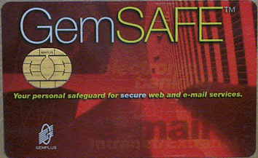

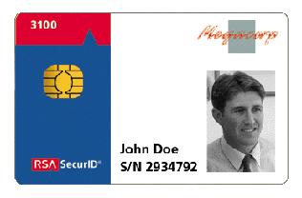


Smart Cards
Microprocessor with memory that can generate and store keys and certificates
Different form factors and interface mechanisms
Cryptographic functions using private key are processed on the card itself

Slide 26
Smart Cards and PKI
Smart cards are «certificate wallets»
Secure storage for:
  Owner private key
Smart Cards are a «PC-in-your-Pocket»
  Generation of owner’s digital signature
Smart cards provide:
  Mobility
  Security
  Transparency

Slide 27
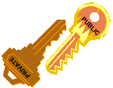
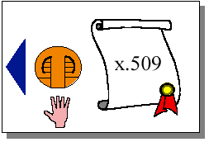
Digital ID
Asymmetric key-pair
  public key
  private key
X.509 certificate
  ISO standard
  public key
  credentials

Slide 28
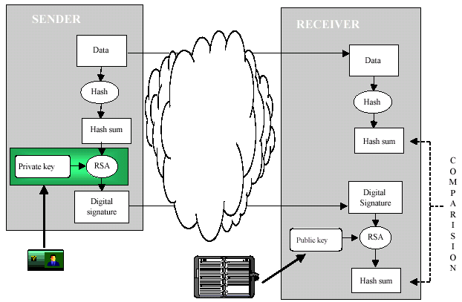
Smart card application example:
Digital Signature

Slide 29
Smart card in heterogeneous environments
Smart cards need readers and drivers
Readers
  desktop or embedded (keyboard, floppy slot)
  optional display and keypad
  PC world ready for installation
  Mac, Unix & Linux ‘waiting’ for USB
Drivers
  PC/SC standard for Windows PC
  custom developments

Slide 30
Pay-TV, did you know it’s PKI ?
Pay-TV systems installed worldwide
  22 millions customers
  pay-per-view
  electronic purse
  Internet
Managed and secured with a very high proprietary secured PKI solution
  based on a smartcard

Slide 31
Signed and Encrypted Email – S/MIME
S/MIME – Secure Multipurpose Internet Mail Extensions
Prevent email spoofing
  Helps preventing forged email
  Helps preventing spam
Protect sensitive messages & documents
Secure business processes
  Signed messages
  S/MIME-based applications

Slide 32
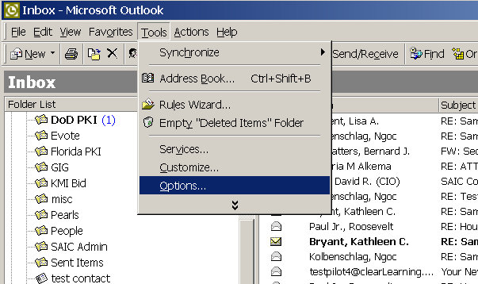
Using PKI Certificates in Outlook (1)
1
Open Outlook. Select Tools from the main menu then choose Options from the drop-down menu.

Slide 33
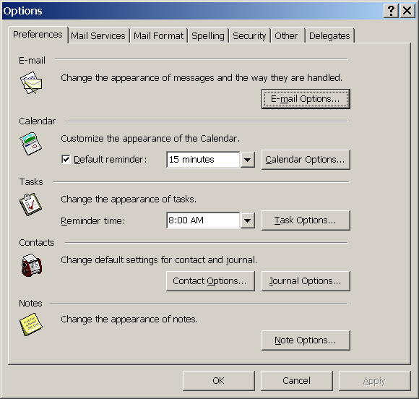
Using PKI Certificates in Outlook (2)
2
Click on the Security tab.

Slide 34
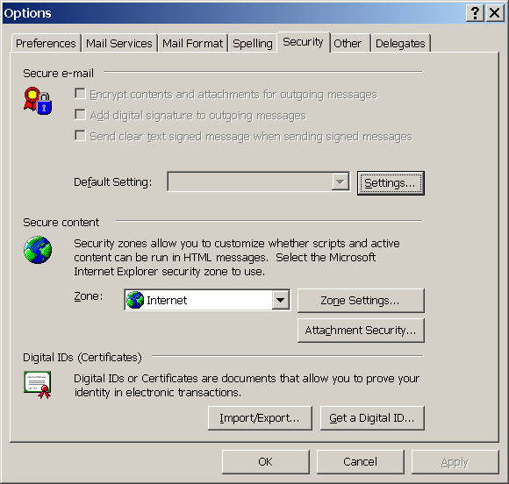
Using PKI Certificates in Outlook (3)
3
Click the Settings button.

Slide 35
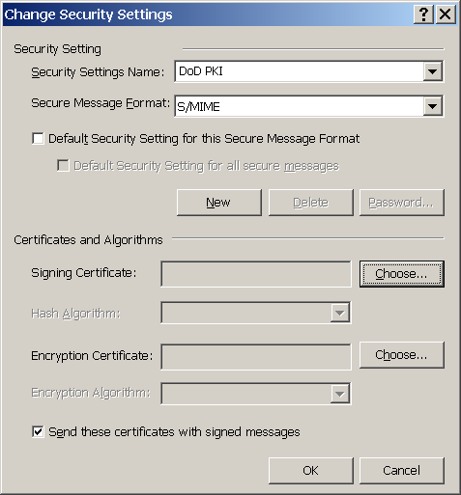
Using PKI Certificates in Outlook (4)
4
In the Security Settings Name field, enter a name for the new Security Setting .
Type S/MIME in the Secure Message Format field.
Click the Choose button next to the Signing Certificate field.

Slide 36
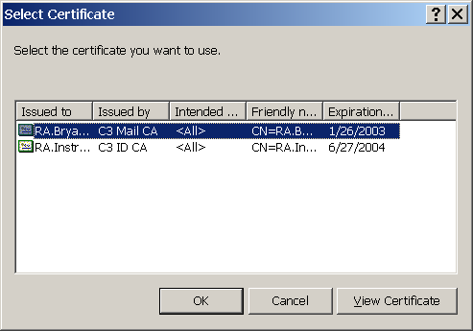
Using PKI Certificates in Outlook (5)
5
Click on the certificate issued by C3 Mail CA. This is your Email Signing certificate. Click OK.

Slide 37
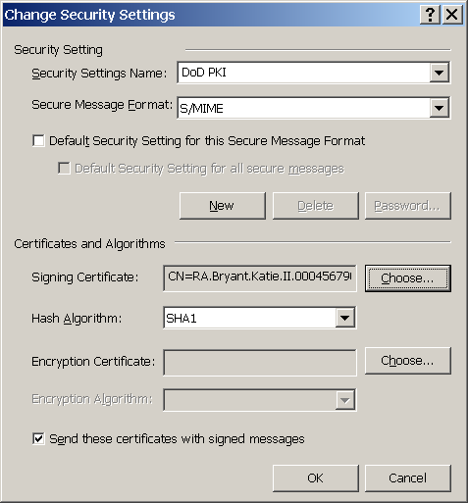
Using PKI Certificates in Outlook (6)
6
Choose SHA1 from the Hash Algorithm drop down menu.
Click on the Choose button next to the Encryption Certificate field.

Slide 38
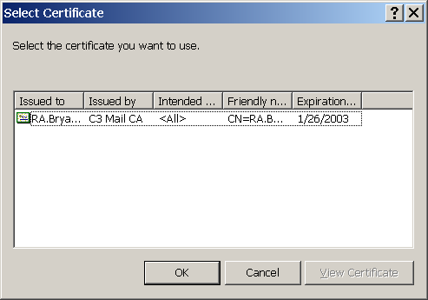
Using PKI Certificates in Outlook (7)
7
Click on the certificate issued by C3 Mail CA. This is your Email Encryption certificate. Click OK.

Slide 39
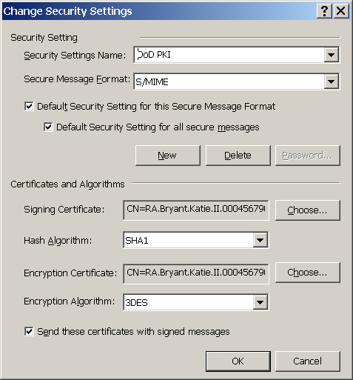
Using PKI Certificates in Outlook (8)
8
Choose 3DES from the Encryption Certificate drop down box.
Check all 3 boxes in the Change Security Settings window.
Click OK.

Slide 40
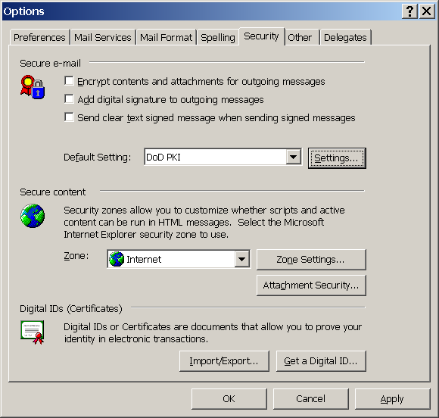
Using PKI Certificates in Outlook (9)
9
Click the Apply button then click OK.

Slide 41

Questions?

