Slide 1

Project - Phase 1
Amazon Sales Analysis
Team Members
Hitesh Sharma (22BDS028)
Lalit Yadav (22BDS034)
Manish Kaushik (22BDS037)
Ayush Pathak (22BDS044)
Github Repo Link: https://github.com/ayushpath123/Amazon_Analysis

Slide 2
Overview of the Project
This dataset captures sales transaction details, including customer, product, pricing, and sales data, along with discount, invoice, and sales rep information. Key features involve sales amounts, margins, and promised delivery dates for each item.
Analyze sales performance based on transactional data to identify trends in discounting, sales margins, and customer behavior. Develop a dynamic dashboard for visualizing sales metrics like total sales, margin performance, and top-selling items.
Deliverables:
Cleaned and preprocessed dataset.
Data visualizations for key metrics (e.g., sales by item, discount analysis).
An interactive dashboard for filtering data by customer, date, and product attributes.
Summary report with actionable insights on sales performance and profitability.
Tools used: Python (Pandas, Plotly,Matplotlib, Seaborn),Power Bi,Git/GitHub for version control.

Slide 3
Progress Achieved (Phase 1)
Key Milestones and Tasks Completed (60% Complete):
Graphs Creation : Made graphs using Python and prepared them for Power BI.
Dashboard Setup : Added graphs to Power BI and set up interactive filters.
Testing : Checked that everything works correctly.
Challenges and Solutions:
Graph Integration: Fixed issues by exporting Python graphs as images or HTML for use in Power BI.
Performance: Improved speed by using Power BI’s tools to handle large data.

Slide 4
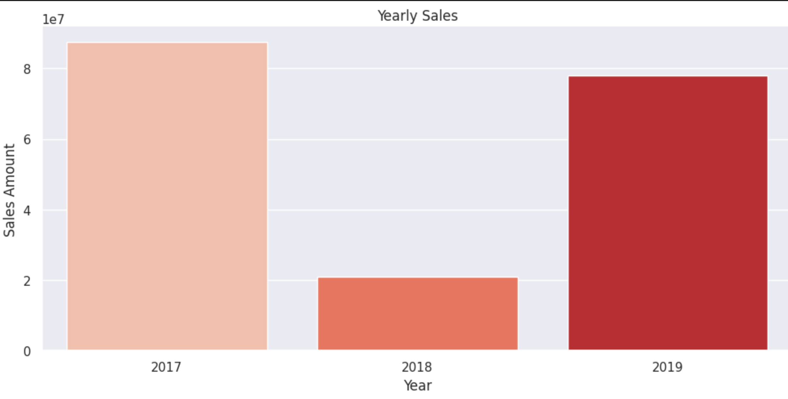

Slide 5
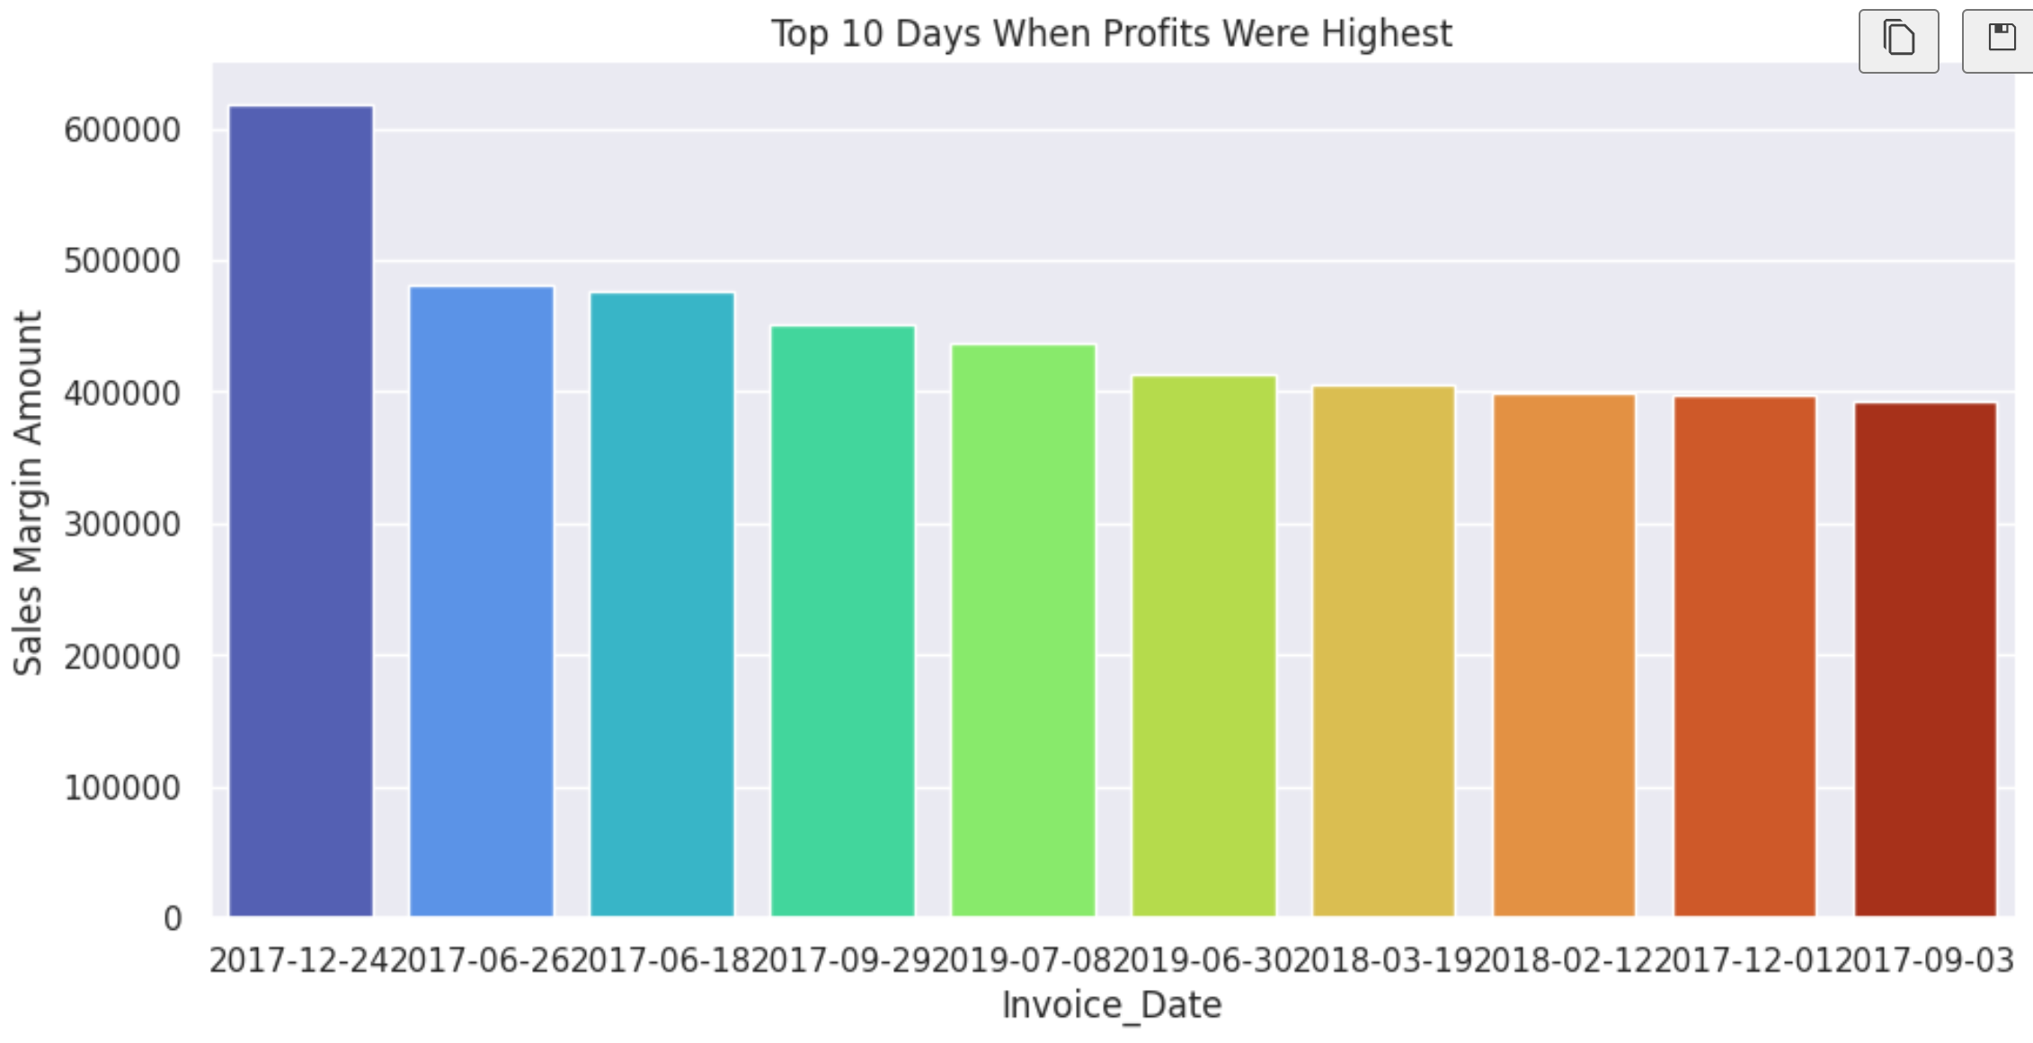

Slide 6
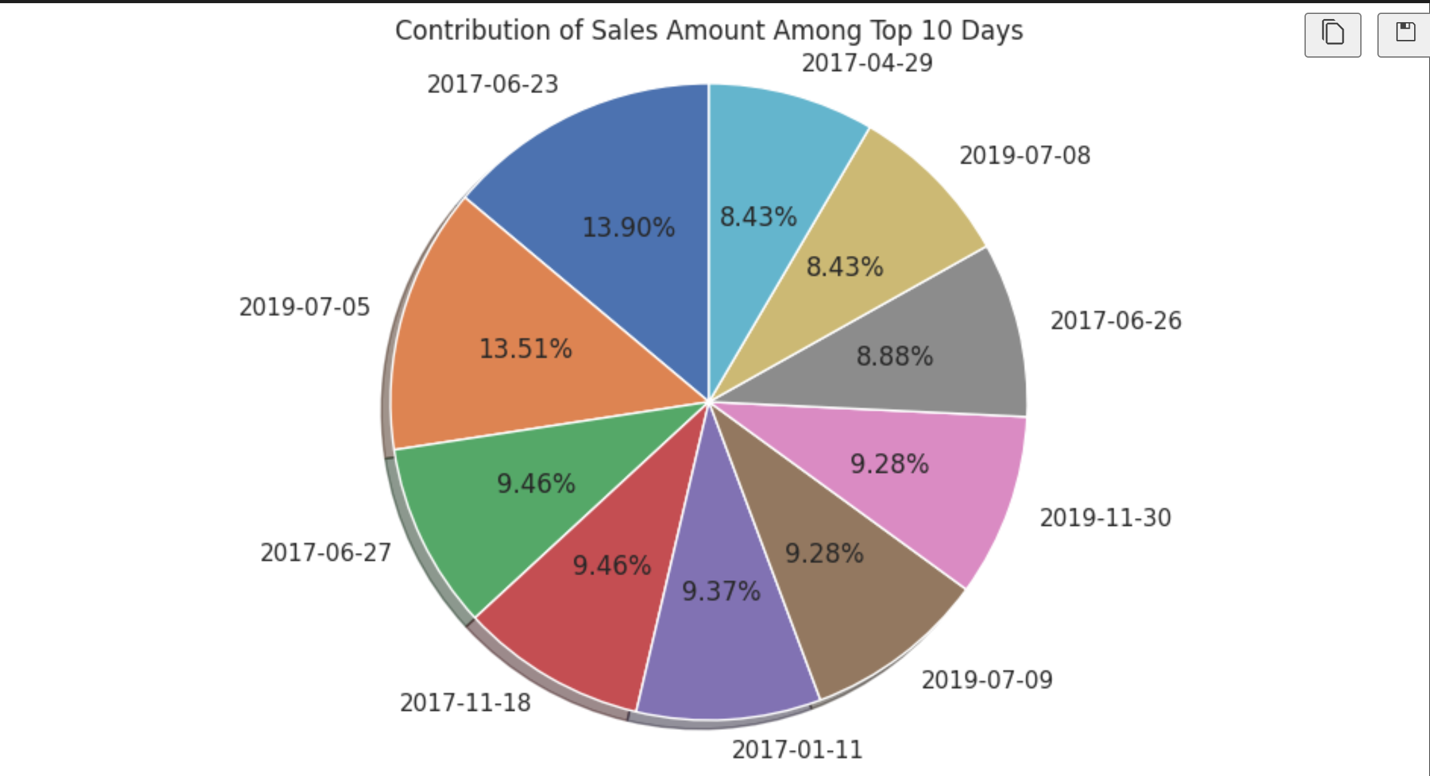

Slide 7
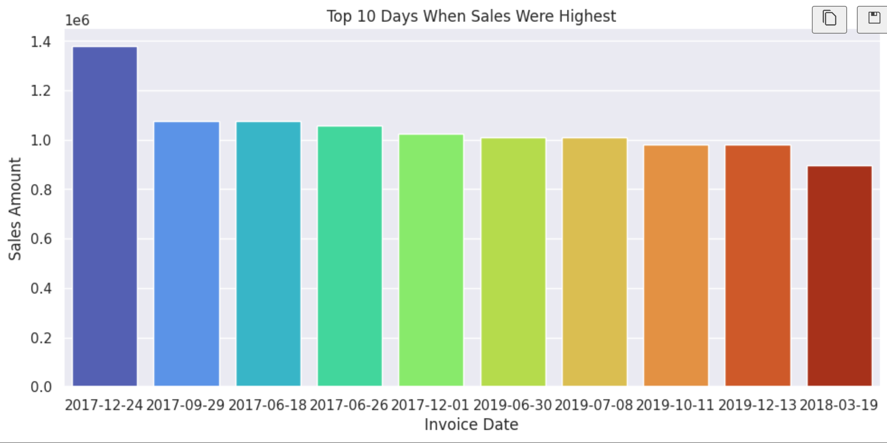

Slide 8
Plan for Next Phase
1. Add Features (3 weeks): Enhance the dashboard with advanced visualizations and interactive elements to provide more insights.
2. Analyze Complex Graphs (3 weeks): Develop and analyze more complex graphs using Python to uncover deeper patterns and trends.
3. Integration and Review (2 weeks): Integrate new features and complex graphs into the existing dashboard and review overall functionality for a seamless user experience.

Slide 9
Conclusion / References
Project Summary
The project has made significant progress by developing and integrating key visualizations and dashboards to analyze sales data. Python-generated graphs have been successfully incorporated into Power BI, enhancing the dashboard’s functionality. The next steps involve adding advanced features, analyzing more complex graphs, and ensuring a smooth integration and review process. This project aims to provide deeper insights into sales trends, customer behavior, and product performance, ultimately supporting data-driven decision-making.
Resources, Tools, and References:
Python: For generating and analyzing complex graphs.
Power BI: For creating interactive dashboards and visualizations.
Pandas: Data manipulation and preparation.
Matplotlib/Seaborn: Graph generation in Python.
Power BI Documentation: For guidance on dashboard features and performance optimization.

Slide 10
Thank You !!!

