Slide 1
Wearables

Slide 2
Human Factor Considerations in Design of Wearable Devices
Wearable devices can be applied to several domains ranging from entertainment to medicine and safety critical systems.
Main challenge related human factor: how to properly fit the computer to the human in terms of interface, cognitive model, contextual awareness, and adaptation to tasks being performed.
When focusing on feasibility of an individual approach, usability and wearability are neglected.
When excluding user’s perspective when designing, device acceptance is compromised.

Slide 3
Human Factor Considerations in Design of Wearable Devices
Wearable device form factors: armband, anklet bracelet, contact lenses, necklace glasses, gloves, jacket, shirt, shoes and watches.
More than half of U.S. consumers who have owned an activity tracker (e.g wristband, smartwatch), no longer use it.
A third of U.S. consumers who have owned it stopped using the device with-in six months of receiving it.

Slide 4
Twenty Wearability Principles
Aesthetics
Affordance
Comfort
Contextual-Awareness
Customization
Ease of use
Ergonomy
Fashion
Intuitiveness
Obtrusiveness
Overload
Privacy
Reliability
Resistance
Responsiveness
Satisfaction
Simplicity
Subtlety
User Friendliness
Wearability

Slide 5
Testing of Wearable Devices: Display
A total of 15 participants used the smart bracelet without a screen, eight of whom were males and seven females, and 21 participants used the smart bracelet with a screen, 10 of whom were males and 11 females.
Males using bracelet with a screen reported to have greater satisfaction than their counterparts without a screen.
Need to acquire and see information gathered (visual representation).
Females showed no significant difference in satisfaction between screen or no screen.
Results showed that participants who used bracelet with a screen reported having a higher level of self recognition.

Slide 6
Testing of Wearable Devices: Motion
If operating a wearable devices causes too much interruption while in motion, it makes it difficult for users to engage in the state of flow.
“Nomadic Usage” refers to use of wearable device while in motion.
Ex. UP by Jawbone or Nike + FuelBand
Nomadic Usage of a wearable device is essentially multitasking.
Both males and females were more entertained when walking than when jogging.
Female participants more entertained than male participants.
Social contact with friends strengthened by using smart watch more while walking than jogging.
Females found smartwatch easier to use when walking than when jogging while males stated no difference between two states of motion.

Slide 7
Charting Design Preferences on Wellness Wearables
Study used a survey to collect data on the subjects (n=84) whose age range is from 20 to 61. The survey was originally intended for young adults but it posted on the city web portal.
The survey consisted of two sections: demographics and a rating system for wearable preferences.
The preferences were separated into five categories, each with sub-categories, totaling 22 options. Subjects were given 100 points to distribute out to the options with the highest being what they cared about the most.

Slide 8
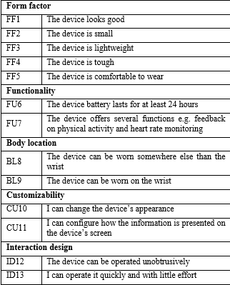
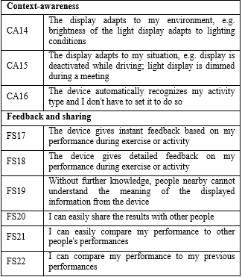

Slide 9
Charting Design Preferences on Wellness Wearables
Results showed that the most important features were the device’s battery life and comfort of the device.
The least important were the ability to share results with other people and the ability to compare with others.
All subcategories of the form factor and functionality are listed in the top half of all features.

Slide 10
Charting Design Preferences on Wellness Wearables
Looking at the results, we have to look at the gender aspects of the study. 64% of the subjects were female and 36% were male.
If we normalize the scores based on genders, we would see that women valued battery life and the form factor more than men. They valued effortless use of the device and the ‘self’ focus aspects of a wearable.
Men tend to prefer the social and competitive aspects of wearables. They also valued the technical aspects of the device more, including feedback and activity recognition.

Slide 11
Charting Design Preferences on Wellness Wearables
“… the device should be as recyclable as possible and safe to the users and the surrounding environment …” (#123, male, 22 years) and: “The ethics and ecological issues (of the products)? How do you dispose or get rid of the device?” (#111, male, 21 years).
“The current devices can’t refine good enough information from the measured data, too many services provide just measured data to the user and leave the interpretation to the user even though analyzing the data and making compilations of it should be the main focus of the companies” (#47, male, 27 years). Moreover, the viewpoint of multiple device ownership was mentioned: “[The device] should integrate itself into my device ecosystem” (#1, male, 30 years).

Slide 12
Charting Design Preferences on Wellness Wearables
This study is limited in the terms of the subjects.
Only 26% of the subjects owned at least one wearable.
This meant that 74% of the subjects may have limited access or interactions with wearables. The subjects may not be familiar with the technical aspects of the wearables, such as feedback or interaction design.

Slide 13
Design for Wearability
The design of this study was to define the meaning of Dynamic wearability.
Dynamic wearability is the interactions between the human body and the wearable object. However, unlike wearability, dynamic wearability extends to include the human body in motion.
This study resulted in the creation of a guideline that tests wearables for obstructions to the fluid human movement.
The difference between a mini-PC and a wearable is that the human body is used as a support environment for the product.

Slide 14
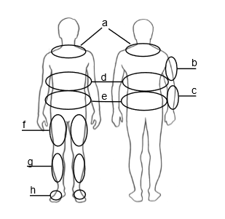
Design for Wearability
The study focused on key areas of the human body where wearables would be the least intrusive to the human movement.
Subjects were interviewed after they were given wearables and were instructed to perform different movements.

Slide 15
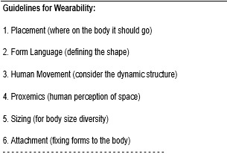
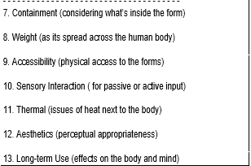
Design for Wearability

Slide 16
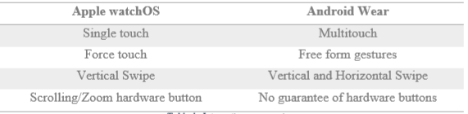
UI Design for Wearable Devices
The purpose of this study was mainly to compare the UI of Android Wear and Apple’s watchOS.

Slide 17
UI Design for Wearable Devices
watchOS generally have the users spend their time using apps from the app launchers on the home screen.
Android Wear tend to have most of the user’s activity on the home screen.
Apple watch has a square screen for easy to read and easy to design User Interface. This allows apps to be easily ported to the wearable.
Android Wear has a much larger selection of watches. While this gives variety, it also limits how apps can be ported. Some wearables have circular screens ( Motorola 360, Huawei, LG, etc), meaning some information may be cut off

Slide 18

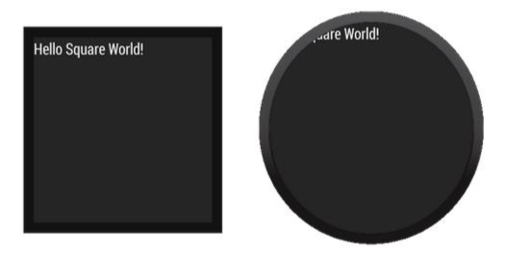
UI Design for Wearable Devices

Slide 19
UI Design for Wearable Devices
How information is displayed is an important part of good UI design. We do not wish to obscure data from the users.
Generally, to avoid this, we give prevalent information to the users first then we have a confirmation at the bottom. Putting the button above the information would force the users to move their fingers away from the text to read it.

Slide 20
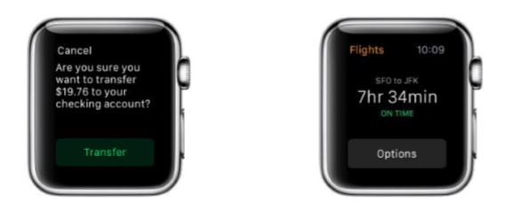
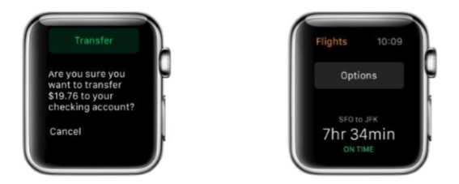
UI Design for Wearable Devices

Slide 21
UI Design for Wearable Devices
With wearables, the amount of time spent using the device should be minimal, much like checking the time on your wrist watch.
The device must have “glancibility.” This mean that information from the device must be clear enough so that users can merely glance at the device to have all relevant information.
User input should also be kept to a minimum. We have to remember that a wearable is not a mini-PC.
Speech input could be a preferred input method due to the limited screen size. Text input should be very limited with preset messages since using a keyboard on the wearable may take long periods of time.

Slide 22
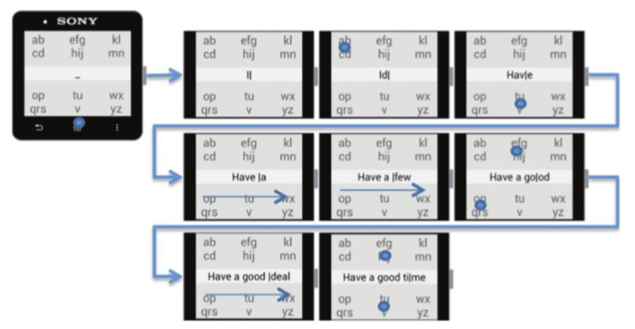
UI Design for Wearable Devices

