Slide 1
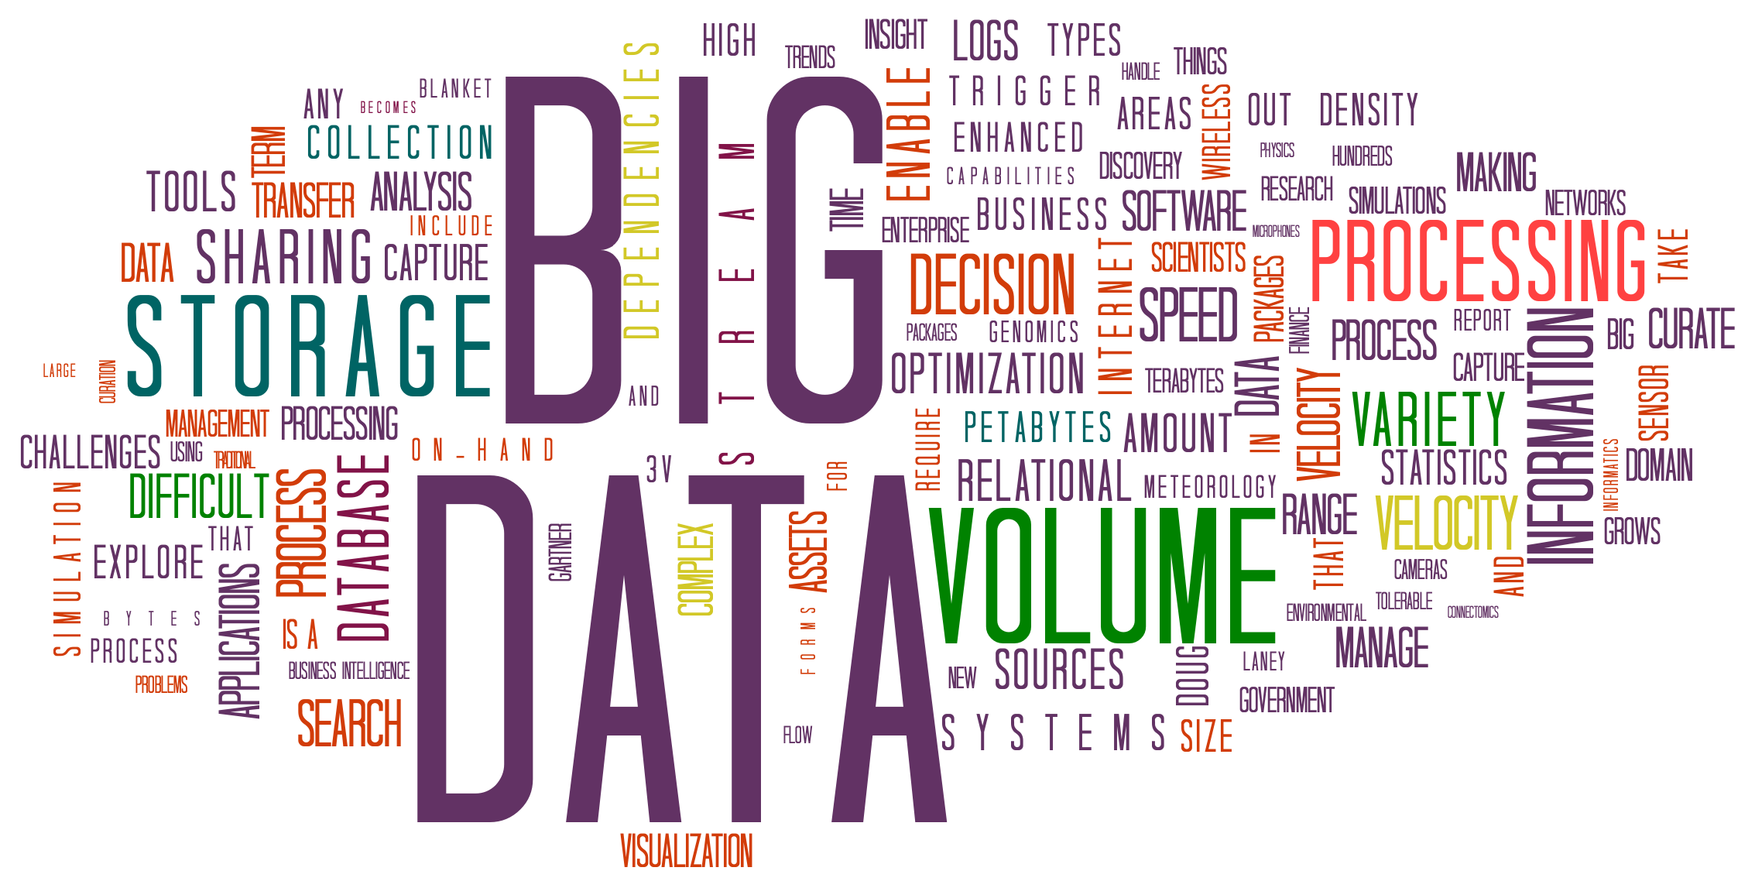

Slide 2

Big Data
Big data is larger, more complex data sets, especially from new data sources. These data sets are so voluminous that traditional data processing software just can't manage them. But these massive volumes of data can be used to address business problems you wouldn't have been able to tackle before.

Slide 3

Introduction of Big Data
What is Big Data?
Characteristics of Big Data
Big Data refers to the vast amount of structured and unstructured data that is generated in our digital world.
Big Data is characterized by its volume, velocity, variety, and veracity, requiring specialized tools and techniques for analysis.

Slide 4

Challenges of Big Data
1
Data Collection and Storage
2
Data Quality and Validity
Acquiring and managing large volumes of data from various sources is a significant challenge.
Ensuring the accuracy and reliability of data is crucial for meaningful analysis.
3
Data Privacy and Security
Protecting sensitive data from unauthorized access and maintaining compliance with regulations.

Slide 5
Big Data and Business Analytics
Improved Decision Making
Enhanced Customer Experience
Optimized Operations
Identifying patterns and trends in Big Data can streamline processes and improve operational efficiency.
Big Data analytics enables businesses to make data-driven decisions for greater accuracy and insights.
By analyzing customer data, businesses can personalize products and services to meet individual needs.

Slide 6


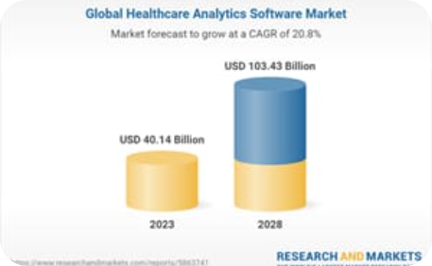
Real-world Examples of Big Data
Smart Cities
E-commerce
Healthcare
Big Data is used to optimize urban infrastructure, transportation, and energy management in smart cities around the world.
Online retailers leverage Big Data to analyze customer behavior, personalize recommendations, and enhance inventory management.
Big Data analytics improves patient outcomes, disease prevention, and medical research through better data-driven decisions.

Slide 7

Conclusion
1
The Power of Big Data
Big Data has revolutionized industries, providing valuable insights, transforming decision-making processes, and unlocking new opportunities.
2
Embracing the Future
Businesses must embrace Big Data analytics to stay competitive and capitalize on the vast potential of data-driven innovation.

Slide 8


