Slide 1
Frequency, Correlation and Regression

Slide 2
Frequency Distribution
Definition
Region | Frequency | Relative %
West | 3,203 | 32.0%
East | 2,848 | 28.5%
Central | 2,323 | 23.3%
South | 1,620 | 16.2%
Shows how often each value or class occurs
Frequency = count
Relative frequency = count ÷ total
Cumulative frequency = running total
Region is categorical, so the frequency table also shows the mode: West is the most common (32.0%).

Slide 3
Grouped Frequency Table (Numerical Data)
Sales class | Frequency | Relative % | Cumulative %
0–50 | 4,596 | 48.4% | 48.4%
50–100 | 1,314 | 13.8% | 62.2%
100–250 | 1,489 | 15.7% | 77.9%
250–500 | 991 | 10.4% | 88.4%
500–1,000 | 658 | 6.9% | 95.3%
Above 1,000 | 446 | 4.7% | 100.0%
Based on 9,494 Sales values. About 78% of order lines are 250 or less, so the data is right-skewed (a long tail of large values).

Slide 4
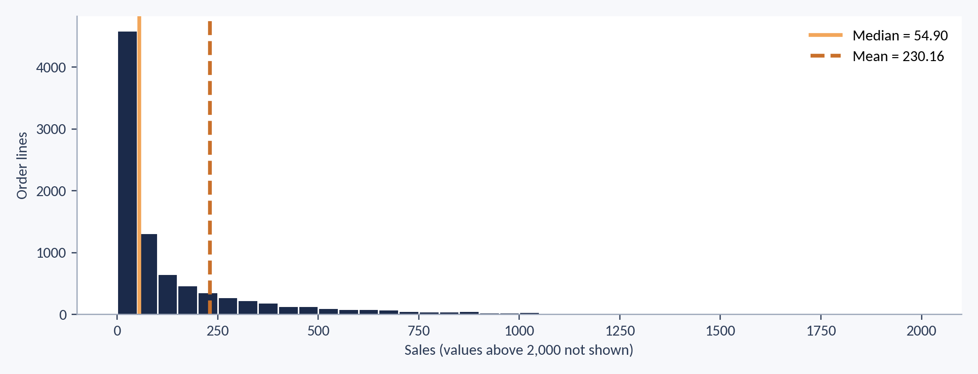
Histogram: The Shape of Sales
Most order lines are small, with a long tail to the right. The mean (230.16) sits far above the median (54.90). plt.hist(sales.dropna(), bins=40)

Slide 5
Skewness: Reading the Shape
Meaning
Superstore values
Skewness measures how lopsided a distribution is
Positive (right) skew: long right tail, mean > median
Negative (left) skew: long left tail, mean < median
Near 0: roughly symmetric
Quantity: 1.28 (mildly right-skewed)
Sales: 13.17 (extremely right-skewed)
Profit: 6.26 (heavy tails, most values near 0)
Skewed data: prefer median and IQR
skewness ≈ Σ((x − x̄) / s)³ / n
Pandas adds a small sample correction: sales.skew() gives 13.17. A common rule: |skew| above 1 is strongly skewed.

Slide 6
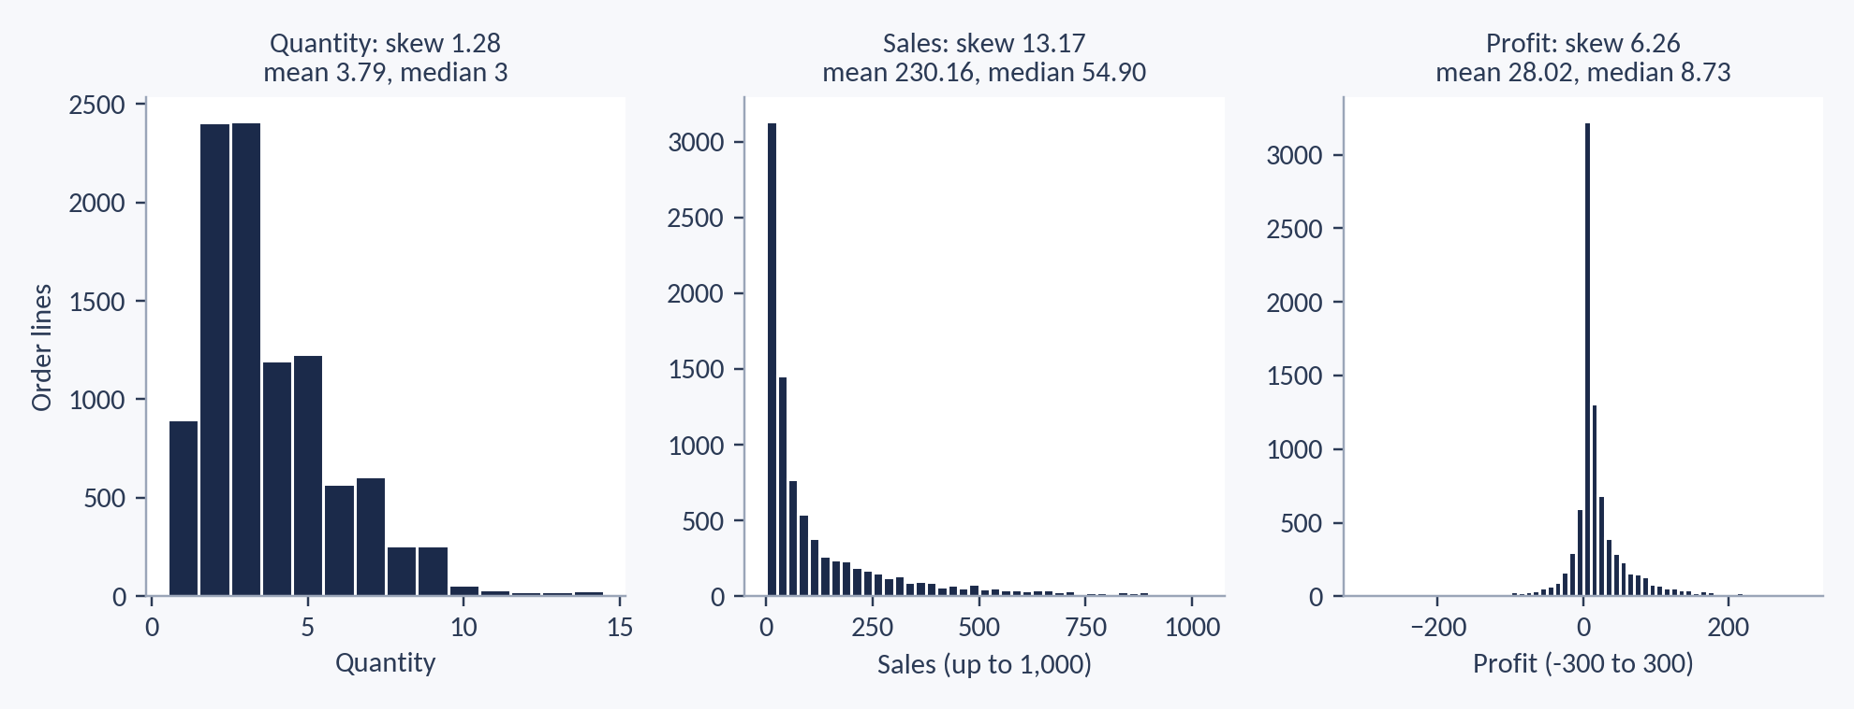
Skewness in Superstore
Quantity, Sales and Profit are all right-skewed. The more skewed the data, the further the mean sits from the median. sales.skew()

Slide 7
Frequency Tables
sales = df["Sales"].replace(999999, np.nan)
df["Region"].value_counts() # frequency
df["Region"].value_counts(normalize=True) # relative
bins = [0, 50, 100, 250, 500, 1000, 1e9]
pd.cut(sales, bins).value_counts() # grouped
np.histogram(sales.dropna(), bins=bins) # NumPy way
Make a relative frequency table for Segment
Expected: Consumer 51.9%, Corporate 30.2%, Home Office 17.8%
Group Quantity into bands with pd.cut

Slide 8
Percentiles and Quartiles
Definitions
Percentile | Sales
P10 | 7.90
Q1 (P25) | 17.34
Median (P50) | 54.90
Q3 (P75) | 210.58
P90 | 573.05
P95 | 957.82
Percentile: the value below which a given % of the data falls
Q1 = P25, Median = P50, Q3 = P75
IQR = Q3 − Q1 = 193.24
Read it as: 75% of order lines have Sales below 210.58, and only 5% are above 957.82. For small data, textbooks can give slightly different quartiles; Pandas and NumPy interpolate.

Slide 9
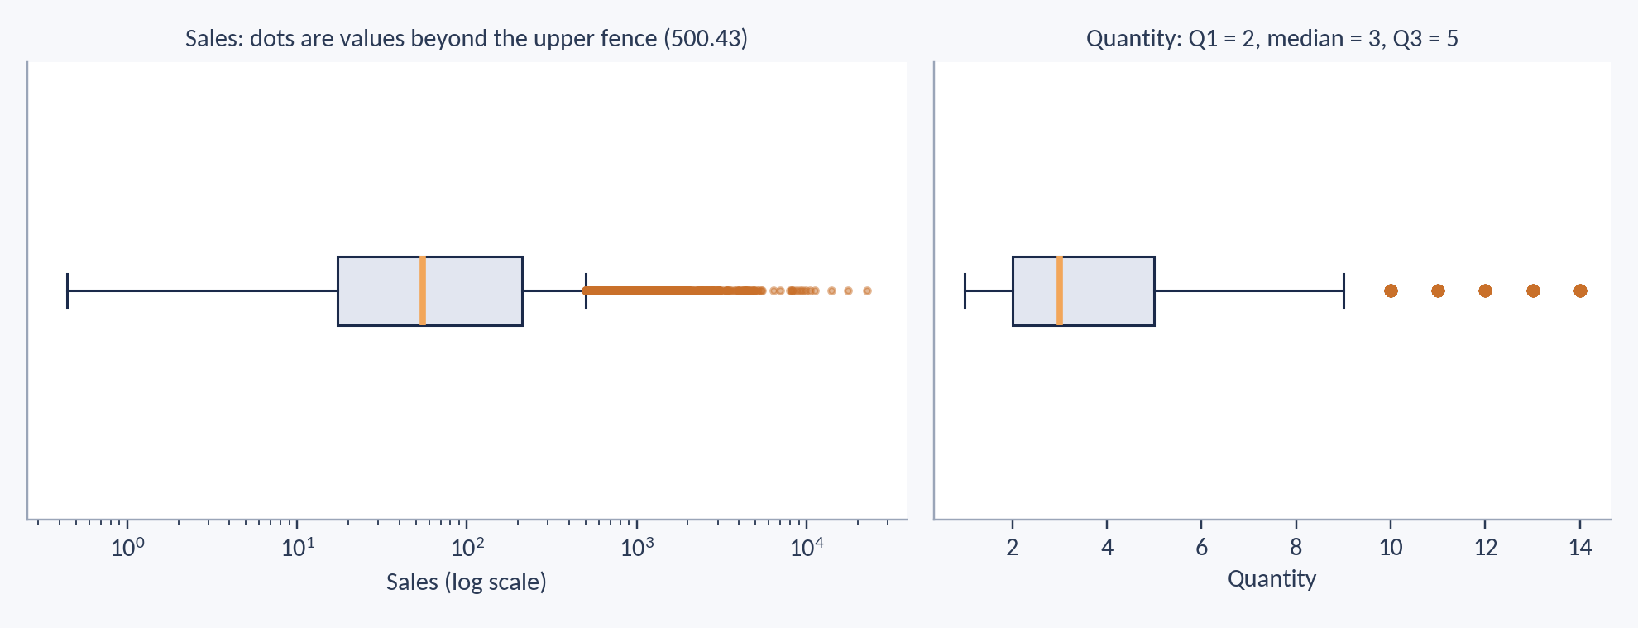
Box Plot: Quartiles and Outliers
The box runs from Q1 to Q3, the line is the median, and dots lie beyond the 1.5 × IQR fences. Sales uses a log scale so the box is visible. plt.boxplot(sales.dropna(), vert=False)

Slide 10
The quantile() Function
sales.quantile(0.25) # Q1 = 17.34
sales.quantile([0.25, 0.5, 0.75]) # Q1, median, Q3
sales.quantile(0.90) # 90th percentile
q1 = sales.quantile(0.25)
q3 = sales.quantile(0.75)
iqr = q3 - q1 # 193.24
upper = q3 + 1.5 * iqr # 500.43
sales[sales > upper] # flagged values
np.nanpercentile(sales.values, [25, 50, 75]) # NumPy
Find Q1, median, Q3 and IQR of Quantity
Expected: 2, 3, 5 and IQR = 3
Find the 90th percentile of Sales (expected 573.05)
Pandas uses 0 to 1; NumPy uses 0 to 100

Slide 11
Z-score
Meaning
Superstore Sales
How many standard deviations a value is from the mean
z = 0 means equal to the mean
Rule of thumb: |z| > 3 is a possible outlier
Mean = 230.16, SD = 628.69
Sales 731.94 → z = 0.80 (ordinary)
Sales 22,638.48 → z = 35.6 (very unusual)
z = (x − x̄) / s
Sales 14.62: (14.62 − 230.16) ÷ 628.69 = -0.34

Slide 12
Z-score vs IQR for Outliers
Method | Rule | Sales flagged
IQR | Below Q1 − 1.5×IQR or above Q3 + 1.5×IQR (upper fence 500.43) | 1,103
Z-score | |z| > 3, which means Sales above 2,116.23 | 113
Sales is right-skewed, so huge values inflate the mean and SD, and Z-score flags fewer values. Use IQR for skewed data and Z-score for roughly bell-shaped data.

Slide 13
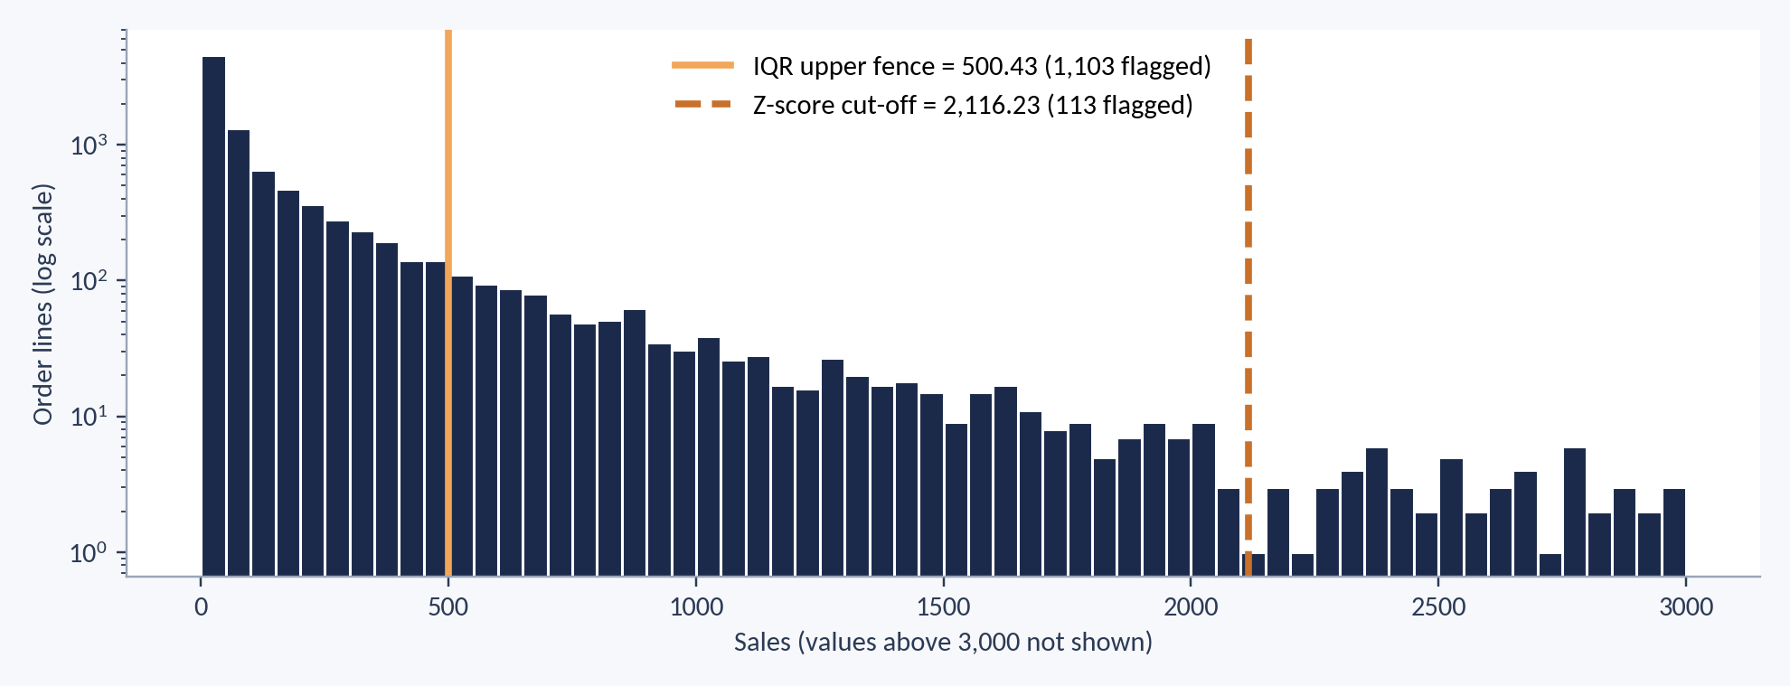
Two Outlier Rules on One Histogram
The IQR rule cuts at 500.43 and flags 1,103 lines. The Z-score rule cuts at 2,116.23 and flags 113. Counts use a log scale. plt.axvline(500.43)

Slide 14
Z-score and Outliers
z = (sales - sales.mean()) / sales.std()
z.round(2).head()
sales[z.abs() > 3] # 127 rows
(z.abs() > 3).sum() # count = 127
# Same idea in NumPy
a = sales.dropna().values
z2 = (a - a.mean()) / a.std(ddof=1)
(abs(z2) > 3).sum() # 113
Find Profit outliers with the Z-score rule
Expected: 99 rows with |z| > 3
Compare with the IQR rule count
Z-score has no single function, so write the formula

Slide 15
Covariance
Meaning
Formula
Shows whether two variables move together
Positive: both rise together
Negative: one rises as the other falls
Unit is x unit × y unit, so the size is hard to read
Sample: Σ(x − x̄)(y − ȳ) / (n − 1)
Population: divide by N
The sign matters more than the size

Slide 16
Covariance: Superstore Hand Example
Order line | Quantity x | Sales y | x − x̄ | y − ȳ | Product
A | 2 | 15 | -1.6 | -7.4 | 11.84
B | 2 | 22 | -1.6 | -0.4 | 0.64
C | 7 | 49 | 3.4 | 26.6 | 90.44
D | 4 | 7 | 0.4 | -15.4 | -6.16
E | 3 | 19 | -0.6 | -3.4 | 2.04
Total |  |  |  |  | 98.8
x̄ = 3.6, ȳ = 22.4. Σ(x − x̄)(y − ȳ) = 98.8, so cov = 98.8 ÷ 4 = 24.7. Positive: more Quantity goes with more Sales.

Slide 17
Correlation
Meaning
Be careful
Covariance scaled to a value between −1 and +1
No unit, so it is easy to compare
+1 rise together, −1 opposite, 0 no straight-line link
Correlation does not prove cause
It measures straight-line links only
Outliers can distort r
r = cov(x, y) / (sx · sy)
Hand example: 24.7 ÷ (2.074 × 15.9) = 0.749

Slide 18
Superstore Correlations
Pair | r | Meaning
Sales and Profit | 0.446 | Moderate positive
Sales and Quantity | 0.197 | Weak positive
Discount and Profit | -0.221 | Weak negative
Quantity and Profit | 0.064 | Almost none
Based on 8,730 rows with no missing values. Higher discounts go with lower profit. Covariance of Sales and Profit is 63,986.2, which is hard to read, so we use r.

Slide 19
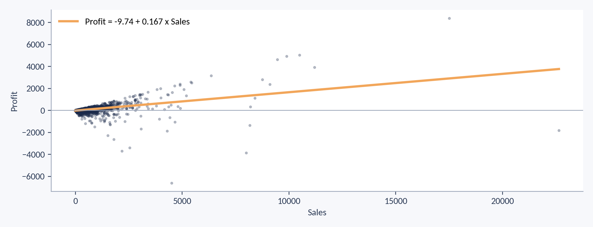
Scatter Plot: Sales and Profit
Most points sit near the bottom left and the line slopes up (r = 0.446). A few very large orders pull the line. plt.scatter(x, y); np.polyfit(x, y, 1)

Slide 20
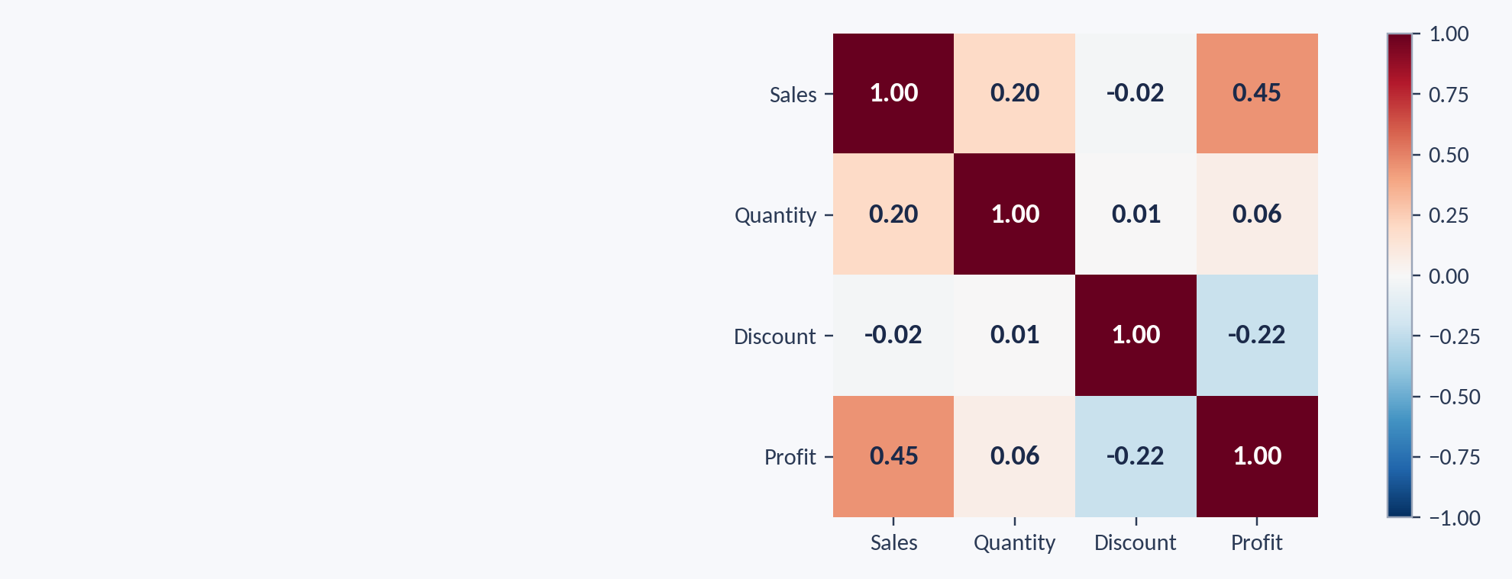
Correlation Heatmap
Dark red is a strong positive link and dark blue a strong negative link. Sales and Profit (0.45) is the strongest pair; Discount and Profit is −0.22. sns.heatmap(df[cols].corr(), annot=True)

Slide 21
Covariance and Correlation
df["Sales"] = df["Sales"].replace(999999, np.nan)
p = df[["Sales", "Profit", "Discount"]].dropna()
p.cov() # covariance table
p.corr() # correlation table
p["Sales"].corr(p["Profit"]) # 0.446
x = p["Sales"].values
y = p["Profit"].values
np.cov(x, y)[0, 1] # covariance
np.corrcoef(x, y)[0, 1] # correlation
Correlation of Quantity and Profit
Expected: about 0.06 (almost none)
Which column has the strongest link with Profit? (Sales, r = 0.446)
Drop missing rows first with dropna()

Slide 22
Practice Set
Tasks
1. Q1, median and Q3 of Profit
2. Z-score of the largest Sales value, 22,638.48
3. Correlation of Discount and Profit
4. How many order lines are in each Segment?
5. Explain in one line why IQR suits skewed data
1. 1.79, 8.73, 29.36
2. z ≈ 35.6
3. r ≈ −0.22
4. Consumer is the largest
5. Huge values inflate the mean and SD

Slide 23
Regression: The Idea
Simple linear regression
Terms to know
Predicts y (dependent) from x (independent) with a straight line
ŷ = a + m·x
Least squares: the line with the smallest total squared error
Residual = actual y − predicted y
a=intercept , m = slope
Slope m: change in y for one unit rise in x
Intercept a: value of y when x = 0
R²: share of the variation in y explained by x
For one x: R² = r²

Slide 24
Regression: Hand Example
Quantity (x) predicting Sales (y), same 5 order lines
Σ(x − x̄)(y − ȳ) = 98.8 and Σ(x − x̄)² = 17.2
m = 98.8 ÷ 17.2 = 5.744
a = 22.4 − 5.744 × 3.6 = 1.72
Prediction: Quantity 5 → Sales = 1.72 + 5.744 × 5 ≈ 30.4
ŷ = a + b·x
m = Σ(x − x̄)(y − ȳ) ÷ Σ(x − x̄)² and a = ȳ − b·x̄

Slide 25
Regression: Profit from Sales
Result
Why only 20%
Profit = -9.74 + 0.167 × Sales
Each extra 1 of Sales adds about 0.17 of Profit
Sales 500 → predicted Profit ≈ 73.77
R² = 0.199: Sales explains about 20% of the variation in Profit
Discount also changes Profit (r = -0.221)
A straight line may not fit all order sizes
Outliers can pull the line
Do not predict outside the range of your data
Check the residuals and add more variables

Slide 26
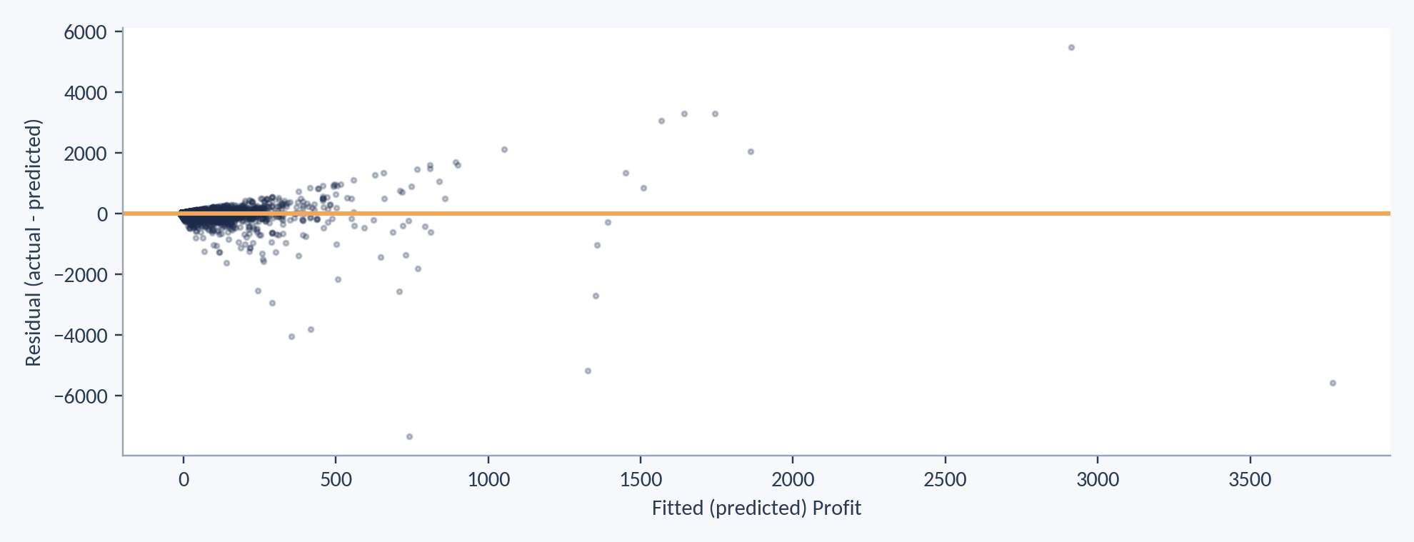
Residual Plot: Checking the Line
Residuals fan out as predicted Profit rises, so errors are bigger for large orders. A straight line is only a rough fit here. plt.scatter(fitted, residuals)
Unit 4 · Lecture 3 | 27

Slide 27
Regression
p = df[["Sales", "Profit"]].dropna()
x = p["Sales"].values
y = p["Profit"].values
m, a = np.polyfit(x, y, 1) # slope, intercept
print(m, a) # 0.167 -9.74
predict = np.poly1d([m, a])
predict(500) # 73.77
r = p["Sales"].corr(p["Profit"])
print(r ** 2) # R squared = 0.199
Regress Profit on Discount
Expected: slope −247.94, intercept 66.49
Predict Profit at a 30% discount (expected −7.89)
polyfit(x, y, 1) fits a straight line

Slide 28
Data Generation
np.random.seed(42) # same numbers every run
np.random.randint(1, 15, 10) # 10 random quantities
np.random.normal(230, 50, 5) # mean 230, SD 50
np.random.choice(["West", "East", "South", "Central"], 5)
np.linspace(0, 100, 5) # 5 evenly spaced numbers
pd.date_range("2016-01-01", periods=3) # 3 dates
sample = df.sample(100, random_state=1) # 100 random rows
sample["Sales"].mean() # compare with 230.16
Set seed 42 and make 10 random Quantities from 1 to 14
Expected: 7, 4, 13, 11, 8, 13, 5, 7, 10, 3 (mean 8.1)
Take 100 random rows and compare the mean Sales
Expected values are for np.random.seed(42); default_rng(42) gives different numbers

Slide 29
Data Conversion in Superstore
Problem | Example | Fix
Text dates | Order Date "11/8/2016" | pd.to_datetime(df["Order Date"], format="%m/%d/%Y")
Mixed case, spaces | Category "technology", " Technology " | .str.strip().str.title()
Wrong number type | Postal Code 42420.0 | .astype("Int64")
Numbers stored as text | "12.5" | pd.to_numeric(errors="coerce")
Numbers to groups | Sales values | pd.cut()
Text to numbers | Region | pd.get_dummies()
Always check df.dtypes after each conversion.

Slide 30
Data Conversion
df["Order Date"] = pd.to_datetime(df["Order Date"],
format="%m/%d/%Y")
df["Category"] = df["Category"].str.strip().str.title()
df["Postal Code"] = df["Postal Code"].astype("Int64")
df["Sales"] = pd.to_numeric(df["Sales"], errors="coerce")
df["Order Date"].dt.month # month number
df.groupby(df["Order Date"].dt.year)["Sales"].mean()
pd.get_dummies(df["Region"]) # text to 0/1 columns
df["Sales"].to_numpy() # Pandas to NumPy
Convert Order Date and find average Sales per year
Expected: 2014: 240.13, 2015: 224.24, 2016: 235.79, 2017: 223.40
errors="coerce" turns bad values into NaN
Check df.dtypes after each step

Slide 31
Pattern Recognition
What to look for
Superstore patterns
Trend: rises or falls over time
Seasonality: repeats each year or month
Groups: categories behave differently
Relationships: variables move together
Unusual points: outliers and gaps
Total Sales is highest in November, December and September
It is lowest in February and January
Higher discounts go with lower profit
Most order lines are small; a few large ones bring most of the revenue

Slide 32
Pattern: Discount and Profit
Discount | Order lines | Average Profit
0% | 4,434 | 65.19
1–20% | 3,505 | 27.06
21–40% | 428 | -80.37
Above 40% | 847 | -107.77
Order lines with a discount above 20% lose money on average. Small discounts still make a profit. This is a pattern, not proof of cause.

Slide 33
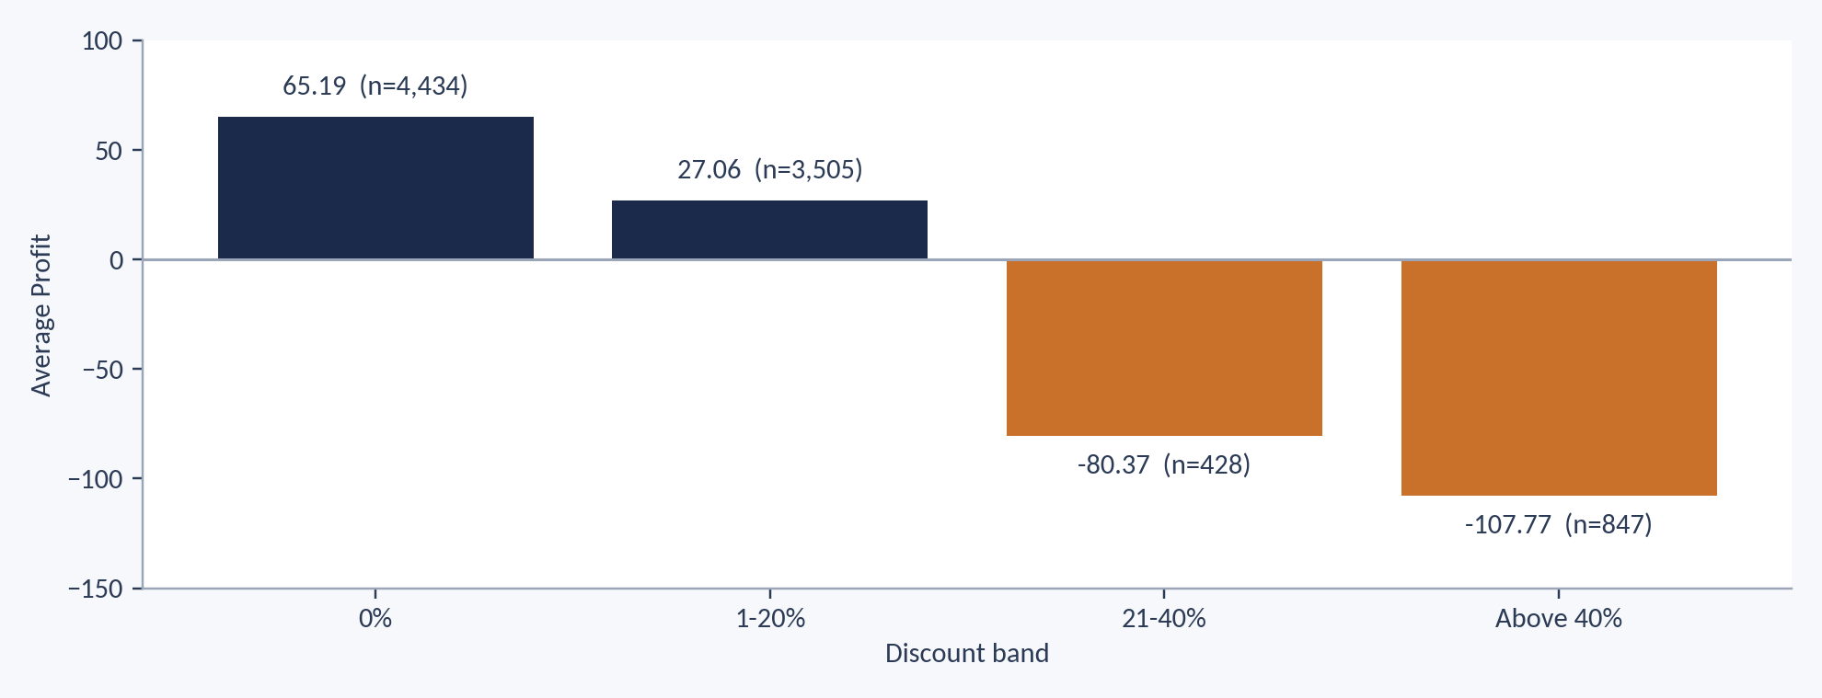
Chart: Average Profit by Discount
Profit turns negative once the discount passes 20%. This is a pattern in the data, not proof of cause. df.groupby(bands)["Profit"].mean().plot(kind="bar")

Slide 34
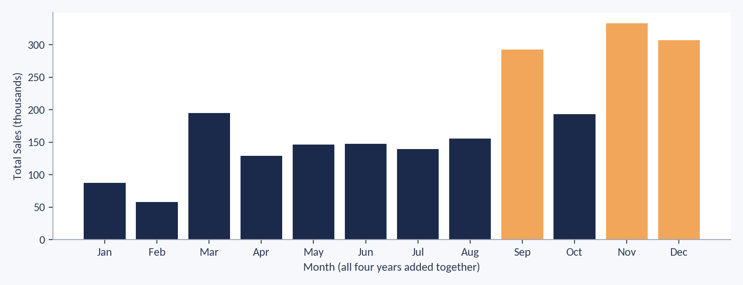
Chart: Monthly Sales Pattern
Total Sales peaks in September, November and December (orange) and is lowest in January and February. df.groupby("Month")["Sales"].sum().plot(kind="bar")

Slide 35
Finding Patterns
df["Month"] = df["Order Date"].dt.month
df.groupby("Month")["Sales"].sum() # monthly pattern
bands = pd.cut(df["Discount"], [-0.01, 0, 0.2, 0.4, 1],
labels=["0%", "1-20%", "21-40%", "Above 40%"])
df.groupby(bands)["Profit"].mean() # discount pattern
df[["Sales", "Profit", "Discount"]].corr() # relationships
Find the average Profit for each Segment
Find the month with the lowest total Sales (expected: February)
groupby() compares groups

Slide 36
Final Practice
Mini task on Superstore
Expected findings
1. Clean Sales (999999 to NaN) and convert Order Date
2. Find the correlation of Discount and Profit
3. Fit a regression of Profit on Discount
4. Group Discount into bands and find average Profit
5. Write two business findings in plain English
r ≈ −0.22
Profit falls as Discount rises
Above 20% discount loses money on average
Keep discounts at or below 20%

Slide 37
Summary
Key takeaways
Frequency tables show counts; percentiles and quartiles show position
Z-score and IQR both flag outliers; IQR suits skewed data
Covariance shows direction; correlation shows direction and strength (−1 to +1)
Regression gives a line for prediction; R² shows how much it explains
Plot the data first: skewness, box plots and residual plots show what numbers hide

