Slide 1
LangChain Basics
Notes:
Minute 0. Welcome. Today: what LangChain is, its parts, then Exp 10 live. Check that every student has a Groq key.

Slide 2
Why a Plain API Call Is Not Enough
MANY STEPS
NO MEMORY
A real app needs a prompt, a model call, parsing and more steps.
Each API call starts fresh. The model forgets the last turn.
NO TOOLS
LOCKED IN
A model alone cannot search the web, calculate or read your files.
Changing the model means rewriting your code.
LangChain gives one standard way to connect all of these.
Notes:
Minutes 0-2. Ask: what would you add to a raw API call to make a real app?

Slide 3
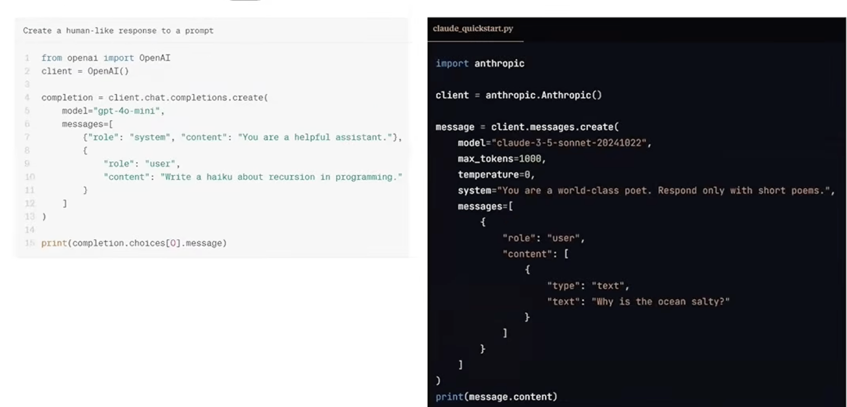
Without LangChain: Direct API Calls
WHAT TO NOTICE
1. Different SDK and import for each provider.
2. System prompt: a message (OpenAI) or a separate argument (Anthropic).
3. Answer is read in different ways: choices[0].message or content.
Each provider means a new SDK and a new code shape.
Notes:
Minutes 2-3.5. Left: OpenAI SDK. Right: Anthropic SDK. Same task, but different import, different request shape and different way to read the answer. Model names in the screenshots are old examples; only the pattern matters.

Slide 4
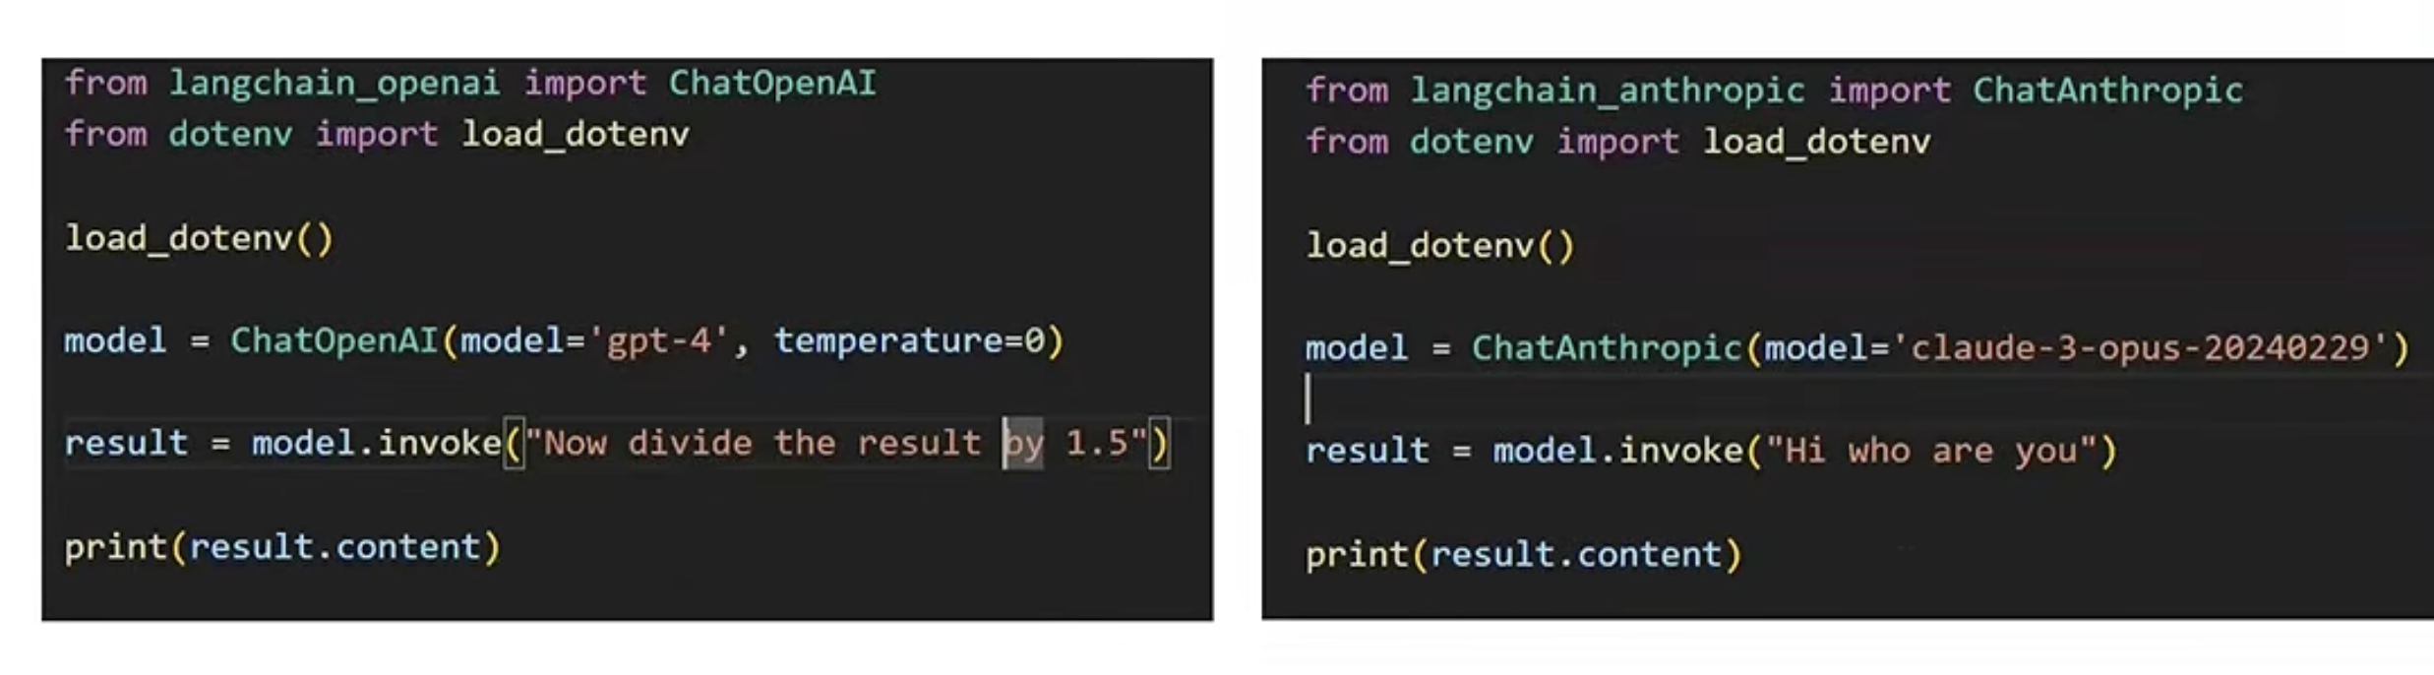
With LangChain: Same Code, Any Model
Only the import and the model line change. The call model.invoke(...) and the answer result.content stay the same.
LangChain hides the provider differences.
Notes:
Minutes 3.5-5. Only the import line and the model line change. The call model.invoke(...) and result.content stay the same. In our lab the import is langchain_groq and ChatGroq.

Slide 5
What Is LangChain?
DEFINITION
MAIN IDEA
SMALL EXAMPLE
An open-source framework for building apps powered by LLMs.
Small building blocks (prompt, model, parser) joined into one flow.
Question > Prompt template > Groq model > Clean text answer
# The whole idea in one line (Session 2 explains the | pipe)
chain = prompt | llm | StrOutputParser()
Think of LangChain as LEGO blocks for LLM apps.
Notes:
Minutes 5-10. Concept, then the small example. Stress: LangChain is not a model. The model runs on Groq.

Slide 6
Why Use LangChain?
ONE INTERFACE
REUSABLE BLOCKS
Swap Groq for another model by changing one line.
Prompts, parsers and tools can be reused in many projects.
READY PATTERNS
EASY DEBUGGING
Chains, agents, memory and RAG are ready to use.
LangSmith shows every step of a run.
LangChain is a toolkit, not a model. The model still lives models on Groq, Llama.
Notes:
Minutes 10-15. Four benefits. Be honest: for tiny scripts the raw API is fine.

Slide 7
The Ecosystem: Libraries
LANGCHAIN-CORE
LANGCHAIN
LANGCHAIN-COMMUNITY
Base blocks: messages, prompts, parsers, Runnable and LCEL.
High-level parts: agents and app patterns, built on core.
Many third-party integrations kept by the community.
LANGCHAIN-GROQ
LANGGRAPH
LANGSMITH
Partner package. Gives us ChatGroq. We use this today.
Builds stateful, multi-step agents as graphs.
Tracing, testing and evaluating your LLM runs.
Install only what you need. Core comes with langchain automatically.
Notes:
Minutes 15-22. Each library is a separate pip package. We install two today: langchain and langchain-groq. Source: LangChain docs overview.

Slide 8
Where Do I Import From?
from langchain_groq import ChatGroq # for importing the model
from langchain_core.prompts import PromptTemplate # prompts create
from langchain_core.output_parsers import StrOutputParser # parsers
from langchain_core.tools import tool # tools
from langchain.agents import create_agent # agents
from langgraph.checkpoint.memory import InMemorySaver # memory saver
RULE
Model > langchain-<provider>. Basic blocks > langchain_core. Agents > langchain.
Old tutorials import from langchain.chains. Those moved. Check the version.
Notes:
Minutes 22-25. Show the rule, not memorising. Every import below was run on langchain 1.4.7 and langchain-groq 1.1.3.

Slide 9
LangChain Architecture: The Layers
Your app (Python script)
HOW ONE CALL FLOWS
1. Your code builds a prompt.
2. langchain-core turns it into messages.
3. ChatGroq sends them to Groq.
4. The answer comes back as an AIMessage. Read it with .content.
langchain: agents and app patterns
langgraph: stateful agent runtime
langchain-core: Runnable, prompts, messages, parsers
langchain-groq: ChatGroq
Groq cloud: openai/gpt-oss-20b
Notes:
Minutes 25-35. Read the stack from top to bottom. Agents in langchain v1 run on LangGraph. Walk the 4-step flow on the right.

Slide 10
Part 1: Chain
CONCEPT
SMALL EXAMPLE
A chain joins steps in order. The output of one step is the input of the next.
Topic "loops" > Prompt: "Explain loops in 2 lines" > Model > Text
prompt = PromptTemplate.from_template("Explain {topic} in {n} lines.")
chain = prompt | llm | StrOutputParser() # the | joins the steps
print(chain.invoke({"topic": "loops", "n": 2}))
Notes:
Minutes 35-42. Concept, example, then code. Chains are covered fully in Session 2 (LCEL).

Slide 11
Part 2: Agent
CONCEPT
SMALL EXAMPLE
An agent lets the model decide which tool to use, and when.
Ask: "How many words in this line?" > model picks word_count > tool runs > final answer
agent = create_agent(llm, tools=[word_count])
result = agent.invoke({"messages": [("user", "How many words in: I love AI")]})
In an agent, the MODEL decides the steps.
Notes:
Minutes 42-47. Key contrast: chain = fixed order, agent = model decides. Groq gpt-oss models support tool calling.

Slide 12
Part 3: Tools
CONCEPT
SMALL EXAMPLE
A tool is a normal Python function the model is allowed to call.
word_count(text) returns the number of words. Search, calculator and file reader work the same way.
@tool
def word_count(text: str) -> int:
"""Count the words in a text.""" # the model reads this line
return len(text.split())
Write a clear docstring. A weak one confuses the model.
Notes:
Minutes 47-51. The docstring matters: the model reads it to decide when to call the tool.

Slide 13
Part 4: Memory
CONCEPT
SMALL EXAMPLE
The model has no memory. Memory means we send past messages again.
Turn 1: "My name is Asha." Turn 2: "What is my name?" Without memory the model cannot know.
agent = create_agent(llm, tools=[], checkpointer=InMemorySaver())
config = {"configurable": {"thread_id": "class1"}} # one thread = one chat
agent.invoke({"messages": [("user", "My name is Asha")]}, config)
Same thread_id = same conversation. New thread_id = fresh start.
Notes:
Minutes 51-55. Models are stateless. Memory = sending earlier messages again. In langchain v1, agent memory uses a LangGraph checkpointer.

Slide 14
All Four Parts Together
CHAIN
AGENT
TOOLS
MEMORY
Turns the topic into a clean prompt and a clean answer.
Decides when to look something up or count something.
Search notes, calculate marks, count words.
Remembers what the student already asked.
Study helper = chain + agent + tools + memory.
Notes:
Minutes 55-60. Example: a study helper. Ask students which part does which job.

Slide 15
Install and Groq Key
python3 -m venv .venv # Open terminal and Creat a virtual enviornment and folder
source .venv/bin/acvtivate #activate the virtual env
python -m pip install -U pip
python -m pip install groq #installing groq lib
python -m pip install python-dotenv langchain langchain-groq # installing dotenv to load env file and langchain for langchain-community and prompts import and lanchain groq for model
STEP 1
STEP 2
# store in .gitignore file
.env
.venv/
__pycache__/
Open console.groq.com, log in, create an API key. keep the key private in a .env file
create a seperate virtual enviornment
STEP 3
STEP 4
MODEL ID
upgrage pip before installing libaries and the install them using pip install
create a .gitignore file to ignore .env file .venv folder and Python cache
openai/gpt-oss-20b (Groq model name)
Notes:
Minutes 60-65. Everyone must reach a printed version number before moving on. Keys: console.groq.com/keys. Never share keys or put them in code.

Slide 16
Exp 10 · Steps 1 and 2: Key and Model
import os
from dotenv import load_dotenv
from langchain_groq import ChatGroq
# loading api key from .env file
load_dotenv()
apikey=getenv(“Name of the variable in which api key is stored in .env file”)
# Create the model object
llm = ChatGroq(model="openai/gpt-oss-20b",
api_key=apikey, # assigning key
temperature=0.5, # keeping temperature low
max_tokens=300, # limiting the usage of token in the particular case
reasoning_effort="low") #keeping the reasoning to low
STEP 6
Import libraries and then load api key and create model object
Notes:
Minutes 65-72. Type live in small steps. Students run after each step.

Slide 17
Exp 10 · Steps 3 and 4: Template and Output
from langchain_core.prompts import PromptTemplate as PT
from langchain_core.output_parsers import StrOutputParser
# A template with two blanks: {topic} and {level}
prompt = PT.from_template(
"Explain {topic} to a {level} student in 3 lines.")
# Fill the blanks, then send the filled prompt to the model
final_prompt = prompt.invoke({"topic": "LangChain", "level": "first year"})
output= llm.invoke(final_prompt)
print(output.content) # .content holds the answer text
llm.invoke gives a AIMessage object in which content is stored in .contents therefore we used output.content
TRY NEXT
Change topic to "variables" and level to "school". Compare both outputs.
Notes:
Minutes 72-85. Students change topic and level, run again, and note how the answer changes.

Slide 18
Common Errors and Fixes
401 / INVALID API KEY
MODEL NOT FOUND
Key was copied wrongly or has extra spaces. Create a new key.
Check the spelling: openai/gpt-oss-20b.
MODULE NOT FOUND
RATE LIMIT (429)
Run pip install -U langchain-groq in the same Python you use.
Too many calls at once. Wait a few seconds and run again.
Read the LAST line of the error first. It tells you the cause.
Notes:
Minutes 85-88. Quick fixes. Rate limits on the free Groq tier can appear when the whole class runs at once.

Slide 19
Wrap-up, Quiz and Homework
QUICK QUIZ
1. Which package holds PromptTemplate?
2. Who picks the steps: chain or agent?
3. What is a tool?
4. What keeps one chat separate from another?
Finish Exp 10 with 3 different topics. Save the 3 outputs and a 2-line note on what changed.
Next: LCEL, prompt chaining and Exp 12.
Notes:
Minutes 88-95. Quiz answers: core; agent; tool; thread_id / checkpointer. Next: Session 2, LCEL and Exp 12.

