Slide 1
PROMPT ENGINEERING
Lecture 2: Tokenization, Embeddings,
Fine-Tuning vs. Prompting, and Sampling
Module 1 · Introduction to LLM and Prompt Engineering (continued)

Slide 2

What We Covered Last Time
NLP tasks
Brief history of LLMs
Generative models
Transformer / BERT / GPT
Popular LLMs today
First mention: prompt engineering
EXPERIMENT 1 CHECK-IN
Collect screenshots at the start of class. Ask 2–3 students to briefly share one interesting output from their 5 prompts (translation, summarization, Q&A, sentiment analysis, or text generation).
Rapid-fire recap: cold-call students to define NLP, LLM, transformer, and generative model in one line each.
2

Slide 3

Tokenization: Breaking Text Apart
Before a model can process text, it must be split into tokens — small chunks, often smaller than a whole word (subwords).
LIVE EXAMPLE
unbelievable
→
un
believ
able
Each colored piece above is one token — the model never sees “unbelievable” as a single unit; it sees three pieces and predicts/reads one piece at a time.
Why subwords, not whole words? A finite token vocabulary can still represent any word — even rare ones — by combining familiar pieces.
3

Slide 4

Embeddings: From Tokens to Meaning
Once text is tokenized, each token is converted into an embedding — a vector (list of numbers) that captures something about its meaning.
"believ" → [ 0.21, −0.08, 0.44, ... , 0.13 ]
This lets the model work with numbers instead of raw text — and, as we saw in Lecture 1, similar-meaning tokens end up with similar vectors (king / queen, happy / joyful).
4

Slide 5

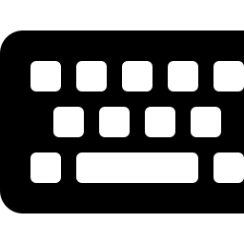
Two Ways to Change Model Behavior
Fine-Tuning
Prompting
Changes the model's WEIGHTS using additional training data.
Changes only the INPUT — model weights stay untouched.
Needs data + compute
No retraining needed
Slower, more expensive
Fast, cheap, immediate
Result: a specialized model
Result: steered behavior, same model
5

Slide 6
When Would You Use Which?
Scenario
Better Fit
You need an answer in the next 5 minutes
Prompting
You have a narrow, repeated task at massive scale (e.g. classify 1M support tickets in a fixed format)
Fine-tuning
You're exploring / iterating on what you even want
Prompting
You need the model to adopt a very specific, consistent voice across thousands of calls
Fine-tuning (or a strong system prompt)
You don't have labeled training data or a compute budget
Prompting
6

Slide 7

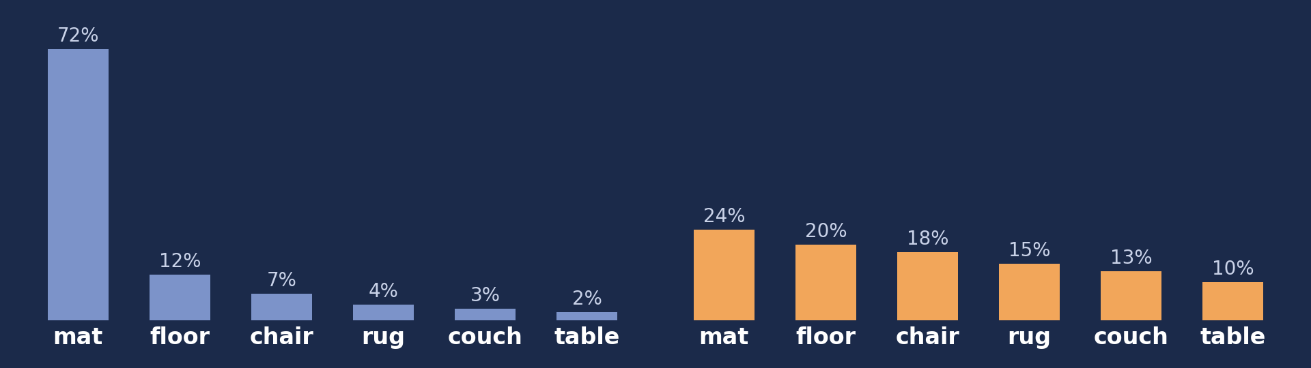
Temperature: The Creativity Knob
Temperature controls how randomly the model samples from its predicted next-token probabilities.
LOW TEMPERATURE · Deterministic, focused, repeatable
HIGH TEMPERATURE · Diverse, creative, less predictable
Illustrative next-token probabilities for "The cat sat on the ___"
7

Slide 8


Top-k and Top-p Sampling
Top-k Sampling
Top-p (Nucleus) Sampling
Restrict the model's choices to only the k most likely next tokens, then sample among those.
Restrict to the smallest set of tokens whose cumulative probability exceeds p.
Example: top-k = 3 → the model can only pick from its 3 most probable next words, however low temperature is set.
Example: top-p = 0.9 → keep adding the next most likely tokens until their combined probability passes 90%.
8

Slide 9
Same Prompt, Different Temperatures
Prompt: "Describe a rainy day in one sentence.“
Reply: “Soft gray clouds blanketed the sky, sending down a rhythmic patter of raindrops that glistened against wet leaves and invited a quiet, comforting warmth indoors.”.
temperature = 0.0
temperature = 0.7
temperature = 1.2
Soft gray clouds blanketed the sky, sending down a steady, rhythmic patter of raindrops that washed the world in quiet solitude and invited a cozy warmth indoors.
Sheets of rain tapped a gentle, steady rhythm against the windows, casting a calm gray hue over the world and wrapping everything in a quiet, cozy stillness.
A steady cadence of raindrops drummed against the windowpane as gray mist wrapped the world in a quiet, moody blanket, painting the damp streets in shimmering neon reflections.
Same, safe phrasing every time
Varied but coherent
Unusual, sometimes incoherent
Try this Prompt yourself: “Apne college ko ek sentence mai describe karo“
9

Slide 10
The Prompt Is the Primary Interface
Without fine-tuning, the prompt is the main lever you have to control model behavior. This is why prompt quality matters so much in practice.
PAIRED EXAMPLE — SAME TASK
VAGUE PROMPT
WELL-SPECIFIED PROMPT
"Write about climate change."
"In 100 words, explain climate change to a 12-year-old, using one everyday analogy."
Result: generic, unfocused, unclear length or audience — could go anywhere.
Result: scoped length, clear audience, concrete stylistic constraint — output is predictable and useful.
10

Slide 11
What Made the Better Prompt Better?
01
02
03
04
Clarity
Context
Format
Constraints
A specific, unambiguous task — no room to guess what you meant.
Enough background for the model to calibrate its answer (audience, purpose).
A stated output shape — length, structure, style.
Explicit boundaries — what to include, exclude, or emphasize.
This is a lead-in only — the full principles of prompt engineering are covered in a later module.
11

Slide 12



Ethics in Prompt Engineering
Bias
Hallucination
Misuse
Responsible Use
Model outputs can reflect and amplify biases present in training data.
Fluent, confident-sounding text that is factually wrong.
The same steering power can generate misinformation or attempt to jailbreak safety behavior.
Using AI tools transparently and appropriately in academic work.
12

Slide 13
Key Terms From Today
Tokenization
Embedding
Fine-tuning
Splitting text into subword pieces
Numeric vector capturing token meaning
Retraining weights on new data
Prompting
Temperature
Top-k / Top-p
Steering output via input only
Knob controlling output randomness
Restrict the sampling pool of tokens
Effective prompting
Bias
Hallucination
Clarity + context + format + constraints
Training-data skew reflected in output
Confident but factually wrong output
13

Slide 14
Looking Ahead: Experiments 2 & 3
EXPERIMENT 2
EXPERIMENT 3 · NEXT LAB SESSION
Cross-Model Comparison
Temperature Testing Script
Enter the same prompt into two different LLMs (e.g. GPT and Gemini) and write a short comparison note on which response was more accurate or relevant.
Think ahead about a Python script using an LLM API to test outputs at temperature values 0.0, 0.7, and 1.2 — you'll build this in the next lab session.
14

Slide 15

Exit Question
"Name one thing that changes when you fine-tune a model vs. when you prompt it."
15

