Slide 1

PRESENTED BY
Akshit Jain
Anshu Ranjan Maurya
Ajatshatru Singh Jodha
Ayush Rai
Aditya Pinjare

Slide 2
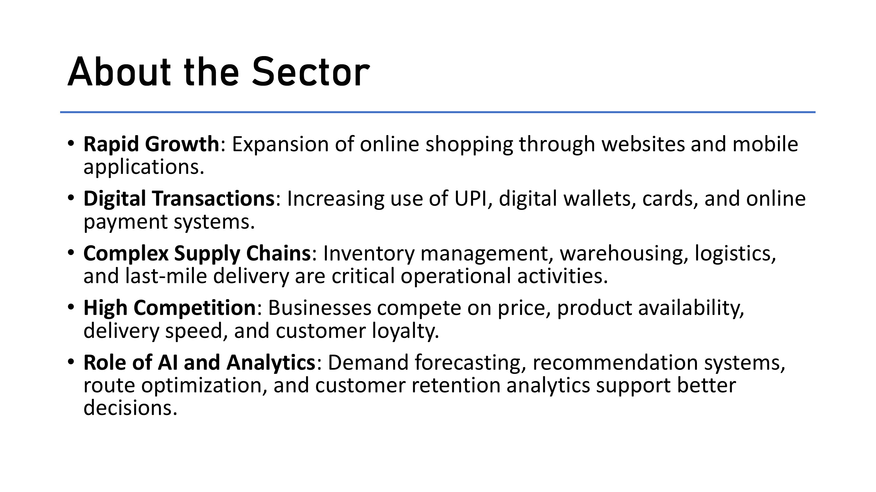

Slide 3


Slide 4
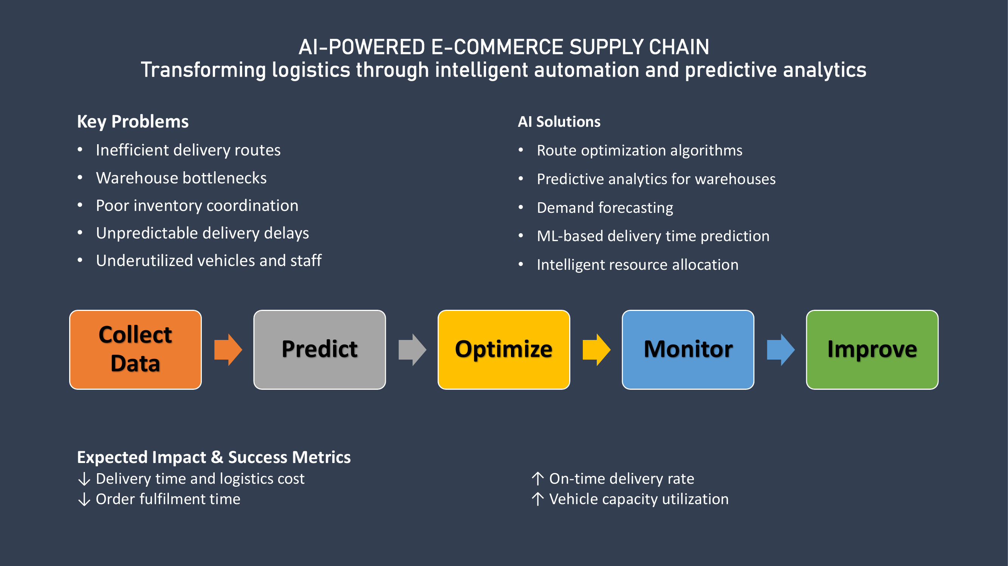

Slide 5
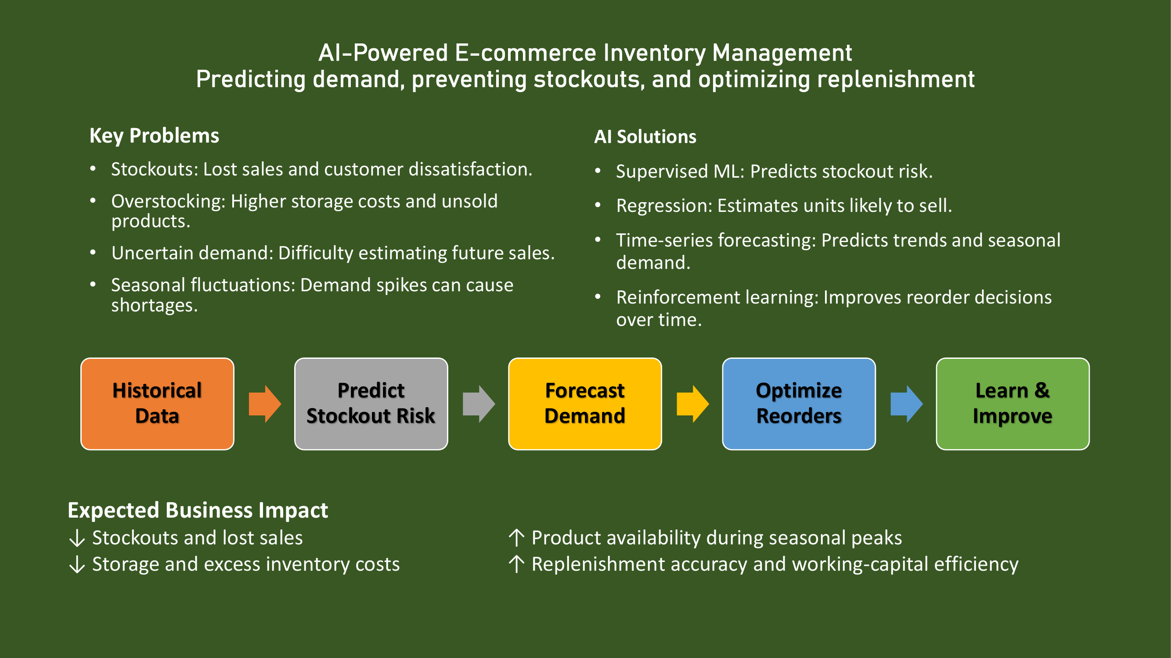

Slide 6
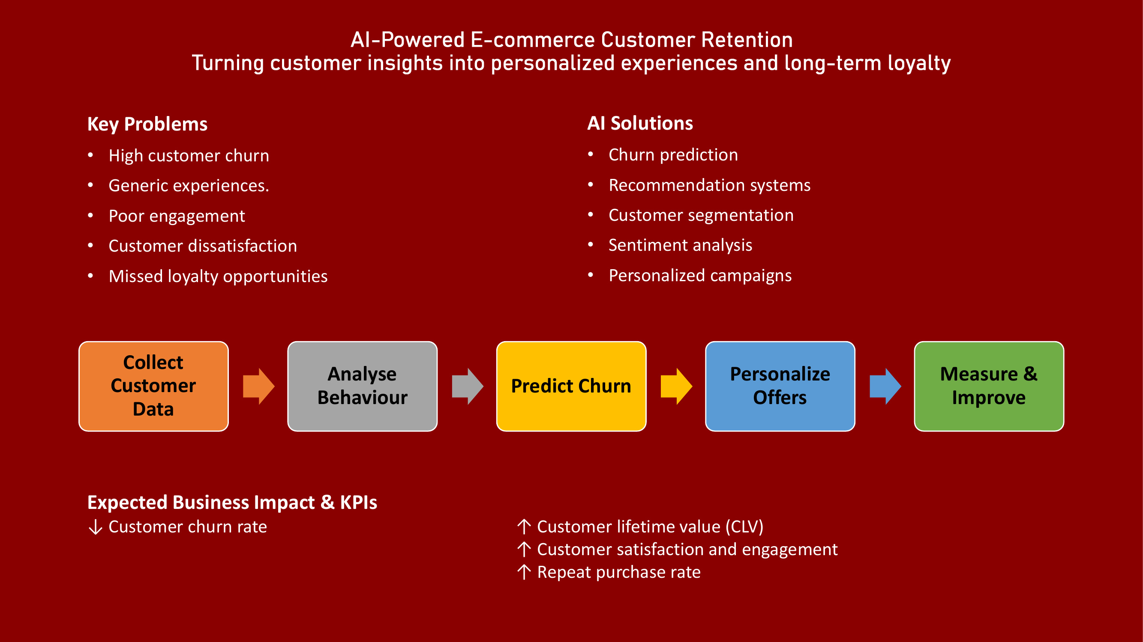

Slide 7
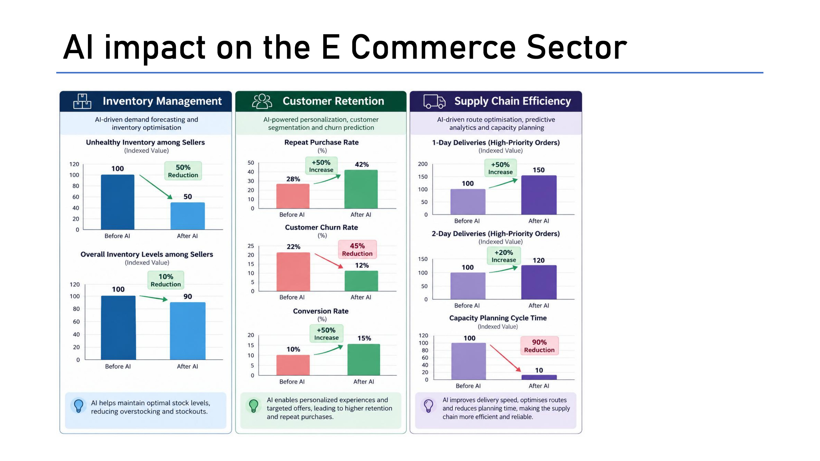

Slide 8
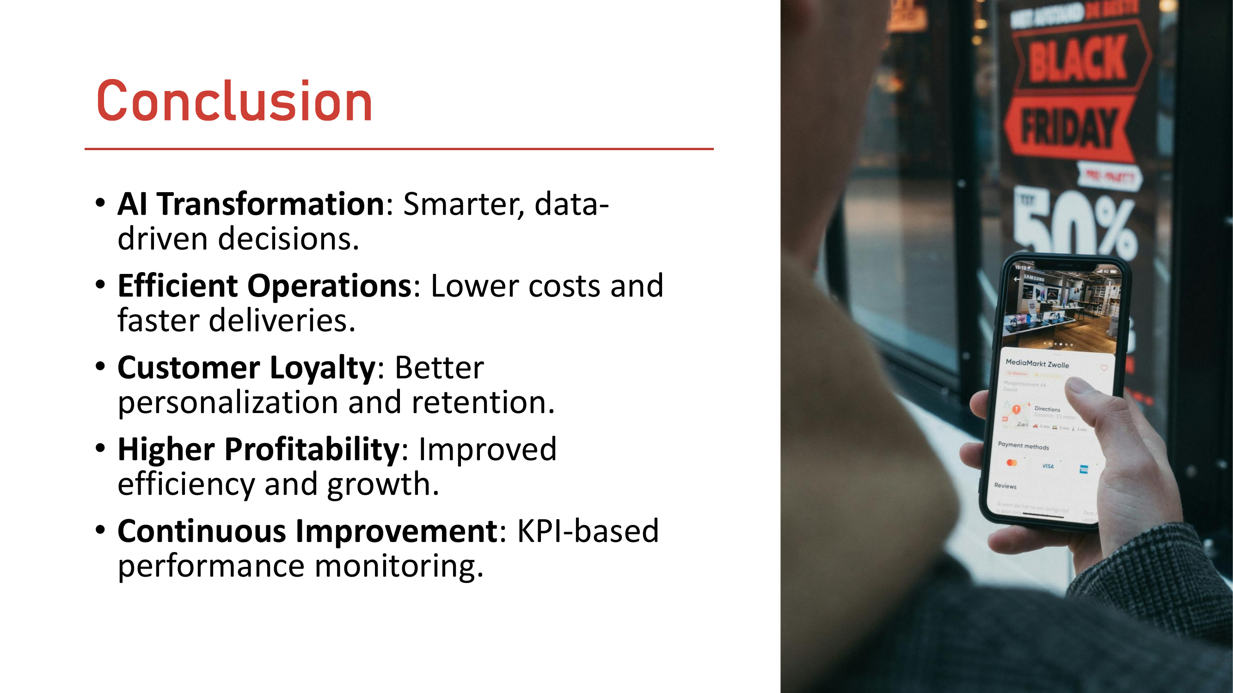

Slide 9


