Slide 1
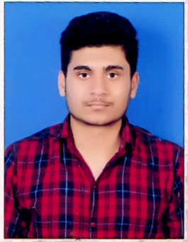

Ayush Raj
Software Engineer I
Ayush is a seasoned professional Engineer with over 1.5+ years of hands-on experience as a Full Stack Developer. His expertise spans across multiple domains and projects, where he has consistently demonstrated his ability to develop, test, maintain, debug responsive web apps/sites with a deep understanding of Modern Web Technologies and best practices.
Bengaluru, India
Mobile: +91 7022709918
Relevant Tools/Skills
Relevant Experience
Tech Stacks : React JS, React Native, Node JS, Vue JS.
Tools/Applications: Git, AWS Cloud , Express(NodeJS), GitHub, Docker , GCP.
Programming Languages: JavaScript, Python, Java.
Demonstrated proficiency across front-end technologies for developing, testing, maintaining, debugging responsive web apps/sites with an understanding of Modern Web Technologies and best practices .
Experienced in building scalable React applications along with deep understanding of configuring bundlers, internal reconciliation process and Diffing Algorithm.
Effectively Implemented Redux toolkit to globally manage the state in the application.
Successfully used AWS CloudFront , leading to a reduction in overall Latency of the Application.
Utilized Node JS to develop RESTful API’s using the MVC architecture within the microservices.
Prioritized graceful error handling by crafting comprehensive unit tests for each of the components.
Orchestrated establishing a well-organized Folder Structure that facilitated development of Modular code ensuring clear separation of concerns.
Adept in Database management , having utilized MySQL and Mongo Db on backend systems.
Identified and Fixed Root cause of some Major bugs in the Application.
Worked Closely with Multiple Stakeholders including Functional Consultants, UX Designers, DevOps and QA team.

