Slide 1
Department of Computer Science & Engineering
PROJECT “ARTHA”
Students Names (USNs)
Abhinav Raj 1BY20CS005
Aryan Agrawal 1BY20CS030
Ayush Raj 1BY20CS035
Himanshu Sharma 1BY20CS064
Under the guidance of:
Dr. Srivani & Prof. Vidya R
2022-23
ODD Semester
1

Slide 2
Department of Computer Science & Engineering
Contents
Introduction
Objectives
Literature Survey
Proposed Methodology
System Architecture/ Design
Subject Mapping (Please discuss with your guides)

Slide 3
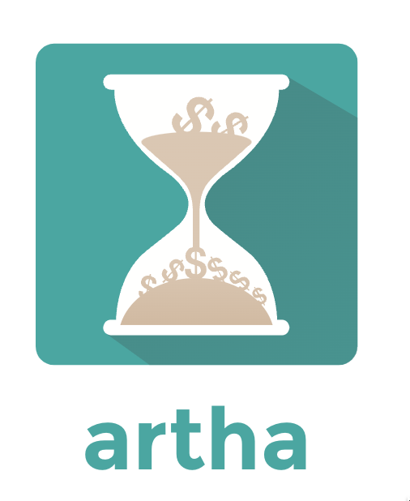
What is project Artha?

Slide 4
Arth : means meaning!

Slide 5
So are we creating a Dictionary which will help us talk to robots?

Slide 6
"Artha" is a Sanskrit word that translates to "wealth" in English and means "money-related."

Slide 7
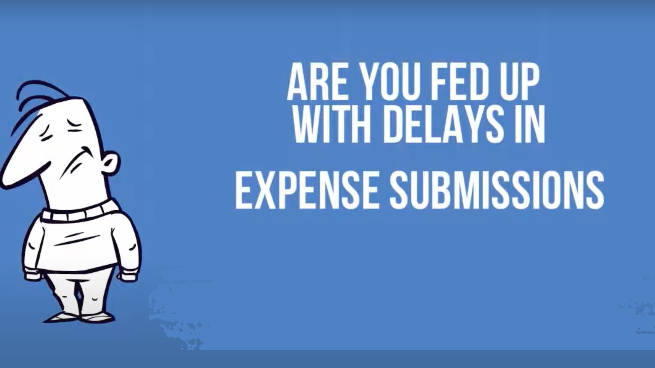

Slide 8
INTRODUCTION
We are trying to provide a virtual accountant for a middle-class person.
This accountant will manage all the repayments and transactions.
This project has many components, such as data manipulation, predictions through linear regression, and curve analysis.
It will help to determine the current balance and potential balance of a particular individual.
We are trying to eliminate the problem of "hazy balance," which means a poorly defined or dispersed balance.
This leads to uneven expenditure and the levying of more debt on the individual, which could create more problems in the future.
It also tries to record events that are not usually registered officially because the transaction might have taken place through cash or any other unregistered means.
Here we are trying to pick out the qualities of certain organizations and applications, such as "cred" and "splitwise," and add more functionality to them with ML predictions and suggestions to encourage positive cash flow.

Slide 9
Objectives
Finding the stagnant balance: it is a balance that is defined as a potential balance after taking actions such as repayments of credit cards, lending, borrowing, income flow, expenses, and other transactions. The positive cash flow is being reduced by factors such as expenses. This balance is functionally not in use and thus can hold some benefits, such as investing in favourable stocks and saving it for future plans and emergencies. We can identify it by targeting the minima of the balance amount all around.
Determining the expenditure per day: when a stagnant balance is being processed, the next step is to determine the safest possible expenditure that can take place per day (the average). This will surely try to maintain the stagnancy of the balance and provide a perfect way to define that individual's jurisdiction over his or her money. It will depend on the occupation and cash flow.
Suggesting shares to invest in: it is an outer scope of the project that will suggest shares and stocks based upon the stagnant balance after deducting potential expenses and excluding doomsday money.
Creating an event handler: it will handle events such as -
Lending: If you have provided someone with money from your account while expecting a return with or without interest
Borrowing: If you accept money at the expense of payback,
Lending with zero returns: providing money with no expectation of getting a return, such as by providing for a relative.
Borrowing with zero returns: means accepting money with no possibility of payback.
Transaction in highlight: an important transaction that should be under supervision.

Slide 10

Literature Survey
‘Middle-class people always remain under financial pressure due to a lack of money. They believe that money management is a very difficult subject as it requires an ample amount of knowledge or consultation with a financial planner. Financial management highly depends on the past and current spending of an individual.’

Slide 11
Name of the Project/Book/Paper | Powered by | Author Name/Powered by | Objective
Ledger Book: Record Income & Expenses | Octal Point | Adil Daisy | The author has discussed about various ways to improve day-to-day expenses
Expense | Vintera Research | Robert Kugel, VP, Ventana | It deals with all the expense occurred during travel trip
Project Open | Project Open | Frank Bergmann,Klaus Hofeditz | It is solution provider to manage the daily expense
Service Desk Plus | manage engine | Team-Based | It considers the input values and stores manages and runs the model

Slide 12
Current System:-
The current system cannot inform individuals of their spending such as credit card repayments, various transactions, income flow, and ideas to improve them (spending).
Because of a lack of coordination and communication among the many authorities, the system fails to build a sense of confidence among people regarding their savings and spending.
Proposed System:-
The proposed system determines the safest possible expenditure plan for an individual which will give him/her a sense of stability and steadiness.
The system will also suggest share and stocks based strategies after removing average expenditure

Slide 13
Proposed Methodology
Project “Artha” will consist of many functions and operations, which lead to more well-defined and accurate results. The components of project “Artha” are :-
Operations: it will carry out certain operations which will give us the results, intermediate state, and observation. the operation that will be performed -
Data manipulation and reading: the controller will read the data and manipulate it accordingly it will record the events and link every entity to each other.
Curve analysis: the attributes or properties which are under observation such as current balance will be taken into consideration and the balance vs time graph will be plotted from which extremes will be determined that will be used to calculate the stagnant balance.
ML prediction: it will train a model upon the history of the stock market and expenditure data and produce predictions for the current situation.
2. Functions:
Stagnant balance
Expenditure prediction
Suggesting stock
Results:
Stagnant balance range
Providing expected expense per day
Method:- We will use python pandas for data manipulation and extraction; matplotlib and NumPy for curve analysis; TensorFlow or Scikit learn tools for creating a model and making predictions.

Slide 14
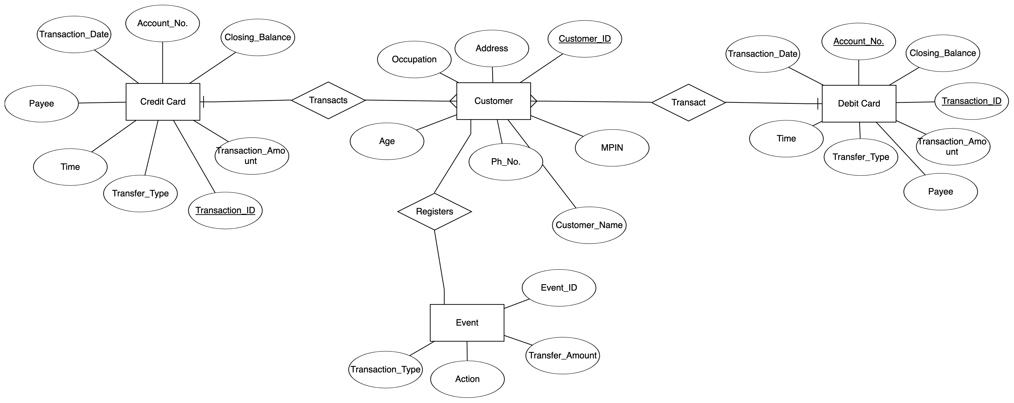
System Architecture/Design

Slide 15
THANK YOU

