Slide 1
APEXPLANET INTERNSHIP
TASK 4
BUSINESS STORY
Data Storytelling &
Statistical Validation
01
Clean & validate
Task 1
02
Discover patterns
Task 2
From cleaned data → business intelligence → customer deep-dive → statistically validated insight
03
Deep-dive customers
Task 3
04
Validate a hypothesis
Task 4
Prepared by Ayush Rathor

Slide 2
01 • EXECUTIVE SUMMARY
One sales story, one validated decision
The dataset shows a large revenue engine with a clear customer-retention opportunity—and a statistical test helps separate signal from noise.
Revenue
Orders
Customers
AOV
Units
₹13.94 Cr
992
947
₹1,40,524
5,435
Three signals that frame the story
The decision lens
01
Electronics drives scale
Protect high-value revenue while moving more recent customers into repeat behavior.
Use statistical validation to avoid over-interpreting demographic differences.
₹50.78M revenue; ~36% of total sales.
02
Retention is the pressure point
The business-rule segmentation places 461 / 947 customers in the At Risk group.
03
Gender difference is not statistically significant
RETENTION + TEST & LEARN
Welch t-test on customer revenue: p = 0.654.

Slide 3
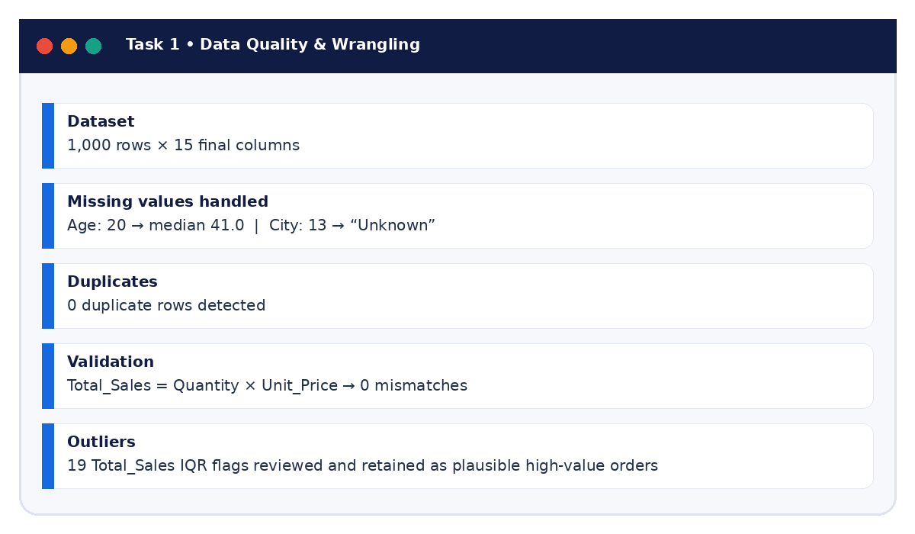
02 • TASK 1 EVIDENCE
Task 1: Clean data before telling the story
The final analysis starts from a validated, analysis-ready dataset.
What changed the analysis
Missingness
20 ages imputed with median 41.0; 13 missing cities labeled Unknown.
Integrity
0 duplicates and 0 Total_Sales validation mismatches.
Feature engineering
Year, Month and Month_Name added for trend analysis.
Outliers
19 high Total_Sales IQR flags retained after review because they may be legitimate high-value orders.
ANALYSIS-READY BASE

Slide 4
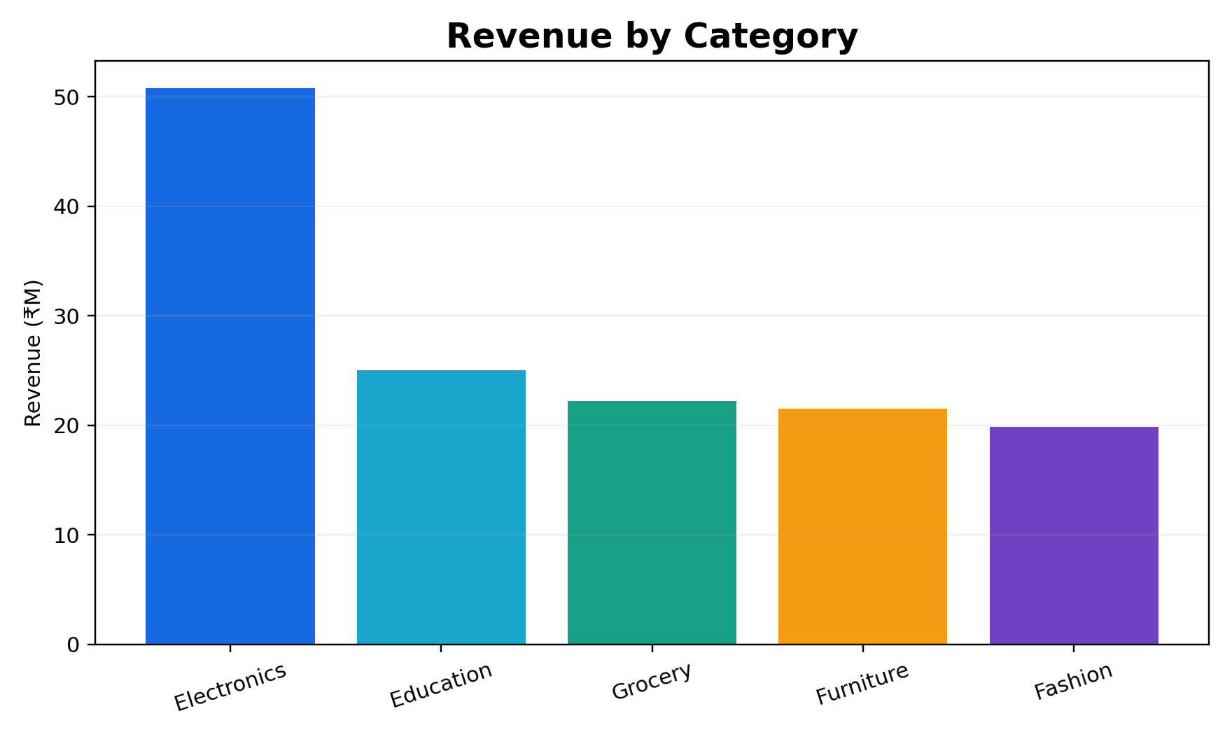
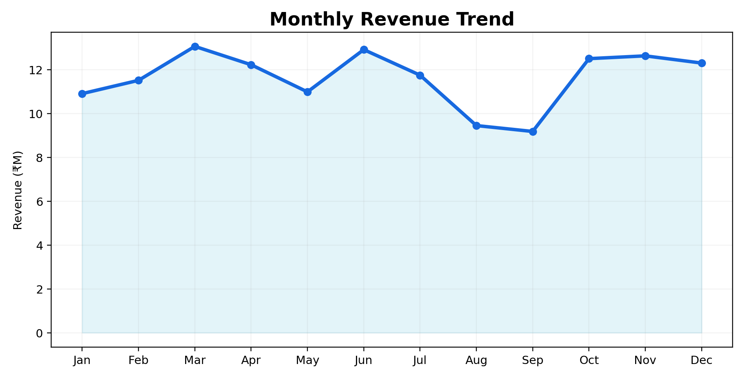
03 • TASK 2 EDA
Task 2: From description to business pattern
EDA translated the cleaned table into clear sales, product and time patterns.
Headline findings
• Electronics leads the category mix at ₹50.78M. • Laptop leads products at ₹25.44M. • March peaks at ₹13.06M; September is the low month at ₹9.18M.
DESCRIPTIVE → ACTIONABLE

Slide 5
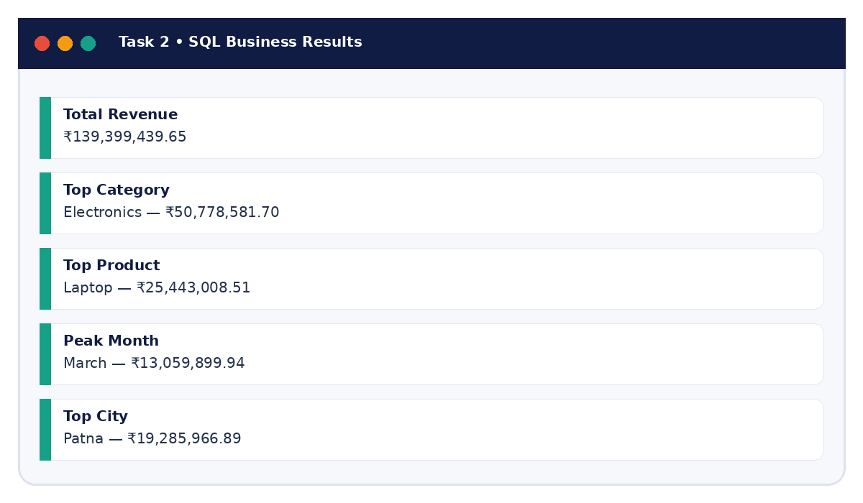
04 • TASK 2 EVIDENCE
SQL business questions made the analysis decision-ready
The SQL layer answered specific business questions using filtering, aggregation and JOIN logic.
Business questions answered
1
Total revenue generated
2
Revenue by category
3
Top 10 products by revenue
4
Monthly revenue trend
5
Top customers by revenue
SQL → EVIDENCE

Slide 6
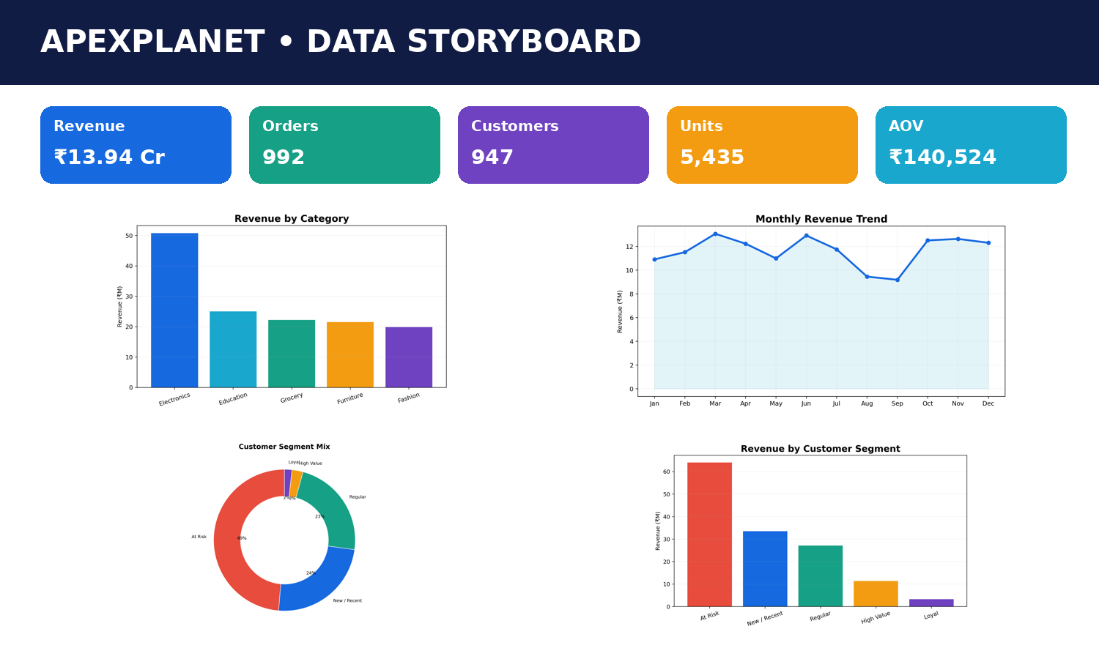
05 • TASK 3 INTEGRATION
Task 3: Turn analysis into an interactive business view
The dashboard brings KPIs, category trends and customer segmentation into one decision surface.
Dashboard contract
KPIs
Revenue, Orders, Customers, AOV, Units
Trend
Jan–Dec monthly revenue
Product view
Revenue ranking by product
Customer view
Segment mix + segment revenue
Filters
Category, City, Customer Segment
INTERACTIVE BI LAYER

Slide 7
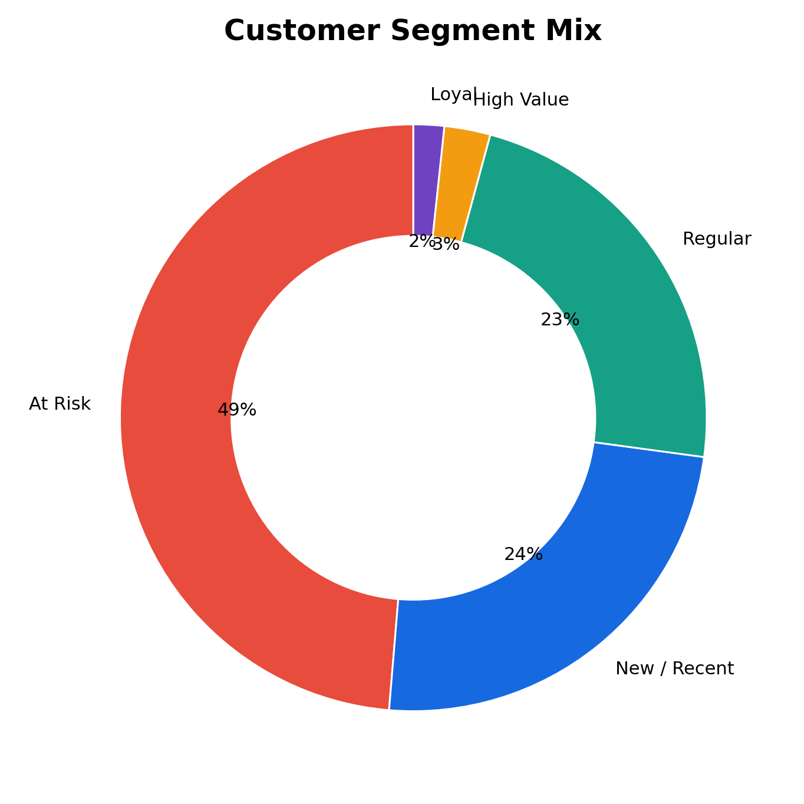
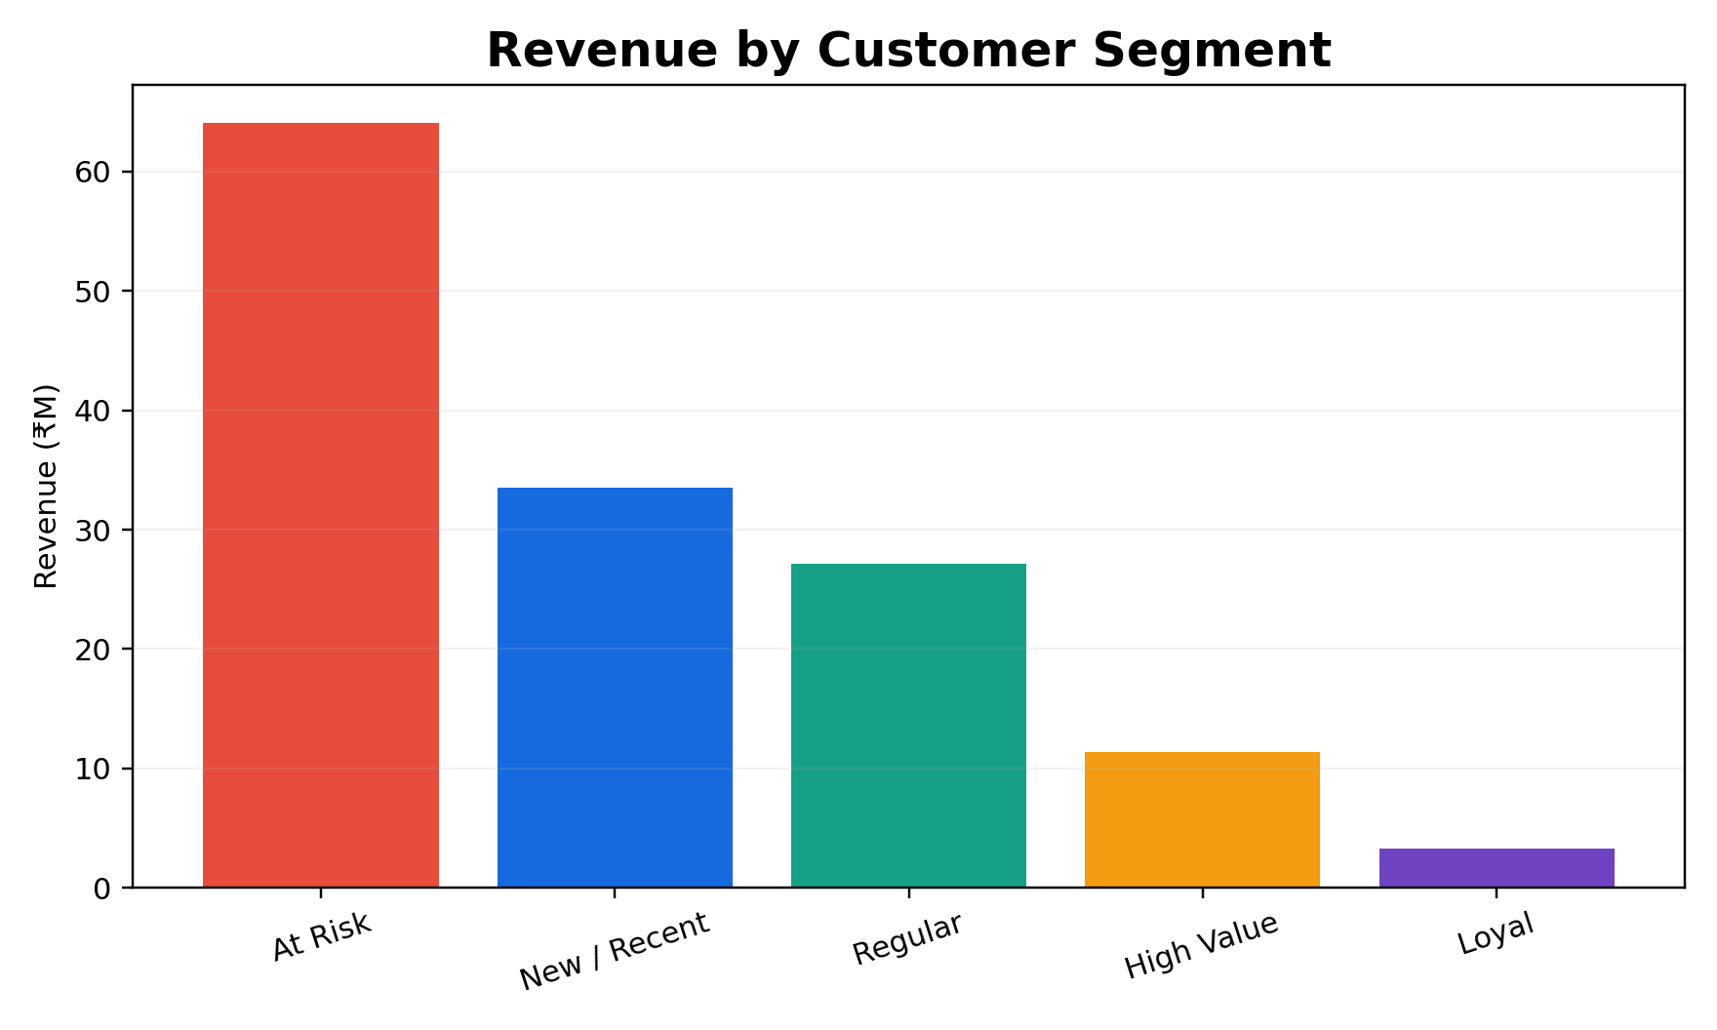
06 • DEEP-DIVE ANALYSIS
Customer segmentation: where retention risk becomes visible
Business-rule based segments convert raw customer history into an interpretable retention lens.
Segment mix
Segment
Customers
Share
Revenue
At Risk
461
48.7%
₹64.10M
New / Recent
229
24.2%
₹33.48M
Regular
217
22.9%
₹27.15M
High Value
24
2.5%
₹11.41M
Loyal
16
1.7%
₹3.27M
Interpretation
The largest segment is At Risk; retention, reactivation and repeat-purchase programs should be prioritized before assuming customer growth alone will solve the revenue challenge.

Slide 8
07 • DATA STORY
The business narrative
Four questions turn the analysis into a stakeholder-ready story.
01
How healthy is the engine?
₹139.4M revenue across 992 orders; AOV ₹140.5K.
Start with scale.
02
Where does growth come from?
Electronics is the largest category; Laptop leads products.
Concentrate what is working.
03
Where is the customer risk?
461 customers fall into the At Risk segment under the defined rules.
Retention becomes the next lever.
04
Which assumptions need validation?
Customer-level gender revenue difference is not statistically significant.
Do not over-index on weak signals.

Slide 9
08 • HYPOTHESIS TESTING
A clean test: do customer-level revenues differ by gender?
To avoid weighting repeat purchasers multiple times, the test uses one revenue total per unique customer.
Test design
Why this is business-relevant
H₀
Mean customer revenue is equal across genders.
• Tests whether a visible demographic difference is large enough to distinguish from sampling variability.
• Keeps the analysis aligned with the business question: customer value, not transaction count.
• Produces both a p-value and a confidence interval for decision context.
H₁
Mean customer revenue differs across genders.
α
0.05 significance level.
Test
Welch independent two-sample t-test.
Unit of analysis
Unique customer (n = 947 total).
STATISTICAL RIGOR

Slide 10
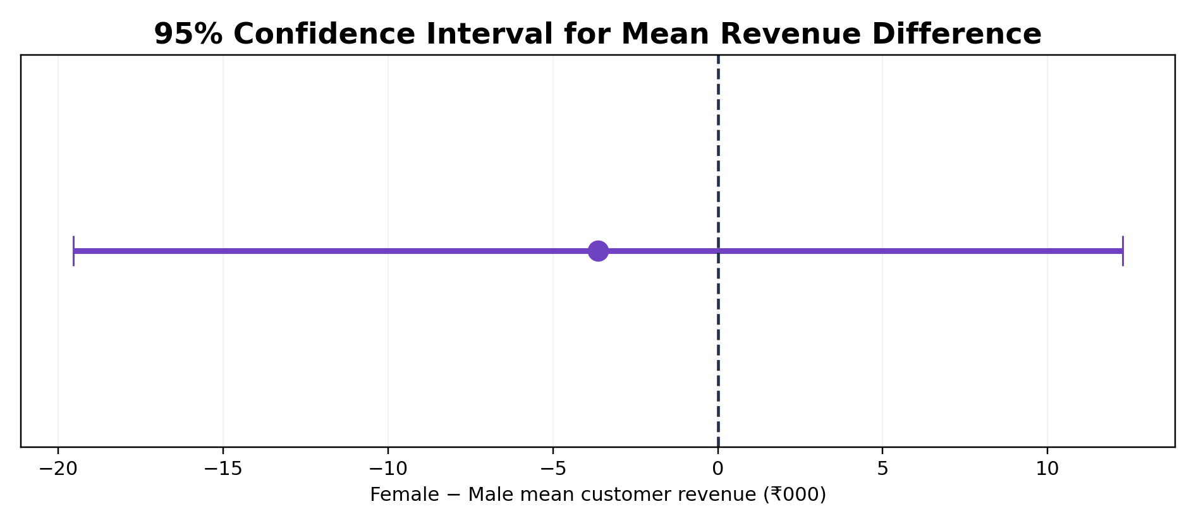
09 • STATISTICAL RESULT
The observed gap is not statistically significant
At the 5% level, the data do not provide enough evidence to conclude that mean customer revenue differs by gender.
RESULTS
p = 0.6541
Mean revenue
Female: ₹145,336
Male: ₹148,970
95% CI
[−₹19,545, ₹12,276]
Business interpretation:
The observed difference is small relative to customer-to-customer variability. Treat gender as a monitoring dimension—not as a strong causal or targeting signal from this dataset alone.

Slide 11
10 • CALL TO ACTION
Move from insight to action
The story ends with business actions that are measurable and testable.
1
Protect the core
Prioritize Electronics/Laptop availability, pricing and merchandising.
Weekly category/product KPI
2
Reactivate at-risk customers
Build win-back campaigns and measure repeat order rate.
Segment-level retention KPI
3
Convert recent customers
Push second-purchase journeys and cross-sell.
30/60/90-day repeat rate
4
Protect high-value customers
Create VIP journeys, service priority and retention offers.
High-value retention / revenue
5
Test, don’t assume
Use A/B tests before scaling demographic or promotional hypotheses.
Lift + confidence interval

Slide 12
The final story
Clean data created trust.
EDA revealed the pattern.
Customer segmentation found the pressure point.
Statistical testing kept the conclusion honest.
FINAL SNAPSHOT
₹139.4M
Revenue
947
Customers
461
At Risk
0.654
p-value
CALL TO ACTION
Use the dashboard to find the signal.
Use statistical tests before scaling the decision.
Prepared for ApexPlanet Software Pvt Ltd • Data Analytics Internship

