Slide 1
APEXPLANET SOFTWARE PVT LTD
DATA ANALYTICS
INTERNSHIP
REVENUE
ORDERS
₹13.94 Cr
992
Total sales
Unique orders
Final Portfolio • Tasks 1–4
CUSTOMERS
UNITS
947
5,435
From data quality and exploratory analysis to business intelligence, deep-dive segmentation, and statistical validation.
Unique customers
Units sold
01
CLEAN
02
EXPLORE
03
DEEP DIVE
04
VALIDATE
Python • Pandas
EDA • SQL
Power BI • DAX
Statistics • Storytelling
AYUSH RATHOR

Slide 2
The internship journey
A single end-to-end analytics workflow, built step by step.
Data Quality & EDA
Cleaned 1,000 sales records, validated fields, handled missing values, and explored distributions.
01
Business Intelligence
Answered business questions with SQL and translated results into a decision-ready sales dashboard.
02
Deep-Dive & Interactive BI
Defined core KPIs and built customer segmentation with interactive Power BI analysis.
03
Storytelling & Validation
Synthesized findings into a business story and statistically tested a customer-revenue hypothesis.
04
Outcome: a portfolio that connects analysis, business context, interaction, and statistical rigor.

Slide 3
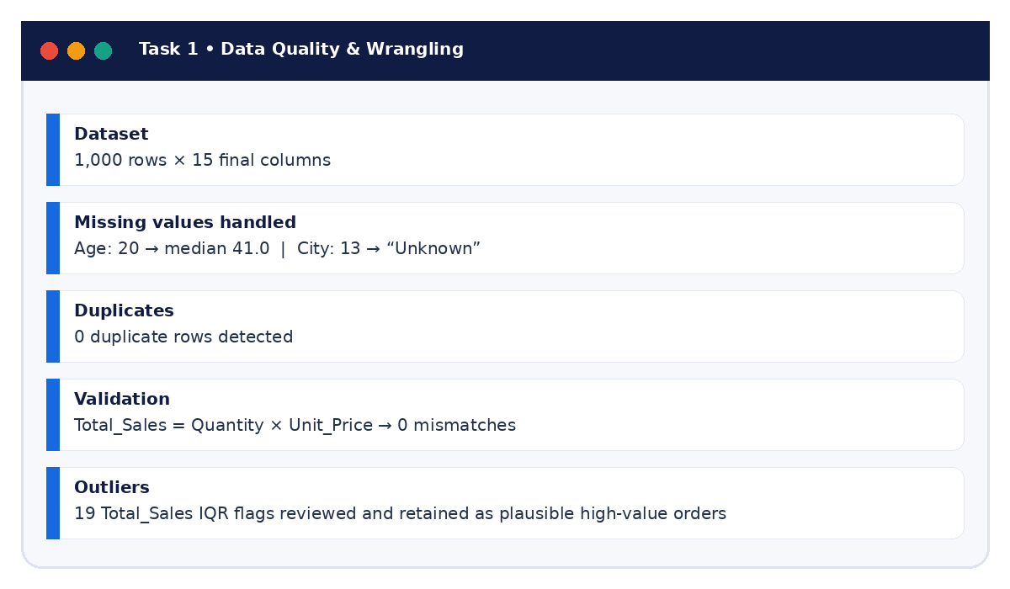
Task 1 • Data quality & wrangling
Cleaning first so every downstream insight is defensible.
TASK 1
What was delivered
1,000 rows with 15 final columns
Missing Age values imputed with the median; missing City values set to “Unknown”
No duplicate rows detected
Total_Sales validated against Quantity × Unit_Price
IQR flags reviewed as plausible high-value orders rather than blindly removed
Why it mattered
A reliable model starts with trusted data. Cleaning decisions were documented so later charts and statistics can be reproduced.

Slide 4
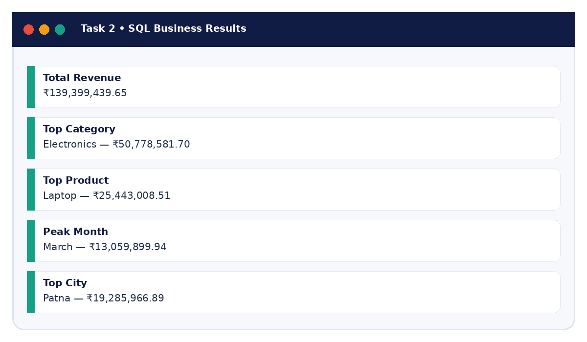
Task 2 • EDA & business intelligence
From descriptive analysis to business-ready answers.
Headline findings
Total revenue
₹139.40M
Top category
Electronics • ₹50.78M
Top product
Laptop • ₹25.44M
Peak month
March • ₹13.06M
Top city
Patna • ₹19.29M
Business value
The workflow moved beyond “what happened?” to “what should the business pay attention to next?”.

Slide 5
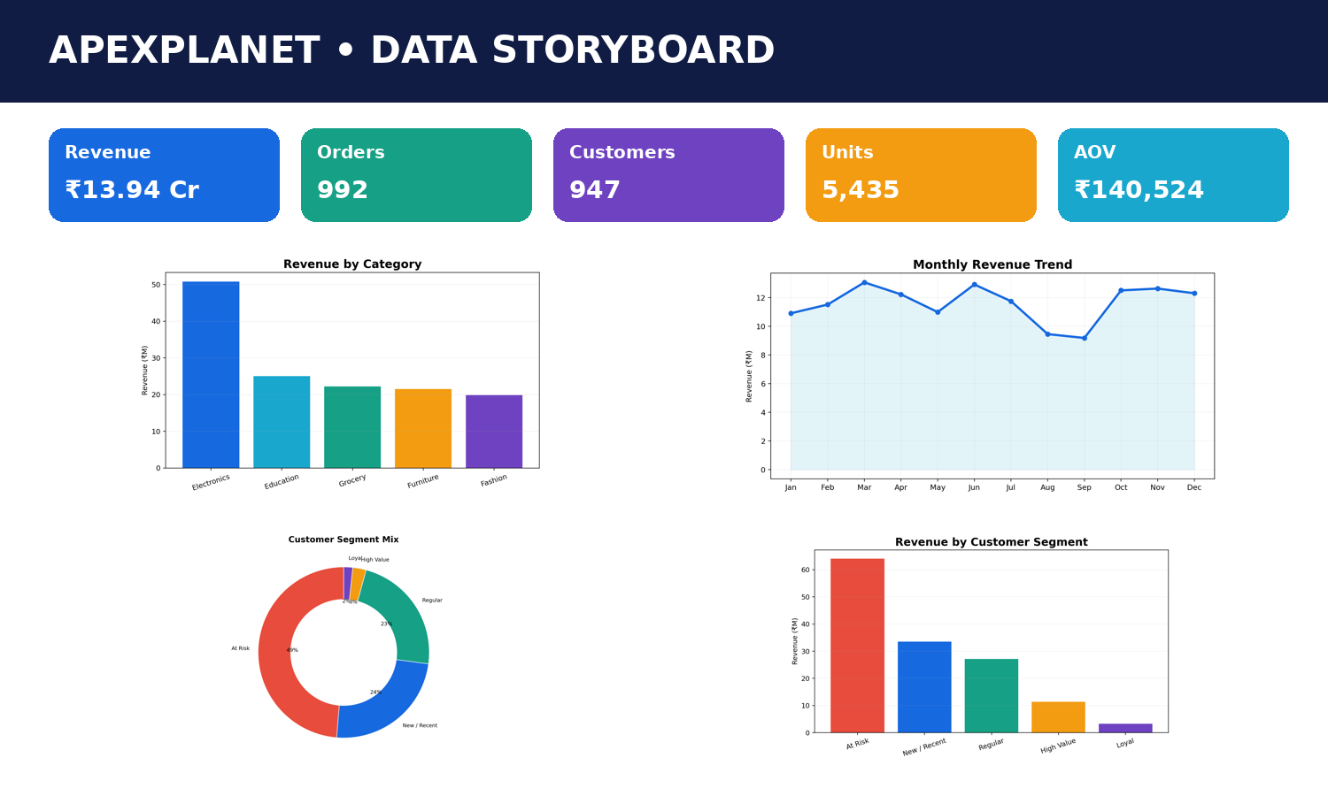
Task 2 • Visual story of performance
A compact view of the metrics that shaped the business narrative.

Slide 6
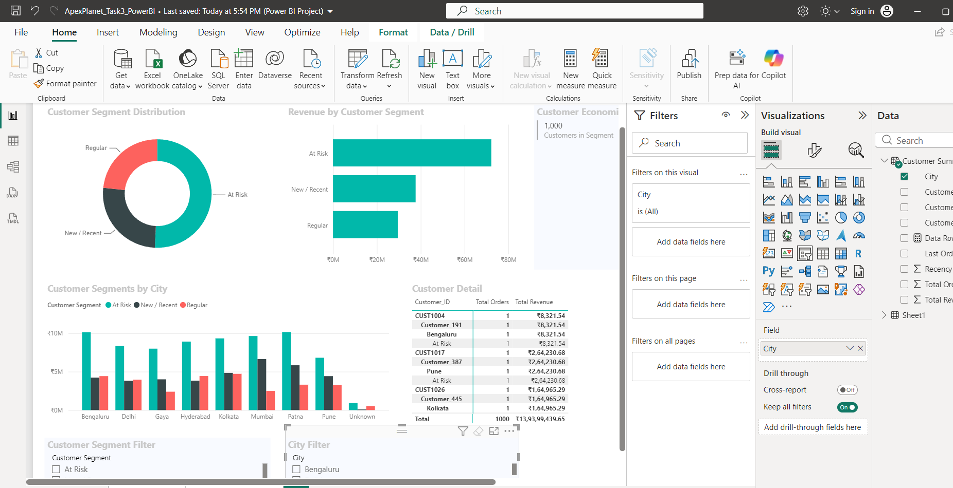
Task 3 • Deep-dive & interactive dashboard
Customer segmentation turns broad sales reporting into targeted decisions.
REVENUE
ORDERS
₹13.94 Cr
992
CUSTOMERS
AOV
947
₹140.5K
Segmentation logic
High Value
Loyal
At Risk
New / Recent
Regular
Interactive filters allow a stakeholder to slice by city and segment while keeping the same KPI logic.

Slide 7
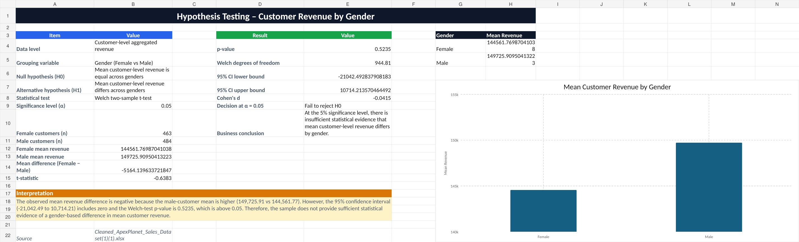
Task 4 • Data storytelling & statistical validation
Turning patterns into a business claim—and then testing the claim.
Hypothesis
H₀: mean customer-level revenue is equal across genders.
p-VALUE
COHEN’S d
0.5235
−0.0415
α = 0.05
Tiny effect
95% confidence interval
−₹21,042.49 to ₹10,714.21
Conclusion
Fail to reject H₀. The sample does not provide sufficient statistical evidence of a gender-based difference in mean customer-level revenue.

Slide 8
What the portfolio demonstrates
A blend of technical execution, analytical judgment, and communication.
ANALYTICS
BI & DASHBOARDS
STATISTICS
COMMUNICATION
Python & Pandas
EDA & descriptive statistics
SQL business questions
Power BI
DAX & Power Query
Interactive filters & KPIs
Hypothesis formulation
Welch t-test
Confidence intervals & effect size
Business storytelling
Presentation design
Actionable recommendations
Demonstrated across Tasks 1–4
Demonstrated across Tasks 1–4
Demonstrated across Tasks 1–4
Demonstrated across Tasks 1–4
Core principle: every technical step should strengthen the business decision—not just the chart.

Slide 9
Final reflection
What changed from the first notebook to the final portfolio.
1 • From cleaning to confidence
I learned to document data-quality choices so downstream KPIs, dashboards, and tests remain reproducible.
2 • From charts to decisions
The strongest analyses connect a pattern to a business question, a stakeholder action, and a measurable outcome.
3 • From assumption to evidence
Statistical validation adds rigor: a visible difference is not automatically a meaningful difference.
Next step: publish the master portfolio and continue building decision-ready analytics.

Slide 10
THANK YOU
AYUSH RATHOR
Data Analytics Internship • ApexPlanet Software Pvt Ltd
Portfolio repository
Built around one principle:
github.com/ayushrathor20
Data → Insight
Insight → Decision
Decision → Impact
Thank you

