Slide 1
Opening a New Restaurant in the Capital City of India-Delhi

Slide 2
Looking for a location to open a Restaurant is valuable for potential Restaurant Owners
Generally, finding a location is a problem for people looking to invest in a restaurant business.
Potential owners have a hard time to figure out what factors to consider before making a decision.
A Location/Neighbourhood recommendation system helps the potential owners.
A recommendation system uses data to drive decisions.

Slide 3
Data acquisition and cleaning
Borough and Neighbourhood Data from Wikipedia Page of Neighbourhoods of Delhi.
City and Neighbourhood coordinates from geocoder library.
Venue details using Foursquare API.
In total, 519 rows and 7 features in dataset.

Slide 4
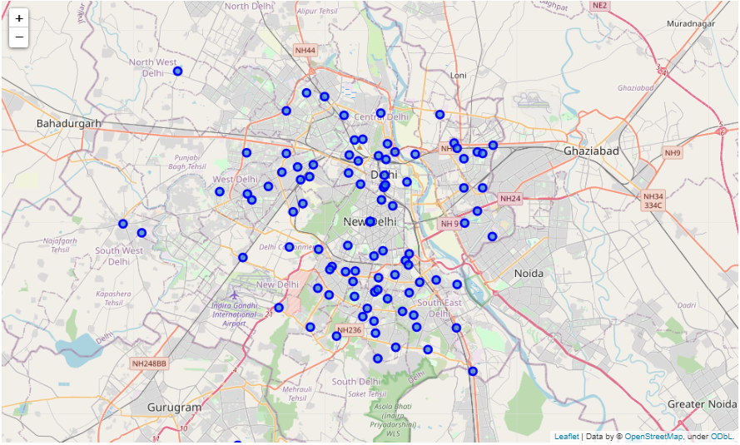
Neighbourhood Spread of Delhi Visualized

Slide 5
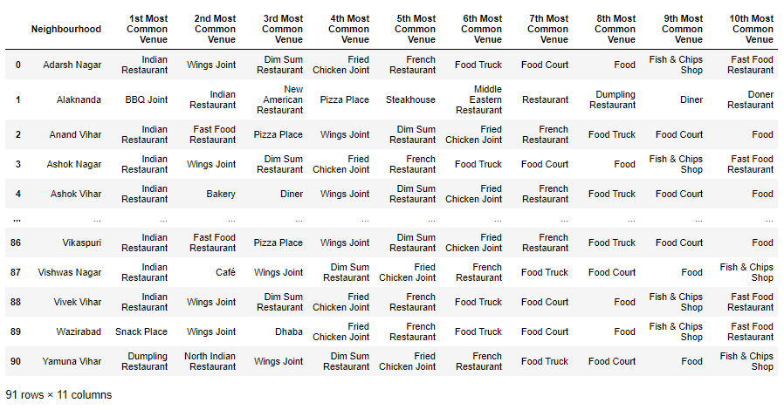
10 most common Venues for different Neighbourhoods

Slide 6
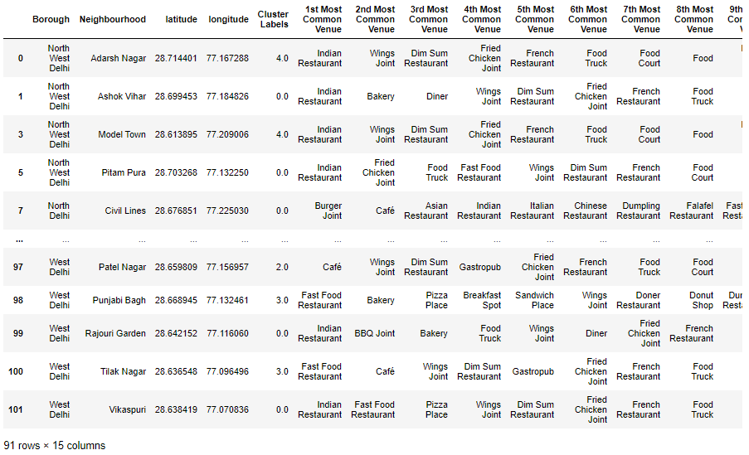
Cluster Classification

Slide 7
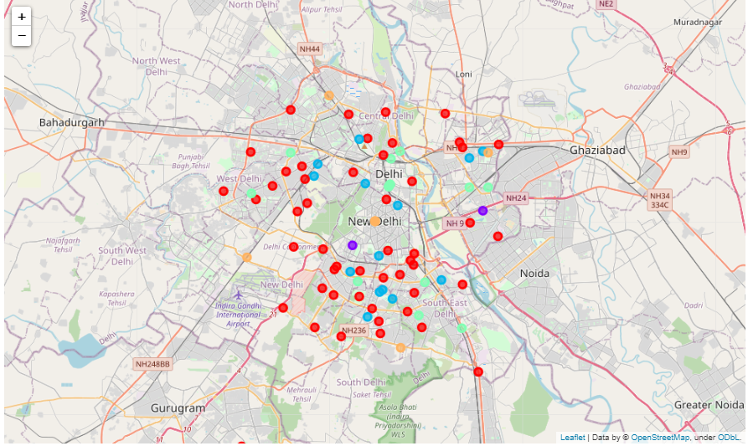
Different Clusters Visualized

Slide 8
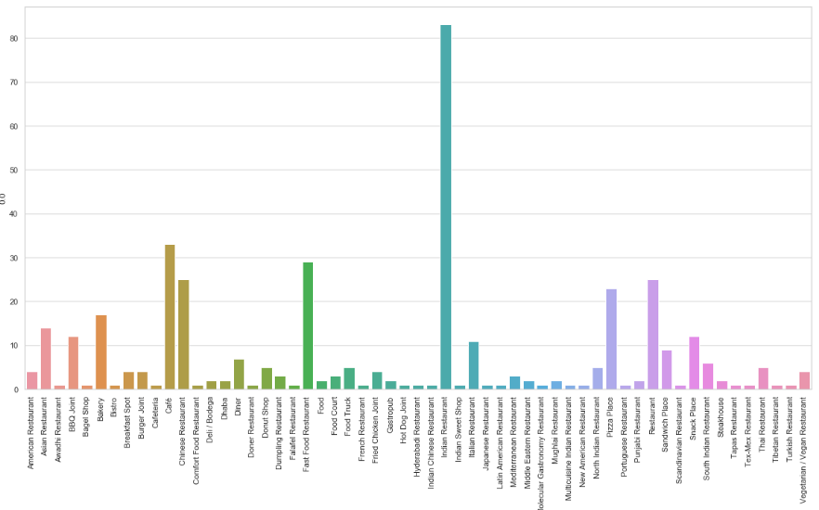
Analysis of Cluster Data
Cluster 0

Slide 9
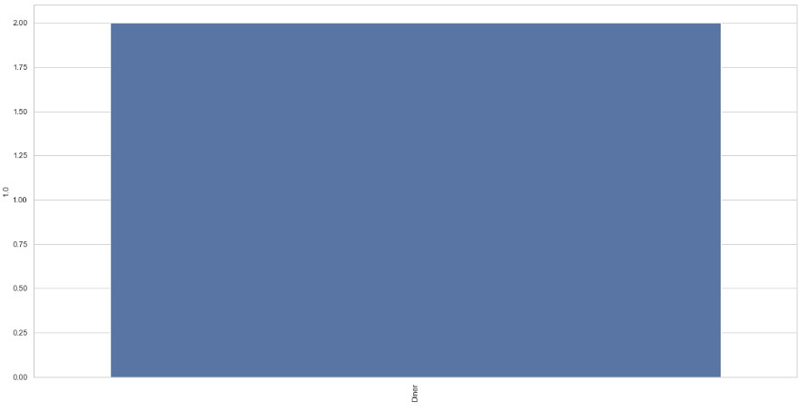
Cluster 1

Slide 10
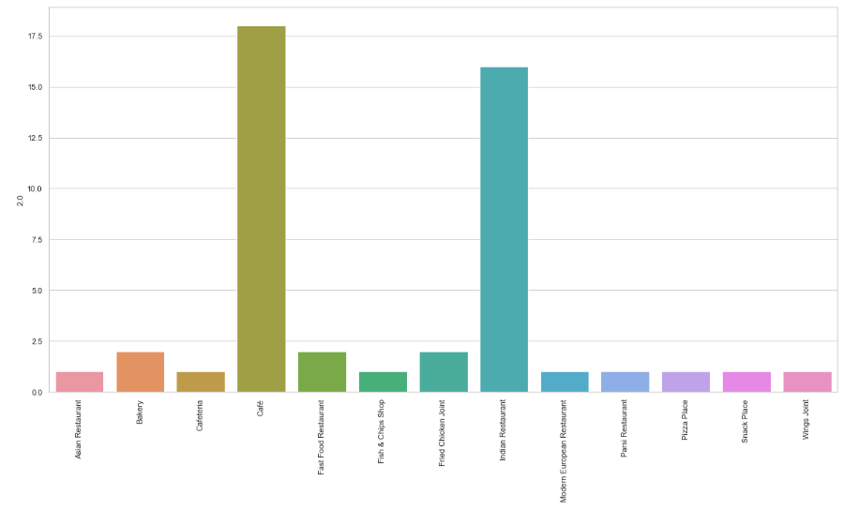
Cluster 2

Slide 11
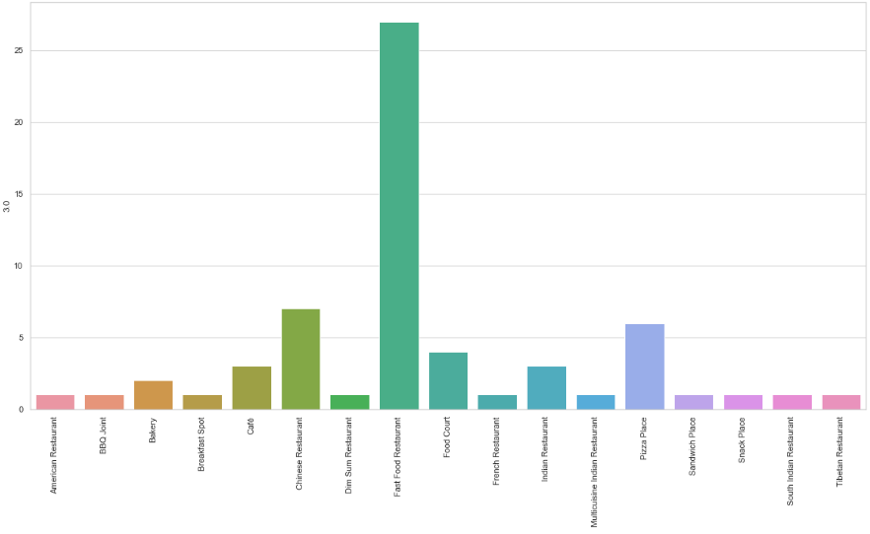
Cluster 3

Slide 12
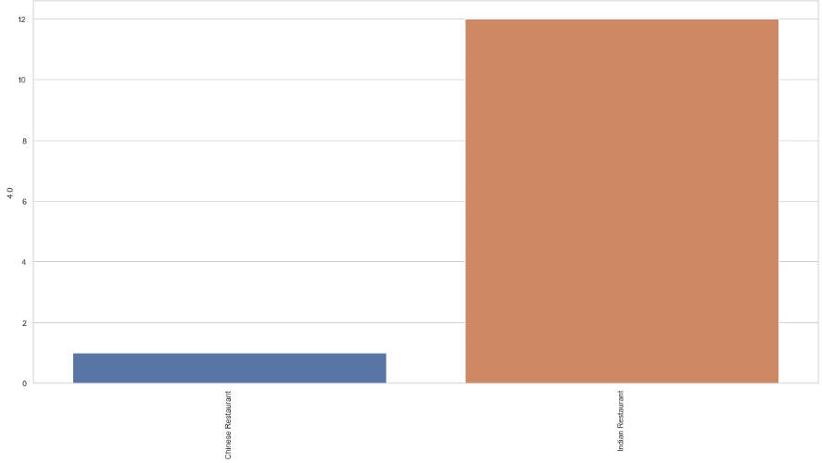
Cluster 4

Slide 13
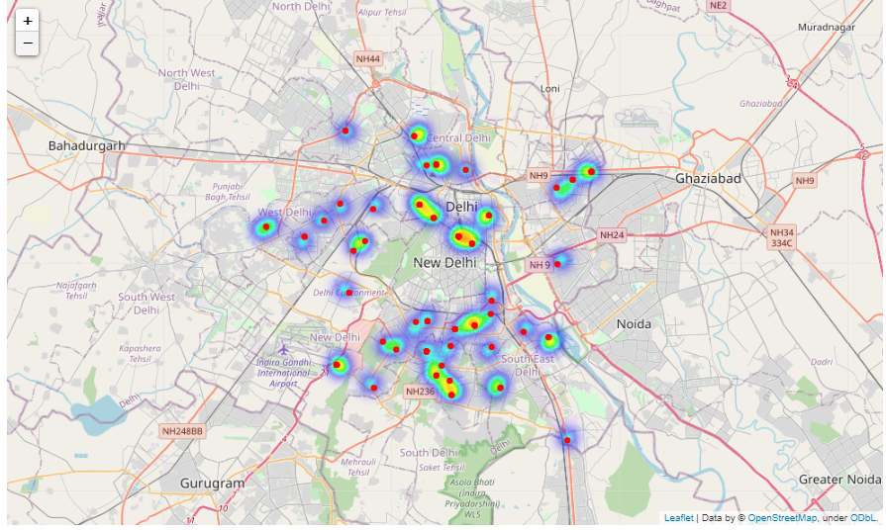
HeatMap of Neighbourhoods with lower density of Food Venues and Indian Restaurants

Slide 14
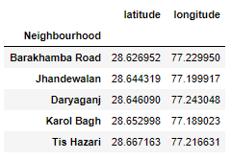
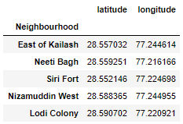
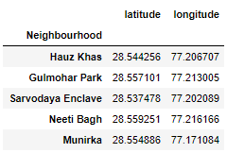
Recommended Neighbourhoods near Popular Neighbourhoods
Near Connaught Place
Near Defence Colony
Near Hauz Khas Village

Slide 15
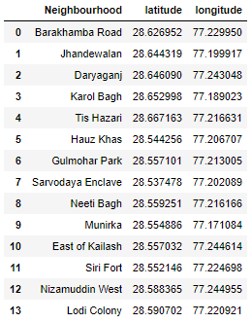
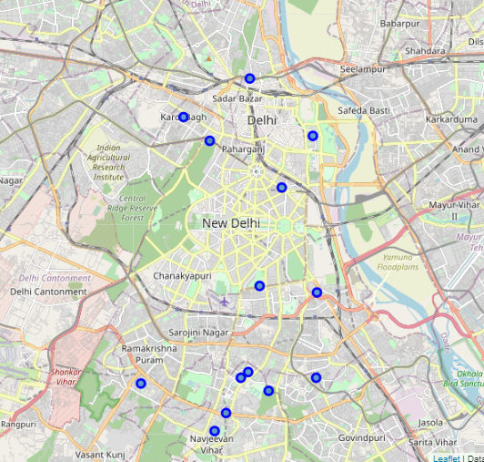
Final Recommendations
List of Recommendations
Visualizing the Recommended Locations

Slide 16
Conclusions and Future Directions
Built a Recommendation system that recommends Neighbourhoods with low density of a particular type of Food Venue and high demand based on number of venues in the Neighbourhoods.
In future, we can add the features of the kind of ratings food venues get at different neighbourhoods and the income of the surrounding areas to target a specific set of customers.
More research and data can result in a better performance of the recommendation system.

