Slide 1
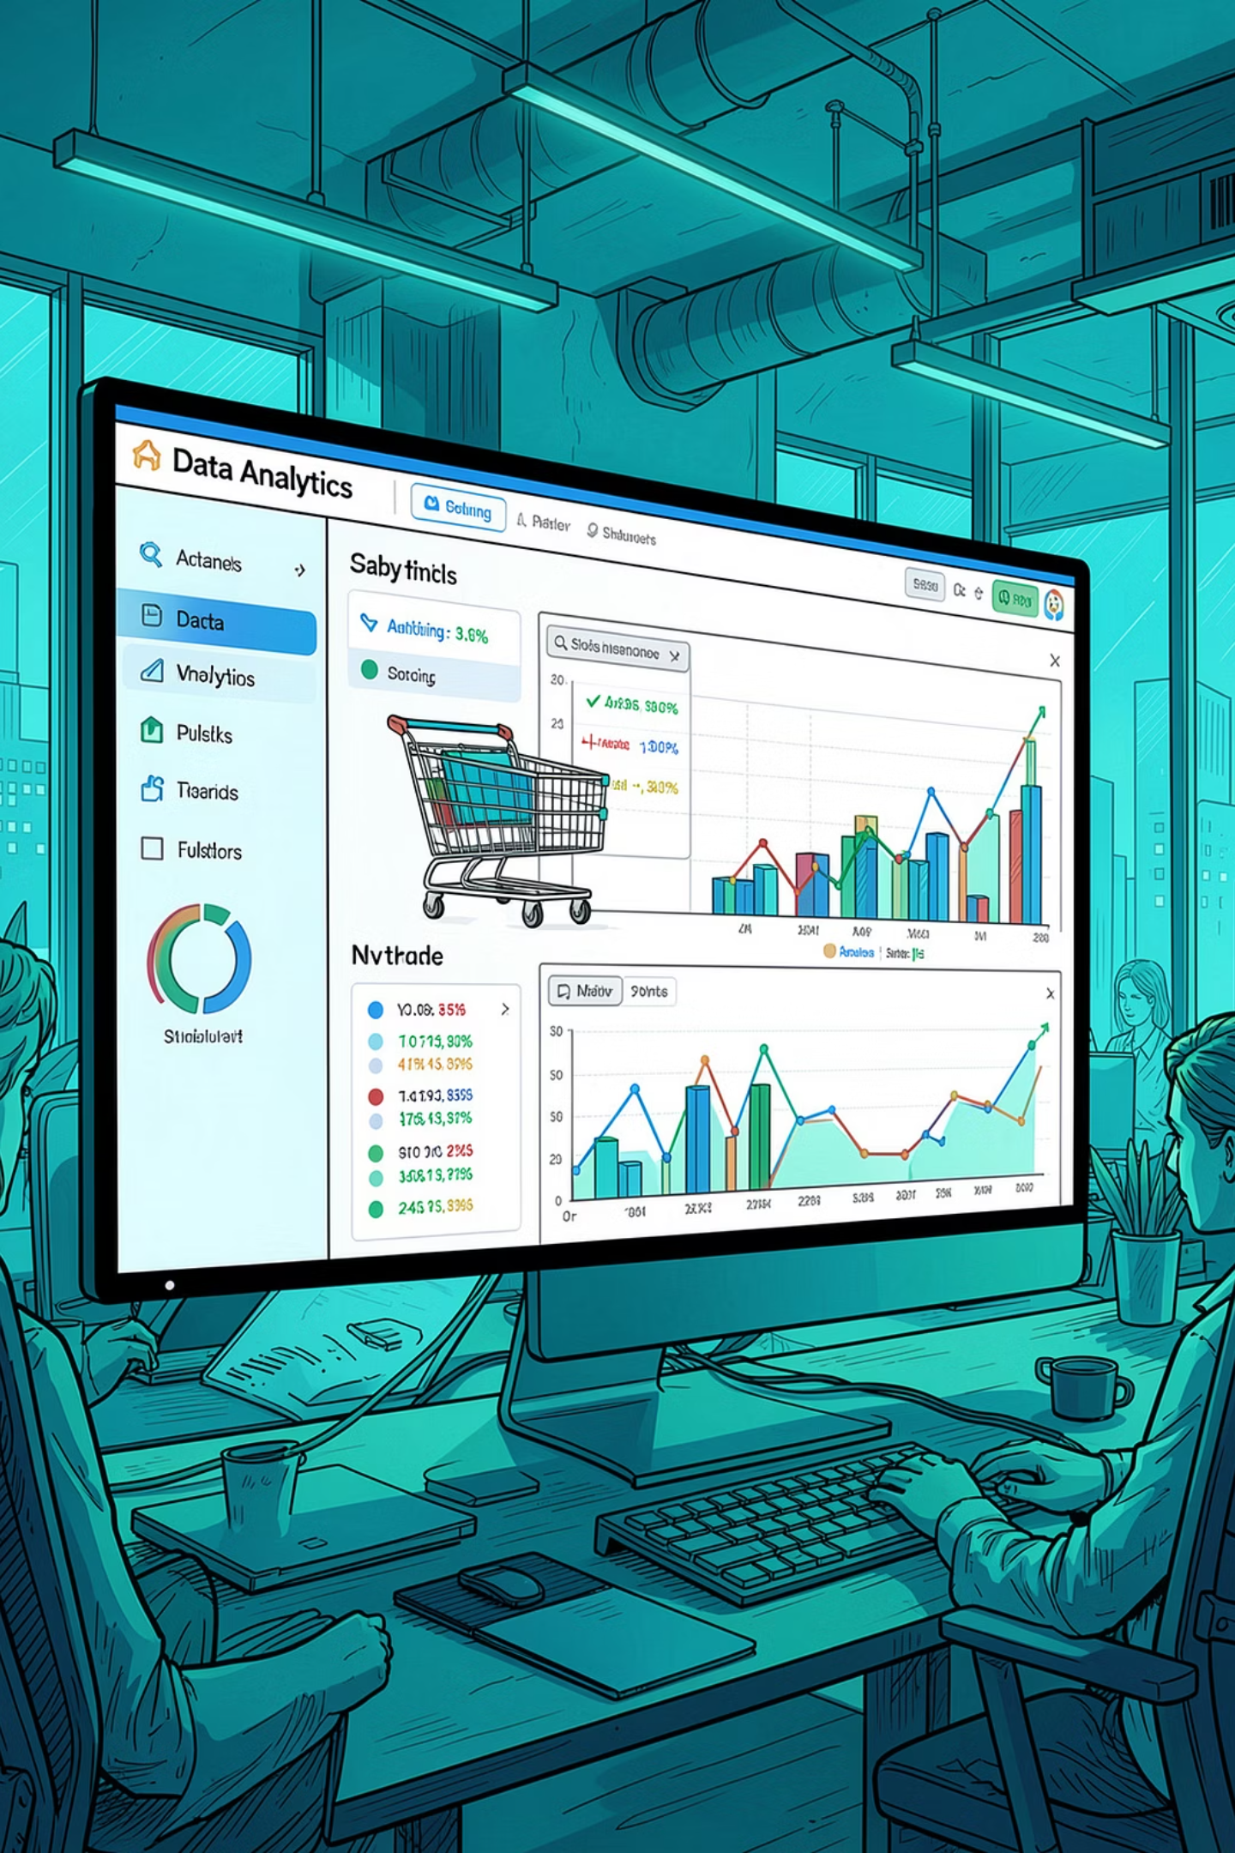
Customer Shopping Behavior Analysis
Uncovering spending patterns, customer segments, and product preferences from 3,900 transactions to guide strategic business decisions.

Slide 2
Dataset at a Glance
3,900
18
Total Purchases
Data Columns
Transactional records analyzed
Demographics, behavior & purchases
37
25
Missing Values
Product Types
In Review Rating column only
Across 4 categories
Key features include customer demographics (Age, Gender, Location, Subscription Status), purchase details (Item, Category, Amount, Season), and shopping behavior (Discount, Promo Code, Frequency, Review Rating, Shipping Type).

Slide 3


Data Preparation in Python
Load & Explore
Imported via pandas; used df.info() and .describe() for structure and summary statistics.
Clean & Standardize
Imputed missing Review Ratings using median per category; renamed columns to snake_case.
Feature Engineering
Created age_group bins and purchase_frequency_days; dropped redundant promo_code_used column.
Database Integration
Loaded cleaned DataFrame into PostgreSQL for SQL-based analysis.

Slide 4
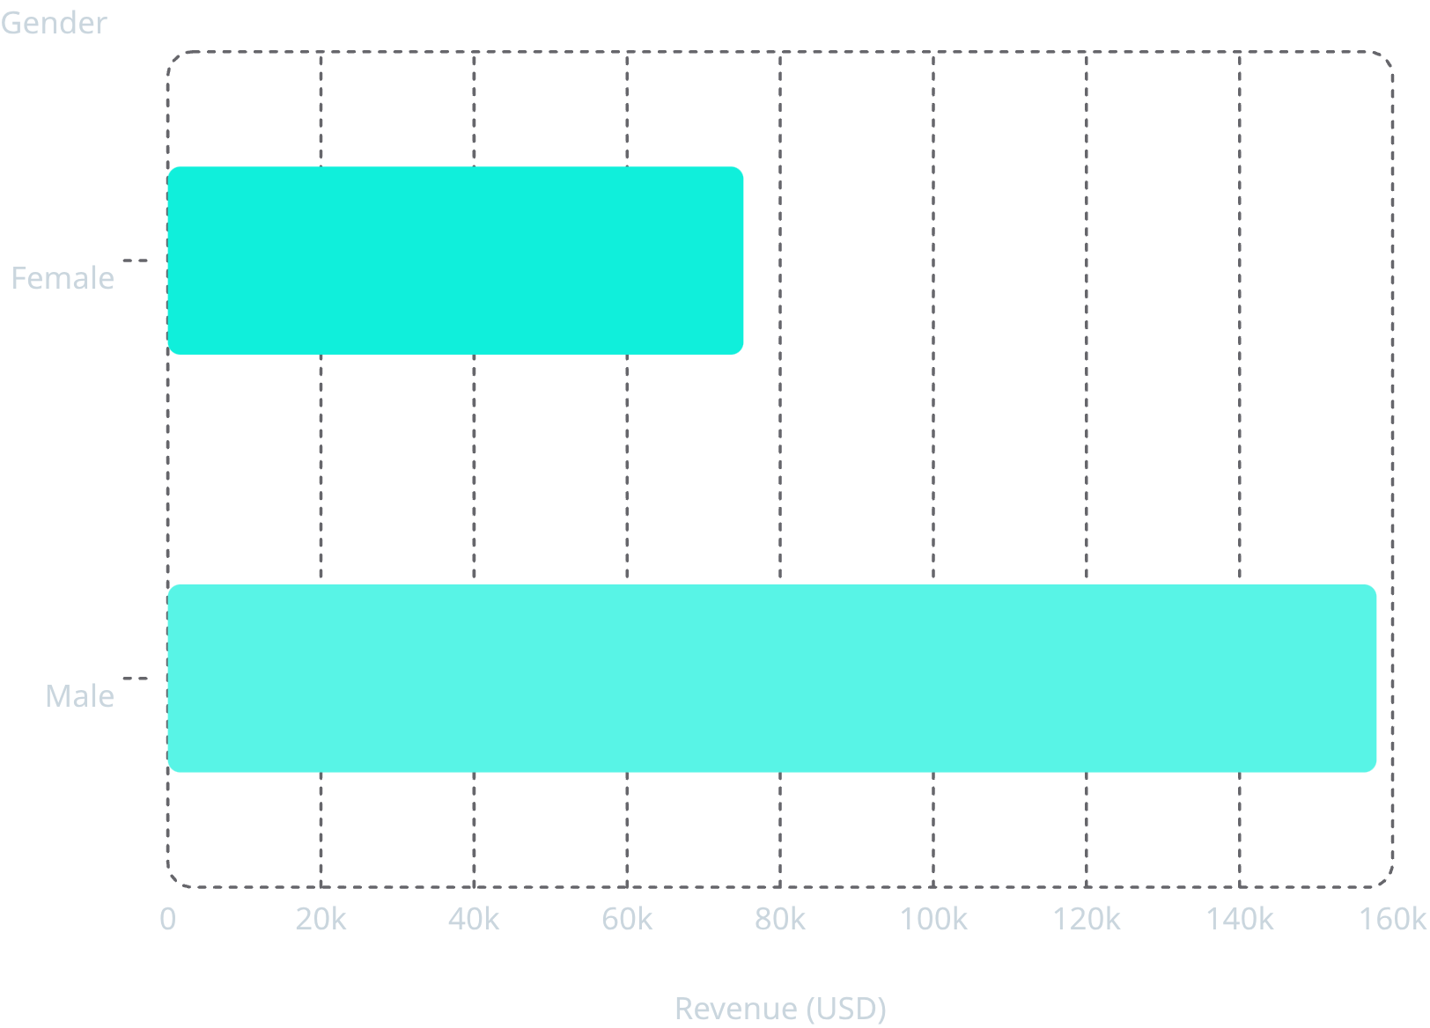
Revenue by Gender
Male Customers Drive 2× Revenue
Male customers generated $157,890 in total revenue compared to $75,191 from female customers — a significant gap that warrants targeted marketing strategies.
This analysis was performed in PostgreSQL, comparing total purchase amounts grouped by gender across all 3,900 transactions.

Slide 5
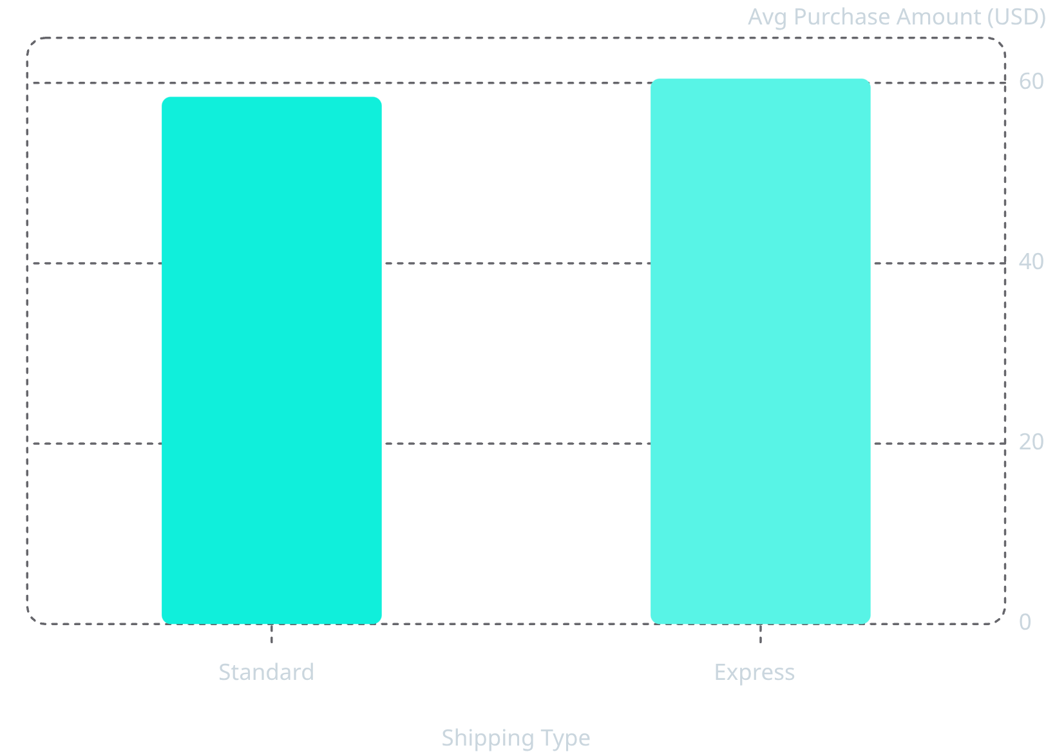
Spending, Shipping & Subscriptions
Shipping & Subscription Insights
Express shipping customers spend slightly more on average ($60.48 vs. $58.46).
Among subscribers: 1,053 customers, avg spend $59.49, total revenue $62,645.
Non-subscribers: 2,847 customers, avg spend $59.87, total revenue $170,436.
Of customers with more than 5 purchases, 958 are subscribers and 2,518 are not — suggesting repeat buying does not strongly correlate with subscription status.

Slide 6
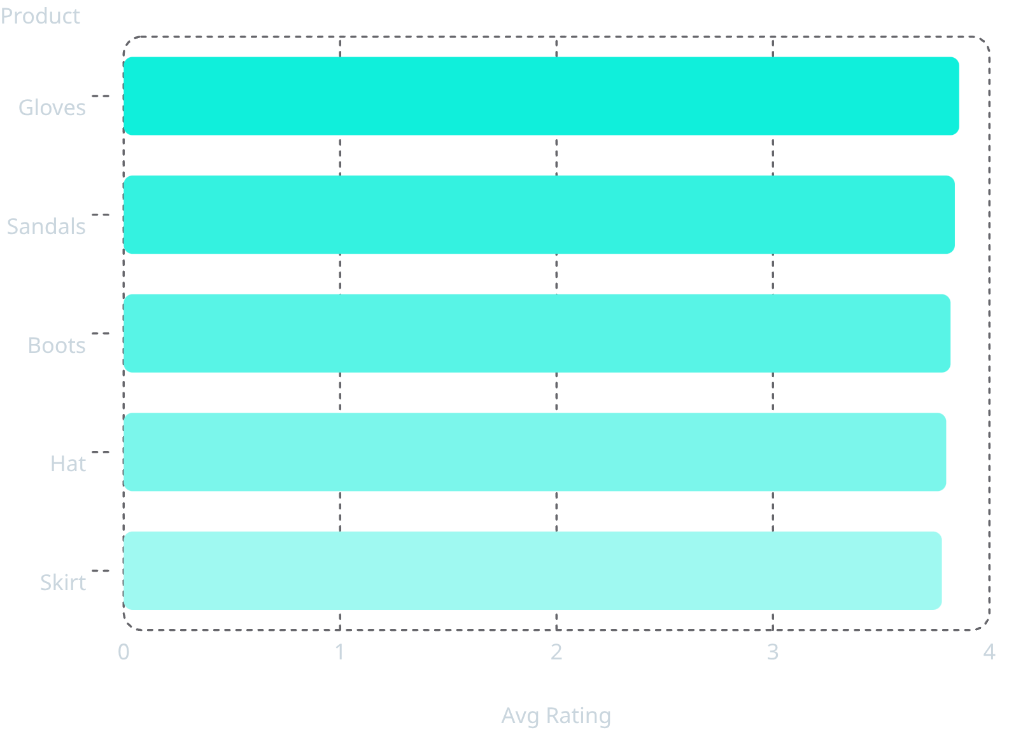
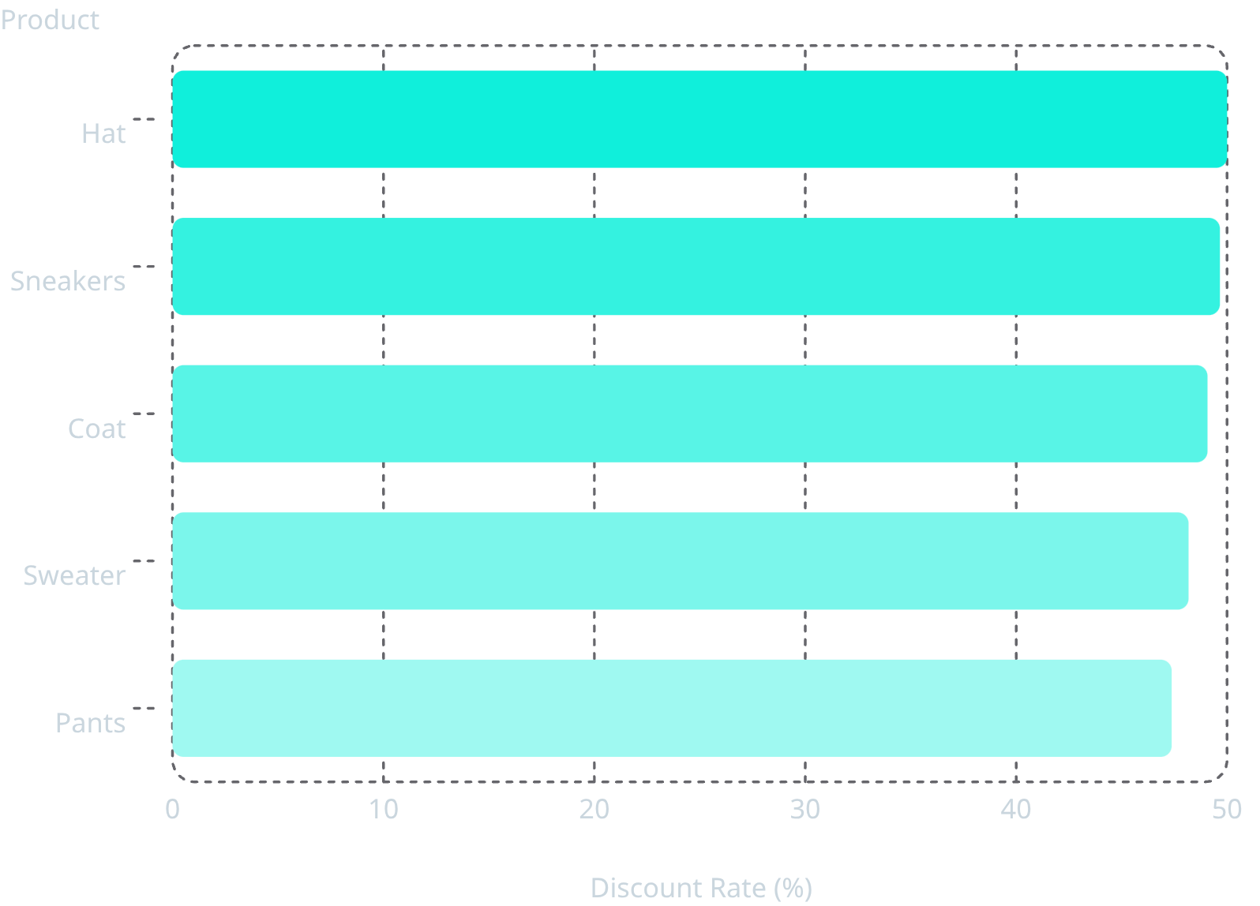
Top Products by Rating & Discount Dependency
Top 5 Products by Average Rating
Products Most Often Discounted
Hats and Sneakers appear in both lists — highly rated yet heavily discounted, suggesting strong customer demand or promotional strategy.

Slide 7
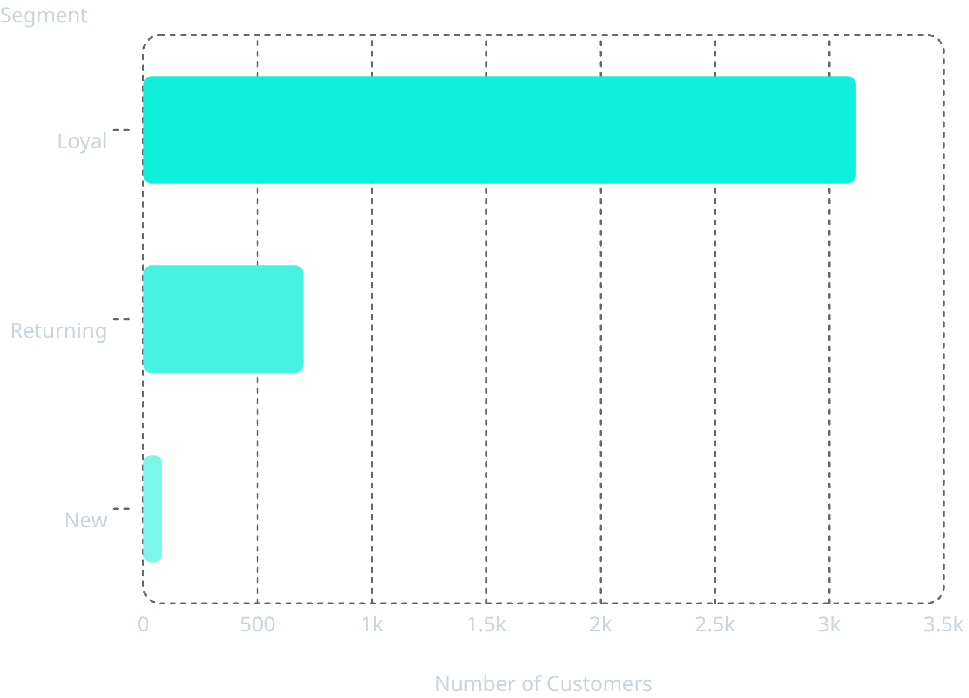
Customer Segmentation
Segment Breakdown
Customers classified by purchase history into three segments:
Loyal — 3,116
Overwhelming majority of the customer base
Returning — 701
Repeat buyers with growth potential
New — 83
First-time buyers, key acquisition target

Slide 8
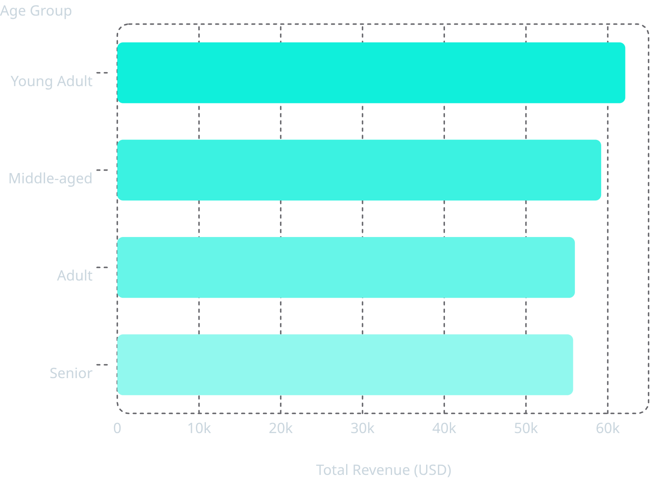
Revenue by Age Group
Young Adults Lead Revenue
Young Adults contribute the highest total revenue at $62,143, followed closely by Middle-aged ($59,197), Adult ($55,978), and Senior ($55,763) groups.
Revenue is relatively evenly distributed across age groups, with Young Adults generating approximately 11% more than Seniors — a modest but meaningful difference for targeted marketing.

Slide 9
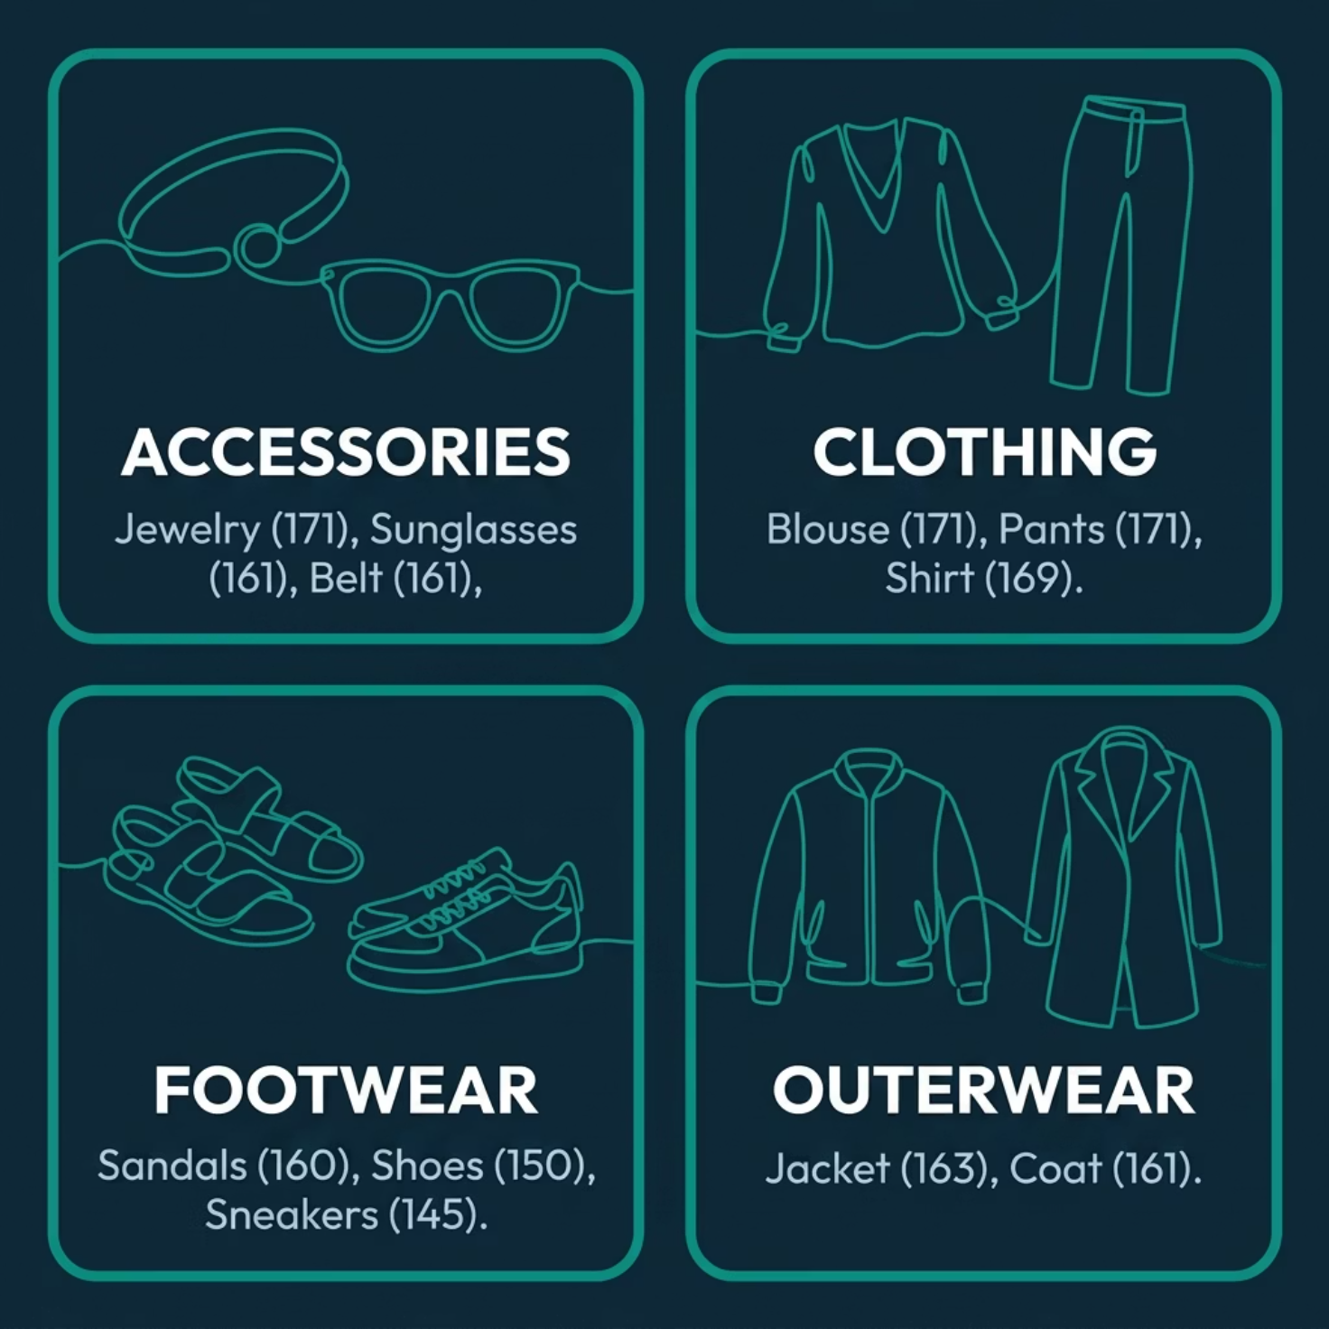

Top Products by Category
The top 3 most purchased products within each of the four categories:
Category Leaders
Accessories: Jewelry leads with 171 orders, followed by Sunglasses and Belt (161 each).
Clothing: Blouse and Pants tie at 171 orders; Shirt follows closely at 169.
Footwear: Sandals top the category with 160 orders, then Shoes (150) and Sneakers (145).
Outerwear: Jacket (163) and Coat (161) dominate this category.

Slide 10
Business Recommendations
Boost Subscriptions
Loyalty Programs
Review Discount Policy
Promote exclusive subscriber benefits to convert the 73% non-subscriber base.
Reward repeat buyers to grow the Loyal segment beyond 3,116 customers.
Balance sales boosts with margin control on heavily discounted products.
Targeted Marketing
Product Positioning
Focus on high-revenue age groups (Young Adults) and express-shipping users.
Highlight top-rated and best-selling products in marketing campaigns.

