Slide 1

Experiential Learning
Project Assessment-I on
“Random Password Generator in Python” under the course
Python Programming Language (N-PCCCM304P)
Presented By :
Ayush Rahangdale [CM25009]
Under the Guidance
of
Mrs. Suchita Meshkar
Session:2026-27 (ODD )
Department of CSE(AI&ML)
S. B. JAIN INSTITUTE OF TECHNOLOGY MANAGEMENT AND RESEARCH,NAGPUR
An Autonomous Institute, Affiliated to RTMNU, Nagpur

Slide 2
Problem statement
People often create simple passwords like 123456 or their own names.
Predictable passwords make user accounts easy to hack.
It is hard for users to manually make strong, complex passwords with numbers and symbols.
We need a Python program to generate strong, random, and unguessable passwords automatically.

Slide 3
Objectives
To develop a simple tool that generates secure, random passwords.
To let the user choose the password length.
To allow users to select uppercase, lowercase, numbers, and special symbols.
To ensure at least one character from each selected category is included.
To check and display the password strength rating (Weak, Moderate, Strong).

Slide 4
Algorithm
Start the program.
Ask the user for the password length.
Ask the user which character types to include (upper, lower, digits, symbols).
Combine all selected character sets into one pool.
Pick random characters from the pool until the desired length is reached.
Shuffle all characters randomly so the pattern cannot be guessed.
Display the generated password and its strength rating.
Stop the program.

Slide 5
Flowchart/pseudocode
Start
1. Input Password Length
2. Select Character Types (A-Z, a-z, 0-9, Symbols)
3. Combine Selected Groups into Character Pool
4. Pick Characters Randomly Using secrets Module
5. Shuffle Characters Randomly
6. Show Password and Strength Rating
End

Slide 6
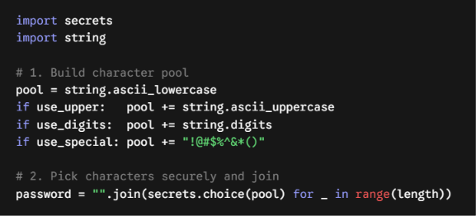
Understanding of Python logic

Slide 7
How it works
Takes Your Choice: You type how long you want the password to be and choose what to add (capital letters, numbers, or symbols).
Makes a Letter Box: The program puts all your chosen letters, numbers, and symbols into one single list.
Picks Randomly: It picks one random character from the list one by one until your password reaches the full length.
Shows the Password: It joins all the picked characters together and shows your new password on the screen.

Slide 8
Benefits
Very Safe: Passwords are fully random, so hackers cannot guess them.
Easy to Change: You can easily make short, long, simple, or complex passwords.
Saves Time: You get a strong password in just one second without thinking hard.
No Bad Habits: Stops people from using easy passwords like their name or 123456.
Fast and Simple: Works instantly without slowing down your computer.

Slide 9
GitHub Details & My Contribution
Repository Name : random-password-generator
My Contribution:
Understood the security requirements and designed the algorithm.
Wrote the clean Python program using secrets and string modules.
Added validation and password strength evaluation.
Created the GitHub repo and prepared presentation slides.

Slide 10
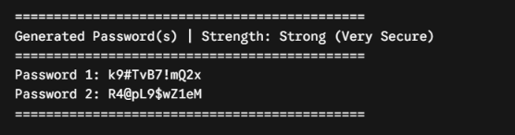
Result / Expected Output

Slide 11
Thank You
S. B. Jain Institute of Technology Management and research

