Slide 1


Business Analytics
Dashboard Report
Comprehensive Analysis and Recommendations for XYZ Inc.

Slide 2

Table of
Content
About me
Top 5 Findings/Insights
Top 3 Immediate Actions
One-Year Forecast
Infographic
Our Advance

Slide 3
About Me
I am a passionate and driven third-year student pursuing a Bachelor's degree in Computer Science at Symbiosis Institute of Technology. Alongside my regular coursework, I am also actively engaged in an extra course specializing in Data Science. I have always been fascinated by the power of data to drive insights and decision-making, which is why I chose to delve deeper into this field. Throughout my academic journey, I have developed a strong foundation in programming, data analysis, and machine learning techniques. I am enthusiastic about applying my skills to real-world challenges and contributing to meaningful projects that make a positive impact. With a blend of theoretical knowledge and practical experience, I am eager to embark on a career journey in data analytics, where I can continuously learn, grow, and make a difference.

Slide 4
About Tools
Excel, a versatile spreadsheet software developed by Microsoft, offers a wide range of tools and functionalities essential for data analysis and management. Its intuitive interface and powerful features make it a popular choice for professionals across various industries. Excel provides robust capabilities for data organization, manipulation, and visualization, including functions for mathematical calculations, statistical analysis, and financial modeling. PivotTables enable users to summarize and analyze large datasets with ease, while charts and graphs offer dynamic visual representations of data trends and patterns. Additionally, Excel offers advanced features such as conditional formatting, data validation, and macros, allowing users to automate tasks and streamline workflows. With its extensive toolkit and flexibility, Excel remains a cornerstone tool for data analysis and reporting in both academic and professional settings.

Slide 5
Data Preprocessing
During the data preprocessing phase, several steps were undertaken to ensure the quality and integrity of the dataset. Firstly, the dataset was examined for anomalies, revealing the presence of two negative values in the "Total Cost" column. To maintain data consistency, these negative values were removed from the dataset. Subsequently, the profitability of each transaction was calculated by multiplying the unit cost by the number of units sold, and the resulting column was subtracted from the total cost to obtain accurate financial metrics, profit. Various statistical analytics were performed on the dataset to gain insights into the distribution and characteristics of the data, including counts, means, standard deviations, minimum and maximum values, as well as quartiles (25th, 50th, and 75th percentiles). Additionally, null values were identified and addressed to ensure completeness and reliability in the dataset. Through these preprocessing steps, the dataset was refined and prepared for further analysis and interpretation.

Slide 6
Top 5 Findings/Insights
Highest sales in North America ($10.5 Billion) and Europe ($8.3 Billion):
This indicates that North America and Europe are the two most significant regions in terms of sales revenue for the company.
North America leads in sales with $10.5 billion, followed by Europe with $8.3 billion.
Understanding regional sales performance helps in allocating resources and developing targeted marketing strategies for each region
. 2. Significant variation in sales across customer segments:
Premium Customers: $12.4 Billion
Premium customers contribute the highest sales revenue, totaling $12.4 billion.
These customers likely purchase high-value products or buy in larger quantities, indicating strong purchasing power.
Standard Customers: $4.1 Billion
Standard customers contribute $4.1 billion in sales, indicating a significant but lower contribution compared to premium customers.
Understanding sales variations across customer segments helps tailor marketing strategies and customer service approaches to meet the needs of different customer groups.

Slide 7
Top 5 Findings/Insights
3. Top products by sales:
Furniture: $1.75 Billion
Furniture emerges as the top-selling product category, generating $1.75 billion in sales.
This suggests a high demand for furniture products among customers, indicating potential opportunities for product expansion or targeted marketing efforts within this category.
Electronics, electronic appliances: $1.52 Billion
Electronics and electronic appliances follow closely behind furniture, contributing $1.52 billion in sales.
This highlights the importance of electronics in the company's product portfolio and suggests opportunities for innovation and product development within this category.
. 4. Wide range in cost per unit::
Min Cost: $2.01
The minimum cost per unit is $2.01, indicating the lowest price point for products offered by the company.
This information helps in understanding the pricing range and cost structure of the company's products.
Max Cost: $535,950.04
The maximum cost per unit is significantly higher at $535,950.04, indicating the presence of high-value or luxury products within the product range.
Understanding the cost per unit range helps in pricing strategies, cost management, and product positioning.

Slide 8
Top 3 Immediate Actions
Focus on High-Revenue Areas:
Basis: The data shows that North America and Europe are the regions contributing the highest sales revenue.
Actions:
Increase Marketing and Sales Efforts: Allocate more resources towards marketing campaigns and sales initiatives targeted at these regions to capitalize on their potential.
Expand Distribution Channels: Explore opportunities to expand distribution networks, such as partnering with more retailers or establishing direct-to-customer sales channels, to reach a broader audience in these high-revenue regions.
Optimize Product Portfolio:
Basis: The top-selling products, such as Furniture and Electronics, generate significant revenue.
Actions:
Invest in Top-Performing Products: Allocate resources towards further developing and promoting these top-performing products to maintain and potentially increase their market share.
Analyze and Prune Low-Performing Products: Conduct a thorough analysis of products with lower sales and profitability. Consider discontinuing or repositioning these products to focus resources on more lucrative areas of the product portfolio.

Slide 9
Top 3 Immediate Actions
Conduct Cost Analysis and Renegotiation:
Basis: The wide range in cost per unit indicates potential opportunities for cost optimization.
Actions:
Review Cost Structure: Conduct a detailed analysis of the cost structure to identify areas where costs can be reduced without compromising product quality or customer satisfaction.
Negotiate with Suppliers for Better Pricing: Engage in negotiations with suppliers to secure better pricing terms, volume discounts, or explore alternative sourcing options to lower the cost per unit. Additionally, consider optimizing supply chain processes to reduce operational costs associated with procurement, manufacturing, and distribution.
By implementing these actions, the company can strategically leverage its strengths, address areas of improvement, and optimize its operations to enhance profitability and competitiveness in the market.

Slide 10
One-Year Forecast
Focus on High-Revenue Areas:
Expected Impact: Increased sales due to targeted marketing and expanded distribution channels.
Estimated Contribution to Growth: +2%
Optimize Product Portfolio:
Expected Impact: Enhanced revenue from top-performing products and reduced costs from low-performing products.
Estimated Contribution to Growth: +2%
Conduct Cost Analysis and Renegotiation:
Expected Impact: Improved margins and profitability through cost reduction.
Estimated Contribution to Growth: +1%
Total Projected Growth Rate:
Base Growth Rate: 5%
Additional Growth from Actions: 2% + 2% + 1% = 5%
Total Projected Growth Rate: 5% (base) + 5% (actions) = 10%
Forecast Calculation:
Current Year Sales: $19,444,937,906.93
Total Projected Growth Rate: 10% (0.10)
Formula: Forecasted Sales = Current Year Sales * (1 + Growth Rate)
Calculation:
Forecasted Sales = $19,444,937,906.93 * (1 + 0.10)
Forecasted Sales = $19,444,937,906.93 * 1.10
Forecasted Sales = $21,389,431,697.62

Slide 11
Opportunities for Expansion/Shrinkage
Expansion Opportunities:
Products: High-Revenue Products
Furniture: $1.75 Billion
Electronics: $1.52 Billion
Why: These products demonstrate strong market demand and customer preference, making them prime targets for expansion efforts.
Countries: High-Revenue Regions
North America: $10.5 Billion
Europe: $8.3 Billion
Why: These regions generate significant revenue and offer substantial market potential, making them ideal for expanding your business operations.
Industries: Growing Sectors
Consumer Electronics: High demand for electronics.
Home Furnishings: Growing trends in home improvement.
Why: Both industries exhibit strong sales and promising market trends, presenting attractive opportunities for expansion and growth.

Slide 12
Opportunities for Expansion/Shrinkage
Shrinkage Opportunities:
Products: Low-Performing Products
Why: By reallocating resources from low-performing products to higher-performing ones, you can optimize efficiency and profitability within your product portfolio.
Countries: Underperforming Regions
Why: Optimizing resource allocation away from underperforming regions allows you to focus investments and efforts where they can yield greater returns, maximizing overall profitability.
Industries: Declining Sectors
Why: Shifting focus away from declining sectors toward industries with higher growth potential ensures your business remains aligned with market trends and opportunities for sustained success.

Slide 13
Additional Considerations
Enhanced Data Analytics Capabilities:
Why: Improve data-driven decision-making.
Action: Implement predictive analytics, AI, and machine learning.
Customer Experience Enhancement:
Why: Increase customer satisfaction and retention.
Action: Enhance customer support and personalized services.
Sustainability Initiatives:
Why: Improve brand image and meet consumer demand.
Action: Implement sustainable practices and eco-friendly packaging.
Digital Transformation:
Why: Streamline operations and enhance engagement.
Action: Invest in digital tools and e-commerce platforms.
Diversification of Product Lines:
Why: Reduce risk and open new revenue streams.
Action: Explore new product categories and innovations.

Slide 14
Additional Considerations
Global Market Expansion:
Why: Tap into new growth opportunities.
Action: Enter high-potential markets with tailored strategies.
Talent Development and Retention:
Why: Foster growth and innovation.
Action: Invest in employee development and a positive work culture.
Risk Management and Mitigation:
Why: Safeguard assets and reputation.
Action: Develop robust risk management strategies.
Implementing these actions can help drive growth, innovation, and resilience in your organization.

Slide 15
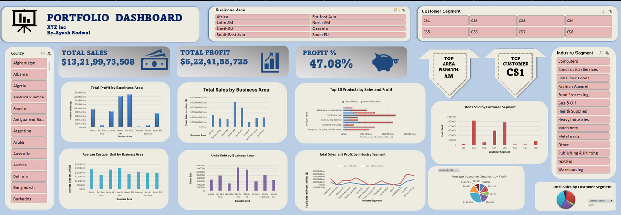
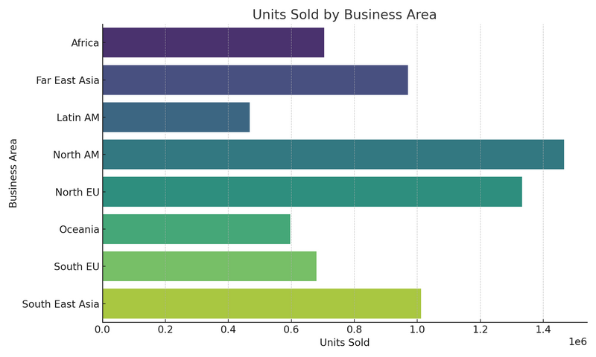
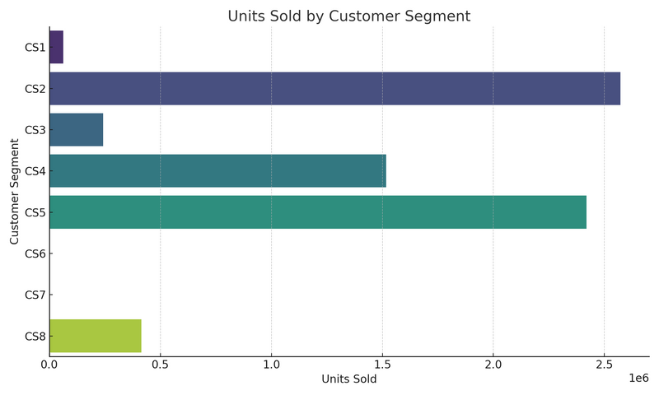
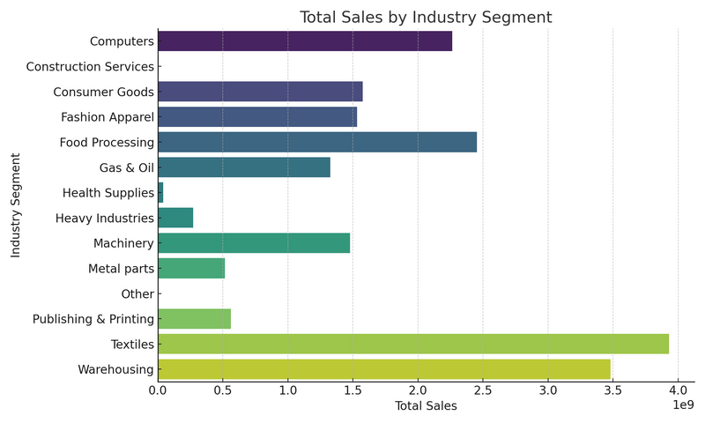
Dashboard

Slide 16
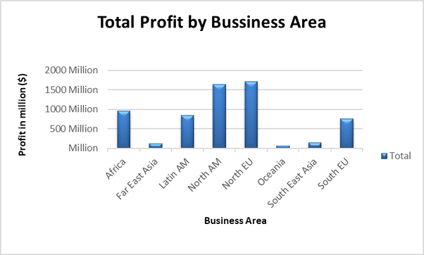
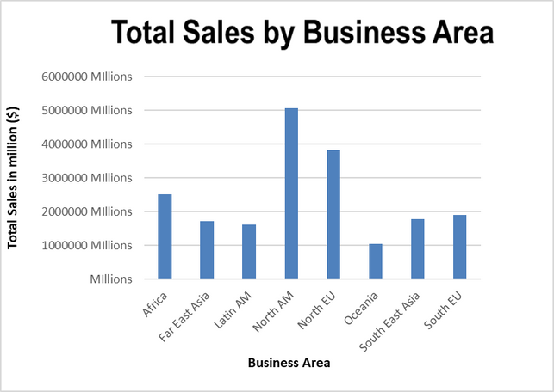
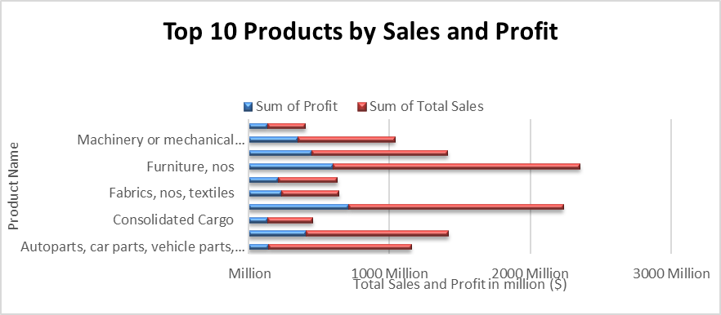
Visual Insights from Dashboard

Slide 17
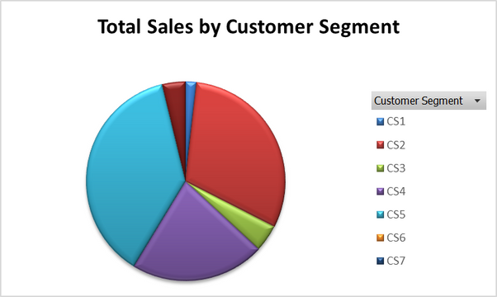
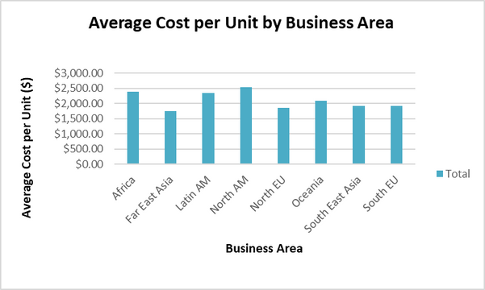
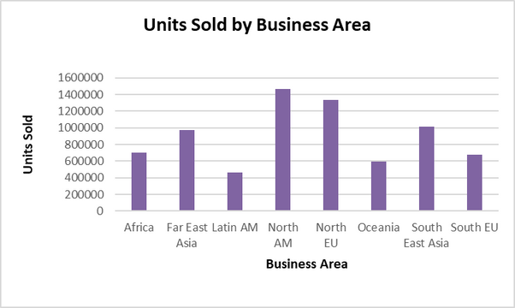
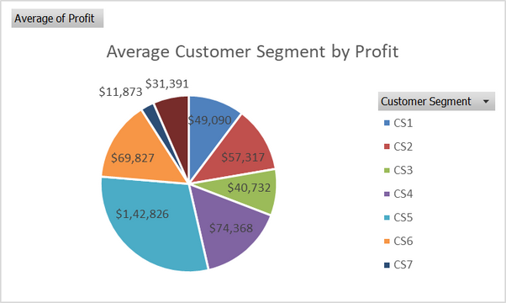
Visual Insights from Dashboard

Slide 18
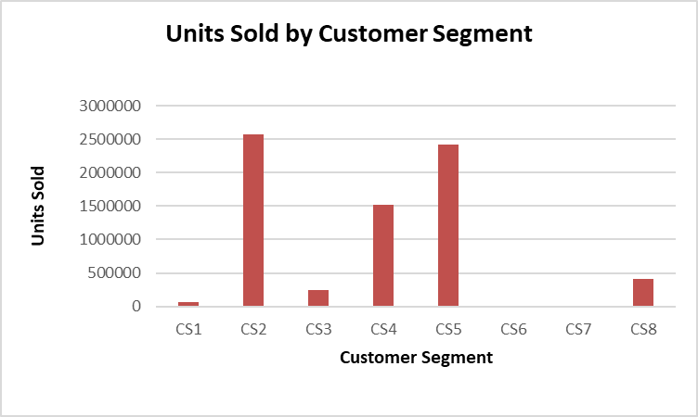
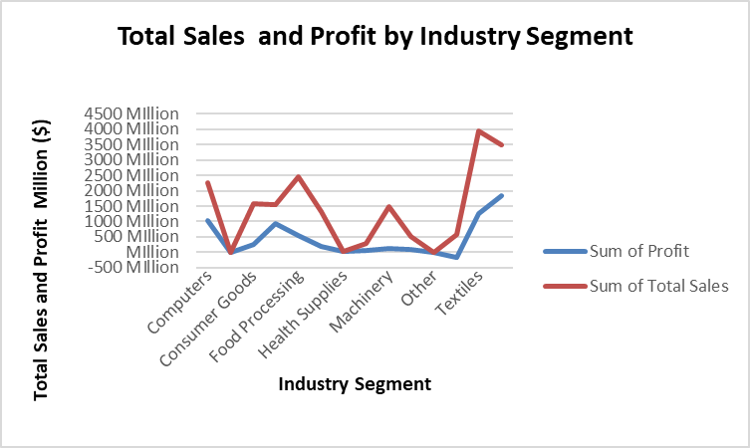
Visual Insights from Dashboard

Slide 19



Thankyou
for your purchase

