Slide 1
SmartRoute:
City Transit & Delivery Dispatch Dashboard
A Data Structures and Algorithms (DSA) Project & Optimizing Dispatch & Routing Systems

Slide 2
Project Overview
What is SmartRoute?
  An interactive, enterprise-grade fleet management dashboard built to visualize and manage pan-India logistics.
Core Objective
  To practically implement theoretical DSA concepts (Graphs, Min-Heaps) in solving real-world routing and dispatch prioritization problems.
Scale & Scope
  Manages deliveries across 115+ Indian cities, dynamically calculating optimal paths, estimated costs, and real-time ETAs.

Slide 3
Key DSA Concepts Implemented
Dijkstra's Algorithm (Graph Theory)
  Computes the shortest and most cost-effective path from the Headquarters to any destination hub. Edge weights dynamically adapt to simulated traffic and weather conditions.
Priority Queue (Min-Heap Array Logic)
  Dynamically sorts and manages pending orders based on urgency levels (P1-Urgent, P2-Express, P3-Standard). Ensures emergency deliveries are dispatched first.

Slide 4
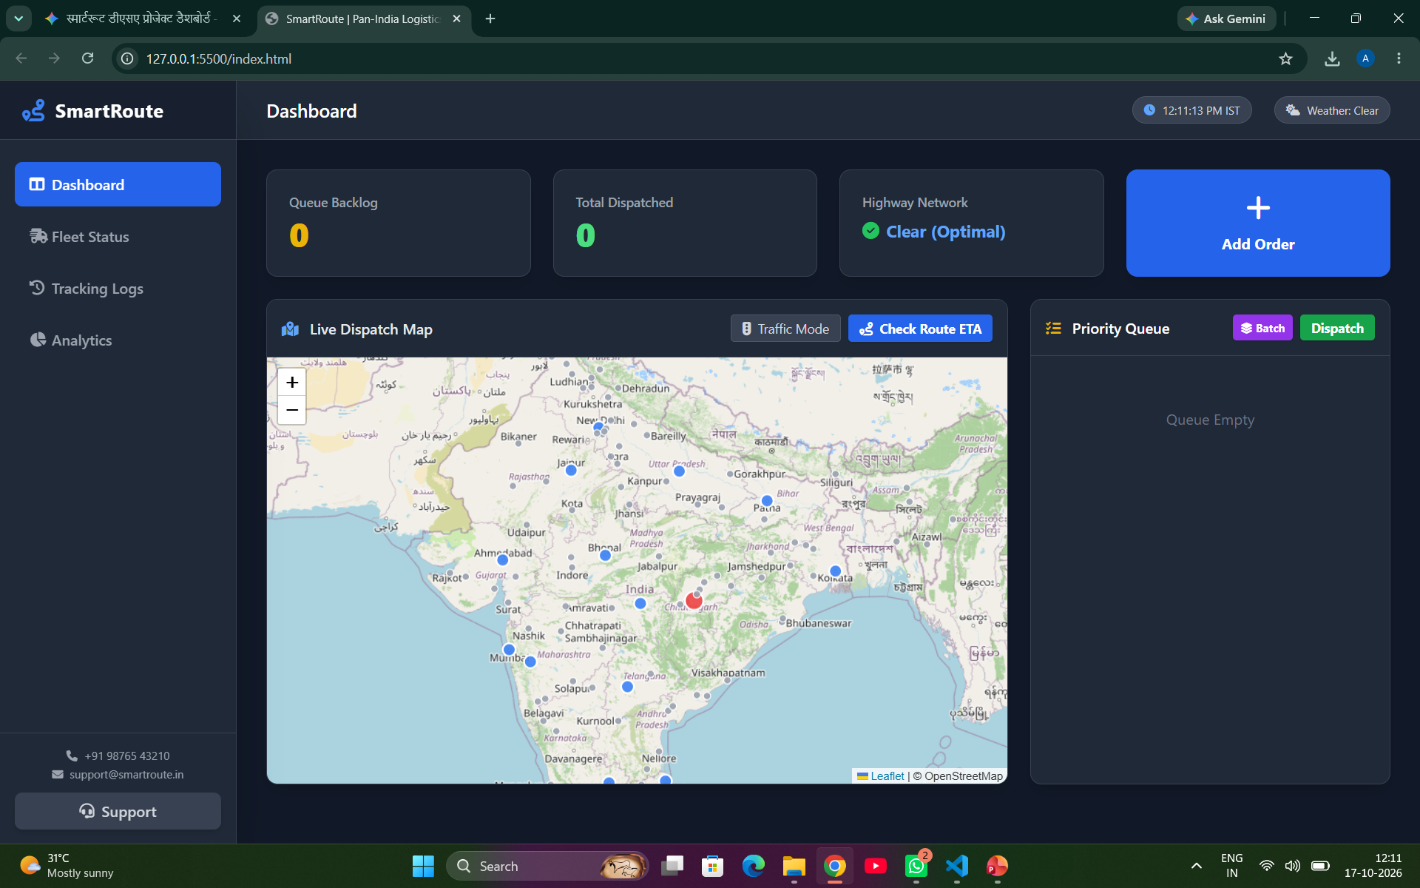
Live Dispatch Map & UI

Slide 5
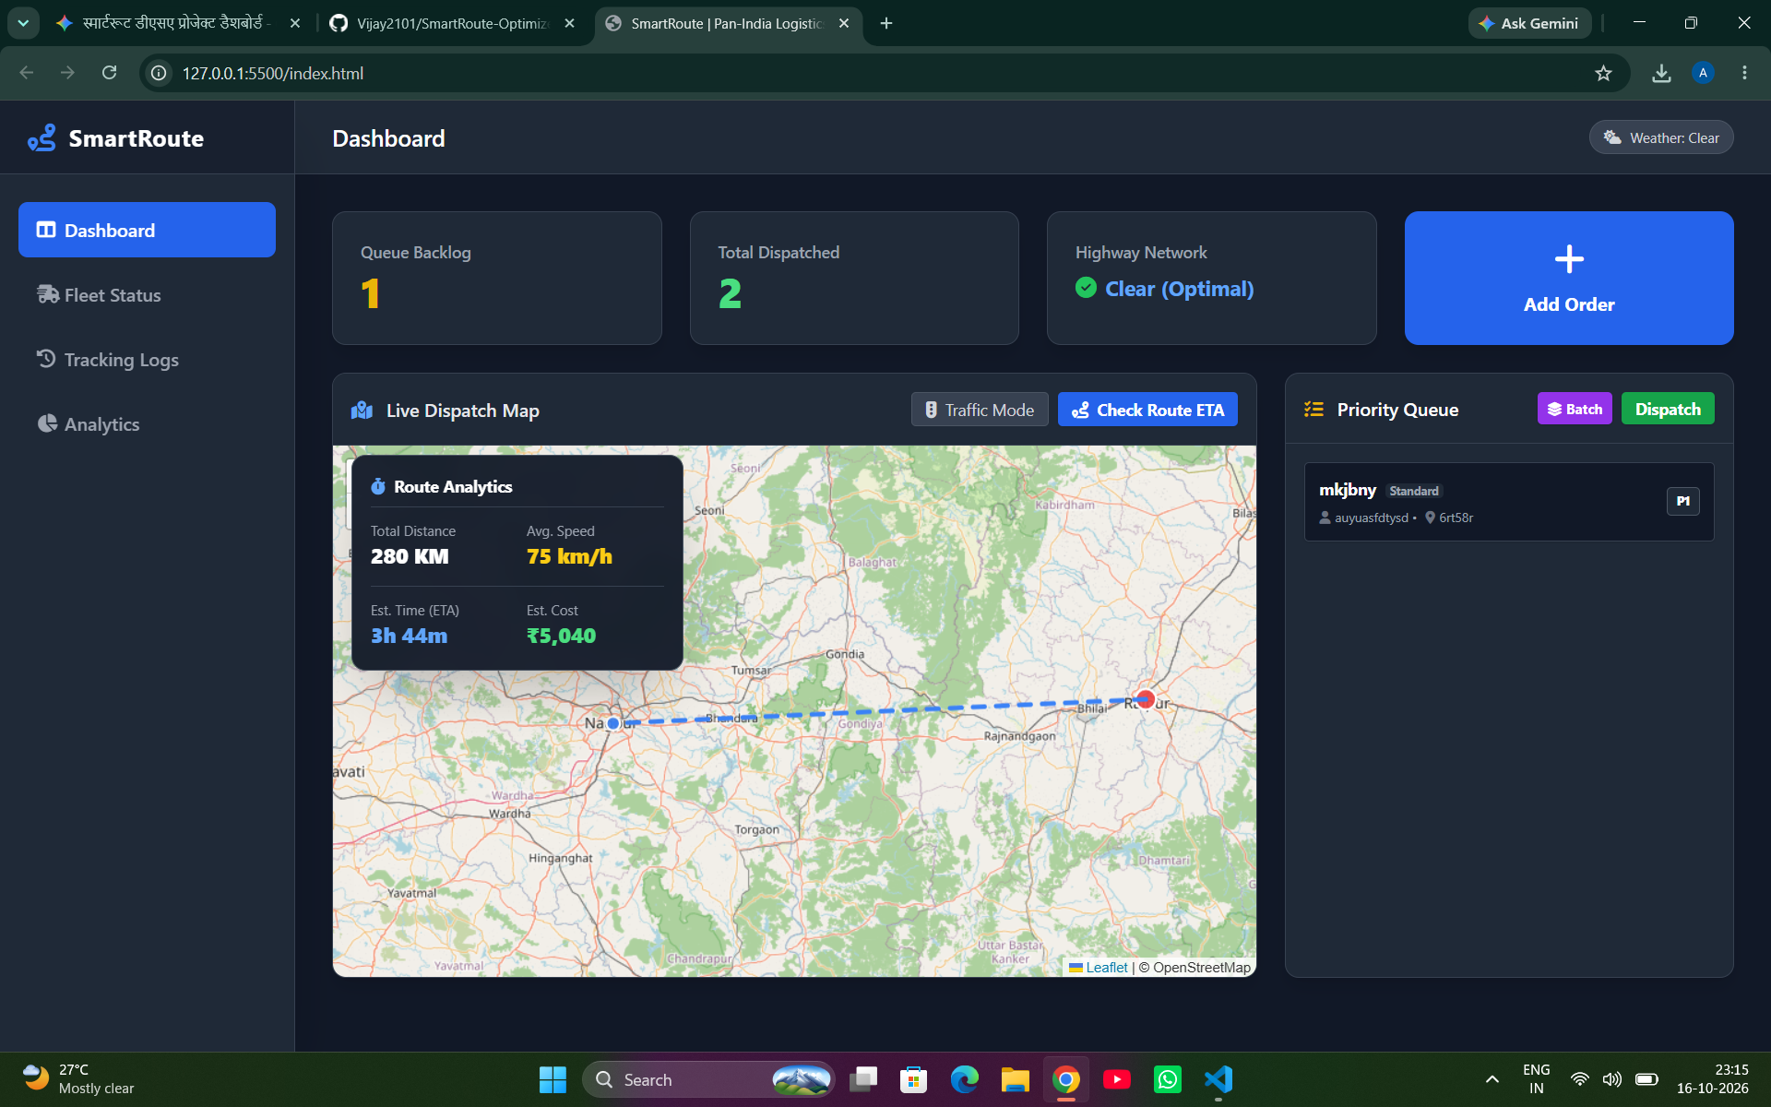
Dynamic Route Analytics & ETA

Slide 6
Advanced Features & Visual Simulations
Real-World Traffic & Weather Toggles
  Simulates roadblocks and storms by dynamically increasing graph edge weights, altering the ETA, speed, and cost of routes in real-time. Displays visual glow zones on the map.
Batch Dispatching & Fleet Engine
  Auto-assigns the top priority orders to available fleet vehicles. Features automated fuel tracking and status updates (Idle vs. In Transit).
Comprehensive Export
  One-click CSV export functionality that downloads highly detailed dispatch history reports directly to the user's local machine.

Slide 7
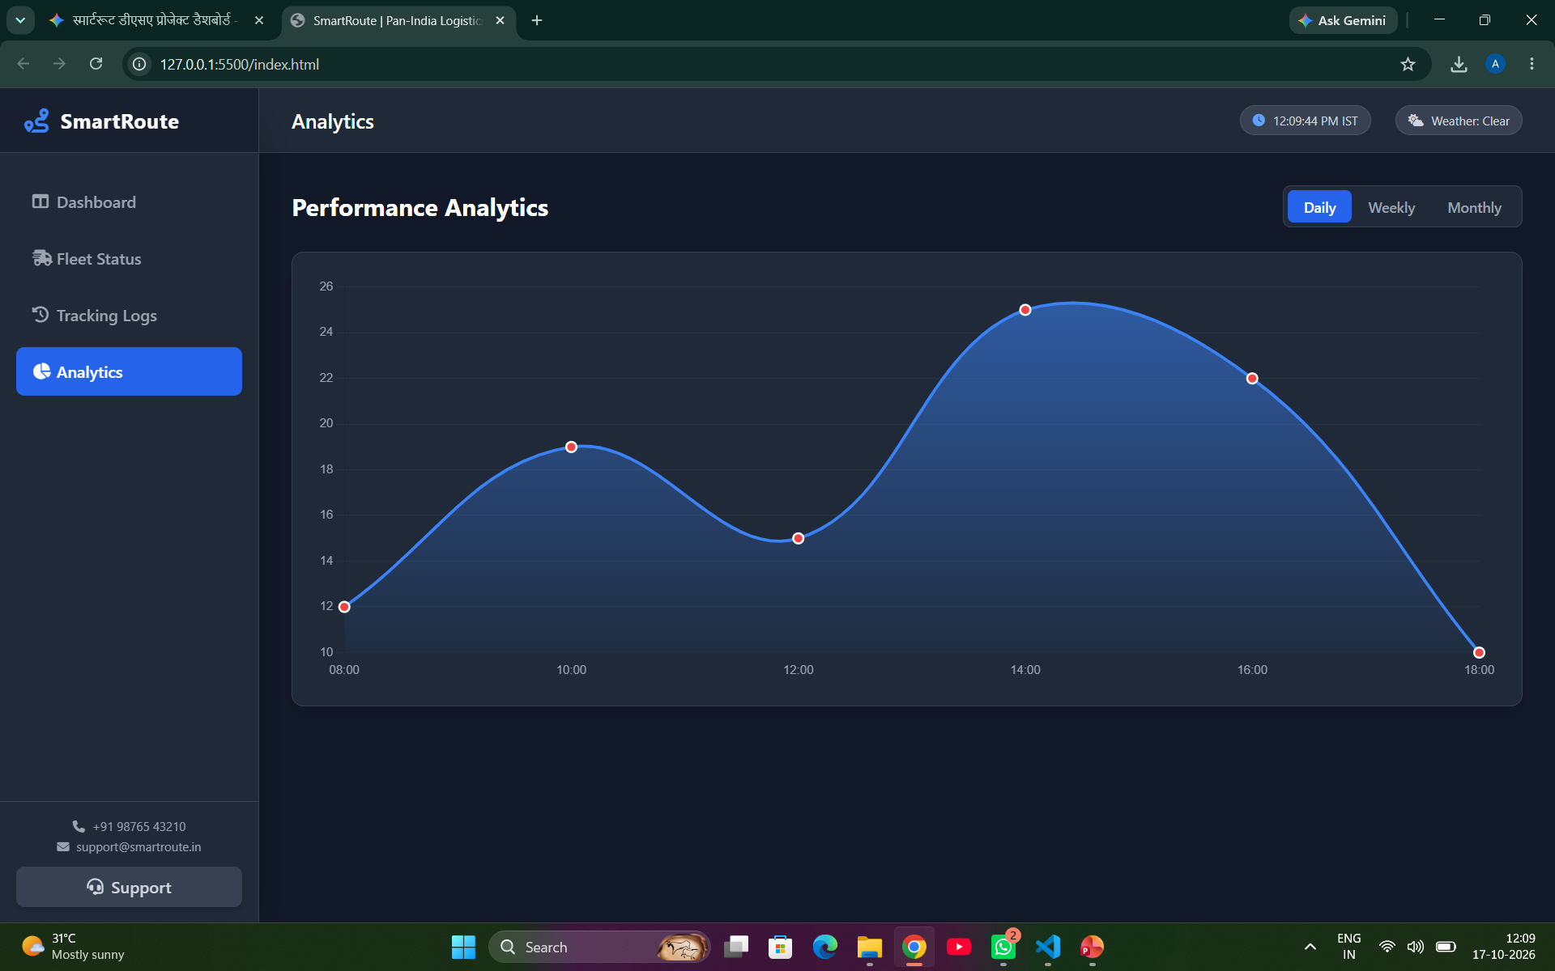
Performance Analytics
(Smooth Line Graph)

Slide 8
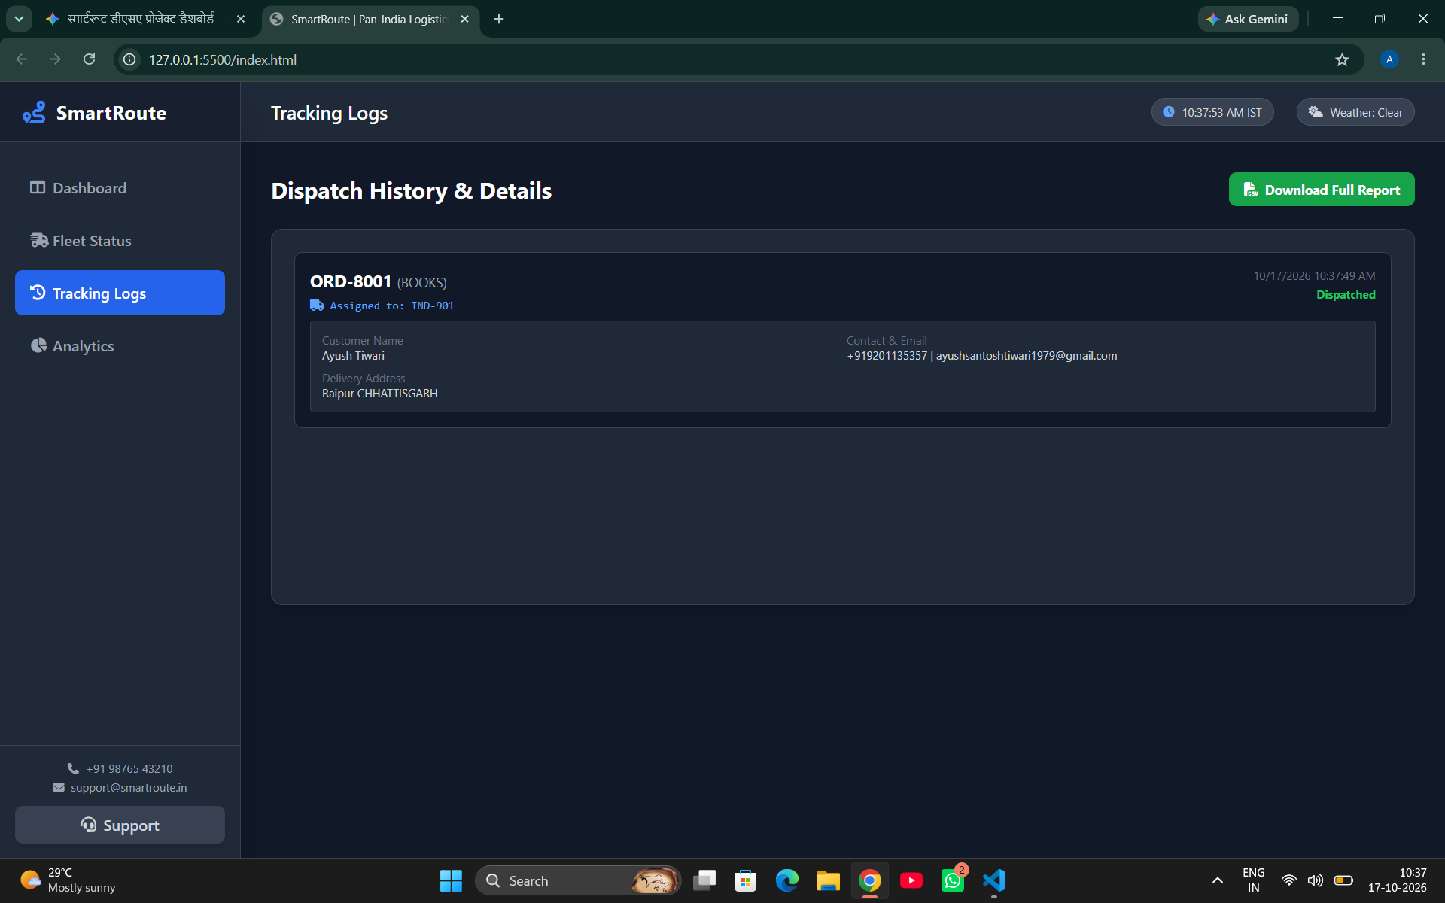
Dispatch History & Detailed Logs

Slide 9
Technology Stack
Frontend Interface & Styling
  HTML5, Tailwind CSS, and Font Awesome used to create a sleek, responsive, dark-themed command center UI.
Mapping & Data Visualization
  Leaflet.js configured with OpenStreetMap tiles for zero-API-cost mapping, and Chart.js for rendering smooth gradient performance analytics.
Core Algorithms & Backend Logic
  100% Vanilla JavaScript handling custom Graph construction, Min-Heap arrays, state management, and real-time clock mechanics.

