Slide 1

FINAL PORTFOLIO PRESENTATION
Ayush Thoniparambil Saseendran M.S. in Applied Data Science, Syracuse University
Portfolio
GitHub

Slide 2

Contents
Introduction
Portfolio Outlook
Folder Structure
Education
Professional Experience
Projects
Cloud Management – IST 615
Data Warehouse – IST 722
DBMS – IST 659
Introduction to DS – IST687
Skills and Certifications
Conclusion

Slide 3
Introduction
Graduate student at Syracuse University with 4.5+ years of experience
Skilled in data engineering, cloud platforms, and business intelligence
Passionate about transforming raw data into actionable insights

Slide 4
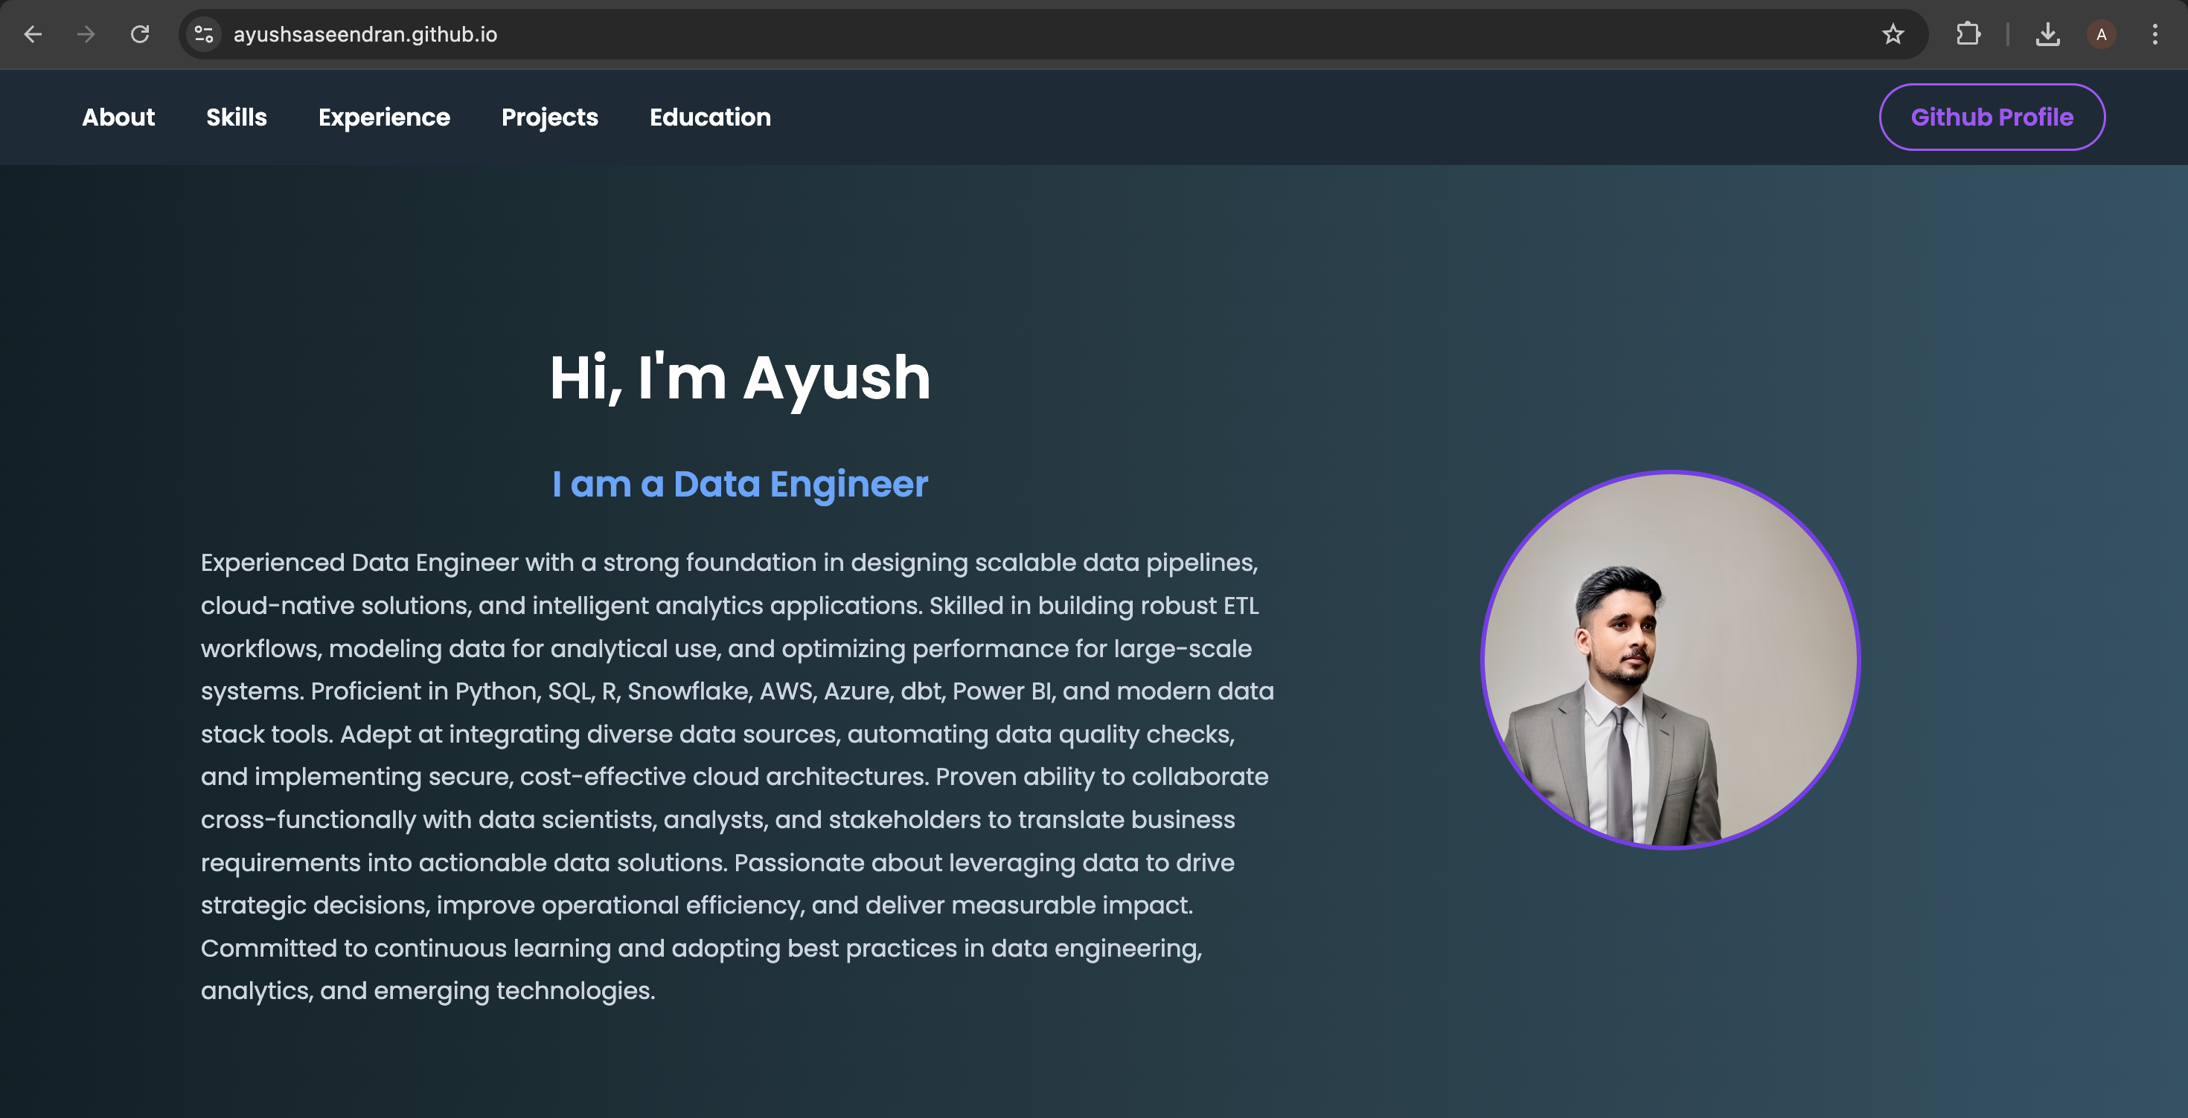
Portfolio Outlook
Portfolio

Slide 5
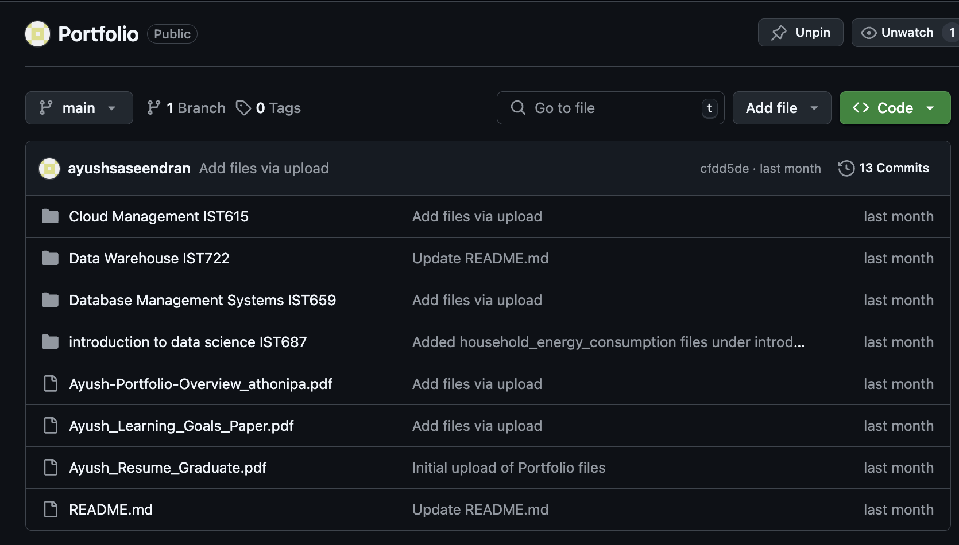
Folder Structure
GitHub

Slide 6


Education Background
🎓 Master of Science in Applied Data Science
Syracuse University, NY (Aug 2023 – May 2025)
GPA: 3.9/4.0
Focus: Data Engineering, Machine Learning, Big Data, Cloud Computing
🎓 Bachelor of Engineering in Electronics and Telecommunication
University of Mumbai, Vidyalankar Institute of Technology (Jul 2015 – May 2019)
GPA: 3.0/4.0
Projects: Drone-based mapping using LiDAR, Raspberry Pi integration, ROS
Built foundation in programming, control systems, and signal processing

Slide 7

Professional Experience
🔹 BioMarin Pharmaceutical Inc. (Data Science Intern)
Migrated Excel risk data into SQL Server with audit triggers
Built PowerApps UI for data entry and role-based access
Improved data accuracy by 20% and user satisfaction by 35%
🔹 Accenture (Data Engineering Analyst)
Developed ETL pipelines using Informatica and shell scripts
Reduced processing time by 30% via automation and tuning
Collaborated on data warehouse migrations and performance tuning

Slide 8

Project 1: Cloud Management – IST615
Built cloud-native workflows using AWS Lambda, Azure Functions
Implemented role-based access controls and optimized cloud spend
Showcased scalability and cost-efficiency using serverless architecture

Slide 9
Project 2: Data Warehouse – IST722
Developed FEC campaign finance warehouse using Snowflake and dbt
Created star schema with contribution/expenditure fact tables
Built Power BI dashboards to visualize trends across demographics

Slide 10

Project 3: DBMS Travel App – IST659
Designed ER diagrams and normalized schemas
Implemented CRUD operations with PowerApps interface
Enabled managers to review and act on travel bookings interactively

Slide 11
Project 4: Energy Forecasting – IST687
Used R to forecast electricity demand using weather + usage data
Achieved 90%+ accuracy; deployed interactive shiny dashboard
Insights help utilities manage load and policy recommendations

Slide 12

Skills & Certifications
Languages: Python, SQL, R, Shell Scripting
Tools: Power BI, dbt, SSMS, Git, Docker, PowerApps
Cloud: AWS (certification in progress), Azure (certified)
Big Data: Spark, Kafka, Snowflake, Informatica

Slide 13
Conclusion
Prepared to solve real-world challenges through data
Combining strong engineering with ethical responsibility
Eager to grow, collaborate, and innovate in future roles

