Slide 1

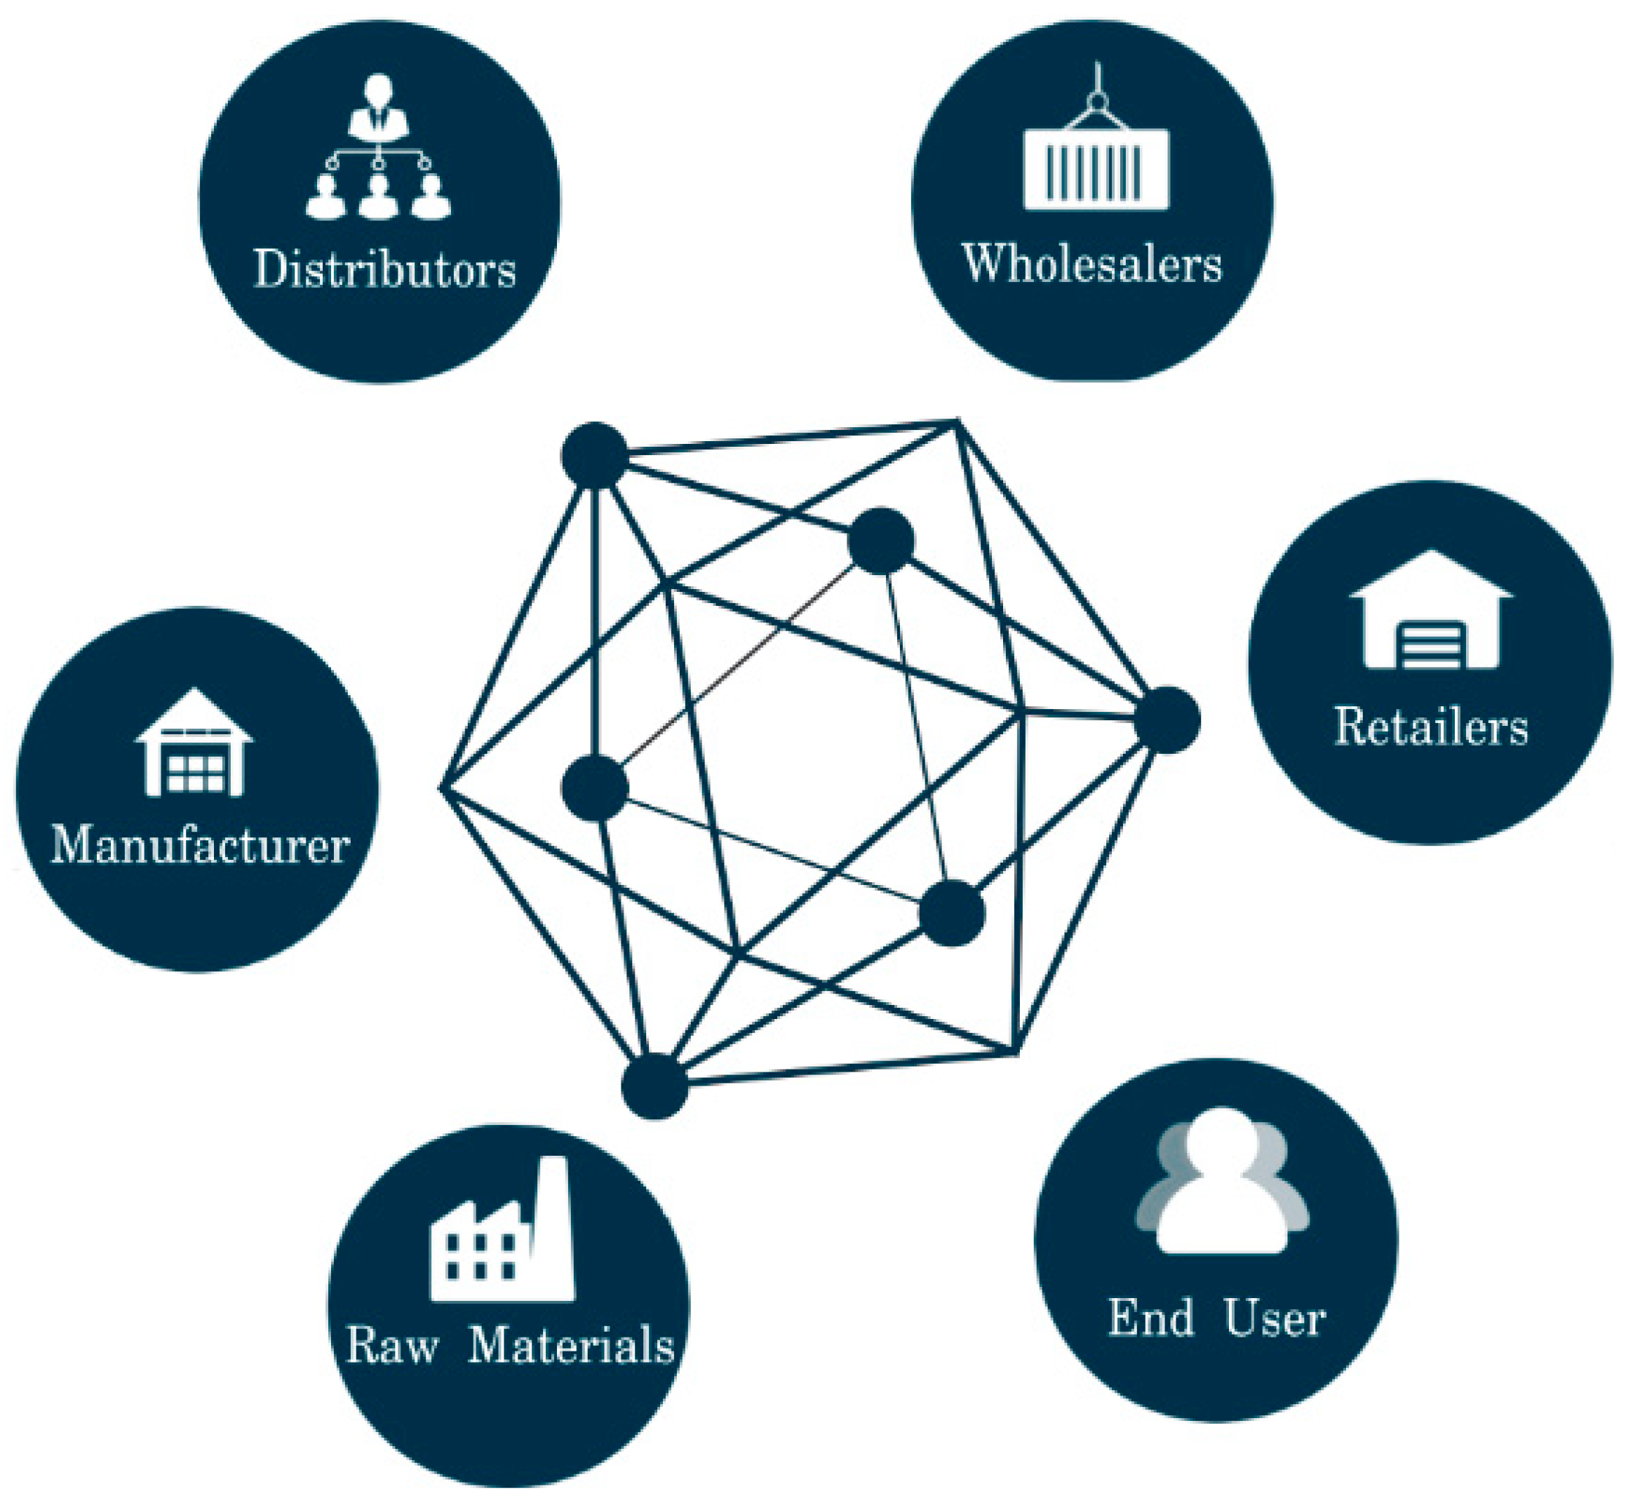
Supply Chain Traceability for Organic Jaggery using Blockchain

Slide 2
TABLE OF CONTENTS
01
04
02
05
03
06
What are we working on
Methodology
International & National Status
Origin of the project
About the project
Budget and Project Goals

Slide 3
OUR PROJECT GUIDE
OUR TEAM
Dr. Priya M. Shelke
Associate HOD, Department of I.T.
Aadesh Ingle, B.Y. I.T.
Ashish Gole, B.Y. I.T.
Ayush Bansal, B.Y. I.T.
Lokesh Budhlani, B.Y. I.T.
Siddesh Vyavahare, B.Y. I.T.

Slide 4
ORIGIN OF THE PROJECT
A supply chain is a network between a company and its suppliers to produce and distribute a specific product to the final buyer.
The steps include moving and transforming raw materials into finished products, transporting those products, and distributing them to the end-user.
Nowadays, the customers are unaware of the events happening to the items in the supply chain which creates a lack of trust in their minds.
So, the solution to this problem can be implemented efficiently using blockchain technology.

Slide 5




WHAT WE ARE WORKING ON
Multichain
IOT
MultiChain is an off­-the-­shelf platform for the creation and deployment of private blockchains.
Sensors including light sensor, temperature & humidity sensor are being used to verify the quality of the product.
Javascript
AWS
JavaScript is a lightweight, interpreted programming language. It is designed for creating network-centric applications.
Amazon Web Services is a subsidiary of Amazon providing on-demand cloud computing platforms and APIs to individuals, companies, and governments, on a metered pay-as-you-go basis.

Slide 6
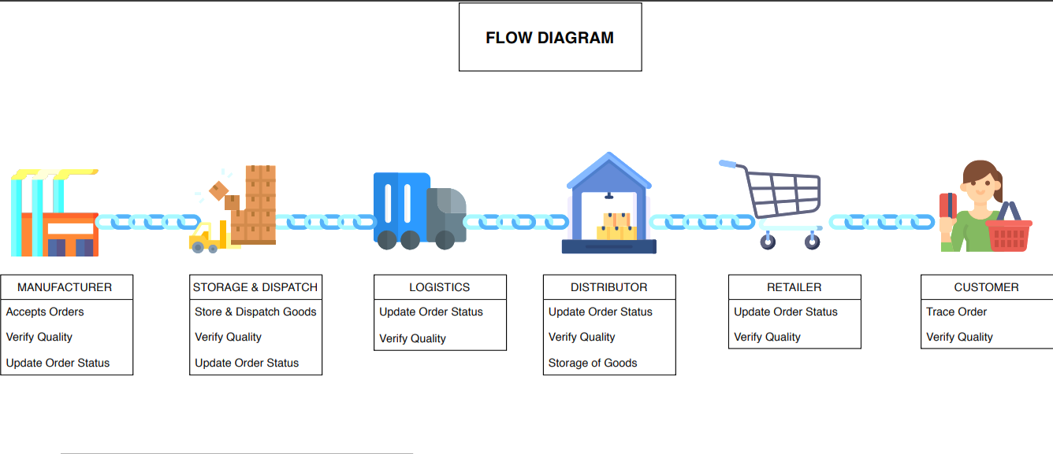
FLOW IN SUPPLY CHAIN

Slide 7
ABOUT THE PROJECT
Intended to explore transparency in the supply chain of organic products like Jaggery by the usage of Blockchain technology.
Expected to replace the ongoing methods employed by the industry to trace products in the supply chain.
Trace products in a reliable and tamper-proof environment with no central authority controlling the data.
The blockchain could also be deployed on cloud services to increase availability and reliability.

Slide 8
METHODOLOGY
The backend i.e. business logic will be developed using JavaScript language on the MultiChain framework which is based on Blockchain technology.
The frontend i.e. user interface will be developed using HTML, CSS, JavaScript, and use of any particular frontend framework like AngularJS, ReactJS.
The nodes representing the various actors will be deployed on AWS Cloud Services to ensure high availability and fault-tolerant working of the application.

Slide 9
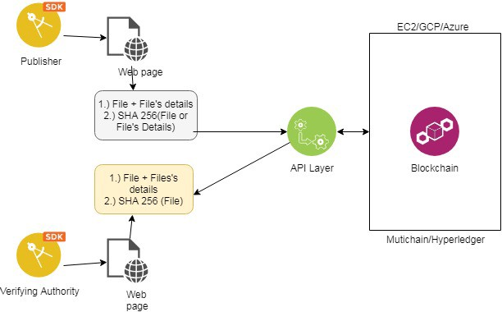
METHODOLOGY

Slide 10
-DAVE WATERS
“Blockchain provides supply chain capabilities that were not possible in the recent past.”

Slide 11
INTERNATIONAL & NATIONAL STATUS
Supply Chain for Walmart Food stores- Developed by IBM (Hyperledger Fabric).
Tracing yellowfin and skipjack tuna fish in Indonesia- Provenance pilot blockchain technology.
Supply chain journey of the beans of coffee for Starbucks - Developed by Microsoft.
Amazon is also planning to develop a Blockchain-based application that will trace products in the Supply Chain.
Trace organic fruits and vegetables- Deployed by Sahyadri Farms, Nashik using the MultiChain platform.
Supply chain finance(SCF)- Developed by Kryptech company based out of Mumbai.

Slide 12
BUDGET
10%
40%
20%
30%
Sensor
Raspberry Pi
AWS
Publication
DHT22 AM2302 Sensor
To connect to and configure the sensors
To host the nodes on AWS Cloud EC2
Publishing Research Paper in IJSER.
₹ 10,000/-

Slide 13
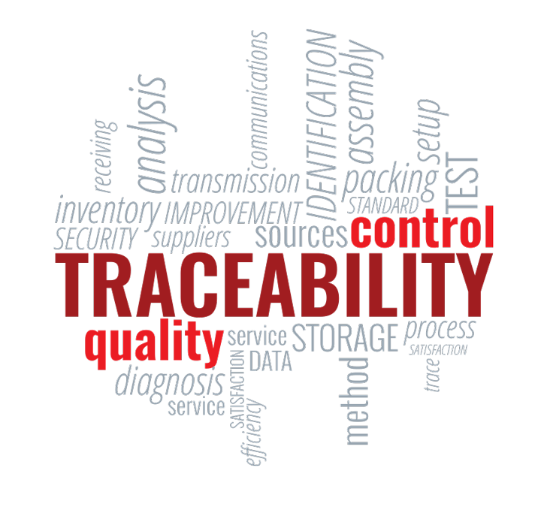
PROJECT GOALS
Traceability
Transparency
Developing trust
Security
Reduction in cost and time

Slide 14
TIMELINE
Implementing Basic Traceability and Creating Documentation
Integrating IoT in the application
Sept - Oct 2020
Feb - Apr 2021
Jul - Aug 2020
Nov 20 - Jan 21
May - June 2021
Research about SCM and Various - blockchain Platforms
Migrating to the cloud and implementing special cases
Report Submission and Paper Publication

Slide 15
THANKS
Do you have any questions?

Slide 16
RESOURCES
https://www.multichain.com/
https://ethereum.org/en/
www.coursera.org/learn/aws-fundamentals-going-cloud-native
https://www.ey.com/Publication/vwLUAssets/ey-blockchain-and-the-supply-chain-three/$FILE/ey-blockchain-and-the-supply-chain-three.pdf
http://apeda.gov.in/apedawebsite/SubHead_Products/Jaggery_and_Confectionary.htm
https://ieeexplore.ieee.org/abstract/document/8842690

