Slide 1
Basics of Electrochemical Impedance Spectroscopy
10/6/2015

Slide 2

Definition of Resistance and Impedance
Resistance is the ability of a circuit element to resist the flow of electrical current.
Ohm's law defines resistance in terms of the ratio between voltage, E, and current, I.
While this is a well known relationship, its use is limited to only one circuit element -- the ideal resistor.
An ideal resistor has several simplifying properties:
It follows Ohm's Law at all current and voltage levels.
Its resistance value is independent of frequency.
AC current and voltage signals though a resistor are in phase with each other.

Slide 3
Definition of Resistance and Impedance
Most real applications contain more complex circuit elements and more complex behavior.
Impedance replaces resistance as a more general circuit parameter.
Impedance is a measure of the ability of a circuit to resist the flow of electrical current
Unlike resistance, it is not limited by the simplifying properties mentioned earlier.

Slide 4
Direct current (Dc) vs. Alternating current (Ac)
Voltage
Voltage
Time
Time
1 Cycle
Alternating Current is when charges flow back and forth from a source.
Frequency is the number of cycles per second in Hertz.
In US, the Ac frequency is 50-60 Hz.
Is the one way flow of electrical charge from a positive to a negative charge.
Batteries produce direct current.

Slide 5
Making EIS Measurements
Apply a small sinusoidal potential (or current) of fixed frequency.
Measure the response and compute the impedance at each frequency.
Z_{ω} = E_{ω}/I_{ω}
E_{ω =} Frequency-dependent potential
I_{ω} = Frequency-dependent current
Repeat for a wide range of frequencies
Plot and analyze

Slide 6
Summary: the concept of impedance
The term impedance refers to the frequency dependant resistance to current flow of a circuit element (resistor, capacitor, inductor, etc.)
Impedance assumes an AC current of a specific frequency in Hertz (cycles/s).
Impedance: Z_{ω} = E_{ω}/I_{ω}
E_{ω =} Frequency-dependent potential
I_{ω} = Frequency-dependent current
Ohm’s Law: R = E/I
R = impedance at the limit of zero frequency

Slide 7
Reasons To Run EIS
EIS is theoretically complex – why bother?
The information content of EIS is much higher than DC techniques or single frequency measurements.
EIS may be able to distinguish between two or more electrochemical reactions taking place.
EIS can identify diffusion-limited reactions, e.g., diffusion through a passive film.
EIS provides information on the capacitive behavior of the system.
EIS can test components within an assembled device using the device’s own electrodes.
EIS can provide information about the electron transfer rate of reaction

Slide 8
Applications of EIS
Study corrosion of metals.
Study adsorption and desorption to electrode surface
Study the electrochemical synthesis of materials.
Study the catalytic reaction kinetics.
Label free detection sensors.
Study the ions mobility in energy storage devices such as batteries and supercapacitors.

Slide 9

Phase shift
i leads e
Resistor
Ė = İ R
ω
Capacitor
İ
π/2
Ė = –jX_{C}İ
Ė
φ
$$j=\sqrt{−1}$$
X_{C} = 1/ωC
π
0
İ
Xc is the impedance of the capacitor
is the angular frequency = 2 π f
C is the capacitance of the capacitor
−π/2

Slide 10
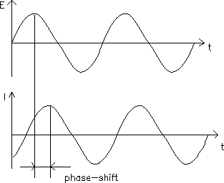

Phase shift and impedance
The excitation signal, expressed as a function of time, has the form
where E_{t} is the potential at time t, E₀ is the amplitude of the signal, and ω is the radial frequency. The relationship between radial frequency ω (expressed in radians/second) and frequency f (expressed in hertz) is:

Slide 11


Phase shift and impedance
The response signal, I_{t}, is shifted in phase (Φ) and has a different amplitude than I₀.
An expression analogous to Ohm's Law allows us to calculate the impedance of the system as:
The impedance is therefore expressed in terms of a magnitude, Z_{o}, and a phase shift, Φ.
Remember

Slide 12

With Eulers relationship,
Where ϕ is real number and j is imaginary unit.
it is possible to express the impedance as a complex function. The potential is described as,
and the current response as,
The impedance is then represented as a complex number,

Slide 13
EIS data may be presented as a Bode Plot or a Complex Plane (Nyquist) Plot
Representations of EIS
Nyquist Plot
Bode Plot

Slide 14
Nyquist Plot
Z_{Im}
ω = 1/R_{ct}C_{d}
Z_{Im}
R_{Ω}
R_{Ω} + R_{ct}
Z_{Re}
Z_{Re}
Kinetic control
Mass-transfer control
If system is kinetically slow, large R_{ct} and only limited f region where mass transfer significant. If R_{ct} v. small then the system iskinetically facile
Z_{Im}
ω = 1/R_{ct}C_{d}
R_{Ω}
R_{Ω} + R_{ct}
Z_{Re}

Slide 15
Bode plots

Slide 16
Nyquist vs. Bode Plot
Bode Plot
Individual charge transfer processes are resolvable.
Frequency is explicit.
Small impedances in presence of large impedances can be identified easily.
Nyquist Plot
Individual charge transfer processes are resolvable.
Frequency is not obvious.
Small impedances can be swamped by large impedances.

Slide 17
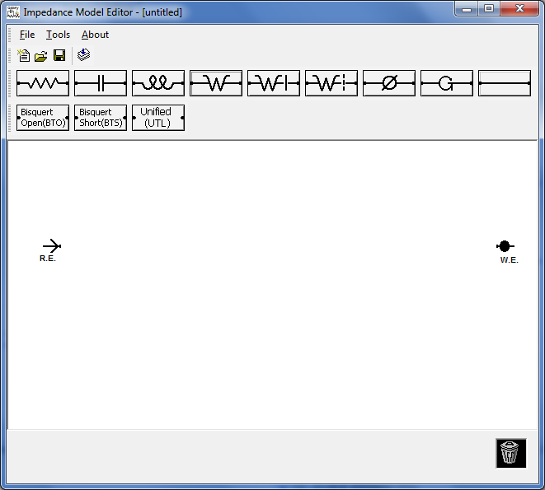
Analyzing EIS: Modeling
Electrochemical cells can be modeled as a network of passive electrical circuit elements.
A network is called an “equivalent circuit”.
The EIS response of an equivalent circuit can be calculated and compared to the actual EIS response of the electrochemical cell.

Slide 18
Frequency Response of Electrical Circuit Elements
Resistor Capacitor Inductor
Z = R (Ohms) Z = -j/ωC (Farads) Z = jωL (Henrys)
0° Phase Shift -90° Phase Shift 90° Phase Shift
j = √-1
ω = 2πf radians/s, f = frequency (Hz or cycles/s)
A real response is in-phase (0°) with the excitation. An imaginary response is ±90° out-of-phase.

Slide 19
Electrochemistry as a Circuit
Double Layer Capacitance
Electron Transfer Resistance
Uncompensated (electrolyte) Resistance
Randles Cell
(Simplified)

Slide 20
Bode Plot
Ru + Rp
Impedance
C_{DL}
R_{U}
Phase Angle
R_{P}
Ru

Slide 21
Complex Plane (Nyquist) Plot
High Freq
Low Freq
C_{DL}
R_{U}
R_{P}
Ru
Ru + Rp

Slide 22
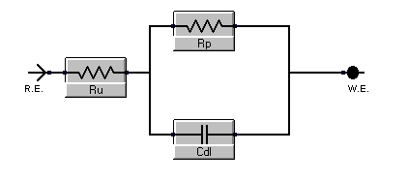
Nyquist Plot with Fit
Results
Rp = 3.019E+03 ± 1.2E+01
Ru = 1.995E+02 ± 1.1E+00
Cdl = 9.61E-07 ± 7E-09

Slide 23
Other Modeling Elements
Warburg Impedance: General impedance which represents a resistance to mass transfer, i.e., diffusion control. A Warburg typically exhibits a 45° phase shift.
Constant Phase Element: A very general element used to model “imperfect” capacitors. CPE’s normally exhibit a 80-90° phase shift.

Slide 24
EIS Modeling
Complex systems may require complex models.
Each element in the equivalent circuit should correspond to some specific activity in the electrochemical cell.
It is not acceptable to simply add elements until a good fit is obtained.
Use the simplest model that fits the data.

Slide 25


Parameters measured by EIS
Electrolyte Resistance
Solution resistance is often a significant factor in the impedance of an electrochemical cell. A modern three electrode potentiostat compensates for the solution resistance between the counter and reference electrodes. However, any solution resistance between the reference electrode and the working electrode must be considered when you model your cell.
The resistance of an ionic solution depends on the ionic concentration, type of ions, temperature, and the geometry of the area in which current is carried. In a bounded area with area, A, and length, l, carrying a uniform current, the resistance is defined as,
ρ is the solution resistivity. The reciprocal of ρ (κ) is more commonly used. κ is called the conductivity of the solution and its relationship with solution resistance is:
Unfortunately, most electrochemical cells do not have uniform current distribution through a definite electrolyte area. Therefore, calculating the solution resistance from the solution conductivity will not be accurate. Solution resistance is often calculated from the EIS spectra.

Slide 26
Double Layer Capacitance
An electrical double layer exists on the interface between an electrode and its surrounding electrolyte.
This double layer is formed as ions from the solution adsorb onto the electrode surface. The charged electrode is separated from the charged ions by an insulating space, often on the order of angstroms.
Charges separated by an insulator form a capacitor so a bare metal immersed in an electrolyte will be have like a capacitor.
You can estimate that there will be 20 to 60 μF of capacitance for every 1 cm² of electrode area though the value of the double layer capacitance depends on many variables. Electrode potential, temperature, ionic concentrations, types of ions, oxide layers, electrode roughness, impurity adsorption, etc. are all factors.
X_{C} = 1/ωC
X_{C} = 1/2πfC
X_{C} is the capacitor impedance

Slide 27
Parameters measured by EIS
Charge Transfer Resistance
Resistance in this example is formed by a single, kinetically-controlled electrochemical reaction. In this case we do not have a mixed potential, but rather a single reaction at equilibrium.
Consider the following reversible reaction
This charge transfer reaction has a certain speed. The speed depends on the kind of reaction, the temperature, the concentration of the reaction products and the potential.

Slide 28

The general relation between the potential and the current (which is directly related with the amount of electrons and so the charge transfer via Faradays law) is:
with,
i₀ | = exchange current density
C_{O} | = concentration of oxidant at the electrode surface
C_{O}* | = concentration of oxidant in the bulk
C_{R} | = concentration of reductant at the electrode surface
η | = overpotential
F | = Faradays constant
T | = temperature
R | = gas constant
a | = reaction order
n | = number of electrons involved

Slide 29


When the concentration in the bulk is the same as at the electrode surface, C_{O}=C_{O}* and C_{R}=C_{R}*. This simplifies the previous equation into:
This equation is called the Butler-Volmer equation. It is applicable when the polarization depends only on the charge-transfer kinetics.
Stirring the solution to minimize the diffusion layer thickness can help minimize concentration polarization.
When the overpotential, η, is very small and the electrochemical system is at equilibrium, the expression for the charge-transfer resistance changes to:
From this equation the exchange current density can be calculated when R_{ct} is known.

Slide 30
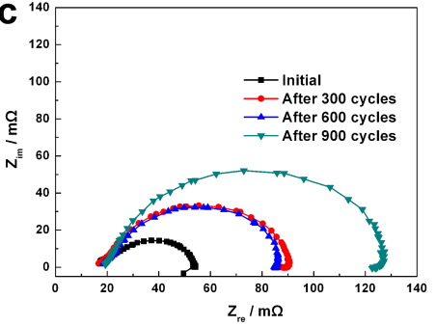
Real systems: EIS
Study electrochemical behavior of catalysts for fuel cells
What do you understand from the study of the Pd/c catalyst stability above
J. Fuel Cell Sci. Technol 11(5), 051004 (Jun 10, 2014)

Slide 31
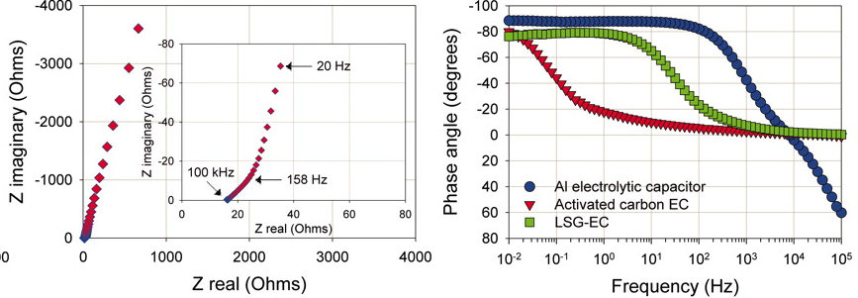
Electrochemical Capacitors
What you may understand from the two figures
Maher F. El-Kady et al. Science 2012;335:1326-1330

Slide 32
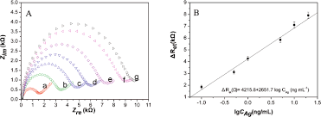
Developing biosensors
Which is the highest conc of standard and why?
Anal. Chem. 2008, 80, 2133 - 2140

Slide 33
EIS Instrumentation
Potentiostat/Galvanostat
Sine wave generator
Time synchronization (phase locking)
All-in-ones, Portable & Floating Systems
Things to be aware of…
Software – Control & Analysis
Accuracy
Performance limitations

Slide 34
EIS Take Home
EIS is a versatile technique
Non-destructive
High information content
Running EIS is easy
EIS modeling analysis is very powerful
Simplest working model is best
Complex system analysis is possible.

Slide 35
References for EIS
http://www.gamry.com/application-notes/EIS/basics-of-electrochemical-impedance-spectroscopy/
Electrochemical Impedance and Noise, R. Cottis and S. Turgoose, NACE International, 1999. ISBN 1-57590-093-9.
An excellent tutorial that is highly recommended.
Electrochemical Techniques in Corrosion Engineering, 1986, NACE International
Proceedings from a Symposium held in 1986. 36 papers. Covers the basics of the various electrochemical techniques and a wide variety of papers on the application of these techniques. Includes impedance spectroscopy.
Electrochemical Impedance: Analysis and Interpretation, STP 1188, Edited by Scully, Silverman, and Kendig, ASTM, ISBN 0-8031-1861-9.
26 papers covering modeling, corrosion, inhibitors, soil, concrete, and coatings.
EIS Primer, Gamry Instruments website, www.gamry.com

