Slide 1

Lithium Iron Phosphate
Athena Combs - Hurtado
Marc Hansel

Slide 2
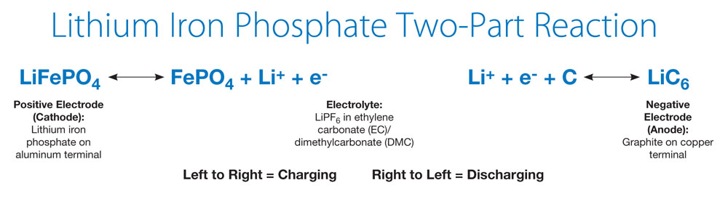
Chemical Reaction

Slide 3
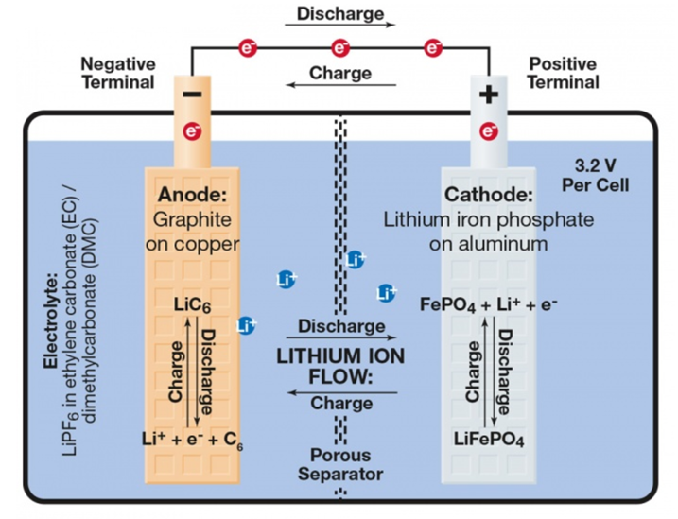
Battery Composition

Slide 4
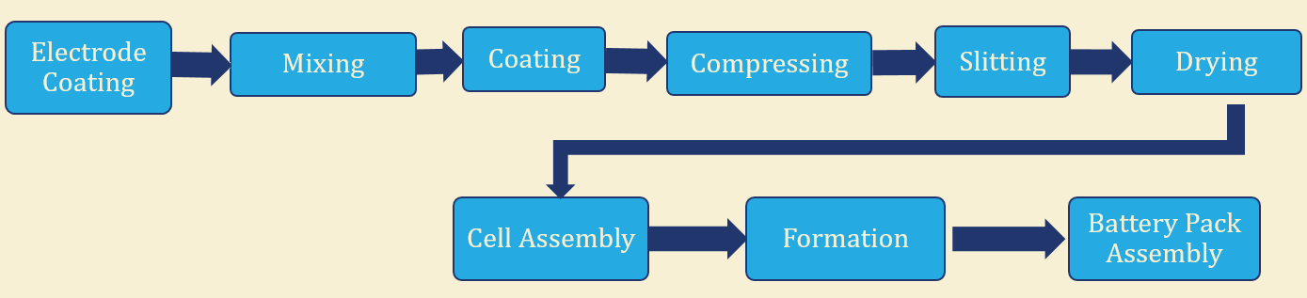
Manufacturing Techniques
Use the same process as other lithium ion batteries
Two principal methods of producing a LiFePO4 cathode: solid state and solution based
Carbon coating (graphite or acetylene black) increases conductivity
Notes:
MIXING : Make a cathode and an anode
COATING : Metallic foil is then given a coating of the mixture on each side in the coating machine. coating machines can apply a coating to each side. COMPRESSING : After the foil is coated, it is compressed to the correct thickness by two laminating rollers. SLITTING : In the slitting process, the press line quickly and uniformly cuts down the foil reel into plates. DRYING : The plates are set to dry in a large oven.
F0RMATION: The materials in the cell are then activated through a controlled charge-discharge cycle so that the cell can become a useable product
(n.d.). In Amita Technology Inc.. Retrieved October 17, 2017, from http://www.amitatech.com/capability.php?c=Production

Slide 5
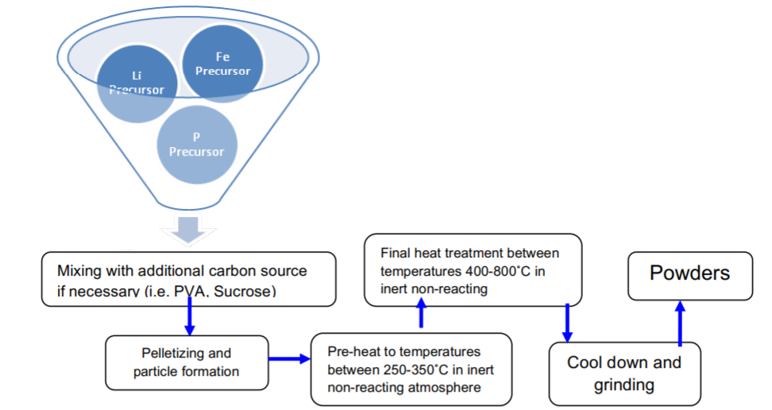
Solid State
Requires high temperatures and long sintering times
Well suited for the mass production because it creates an ordered crystal structure
Inexpensive for manufacturing but does not yield best results
Notes:
Mix Li Fe and P in atmospheric conditions
Mix with carbon source to increase conductivity
Particles form
Pre – calcination (250-350 C) to expel gasses
Final calcination
Cool down
Grind into powder

Slide 6
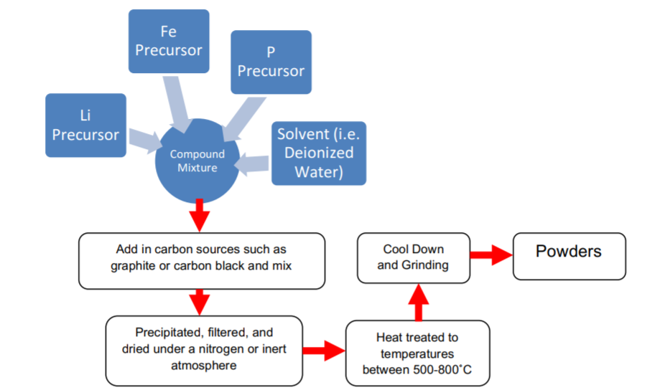
Solution Based
Creates a more complex/ideal carbon coated crystalline structure
Better conductivity and higher density performance
Difficult to manufacture
Notes:
Mixing Li, P, and solvent (DI water)
Control PH values
Precipitation in filtered under an inert atmosphere
Heat treatment (500 – 800 C) in N2 atmosphere
Grind into powder

Slide 7
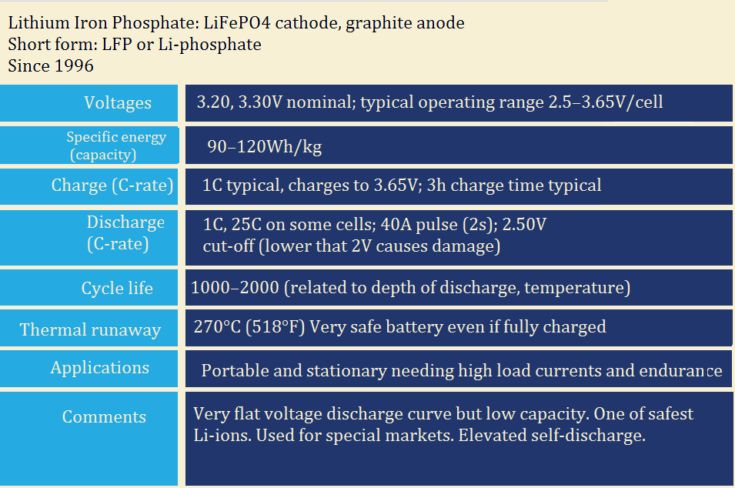
Specifications

Slide 8
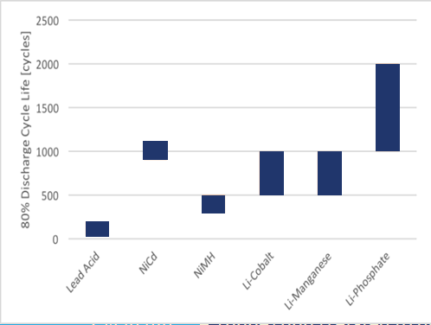
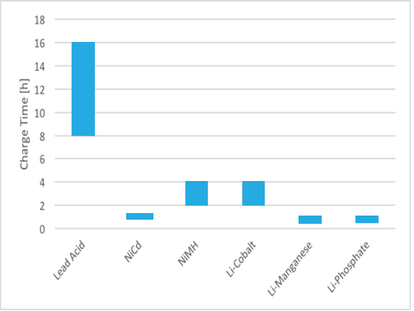
Cycle Life and Charge Time
Longer cycle life for than other lithium ion batteries
Shorter charge time implies higher power

Slide 9
Cost Analysis
Cell chemistry | Cost ($/kWh)
Lead-acid | $56–$145
Lithium cobalt oxide | $356
Lithium iron phosphate | $300
Lithium manganese oxide | $356
Zinc-carbon | $316
Notes:
Lead acid batteries are cheaper but lithium ion batteries produce a better results and have a longer cycle life.

Slide 10
Current Uses
Electric vehicles
Limited adoption compared to other Li-ion chemistries
Residential
sonnenBatterie
Starting off with municipal/utility
Coda Energy constructing a 10MW storage facilty

Slide 11
SWOT
Strengths
Weaknesses
Opportunities
Threats

Slide 12
Strengths
High power density
Charges faster
Constant charge and discharge rate – compared to lead acid batteries
High discharge rate
Longevity
Safety
Low fire hazard

Slide 13
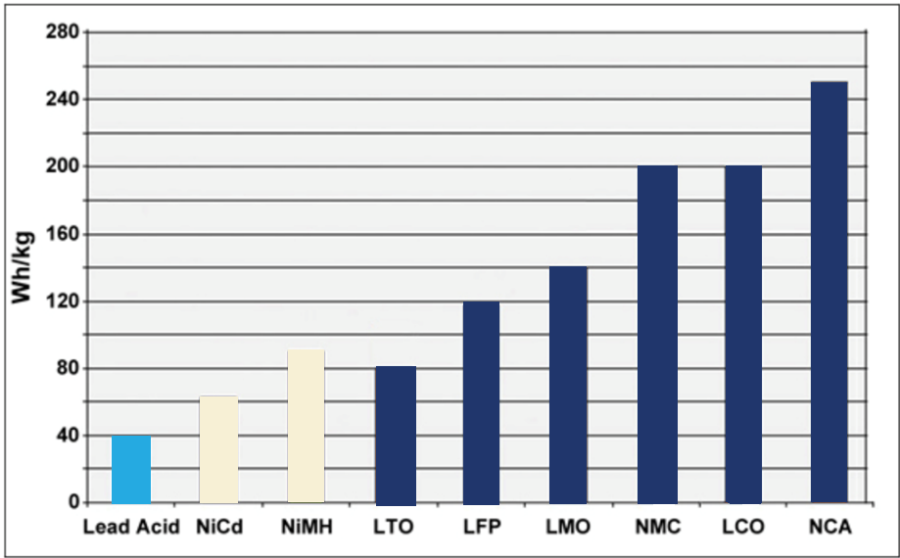
Weaknesses
High initial costs
Degradation
If not in use, life time starts to degrade
Degrades faster if exposed to heat
Cold temp reduces performance – all lithium ions do this
Long shelf time reduces performance like lithium ions do
Lower energy density compared to other Li-ion batteries
Figure 3: Energy density of various battery technologies

Slide 14
Opportunities
Very little utility scale production
Coda Energy
Excellent application fit
Opportunity for growth in a new sector
SonnenBatterie manufacturing in US now
Drive costs down
Limited exposure to date
A lot of advantages

Slide 15
Threats
High initial cost
More common Li-ion technologies benefit from larger economies of scale in transportation and portable devices
Lithium-Cobalt improvements
Safety
Cycle life
New technology?

Slide 16
Conclusions
Excellent for stationary applications – residential and utility scale
Similar value proposition to other Li-ion
Safer than other Li-ion
Long lifetime
Lower energy density can be overlooked
Good traction in residential market
Starting out in utility market, but shows potential
“LiFePO4 is one of the most popular technologies for stationary storage systems due to its uniquely high chemical stability and resulting extremely high application reliability, durability and long life” - SonnenBatterie

Slide 17
References
Song, Xuefeng; Wang, Xiaobing; Sun, Zhuang; Zhang, Peng; and Gao, Lian. “Recent Developments in Silicon Anode Materials for High Performance Lithium-Ion Batteries.“ Retrieved 2017-10-14. Path: http://www.sigmaaldrich.com/technical-documents/articles/materials-science/ recent-developments-in-silicon-anode-materials.html.
"LiFePO4: A Novel Cathode Material for Rechargeable Batteries", A.K. Padhi, K.S. Nanjundaswamy, J.B. Goodenough, Electrochemical Society Meeting Abstracts, 96-1, May, 1996, pp 73.
Armand, Michel; Goodenough, John B.; Padhi, Akshaya K.; Nanjundaswam, Kirakodu S.; Masquelier, Christian (Feb 4, 2003), Cathode materials for secondary (rechargeable) lithium batteries. Retrieved 2016-02-25.
“BU-205 Types of Lithium-Ion.“ 2016 Retrieved 2017-10-14. Path: http://batteryuniversity.com/learn/article/types_of_lithium_ion.
"Harding Energy | Lithium Ion batteries | Lithium Polymer | Lithium Iron Phosphate". Harding Energy. Retrieved 2016-04-06.
Hanisch, Christian; Diekmann, Jan; Stieger, Alexander; Haselrieder, Wolfgang; Kwade, Arno (2015). "27". In Yan, Jinyue; Cabeza, Luisa F.; Sioshansi, Ramteen. Handbook of Clean Energy Systems – Recycling of Lithium-Ion Batteries (5 Energy Storage ed.). John Wiley & Sons, Ltd. pp. 2865–2888. ISBN 9781118991978. doi:10.1002/9781118991978.hces221.
Torrey Hills Technologies, LLC. “Furnace Temperature and Atmosphere Influences on Producing Lithium Iron Phosphate(LiFePO4) Powders for Lithium Ion Batteries.” Retrieved October 18, 2017. Path: http://www.beltfurnaces.com/doc/White_paper_Battery.pdf
Zipp, Kathie. "What are the components of a solar energy storage system?." Solar Power World, Solar Power World, 13 Aug. 2017. Retrieved 18 Oct. 2017. Path: https://www.solarpowerworldonline.com/2017/08/components-solar-energy-storage-system.
Comparison of commercial battery types (2017, September 10). In Wikipedia. Retrieved October 18, 2017. Path: https://en.wikipedia.org/wiki/Comparison_of_commercial_battery_types#endnote_cost
Messenger, Roger, and Amir Abtahi. Photovoltaic Systems Engineering. fourth ed., Baca Raton, CRC Press, 2017, Ch. 3.

