Slide 1

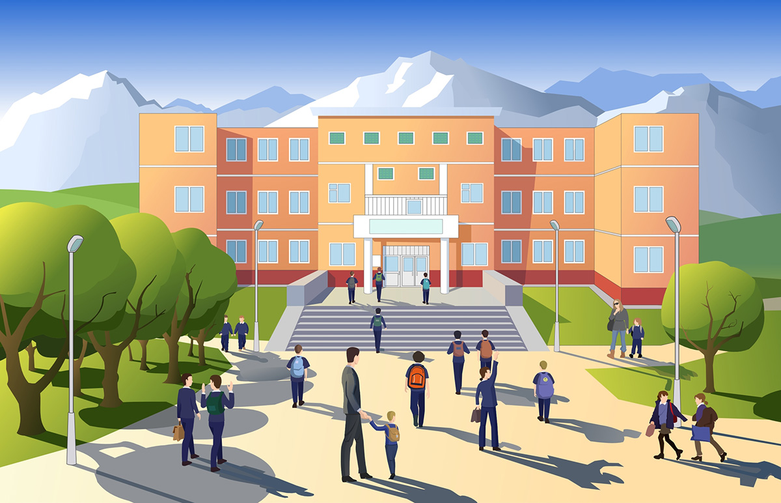
Chapter 2
Crime Algorithm

Slide 2
Days passed and passed. Jon was fully occupied with the quizzes and daily homework. Initially, it was very difficult for him to cope up with his daily schedule he was having. But later with his devotion, active involvement in every class and seriousness, he somehow managed to cover up all the backlogs in every subject.
One day after the chemistry lab, someone from Jon’s batch stole 5 pieces of Zinc granule(zinc granules gives explosive gasses when left in the air for long time). Next day the principal Raven came to class and picked up five suspected students.

Slide 3
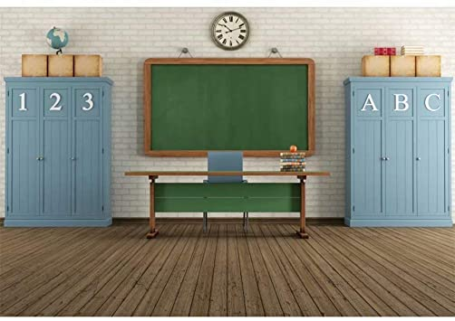

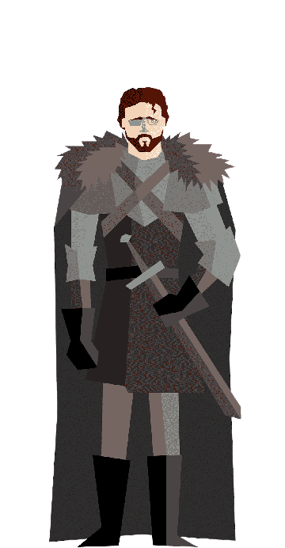

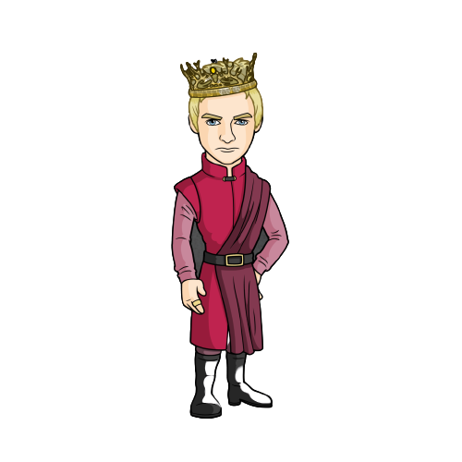
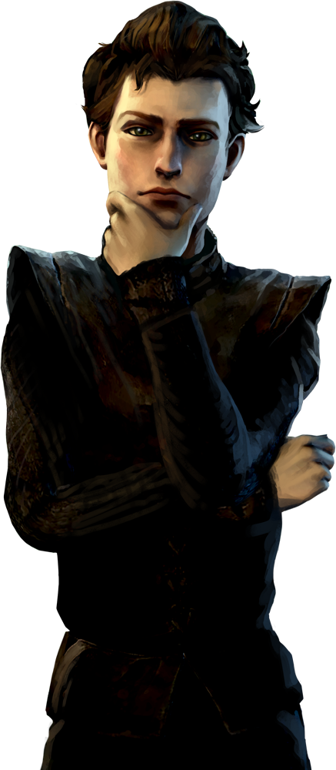
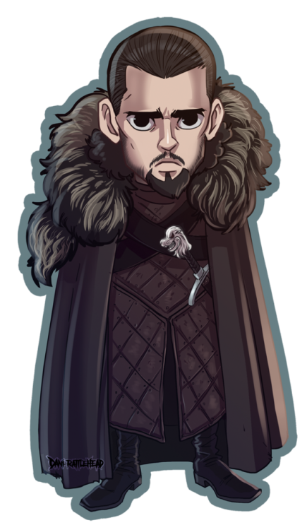
(Shouting)Jon, Tyrion, Ramsey, Joffrey and Bran… You all come to my office now!

Slide 4

All of them in a frightened state reached the principal's office. As they were last 5 to leave the chemistry lab, Raven was sure that the culprit was one of them. Raven started Interrogating each of them.

Slide 5


Have patience Jon! What about you Ramsey?
Ma'am, believe me or not I haven’t stolen that thing from the chemistry lab but suspect Tyrion as he might have stolen it with a reason of forgetting his notebook.
I agree with Joffrey. I also saw Jon with Tyrion without any reason
But I suspect Joffrey… He often steals our things like pencils, lunch box, notebooks etc. He also took one test tube from the biology lab to home and later said it was by mistake. But this time he should learn a lesson by getting punished.
Ma'am, I haven’t
stolen, and I don’t know about it. I was last to come out of lab because I forgot my notebook inside the lab and had
gone for it.
Ma'am, I suspect Jon. He was with Tyrion but didn’t have any reason to go back again inside the lab.

Slide 6
Principal Raven thought about this scenario but in vain. She let the children continue their classes. On her way home she met Sam. Sam asked her about what made her look so tensed. She explained the situation to Sam and asked him for help. Sam suggested her the crime algorithm which uses graph theory, where a directed edge from A -> B means, If B is culprit then A is telling the truth . Principal Raven found the following graph and truth table using Crime-Algo

Slide 7

Bran
Jon
STUDENT | TRUTH VALUE
JON | 3
BRAN | 1
RAMSEY | 1
TYRION | 1
JOFFREY | 2
Ramsey
Tyrion
Joffrey

Slide 8
Next day at school, Raven met Jon's class teacher regarding this issue where she claimed that Jon is a very sincere boy and cannot do such things. Raven that day met a few more teachers independently and also Lab assistants and the came to the point that Jon can’t do such things and never speaks a lie. She later confirms through CCTV camera, outside the Lab, that Tyrion came out the Lab at the end with his notebook. Using the crime Algo, she confirmed who stole the the zinc granules and calls the five students to her office the next day.

Slide 9
So I have figured out who is the main culprit here. He is really very smart, but not smarter than us!

Slide 10
Joffrey! Why did you do this? This time I will make sure you get punished.

Slide 11
Later that day telephone in principal’s office rang and it was from Joffrey’s mom, telling about some bluish-white solid stuff in his desk.
Our principal was lucky with the crime Algorithm as he figured there is only one person with Truth-Value 2 and that is Joffrey. Thanks to SAM again!

