Slide 1
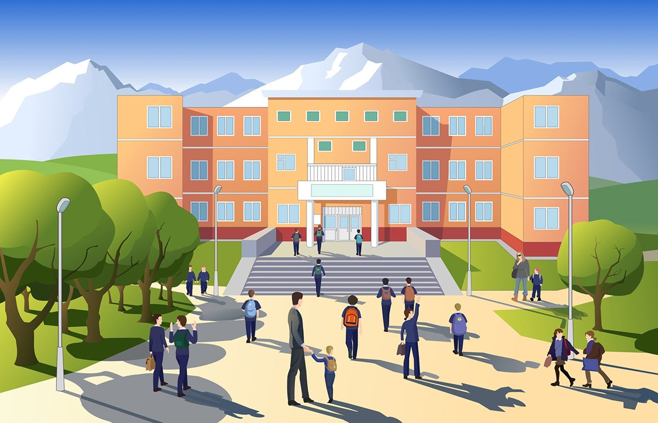
Chapter 5
Face Recognition

Slide 2
Attendance system in school has been troubling to the staff and administration as they have been fed up with students giving proxy attendance for the absent students. So the teachers came up with a new attendance system for the students involving facial biometric. The initial data for the students had been taken from their photographs in the registration form.

Slide 3

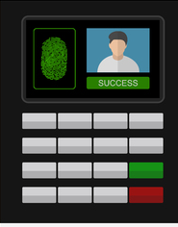

Hey students, due to the notice of proxy attendance in classes, the school is introducing a new facial attendance system
But madam, I have heard such systems are fake and do not work. So how will the problem of proxy be solved?

Slide 4
This machine has been developed by the teachers at our school itself and is very effective. We have tried it for a week and works pretty fine.
Oh, if you don't mind, I am eager to know how the software on this machine works.

Slide 5
This machine works on the principal of Local Binary Patterns Histogram.
Uh, okay

Slide 6
This algorithm is very efficient texture operator which labels the pixels of an image by thresholding the neighborhood of each pixel and considers the result as a binary number.
Oh! This seems promising.

Slide 7
If you want to learn more about it then you can refer to the face rec documentation given in face rec Directory.
Okay miss I'll surely check it out!

Slide 8
Okay Now I will call out the names of the students for attendance to register their presence through the machine.

Slide 9
Tanishq, Vaibhav and Nitin! Please come one by one

