Slide 1
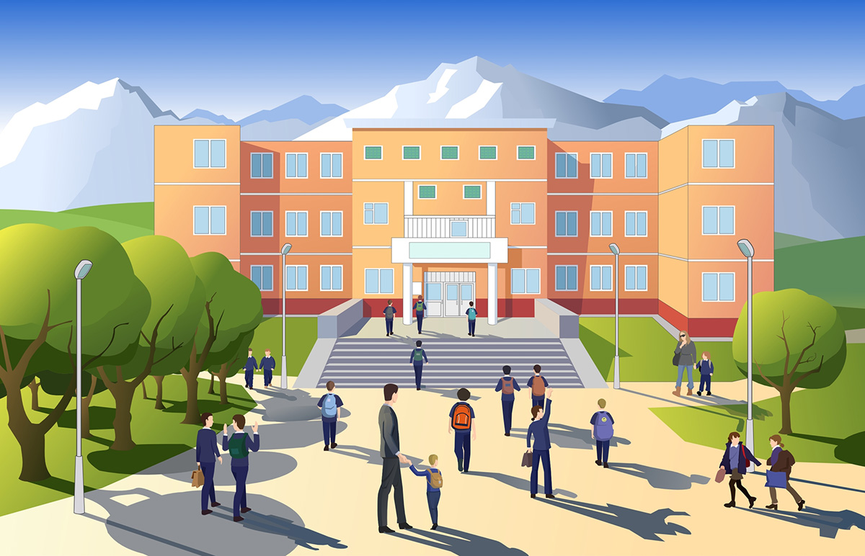
Chapter 1
Tic-Tac-Toe

Slide 2
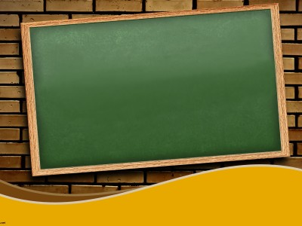
The first day of school. Jon was excited to make new friends. Volvo International follows the same routine as trivial Schools on Earth.
- After attending the morning assembly he went to his Maths class. He found Samwell and Tyrion sitting on the same bench. Samwell, also known as Sam, was an expert in algorithms. Jon spoke to Sam and Tyrion and soon the three became good friends. One day Jon was waiting in the class room where Joffrey and Ramsey were discussing something.

Slide 3
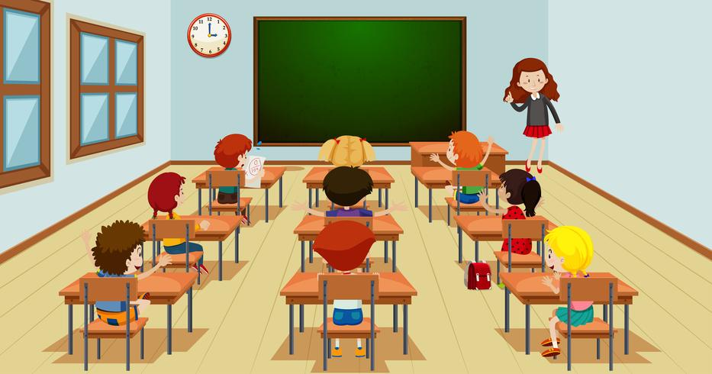
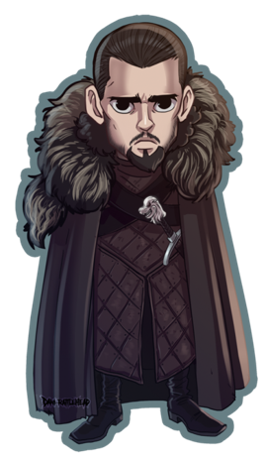
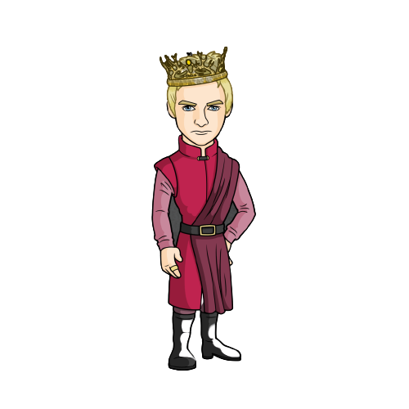
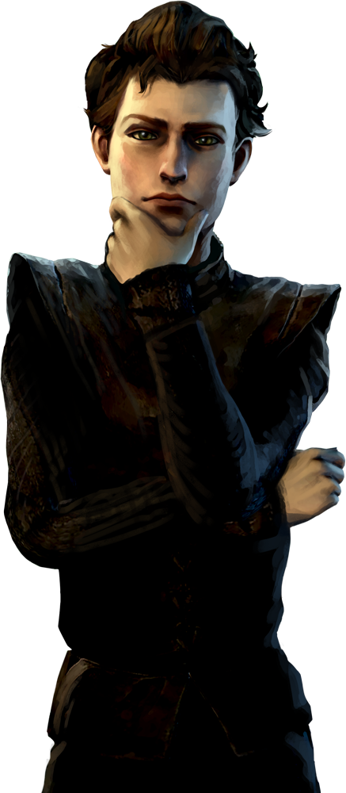
Hey Ramsey! Let’s go for a movie. There’s a new arrival called “Death of the Dawn”. It’s IMDB rating is 9/10. It’s worth watching. What say?
Yeah, but we literally got much 30 pages assignment to complete.
Not possible today. Dude let’s postpone it!

Slide 4
What no way! Movie is on! But what about the assignment. Teacher is very strict.
Bro if you want spoilers from others batchmates then be prepared.

Slide 5
We need someone to complete it! Hey look at him ( pointing towards Jon ). He is a fresher. What is his name?
I remember him saying ‘Jon’. But how we will convince him to write our assignment.

Slide 6
Bro! You know how to play TIC-TAC-TOE right. You never let the other person win though the match draws. Just wait.(shouts Jon’s name loudly)

Slide 7
(On hearing his name called approaches Joffrey)Yes!

Slide 8
( Being Nice to him ) Hello Jon! It's a pleasure to meet you. I’m Joffrey and this is Ramsey ( pointing toward Ramsey ). So, how was your first day?
Yeah! It was great. I always wanted to be here. I’m really happy.

Slide 9
What? But! Why? (Thinking about his and Daenerys meeting after school) What if I don't accept it, as I have to go somewhere?
Ok nice. Now listen Jon, here is a challenge for you.

Slide 10
So Jon, your challenge is that you have to play Tic-Tac-Toe against Ramsey three matches back-to-back. And note my words “If Ramsey wins any two matches then you will have to complete our 30-page assignment
Hey! Little cute chick you can’t decline it. That’s why it is the challenge. So listen very carefully! Otherwise your good going day will be spoiled, only because you are not paying attention to something important.

Slide 11
that is, total 60 page. In any other case, you are free to go anywhere you want”.
Even if you decline you still have to do our assignment. Understood?
( with a sad and frightened face ) Yes!

Slide 12
You have half an hour to decide whether you accept it or not. Meet at the library after half an hour . And don’t try to run away from this. School watchman is our friend and how many days will you be running from us!

Slide 13
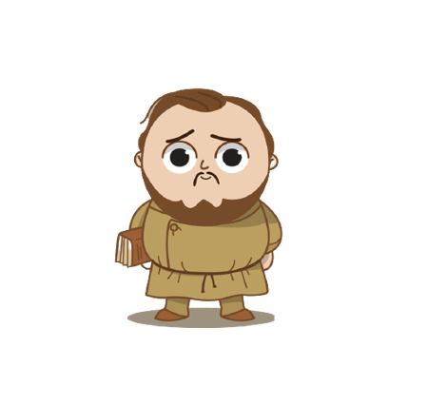
( with sobbing face running towards Sam ) Hey! Sam please help me.(He told everything to Sam.)
Ohk, let me think. (Silence for a few minutes…). Wait, I can teach you an algo known as “Minimax”. That will guarantee that you will not fail.

Slide 14
Yeah definitely! Teach me but in a very fast and easy way. We don’t have much time.
This is the most basic implementation, and you will not fail if you follow it very correctly. Do you want to learn?

Slide 15
Sam taught him the minimax Algorithm within 25 minutes. Now our boy Jon is confident of not at least losing the game. The library became a place of tournament as the librarian wasn’t there. First round Ramsey wins. Jon intensified . Took a deep breath. Next two rounds resulted in a draw. Jon jumped with joy and left for the park where Daenerys was waiting for him.
Joffrey and Ramsey learnt a lesson of never underestimating an opponent.
Sam was peeking all this through a hidden window and got a big smile on his face because of helping Jon successfully.
[ If you want to learn ‘minimax algorithm’ follow the documentation]

