Slide 1
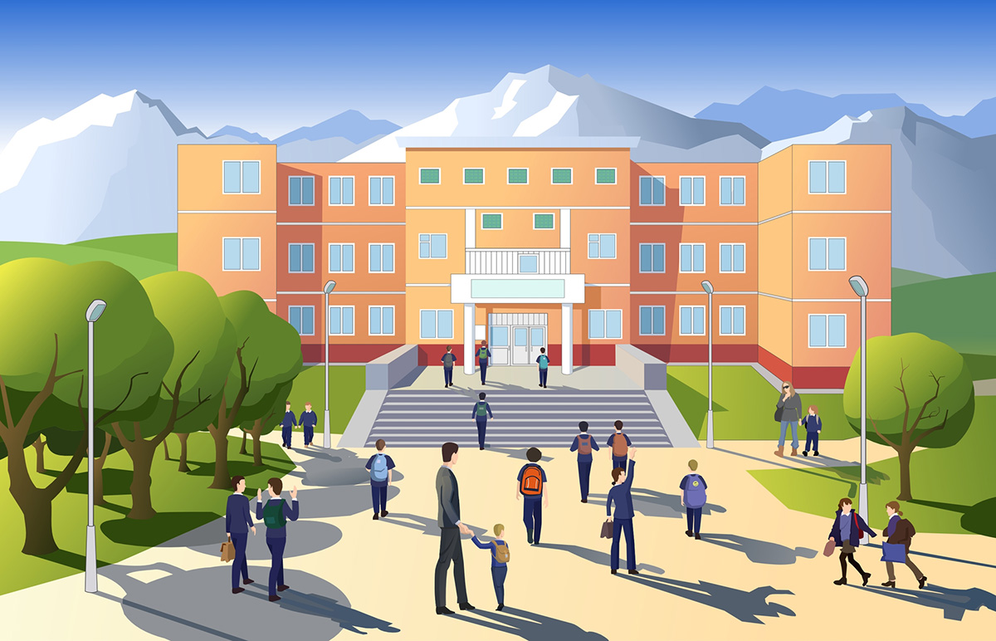
Chapter 4
Compression

Slide 2
The Global Association of planet analysis(GAPA) organized a competition named.” The Alan Turing award” which was open for students aged between 14 - 18 years. The competition will be held among teams of 3 people. One of the team members will be sealed in room1 and the other 2 in room2. The person in room 1 will have some of the information which he has to send to teammates seated in the room2. This looks easy right . But the twist is the person in room 1 can’t send more than 40KB data at a time and the data provided will be between 4 to 5 MB, connection speed is very high. The GAPA is doing this because they wanted to keep problems faced by astronauts in space in front of students and inculcate the instincts of on-the-spot problem solving in them. The team which does this in the least amount of time wins and will get a chance to go to the space station on GAPA.
Sam got to know about it and went to Jon and narrated the whole prompt. They were excited about it but sad at the same time as they did not have the third team member as Tyrion was on sick leave.

Slide 3



Why not Daenerys?
Who will be our third member??

Slide 4
Yeah! good idea, so inform her, we will meet at your house at 5 pm today.

Slide 5



Yes, but Sam it is not allowed to send data of 3-4 MB!! How will we be able to send it! How?
We should have withdrawn from this competition earlier only.
Is everyone clear with the task for the competition.
All the three started working as the time was very less. Sam was helping both to understand different algorithms that would do the needful. They were in a quest to find the best algo.

Slide 6
Listen, if a file contains AAAABBBAABBBBBABB then we can write the file as 4A3B2A5B, yes, and then the file size is reduced to 8 bytes instead of 17 bytes!!
But what if the file contains just ABAB i.e. no sequential distribution ??
We have a second way! we can give code 1 to AA and code 2 BB or any other repetitive structure.
Make a structure like a dictionary for the codes.
Hurray!!

Slide 7
Right question, we will iterate over each element in the file and check if the old string we find up till now plus the new element is present already in the string then we will update old string to old plus new element and check that again, and if not present then we will add old string + element to dictionary.
But how will be able to find sequential strings that will repeat??
And write the code instead of text file in the dictionary.
RIGHT SAM?

Slide 8
​
​
​
You know nothing, Jon Snow. Yes ,it is fully optimized and how to recover the information is we will send dictionary of the string for which the code is used in the file to decode the compressed file.​
Now!! Let's practice this .​
​
​
​
but how do we recover the information??
Is it fully optimized??
(3 days left in competition)

Slide 9
Jon, Sam and deanery gave their best but they came second as the algorithm which they were using was optimized further by any other team in different school.​
Jon – Let's end the story team O, if readers wanted to know more about their optimization ,go checkout documentation for the algorithm given.​
Bye!!​
This algorithm was developed by Abraham Lempel, Jacob Ziv and Terry Welch and was published in 1984 as improved implementation of LZ78 algorithm published by Lempel and Ziv in 1978.
For more details on the algorithm used check out the documentation given on the algorithm

