Slide 1
INTRODUCTION

Slide 2
The Age of Humanity on the planet Earth has come a long way along with remarkable and unimaginable development in the Science and Tech world. Development was to such an extent that they sent around 50-60 satellites which followed the orbit of moons of Jupiter and Saturn.
As we know everything has a date of extinction. The GAPA (Global Association of Planet Analysis) scientists found out that Planet Earth will have its doom’s day in 178 to 190 years from 3501, i.e, in between 3679 and 3691. This is because the planet Earth will blast due to extensive global warming.
Humanity wasn’t able to control their global warming level. But they found the planet ‘Volkov’ which supports life, even better than Earth. Therefore, they started making batches of people to transfer there. The limitation of fuel in spite of such a huge development stops them from 100% success. They were able to only transfer 73.44% of existing humans for preventing Humanity from extinction

Slide 3
let’s come back to the present time, year 4001. Today is 22nd Jan 4001. Yeah, the date and time system here on planet ‘Volkov’ is the same as on Earth.
Jon Wons is a 14 year old ideal boy that every parent wants, really innocent and sweet. He has a peculiar talent of “Ayatori” i.e. string games. His father taught him the basics of Ayatori but he made himself better at it that is worth more than any appreciation.
He was singing a song while on his way toward home. He was returning from his crush Daenerys house. With whom he watched a movie ‘Interstellar’ and a show ‘Lost In Space’. He was unknown of the fact that his mom and dad were waiting home with a little surprising news for him.

Slide 4


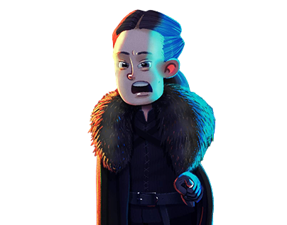
Yeah! I'm sorry about that. Actually, we started 1 more episode out of excitement and forgot about the time. It won’t happen again.
Jon why are you so late? Weren't you supposed to come home 1 hour ago?

Slide 5
Fine! Leave it but take care of timing from next time. (Lyanna takes a deep breath ) . We have news for you. Let’s get in. Your dad will tell you about it.

Slide 6

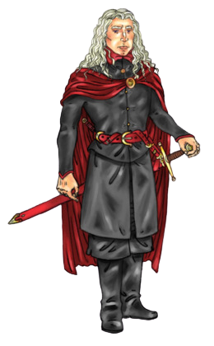
Truly speaking, It was Awesome. We watched movies for hours and Daenery's mom made popcorn for us. We enjoyed a lot.
Here’s my boy! How was your day Jon?

Slide 7
(With a smile on his face) That sounds good. But now your days of fun need to be scheduled.
Why Dad? I have already apologized to mom for being late. If you want that I say to you too then “Sorry!”, but please don’t limit my playtime.

Slide 8
Son, no need to say sorry. I’m not restricting you from playing rather You got admission in Volvo International School. And you have to join the day after tomorrow. Therefore, you need to schedule your timings.
(with joy on his face) What! Really! Oh yeah! I am so happy today!!

Slide 9
Jon, from one year, was trying to get into Volvo International school, because Daenerys also studied in the same school. He is now really amazed that he made it and very excited to join the school.
Jon's family had a great dinner after which Jon called his friend Daenerys and told her about his admission into Volvo international school. She felt really happy and they both planned to meet on the first day after school.
Further story deals with the journey of Jon Wons and his experience in his new school and how Algorithm Analysis and its implementation becomes very helpful and important in his journey.

