Slide 1

Chapter 3
The Halloween Trouble

Slide 2

Outline
It's Halloween and its trick or treat. Last year of Halloween wasn't a great memory for Jon as his treats were snatched away by the cruel Joffrey and Ramsey. Jon is sad and has second thoughts on going out for Halloween this year when he ran into Samwell.

Slide 3
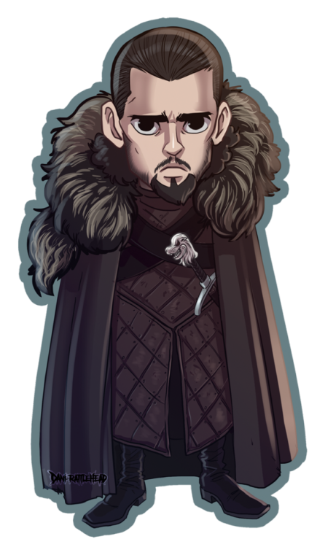
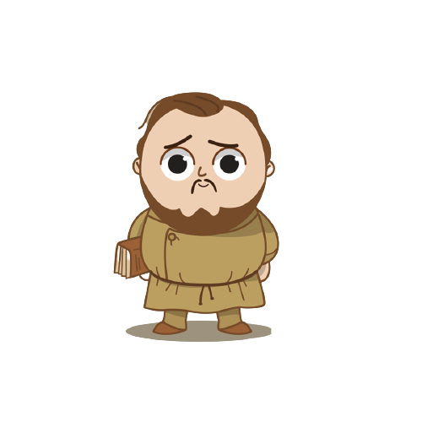
It’s nothing Sam, I’ve decided not to go out for Halloween this year.
Hey Jon, you look sad ☹

Slide 4
We are supposed to have fun on Halloween, but my last year didn’t prove great
But why do you say so?

Slide 5
But HOW?
Don’t worry Jon, it won’t happen this time. I promise

Slide 6
Which algorithm is gonna get me out of this trouble?
Well there is no trouble which isn’t solvable using algorithms.

Slide 7
But that isn’t my major concern. I just want to save my treats.
There is an algorithm known as Minimum Spanning Tree Algorithm. It helps you to cover a given set of nodes with the minimum travel or cost.

Slide 8
This looks promising Sam. Okay, I’ll try this!
There’s a trick to it, it can be modified in order to avoid those roads where the bullies can be encountered.

